Slide 1



Water use and water availability constraints to decarbonised electricity systems
European Geophysical Union General Assembly 2016, 20th April 2016
ERE 1.8 – Energy and environmental system interactions – Policy & modelling
Edward Byers
Jaime Amezaga, Chris Kilsby, Greg O’Donnell, David Alderson – Newcastle University
Jim Hall, Martino Tran – University of Oxford
Meysam Qadrdan, Modassar Chaudry – Cardiff University

Slide 2
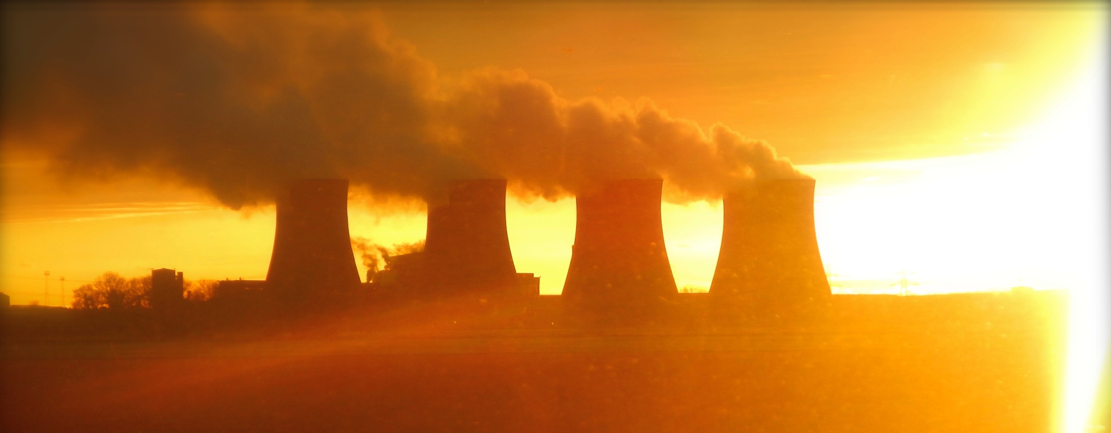
Good value?
~1 Olympic swimming pools / hour evaporated
Electricity for 2 million people (12 kWh/p/d)

Slide 3
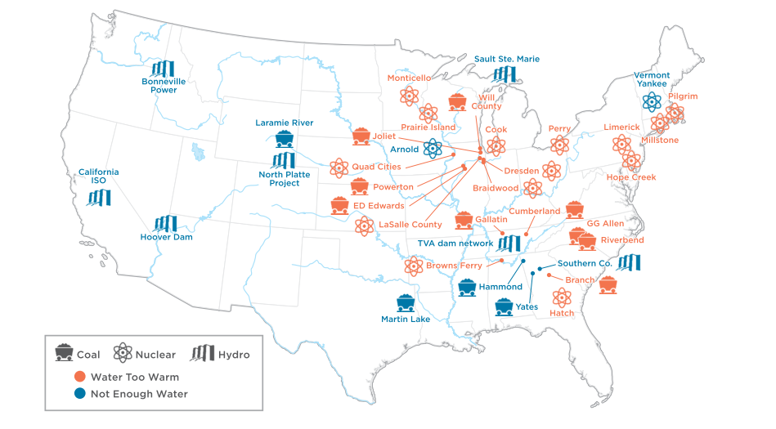
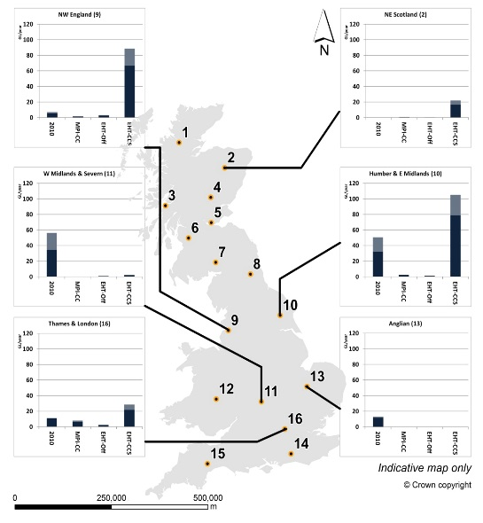
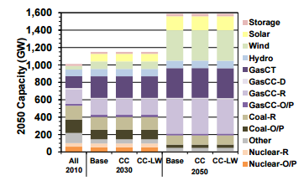
Drought and scarcity
Union Concerned Scientists, 2006-2013
Reduce production during low flows & heat waves
U.S., France, Spain, China, India, Germany, Romania, Brazil, Turkey, …
Impact on planning decisions and long term performance
Water availability and climate impacts
Costs of climate resilience and uncertainty
Cohen et al. 2014
Byers et al. 2015; Tran et al. 2014

Slide 4
Drought and scarcity
Union Concerned Scientists, 2006-2013
Reduce production during low flows & heat waves
U.S., France, Spain, China, India, Germany, Romania, Brazil, Turkey, …
Impact on planning decisions and long term performance
Water availability and climate impacts
Costs of climate resilience and uncertainty
Cohen et al. 2014
Byers et al. 2015; Tran et al. 2014

Slide 5
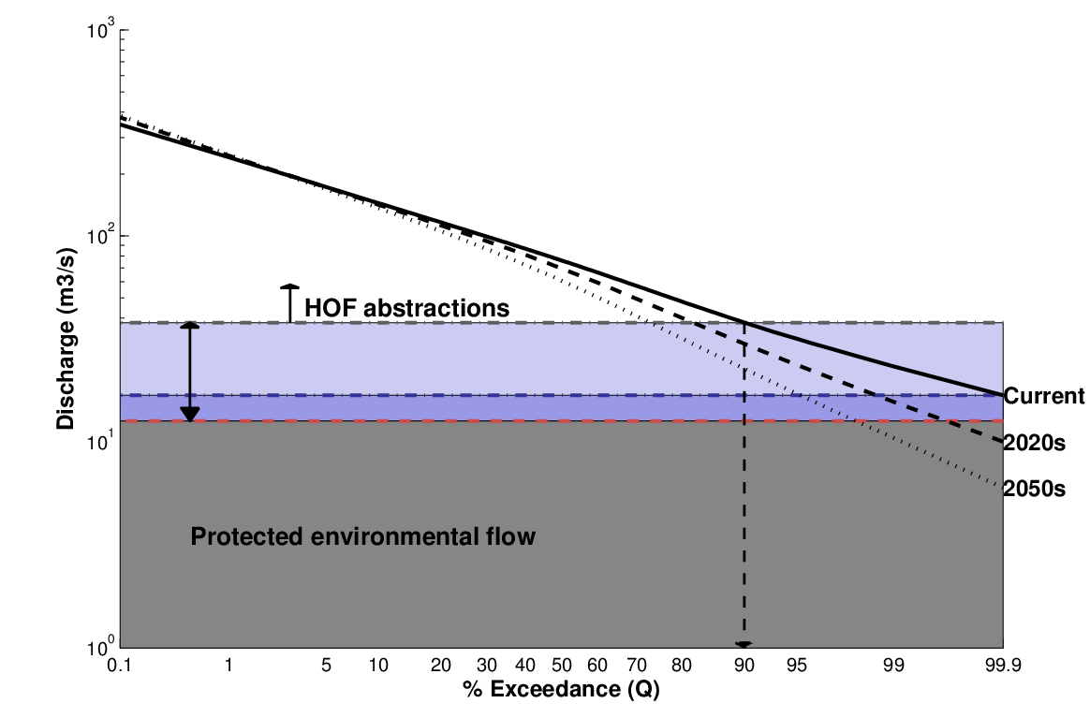
Reliability, variability and uncertainty
Water withdrawal and allocation planning
How much water can be reliably used during low flows?
How might this change in future? (climate change, regulation, environment)
What is the variability and uncertainty? – not just means, but extremes…
Byers et al. 2016

Slide 6
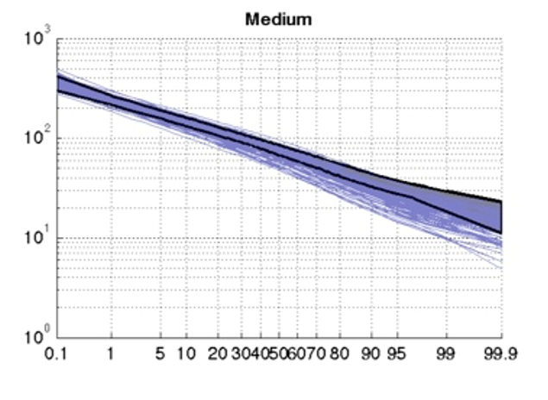
Reliability, variability and uncertainty
Water withdrawal and allocation planning
How much water can be reliably used during low flows?
How might this change in future? (climate change, regulation, environment)
What is the variability and uncertainty? – not just means, but extremes…
Byers et al. 2016

Slide 7
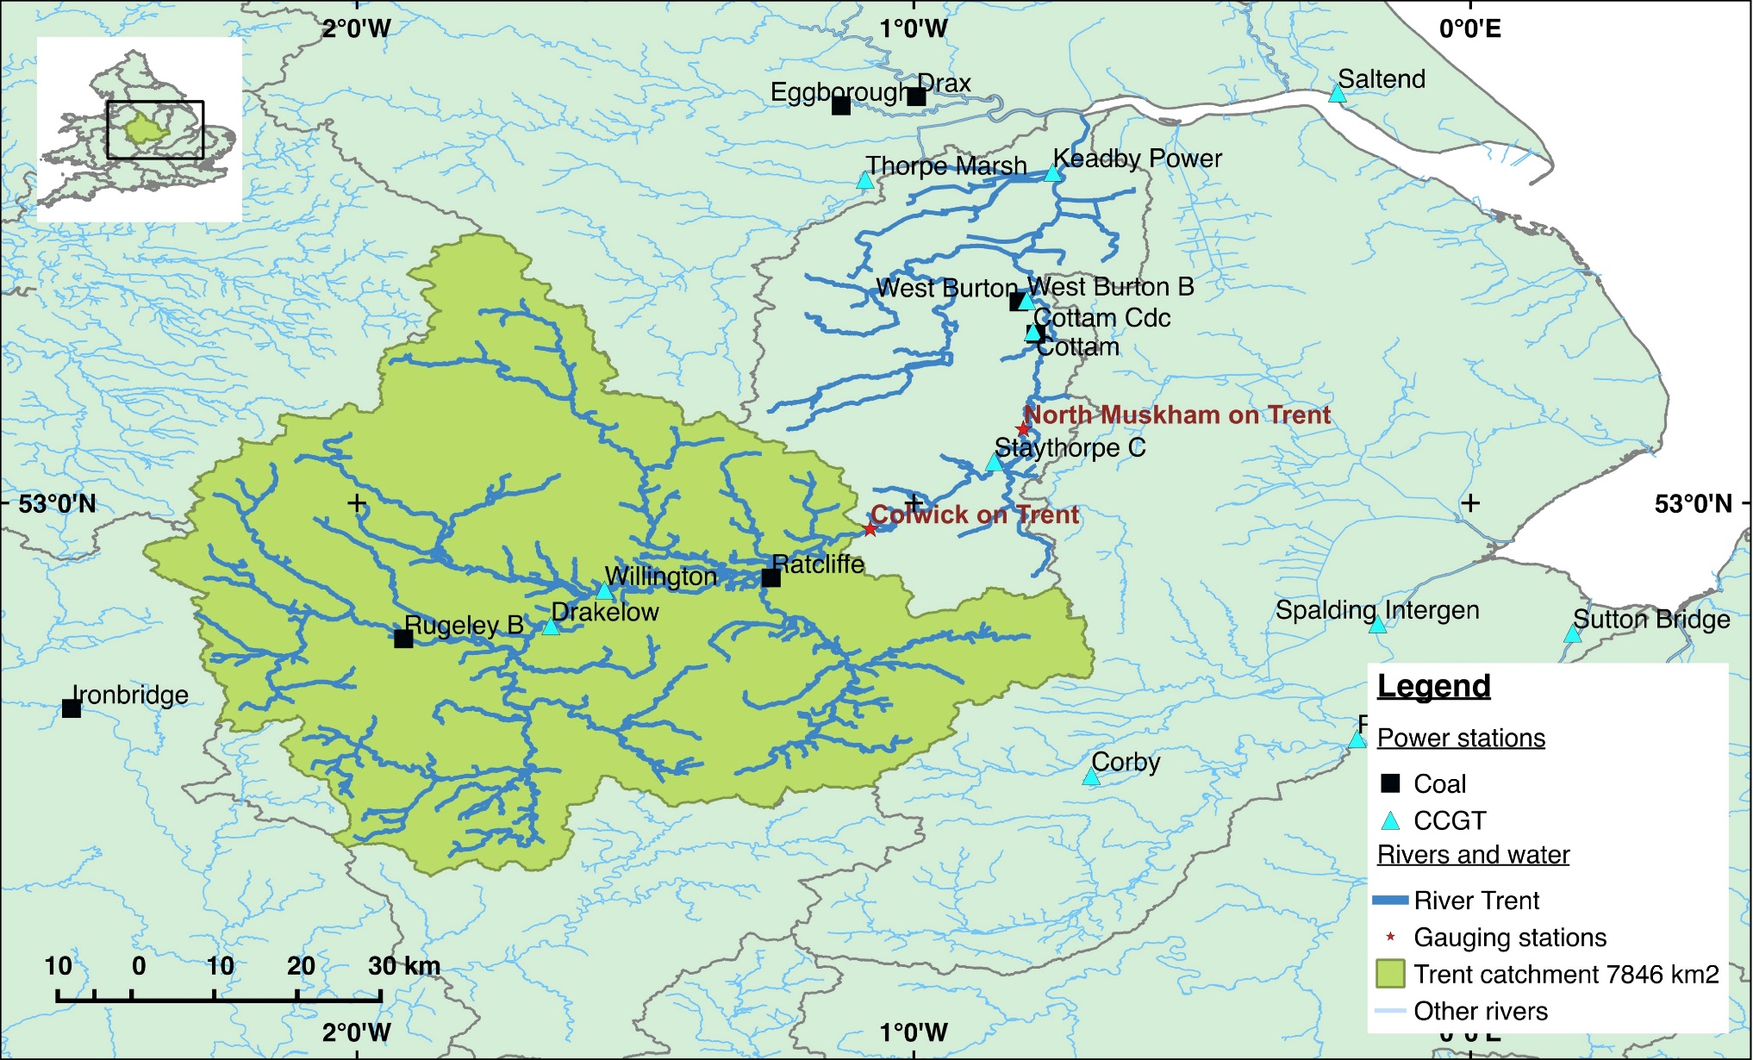
Catchment study: River Trent, UK
Byers, E.A., Hall, J.W., Amezaga, J.M., O’Donnell, G.M., Leathard, A., 2016. Water and climate risks to power generation with carbon capture and storage. Environmental Research Letters 11, 2. http://dx.doi.org/10.1088/1748-9326/11/2/024011
Notes:
54000 years of hydrological data

Slide 8
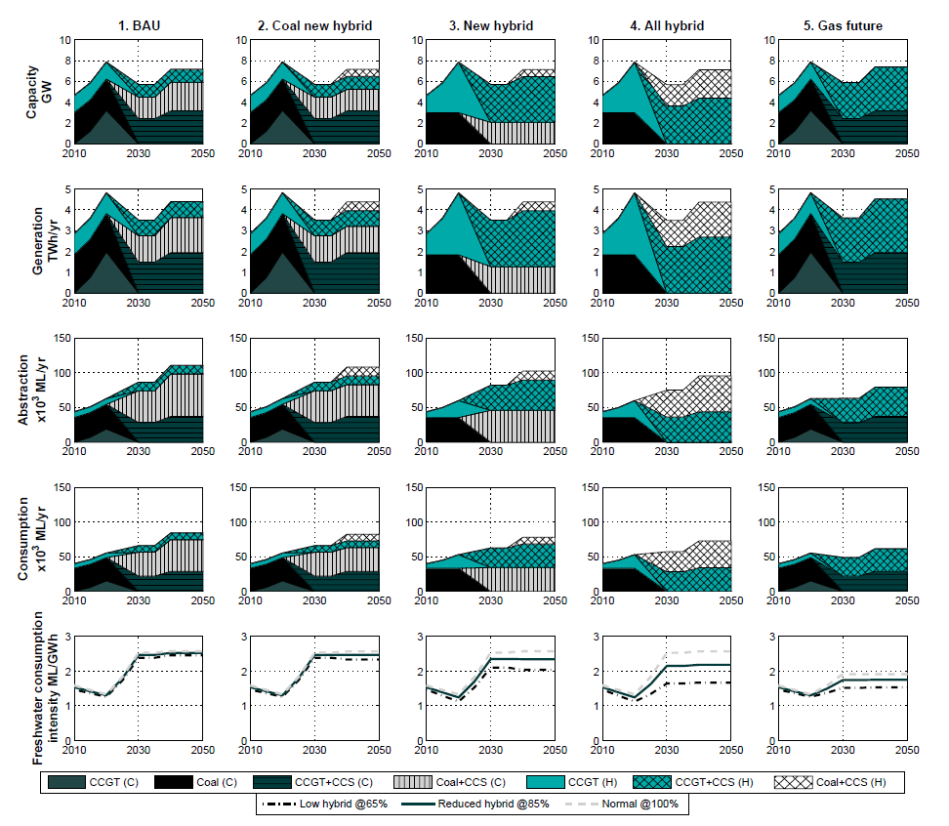
CCS Capacity portfolios
5 capacity portfolios of coal and CCGT
All 100% CCS by 2030
Different cooling systems and water demands
Byers et al. 2016

Slide 9
CCS Capacity portfolios
5 capacity portfolios of coal and CCGT
All 100% CCS by 2030
Different cooling systems and water demands
Byers et al. 2016

Slide 10
Climate impacts on very low flows
Byers et al. 2016

Slide 11
Regulatory reliability simulation
Current regime
Proposed regime
Power plant reliability
VERY low flow < < < < < < < Low flow
Byers et al. 2016
Water reliability

Slide 12
National water-constrained capacity expansion (CGEN+Water)
Spatially explicit Combined Gas and Electricity Network model¹
What if UK electricity planning model (CGEN) considers water constraints?
  Freshwater availability limits (Q₉₅) & tidal water thermal limits
  Cooling system CapEx & OpEx costs
How does that change with climate change? (Q_{95, CC2050})
¹ Qadrdan et al. 2012

Slide 13
Key conclusions
Volume is usually important; low flows and variability are always important
Disruption events
Long-term plant economics
Capacity planning and location
Representation of regulation is crucial and informative
Environmental flows and climate change
Water trading and rights
Efficient allocation
Water efficiency
Adaptation of power plants is costly, get it right first time
Gas CCGT needs much less cooling (water) than coal
Water use of CCS clusters must be planned in advance

Slide 14
European Geophysical Union General Assembly 2016, 20th April 2016
ERE 1.8 – Energy and environmental system interactions – Policy & modelling
Edward Byers
Jaime Amezaga, Chris Kilsby, Greg O’Donnell, David Alderson – Newcastle University
Jim Hall, Martino Tran – University of Oxford
Meysam Qadrdan, Modassar Chaudry – Cardiff University

