Slide 1
Modeling sustainable bioenergy feedstock production in the Alps
Sylvain Leduc(1), Florian Kraxner(1), Hernán Serrano León(1), Georg Kindermann(1), Sabine Fuss (1,2), Annika Marxen(2,3), Chris Walzer(4)
(1) Ecosystems Services and Management Program, IIASA, Laxenburg, Austria
(2) Working Group on Sustainable Resource Management and Global Change, Mercator Research Institute on Global Commons and Climate Change (MCC), Berlin, Germany
(3) Technical University Berlin, Berlin, Germany
(4) Research Institute of Wildlife Ecology, University of Veterinary Medicine, Vienna, Austria
European Geosciences Union General Assembly 2016,
Vienna, Austria, 17–22 April 2016

Slide 2
Objective
To identify
the potential and cost of production
of renewable energy (RE) in the Alps
in regards with the protection
of the ecosystems services (ESS)

Slide 3
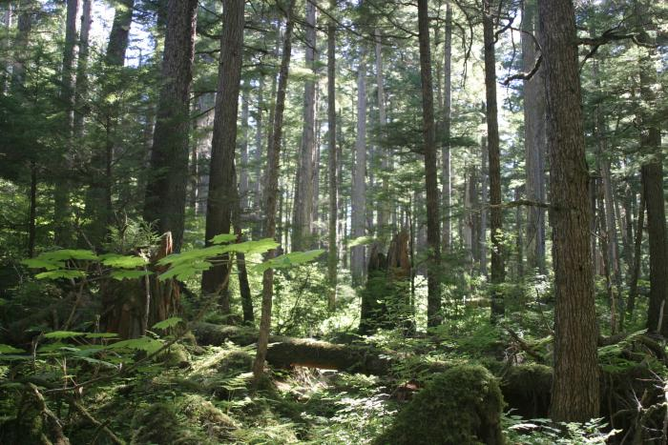
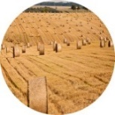
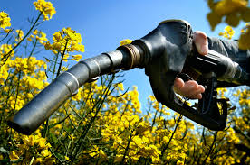
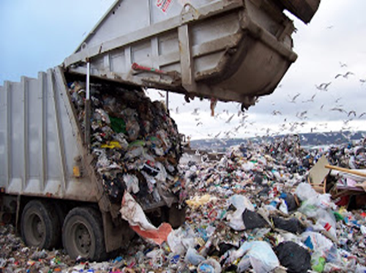
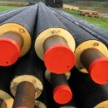

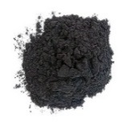

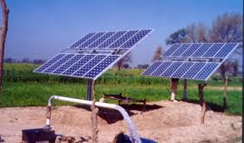
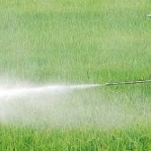

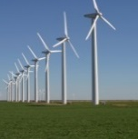
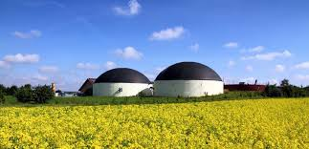


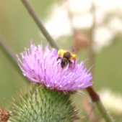
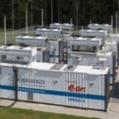
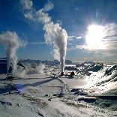
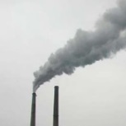

The BeWhere Umbrella
Forest resources
Crop residuals
Biofuel
MSW
Heat
Algae
Biochar
Solar
Fertilizers
Wind
Biogas
Hydro
Power
Ecosystem services
Power to liquid/gas
Geothermal
Co-firing
BECCS

Slide 4
BeWhere Model
Biomass
Existing industries
Demand
Reference system
Domestic biomass
Forest industries
Heat
& power
Fossil fuel
Sawmill
residuals
CHP
Transport fuel
Biofuel Import
Biomass
import
New bioenergy plants
Existing flows
Optional flows

Slide 5

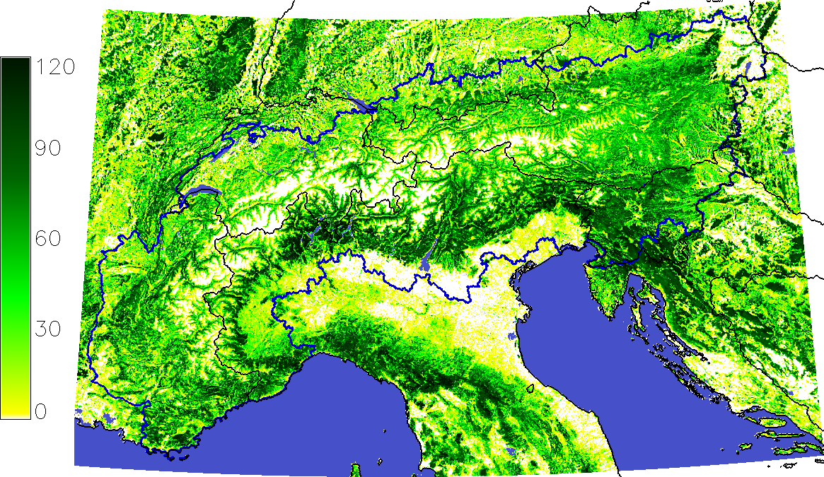
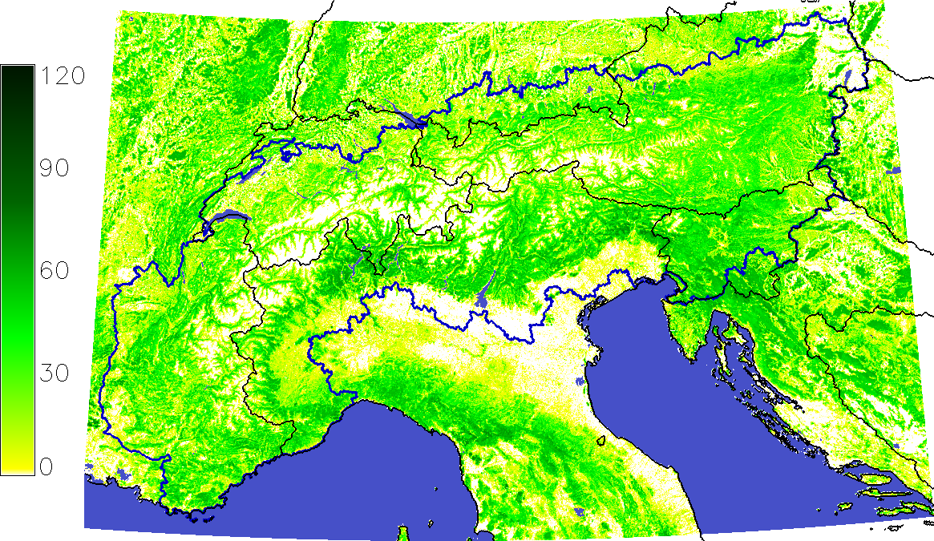
Ecosystem trade-offs of forest areas
G4M estimates the impact of forestry activities on carbon sequestration and supply of biomass in the Alps (258,000 km² total area, 115,000 km² forest).
Forests managed to maximize two ecosystem values through changing the rotation period:
  S1: Maximization of carbon stock in forests.
  S2: Maximization of biomass production.
1: Carbon sequestration scenario (stock)
tC/ha
2: Biomass production scenario (stock)
tC/ha
 | S1: Carbon sequestration | S2: Biomass production
Harvest potential Mt C /year | 11 | 23
Carbon stock Mt C | 1,057 | 577
Source: G4M www.iiasa.ac.at/g4m
Notes:
The two scenarios are created by variations in the rotation time in G4M/the forest management. In the carbon sequestration scenario (S1), the forest rotation period is increased (on average about 200 years instead of 100 years in S2) such that a maximal amount of carbon is being stored in the forest, considering that damage to forest increases with the age of the trees. In the biomass production scenario, the forest rotation period is decreased such that the forest growth is maximized, leading to a high availability of biomass for energy purposes. About the double amount of harvesting potential is available under this scenario (S2, 23 Mt C/y) compared to S1 (11 Mt C/y). On the other hand, the C stock is almost twice as much S1 than under S2 (see table). Note that both scenarios lead to sustainable forest management and no forest degradation, deforestation, nor afforestation.
Note: the stock difference of 480 MtC between the scenarios will be leveled out with increment in approximately 40 Years! (e.g. if you store the harvested increment in furniture and buildings instead of storing the increment in the forest.) Every year after this 40 years you will "win" in the scenario S2 (Maximization of biomass production) approx. 11.5 MtC per year compared to S1. So, if you “store” (in furniture etc.) instead of burning for bioenergy, the “intensive management” scenario (S2) outperforms the “low intensive management” scenario (S1) after 40 years.

Slide 6

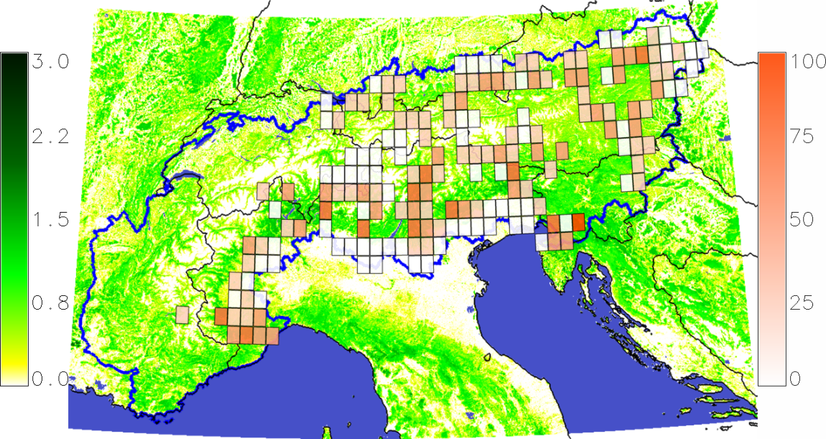
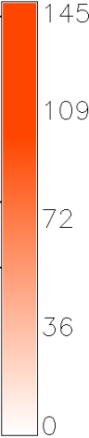
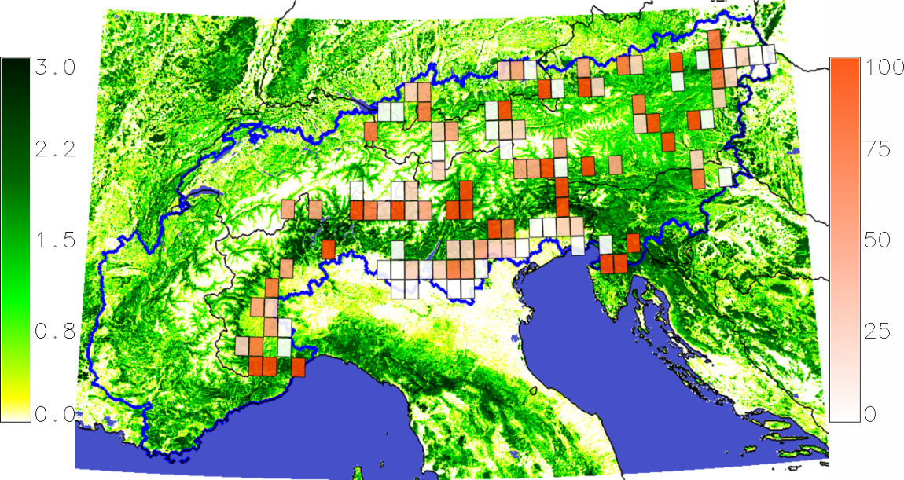

Economic bioenergy potential
BeWhere estimates the optimal allocation of bioenergy production plants and associated harvesting intensity.
Bioenergy is competing with other energy production types (i.e. costs of fossil fuels).
Economic supply: 14 TWh (heat & electricity) met by both scenarios.
Significant local difference of harvesting intensity.
S1: Carbon sequestration scenario (increment)
tC/ha
1,000 m³
S2: Biomass production scenario (increment)
tC/ha
1,000 m³
Harvesting intensity/cell (1,000 m³/ yr) | Total harvested amount in S1: (1,000 m³/ yr) | Total harvested amount in S2: (1,000 m³/ yr)
0 – 12 | 208 | 88
13 – 32 | 1,098 | 498
33 – 60 | 2,820 | 1,341
61 – 87 | 1,851 | 1,194
88 – 141 | 478 | 3,290
Source: BeWhere www.iiasa.ac.at/Bewhere
Notes:
Once the two scenarios are created, we use the BeWhere model to optimize the location of bio-energy plants. The bio-energy plants are CHP plants that produce both heat and electricity. Under this constellation, we can produce 14 TWh which corresponds to 30% of electricity consumption in Austria (70 TWh in 2010).
The harvesting intensity per grid cell is indicated by a red color scale (the darker the red, the higher the harvesting intensity per grid cell). Now we can see that in S1the maximizing of C sequestration comes at a cost: In contrast to S2, where the biomass is harvested intensively from the most productive plots, sequestration requires a much more spread-out harvesting pattern at low intensity rates.

Slide 7
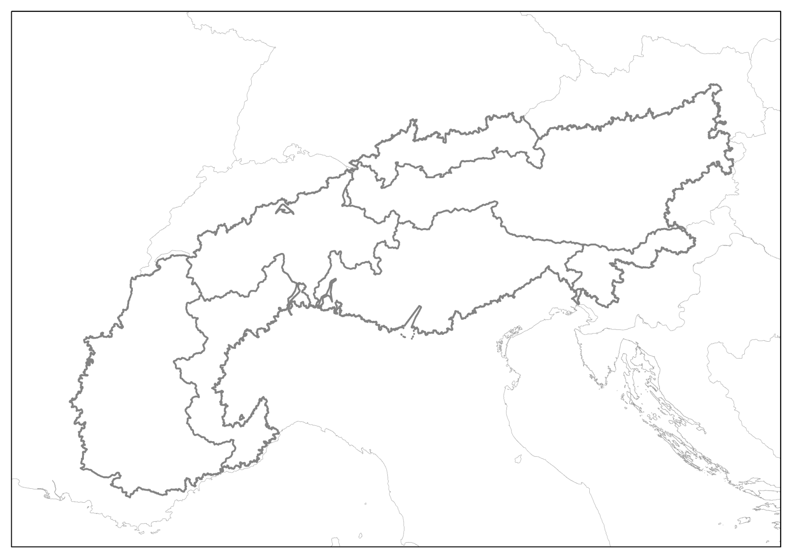
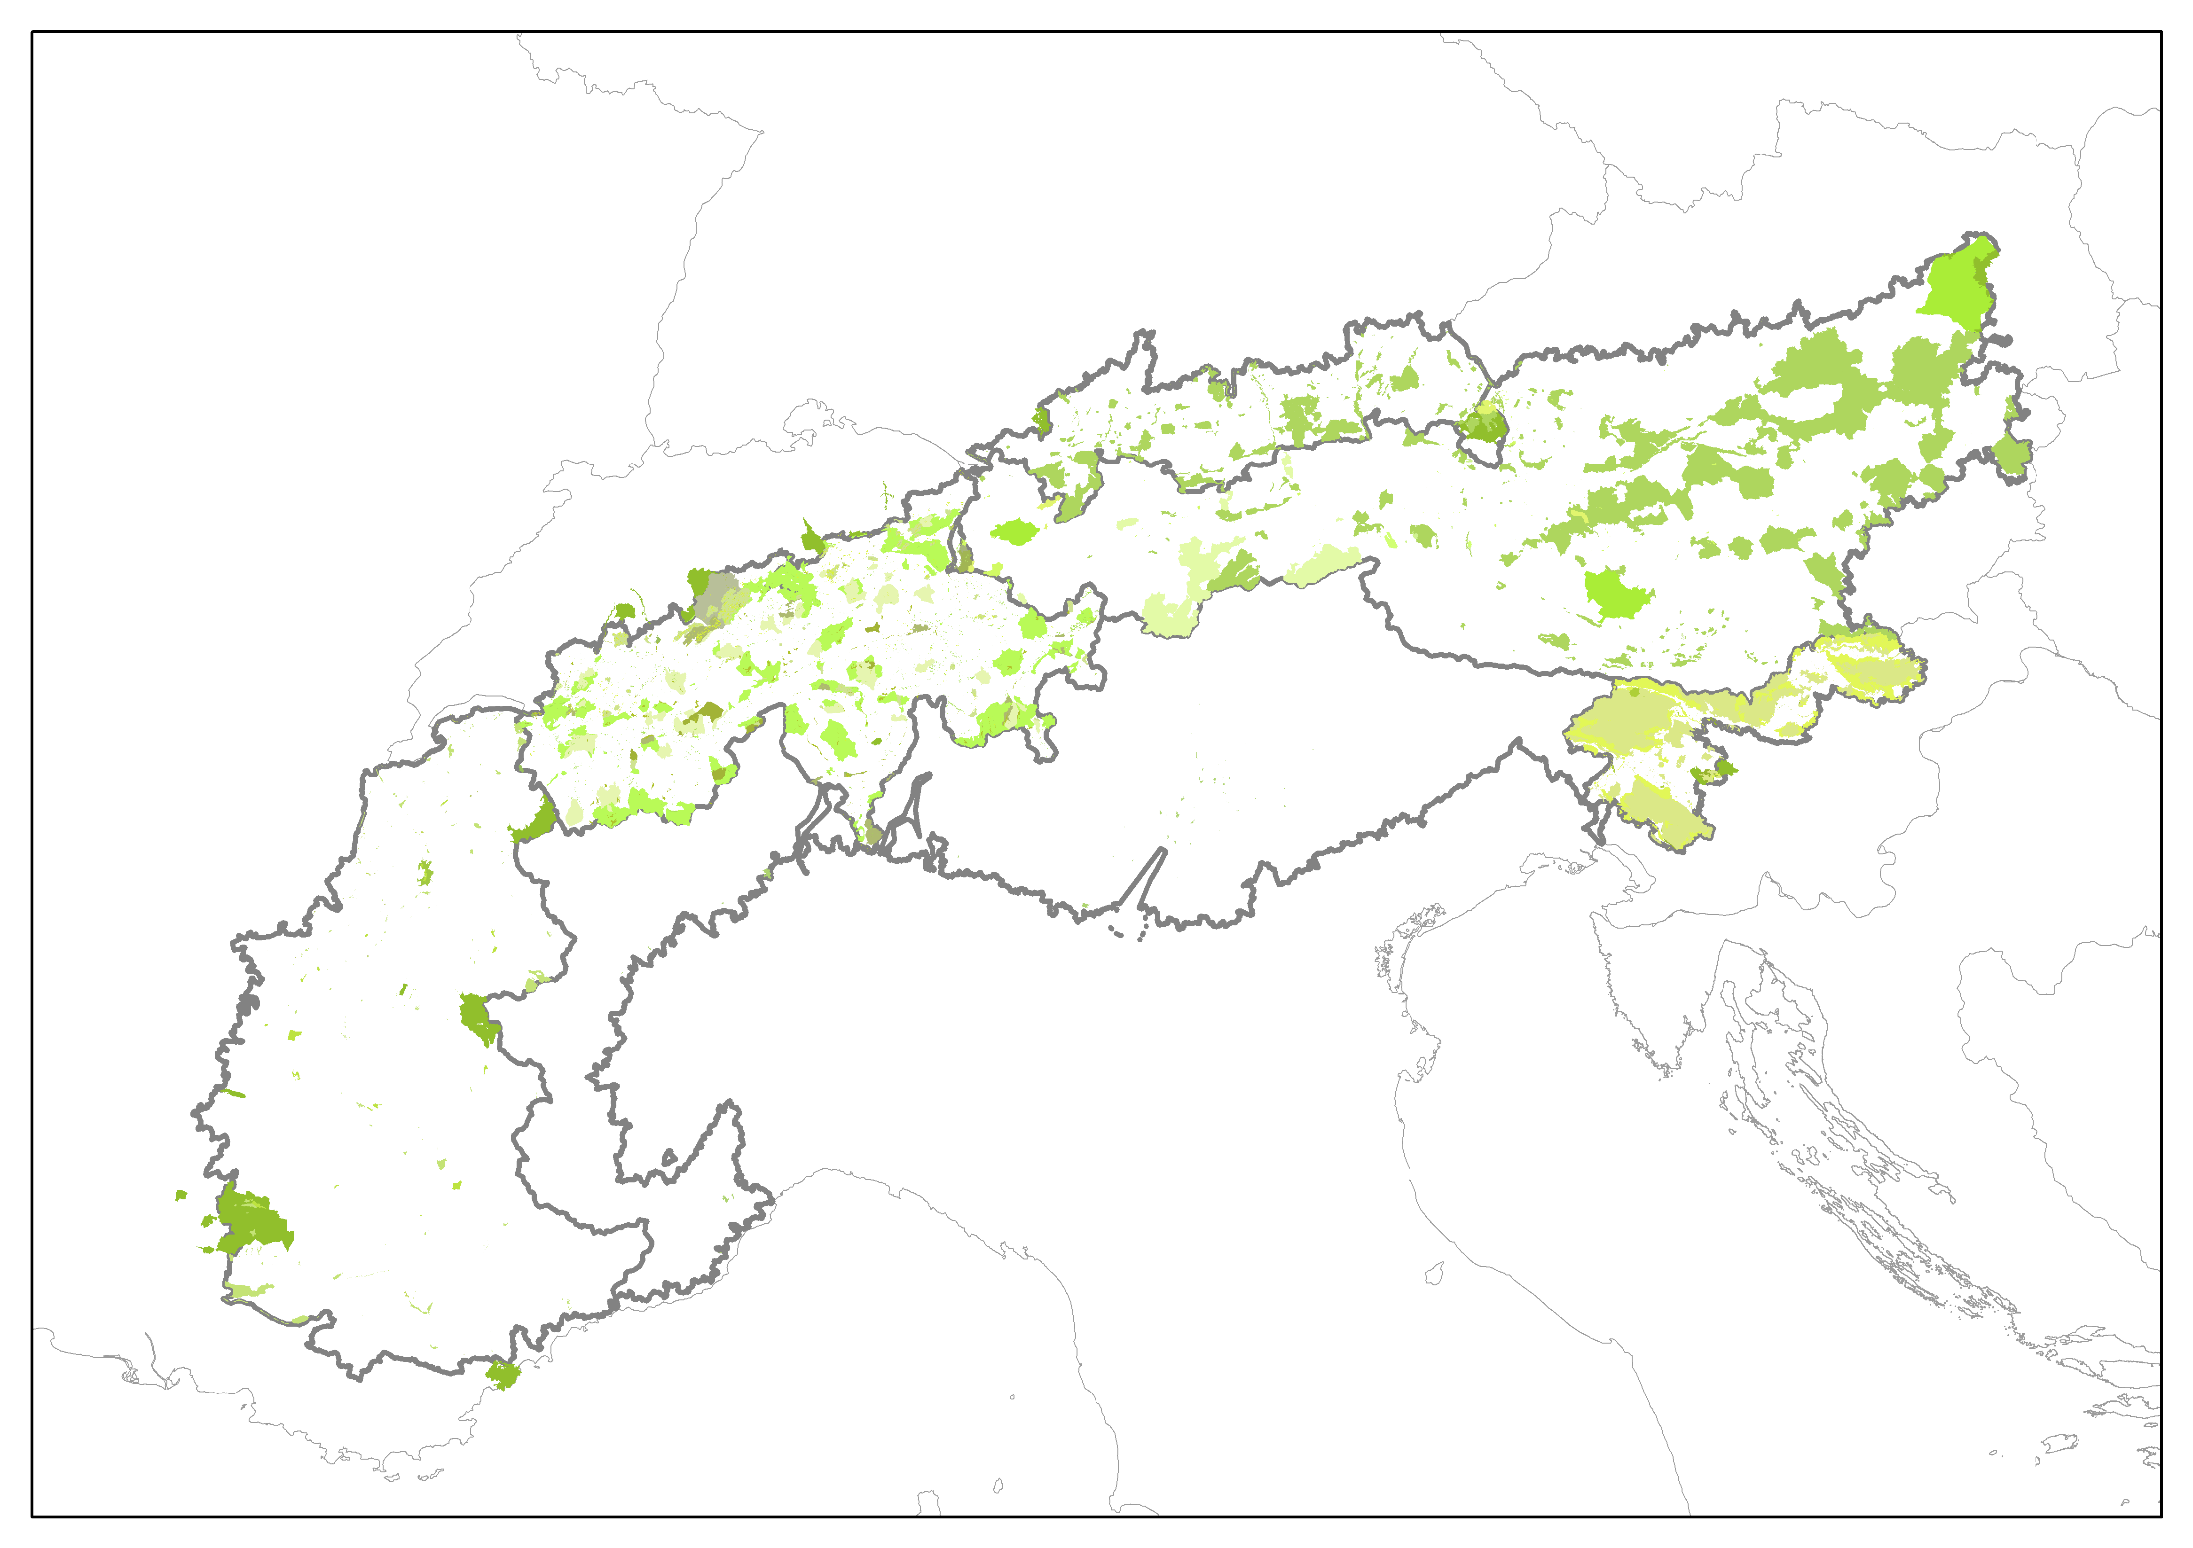
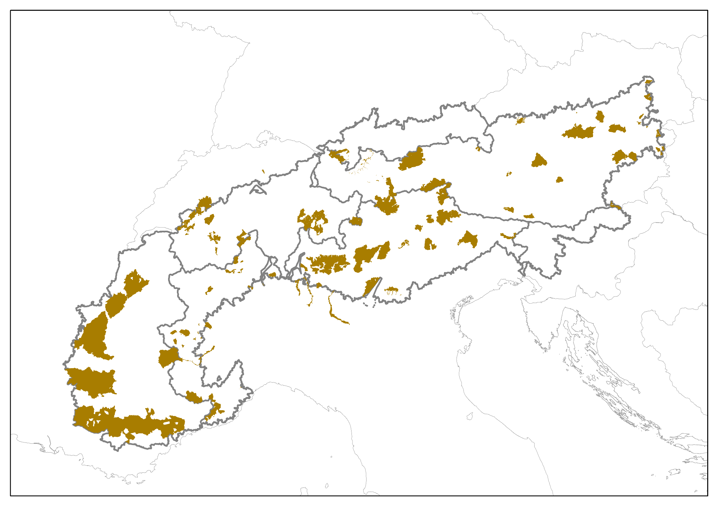
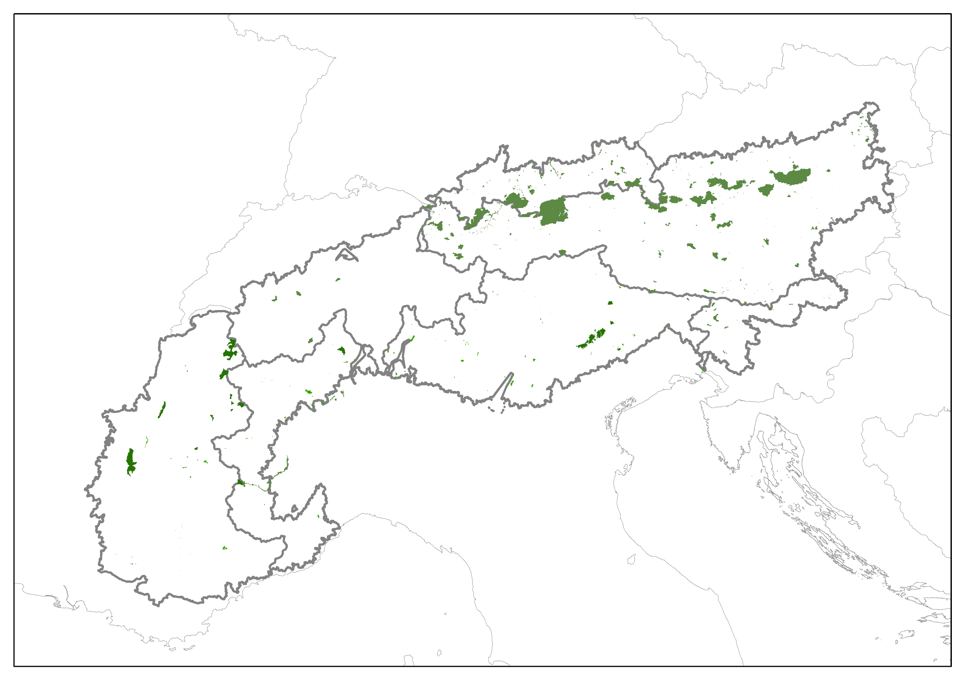
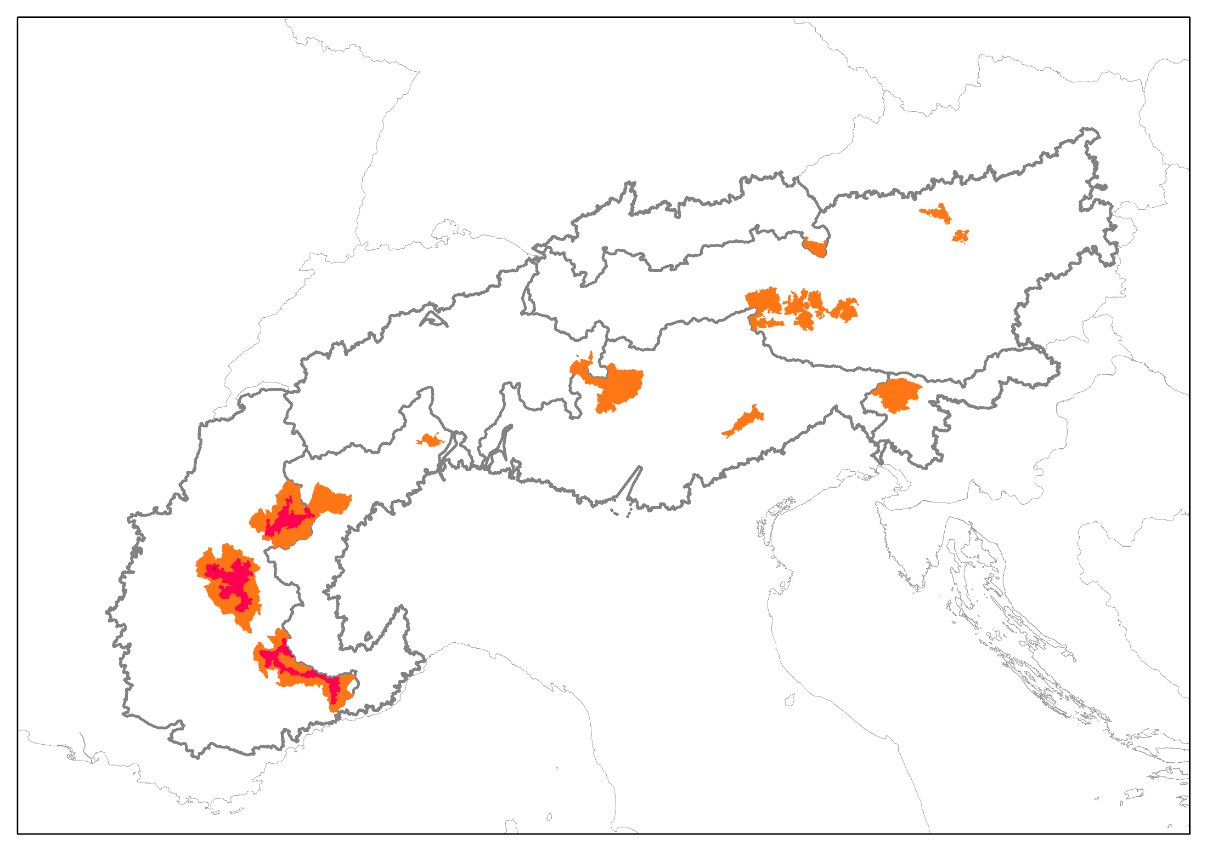
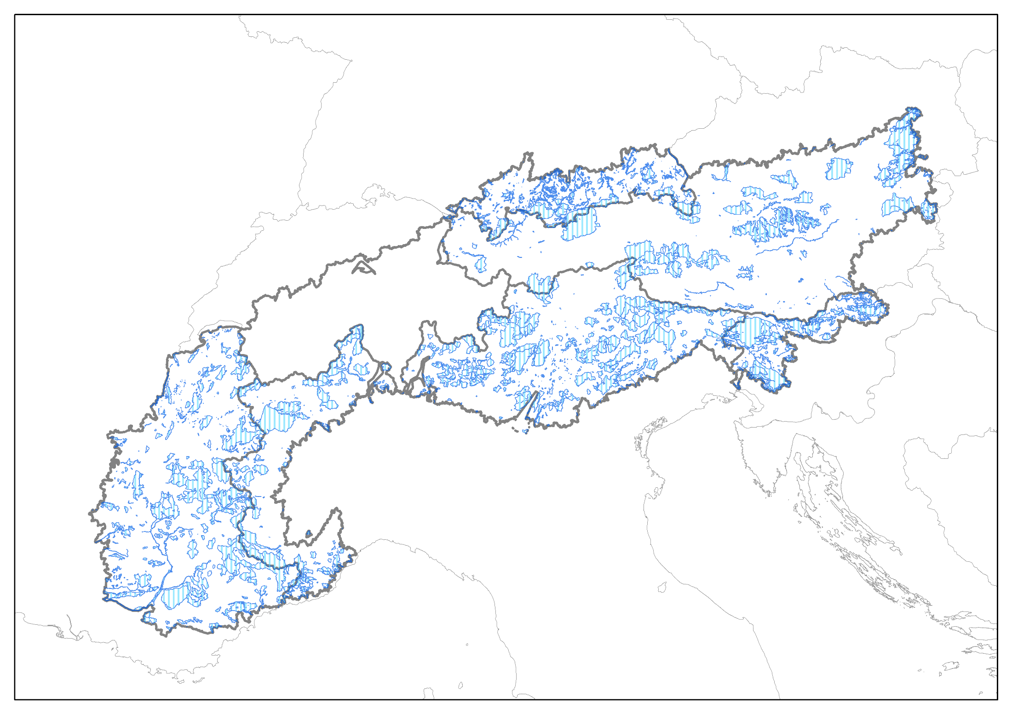
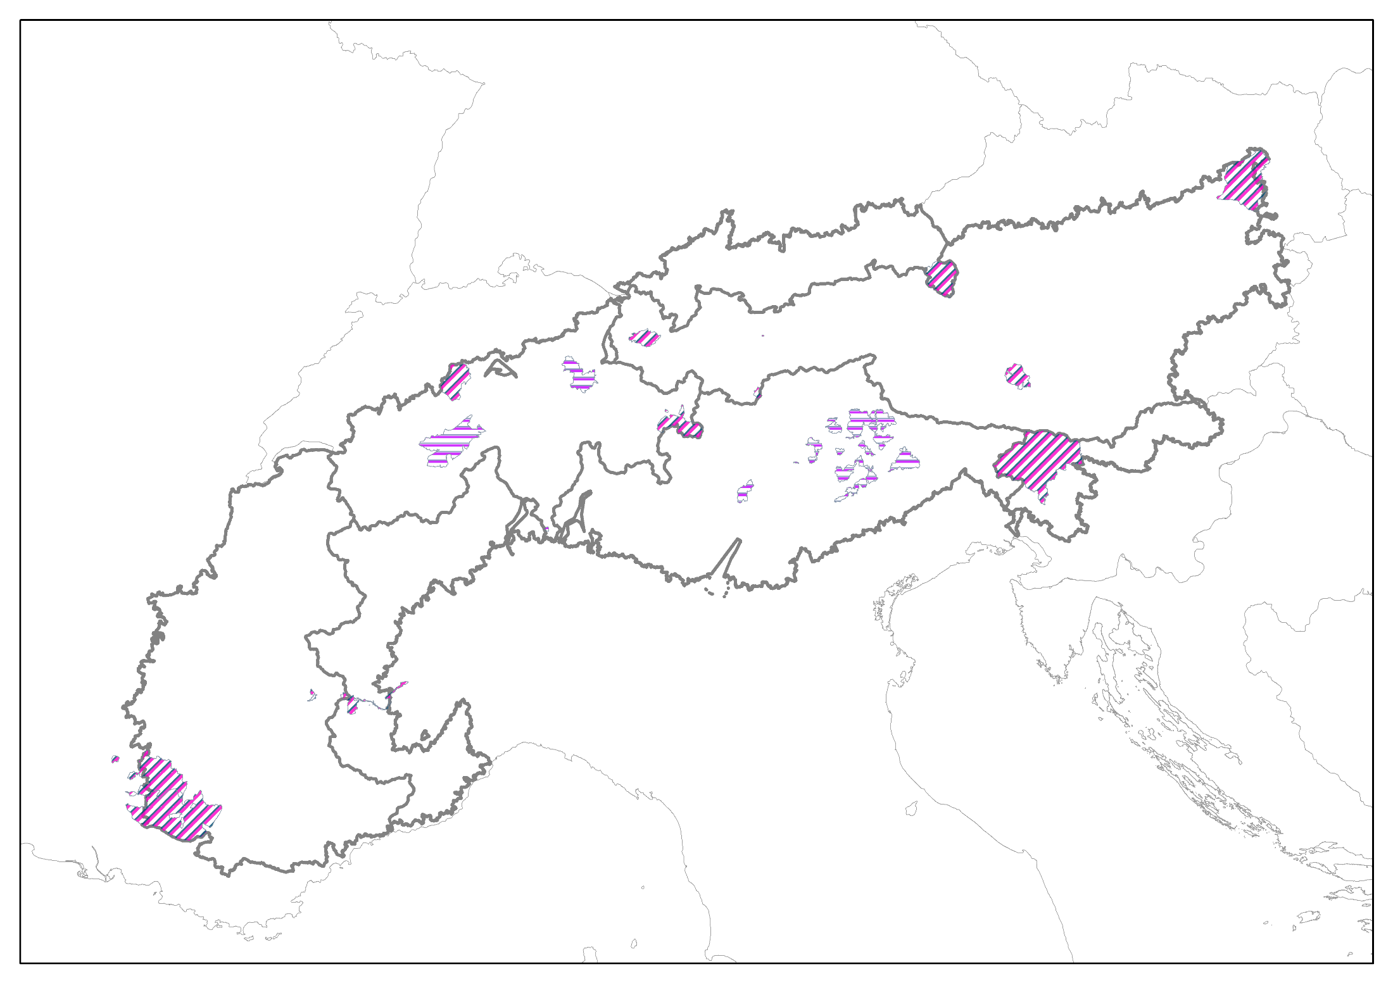
Protected Areas
Combined map of Protection Areas
Particular Protection
Sources: combined from EEA - European Environment Agency, WDPA - World Database on Protected Areas, and ALPARC.

Slide 8
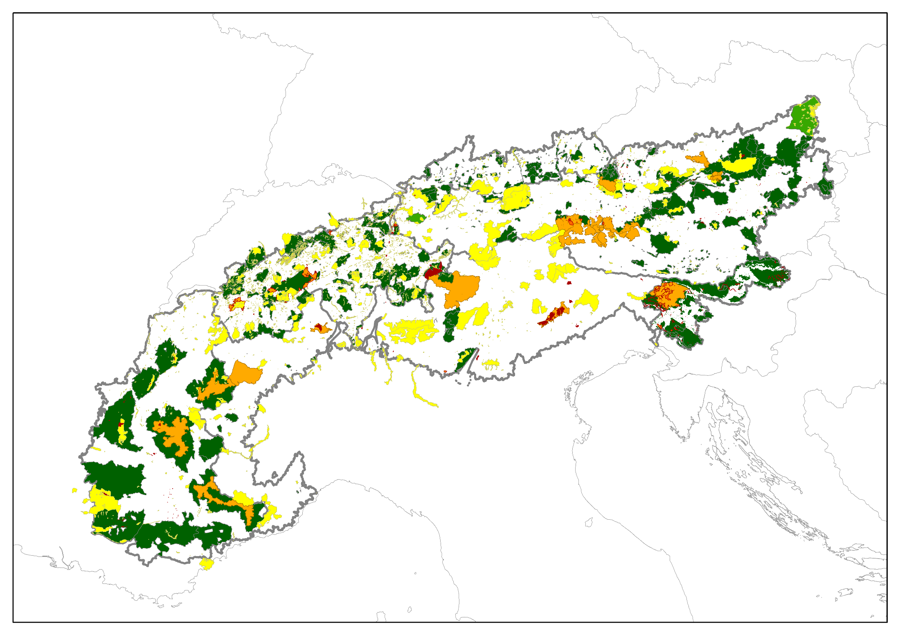
IUCN Categories
International Union for Conservation of Nature
Ia – Strict Nature Reserve
Ib – Wilderness Area
II – National Park
III – Natural Monument or Feature
IV – Habitat/Species Management Area
V – Protected Landscape
VI – Protected Area with Sustainable
Use of Natural Resources
Sources: combined from EEA - European Environment Agency, WDPA - World Database on Protected Areas, and ALPARC.

Slide 9

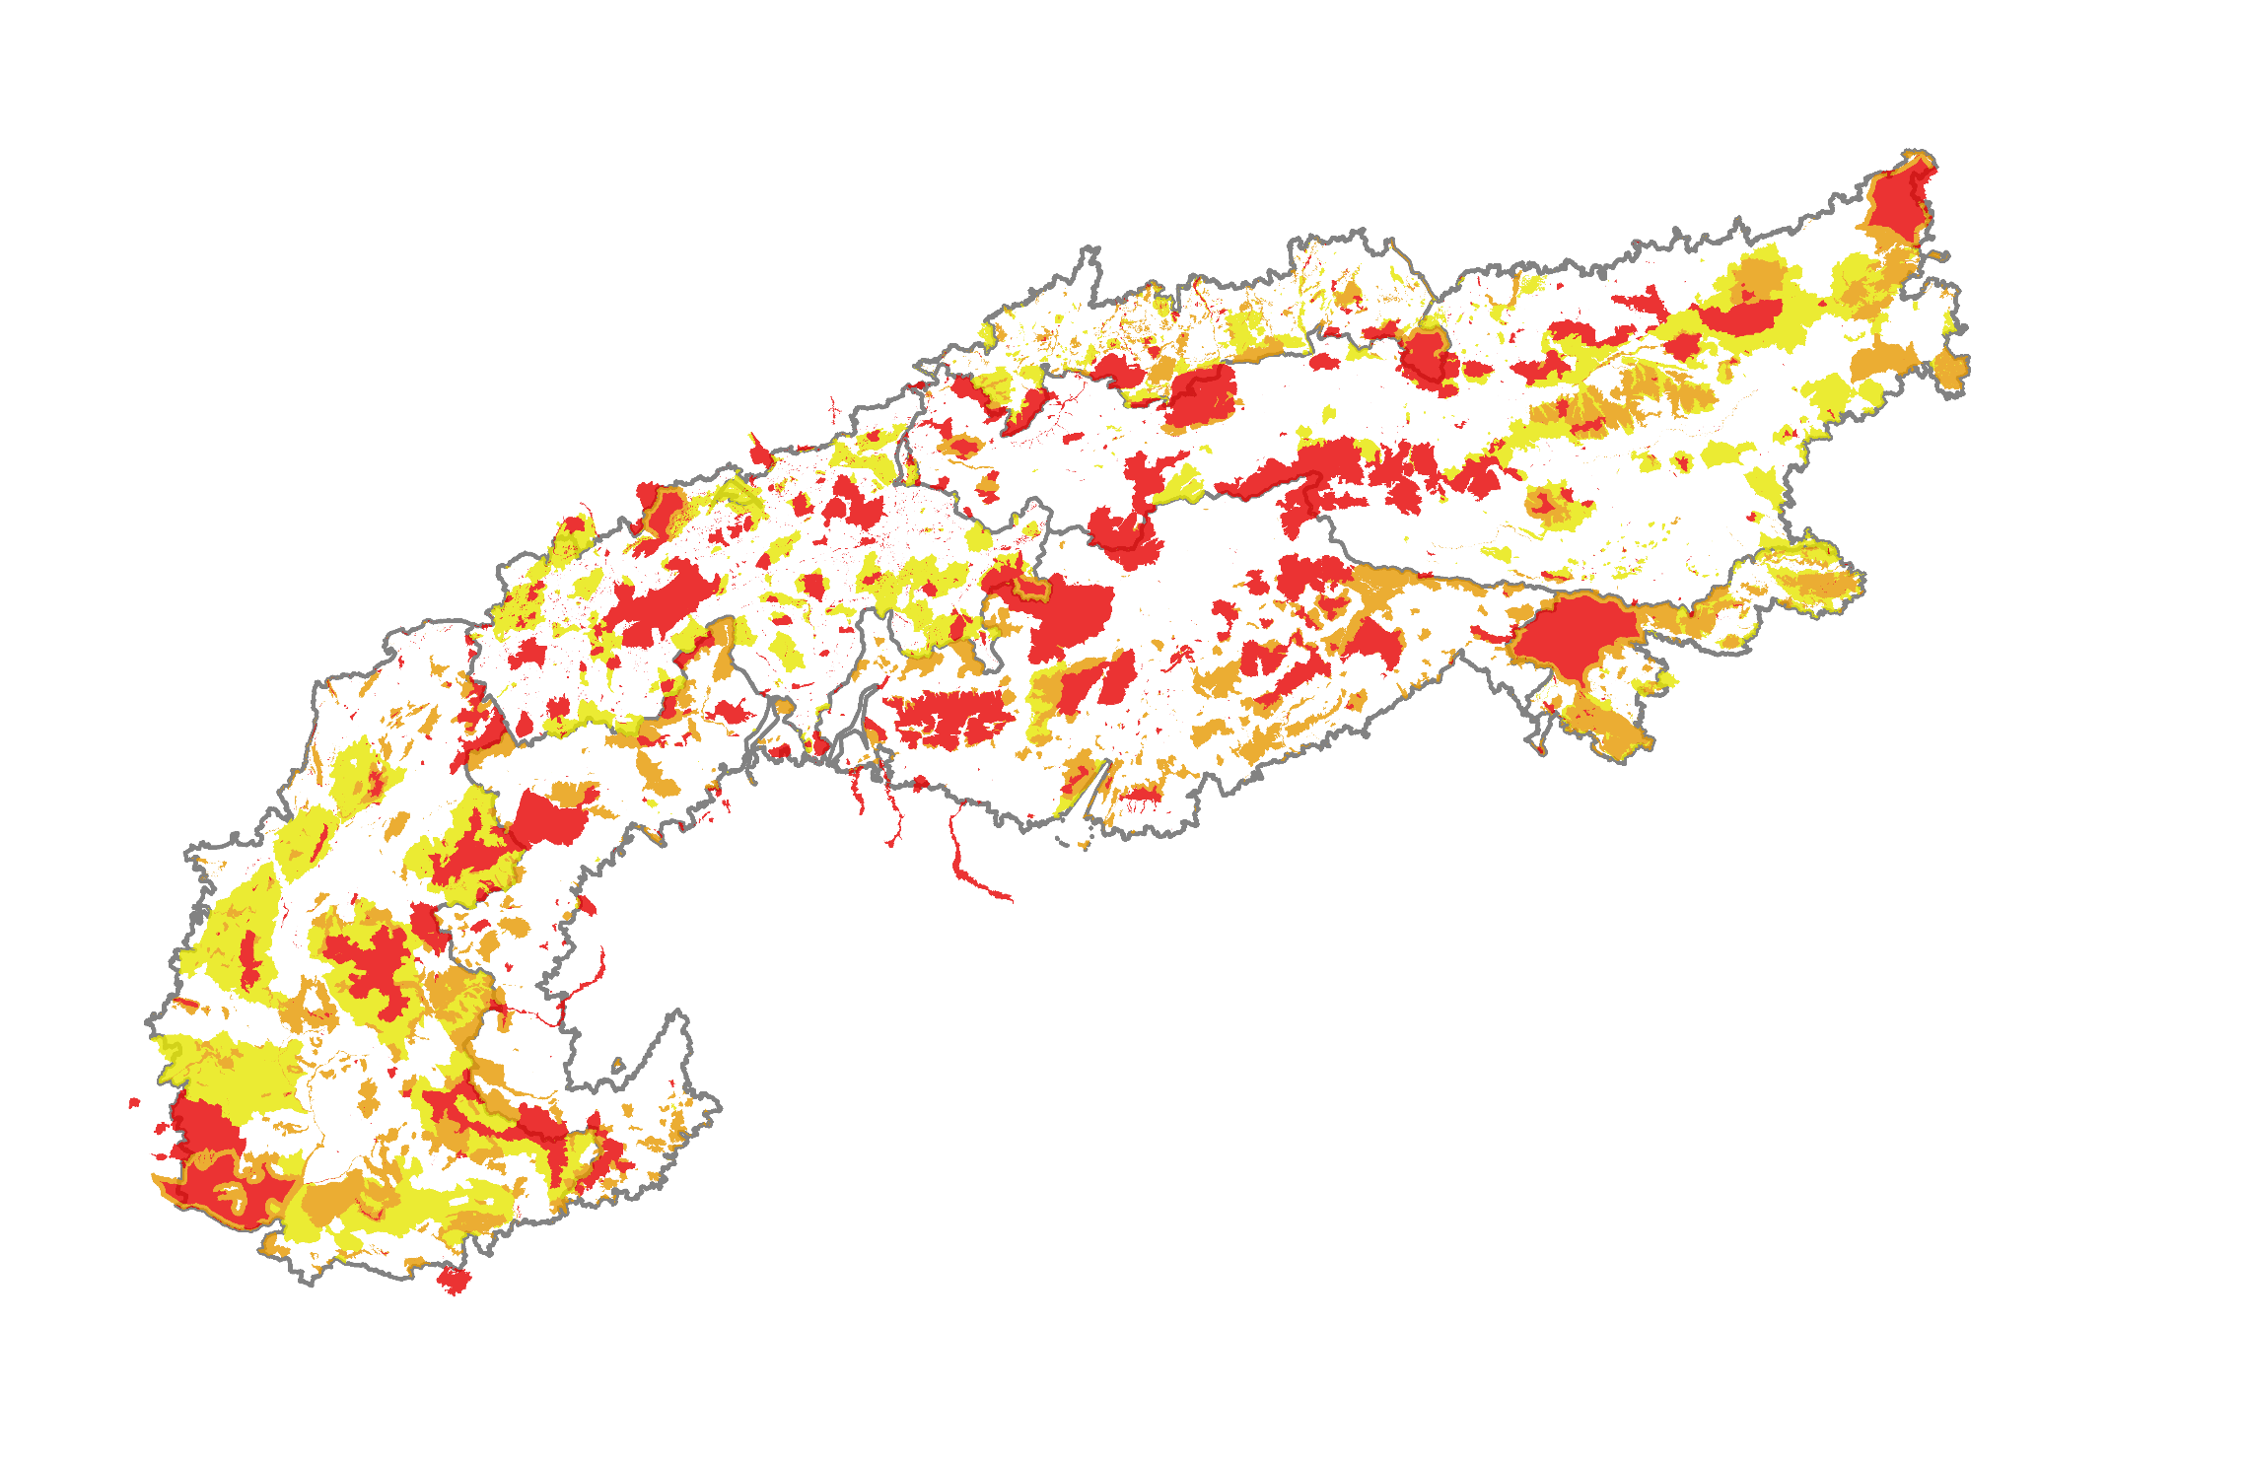
Harmonized Protected Areas
Scenario 1 – General protection level
Production restrictions
High protection
Medium protection
Low protection

Slide 10
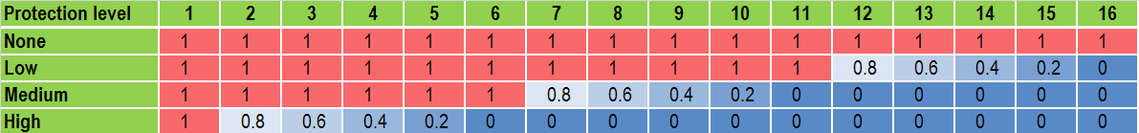
Marginal protection cost

Slide 11
JECAMI
http://www.jecami.eu/RG_v2/

Slide 12
Summary and Outlook
Forests provide a number of essential ecosystem services and the full range of implication of changes in management needs to be considered.
Similar energy demand can be met under different scenarios. However, -sequestration maximization does not allow for lower cost high-intensity harvesting practices.
The pros and cons of bioenergy production have to be weighted against each other in an integrated and systematic manner while considering trade-offs with ecosystem services (e.g., carbon sequestration or biodiversity).
Notes:
Sustainability in this case means: not using more biomass than regrows in the same time (max. the increment will be used)

Slide 13
Thank you!
More information on IIASA
www.iiasa.ac.at
More on BeWhere
www.iiasa.ac.at/bewhere
Contact
Sylvain Leduc, leduc@iiasa.ac.at

