Slide 1
Systemic risks and cascading disruptions in complex supply chains
EEP Symposium — 28 July 2016
Celian Colon (Ecole Polytechnique, Ecole Normale supérieure, Paris)
Joint work with Åke Brännström, Elena Rovenskaya and Ulf Dieckmann (IIASA)

Slide 2
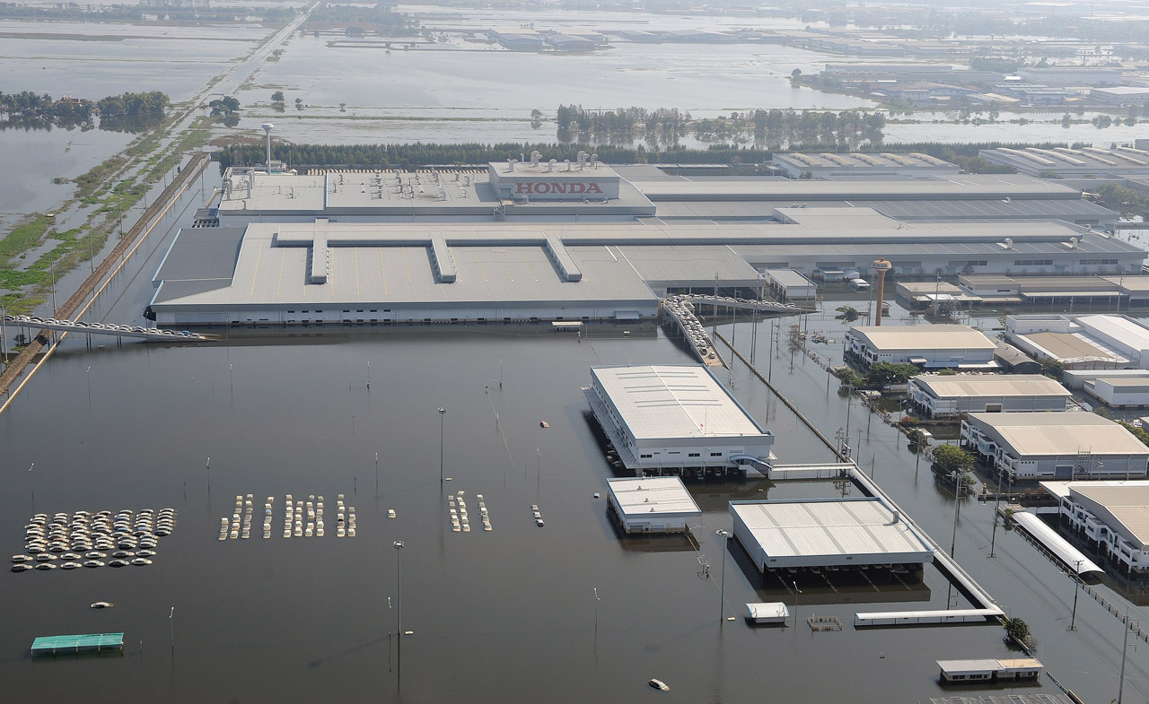
© Bloomberg

Slide 3
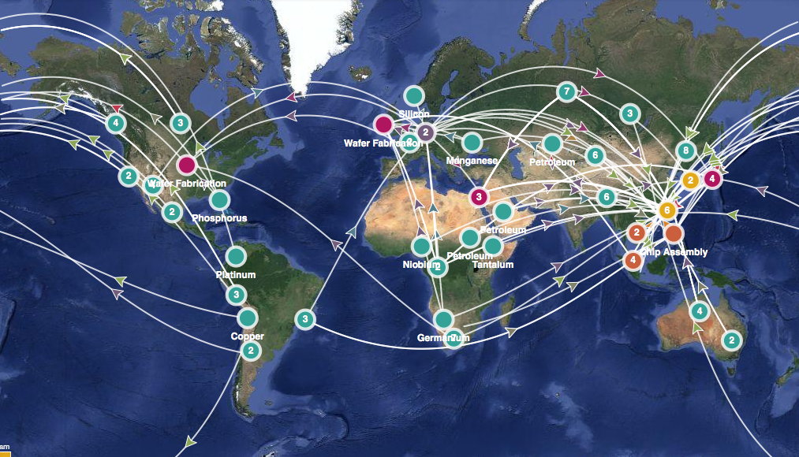
The supply chain of a laptop
Source: sourcemap.com

Slide 4
“Over 85% of the respondent had suffered at least one significant supply chain disruption in the last 12 months”*
*3rd Annual Survey of the Business Continuity Institute, conducted over 550 organizations from 60 countries, 2011, Zurich

Slide 5
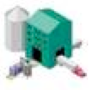


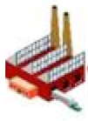
Mitigating the risks of supply disruption
Potential solutions:
Build inventories of critical inputs
Make the production process more flexible
Increase purchases from different suppliers ➔"overordering”
Key challenges:
More globalized and fragmented supply chains
Interdependencies between a growing number of firms
Lack of visibility of along the supply chains
Notes:
1-- embedded, map exposure to risks
2-- Disrupt production, transportation.
Propagate many pathways
For firms and policy-makers

Slide 6
Research questions
Do profit-maximization of each individual firm lead to the lowest risk? Is there an effect of supply fragmentation?
Are there firms that can most effectively mitigate systemic risks? How can they be identified?
Which policy measures or business practice can reduce systemic risks?

Slide 7
Complex supply chain interactions
Network
Raw materials
Acyclic random network of production units
Final consumers

Slide 8
Impact of firm behavior on the whole supply chain
Agent-based
Linear production function
with full substitutability
1
Characterized by:
- productivity
- failure rate
- overordering rate
2
0.5
------
0.75
50%

Slide 9
Evaluate response to perturbations
Dynamic
Unit-level
Supply chain-level
Profit of firm 2
Total profit
Profit of firm 6
Time
Profit of firm 8
Time

Slide 10
Adaptive strategies
Evolutionary
Groups of units are cooperating (e.g. integrated firms)
Each unit gradually adjusts its overordering rate to minimize the loss if its group
Convergence to an evolutionary equilibrium
Global cooperation
Local cooperation
Complete fragmentation
0
Fragmentation index
1

Slide 11
Results

Slide 12
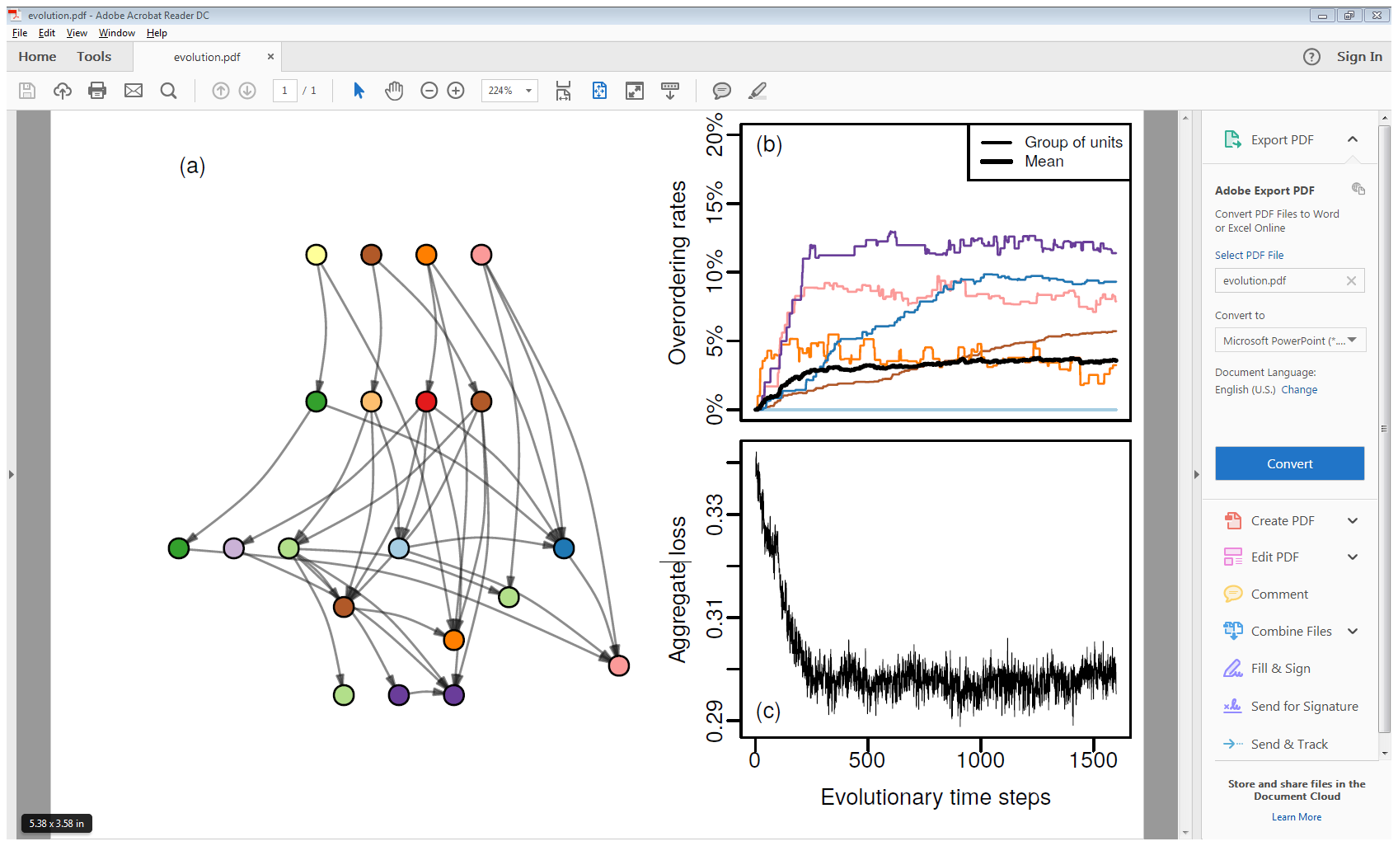
Result #1: The optimal strategy widely differs between units
A supply chain with 20 units and 12 groups of cooperating units, indicated by the colors

Slide 13
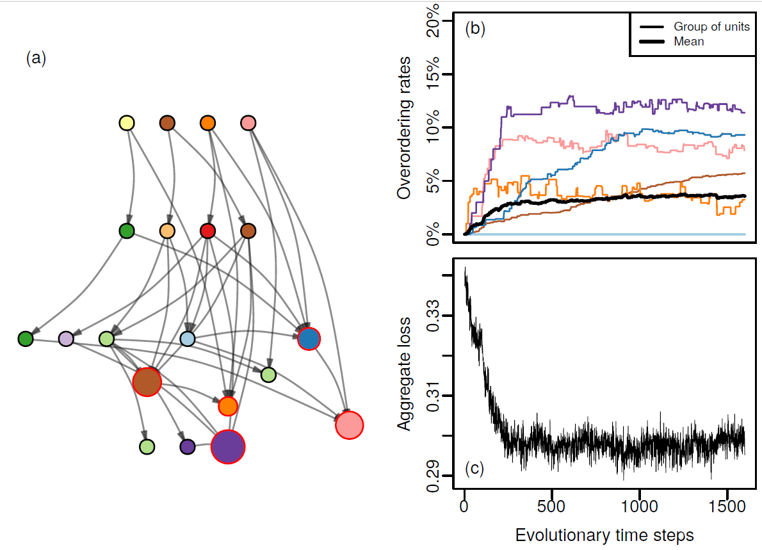
Result #1: The optimal strategy widely differs between units

Slide 14
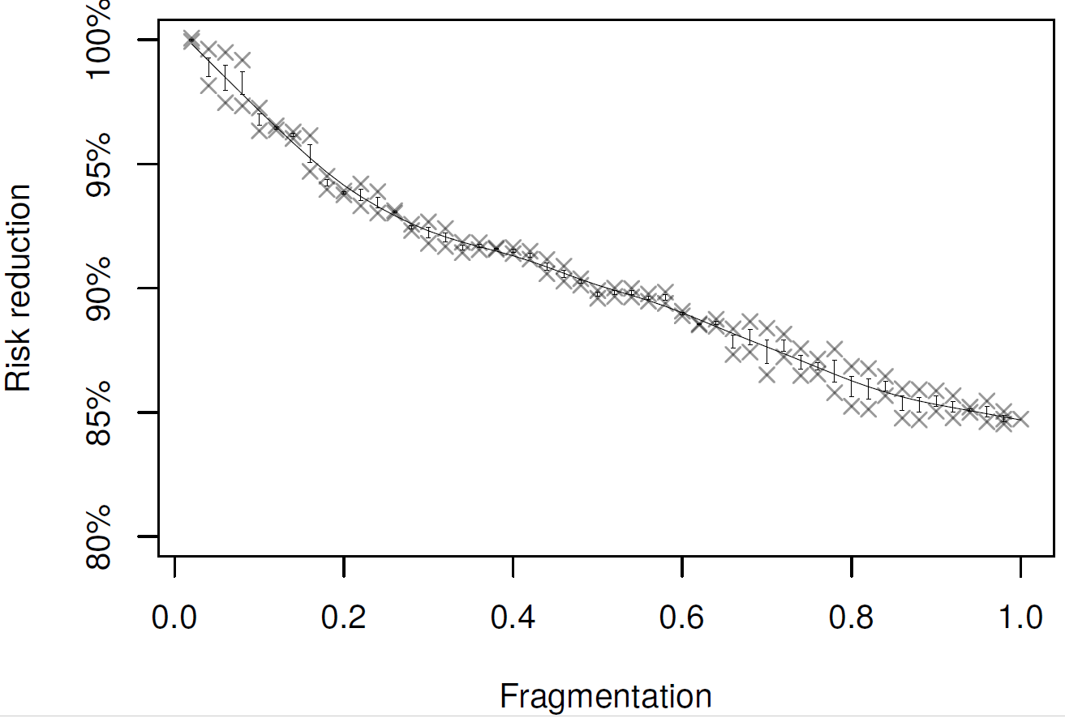
Result #2: Fragmentation leads to higher risks
Risk reduction achieved for different fragmentation scenarios
Result obtained for a supply chain with 50 units

Slide 15
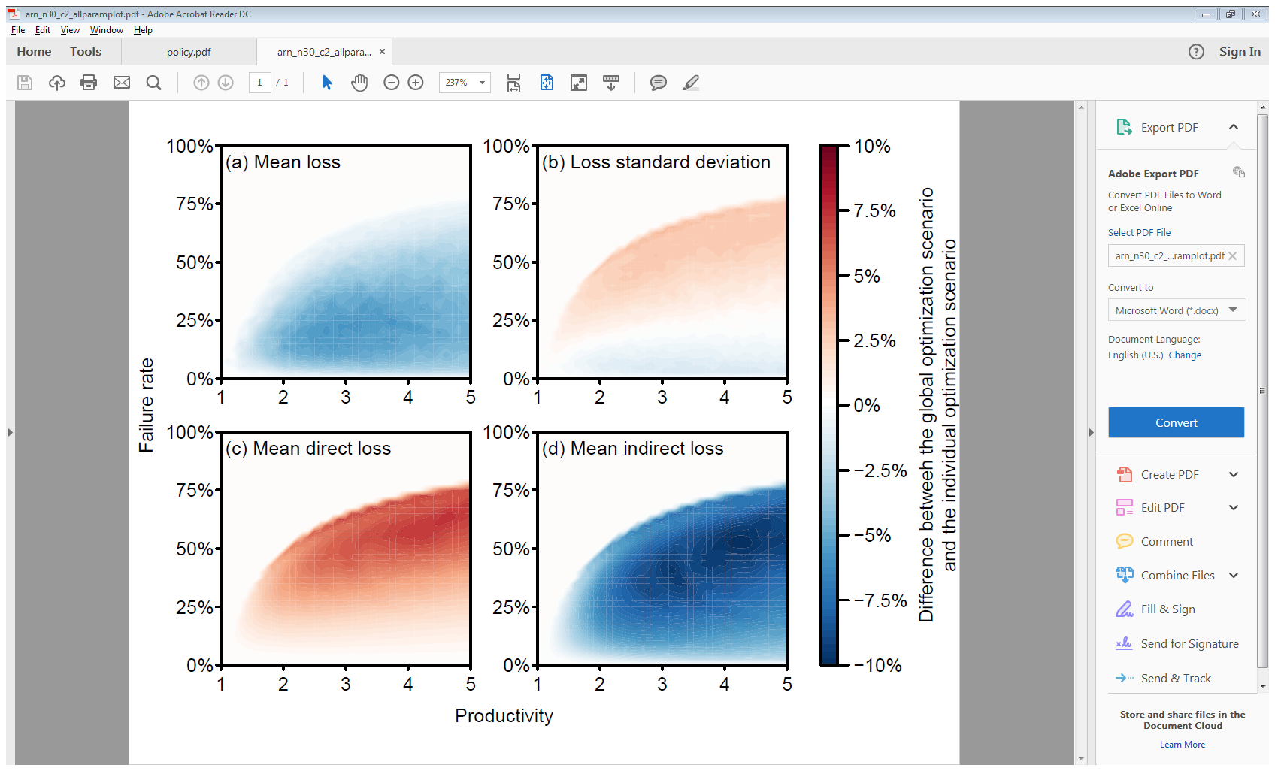
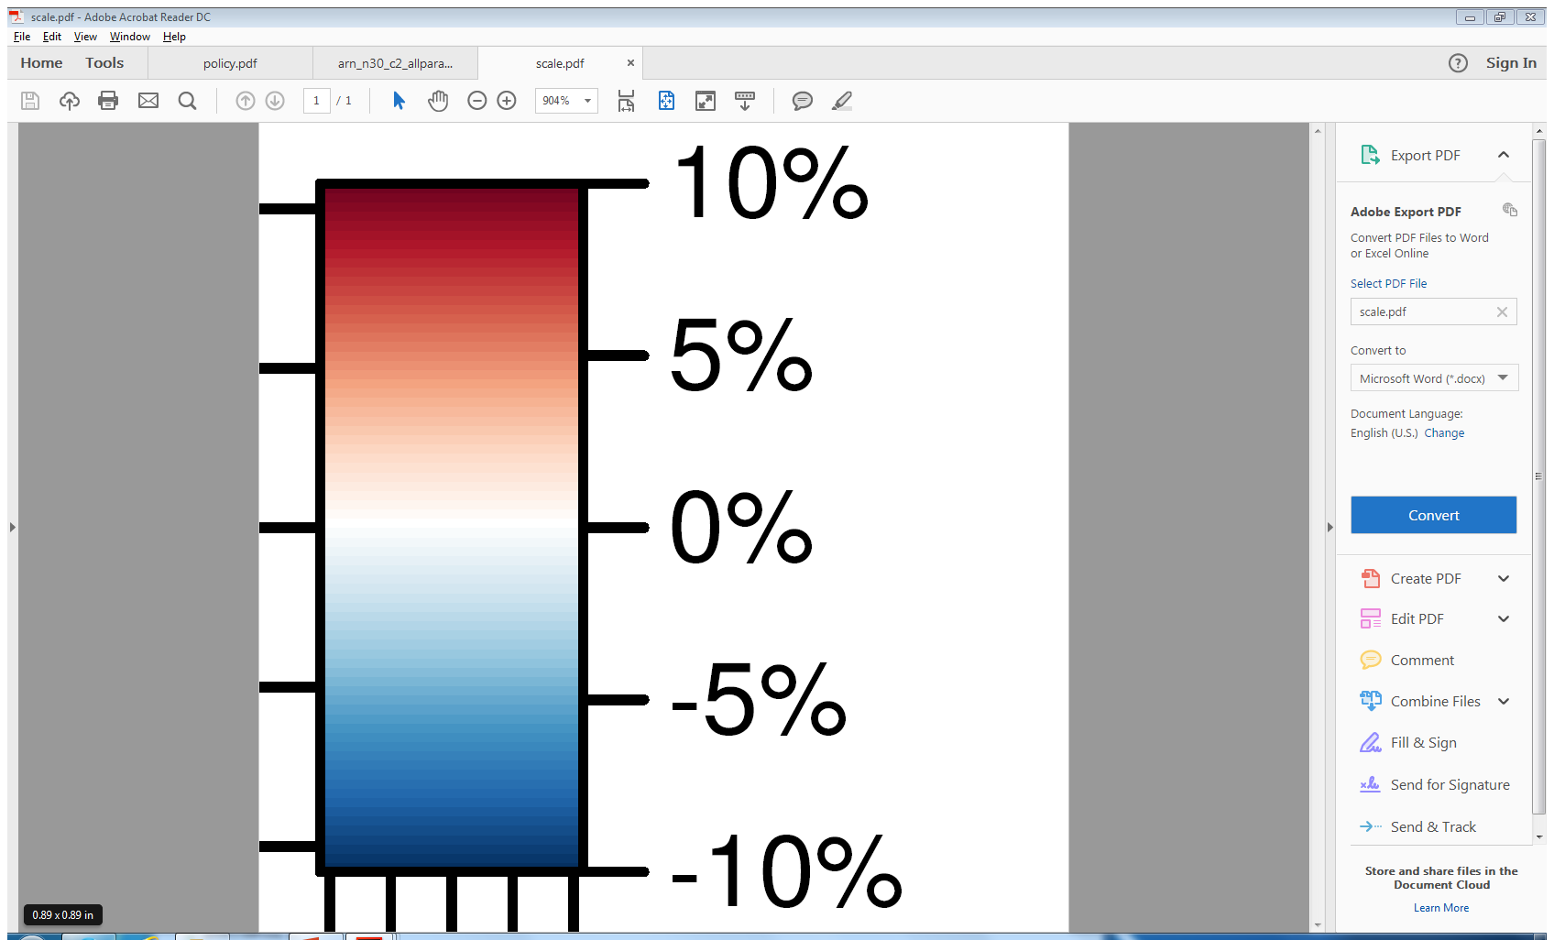
Result #3: Global cooperation robustly reduces risks
Change in the mean (a) and standard deviation (b) of aggregate loss over the parameter plane

Slide 16
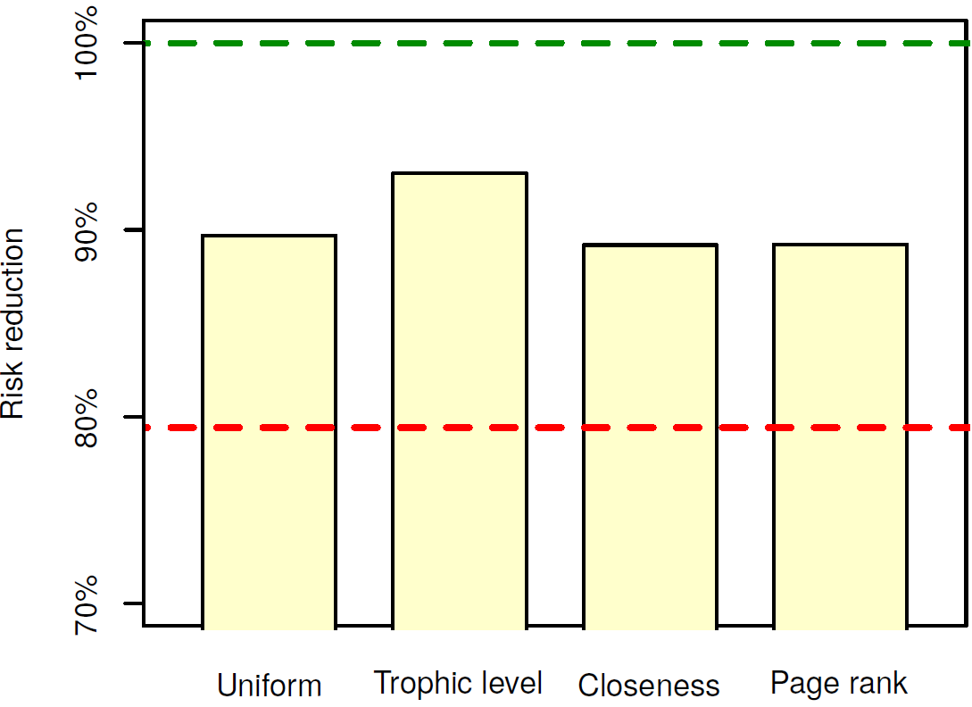
Result #4: The top-down allocation of buffers only partially covers risks
Maximum risk reduction achieved by a centralized allocation of overordering rates, according to four different criteria
Global cooperation
Complete fragmentation
(a)
No criteria,
same rate for all
(b)
Rate modulated by the trophic level
(c)
Rate modulated by closeness centrality
(d)
Rate modulated by page rank

Slide 17
Thank you for your attention!

Slide 18
Summary of the findings
Diversity of suppliers enables fine adaptation to risks
Risk-mitigating measures induces externalities
Profit-maximization does not lead to lowest systemic risks
Coordinated overordering dampens propagation and increases the net value created by the supply chain
It can increase volatility under intense perturbations
Final producers can significantly reduce systemic risks
Among other firms, it is difficult to identify a priori which ones can most decisively reduce systemic risks

Slide 19
A positive correlation between the size of the supply network and overordering

Slide 20
A shift in the structure of the value chain
Baseline
System-oriented
Final
producers
Primary
producers

Slide 21
Result #1: Supplier diversity enables finer adaptation to risks
Final producer with n suppliers:
Optimal overordering rate
Optimal profits

Slide 22
Result #2: There are strong externalities associated with overordering
2 firms per layer
Primary
producers
without overordering
with 100 % overordering
20
layers
Profits relative to the case where no firm overorder
Primary
producers
Final
producers
Final
producers

Slide 23
Result #2: There are strong externalities associated with overordering
2 firms per layer
Primary
producers
without overordering (except layer-9 firms)
20
layers
Profits relative to the case where no firm overorder
Primary
producers
Final
producers
Final
producers

Slide 24
Result #2: There are strong externalities associated with overordering
2 firms per layer
Primary
producers
without overordering
with 100 % overordering
20
layers
Profits relative to the no-overordering case
Primary
producers
Final
producers
Final
producers

Slide 25
Result #3: Overordering increases with productivity and peaks with failure rate
Average overordering rates and productivity — baseline
(averaged over 30 acyclic random networks with 30 firms, failure rate 3)
Average overordering rates and failure rate — baseline
(averaged over 30 acyclic random networks with 30 firms, productivity 2)

Slide 26
Result #4: Intense perturbations predominantly lead to indirect losses
Losses as a function of the failure rate — baseline
(averaged over 30 acyclic random networks with 30 firms, productivity 3)
Percentage of loss of total profit

Slide 27
Result #5a: System optimization lead to a reduction of disruption propagation through overordering
Baseline
maximize individual profit
System-oriented scenario
maximize total profit of the supply chain
Change in direct loss
(averaged over 30 acyclic random networks with 30 firms)
Change in indirect loss
(averaged over 30 acyclic random networks with 30 firms)
Sd of NVA

Slide 28
Result #5b: System optimization leads to higher value added
Baseline
maximize individual profit
System-oriented scenario
maximize total profit of the supply chain
Change in total profit
(averaged over 30 acyclic random networks with 30 firms)
Change in the standard deviation of the total profit
(averaged over 30 acyclic random networks with 30 firms)

Slide 29
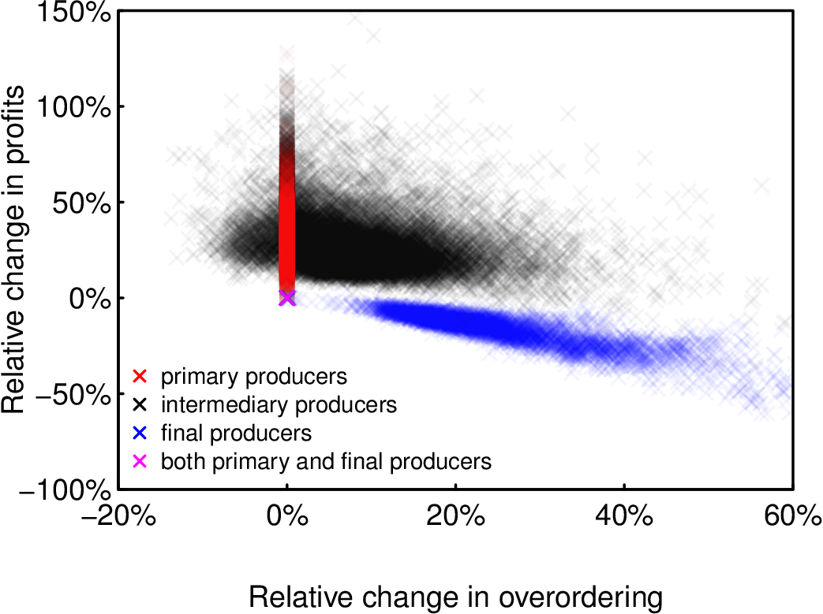
Result #6: Final producers contribute the most to systemic risk reduction
Baseline
maximize individual profit
System-oriented scenario
maximize total profit of the supply chain
+5% overordering
+29% profit
Relative change in profits
+26% overordering
-17% profit
Relative change in overordering rate
(1100 networks with 30 firms, productivity 2, failure rate 0.1)

