Slide 1
Air pollution in Europe and Asia
From Science to Policy
Markus Amann
Program Director
Air Quality and Greenhouse Gases

Slide 2
Origin of PM2.5 in European cities - 2009
Netherlands
average of the urban AIRBASE stations
Lyon, Centre Ville
How to balance
emission controls
in the most cost-effective way?
Source: IIASA
Kiesewetter et al., ACP 2014

Slide 3
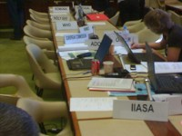


Greenhouse gas–Air pollution Interactions and Synergies:
IIASA’s GAINS model provides a systems approach for negotiations
Social development
and economic activities
§
National
Emission
Ceilings
National emission ceilings
Emission control options: ~2000 measures,
co-control of 10 air pollutants and 6 GHGs
Emissions
Costs
Least-cost optimization
Atmospheric dispersion
Health, ecosystems and climate impact indicators
Policy targets

Slide 4
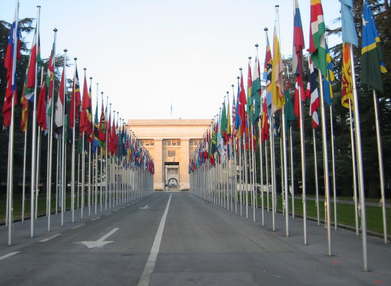
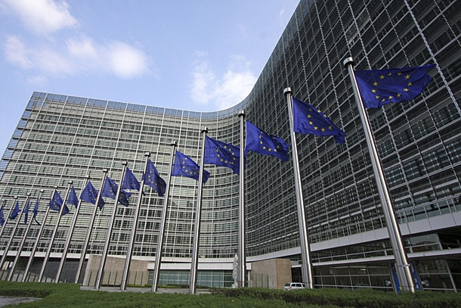
GAINS - the central analytical tool for air pollution negotiations in Europe
Convention on Long-range Transboundary Pollution
1994 Second Sulphur Protocol
1999 Gothenburg Multi-pollutant/Multi-effect Protocol
Revised Gothenburg Protocol
IIASA designated as EMEP Centre for Integrated Assessment Modelling
  European Union
  1995 EU Acidification Strategy
  2001 National Emission Ceilings Directive
  2005 Thematic Strategy on Air Pollution
  Clean Air Policy Package
  IIASA leads the “European Consortium for Modelling of Air and Climate Strategies”

Slide 5


Source contributions to PM2.5 in Delhi 2015
Indian standard
WHO guideline
Notes:
Air pollution receives growing attention in developing countries who repeat the mistakes of our growth paths.
Systems analysis can show more efficient way forward, provide rationale for multiple benefits for cc, sdg, etc –
Many decisions taken at local scale without solid knowledge - Think globally and long-term, act locally and now
Source apportionment India – new governance structures, new sectors, new co-benefits

Slide 6

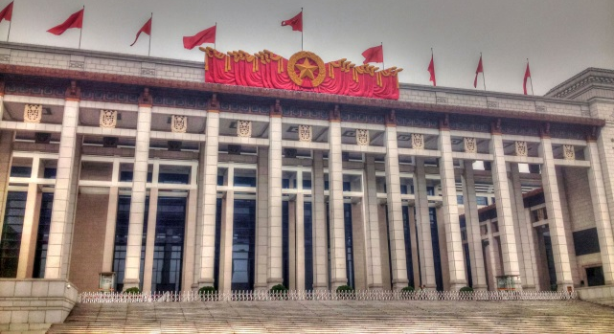
Air quality as driver for improved nitrogen management
World Bank support to China
2016: Nitrogen use efficiency
adopted as one key element of World Bank support for the JingJinJi Clean Air Action program of the Chinese government
Ammonia emission densities 2010
Stohl et al. ACP (2015)
Klimont et al. ACP (2016)

Slide 7
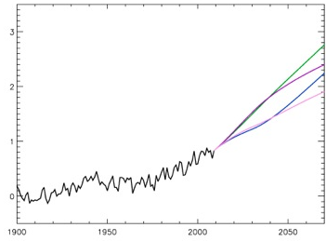


Reducing near-term climate impacts of air pollutants
Global temperature 1900-2070
Climate and Clean Air Coalition (CCAC)
Formed in 2012 to promote implementation of the 16 measures
identified by IIASA
Now 51 countries and
55 non-state partners and NGOs
Voluntary, action-oriented, in context with other development goals
IIASA on Science Advisory Panel
Reference
CO₂ measures
The 16 SLCP measures
CO₂ + SLCP measures

Slide 8
IIASA provides the key requirements for turning scientific findings into insights relevant for decision making
Independence/perceived legitimacy of the institution
Scientific networks involving multiple disciplines
Quality control: Peer review + strict QAQC procedures
Transparency, e.g., open access to models and data
Continuous dialogue with decision makers and stakeholders

