Slide 1
“IIASA Community Services” in the context of the IPCC
Keywan Riahi
Program Director, Energy
International Institute for Applied Systems Analysis
riahi@iiasa.ac.at
IIASA Evaluation Committee Visit
Laxenburg, 27 February 2016
Notes:
IIASA’s activities go beyond the pure scientific research
Another important contribution is related to services that IIASA provides to the scientific community.
I want to present four different types of activities in this area
And I will use the IIASA-IPCC involvement as an example, since it provides a nice example of such activities that sometimes involve various programs at the institute and help further integration at the Institute.

Slide 2
IIASA Community Services related to the IPCC
Community building (IAMC)
Coordination of community research activities (RCPs, SSPs)
Conduct research and provide scientific input
Host of major community data sets
Notes:
Different roles of IIASA in the IPCC

Slide 3
-1- Community Building
WGI
Climate
Projections
WGIII
Mitigation
WGII
Impacts
Vulnerability
Adaptation

Slide 4
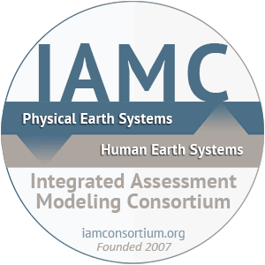
The Integrated Assessment Modeling Consortium
Co-founders: NIES, IIASA, and Stanford University
Main scientific organization of the climate mitigation research community
Identifies community research priorities and organizes community-wide activities and processes (eg., IPCC SSP, RCPs)

Slide 5
New Community Scenarios for Integrated CC Assessments
Socio-economic Pathways
(SSPs)
Descriptions of Alternative Socioeconomic Pathways
Representative Concentration Pathways (RCPs)
Integrated Analysis
Forcing, Emissions, concentrations, land use, land cover
Mitigation, Adaptation, Impacts
Earth System Model Simulations
(CMIP5)
Climate Change, climate variability
Currently under way….
Based on Moss, Edmonds, et al. (2010)

Slide 6
-2- Coordination of Community Research Activities

Slide 7
SRES: Special Report on Emissions Scenarios
IPCC Emissions Scenarios
Extensive literature review
Four narrative storylines
Six modeling frameworks
Forty emissions scenarios
Six illustrative scenarios
Nakicenovic et al, 2000

Slide 8
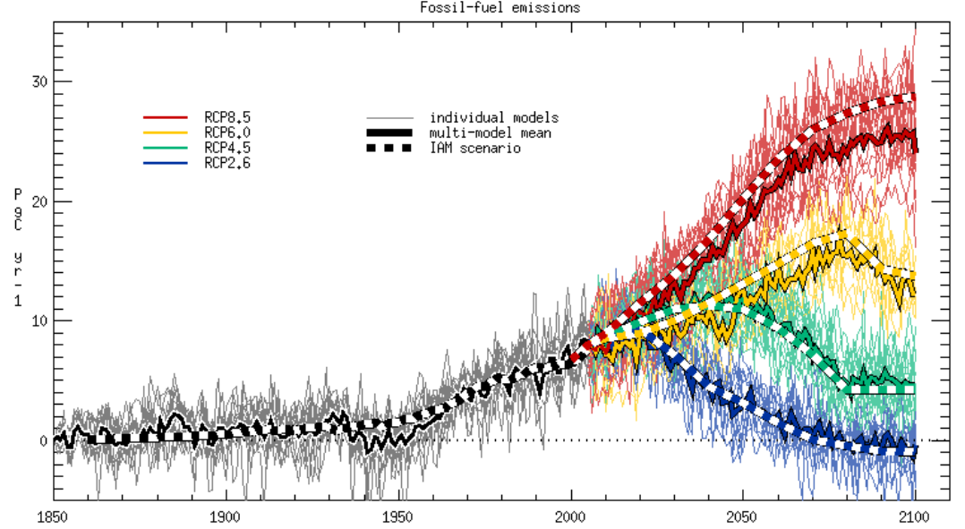
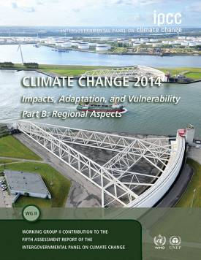
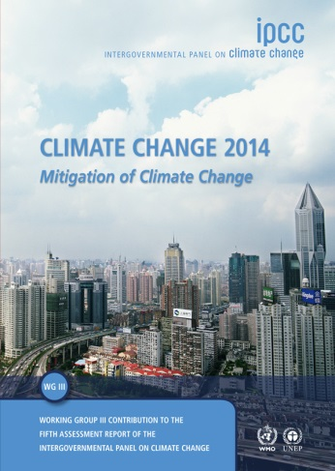
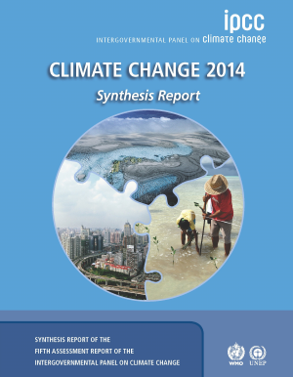
The Representative Concentration Pathways (RCPs)
MESSAGE
(IIASA)
AIM
(NIES)
GCAM
(PNNL)
IMAGE
(PBL)
van Vuuren et al, 2011; Jones et al, 2013
Notes:
RCP as an example of community efforts
WG1 climate models in comparison to the IAMs
RCPs are the back-bone of the Climate Assessment in AR5

Slide 9
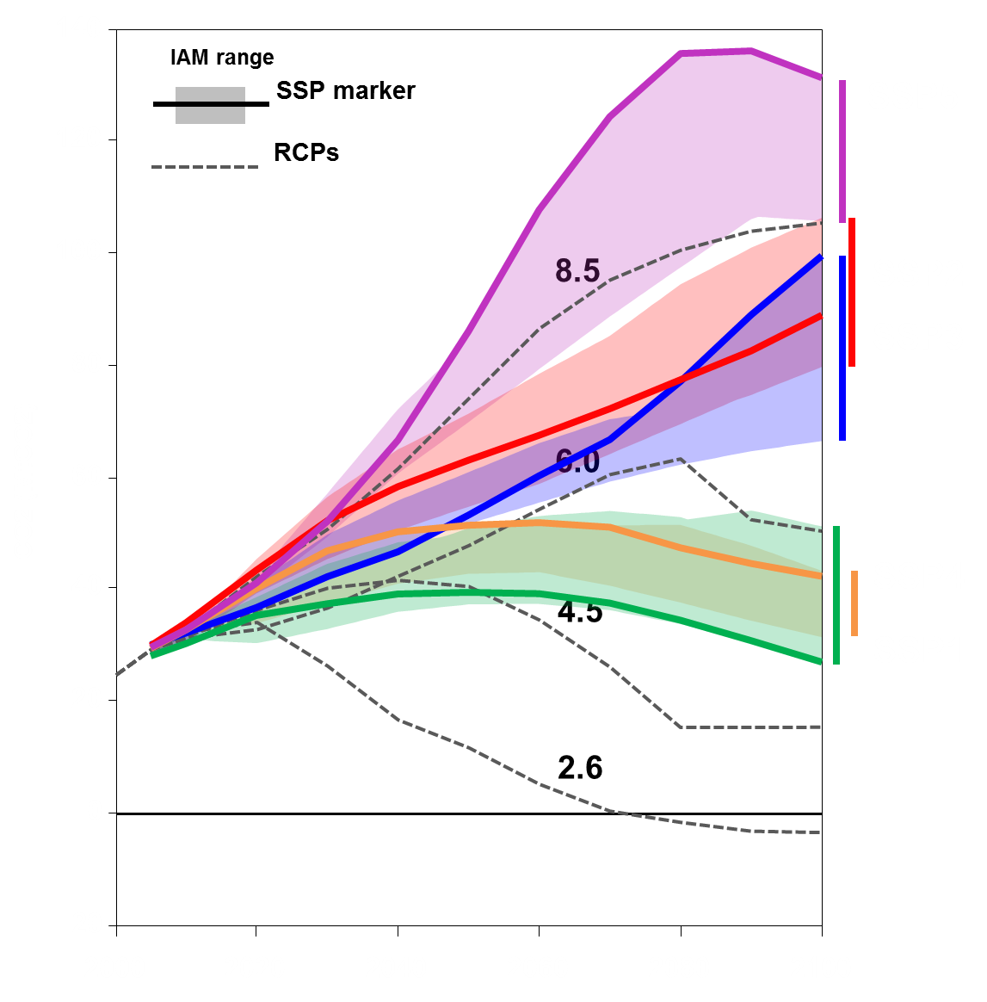
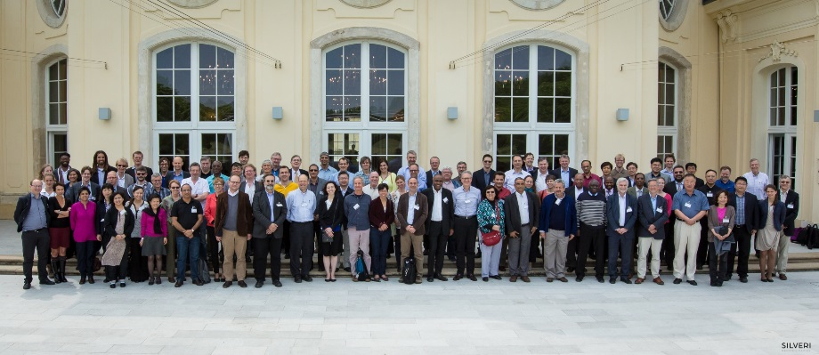
SSPs – Shared Socioeconomic Pathways for the AR6
SSP1
SSP4
SSP2
SSP3
SSP5
CO2 Emissions
Mitigation costs
Carbon price
(2010$/tC)
8.5
Baseline
>50$
6.0
Baseline
20$
RCPS / Forcing level (W/m²)
4.5
10$
3.4
5$
2.6
2$
2.0
<1$
Riahi et al, 2016
IPCC Expert Meeting on Scenarios, IIASA, 2015
Notes:
New range of emissions
Perhaps more importantly a new design, storylines, and for the first time a flexible framework for joint mitigation/adaptation and impacts assessments
Reviewed and Endorsed at the last IPCC scenarios expert meeting that I had the pleasure to organize in 2015

Slide 10
-3- Selected Scientific Contributions to the AR5

Slide 11
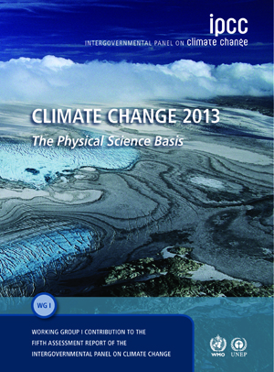
IIASA & IPCC AR5: 2009 - 2014
WGI
WGII
Z. Klimont
J. Rogelj
P. Lemke
R. Mechler
P. Kabat
T. Patt
J. Bayer, W. Lutz
N. Nakicenovic
A. Grubler, V. Krey
K. Riahi, J. Jewell
L. Gomez-Echeverri
J. Rogelj, P. Kolp
D. McCollum,
N. Johnson, T. Patt
H-H. Rogner,
H. Boettcher,
M. Rogner, K. Parikh
WGIII
Synthesis
L. Gomez-Echeverri
K. Riahi
J. Rogelj

Slide 12
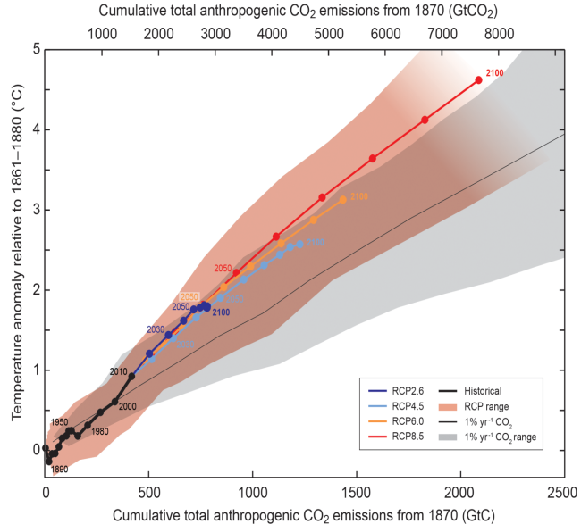
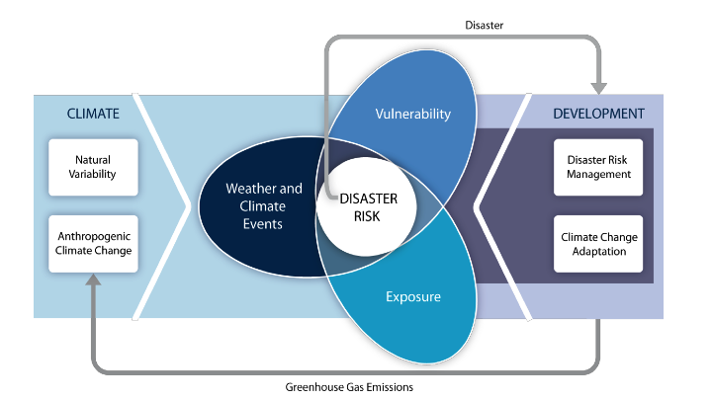
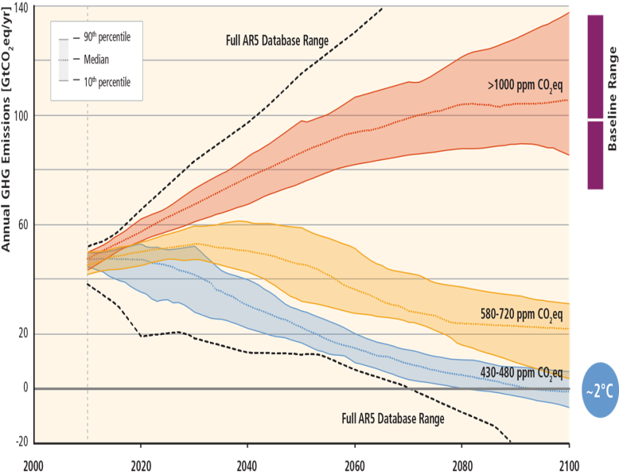
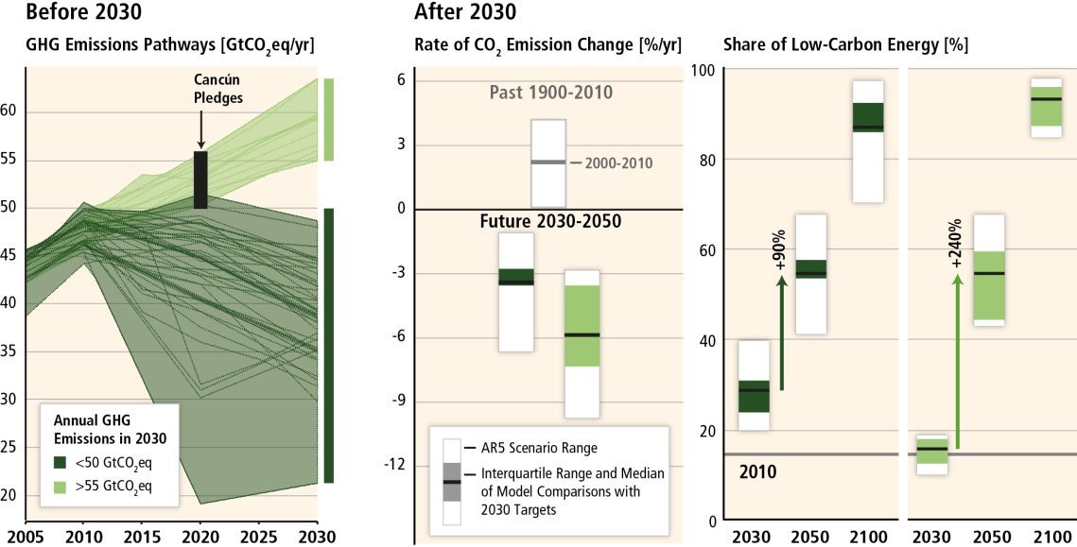
Some key inputs to the IPCC AR5
WGI: Emissions Budgets
WGII: Risk Framing
WGIII assessment largely based on five international intercomparison projects:
EMF 27 (Technology)
AMPERE (Delay & Policy)
LIMITS (Burden sharing)
AME (Asian focus)
ROSE (Uncertainty)
WGIII: Mitigation Scenarios
WGIII: Implications of “Delays”

Slide 13
Some key inputs to the IPCC AR5
WGI: Emissions Budgets
WGII: Risk Framing
WGIII assessment largely based on five international intercomparison projects:
EMF 27 (Technology)
AMPERE (Delay & Policy)
LIMITS (Burden sharing)
AME (Asian focus)
ROSE (Uncertainty)
WGIII: Mitigation Scenarios
WGIII: Implications of “Delays”

Slide 14
GEA has served as a role-model of the IPCC’s assessment of climate change mitigation co-benefits (e.g. for air pollution & energy security)

Slide 15
-4- IIASA as a Hub for Community Data Services

Slide 16
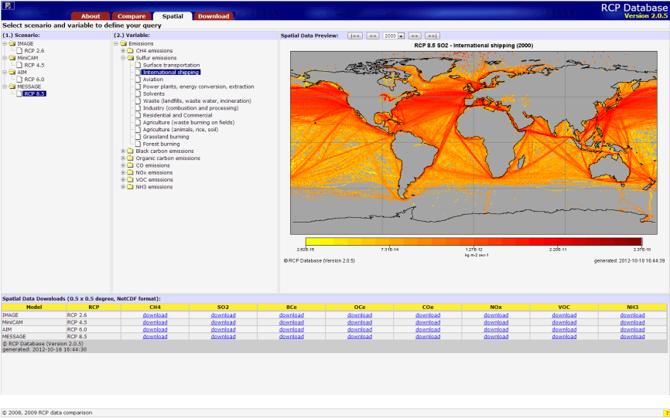
IIASA-IPCC Scenario Databases
IIASA-IPCC AR5 database:
2016
60,000 visits
4,7 million hits
2 TB downloads
https://secure.iiasa.ac.at/web-apps/ene/AR5DB
IIASA-RCP & SSP database:
http://tntcat.iiasa.ac.at/RcpDb/
Other major databases:
Energy Modeling Forum (EMF24, EMF27, EMF28)
Global Energy Assessment (GEA)
Asian Modeling Exercise (AME)
AMPERE, LIMITS, ADVANCE (EU-FP7 project)
CD-LINKS (SDG-Climate)
Latin American Modeling Project (LAMP)
Notes:
Over the past years, the ENE program has developed a number of data dissemination tools. On the one hand, we host a number of web-databases which are mostly addressing the scientific community; examples include:
Representative Concentration Pathway (RCP) database which hosts emissions, land use data, both as regional and gridded data, for the IPCC AR5 process
Global Energy Assessment (GEA) scenario database
Several databases for modeling comparison projects of the integrated assessment modeling community

Slide 17
Thank you!
riahi@iiasa.ac.at
Notes:
Countries/NMO linkages as another community…
Add why at IIASA

Slide 18
Integration across climate and other objectives is key for cost-effectivly addressing environmental challenges

