Slide 1
Developing and Applying
Population and Human Capital
Projections around the World
World Population Program (POP)
Director: Wolfgang Lutz
Deputy Director: Sergei Scherbov

Slide 2
Long History of Population Research at IIASA
1974-1984 Andrei Rogers
1984-1994 Nathan Keyfitz
1994 - … Wolfgang Lutz, Sergei Scherbov ….
What stands out as unique contributions of POP?
Multi-dimensional (multi-state) Demographic Methods
Pioneering Global Probabilistic Population Projections
Population – Development – Environment Analysis
Modeling of Human Capital Formation
Re-defining age and ageing

Slide 3
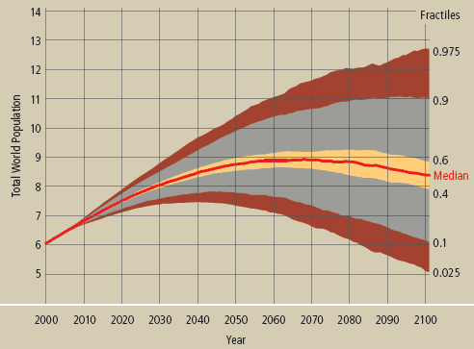

First probabilistic world population projections:
Lutz, Sanderson & Scherbov (IIASA)
Nature (1998): Doubling of world population unlikely
Nature (2001): The end of world population growth
Nature (2008): The coming acceleration of global
population ageing

Slide 4
Oxford University Press
2014
1056 pages,
26 lead authors,
46 contributing authors,
550 expert assessments,
191 country tables

Slide 5
World Population Projections

Slide 7
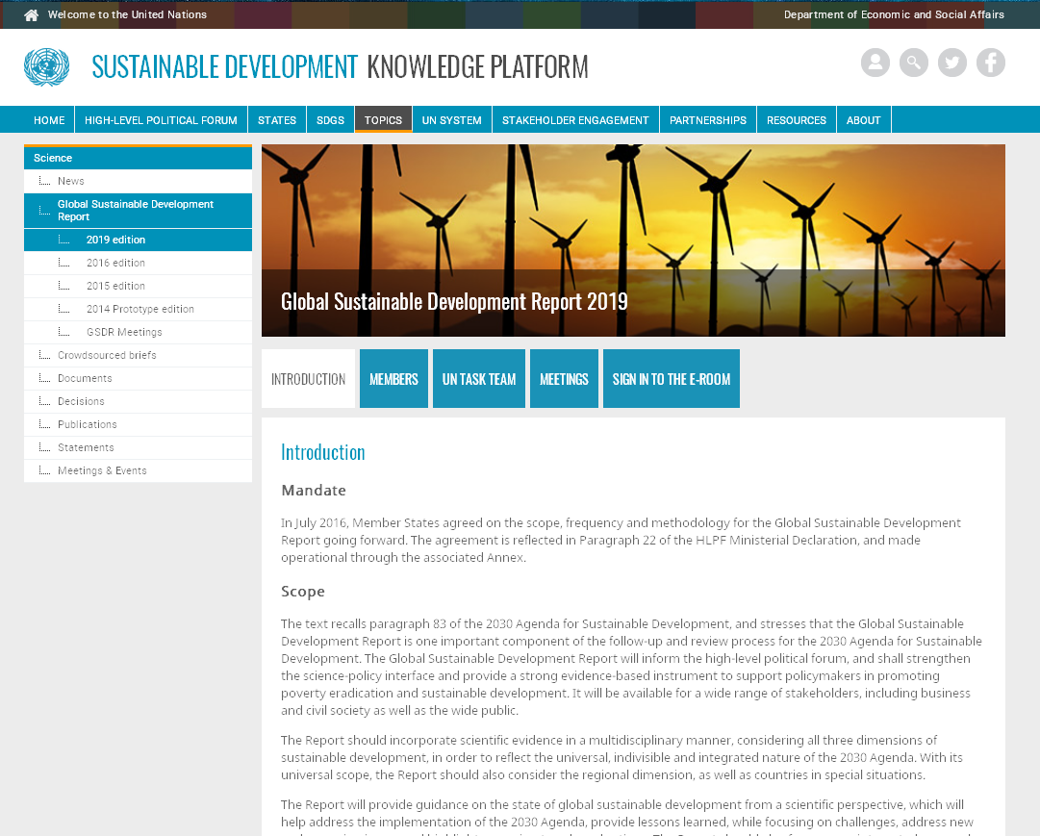
Membership in the Group of 15 Independent Scientists to draft the 2019 Global Sustainable Development Report

Slide 8
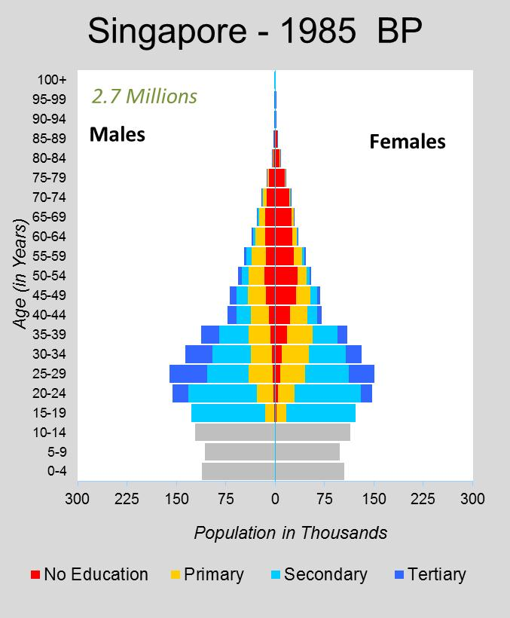
Demographic Metabolism:
Population Dynamics by Age, Sex and
Level of Education
Education is most important source of measurable population heterogeneity after age and sex.
Proxy measure of social inequality?
The Human Core of the SSPs (Shared Socioeconomic Pathways)

Slide 9
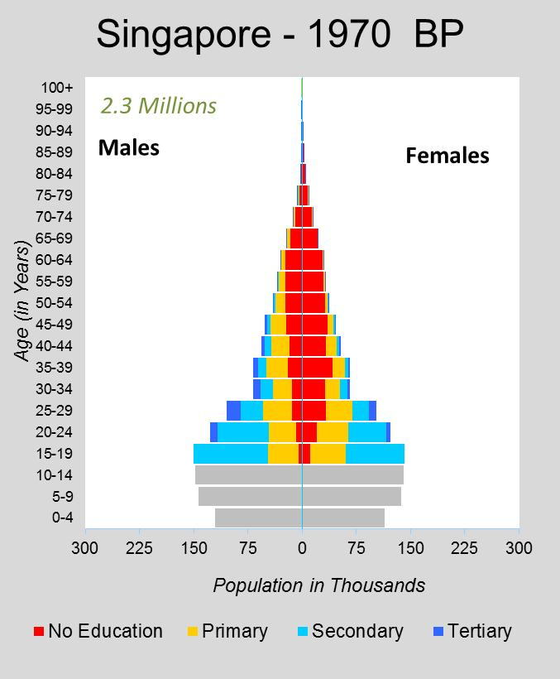

Slide 10
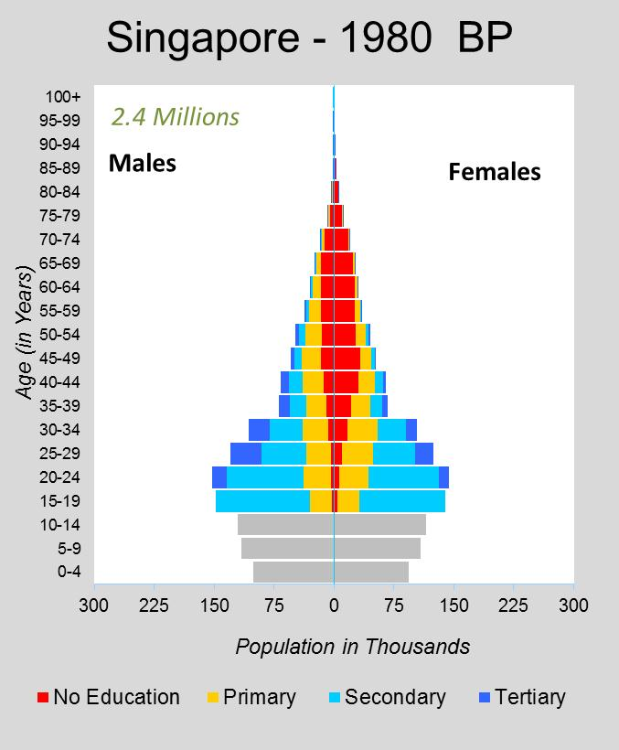

Slide 11
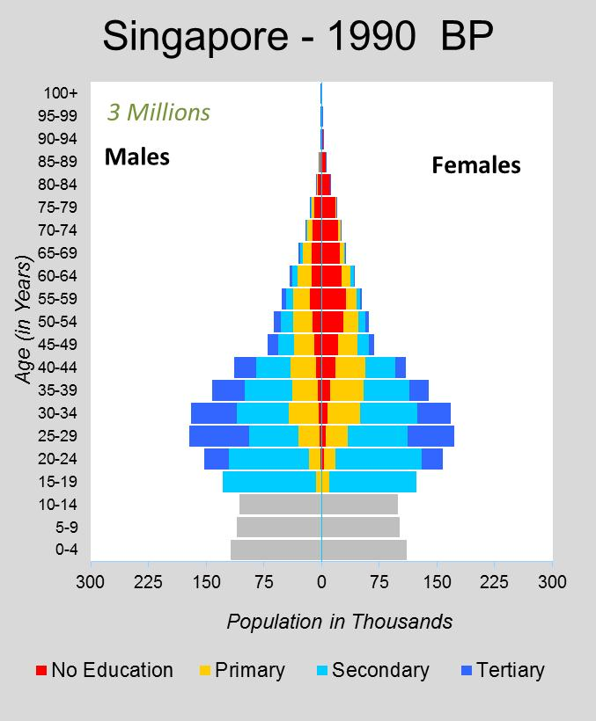

Slide 12
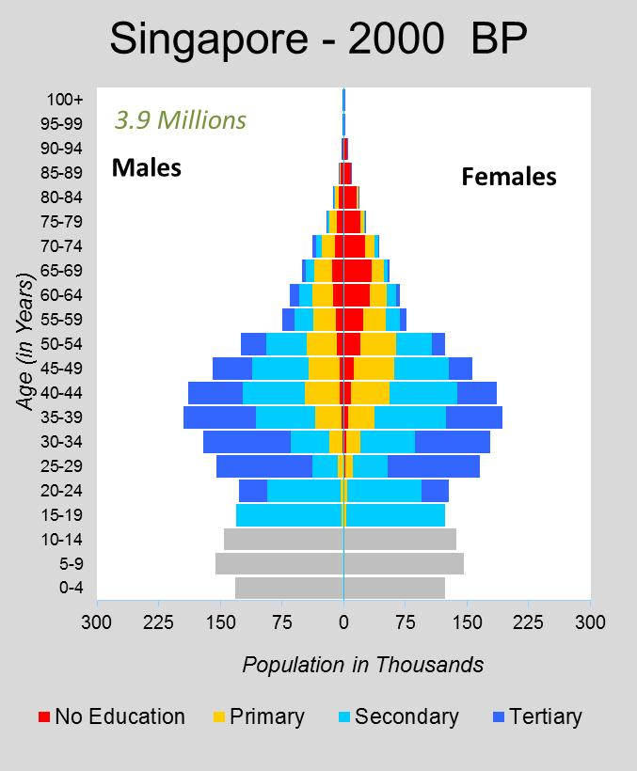

Slide 13
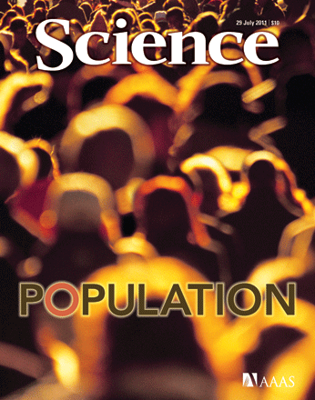
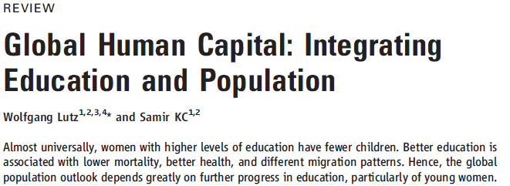
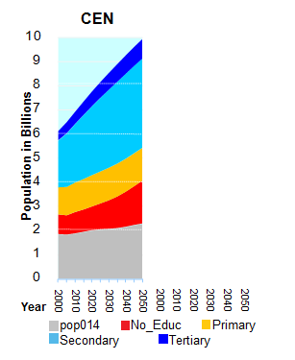
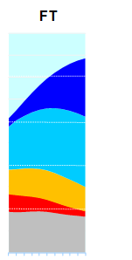
Assuming identical education-specific fertility trends different education scenarios make a difference of more than 1 billion people by 2050.
CEN gives the world population trend according to the most pessimistic scenario assuming that no new schools will be built
FT gives the most optimistic scenario assuming that countries can achieve the rapid education expansion that South Korea achieved

Slide 14
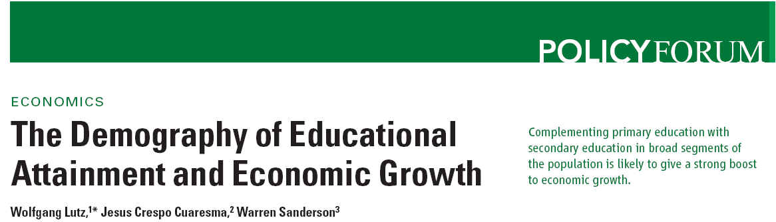
(all IIASA)
2015: Sustainable Development Goal 4:
…. quality primary and secondary education
for all girls and boys …. .

Slide 15
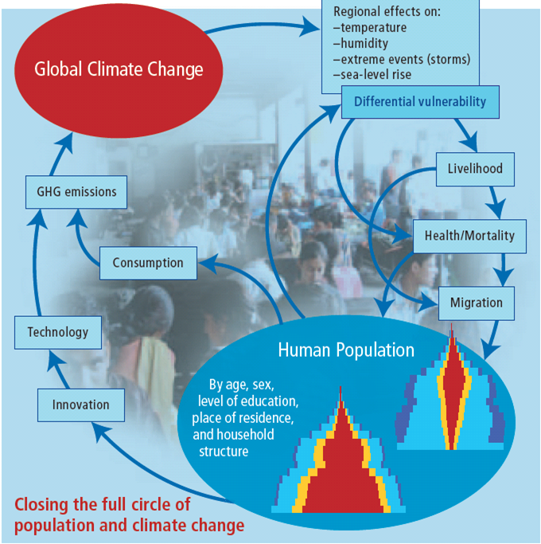
Forecasting Societies‘ Adaptive Capacities to Climate Change (ERC Adv. Grant to WL, IIASA)

Slide 18

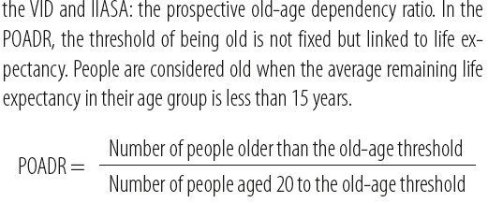
Redefining Age and Ageing
ERC Adv. Grant, Sergei Scherbov (IIASA)

Slide 19
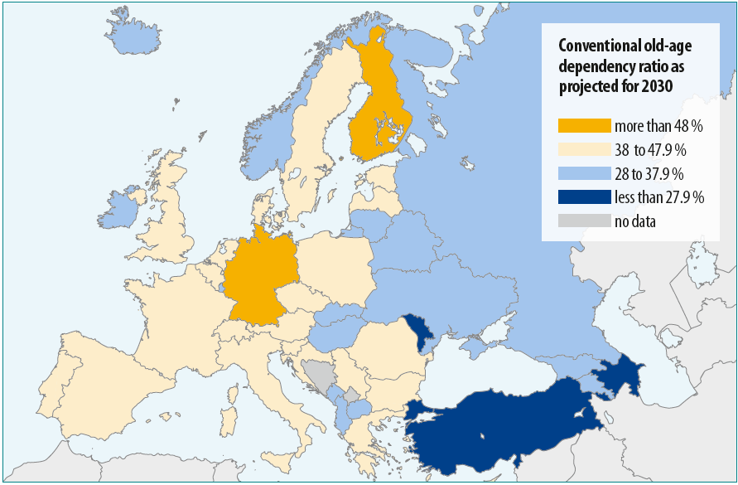

Slide 20
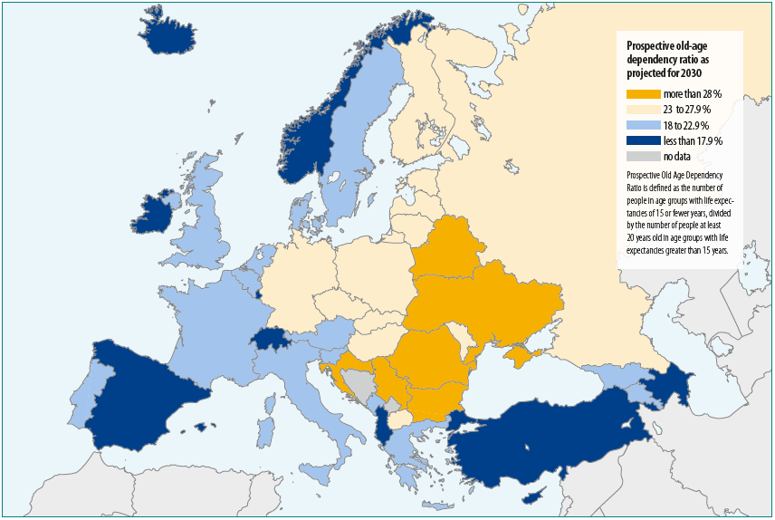

Slide 21


Slide 22
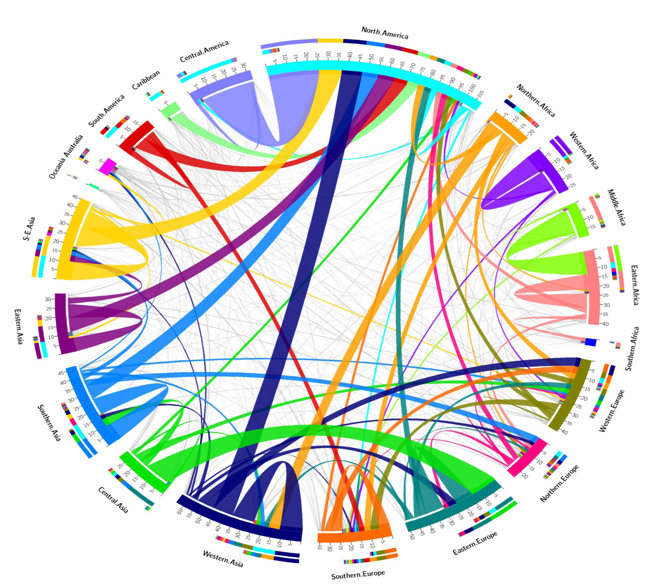
Global Migration Streams 2005-10

Slide 23
Workplan of JRC/IIASA Centre
The cooperation is to be based on equal partnership between the two research institutions.
A team of 10 researchers will be dedicated to the task (5 at IIASA, 5 at JRC-Ispra).
Timed to feed results into the work plan of the new European Commission to take office in 2019
Structure of work:
Component (a): Analysis of “Push Factors” in Africa and Western Asia and “Facilitating Factors”,
Component (b): Analysis of “Pull Factors” in the EU,
Component (c): Modelling of alternative possible migration streams and their impacts on population ageing and its economic consequences in the EU.

Slide 24
Education specific labour force projections for the EU
Total labour force in EU26 countries, 2003-2053, by scenario, considering education (solid lines) or not (dotted lines)
Potential economic dependency ratio in EU26 countries, 2008-2003, considering education (solid lines) or not (dotted lines)
Source: Adapted from Loichinger (2015)

