Slide 1
Overview and IIASA self-assessment report
Professor Dr. Pavel Kabat
IIASA Director General and
Chief Executive Officer
IIASA Institutional Review
27 February 2017

Slide 2
CONTENTS
IIASA’s Origin and Niche
IIASA’s Unique Approach
Changing IIASA
IIASA’s Challenges & Opportunities
IIASA into the Future

Slide 3

IIASA’S
ORIGIN AND NICHE
Notes:
IIASA’s approach is to attract the best scientists

Slide 4
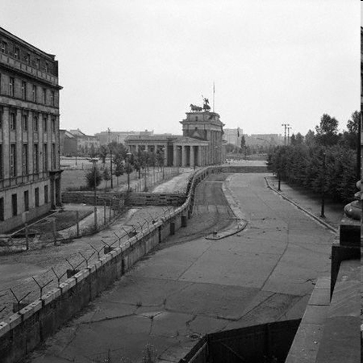
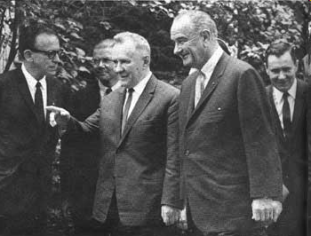
THE 1960s
Sources: US Department of Interior, The Guardian
Notes:
In the 1960s, the Cold War was epitomized by the nuclear arms race and the Berlin Wall which completely encircled West Berlin, separating it from East Germany, including East Berlin, and existed from 1961 to 1989.
During this time: The two world leaders US President Lyndon Johnson and the USSR Premier Alexey Kosygin met for three days, from June 23 to June 25, 1967, at Glassboro State College. Although Johnson and Kosygin failed to reach agreement on limiting anti-ballistic missile systems, the generally amicable atmosphere of the summit was referred to as the "Spirit of Glassboro". It also marked the start of discussions between the powers to establish an international scientific institute to use scientific cooperation to build bridges across the Cold War divide and to confront growing global problems on an international scale.

Slide 5
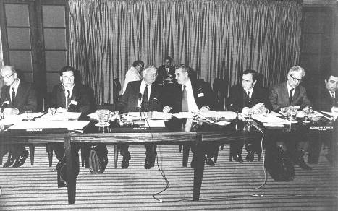
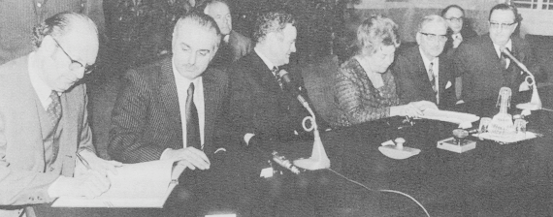
1972
Sources: IIASA
Notes:
Five years later in 1972, IIASA was established.
1. Top photo: In London in 1972 at the Royal Society, representatives of 12 countries including the Soviet Union, the United Kingdom and the United States sign the charter establishing IIASA.
Starting from the left: Philip Handler (President of the U.S. National Academy of Sciences), second person (not known), Lord Solly Zuckerman, Jermen Gvishiani, Andrei Bykov (Secretary to IIASA), Alexander Letov (Deputy Director of IIASA), Boris Milner (from Gvishiani's institute in Moscow - did not have a function at IIASA)
2. Bottom photo: IIASA’s first Director and Chair, Raiffa and Gvishiani, sign the agreement with Austria to locate IIASA in Schloss Laxenburg in Austria.

Slide 6

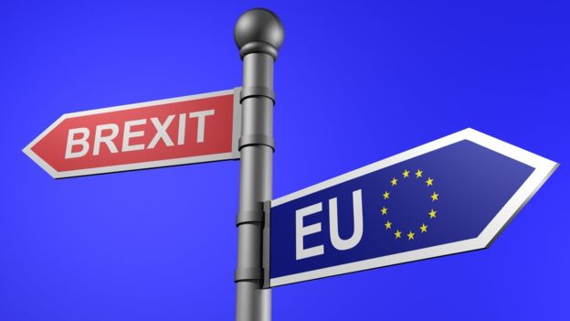
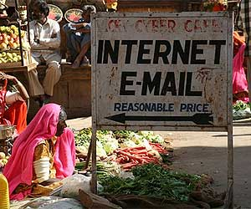
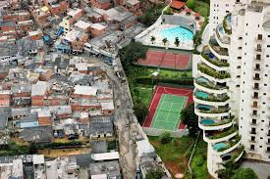
Bridging new divides……..
Sources: BBC, Salon
Notes:
It seems like we are more divided than ever.
We have large political divides along with socioeconomic class divides that have increased—not decreased—over time.

Slide 7
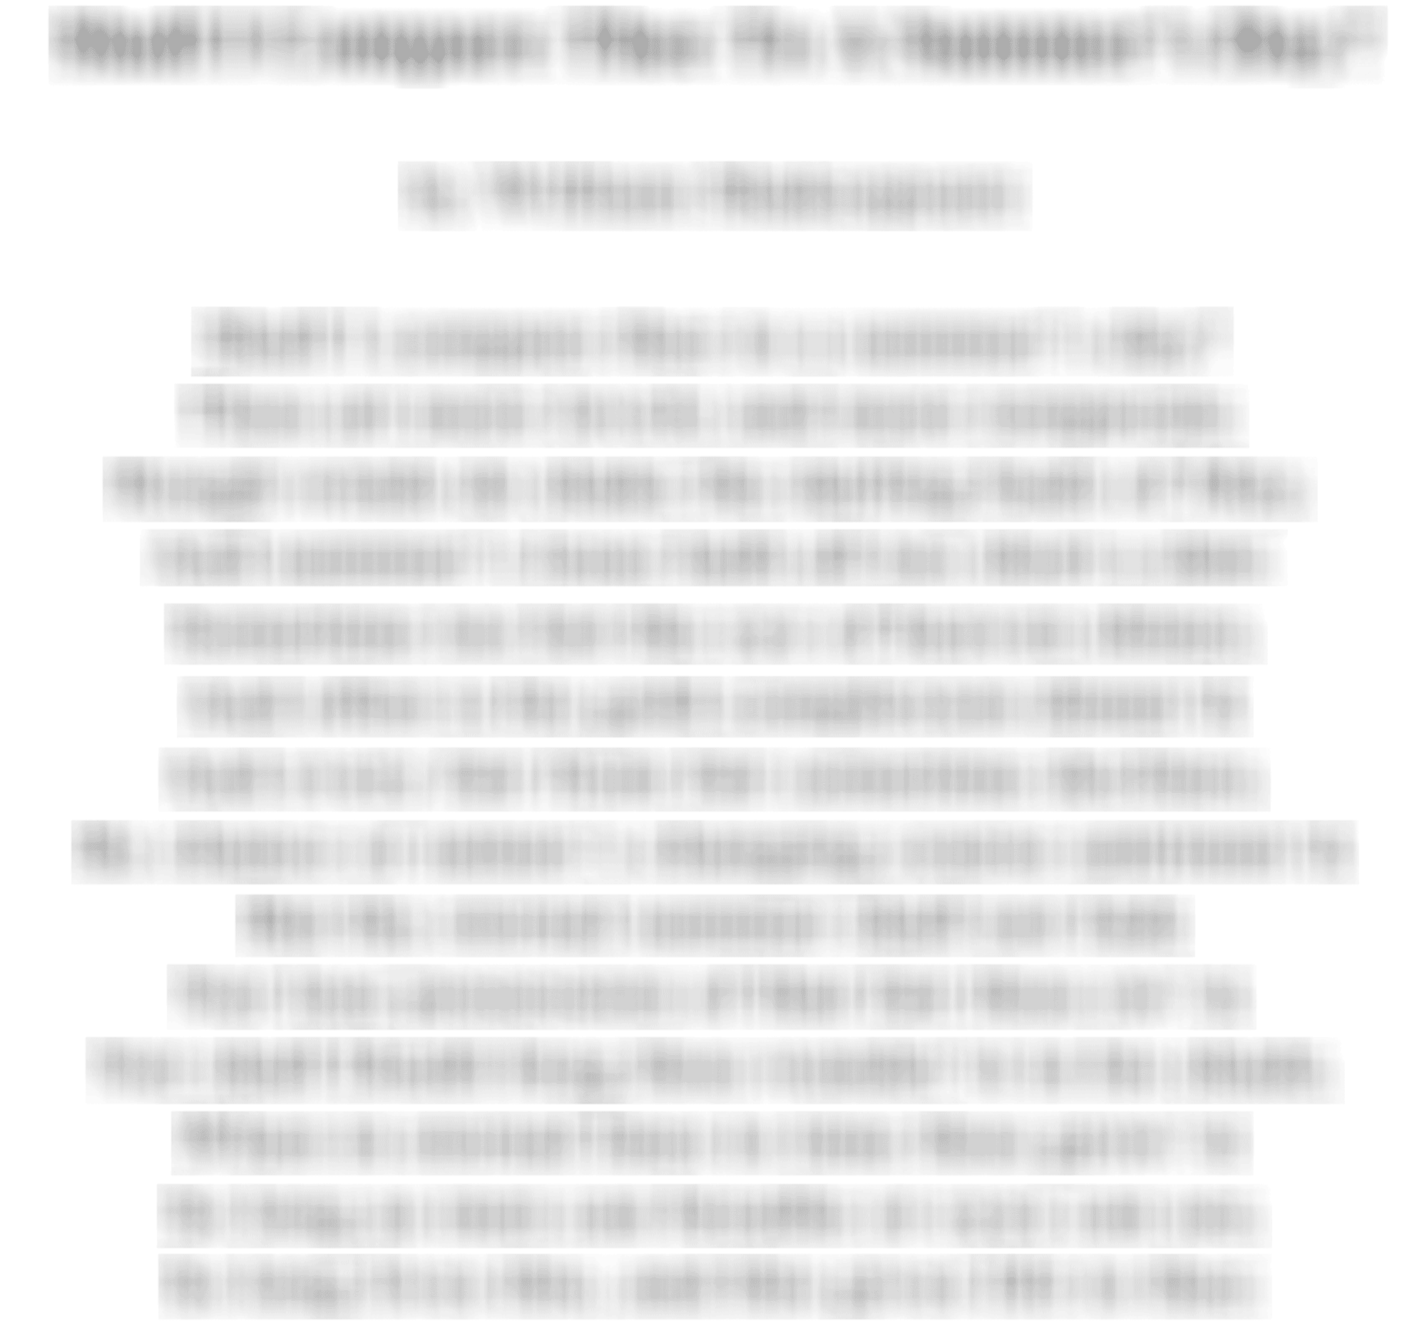
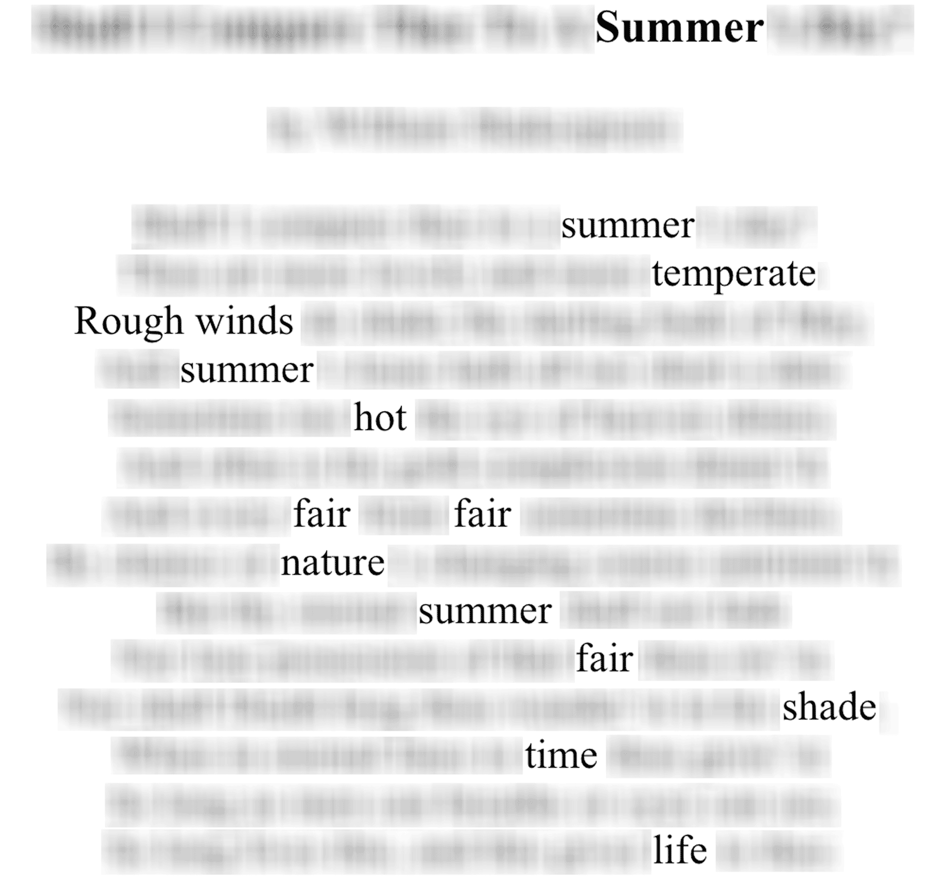
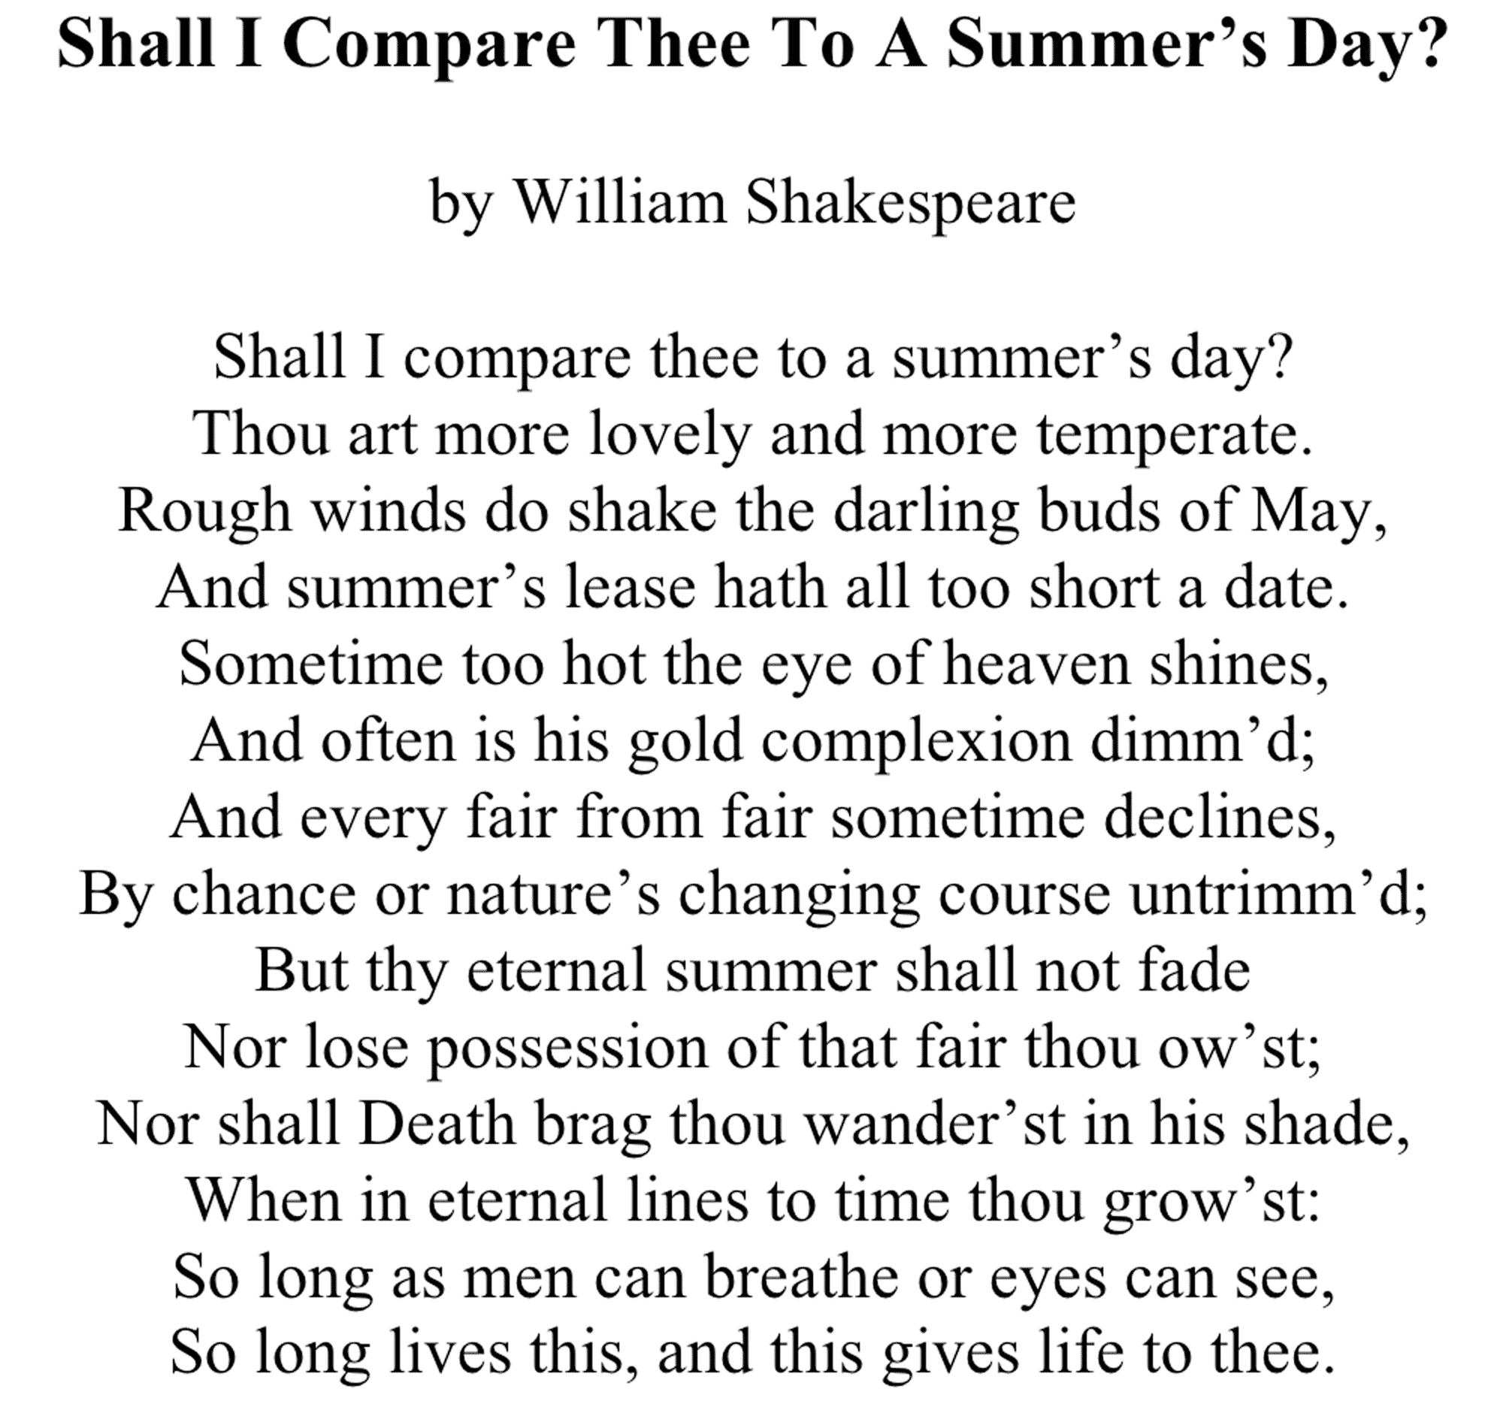

Slide 8
RESEARCHING GLOBAL CHALLENGES
}
Integrated
Interdisciplinary
International
Independent
Solution-oriented
Long term
Trade offs
= Systems Analysis
Notes:
Systems analysis is one of the few tools available to study global challenges in an integrated, interdisciplinary and international way. It finds solutions that are independent, long term and explores the trade-offs of the solutions.

Slide 9

IIASA SYSTEMS RESEARCH STRATEGY & RESULTS
Policy and Governance
Drivers of Global Transformations
Advanced Systems Analysis
Food
&
Water
IIASA HIGHLIGHTS 2011-2015
http://www.iiasa.ac.at/web/home/about/achievements/Highlights.html
Energy
&
Climate Change
Poverty
&
Equity

Slide 10
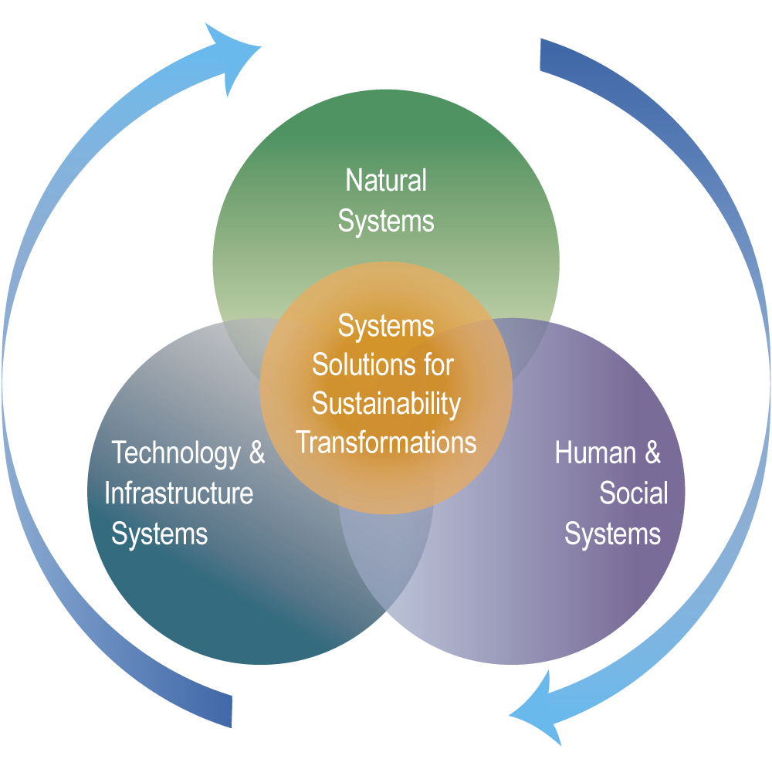
IIASA ENHANCED SYSTEMS RESEARCH FRAMEWORK 2016-2020
Systems Approaches for Global Transformations
IIASA Research Plan 2016 – 2020
http://www.iiasa.ac.at/web/home/about/leadership/strategicplan/IIASA-Research-Plan2015-2020.pdf

Slide 11








Given the changing international and scientific landscape, what will continue to make IIASA unique and relevant over the next 10-20 years? And value added to organizations such as:

Slide 12
IIASA’S UNIQUE
APPROACH
IIASA’s members
IIASA’s truly integrated and international research
IIASA’s science to policy has impact
IIASA’s science diplomacy
Notes:
IIASA’s approach is to attract the best scientists

Slide 13

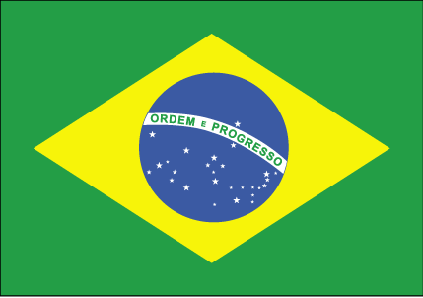






















IIASA NATIONAL
MEMBERS:
Represent scientific and science to policy community of a country and are often the National Academy or principal research funding agency
Notes:
Shape and approve IIASA strategy (every 10 years) and research plans (every 5 years), budget (every year)-
Ensure IIASA activities are in line with its strategy, Charter and interests of member countries
Admit/expel member countries (Each country votes on accepting a new country and also votes of expelling a country – only happened because on non-payment of membership fees)
Provide financial oversight
Appoint Director General – Council appoints DG for 3 years, can be extended; DG recommends a Deputy DG to Council to appoint. Council can also dismiss a DG and DDG, appoint interim DG etc

Slide 14
IDENTIFY AND IMPLEMENT MUTUALLY BENEFICIAL ACTIVITIES (examples)
GLOBAL | REGIONAL | NATIONAL
Global Energy Assessment Climate Change Scenarios Global Food Analysis | Arctic Futures Initiative Eurasian Economic Integration Tropical Futures Initiative | Linking globally focused IIASA studies to national interests IIASA models and methods applied to national issues
IIASA’s value proposition is a combination of global, regional and national system analytical collaborative projects and capacity development and training activities.
Notes:
Also, we are working on identifying and implementing mutually beneficial activities.
These activities will include global, regional, and national activities. Examples listed.
So IIASA value proposition is a combination of global, regional and national system analytical collaborative projects and capacity development and training activities.

Slide 15
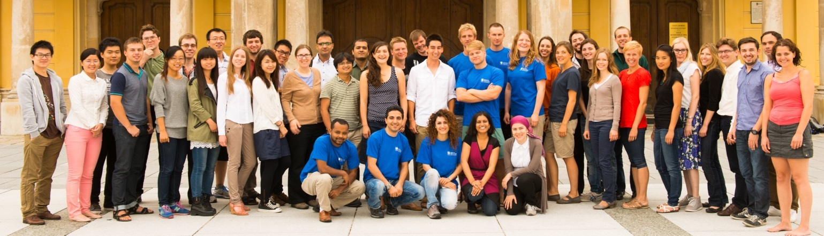
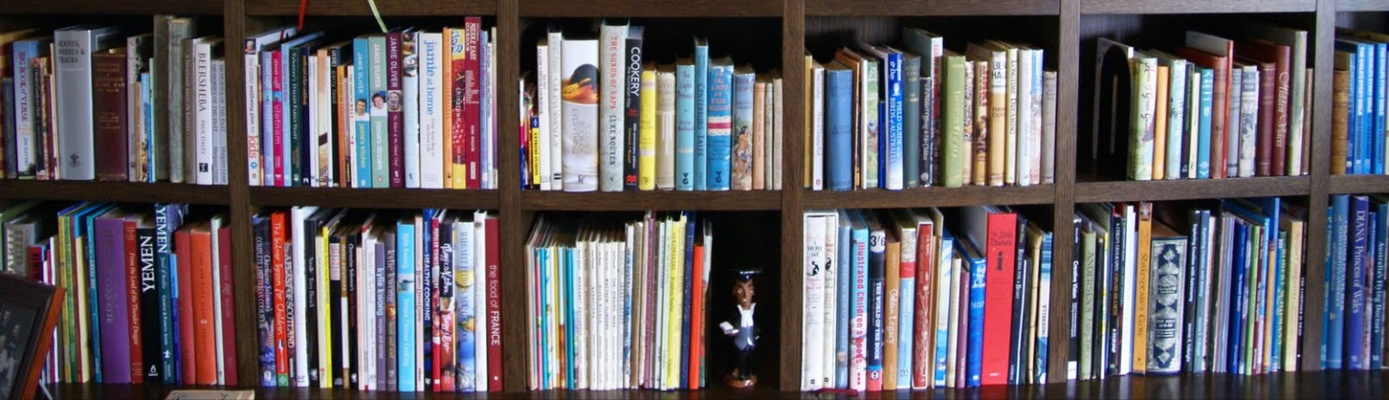
Young Scientists Summer Program 2008-2015 | China 54 | USA 77 | France 4
Publications from country collaborations 2008-2014 | Germany 691 | Austria 1052 | Israel 3

Slide 16
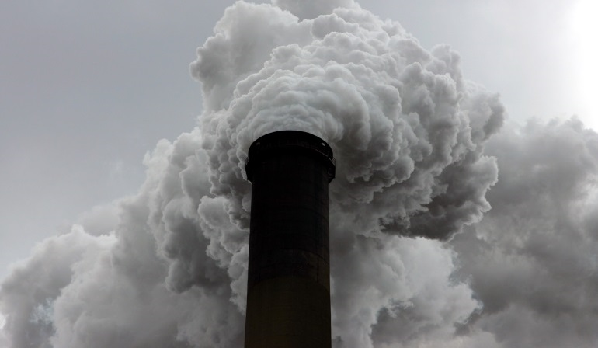
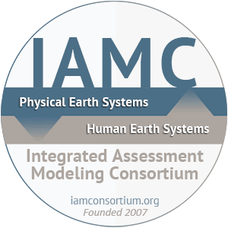


GAINS – Integrated Assessment Model to identify cost-effective measures to improve air quality and reduce greenhouse gas emissions
National versions of GAINS model | China | Netherlands | Republic of Korea | Russia | Sweden | Turkey?
IAMC - Advancing the methods of integrated assessment modeling
IAMC Founders | IIASA | Japan | USA | Canada?

Slide 17
ACTIVITIES WITH USA (2008-2016) - EXAMPLE
National Member Organization | National Academy of Sciences (NAS)
Membership start date | 1972 (founding member)
Research partners | 73 organizations in the US
Areas of research collaborations | Advancing Energy and Integrated Assessment Modeling in the US Global Energy Assessment and the US Curbing the Release of Black Carbon and Methane Projecting Changing Population in the US Improving the Use of Land for Food and for Combating Climate Change Advising Countries with Economies in Transition Increasing the Resilience of Vulnerable Communities Analyzing Ecological and Evolutionary Dynamics
Capacity Building | Over 100 young scientists from the US have participated in IIASA’s Young Scientists Summer Program 6 in IIASA’s Postdoctoral Fellowship Program 5 in the Southern African Young Scientists Summer Program
Publication output | 873 publications
Staff | Over 40 US nationals have been employed by IIASA every year

Slide 18
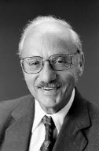
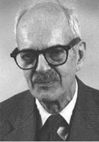
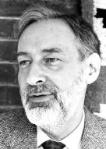
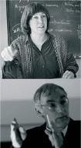
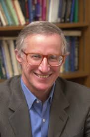
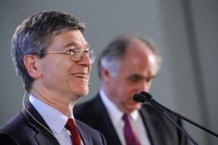

SOME LEADING US PERSONALITIES FROM ACADEMIA AND ASSOCIATED WITH IIASA
George Dantzig
Nathan Keyfitz
Tjalling Koopmans
Donella & Dennis L Meadows
William D. Nordhaus
Jeffrey Sachs
Thomas C. Schelling
Notes:
Professor George Dantzig, an American mathematical scientist who made important contributions to operations research, computer science, economics, and statistics and the won the US National Medal of Science in 1975; headed up IIASA's methodological program during the 1970s.
Professor Nathan Keyfitz, who is credited for developing the field of mathematical demography, came to IIASA from Harvard University in 1983. At IIASA, where he led the Population Program between 1983 and 1992, he pioneered the application of demographic methods to several other fields.
Professor Tjalling Charles Koopmans was a Dutch-American mathematician and economist who jointly won the Nobel Prize in Economics in 1975. He joined IIASA in the 1970s to work with fellow Nobel Prize winner, Professor Leonid Kantorovich, to expand IIASA’s study of advanced systems science and methodology.
Dr. Donella Meadows and Professor Dennis L Meadows, widely known as authors of The Limits to Growth, and key figures in the development of sustainability as a field of study, researched at IIASA during the 1980s.
Professor William D. Nordhaus of Yale University and known as "the father of climate change economics" by the Economist, developed his first economic model of global warming as a young researcher at IIASA during the 1970s. He has collaborated with the Institute ever since.
Professor Jeffrey Sachs, Director of the Earth Institute at Columbia University and Special Advisor to the UN Secretary-General, has collaborated with IIASA since the early 1990s when he participated in IIASA's Economic Reform and Integration project that brought together leading economists from Eastern and Western Europe, Japan, USA, and USSR to identify the policies to guide the Soviet Union through its economic crisis and make the transition into a market economy.
Professor Thomas C. Schelling, who was jointly awarded the 2005 Nobel Prize in Economics, worked at IIASA in several research areas from 1994–1999.

Slide 19
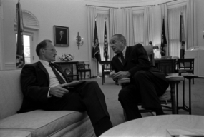
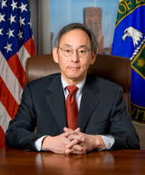
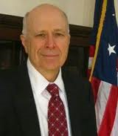
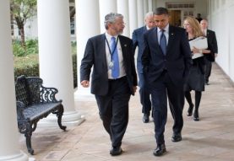
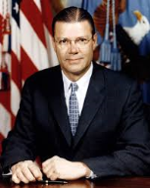
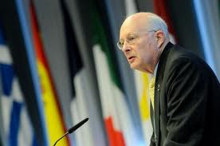
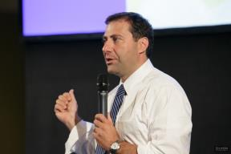
SOME LEADING US PERSONALITIES FROM GOVERNMENT AND ASSOCIATED WITH IIASA
McGeorge Bundy
Steven Chu
E. William Colglazier
John P. Holdren
Robert S. McNamara
Norman Neureiter
Vaughan Turekian
Notes:
Mr McGeorge Bundy, Advisor to Presidents John F. Kennedy and Lyndon B. Johnson, initiated the discussions in 1967 with the Soviet Union which led to the establishment of IIASA.
Dr Steven Chu was US Secretary of Energy from 2009 to 2013 and a Nobel Prize Laureate (Physics in 1997). He most recently collaborated with IIASA researchers on a book examining how to shift to a more sustainable transport system.
Dr. E. William Colglazier was appointed in July 2011 as the fourth Science and Technology Adviser to the US Secretary of State and has followed IIASA’s contributions for 30 years. Most recently he spoke at IIASA’s Anniversary Conference in 2012.
Dr. John P. Holdren is Assistant to the US President for Science and Technology and Director of the White House Office of Science and Technology Policy. He was one of the key members of an IIASA research team that compared fusion and fast breeder nuclear reactors as part of IIASA's Energy Program's systematic analysis of energy supply options.
Mr. Robert S. McNamara, US Secretary of Defense from 1961 to 1968 and subsequently President of the World Bank until 1981, gave the second distinguished lecture in IIASA's Dr. Bruno Kreisky Lecture Series in 1986.
Dr. Norman Neureiter, the first Science and Technology Adviser to the US Secretary of State, and currently Director, Center for Science, Technology and Security Policy at the American Association for the Advancement of Science is Chairman of the Board of the IIASA Endowment Fund.
Dr Vaughan Turekian gave a public lecture at IIASA on science diplomacy shortly before his appointment as the fifth Science and Technology Adviser to the US Secretary of State in 2015.

Slide 20
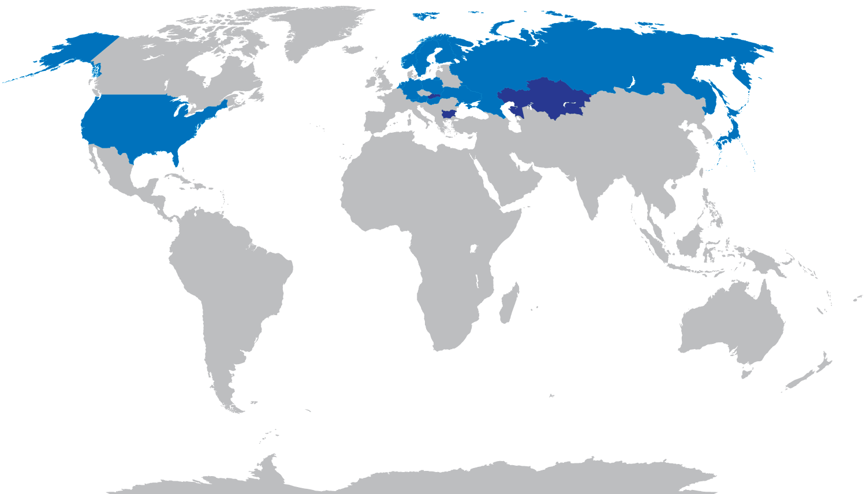
HISTORICAL FOCUS: EAST - WEST
2000:12 NMOs + 3 affiliate NMOs
(Global North)
Notes:
12 NMOs in 2000:
Austria, Finland, Germany, Hungary, Japan, Netherlands, Norway, Poland, Russia, Sweden, Ukraine, USA
Affiliate NMOs: Bulgaria, Kazakhstan, Slovakia

Slide 21
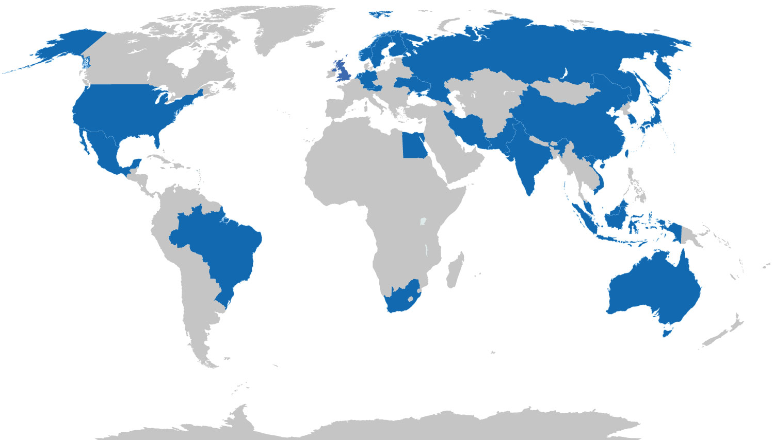
TODAY’S FOCUS: GLOBAL
2016:24 NMOs
(Global North and Global South)

Slide 22
REGIONAL APPROACH
ARCTIC
EURASIA
PACIFIC
RIM
MIDDLE EAST
PACIFIC
RIM
TROPICS

Slide 23
IIASA’S UNIQUE
APPROACH
IIASA’s members
IIASA’s truly integrated and international research
IIASA’s science to policy has impact
IIASA’s science diplomacy
Notes:
IIASA’s approach is to attract the best scientists

Slide 24
IIASA AS A GLOBAL HUB FOR SYSTEM ANALYSIS RESEARCH
1,815 visitors & collaborators in 2015
Plus ~25% of IIASA alumni (3,875 people worldwide) remain actively involved in IIASA research
Plus ~650 partner institutions
In sum, ~3000 researchers from some 65 countries involved in IIASA’s research network (external faculty)
And it is not just research networks: IIASA researchers took part in 112 advisory boards and steering committees in 2015

Slide 25
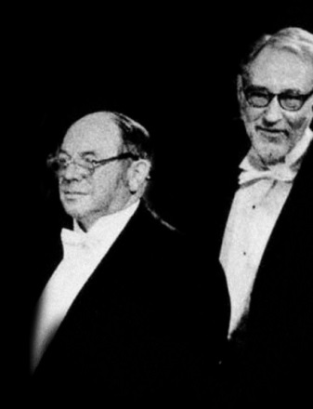
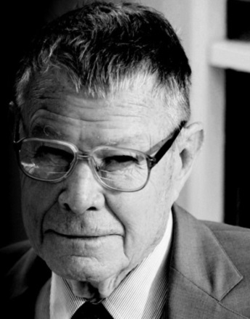
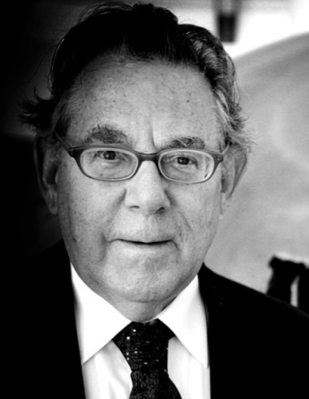
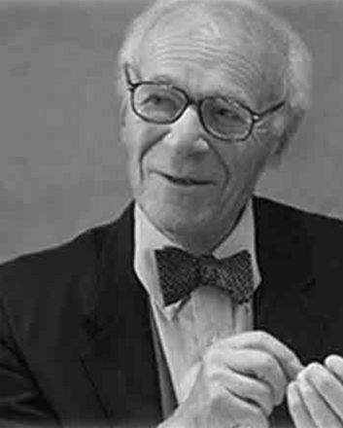
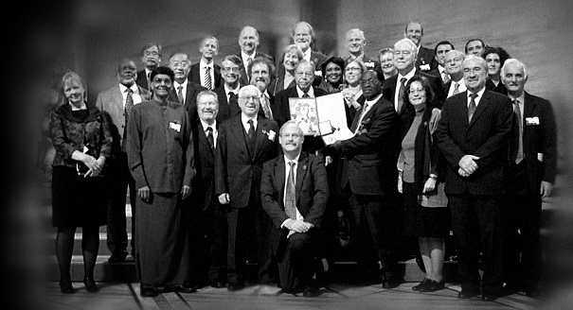
ATTRACTING THE BEST RESEARCHERS
  Professor Paul Crutzen
Nobel Prize for Chemistry (1995)
  Professor Lawrence Klein
  Nobel Prize in Economics (1980)
  Professor Thomas C. Schelling
Nobel Prize for Economics (2005)
Professor Tjalling Koopmans
and Professor Leonid Kantorovich
Nobel Prize in Economics (1975)
Authors of the Intergovernmental Panel
on Climate Change Reports
Nobel Peace Prize (2007)

Slide 26
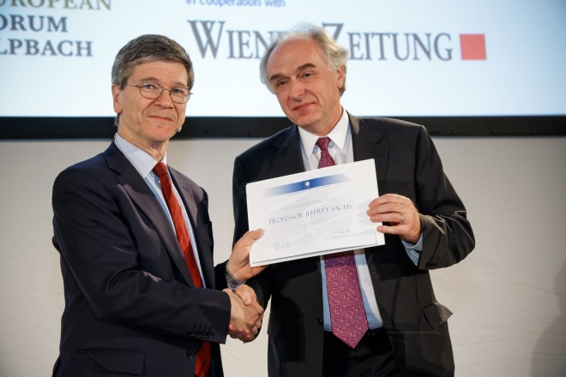
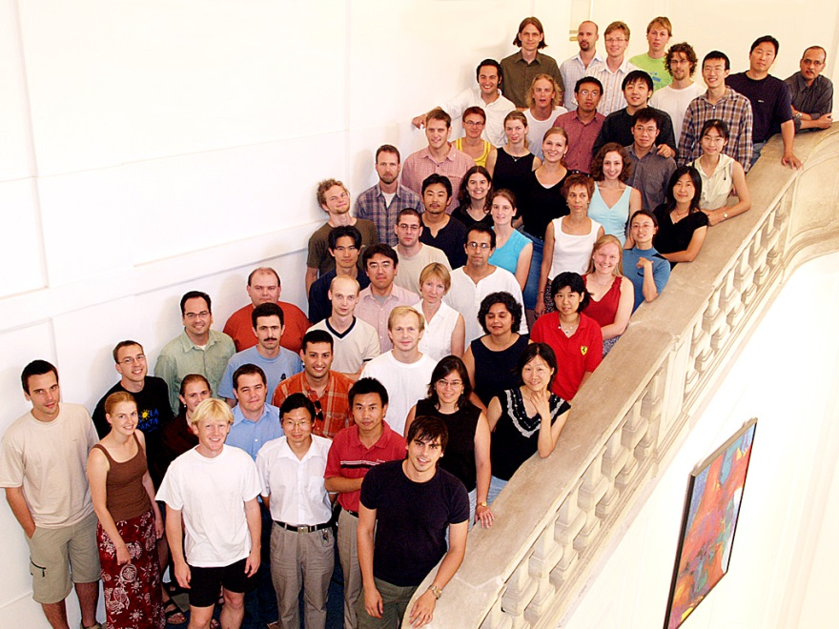
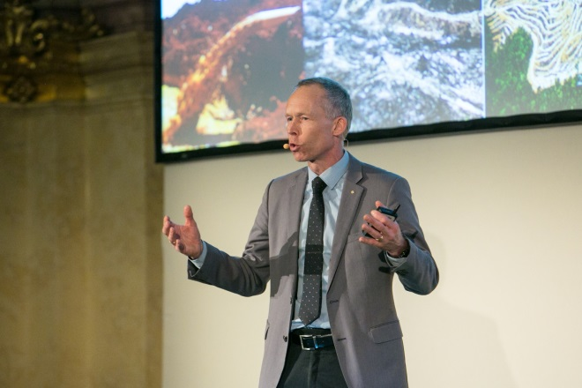
ATTRACTING THE BEST RESEARCHERS
  OF TODAY
  OF TOMORROW
Professor Jeffrey Sachs
  Professor Johan Rockström

Slide 27
RESEARCHER MOBILITY
Research Staff | 2016 | 2015 | 2014
Leavers | 106 | 119 | 97
Newcomers | 129 | 125 | 115
Returning researchers | 27 | 30 | 26
Nationalities | 48 | 49 | 45
Notes:
Leavers and newcomers include YSSPers (about 50 PhD students a year)
Returning Researchers that previously had a contract at IIASA and return to work at the Institute.

Slide 28
INTERDISCIPLINARY SCIENTISTS
“It is often at the intersection of disciplines that the most exciting and groundbreaking advances are made.”
Notes:
Background disciplines of IIASA’s researchers in 2014

Slide 29
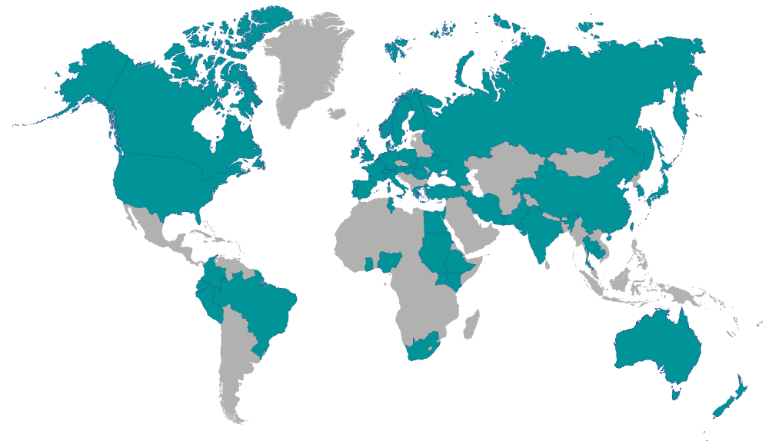
INTERNATIONAL COLLABORATIONS (2015)
562 publications
including 315 peer-reviewed articles
1014 authors
from 462 institutions
in 50 countries
Notes:
As an example of IIASA’s international collaborations, this map shows the 50 countries of all co-authors on journal articles that include an author from IIASA (source: Web of science).

Slide 30
OPEN IIASA
Open access to publications:
6935 publications freely available
Open access to data:
24 databases and tools freely available
Developing an open access to data policy including community-developed IIASA modeling tools

Slide 31
IIASA’S UNIQUE
APPROACH
IIASA’s members
IIASA’s truly integrated and international research
IIASA’s science to policy has impact
IIASA’s science diplomacy
Notes:
IIASA’s approach is to attract the best scientists

Slide 32
IIASA RESEARCH HAS HAD A POSITIVE IMPACT
Convention on Long-range Transboundary Air Pollution of the United Nations Economic Commission for Europe
EU National Emissions Ceiling Directive
EU Thematic Clean Air Strategy
EU Climate and Energy Strategy for 2030
Climate and Clean Air Coalition to reduce short-lived climate pollutants
Objectives of the UN Secretary General’s Sustainable Energy for All Initiative
Shaping the Sustainable Development Goal on Energy
Helps Brazil with long term planning for future energy
Emission scenarios for IPCC Third, Fourth and Fifth Assessment Reports
Pioneer and development of integrated assessment models
Climate smart agriculture in China
Catastrophe Bonds to make Mexican public finances resilient to major natural disasters
Pest management practices in forests in North America and Scandinavia
Forest management practices in Russia
Underpins US Dept of Justice antitrust case against Microsoft (technology lock-in)

Slide 33
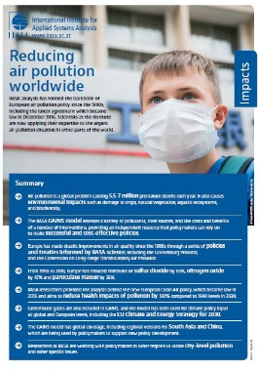
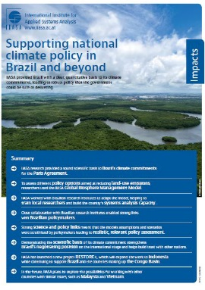
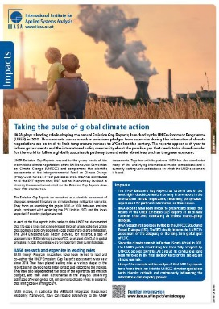
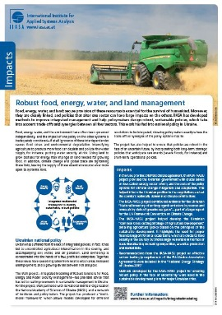
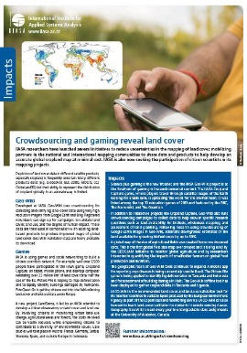
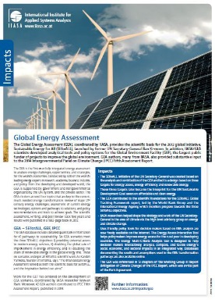
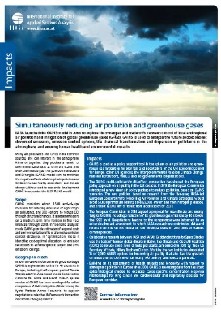
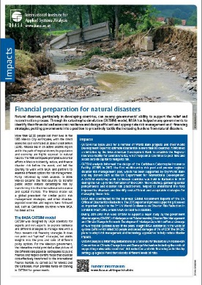
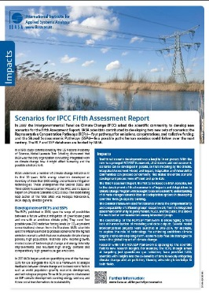
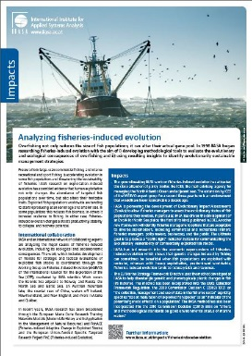







IMPACT SHEETS

Slide 34
IIASA’S UNIQUE
APPROACH
IIASA’s members
IIASA’s truly integrated and international research
IIASA’s science to policy has impact
IIASA’s science diplomacy
Notes:
IIASA’s approach is to attract the best scientists

Slide 35

IIASA Charter (1972): “Convinced that science and technology, if wisely directed, can benefit all mankind,
Believing that international co-operation between national institutes promotes co-operation between nations and so the economic and social progress of peoples;
Hereby resolve to establish an International Institute for Applied Systems Analysis.”

Slide 36
IIASA IN THE 1970s AND 1980s
Founding members bring together scientists from Bulgaria, Canada, Czechoslovakia, France, Germany (Democratic Republic & Federal Republic), Italy, Japan, Poland, UK, USA, USSR
Conducts first international and integrated assessments in energy (1973-1981), climate change (1976-78)
Develops new research field of adaptive ecosystem policy and management (1975)
Develops more reliable population projections (1980)
Its research findings influence water policy in Europe, USA and USSR (1982)
An international environmental treaty is first to accept a single scientific model to guide its negotiation and implementation (1989)

Slide 37


1989
2015

Slide 38

GLOBAL NETWORK OF FOREIGN MINISTRY SCIENCE AND TECHNOLOGY ADVISERS
Science diplomacy short course at IIASA, 18-19 October 2016
Co-organized with Fletcher School of Law and Diplomacy at Tufts University, and the International Network of Government Science Advice
Teaching from science advisors from foreign ministries in Japan, New Zealand, UK and USA
Participants from foreign ministries in Argentina, Chile, Ghana, Kazakhstan, Kenya, Malaysia, Oman, Panama, Poland, Senegal, South Africa, Ukraine, and Vietnam among others.

Slide 39
IIASA IS CHANGING

Slide 40
IIASA IS CHANGING
 | 2000 | 2005 | 2010 | 2012 | 2014 | 2015 | 2016
Member countries (National Member Organizations - NMOs) | 11 | 16 | 17 | 20 | 22 | 23 | 24
Income from NMO Contributions (in thousand Euros) | 6,287 | 7,287 | 7,753 | 8,998 | 11,326 | 11,793 | 12,756
Income from External Contracts & Grants (in thousand Euros) | 3,065 | 3,746 | 7,900 | 7,825 | 8,786 | 9,826 | 9,587
Researchers working at IIASA (on site) | 90 | 184 | 209 | 278 | 323 | 333 | 348
Leadership in international projects – number of projects over €100,000 (ERC grants) |  | 10 (0)** | 44 (2) | 48 (2) | 63 (5) | 63 (5) | 63 (4)
IIASA Publications (in IIASA’s Publications Repository) | 330 | 395 | 330 | 530 | 512 | 562 | 615
Citations (according to SCOPUS) | 1051 | 3023 | 4425 | 6976 | 11740 | 13402 | 14443

Slide 41
IIASA’S CHALLENGES AND OPPORTUNITIES

Slide 42

Global, regional, and national foci, in the context of IIASA as a “global good” and under the increased demand and expectations from individual member countries.
Notes:
• Global, regional, and national foci, in the context of IIASA as a “global good” and under the increased demand and expectations from individual member countries.
•

Slide 43

Expansion and growth (accompanied by increased demand) with consolidation around a shared value proposition and current areas of expertise, resources, and existing infrastructure.
Geographical and geopolitical representation and expectations – North/South, East/West, Developed/Developing.
Notes:
Expansion and growth (accompanied by increased demand) with consolidation around a shared value proposition and current areas of expertise, resources, and existing infrastructure.
Geographical and geopolitical representation and expectations – North/South, East/West, Developed/Developing.

Slide 44

World-class discipline based science, with science-to-policy/policy relevance, and capacity building.
Methodological and applied science.
Innovation and application—that is, exploratory (‘room to think’) versus delivery-type activities.
Notes:
World-class discipline based science, with science-to-policy/policy relevance, and capacity building.
Methodological and applied science.
Innovation and application—that is, exploratory (‘room to think’) versus delivery-type activities.
Vertical and horizontal investment—that is, research program (vertical) investment to maintain core capability versus cross-program (horizontal) investment to promote integration and collaboration.

Slide 45
Vertical and horizontal investment—that is, research program (vertical) investment to maintain core capability versus cross-program (horizontal) investment to promote integration and collaboration.
Activity | Research Program
 | ASA | AIR | ESM | ENE | EEP | RISK | TNT | WAT | POP
Cross-cutting research
Nexus++
Equitable governance
Socioeconomic heterogeneity
Systemic risk & network dyn.
Climate community scenarios
Dynamic vegetation models
Large-scale integrated projects supporting global transformations
Arctic Futures
Eurasian Econ. Integration
Tropical Futures
Water Futures
TWI2050
IS-WEL
Notes:
World-class discipline based science, with science-to-policy/policy relevance, and capacity building.
Methodological and applied science.
Innovation and application—that is, exploratory (‘room to think’) versus delivery-type activities.
Vertical and horizontal investment—that is, research program (vertical) investment to maintain core capability versus cross-program (horizontal) investment to promote integration and collaboration.

Slide 46
IIASA INTO THE FUTURE

Slide 47
Bridging new divides……..
Sources: BBC, Salon
Notes:
It seems like we are more divided than ever.
We have large political divides along with socioeconomic class divides that have increased—not decreased—over time.

Slide 48


Achieving the transformation to sustainable development requires an integrated understanding across multiple sectors, scientific disciplines, and countries
Integrated Solutions for Water, Energy, and Land project

Slide 49




It also requires preventing and mitigating (systemic) risks of these transformational pathways, and a clear priority on full inclusion and understanding of the social transformations (from institutions to human behavior) that must support such global change.
SYSTEMIC TRADE RISK OF CRITICAL RESOURCES

Slide 50

WORLD LEADER IN SYSTEMS ANALYSIS
Fundamental theoretical research in system analysis
Applied systems analysis to inform policy

Slide 51
INVESTING IN IIASA MEMBER COUNTRIES
Combined value proposition of IIASA work at the global, regional and national scales
Engagement strategies to strengthen and operationalize our partnerships
Focus on multilateral activities that combine members’ interests
Building internationally balanced research teams

Slide 52
INVESTING IN CAPACITY DEVELOPMENT IN SYSTEMS ANALYSIS
Build the bilateral postdoc program (fellowships already in place with Brazil, Finland, Korea, Mexico and Sweden)
International School of Excellence
System analytical courses (e.g. courses for PhD students in Russia and South Africa in 2016)

Slide 53
INVESTING IN HUMAN CAPITAL
New IIASA Secretary for Human Capital Development
New carrier perspective at IIASA – e.g. joint tenure tracks, joint and collaborative appointments
Diversity, gender balance, equity in highly dynamic international environment
Developing a critical mass of mid-career researchers at IIASA
Formalizing IIASA’s external network into an external faculty

Slide 54
IIASA TOWARD 2025
“Systems science needs to provide new narratives and paradigms in order to challenge the current perception that environmental protection is an enemy to economic growth and development. A shared concept of turning the threats into opportunities is needed, grounded in large-scale, interconnected transformations that span technological, economic, social and human capital arenas. These in turn will trigger new economic opportunities, and the “inclusive growth” or “sustainable growth” concept needs to be further developed and scientifically substantiated. IIASA should assume a pivotal role in this development.”
IIASA Self Evaluation Report (2017)

