Slide 1


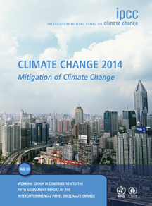


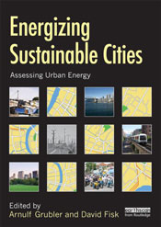

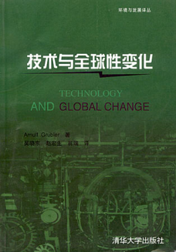
Transitions to New Technologies (TNT)
Institutional Review Panel Site Visit February 27, 2017

Slide 2
Why study Technology?
IIASA’s research mission:
human dimension of global change
Main driver: people and their tools (technology)
- embodied knowledge (hardware, artefacts)
- disembodied knowledge
-- software, know-how, know-why
-- “orgware” (institutions, rules, norms)
Policy interest: “man-made resource”, but..
-- Change costly (investments!)
-- High uncertainty
(innovation and diffusion)
-- Large inertia for major transformations
(lock-in, path dependency)
-- Slow rates of change (systems/infrastructures)

Slide 3
Global Access to Technologies (Lorenz Curves)
Granularity Equity
0.87
0.26
GDP
0.35
0.11
0.08
0.78
0.92
Technologies &
Infrastructures
Notes:
Global Lorenz curves for access to technologies.
Development gaps as technology gaps
Traditionally: most democratic technologies were: radio (yellow) and bicycles (green)
Now cellphones (and within 10 years) [blue lines]
Internet (magenta) continues to remain extremely inequitable = digital divide
TNT research:
-- try to answer why some technologies grow fast and others only slowly
-- policies for accelerating change and access to technology

Slide 4
TNT - Transitions to New Technologies
TNT niche:
- Systems view (innovation systems, techn. complexity)
- Novel modeling approaches (agent-based)
- Long view (1700 – 2100)
- “Metastudies”
Focus 2010-2015:
- ETIS (Energy Technology Innovation System)
- Energy & carbon transitions
- Climate innovation portfolio biases
- International Assessments (IPCC AR5, GEA)
Focus 2015-2020:
- Nexus (Energy-Land-Water-Air) Technologies
- Comparing technological & behavioral change dynamics
- Technology & Innovation for SDGs (The World in 2050)
Notes:
Keywan: just read through bullets w/o too much explanation.
Then focus on 1 aspect: scaling analysis and metastudies
Because 2013 TNT YSSP Dominique Throniker will work in this area

Slide 5
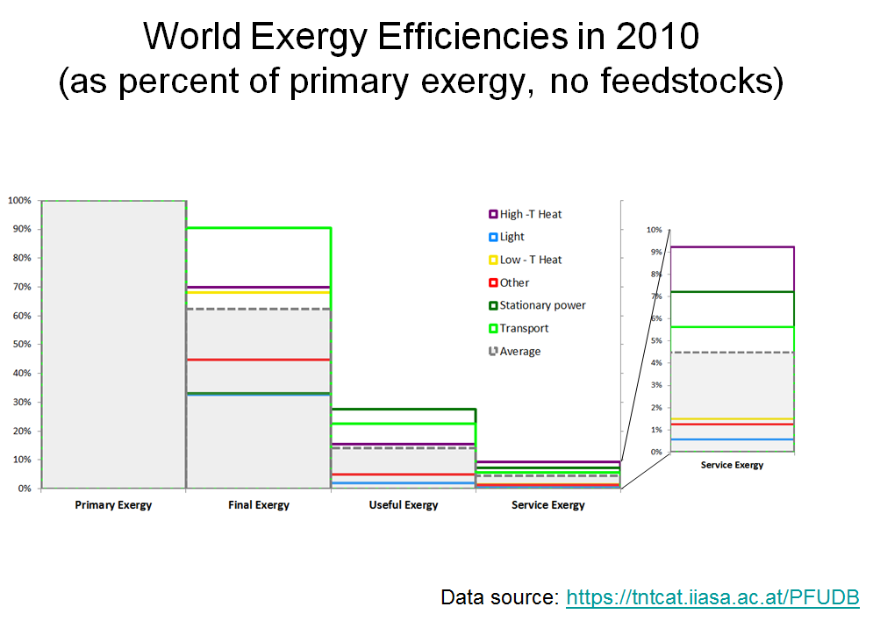
Efficiency of Resource Use (Production AND Consumption): percent of primary input remaining at step of conversion/use chain
Example Energy (per service, exergy efficiency) and Water (irrigated agriculture & food, water usage efficiency)
Water Crop Food Nutrition

Slide 6
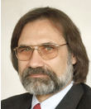








More on TNT & IIASA
Science – Policy cycles:
1. Retrospective: GEA
2. Prospective: TWI2050
Science assessments:
3. IPCC
Outputs:
4. Tools, DBs, community services
5. Publications
Naki Luis
Caro Matthias Sebastian
Keywan
Peter Benigna
Arnulf

