Slide 1
Risk and Resilience
(RISK)
JoAnne Linnerooth-Bayer
Notes:
REALLY FINAL
It is a seldom privilege to present our Program to such a distinguished committee

Slide 2

Mission
Contribute to transforming the way societies manage risks to economic, ecological, and social systems while confronting the global trends that are amplifying these risks
Two foci:
Risks from extreme weather events and renewable energy technologies

Slide 3
Theme 1
Risk analysis and modeling

Slide 4
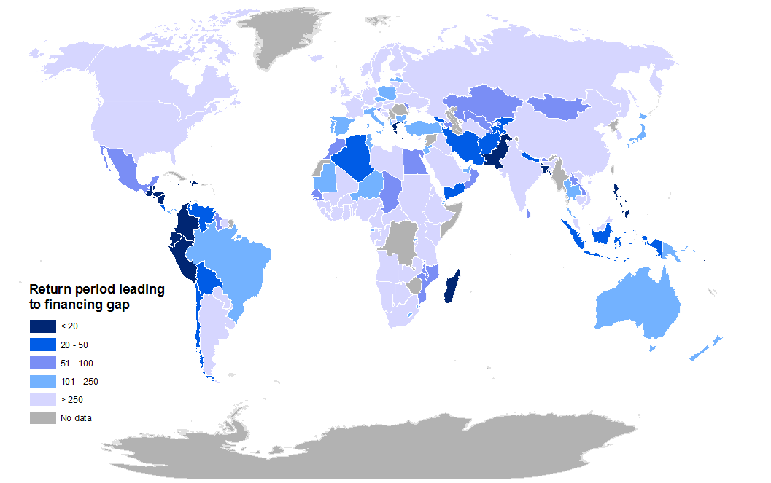
Highlight: Fiscal gaps across the world estimated from RISK’s CATSIM model
Fiscal gap = country losses – country coping capacity
Cost of eliminating the gap with financial instruments is estimated at approximately USD 5 billion annually

Slide 5
Theme 2
Risk management and climate adaptation

Slide 6
Highlight: Measuring flood resilience
RISK scientists are working with the Zurich Flood Resilience Alliance to test the Alliance’s Measurement Tool in 70 communities across eight countries worldwide

Slide 7
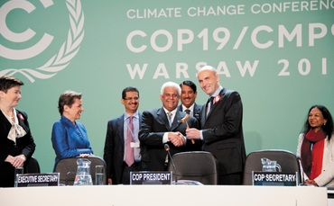

The International Loss & Damage Mechanism
Endorsed at Paris (COP19) to deal with & provide support for residual climate-related damages after adaptation (3rd pillar)
RISK as a hub for L&D research
Continue to contribute to the debate, most recently with a risk-layer approach
Established a research-policy network
Preparing a book on the topic
Mechler, et al. Nature Climate Change 2014

Slide 8
Theme 3
Risk governance in transition

Slide 9
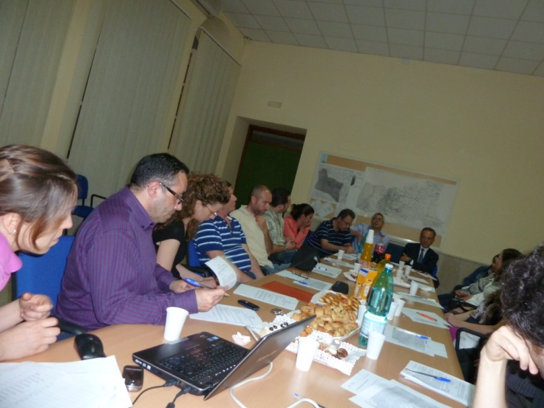
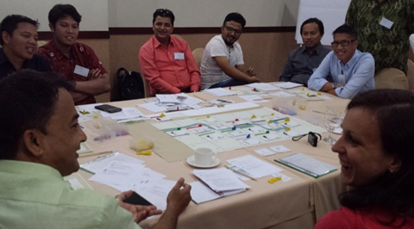
Innovation in designing stakeholder processes
3 year stakeholder process in Italy to assess options for landslide mitigation using plural rationality theory;
7 stakeholder workshops in Jordan to assess energy futures using multi-criteria analysis;
Multiple stakeholder processes using policy games to assist stakeholders in policy exploration, decision making and strategic change.

Slide 10
Thank you, and enjoy the posters and games

Slide 11
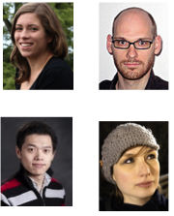
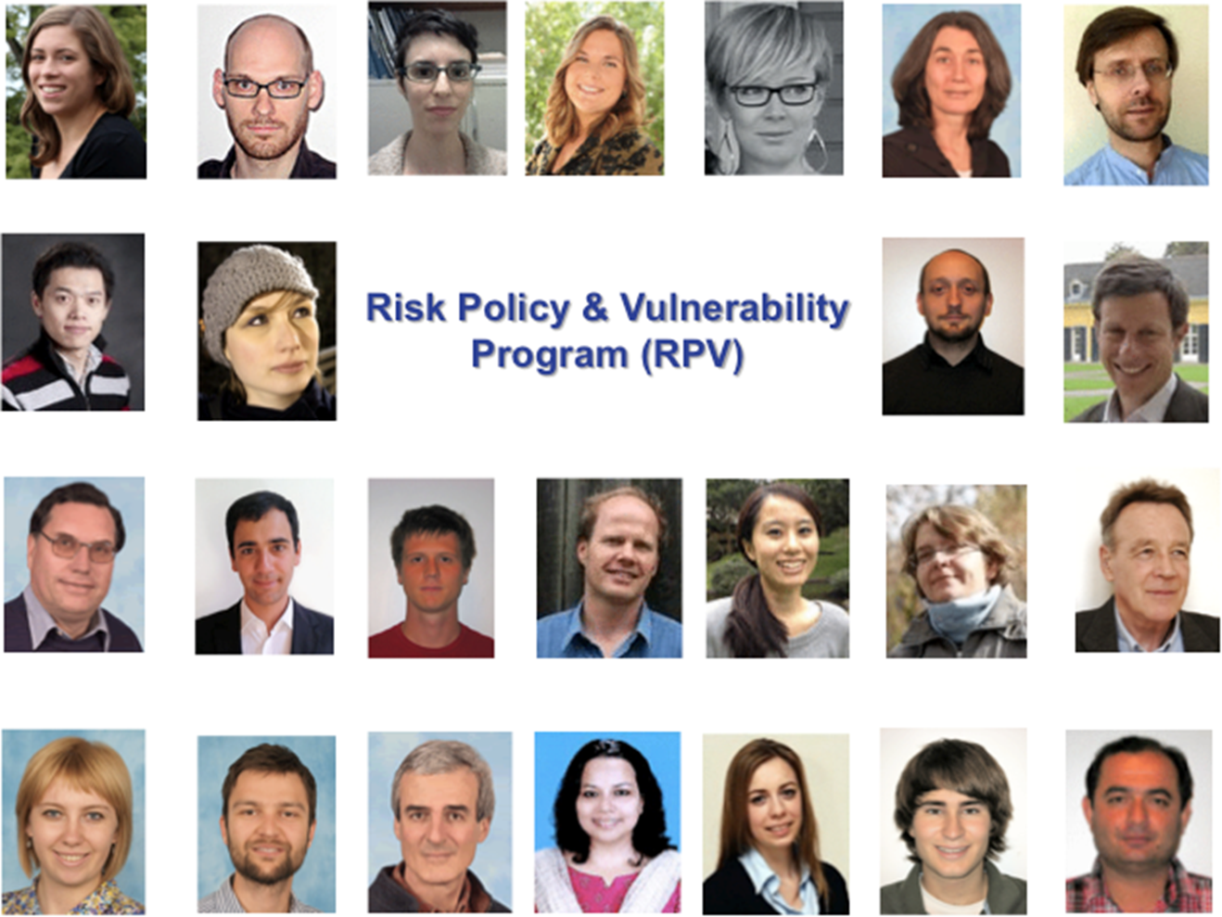
Risk and Resilience

Slide 12
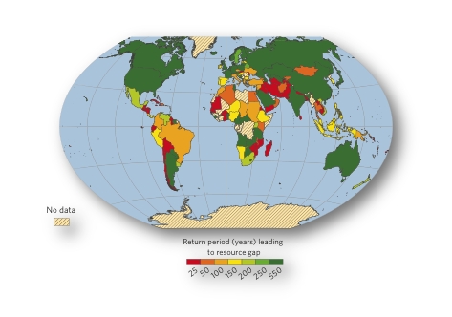
Estimating the fiscal gap, or vulnerability, across the globe
Hochrainer-Stigler, Mechler et al. Global Environmental Change 2014

Slide 13
Catastrophe Simulation Model CATSIM
Hazard
Exposure
People and Assets
Physical Vulnerability
1. Direct Risk
Produced capital
Human capital
Environmental capital
2. Financial Resilience
Ex-post sources
Ex-ante sources
3. Fiscal Gap
Result of an event causing losses which exceed a country’s ability to cope
Risk Management
Economic Risk

Slide 14
Flood resilience
Goal: Positively affect 250,000 households by 2018
Shared understanding of resilience
Bouncing forward
Resilience measurement: Mexico, Indonesia, Peru, Nepal
Participatory, adaptive management approach for resilience
  Systems dynamics modeling
  Gaming
  Citizen science
Chosen by UNFCCC’s Momentum for Change initiative as an exemplary Lighthouse Activity at COP 20 in Lima

Slide 15
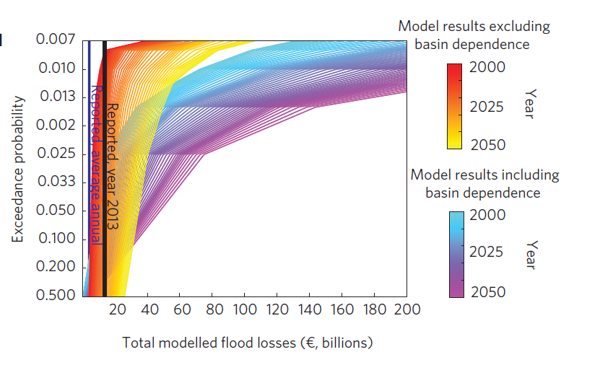

European flood risk is much higher than previously estimated taking account of basin dependencies
Probabilistic losses without dependencies
Probabilistic losses with dependencies
Jongman, Hochrainer-Stigler, Mechler, et al, 2014

Slide 16
Mission
Contribute to transforming the way societies manage risks to economic, ecological, and social systems while confronting the global trends that are amplifying these risks

Slide 17



3 thematic areas
      Risk Analysis and Modeling
      Risk management and climate adaptation
      Governance in transition
Notes:
On the forefront of the mathematics of probabilistic risk assessment and catastrophe modeling
For the first time with a systems approach
Where RPV contributed significantly to the merging of the disciplinary communities of DRM and CCA, whch was so influential in the latest reports of the IPCC
A distinctly RPV niche that has set the agenda, also for climate adaptation
New area building on long history of bottom up participatory research and application

