Slide 1
IIASA’s Water Program: History, Strategy, and Progress
Yoshihide Wada, Dr., Deputy Director, Water Program
Simon Langan, William Cosgrove, Peter Burek, Molly Convery, Kees Dorland, Luis Gomez Echeverri, Günther Fischer, Martina Flörke, Stephanie Esiner, David Grey, Eva Hizsnyik, Mohamed Taher Kahil, Piotr Magnuszewski, Luzma Fabiola Nava Jimenez, Claudia Pahl-Wostl, Naota Hanasaki, Yusuke Satoh, Angelika Scherzer, Laixiang Sun, Geza Toth, Sylvia Tramberend, Michelle van Vliet, Harrij van Velthuizen, Wim van Vierssen, Charles Vörösmarty, David Wiberg, Paul Yillia, Eric Wood, Pavel Kabat
IIASA, February, 2017
Notes:
Introduce team.

Slide 2
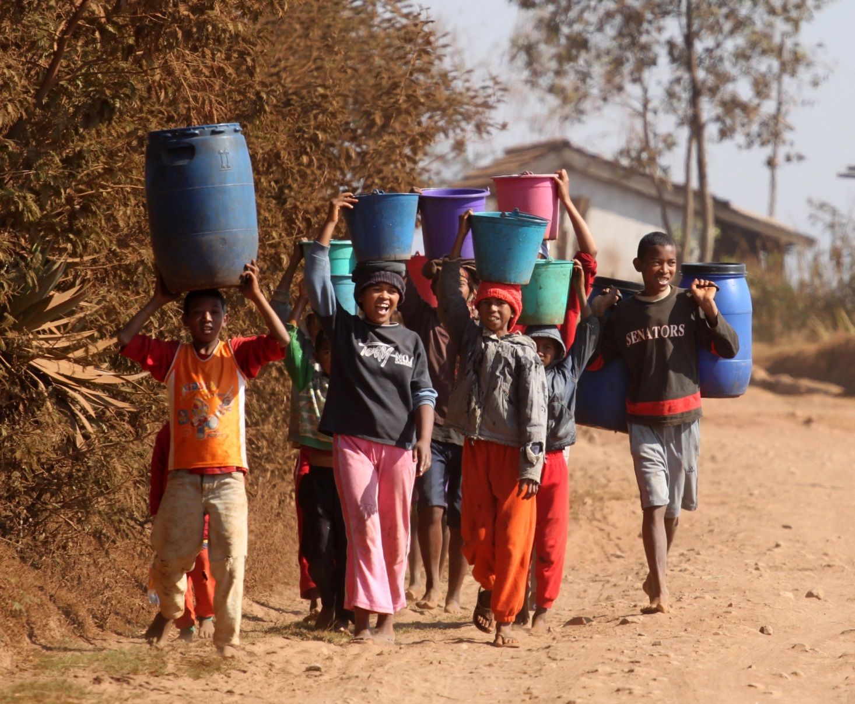
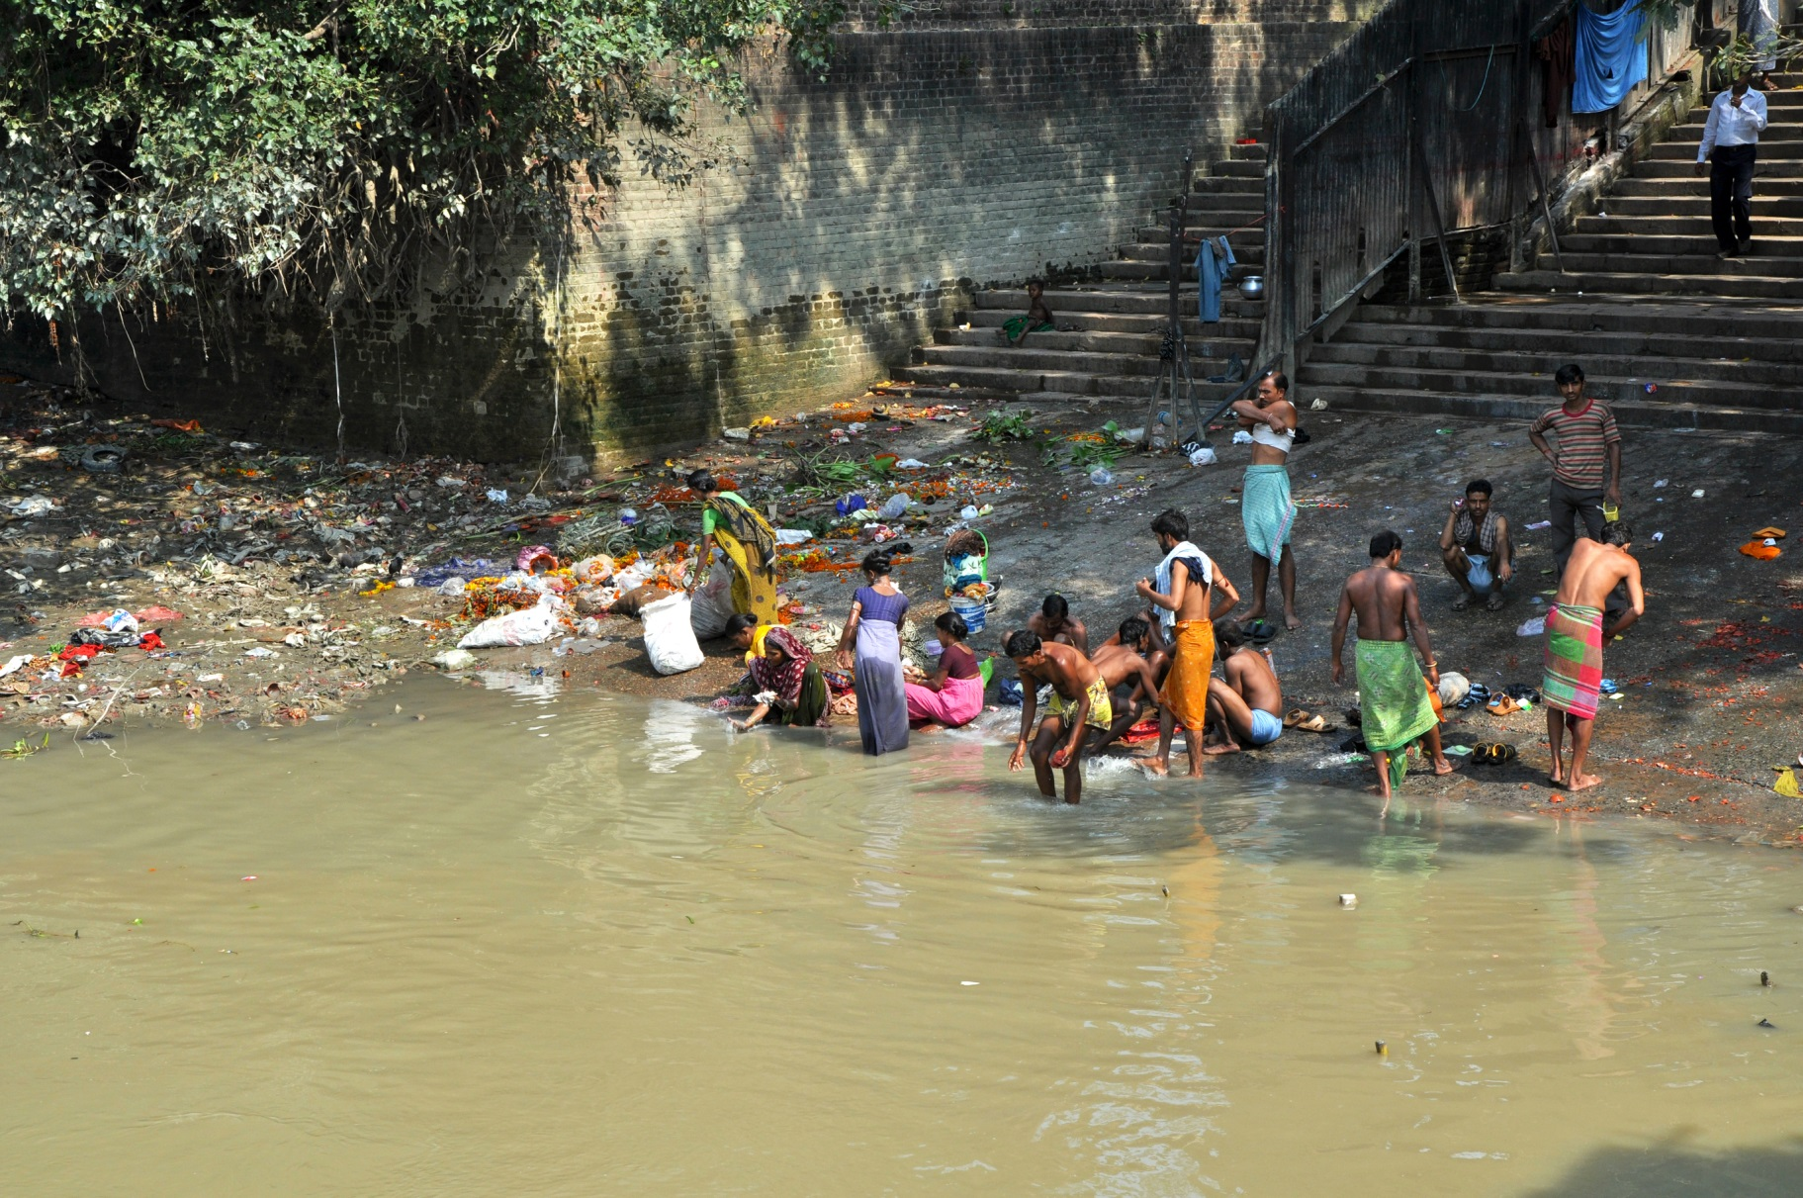
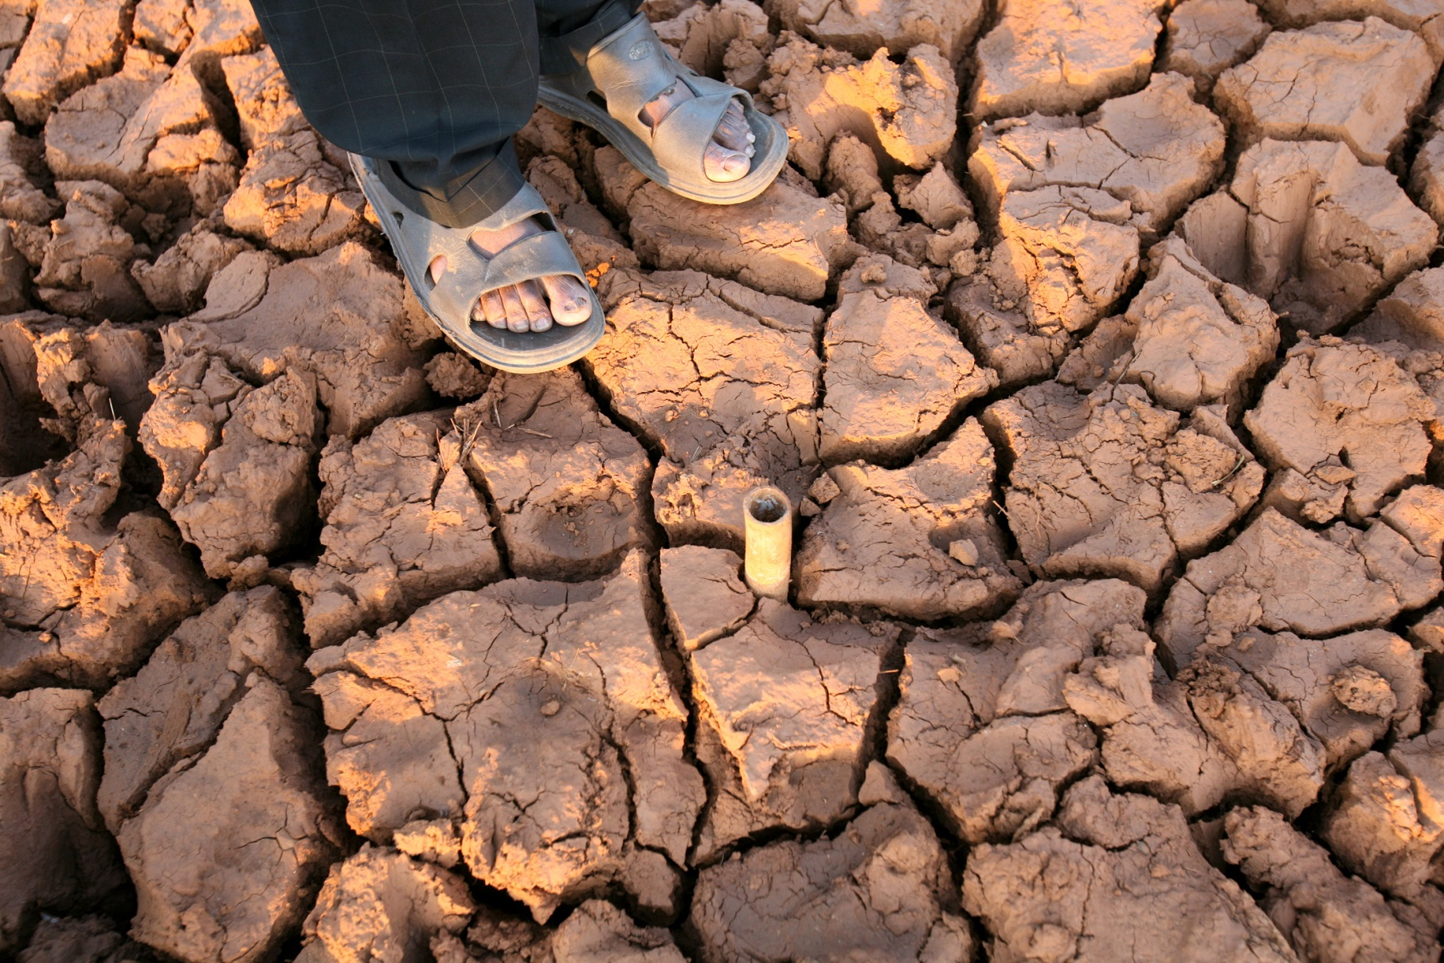
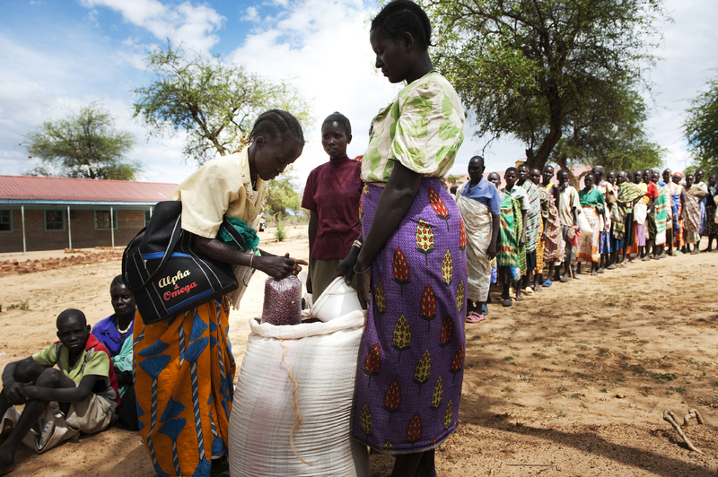
Half our planet’s population are water insecure… uncertain futures
Absent or unreliable WSS
Food security and Irrigation
The impacts of unmitigated variability
including floods & droughts
Degraded water environments
Motivation

Slide 3
Mission:
IIASA’s Water Program (WAT) convenes international, interdisciplinary research on possible water futures and their interactions and implications across larger systems to help identify robust and sustainable options across those futures and systems that can help improve human well-being through enhanced water security and beyond.
Objectives

Slide 4
Water Futures and Solutions (WFaS) Initiative
Towards Innovative Solutions through
Integrative Water Futures Analysis

Slide 5
WFaS Project Structure
Sponsor
Coalition
Consists of three major coalitions
Organized into the following groups
Governing Board
Project Director
Science Coalition
Stakeholder Coalition
ensuring consistency & usefulness of outputs
Sector Actors Group
Scenario Focus Group
Project Team
WaterFutures4
the World
External experts
Secretariat
Notes:
GB is the financing partners and sponsors
SFG and SAG make up the stakeholder coalitions, although the GB and project group can also be considered stakeholders
Project Team is the Science coalition

Slide 6
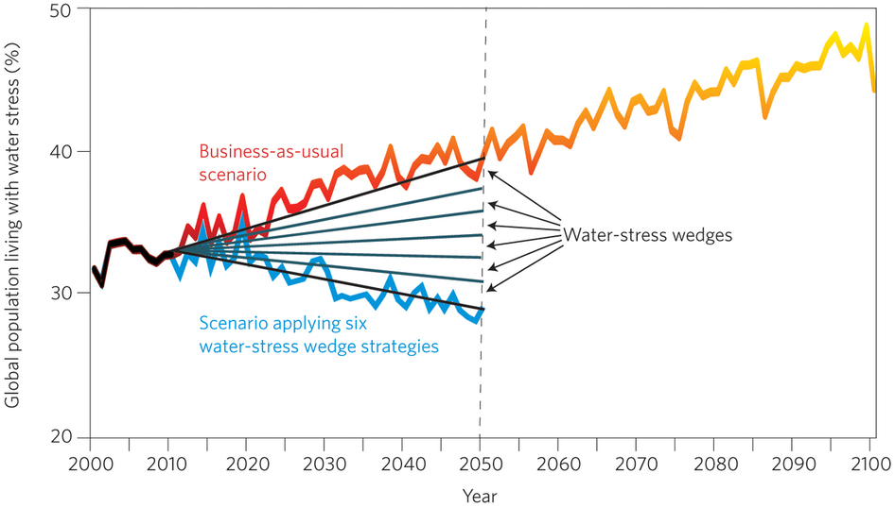
Reducing Water Scarcity Possibly by 2050
Each solution
= 2% reduction
We present six strategies, or water-stress wedges, that collectively lead to a reduction in the population affected by water stress by 2050, despite an increasing population.
- Water productivity – crop per drop
- Irrigation efficiency – decrease losses
- Water use intensity – industry and domestic
- Population
- Reservoir storage
- Desalination
Soft path vs. Hard path
Wada et al. (2014), Nature Geoscience

Slide 7
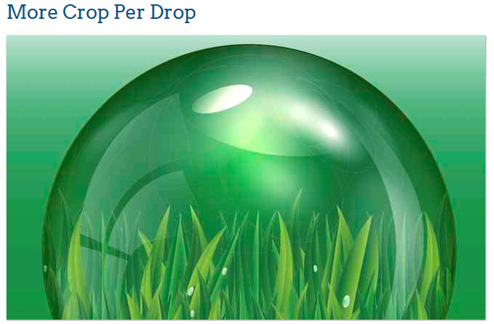
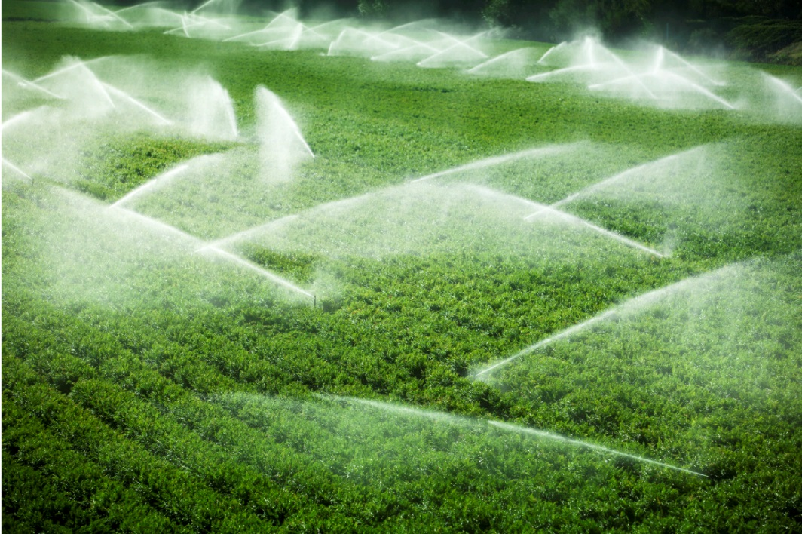
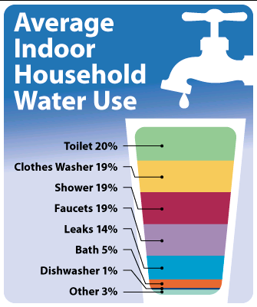
Improvement in water productivity at 0.5% per year (20% by 2050)
Efficiency increase by 1% per year (40% by 2050)
Improvement
of 0.5% per year
(20% by total)
Limit population growth by 0.5 billion
(8.5 billion by 2050)

Slide 8
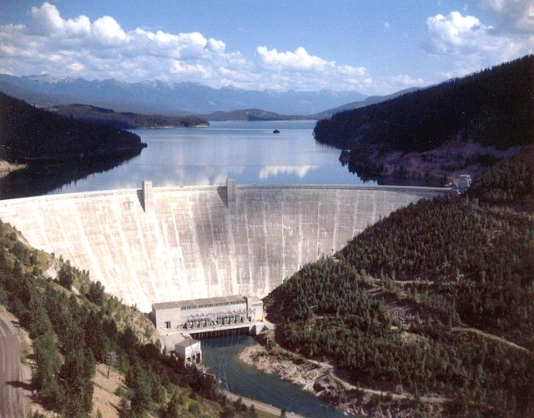
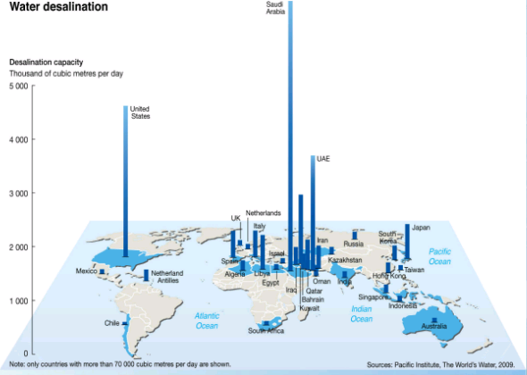
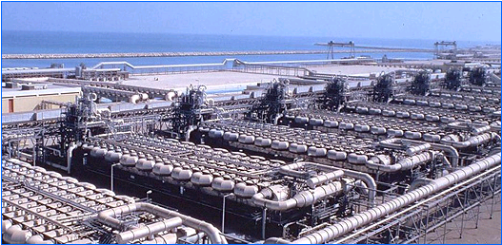
Additional 600 km³ reservoir storage
(by 2050)
US$ 10 billion??
50 times increase in desalination capacity
(by 2050)
US$ 20 billion??

Slide 9
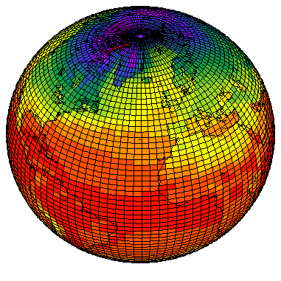
IIASA Community Water Model (CWatM)

Slide 10
Nexus Integration towards SDGs
Enhanced water assessments
Improved analysis feedbacks
MESSAGE
・Electricity
production
・ Energy futures/options
MESSAGE
Energy
Energy
Available water
・ river discharge
・ Variability/Risk
・ Supply costs
・ impacts
・Technical
innovation
・ Temperature?
・ Quality?
Community Water Model
Community Water Model
GLOBIOM
GLOBIOM
Env.
Water
Env.
Water
・ Land use/cover
・ Crop area/type
・ Irrigation area
・ LAI
（・Shadow price of water ?)
Available water
・ river discharge
・ groundwater
・ risk/variability
・soil moisture
・impacts of use
Notes:
What do we propose to do along the water-energy nexus?
Improve the estimation of water demands for those sectors in space, time, and quality (with our energy and land use partners we will be improving )
Improve estimation of energy and land demand for water services.
Assess the interventions and adaptations that can be made in those sectors under water constrained situations.
Link the feedbacks of water withdrawals on availability of water in other times and places.
We will be better able to assess the costs of the water infrastructure needed to supply demands, including ecosystem demands.
We will

