Slide 1


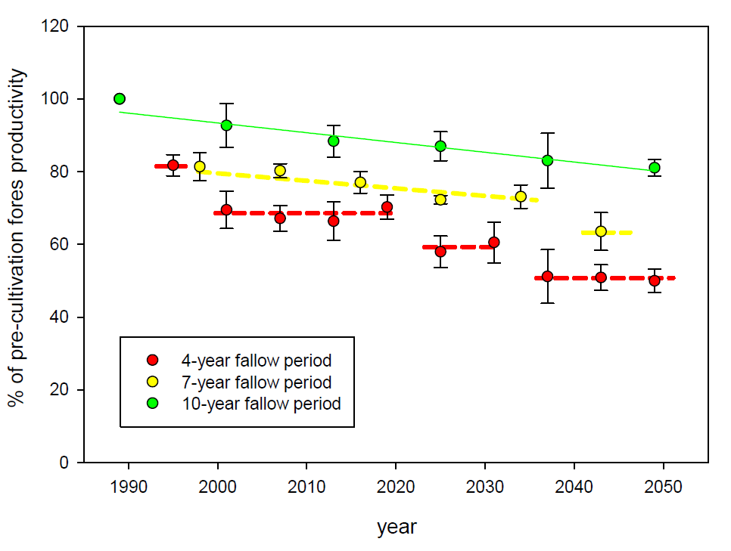
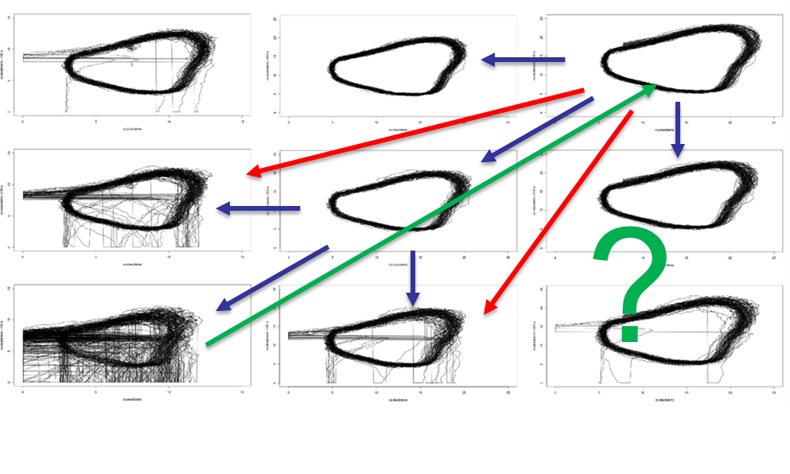
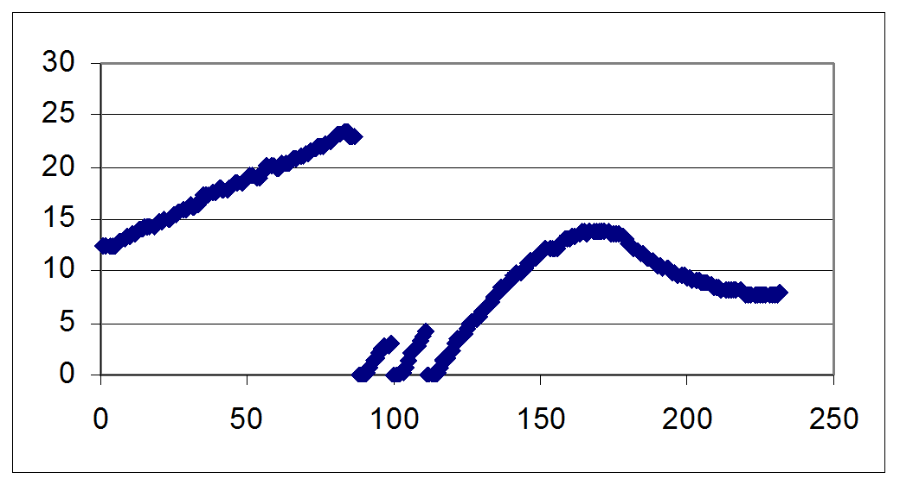
Implications of changes in tropical shifting cultivation intensification on
land productivity and GHG-related biogeochemistry
Bernard Bustierª† , Alfred Ngoye^{b}, Stephan A. Pietsch^{c} and Aline Mosnier^{c}
ª MDN, Genie Militaire, Libreville, Gabon
^{b} CENAREST, IRET, Libreville Gabon
^{c} IIASA, ESM, Laxenburg, Austria, pietsch@iiasa.ac.at
Introduction
shifting cultivation used to be a sustainable type of land use for the subsistence of populations in
tropical rainforests. The vast resource of moist tropical forests together with low population densities allowed for long fallow periods on sparsely distributed slash and burn parcels with large areas of untouched forest in between.
Population growth and concomitant increase in land demand for subsistence as well as increasing infrastructure development for commercial forestry, cash crops and mining, however, altered the picture over recent decades. As a result, fallow periods were reduced due to lack of pristine land.
Data
The TrEco research plots network contains field data from permanent and non-permanent research plots that were sampled and/or installed by IIASA researchers. It is dedicated to serve scientists within and outside of IIASA to compare model results with field data. Currently, TrEco consists of over 150 plots distributed across 8 different sites in Western Central Africa and covers typical tropical vegetation types and land use forms, including virgin forest refuges, exploited and managed forests, open and wooded savannahs, shifting cultivation and forest fallows as well as Agroforestry systems.
http://www.iiasa.ac.at/web/home/research/researchPrograms/EcosystemsServicesandManagement/TrEco.html
Modeling
In BGC-MAN, daily weather data and site information are needed to calculate the cycles of carbon, nitrogen, water and energy within a given ecosystem. Up to 50 parameters describe the ecophysiology, phenology, growth and allocation structure, as well as intrinsic and externally driven biomass mortality of: (i) single species, (ii) assemblies of species, (iii) plant traits, (iv) plant functional types or (v) biomes. Distinct parameter sets exist for the major species of temporal and boreal forests, temperate and boreal grasslands, as well as for distinct tropical forest ecosystems, tropical savannahs and tropical woodlands.
http://www.iiasa.ac.at/web/home/research/researchPrograms/EcosystemsServicesandManagement/BioGeoChemistry_Management_Model_(BGC-MAN)1.html
Results I
Shifting Cultivation may cause changes in Forest Growth Dynamics.
Results II
Changes may be linear or stepwise.
Results III
Declines in productivity may be concomittant with declines in stability. Forest Landscape Restoration may be tricky.
† This work is dedicated to the late Bernard Bustier

