Slide 1


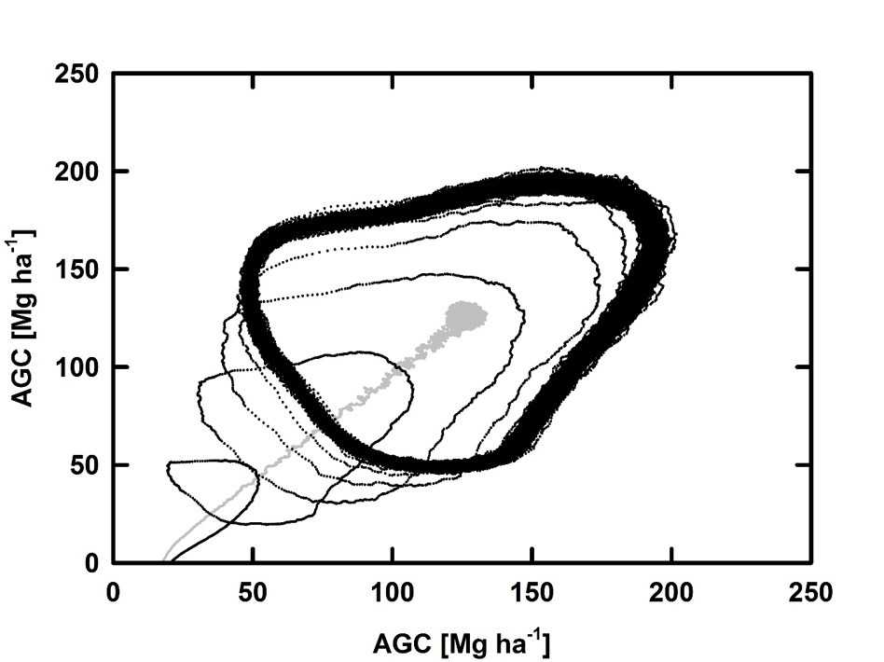
Addressing optimality principles in DGVMs:
Dynamics of Carbon allocation changes
Stephan A. Pietschª
ª IIASA, ESM, Laxenburg, Austria, pietsch@iiasa.ac.at
Introduction
DGVMs are designed to reproduce and quantify ecosystem processes. Based on plant functions or species specific parameter sets, the energy, carbon, nitrogen and water cycles of different ecosystems are assessed. These models have been proven to be important tools to investigate ecosystem fluxes as they are derived by plant, site and environmental factors. The general model approach assumes steady state conditions and constant model parameters. Both assumptions, however, are wrong, since:
(i) No given ecosystem ever is at steady state!
(ii) Ecosystems have the capability to adapt to changes in growth conditions, e.g. via changes in allocation patterns!
Data
The TrEco research plots network contains field data from permanent and non-permanent research plots that were sampled and/or installed by IIASA researchers. It is dedicated to serve scientists within and outside of IIASA to compare model results with field data. Currently, TrEco consists of over 150 plots distributed across 8 different sites in Western Central Africa and covers typical tropical vegetation types and land use forms, including virgin forest refuges, exploited and managed forests, open and wooded savannahs, shifting cultivation and forest fallows as well as Agroforestry systems.
http://www.iiasa.ac.at/web/home/research/researchPrograms/EcosystemsServicesandManagement/TrEco.html
Modeling
In BGC-MAN, daily weather data and site information are needed to calculate the cycles of carbon, nitrogen, water and energy within a given ecosystem. Up to 50 parameters describe the ecophysiology, phenology, growth and allocation structure, as well as intrinsic and externally driven biomass mortality of: (i) single species, (ii) assemblies of species, (iii) plant traits, (iv) plant functional types or (v) biomes. Distinct parameter sets exist for the major species of temporal and boreal forests, temperate and boreal grasslands, as well as for distinct tropical forest ecosystems, tropical savannahs and tropical woodlands.
http://www.iiasa.ac.at/web/home/research/researchPrograms/EcosystemsServicesandManagement/BioGeoChemistry_Management_Model_(BGC-MAN)1.html
Results I
Steady state simulations may lead to the same mean of vegetation Carbon pools. Carbon Fluxes, however, exhibit significant differences.
Results II
Typical patch level development of Carbon pools and Fluxes over time.
I: Optimum growth phase
II: Old Growth and breakdown
III: Regeneration
Results III
Refined representation of fluxes in Results II.
Changes in competition for light and nutrients are concomittant with changes in above/below ground Carbon allocation. During Old Growth and Breakdown below ground allocation is favored. During Regeneration and Adolescence above ground Carbon allocation is favored.

