Slide 1


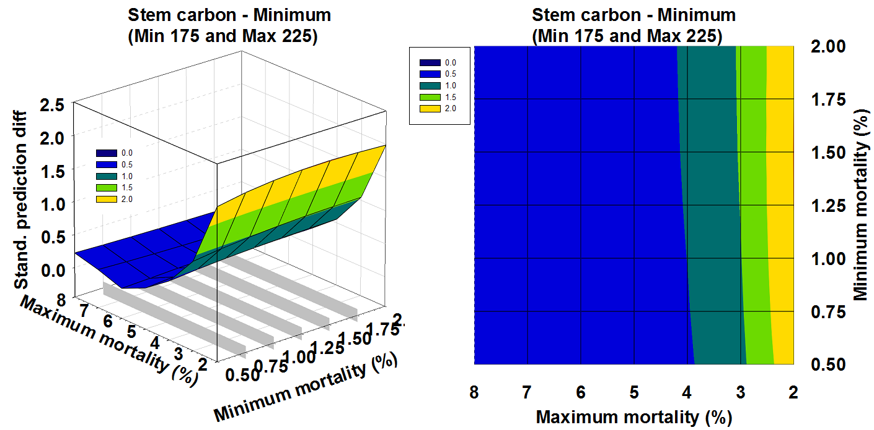
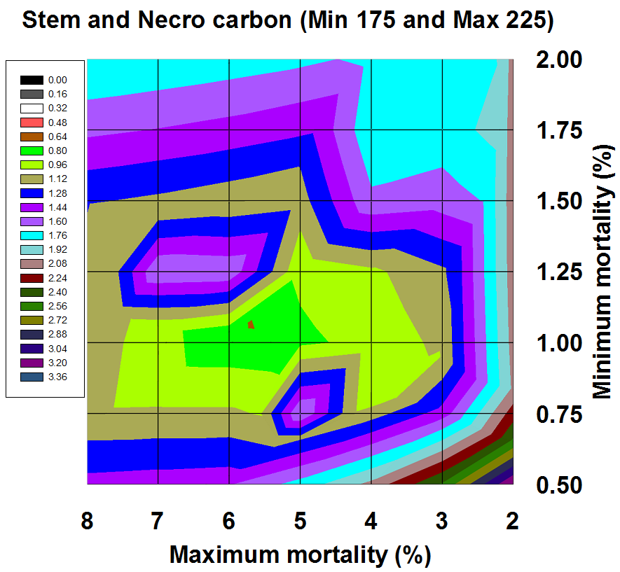
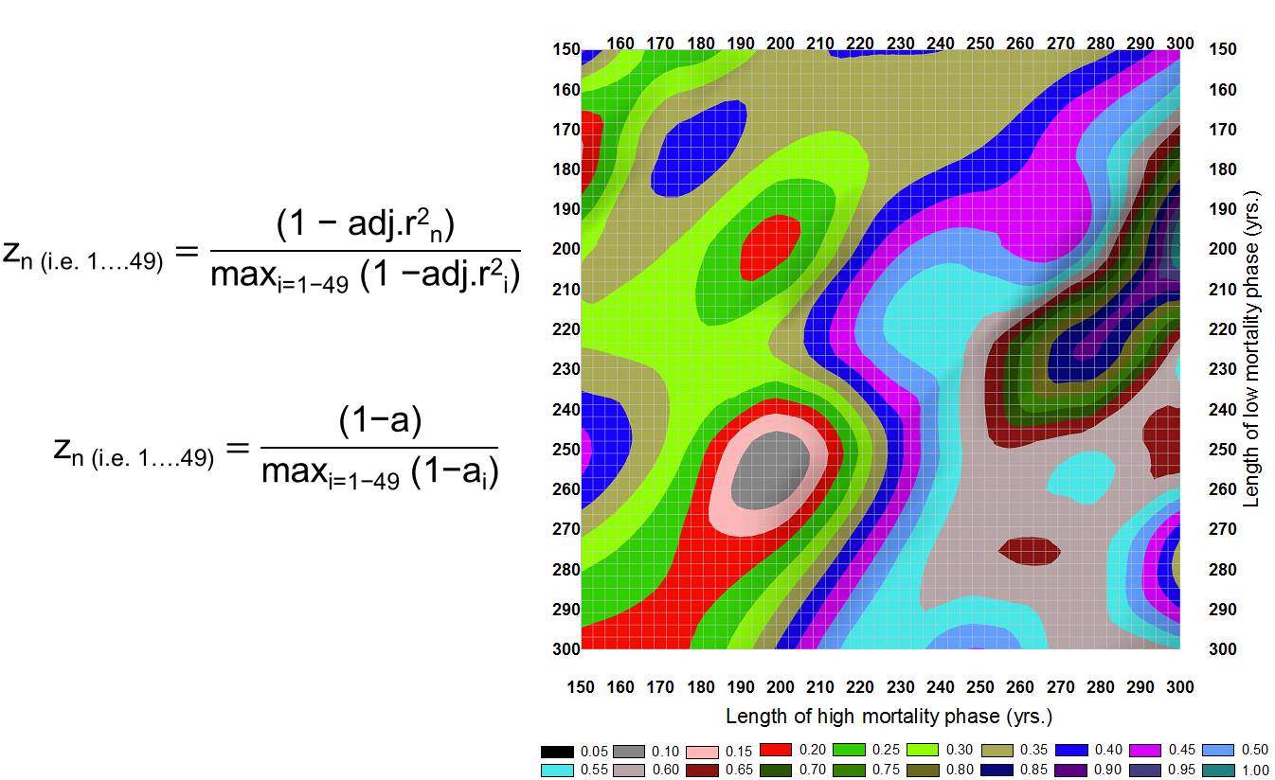
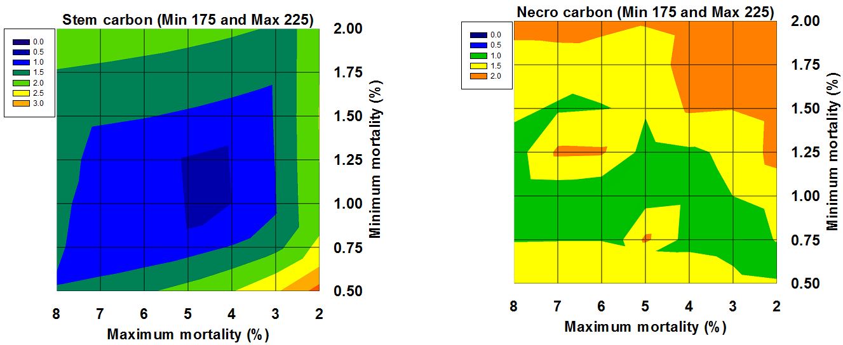
Assessing tropical rainforest growth traits:
Data – Model fusion in the Congo basin and beyond
Stephan A. Pietschª
ª IIASA, ESM, Laxenburg, Austria, pietsch@iiasa.ac.at
Introduction
Virgin forest ecosystems resemble the key reference level for natural tree growth dynamics. The mosaic cycle concept describes such dynamics as local disequilibria driven by patch level succession cycles of breakdown,
regeneration, juvenescence and old growth. These cycles, however, may involve different traits of light demanding and shade tolerant species assemblies.
In this work a data model fusion concept will be introduced to assess the differences in growth dynamics of the mosaic cycle of the Western Congolian Lowland Rainforest ecosystem.
Application of the same procedure to Central American Forests gave similar results.
Data
The TrEco research plots network contains field data from permanent and non-permanent research plots that were sampled and/or installed by IIASA researchers. It is dedicated to serve scientists within and outside of IIASA to compare model results with field data. Currently, TrEco consists of over 150 plots distributed across 8 different sites in Western Central Africa and covers typical tropical vegetation types and land use forms, including virgin forest refuges, exploited and managed forests, open and wooded savannahs, shifting cultivation and forest fallows as well as Agroforestry systems.
http://www.iiasa.ac.at/web/home/research/researchPrograms/EcosystemsServicesandManagement/TrEco.html
Modeling
In BGC-MAN, daily weather data and site information are needed to calculate the cycles of carbon, nitrogen, water and energy within a given ecosystem. Up to 50 parameters describe the ecophysiology, phenology, growth and allocation structure, as well as intrinsic and externally driven biomass mortality of: (i) single species, (ii) assemblies of species, (iii) plant traits, (iv) plant functional types or (v) biomes. Distinct parameter sets exist for the major species of temporal and boreal forests, temperate and boreal grasslands, as well as for distinct tropical forest ecosystems, tropical savannahs and tropical woodlands.
http://www.iiasa.ac.at/web/home/research/researchPrograms/EcosystemsServicesandManagement/BioGeoChemistry_Management_Model_(BGC-MAN)1.html
Data-Model Fusion
Overlay of error fields
  Validation Results
  Congo:
  Mosaic cycle of light demanding species (~300 yrs.): CI: -7.0 – 1.9 %
  Mosaic Cycle of shade tolerant species (~450 yrs.): CI: -1.9 – 8.8 %
  Costa Rica:
  Mosaic cycle of light demanding species (~160 yrs.): CI: -7.1 – 10.8 %
  Mosaic Cycle of shade tolerant species (~250 yrs.): CI: -3.4 – 16.8 %

