Slide 1
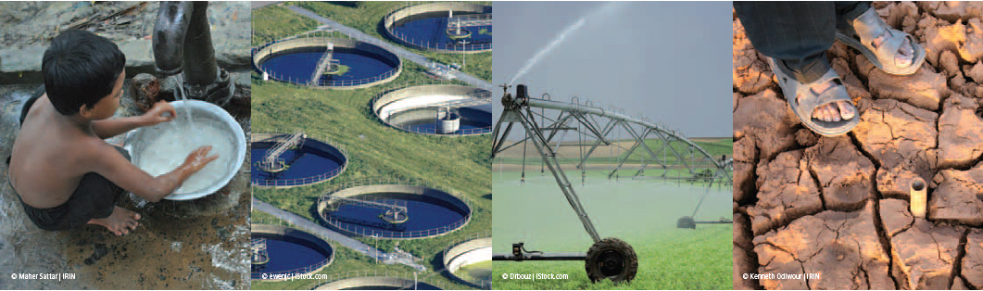
Opportunities and constraints for improved water resources management using different lenses and scales
Simon Langan - Program Director, Water, IIASA
25th April 2017, EGU, Vienna
Notes:
Oral solicited, 27 min + 3 min for questions and discussions in session HS5.4 - Water Resources Management and Policy in a Changing World, room B on Tuesday, 25 Apr 2017, 08:30:
EGU2017-15529
Opportunities and constraints for improved water resources management using different lenses and scales
by Simon Langan

Slide 2
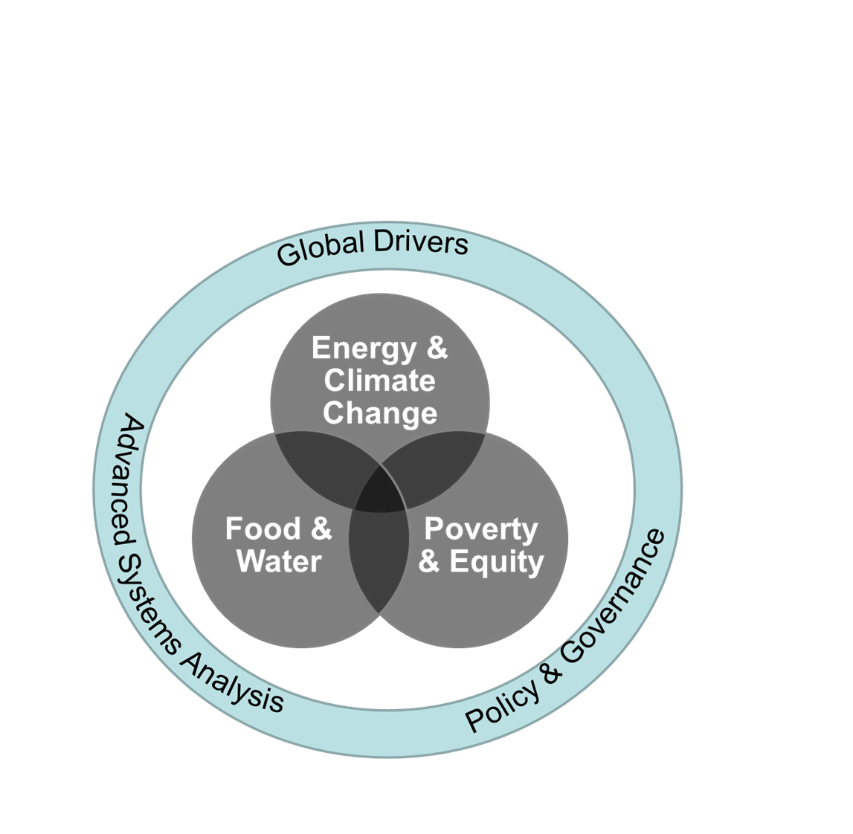
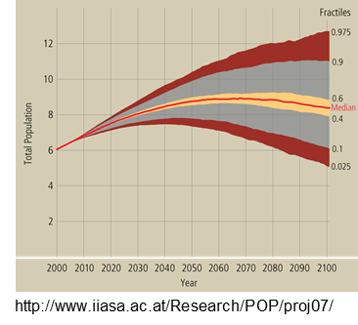
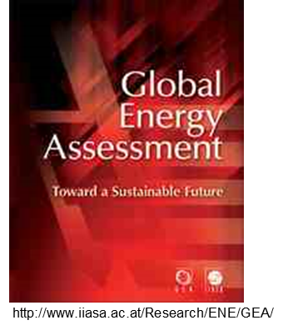
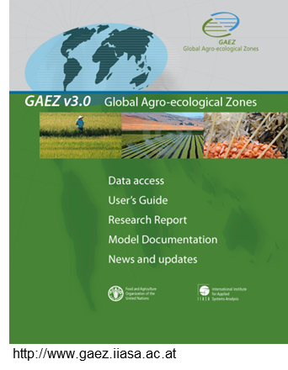
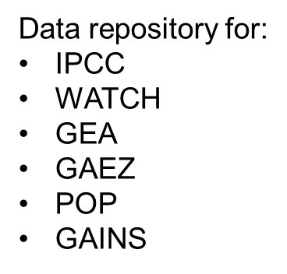
IIASA Research

Slide 3
Focus of the talk
Context and drivers
Modelling water futures
Towards solutions
Future needs
Message: Research and management has to co-evolve!

Slide 4
Context: A rapidly changing world
Up to 2 billion more people by 2050
Need to produce 70 percent more food
With increasing development energy and food demands are rising. Water demands to meet these are expected to rise by 55 percent
Set against a background of a more variable and changing water resource availability
Up to 40 percent of the worlds population will live in severe water stressed regions
Increased migration

Slide 5
Global and National Policy context
SDG’s
Paris agreement
Addis Ababa agreement

Slide 6
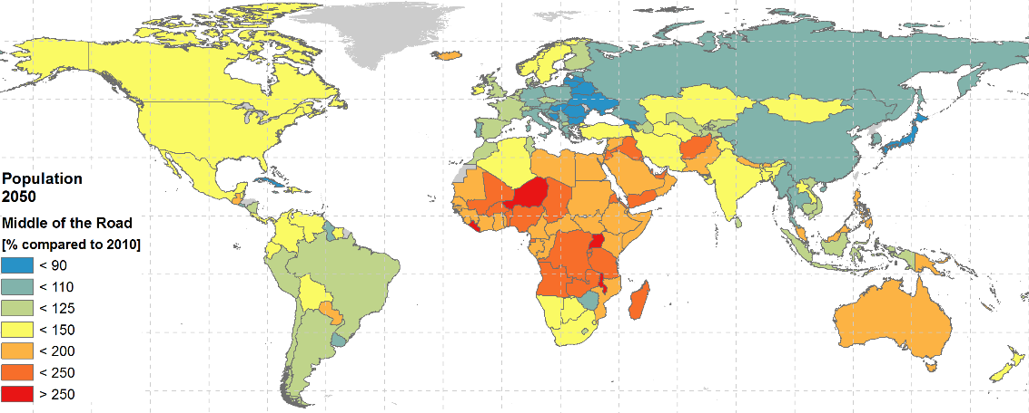
Population and Development continues Continues
Middle of the Road future
33% more people by 2050 compared to 2010 globally
(6.8 billion to 9.1 billion)
Population in [billion]
GDP [1000 billion US$/yr]
GDP per cap (PPP) in [1000US$/cap/yr
Africa
Pop: 1.0 to 2.0 2 times more
GDP: 2.8 to 19.2 7 times more
GDP pc: 2.7 to 9.5 3.5 times more
Asia
Pop: 4.1 to 5.1 1.3 times more
GDP: 26 to 123 5 times more
GDP pc: 6.2 to 24.1 4 times more

Slide 7
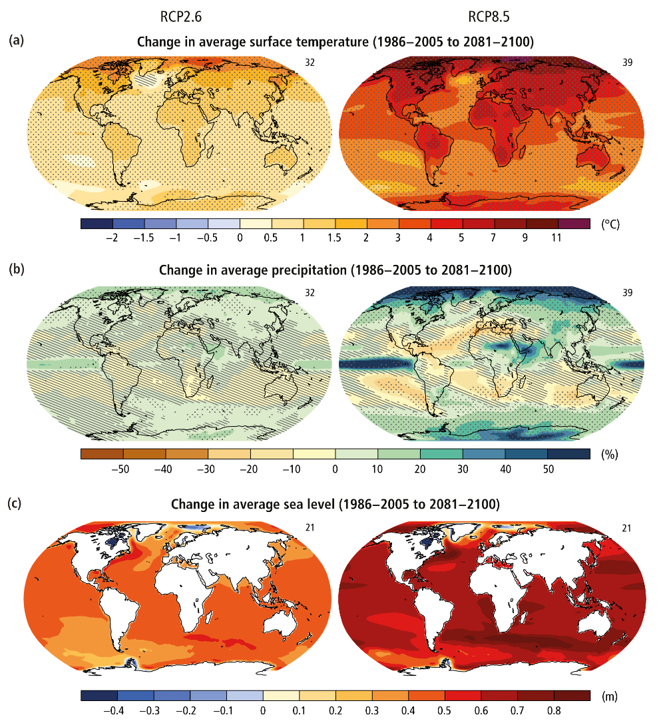
Climate change

Slide 8
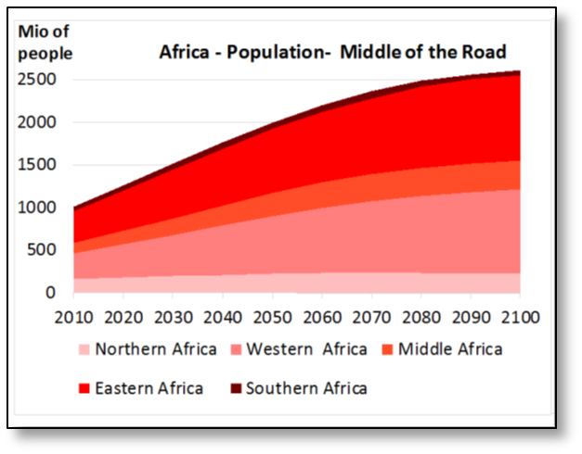
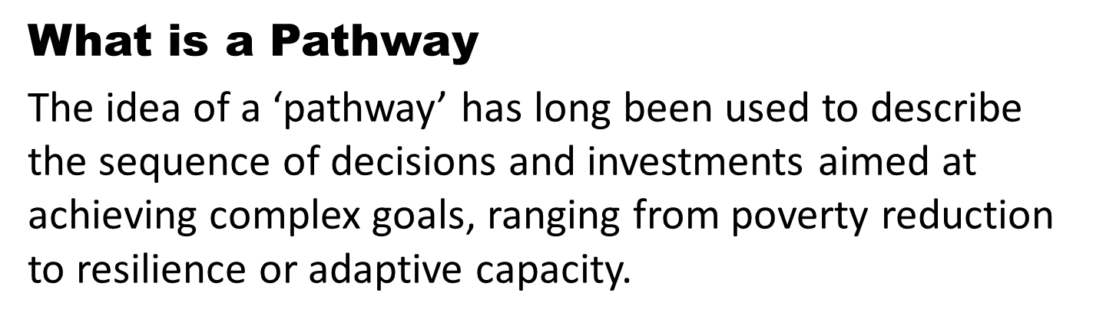

Slide 9
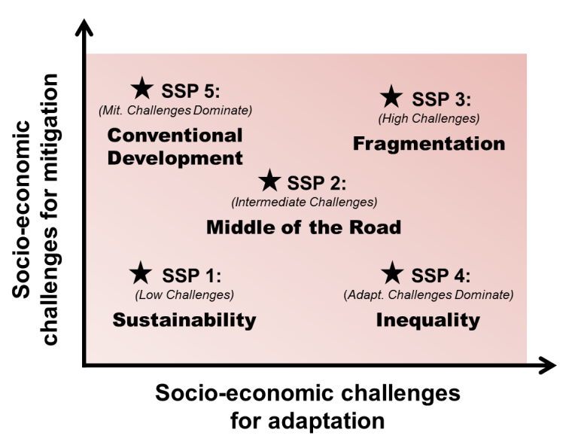
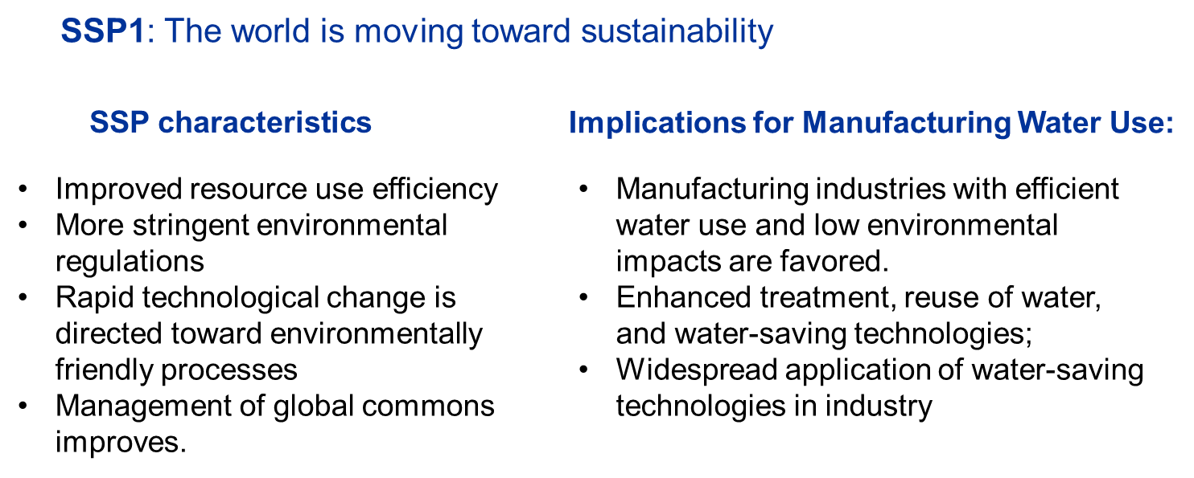
Multiple scenarios/pathways
Developing narratives of the future

Slide 10
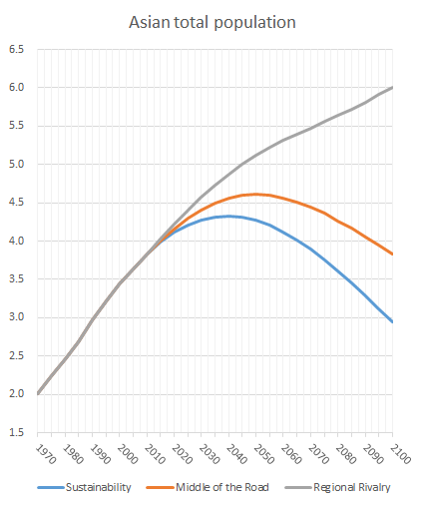
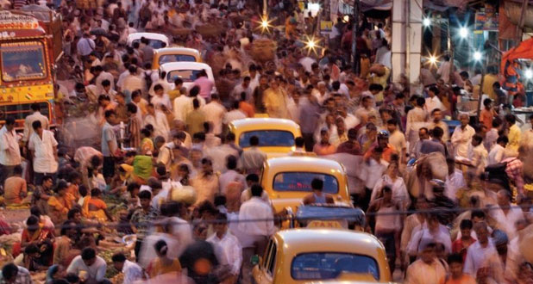
Population Growth Continues
SSP 3 – Regional Rivalry
2050: between 4.3 and 5.1 billion people
SSP 2 – Middle of the Road
2010: 3.8 billion people
SSP 1 – Sustainability
14% (SSP1) to 33% (SSP3)
more people by 2050
Water use has been growing at more than twice the rate of population increase in the last century (FAO & UN-Water)
Notes:
Asia’s total population is estimated at 3.8 billion in 2010. Future projections indicate considerable changes to Asia’s population in the coming decades. It will range between 4.3 and 5.1 billion in the 2050s (+14% to +33% relative to the 2010),

Slide 11
Socio-economic change
 | GDP p.c. (PPP) - Sustainability | GDP p.c. (PPP) - Middle of the Road | GDP p.c. (PPP) - Regional Rivalry
2010 | 1235 | 1235 | 1235
2020 | 1765 | 1744 | 1725
2030 | 3124 | 2690 | 2325
2040 | 5866 | 4091 | 2907
2050 | 10505 | 6257 | 3636
 | Total pop. - Sustainability | Total pop. - Middle of the Road | Total pop. - Regional Rivalry
2010 | 138 | 138 | 138
2020 | 174 | 179 | 184
2030 | 209 | 223 | 240
2040 | 241 | 270 | 304
2050 | 267 | 313 | 373

Slide 12
Water availability
Droughts
Impact of climate change on drought in Africa
Ratio of number of drought days per year.
1980-1999 vs 2080-2099 (Satoh et al. 2015)
Red: increasing days of drought condition

Slide 13
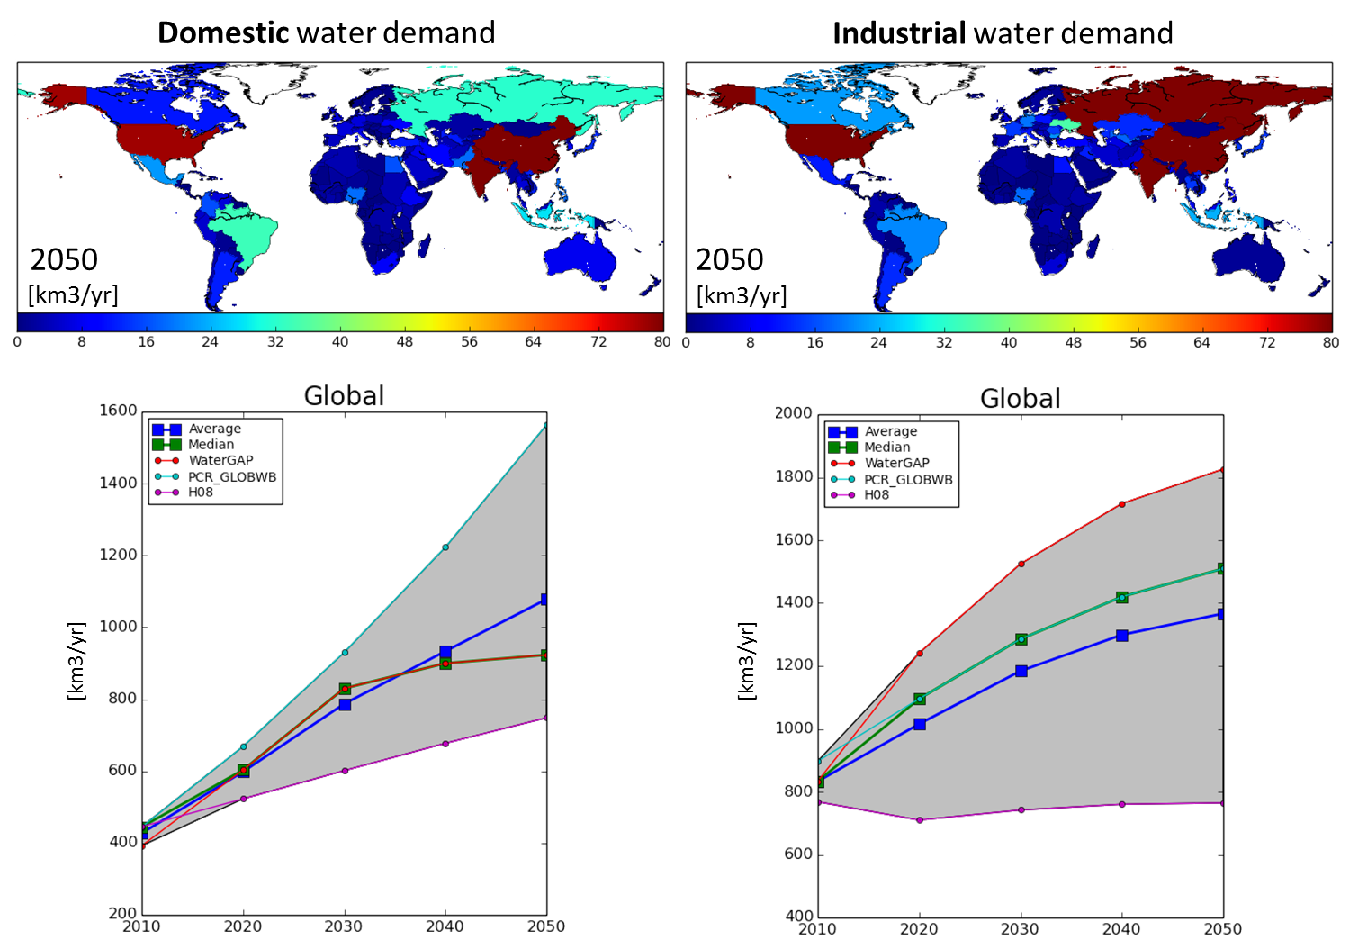
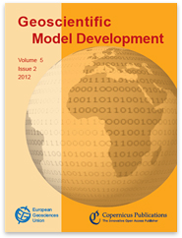
Water Futures and Multi-model Assessment: Water Demand
Models | Institution
Message/Globiom | IIASA
WaterGAP | Kassel University (Germany), Frankfurt University (Germany);
H08 | National Institute for Environmental Studies (NIES, Japan);
PCR-GLOBWB | Utrecht University (The Netherlands); ISI-MIP
LPJmL | Potsdam Institute for Climate Impact Research (PIK; Germany) and Wageningen University (The Netherlands)
IMPACT | IFPRI (USA)
WFS/GAEZ/GLOBWAT | IIASA (Austria)
Wada Y, Floerke M, Hanasaki N, Eisner S, Fischer G, Tramberend S, Satoh Y, van Vliet M, Yillia P, Ringler C and Wiberg D (2015), Geoscientific Model Development
Notes:
Shows demand assessment models that are part of the current fast-track consortium

Slide 14
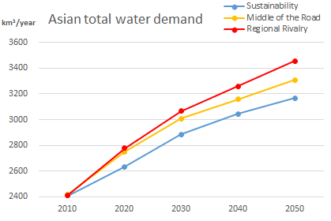
Water Demand - Asia
2010
2050 SSP2
Water demand in Asia region, by sector (km³/yr).
Asian total water demand in the 2010s is about 2410 km³/year and will be
3170 - 3460 km³/year ( increase 30 - 40% ) under the three scenarios

Slide 15
Water demand - Irrigation
a) Irrigation water requirements, by SSP (km³/yr)
b) Distribution in SSP2, by sub-region in 2010
c) Trajectories by sub-region in SSP2.
Source: IIASA, WAT Program WFaS simulations, Jan 2016
Notes:
The figure shows the estimated future irrigation demand (km3/yr) by SSP, the distribution of irrigation water demand by Asian region in 2010, and trajectories of irrigation water demand by region under SSP2 (‘Middle of the Road’) scenario. For SSP2 in 2050 irrigation requirements increase by 18% above 2010 of which nearly one-third is due to global warming (assuming RCP6p0). About half of Asian irrigation demand is in South Asia.

Slide 16
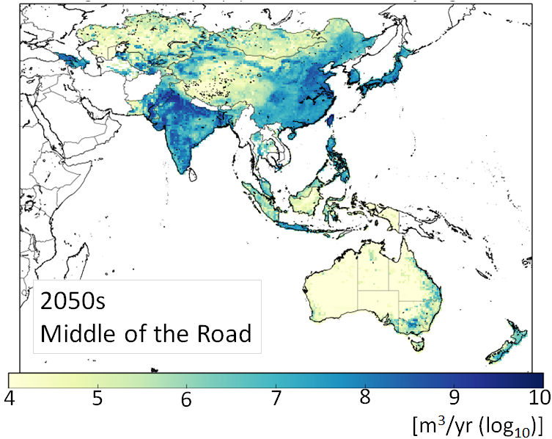
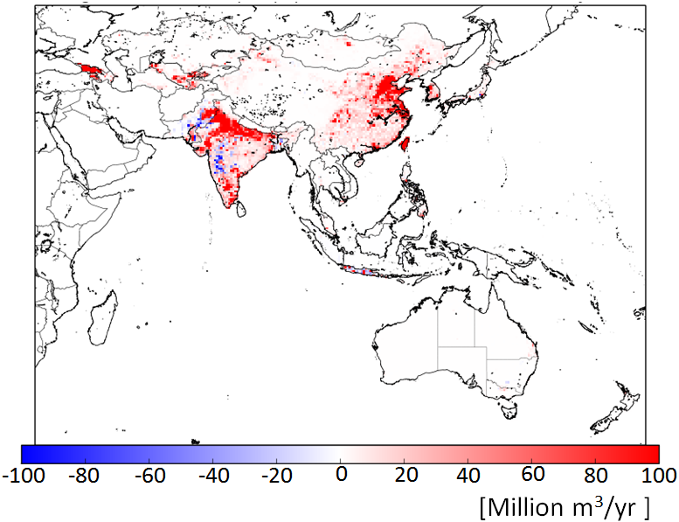
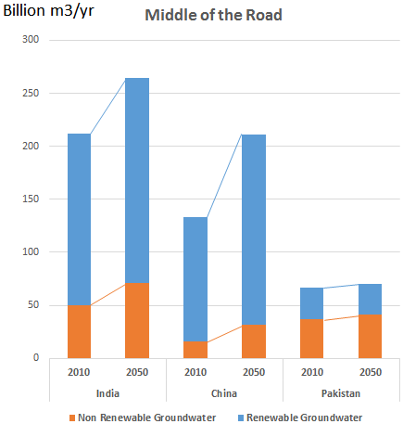
Water availability
Groundwater use and over exploitation
Increase compared to 2010
Groundwater abstraction in 2050
Asia totals:
2010: 464 km³/year
2050: 645 km³/year
Groundwater abstraction in
India, China and Pakistan
Notes:
Groundwater use in Asia totals 464 km³/year in the 2010s. The largest abstractions are taking place in India, China, and Pakistan, followed by Japan, Bangladesh, Uzbekistan, and Georgia. Abstractions in the first three countries account for 86% of total abstractions in Asia. In many countries, groundwater abstraction has already exceeded recharge, leading to the over-exploitation and degradation of important aquifer systems. Growing water requirements leads to considerable growth in demand for groundwater, amounting to 645 km³/year by the 2050s, a 39% increase over current levels.

Slide 17

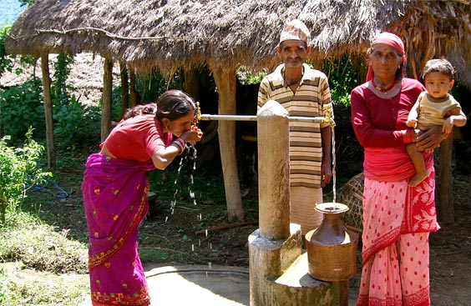
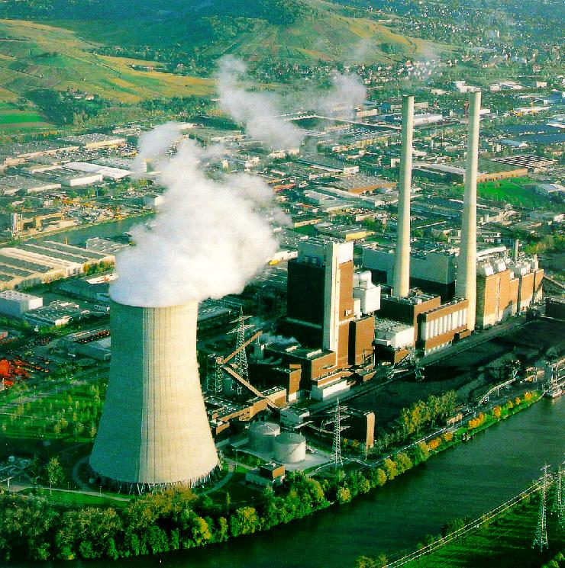
Increasing Demands, Increasing Challenges
Human needs Ecological Health
Food Domestic Energy & Industry Ecology
  Agricultural water requirements in riparian countries increase due to irrigated land expansion ??
  Domestic water withdrawals in riparian countries increase by ??
  Industrial water withdrawals in riparian countries increase by a factor ??
  Loss of wetlands and biodiversity
  River flow significantly reduced overall and seasonal
  Concept of environmental flow

Slide 18
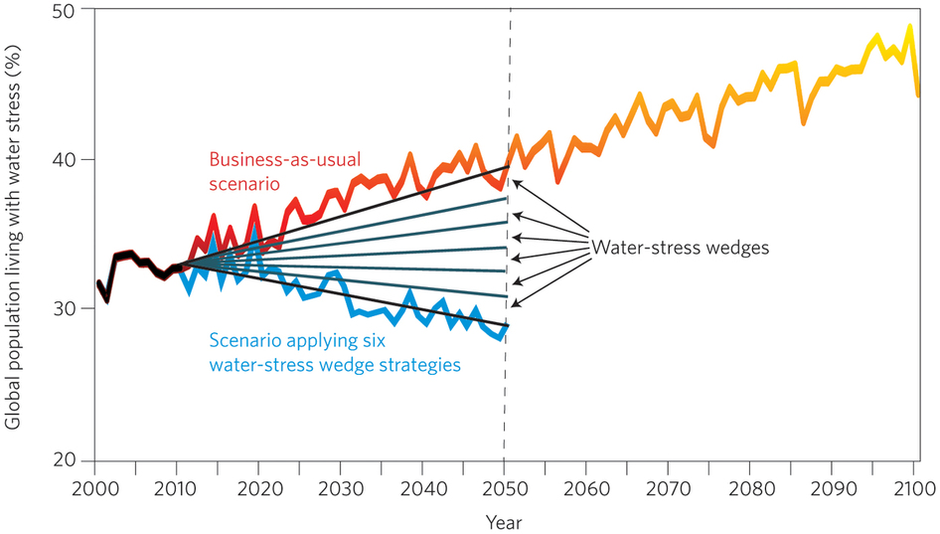
Is it possible to reduce water scarcity by 2050?
Each solution
= 2% reduction
We present six strategies (planned, not autonomous), or water-stress wedges, that collectively lead to a reduction in the population affected by water stress by 2050.
- Water productivity – crop per drop
- Irrigation efficiency – decrease losses
- Water use intensity – industry and domestic
- Population growth
- Reservoir storage
- Desalination
Soft path vs. Hard path
Source: Wada et al. 2014
Notes:
The objective of the wedge approach is to decrease the proportion of population living in water-stress regions by 12% in 2050, from 40% to 28%. Each wedge contributes a 2% decrease.
Currently 30% of global population is living under stress.
The study uses SSP2 (which is comparable to business as usual scenario)
20 ensemble projections of 5 GCMs and 4 RCPs.
In this study, we focus on planned adaptation. This focus is not to imply that autonomous adaptation is costless. However, because the overall objective of the study is to help government plan for risks. We focus on both hard and soft path options.

Slide 19
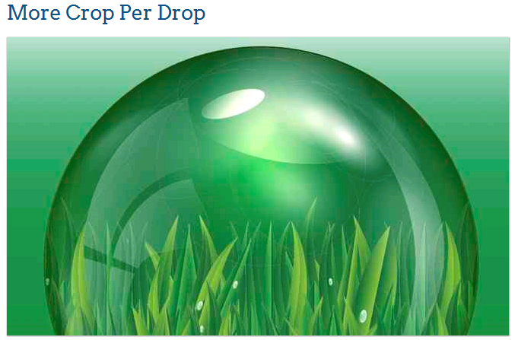
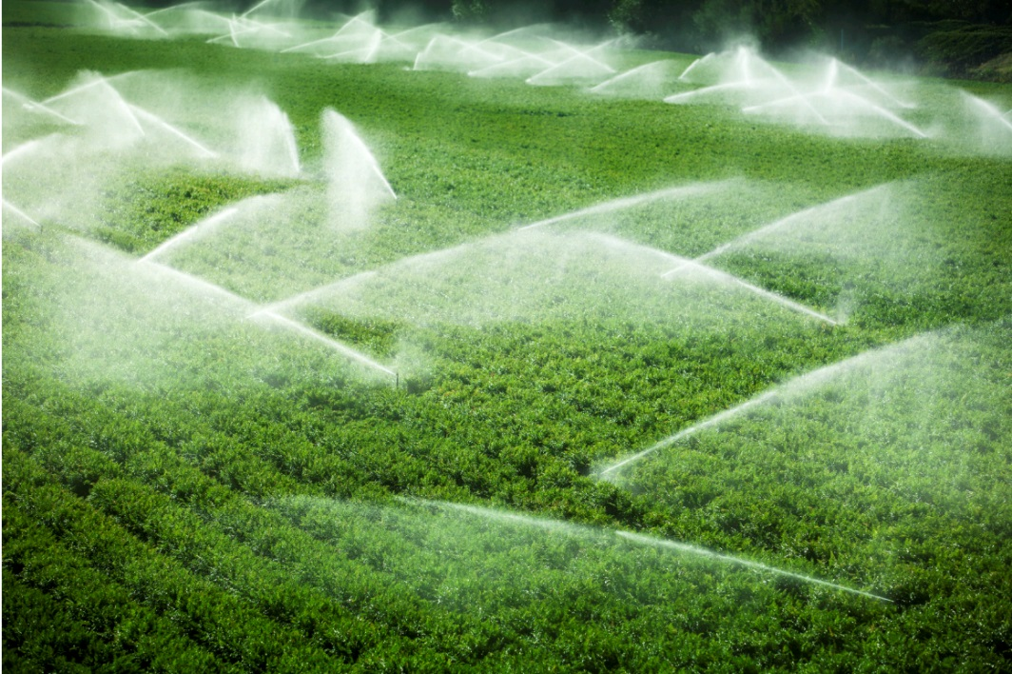
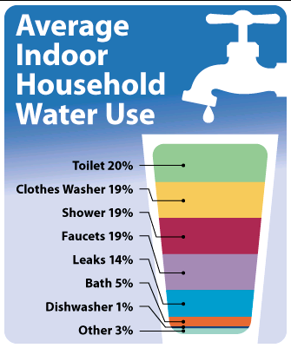

Improvement in water productivity at 0.5% per year (20% by 2050)
Efficiency increase by 1% per year (40% by 2050)
Improvement
of 0.5% per year
(20% by total)
Limit population growth by 0.5 billion
(8.5 billion by 2050)

Slide 20
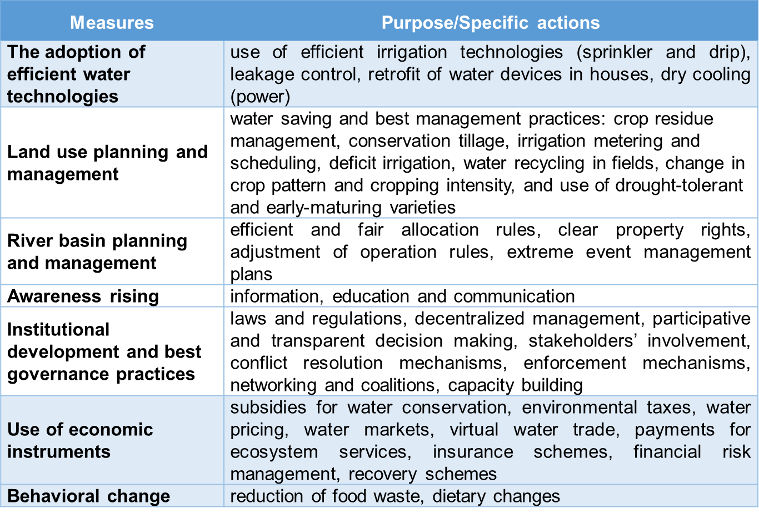
Water demand management

Slide 21
Hydro-Economic Classification
low high
Economic-institutional capacity
HE–2
Water Secure, Rich
HE–3
Water Stress, Rich
HE–1
Water Secure, Poor
HE–4
Water Stress, Poor
low high
Hydro-climatic complexity
(resources/cap, withdrawals/resources, variability, dependency)
Source: Satoh et.al. (2017), in press

Slide 22
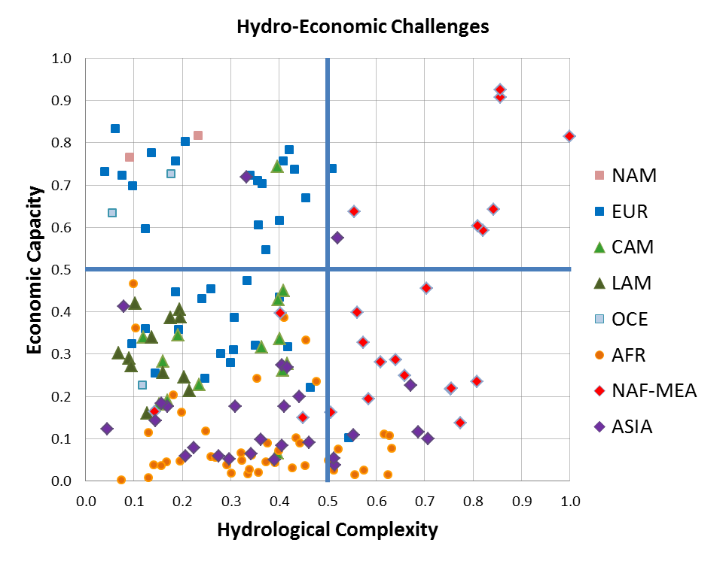
The poorest countries face the greatest water resource variability & complexity of challenges
Hydro-Economic Classification for Countries, 2000
Source: Tramberend, in prep

Slide 23
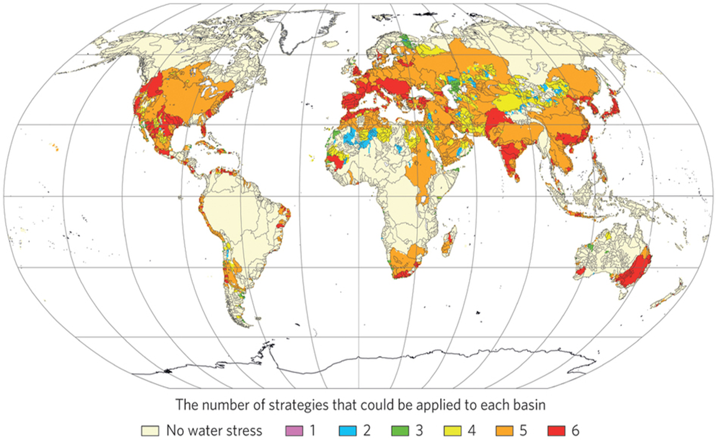
REMOVE SLIDE
Different basins lend themselves to different measures for reducing water stress

Slide 24
Future Needs (selective!)
Developing/sharing common platforms
Representation of multiple water quality issues at regional and global scale
Understanding and portrayal of uncertainty particular focus on hydrological models
Understanding trade and menus of solutions
Building interdisciplinary and trans-disciplinary capacity and forums
Consideration of migration rural to urban and inter country/continent
Governance and decision making

Slide 25
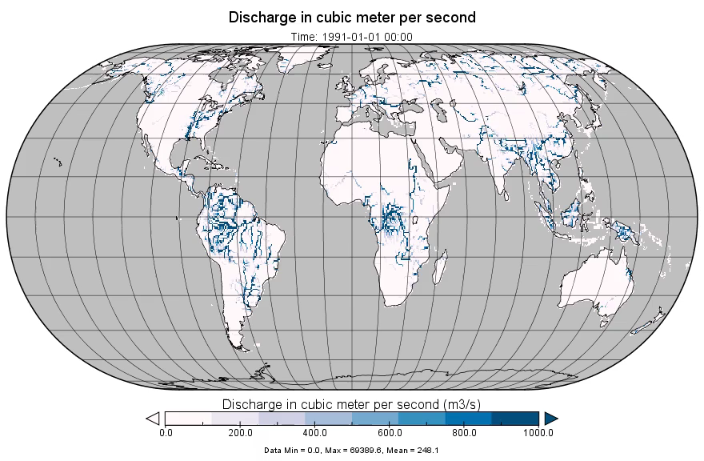
Towards a common platform/apprach
Development of a community driven global water model (CWATM) by IIASA
Model design
Global discharge demo
EGU 2017:
HS2.1.3 Large scale hydrology
Fri, 28 Apr, 17:30–19:00 / Hall A
Vision
CWATM represents one of the new key elements of IIASA’s Water program to assess water supply, water demand and
environmental needs at global and regional level
The hydrologic model is open source and flexible to link in different aspects of the water energy food nexus
Our vision for the short to medium term work is to introduce water quality and to consider qualitative and quantitative measures of transboundary river and
groundwater governance into an
integrated modelling framework.
Contact
www.iiasa.ac.at/cwatm
wfas.info@iiasa.ac.at

Slide 26
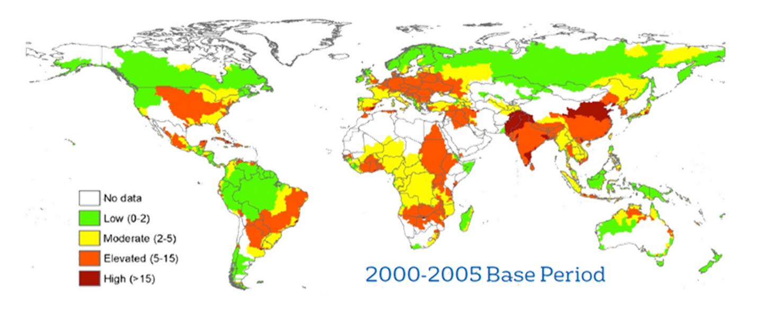
Importance of environmental quality, not just quantity: Water quality risk associated with nitrogen pollution
IFPRI & VEOLIA, The murky future of global water quality: A new global study projects rapid deterioration in water quality, International Food Policy Research Institute (IFPRI), 2015.

Slide 27
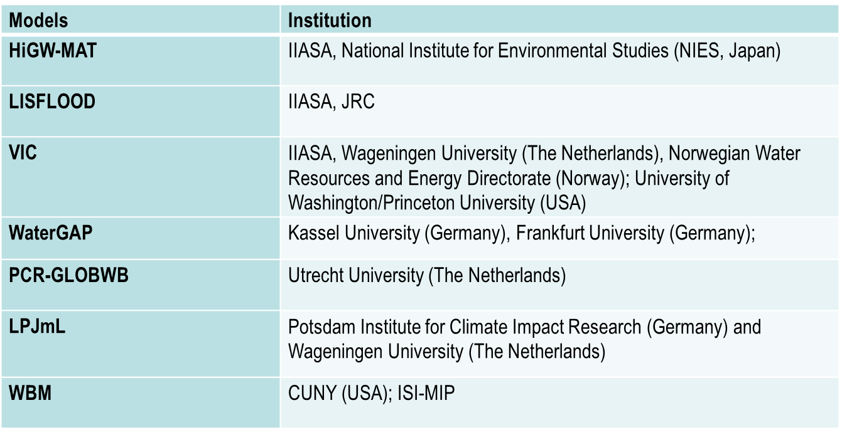
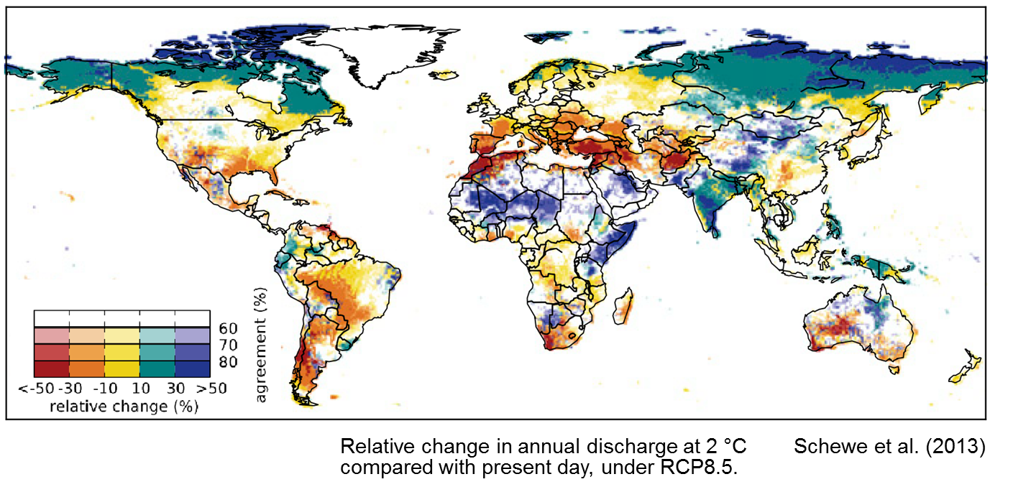
Multi-model uncertainty assessment

Slide 28
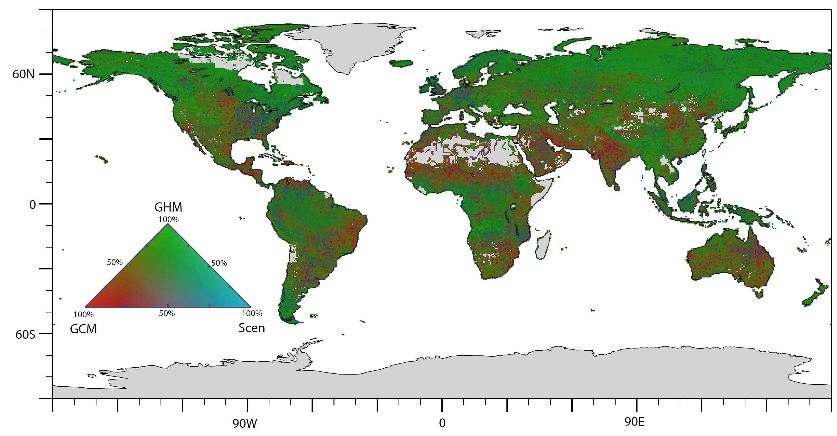
REMOVE SLIDE
Sources of uncertainty
2046-2055
Global Hydrological Models (GHM) are the main source of uncertainty in most regions
Climate Models (GCM) are the main driver of uncertainty in many subtropical regions
Uncertainty stemming from water scenarios (Scen) is less important

Slide 29
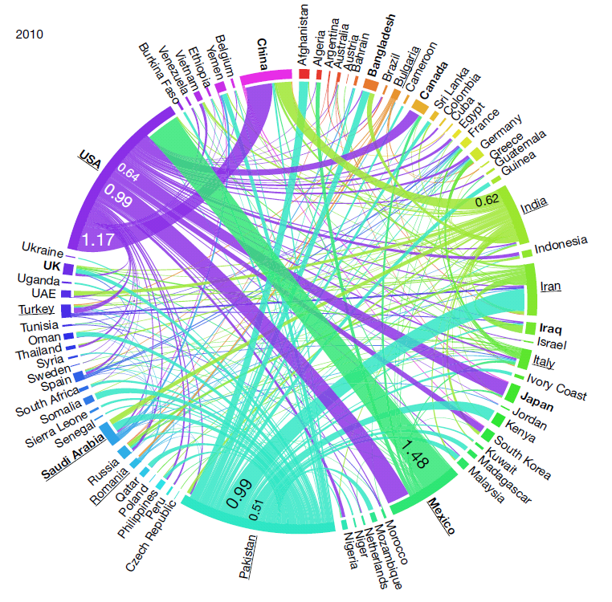
Global Food Trade <=> Water Trade
11% of non renewable GW embedded in int. food trade
2/3 exported by India,USA and Pakistan
KEY
Units km3
Colour=country of export
Top 10 exporters underlined
Top ten Importers in bold
Dalin et al. (2017; Nature)

Slide 30
Food/Land Use System
NEXUS
THINKING
ENERGY FOOD WATER
  - Preparing land
Growing crops
Raising livestock
Harvesting produce
Drying, processing
Storing food products
Transport, distribution
Preparing food
ON
Biomass , crop residues, biofuel feedstocks, land
Runoff, pollution, storage, purification, flood protection
Fertilizer, irrigation, fuel, processing, transportation
Irrigation, food processing, sanitation, health risk
Energy System
Water System
  - Extracting resources
Harnessing hydro, wind, solar, biomass energy
Generating and transmitting electricity
Production, refinement and distribution of transport fuels
Storing, buffering
Hydropower, power plant cooling, extraction, (bio)fuels
  - Manage renewable surface- and groundwater resources
Distribute water supply for human consumption
Collect sewage
Treat wastewater to protect human and ecological health
Transfer between basins
Desalination
Water pumping, delivery, water treatment, energy for desalination

Slide 31
Inform about
challenges, solutions.
Inform about
modeling & scenario tools.
Provide
Stakeholders
Project Team
data for model calibration,
scenarios storylines.
Provide
results of systems analysis
(with synergies and trade-offs).
Enrich
Modeling Framework
Co-evolve
Build capacity for
using models for
policy/investment support.

Slide 32
Research and management has to co-evolve
Consider both demand and supply
Take cross sectoral approach
Audiences: peers, policy advisors, investors and practitioners
Recognise, address and use uncertainties
Take inter- and trans- disciplinary approach

