Slide 1


Source attribution and mitigation strategies for air pollution in Delhi
Gregor Kiesewetter ¹, Pallav Purohit ¹, Wolfgang Schoepp ¹, Jun Liu ¹, Markus Amann ¹, Anil D. Bhanarkar ²
¹ Air Quality and Greenhouse Gases Program, IIASA, Austria
² National Environmental Engineering Research Institute (NEERI), Nagpur, India

Slide 2
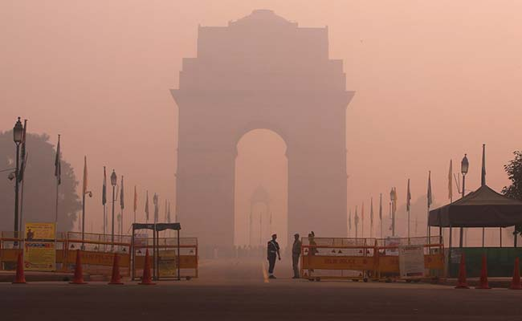
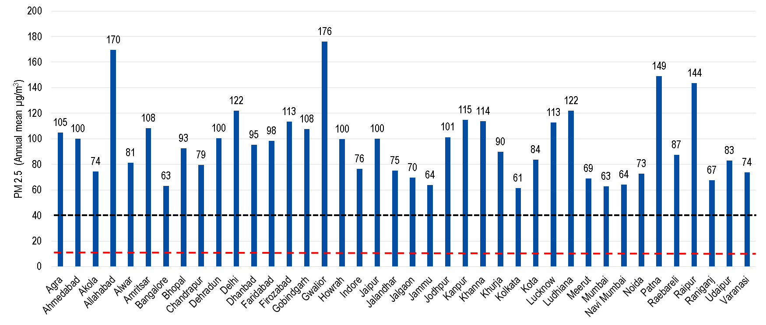
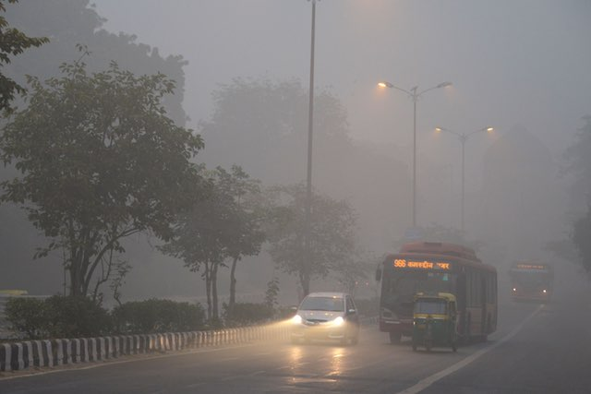
Air quality situation in India
Source: Reuters
NAAQS
WHO guideline
Source: Getty Images
Source: WHO (2016)

Slide 3

The GAINS model
Multi-pollutant, multi-effect integrated assessment model
Accessible online: gains.iiasa.ac.at
Greenhouse gas – Air pollution INteractions and Synergies
PM_{2.5} exposure
Dose-response
Dispersion,
atmospheric chemistry
Health impacts
emissions
Emission factors
Mitigation strategies
Cost optimization
targets
Control technologies
costs
activities
unit costs

Slide 4
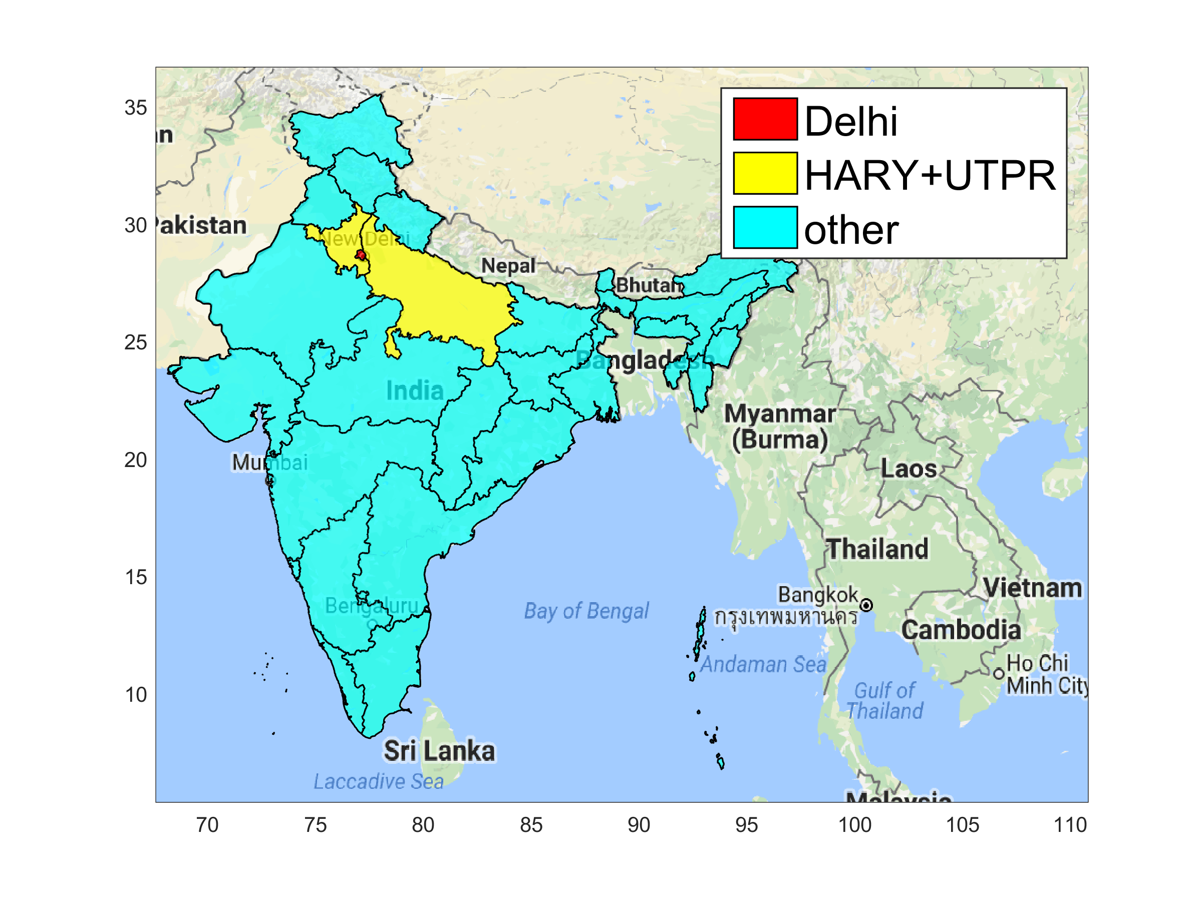
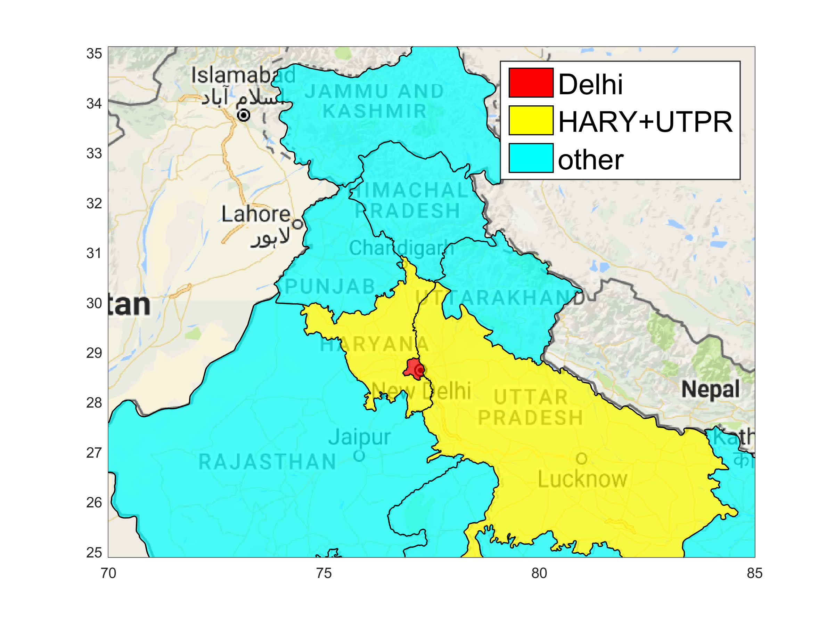
Atmospheric transfer calculations in GAINS
Linear transfer coefficients from full 1-year CTM sensitivity runs (EMEP CTM) on 0.5° grid
From all Indian states
For all source pollutants involved in PM_{2.5} formation: PPM, SO₂, NO_{x}, NH₃, NMVOC
Local dispersion of PM emissions from Delhi: AERMOD based sectoral dispersion coefficients on 2km grid

Slide 5
Validation of the dispersion calculations for Delhi 2015
PM_{2.5}
Amann et al., Atmos Environ (in revision)

Slide 6
Source apportionment of PM_{2.5} in Delhi 2015
I.T.O. Station
Population-weighted mean
~40 %
~60 %
Amann et al., Atmos Environ (in revision)

Slide 7
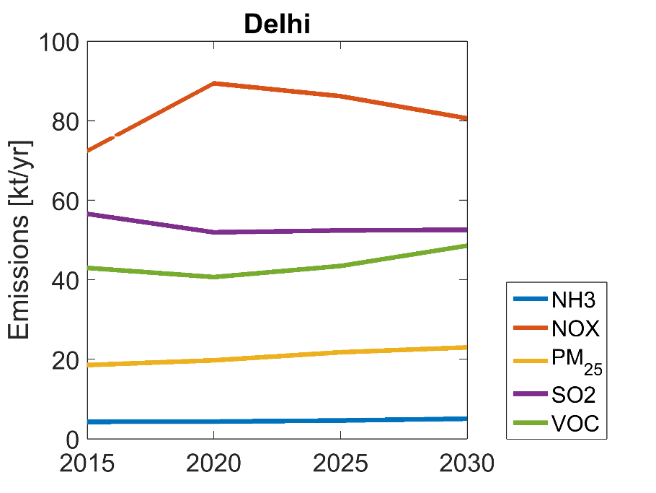
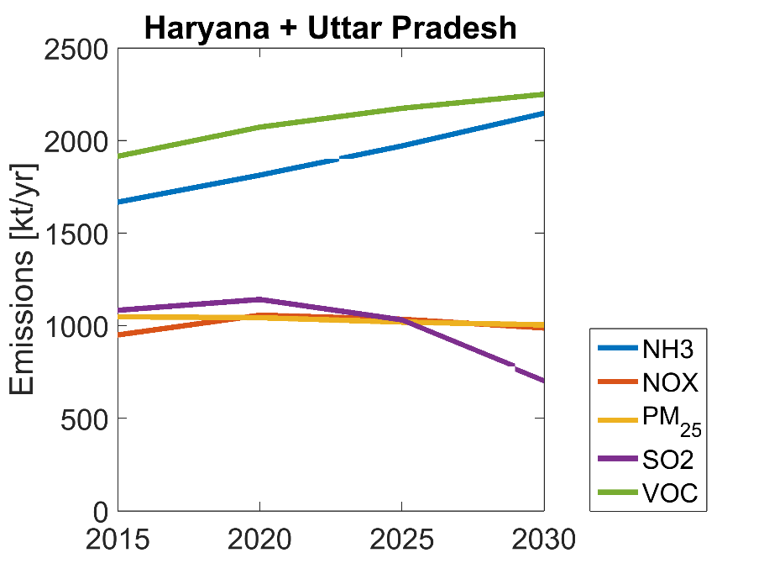
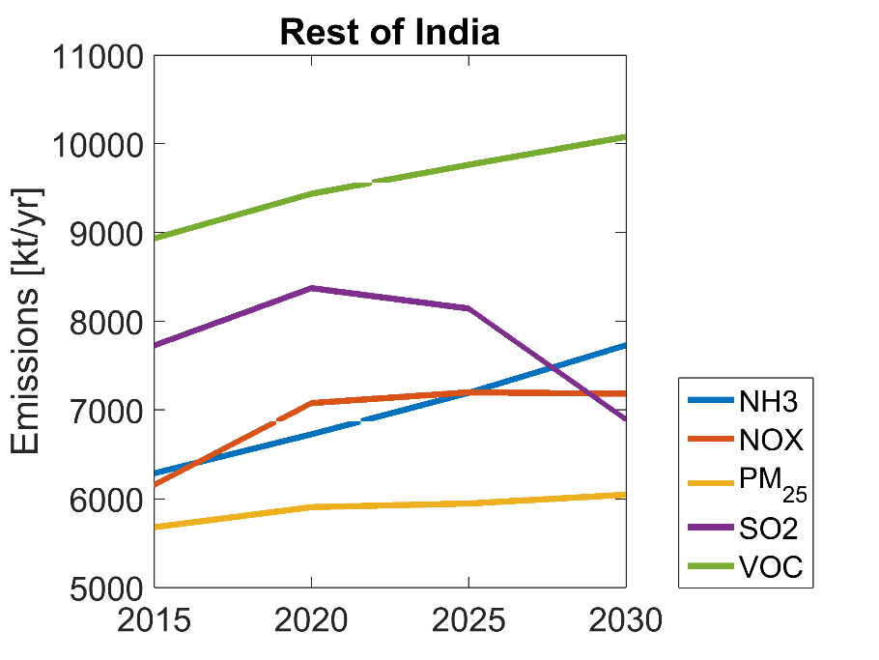
Exploring the future: Assumptions on development
Delhi NCT | Annual growth | In 2030 |  | Annual growth | In 2030
Population | +2.8%/yr | +50% | Energy intensity | -3.6%/yr | -40%
GDP/capita | +5%/yr | +110% | Natural gas | +7.3%/yr | +190%
GDP | +8%/yr | +200% | Liquid fuels | +2.9%/yr | +80%
Transport demand | +8%/yr | +200% | Coal, biomass | ± 0% | ± 0

Slide 8
Delhi’s future air quality:
Today’s situation
Clean Air
Clean Air

Slide 9
Delhi’s future air quality:
2030 with current legislation
Emission controls:
Effective Bharat VI from 2020
CNG for buses and three-wheelers
Enhanced penetration of natural gas
FGD for large power and industries
Clean Air
Clean Air

Slide 10
Delhi’s future air quality:
Advanced Technologies for Delhi
Additional emission controls:
FGD + DeNOx in power sector
Electric cremations
Clean Air
Clean Air

Slide 11
Delhi’s future air quality:
The ‘Clean Air Scenario’ for Delhi
Additional emission controls:
Paved roads
Improved public transport
Natural gas for power and industry
Solid fuels for cook stoves replaced
by electricity/natural gas
50% of BBQs electric/gas
Ban of trash burning
Fewer fireworks
Clean Air
Clean Air

Slide 12
Delhi’s future air quality:
Advanced Technologies for DL+HR+UP
Additional emission controls:
FGD + DeNOx in power sector
Electric cremations
Clean Air
Clean Air

Slide 13
Delhi’s future air quality:
The ‘Clean Air Scenario’ for DL+HR+UP
Additional emission controls:
Ban of agric. waste burning
Paved roads
Improved public transport
Natural gas for power and industry
Solid fuels for cook stoves
replaced by electricity/gas/LPG
50% of BBQs electric/gas
Enforce ban of trash burning
Fewer fireworks
Clean Air
Clean Air

Slide 14
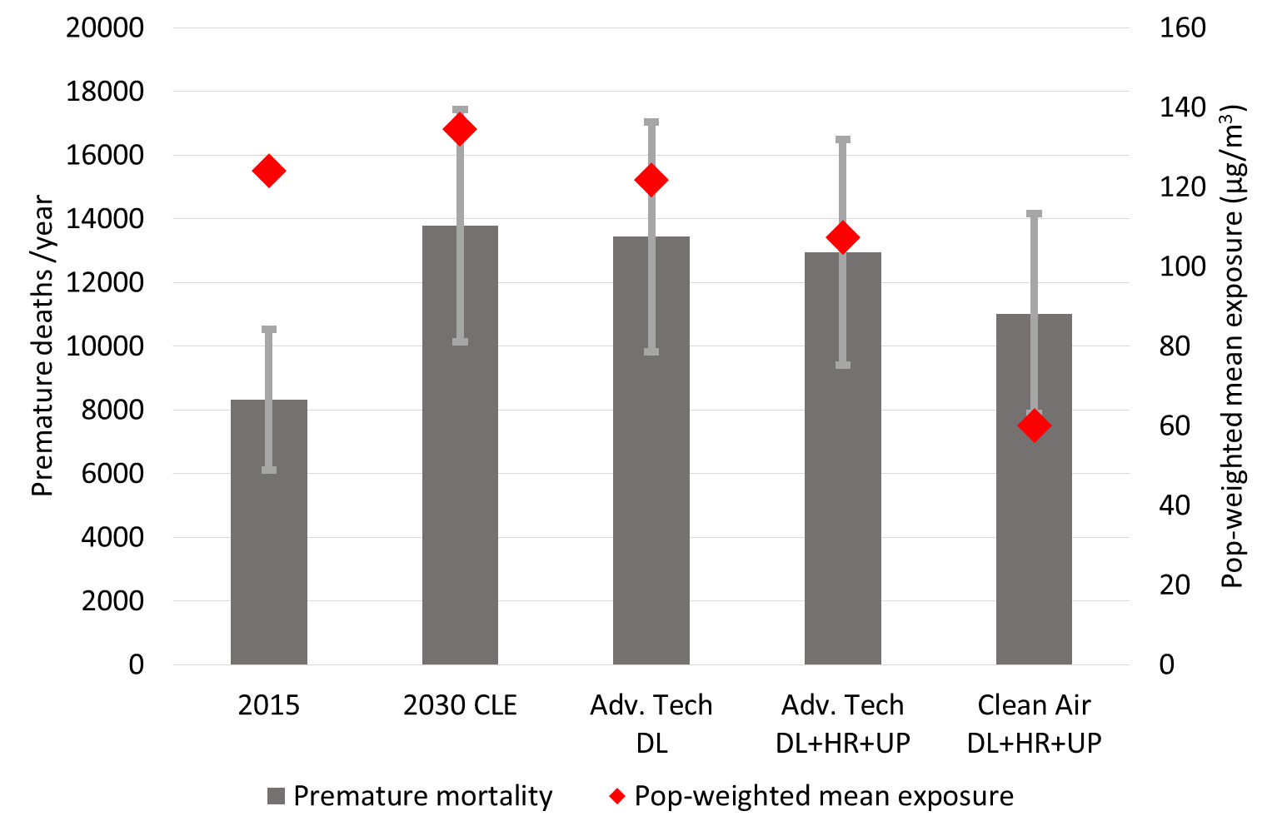
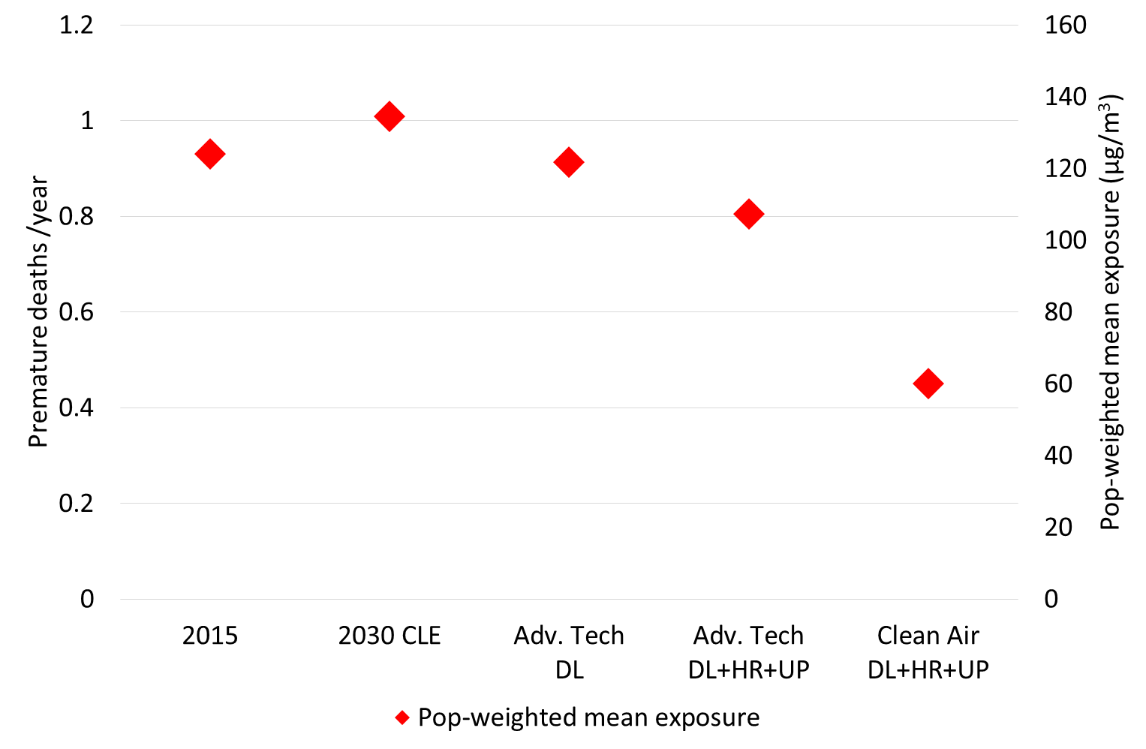
Population exposure to PM_{2.5} and health impacts
Effects influencing calculated premature deaths:
Population growth
Population ageing
Non-linearity of the exposure-response curves
Even under ‘Clean Air’ scenario most people exposed to > 40µg m⁻³ annual mean PM_{2.5} (NAAQS)

Slide 15
Conclusion 1: Effective improvement of Delhi’s air quality requires collaboration with neighboring States
Even stringent emission controls in Delhi NCT will not be sufficient to approach the Indian NAAQs
The new emission standards for large sources will stabilize the inflow from the neighboring States despite the growth in economic activities
Control of transboundary pollution would help also in Delhi
Indian NAAQ standard
Clean Air
Clean Air

Slide 16
Conclusion 2: Effective policy interventions must involve sources that are less relevant in industrialized countries
Priority measures:
Road paving
Clean cooking (ele, gas, LPG)
Waste management
Ban of trash and agr. waste burning
BBQ , fireworks, cremation
in addition to regional SO₂ and NO_{x} controls at large plants
Indian NAAQ standard
Clean Air
Clean Air

Slide 17
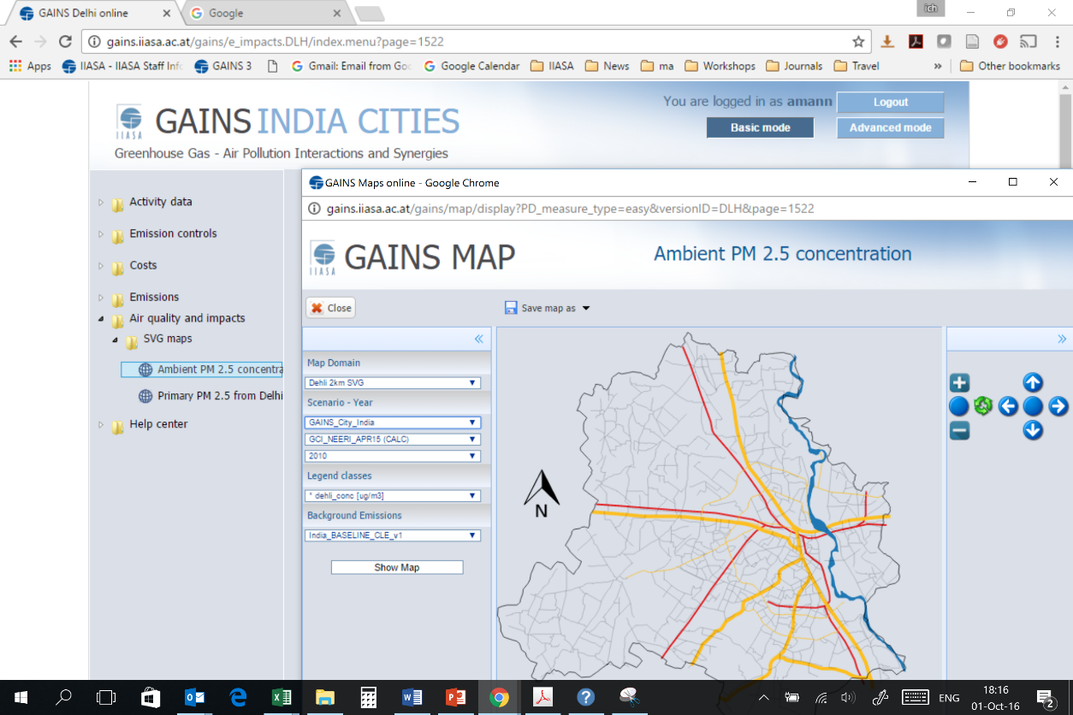
Thank you for your attention!
Access on the Internet: http://gains.iiasa.ac.at
Areas for potential further work:
  Role of agricultural emissions
  Economic aspects, cost-effectiveness
  Socio-economic heterogeneity of the sources and impacts of air pollution

Slide 18
References
Pant, P., Shukla, A., Kohl, S.D., Chow, J.C., Watson, J.G., Harrison, R.M., 2015. Characterization of ambient PM2.5 at a pollution hotspot in New Delhi, India and inference of sources. Atmospheric Environment 109, 178–189. doi:10.1016/j.atmosenv.2015.02.074
Sharma, S.K., Mandal, T.K., Jain, S., Saraswati, Sharma, A., Saxena, M., 2016. Source Apportionment of PM2.5 in Delhi, India Using PMF Model. Bulletin of Environmental Contamination and Toxicology 97, 286–293. doi:10.1007/s00128-016-1836-1
Bisht, D.S., Dumka, U.C., Kaskaoutis, D.G., Pipal, A.S., Srivastava, A.K., Soni, V.K., Attri, S.D., Sateesh, M., Tiwari, S., 2015. Carbonaceous aerosols and pollutants over Delhi urban environment: Temporal evolution, source apportionment and radiative forcing. Science of The Total Environment 521–522, 431–445. doi:10.1016/j.scitotenv.2015.03.083

Slide 19

GAINS-Delhi: A productive TIFAC-NEERI-IIASA cooperation
Pallav Purohit
Jens Borken-Kleefeld
Janusz Cofala
Chris Heyes
Gregor Kiesewetter
Zbigniew Klimont
Liu Jun
Binh Ngyuen
Peter Rafaj
Robert Sander
Wolfgang Schöpp
Anil D. Bhanarkar
Padma S. Rao
Anjali Shrivastava
Dipanjali Majumdar
B. Harshvardhan

Slide 20

Greenhouse gas – Air pollution Interactions and Synergies
The GAINS model
Social development
and economic activities
Decision making on air quality management
National emission ceilings
Emission control options: ~2000 measures,
co-control of 10 air pollutants and 6 GHGs)
¹
¹
Emissions
Costs
Optimization
Atmospheric dispersion
Health, ecosystems and climate impact indicators
Policy targets

Slide 21
Conclusion 3: Many of the policy interventions will have multiple co-benefits on development targets
The ‘Indian Way’ scenario does not only improve air quality in Delhi, it would also
save xxx premature deaths annually in the neighboring States,
reduce GHG emissions (CO₂ and CH₄) by 22% compared to the baseline, etc.
Furthermore, it would
reduce water stress,
improve waste management (ash, soot) and improve land use,
gain labor force through lower demand for biofuels collection,
Reduce emissions of other toxic substances (Hg, POPs) and related health impacts,
improve traffic management, promote new behavioral patterns,
create jobs for local manufacturing of clean technologies (e.g. efficient and electric stoves, renewable energy),
accelerate infrastructure development (power grid expansion, loss reduction, gas pipes and LPG distribution, etc.),
improve protection of historical monuments and buildings,
enhance gains from tourism, etc.

Slide 22
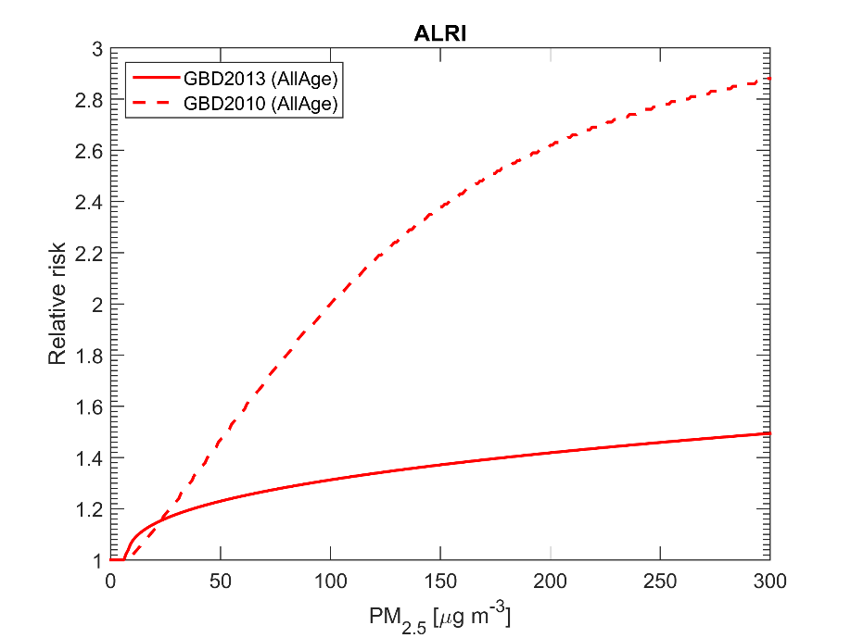
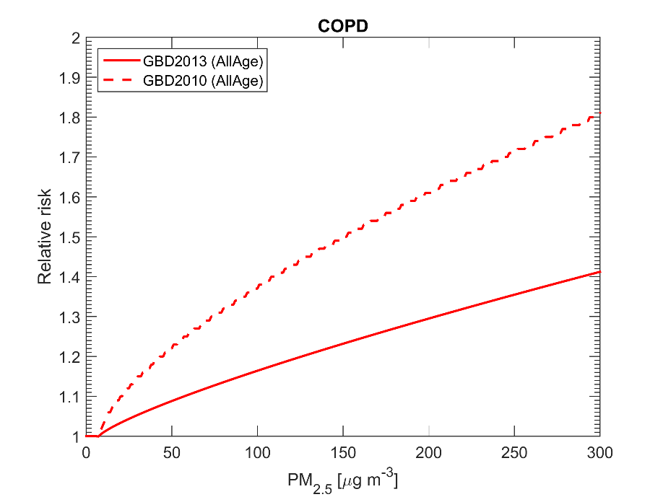
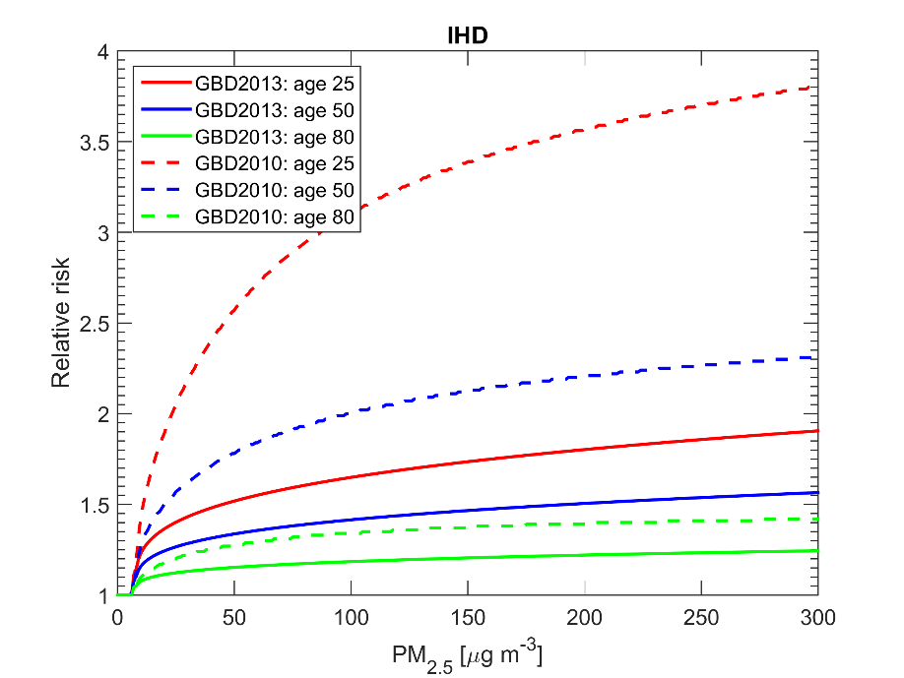
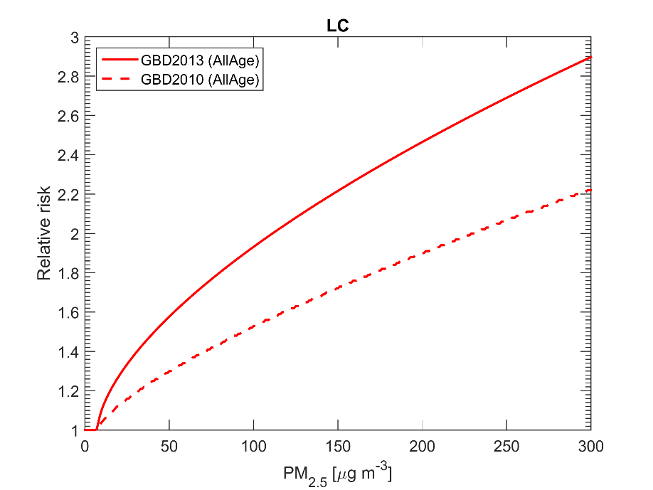
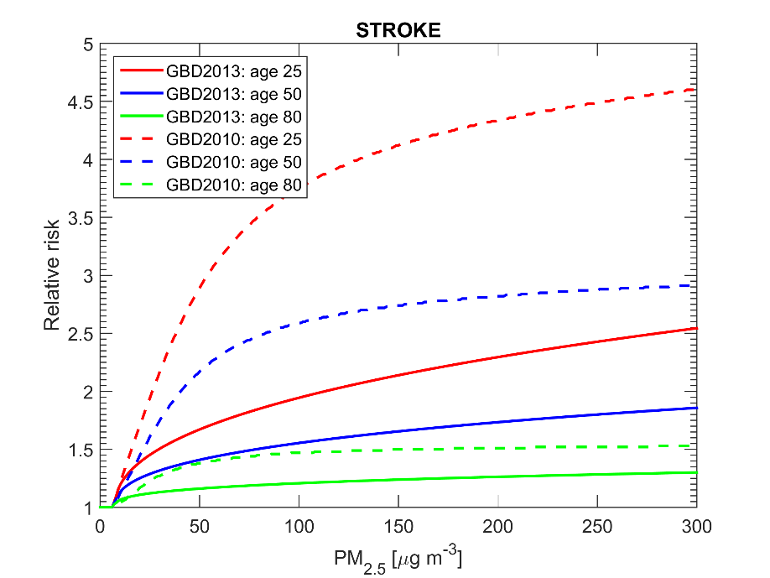
GBD 2010 / 2013 integrated exposure response functions (IERs)
Burnett et al (Environ Health Perspect, 2014)
Farouzanfar et al. (Lancet 2015)
WHO (2016)

