Slide 1
Hydroclimatic risks and uncertainty in the global power sector
Matthew Gidden¹, Edward Byers¹, Peter Greve¹, Taher Kahil¹ Simon Parkinson¹, Catherine Raptis², Joeri Rogelj¹, Yusuke Satoh¹, Michelle van Vliet^{3,1}, Yoshide Wada¹, Volker Krey¹, Simon Langan¹, and Keywan Riahi¹
¹ International Institute for Applied Systems Analysis, Austria
² ETH Zurich, Switzerland
³ Wagenigen University, Netherlands
ERE1.2 Energy and environmental system interactions – Policy and modelling
European Geosciences Union General Assembly 2017
24/04/2017

Slide 2
Water and climate impacts impacts assessment framework
Global mean temperature change scenarios
Global power plants dataset + simulation models
Capacity subsets
Steam thermal
Non-steam thermal
Hydro & pumped storage
Hist
1.5°C
2.0°C
3.0°C
Climate models
5 GCMs
Downscaled & bias corr. to 0.5°x0.5
RCP8.5
Climate impacts
Air temperature
Temp change
Heatwaves
Hydrology
Low flows
Seasonality
Flood risk
Water temp
Risk identification matrix
Capacity subsets
Spatial units
Climate impact
Uncertainty analysis:
GCM & GHM agreement
Climate response
Power plant characteristics
Hydrological models
5 GHMs
Daily timestep
0.5°x0.5°

Slide 3
ISI-MIP – Inter-sectoral inter-comparison modelling project
Climate
Hydrology
Multi-model… multi-model… ensembles
Downscaled, bias-corrected climate model data
5 GCMs [HadGEM, IPSL, GFDL, NorESM, MIROC]
From ~2.5°x ~2.5° to 0.5°x0.5° grid
Historical + 4 RCPs, 1960-2100
Gridded hydrological models using bias-corrected GCM input forcings
Daily timestep data for runoff, evap, discharge, irrigation demands etc
Examples include:
H.08 (U. Tokyo)
PCR-GLOBWB (Utrecht)
VIC (Washington State, Wagenigen)
J.ULES (Met Office, CEH)
WaterGAP (Frankfurt, Kassel, Potsdam)
LPJmL (PIK)
WBM (CUNY)
MPI-HM (Max Planck Inst)
Community Water Model (IIASA) – coming soon….

Slide 4
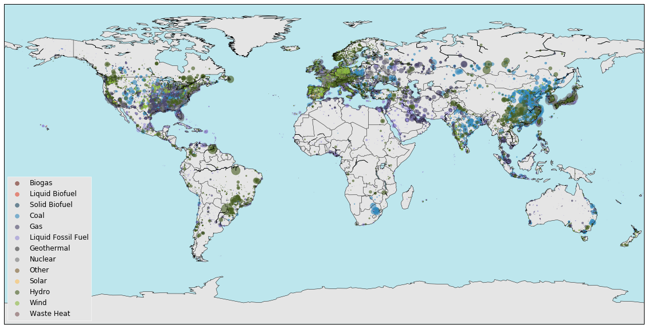
Global power plant dataset
Platts WEPP – June 2013. Licensed database, with no lat/lon information
Carma – based on Platts WEPP ~2010, based on georeferencing algorithm by Kevin Ummel
Raptis – based on Platts WEPP March 2012 for thermal power plants
(Raptis et al. 2016)
Table 7. Top 10 basins (level 3) with capacity that need cooling water
Basin | MW
Mississippi Missouri | 257,386
Yangtze | 200,674
Gironde France West Coast | 175,940
Japan III | 154,181
Huang He | 132,464
China Coast | 118,941
Ziya He Interior | 111,299
North and South Korea Bo Hai Korean Bay North Coast | 108,105
Gulf of Mexico, North Atlantic coast | 104,056
China Coast 1 | 90,908
 | 1,453,955
Notes:
86% of global capacity with locations

Slide 5
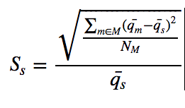
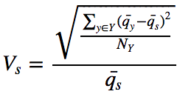
Indicators
Low flows and peak flows
Variability
Low flows
Q₉₀ (10th percentile)
Peak flows
Flooding proxy
Block-maxima approach
Seasonality
Difference between wet & dry seasons
Inter-annual variability
Variability of water availability between years

Slide 6
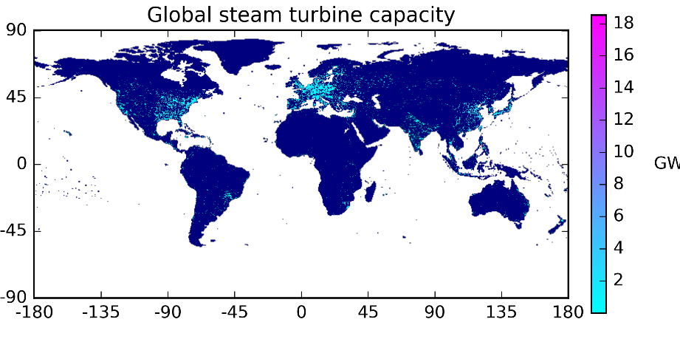
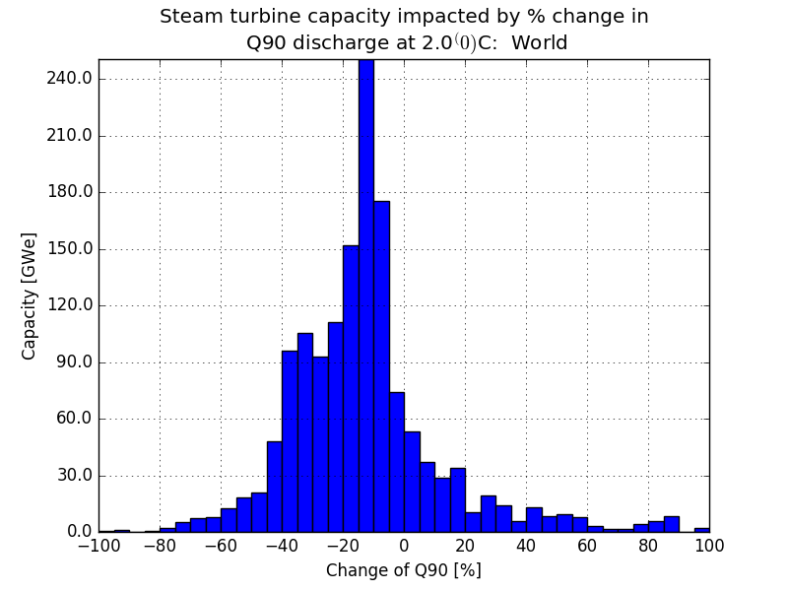
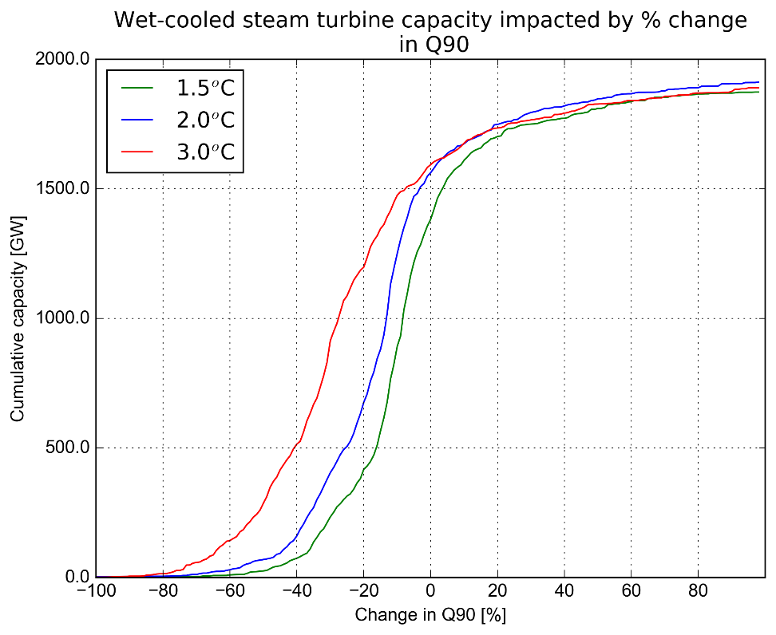
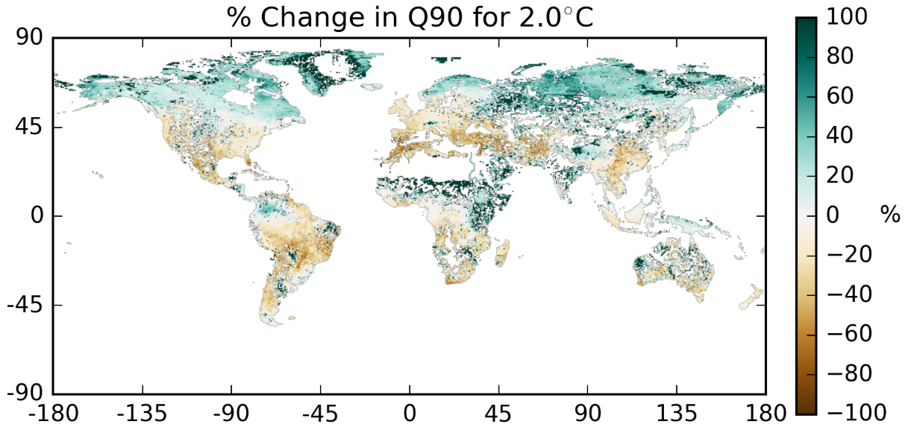
Methodology: Low Flows
Powerplant database
Fuel types | [coal, bio, gas, hydro,…, sun]
Unit types | [CCGT, ST, CT,…IC, HY]
Cooling systems | [ot_fresh, cl_fresh,… air]
Status | [Operational, Planned, Retired]
Impact datasets
Hydrology
Q90 (low flows) | Statistical measure of low river flows
Peak flows | Indicator for flood impacts
Seasonality | Difference between wet & dry seasons
Inter-annual variability | Variability of annual water availability
Water temperature
Temperature change
Heat waves | Duration and frequency of hot days
Degree days | Measure of long term temperature change
- water
+ water

Slide 7
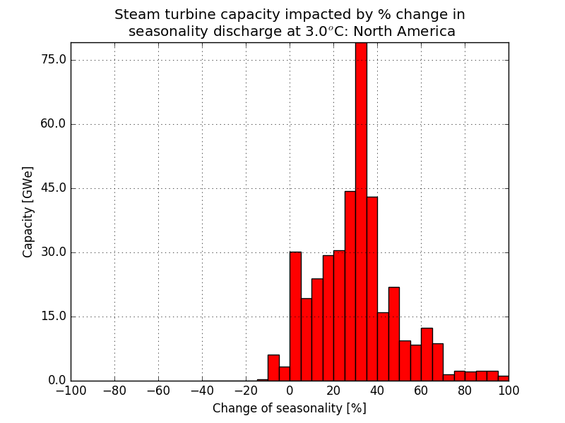
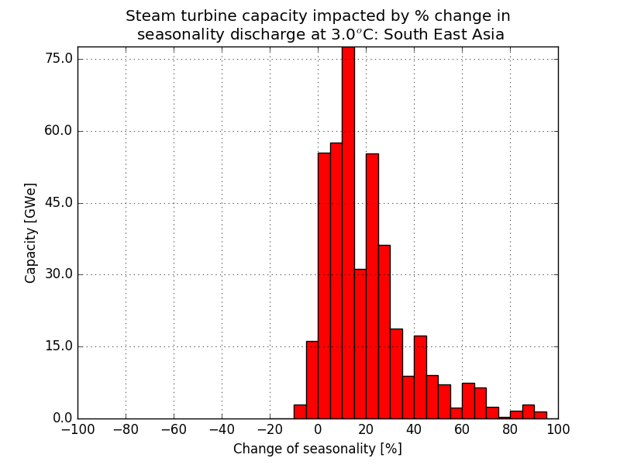
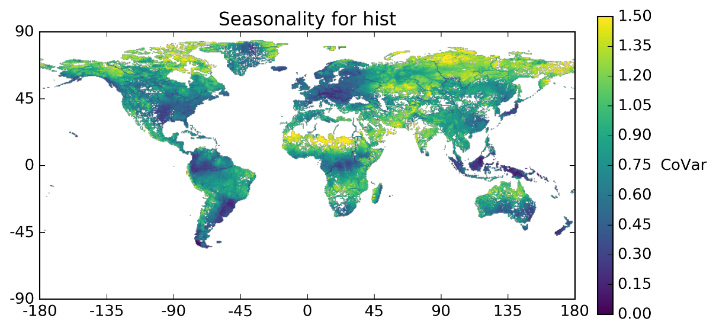
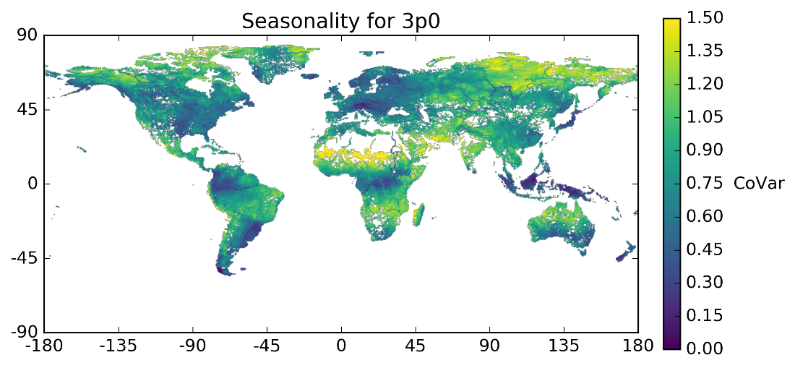
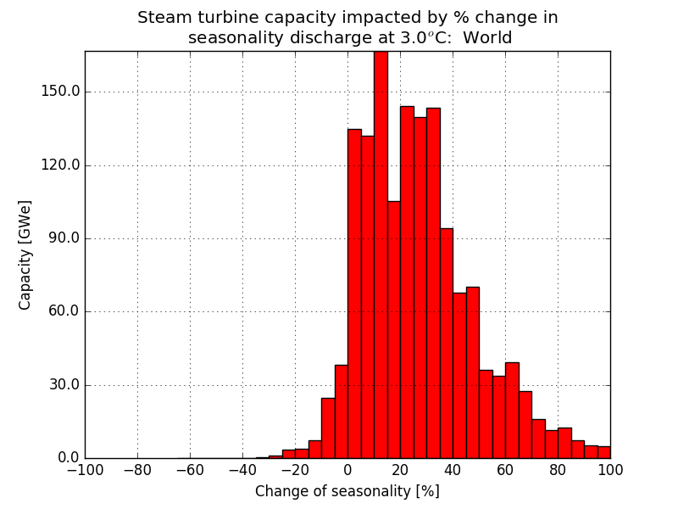
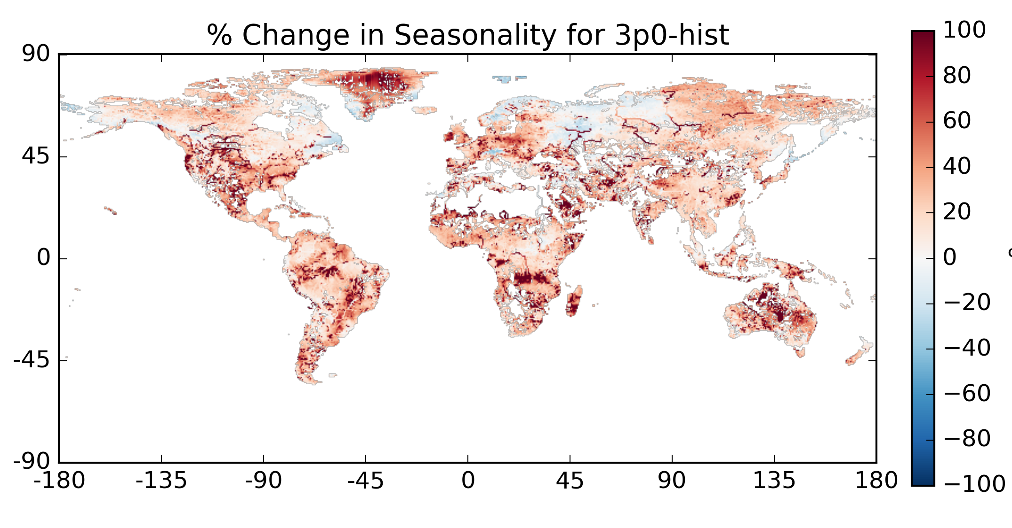
Seasonality

Slide 8
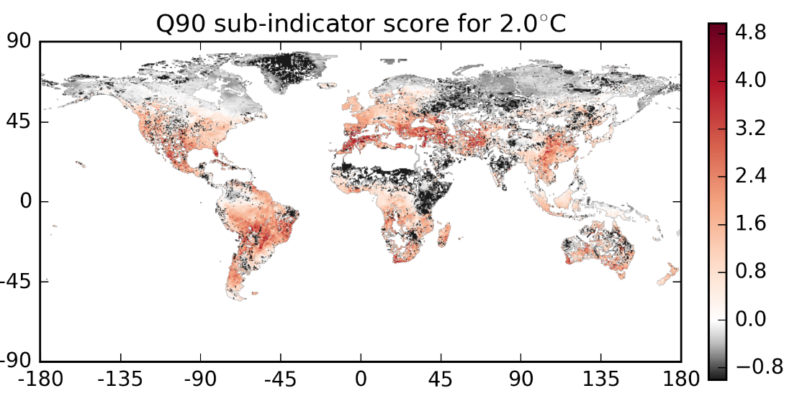
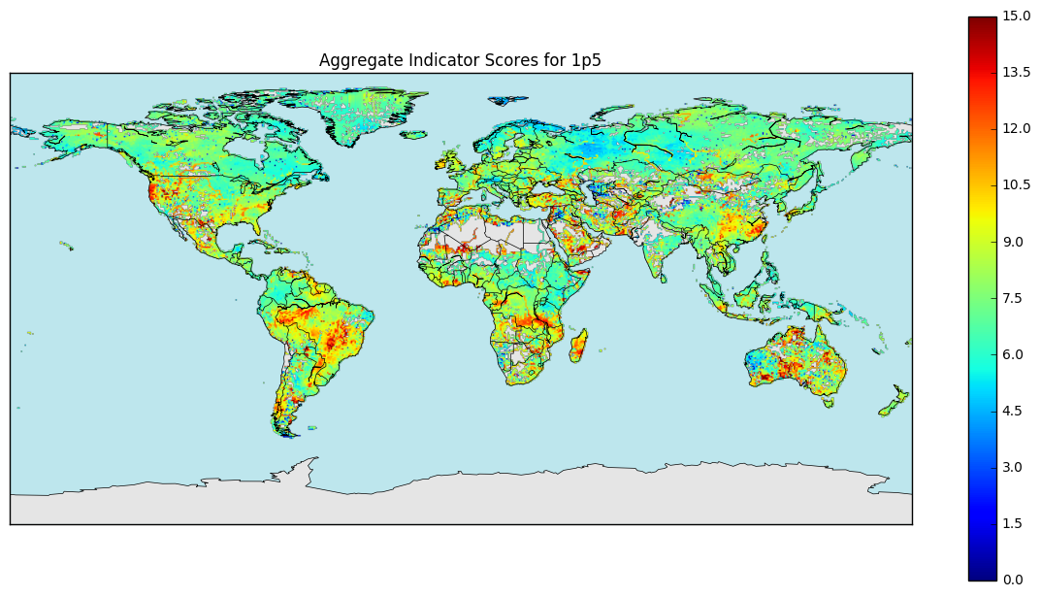
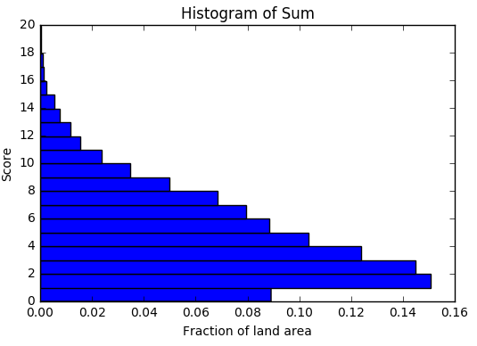
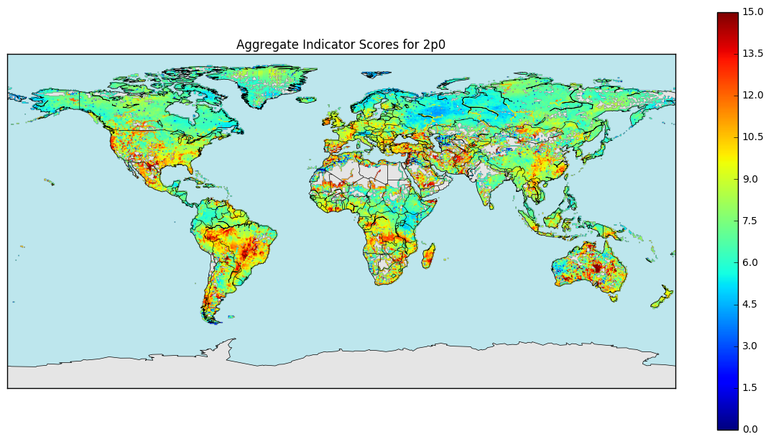
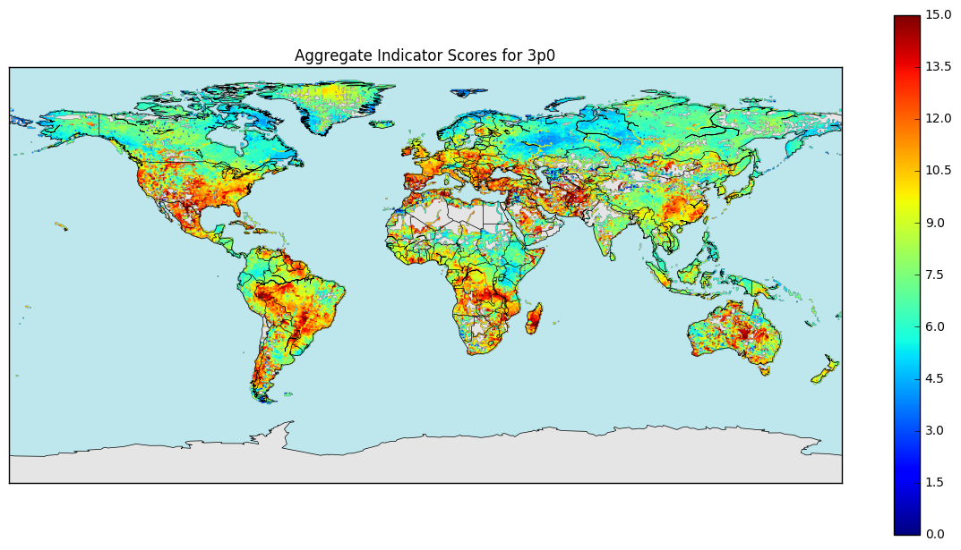
Multiple climate impact scoring
Negative climate impacts scored onto scales
Impacts scales can be adjusted according to preferences
Apply to multiple impacts to make a multi-impact hotspot map:
Q90 low flows
Seasonality
Inter-annual variability
Peak flows
Notes:
Figures to be updated

Slide 9
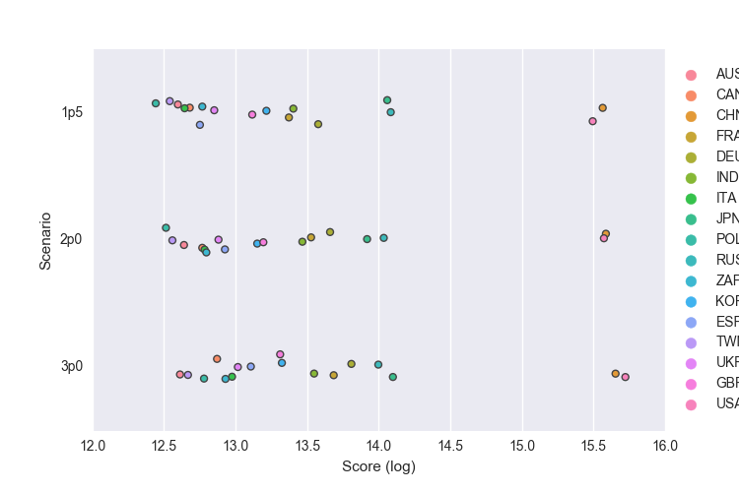
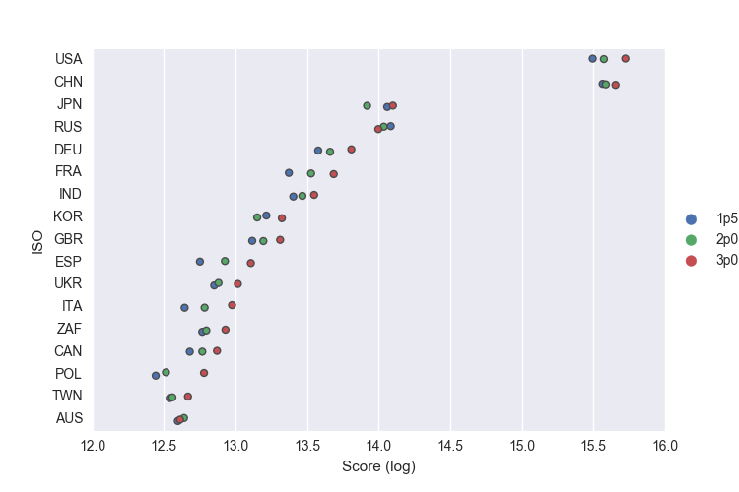
Impact Analysis

Slide 10
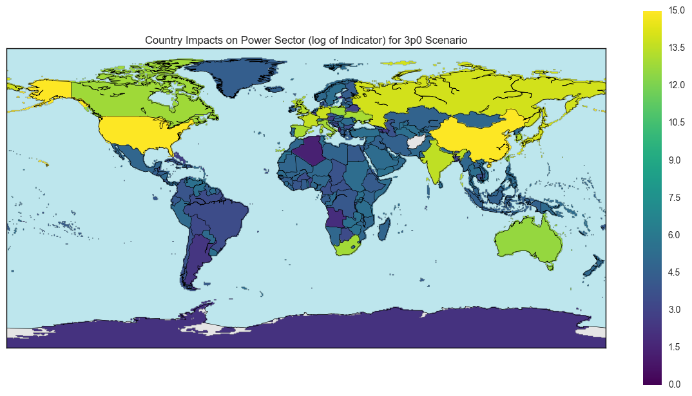
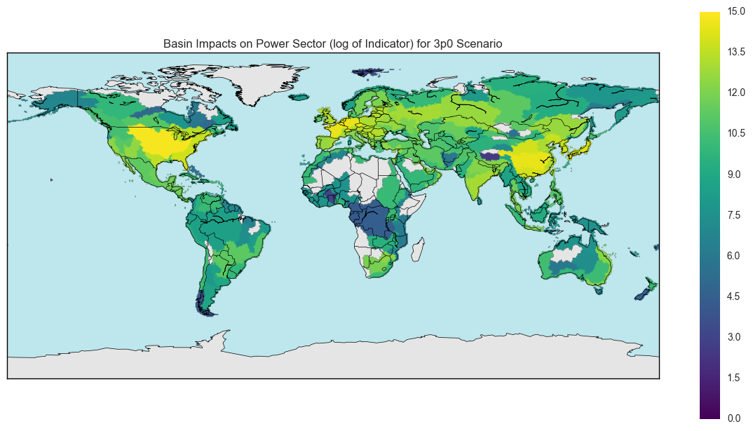
Impact Analysis

Slide 11
Robustness of climate impacts
Multi-model approaches allow exploration of model uncertainties
Information can be scored/weighted according to model uncertainty
High uncertainty doesn’t always mean poor information
Notes:
If we have time we will do the Robustness test which is more comprehensive than looking at model agreement – and gives indication of where there are significant and robust changes.
Based on Knutti and Sedlacek 2012
http://www.nature.com/nclimate/journal/v3/n4/abs/nclimate1716.html
http://www.nature.com/nclimate/journal/v3/n4/extref/nclimate1716-s1.pdf

Slide 12
Conclusions and Future Work
Take Aways
Up Next
Large quantities of capacity affected
Largest combined impacts observed in China, US, and Russia
Not necessarily strict climate ordering
Model robustness (uncertainty) analysis
Aggregate indicator investigation
Disaggregating power plants
1.5 vs. 2-degrees

