Slide 1


Global surface water reservoir storage under climate change, land use constraints, and population growth
2016 AGU Fall Meeting
Presenter: Lu Liu
Co-authors: Simon Parkinson, Matthew Gidden, Edward Byers, Yusuke Satoh, Keywan Riahi, and Barton Forman
Department of Civil and Environmental Engineering
University of Maryland
December 15th, 2016
San Francisco, CA

Slide 2
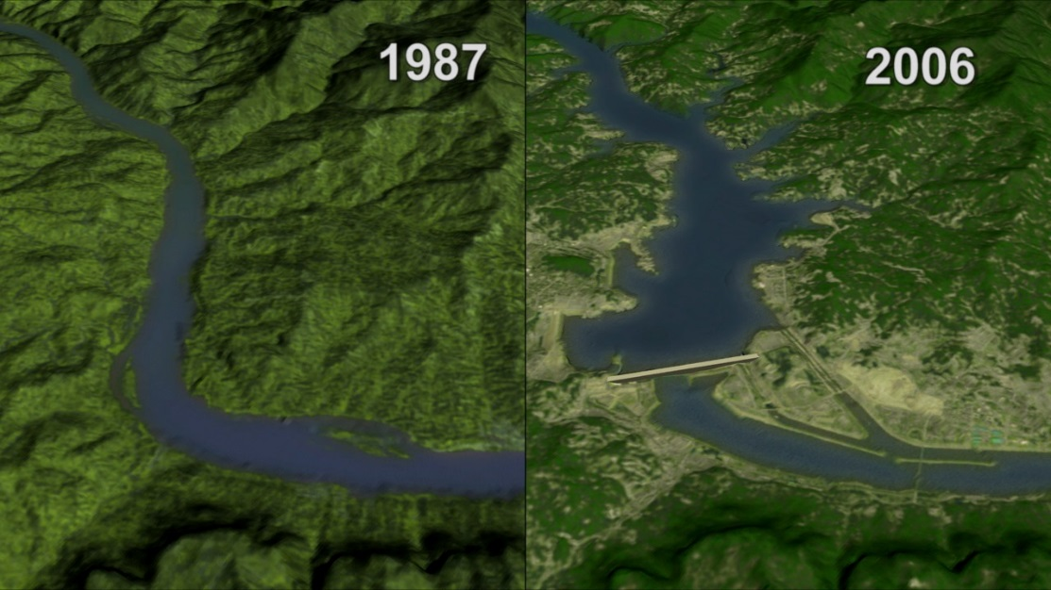
Motivation
Three Gorges Dam Reservoir
Reservoirs
Flood control
Hydro power
Irrigation
Water supply
Recreation
Relocation
Land occupation
Evaporation loss
GHG emissions
(321Tg out of 9500Tg, ~3.4%)
Current global reservoir storage: 6197 km³ (source: GRanD)
Research questions:
What is the global exploitable reservoir storage capacity?
How does streamflow variations affect the reliability of potential reservoirs?
How will climate change, population growth and land-uses affect the potential storage?
Notes:
Three Gorges Dam 22,500 MW 39.3 km³ (1045 km2)
Hoover Dam 2,000 MW 32.22 km³ ⁽640 km²)
GRanD: Global Reservoir and Dam (GRanD) Database

Slide 3
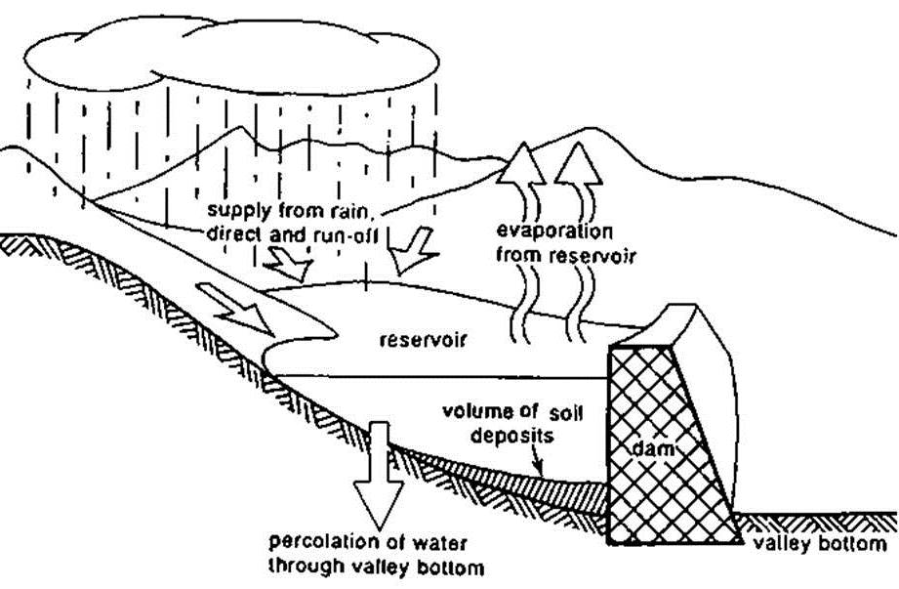
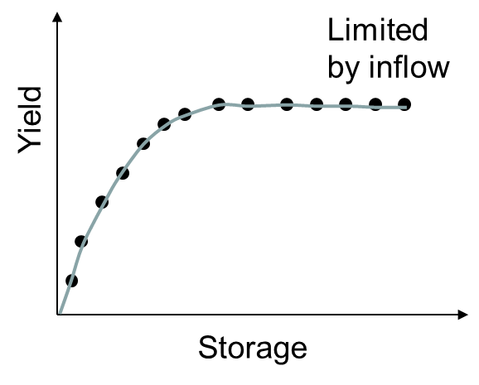
Methodology
Build Storage-Yield curves with Linear Programming
Modify Sequent Peak Algorithm (SPA) to incorporate evaporation loss from reservoirs
Firm Yield (water demand)
Storage-Yield curve
Notes:
As such, percolation or seepage loss is small for most of the reservoirs and progressively gets lowered with the passage of time since the sediment getting deposited at the reservoir bottom helps to reduce percolation losses - See more at: http://rctechite.blogspot.co.at/2013/09/reservoir-losses-and-their-minimization.html#sthash.zrzM3QJV.dpuf

Slide 4
Workflow
ISI-MIP
GRanD reservoir data
2080s
.
.
.
.
.
.
2030s
Surface area-volume relationship
2020s
1971-2000
8 decadal runoff
235 Global hydrological basins
Climate forcing from ISI-MIP
Storage-yield curves
Evaporation from reservoirs
Global reservoir expansion potential and reliability
Exclusion zones
(Population, irrigation areas, protected areas)
Notes:
Proof of concept for methodology
Apply for full model combination
ISI-MIP: The Inter-Sectoral Impact Model Intercomparison Project

Slide 5
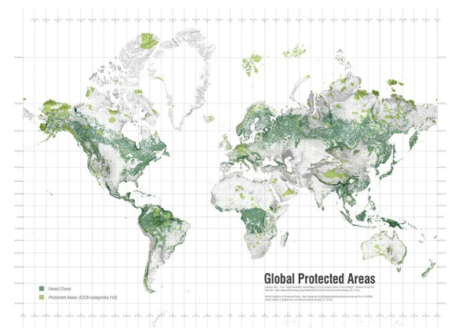
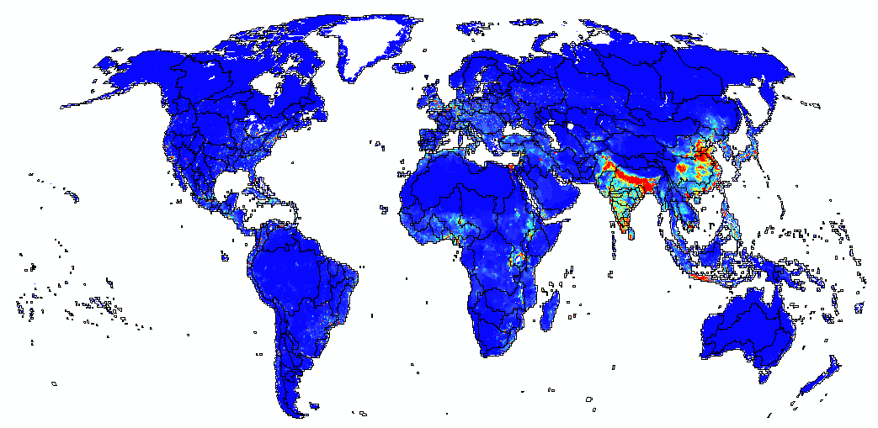
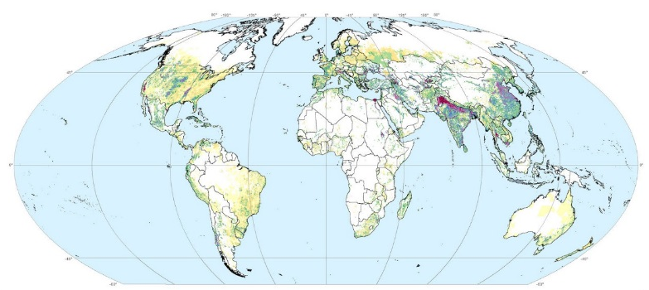
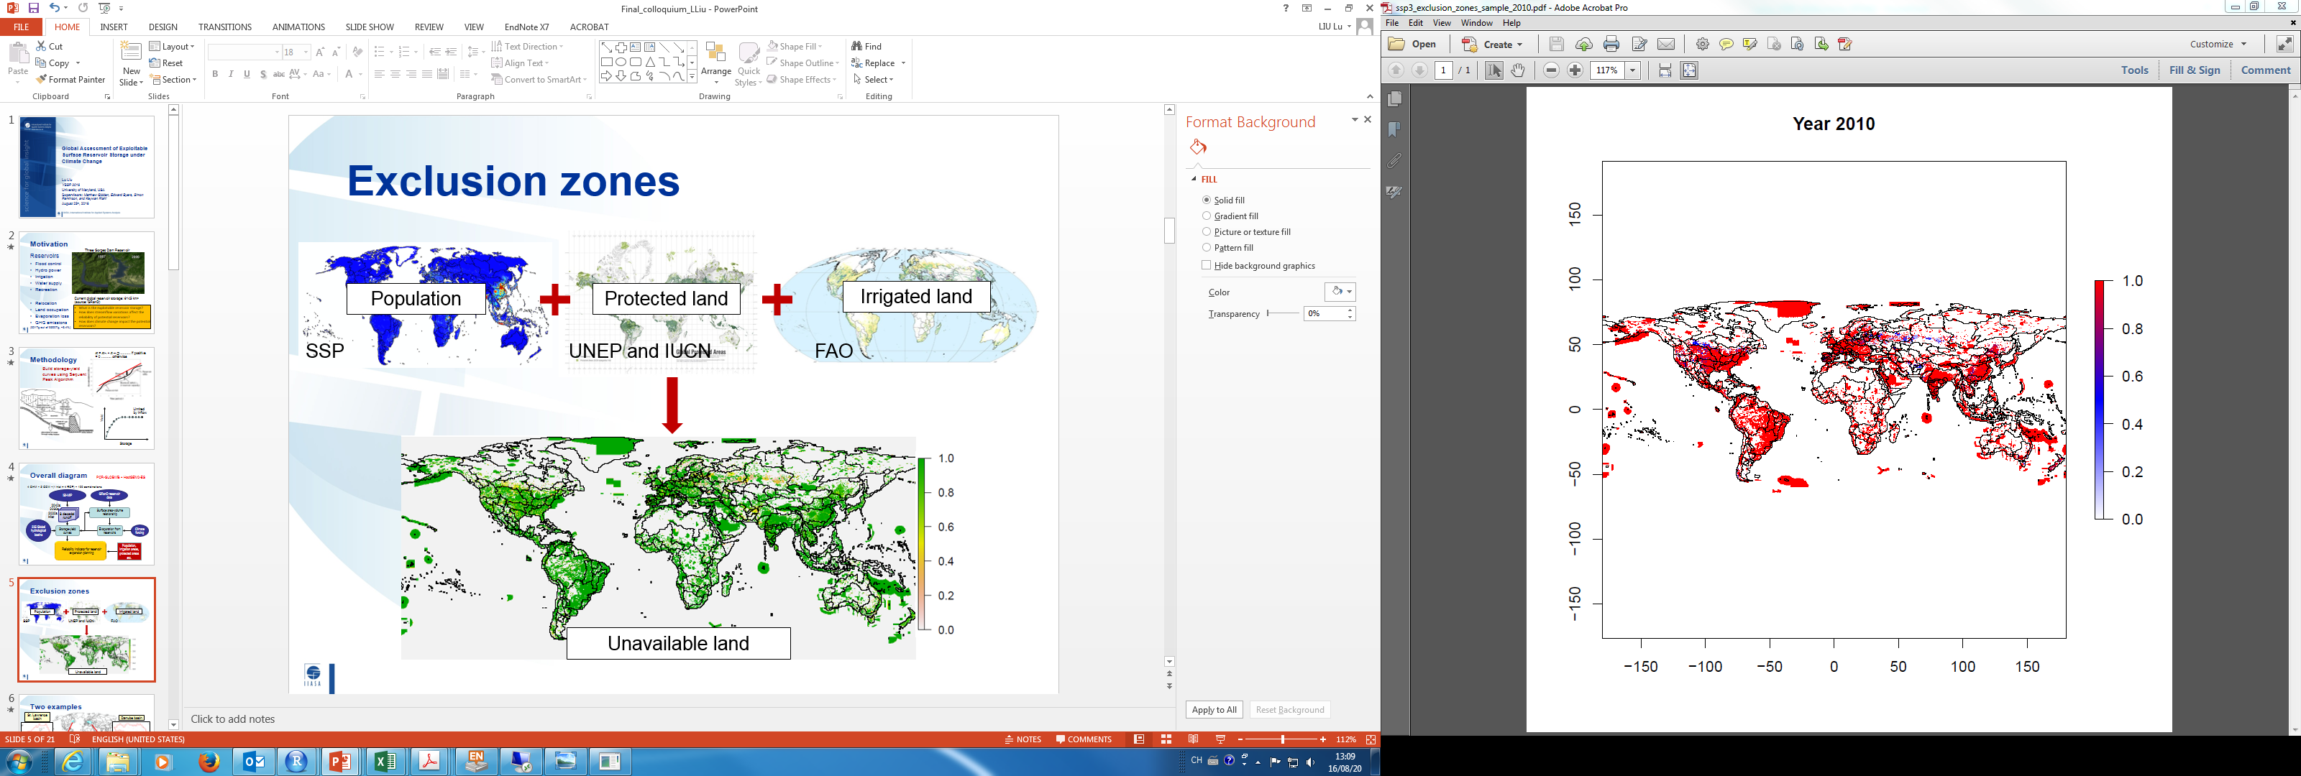
Exclusion zones
Where reservoirs cannot take place
Population
Protected land
Irrigated land
SSP
UNEP and IUCN
FAO
Unavailable land

Slide 6
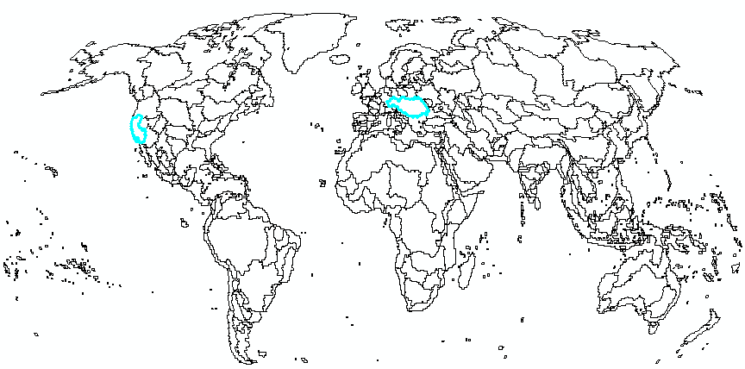
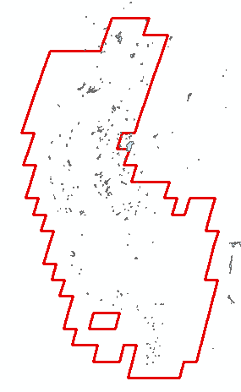
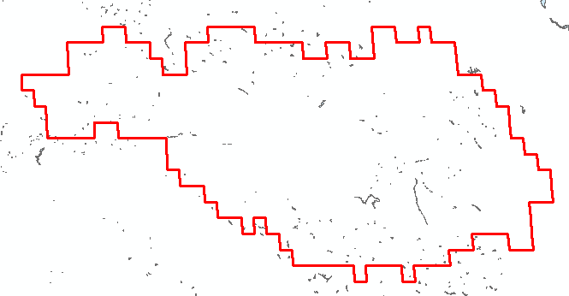
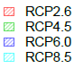
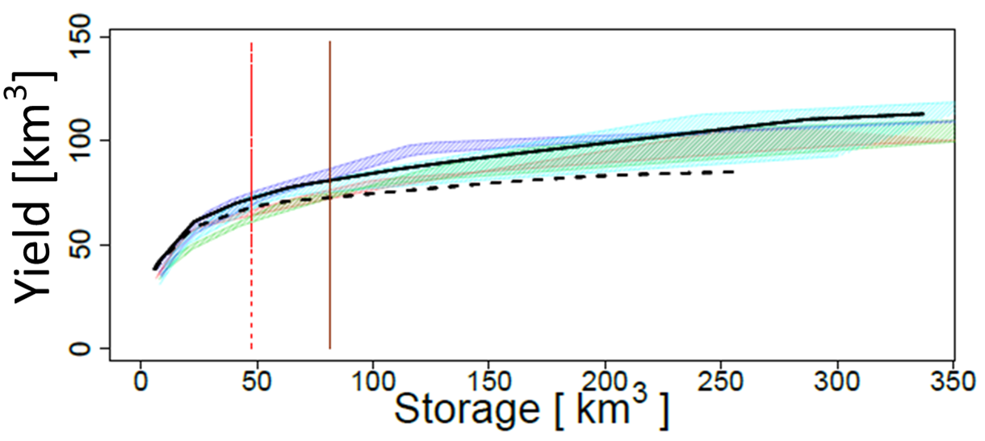
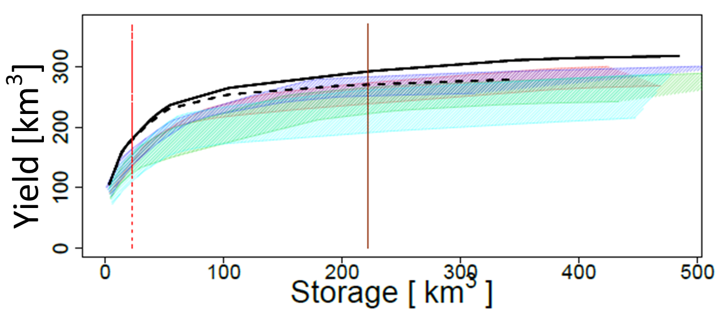
Two examples of S-Y curves
California basin
Danube basin
No E
With E
Current
Exploitable
Notes:
RCP2.6 (0.3 to 1.7)
RCP4.5 (1.1 to 2.6)
RCP6.0 (1.4 to 3.1)
RCP8.5 (2.6 to 4.8)

Slide 7
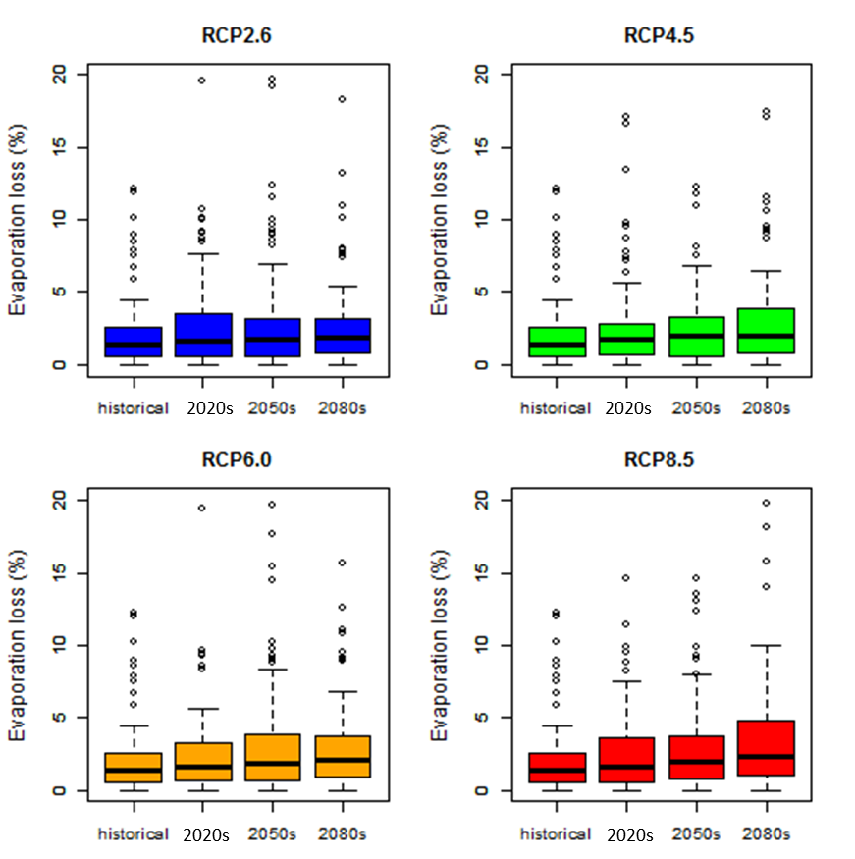
Effect of net evaporation
RCP2.6
RCP4.5
Globally, net evaporation loss from reservoirs accounts for ~2-4% of the current annual firm yield (non-negligible)
Differences between basins are widened
Differences between RCPs are trivial
Increasing impact particularly under RCP8.5
RCP6.0
RCP8.5

Slide 8
How much room for expansion?
Current global capacity ~6200km³
Without exclusion zones, potential capacity is ~5 times of current capacity
However, with exclusion zones, actual exploitable capacity is ~4 times of current capacity
Total firm yield ↑ by 40%

Slide 9
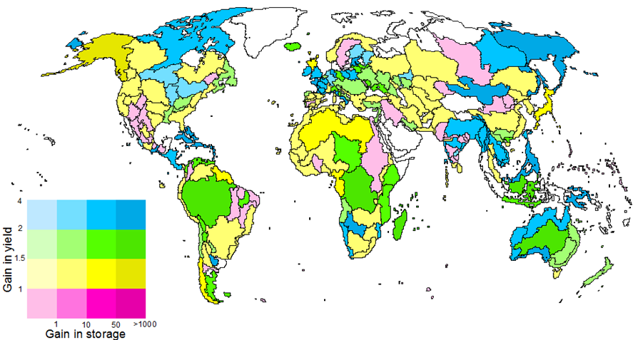
Where are the marginal gains?
Existing
Exploitable
Existing
Exploitable
SSP1 2050s
High
Low

Slide 10
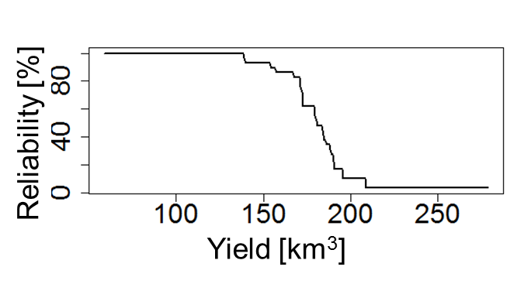
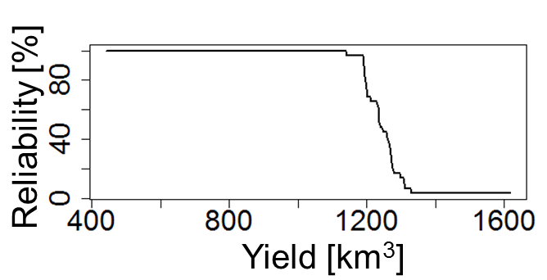
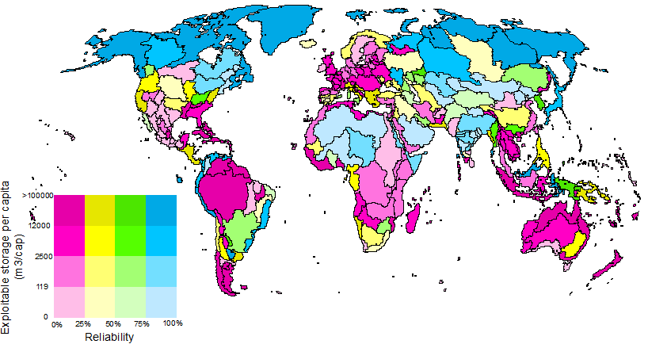
Where to expand reservoirs?
Missouri River Basin
Ganges-Brahmaputra Basin
SSP1 2050s
High
Low

Slide 11
Research outputs
  Data products
  Maps of reservoirs potential under different climate and socioeconomic pathways
  Reliability indicators for long-term reservoir planning
  Policy implications
  Identify regions where reservoir expansion will be particularly challenging
  Marginal gain by expanding reservoirs
  Is building reservoir the solution to water scarcity?

Slide 12
Key messages
Environmental constraints and human development pose significant impact on exploitable reservoir storage (~7-15%)
Evaporation losses are non-trivial (~2-4%)
Regional disparity in reservoir reliability and potential for expansion
Provide scientific support for long-term planning of water infrastructure

Slide 13
Acknowledgement
Young Scientists Summer Program (YSSP) at the International Institute for Systems Analysis (IIASA), Laxenburg, Austria
The Coupled Model Intercomparison Project Phase 5 (CMIP5) and the Inter-Sectoral Impact Model Intercomparison Project (ISI-MIP)

Slide 14
Additional slides

Slide 15
Climate | RCP2.6, RCP4.5, RCP6.0 and RCP8.5
Population | SSP1 and SSP3
Time periods | 1971-2000, 2020s, 2030s, 2040s, 2050s, 2060s, 2070s and 2080s
Model | PCR-GLOBWB (GHM) HadGEM2-ES (GCM)

Slide 16
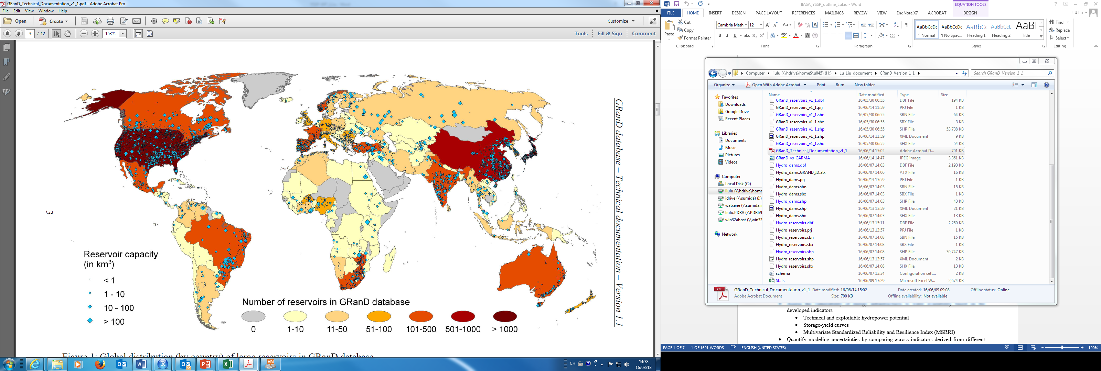
GRanD reservoir database
~6100km³

Slide 17
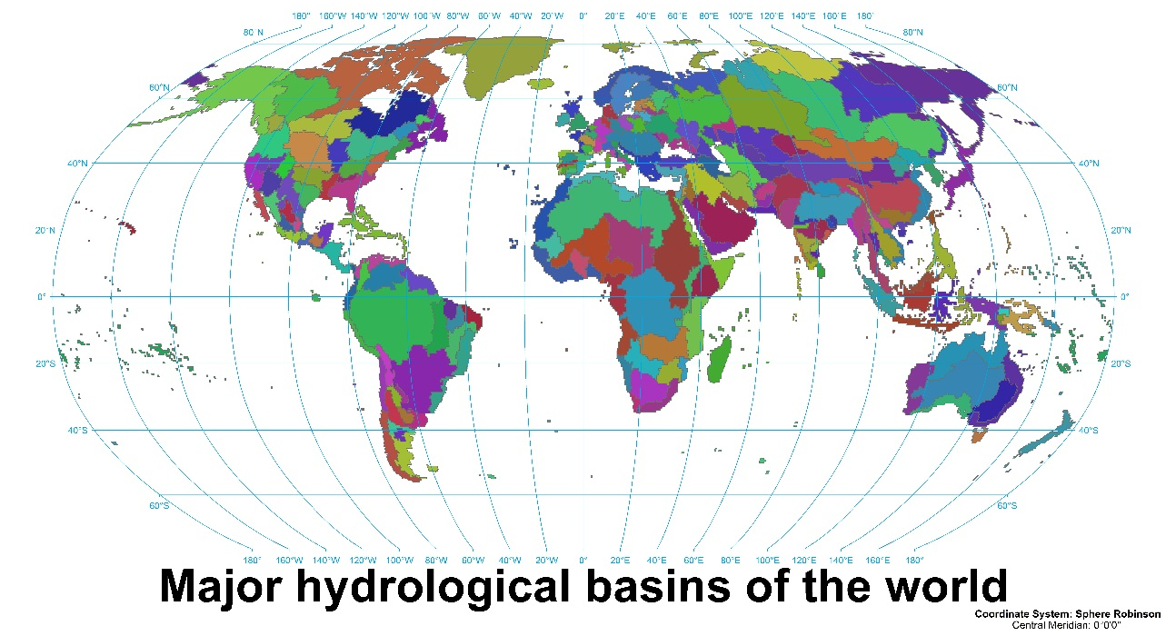
235 hydrological basins

Slide 18
Area-volume relationship
Surface area-volume relationship (log scale) derived from GRanD reservoir database (specific for each of the 235 basin)

Slide 19
Effect of population growth and land-uses
Reduction in potential storage
Increasing impact on reservoir potential over time due to increasing total population
Higher urbanization, smaller impact on reservoir potential
More rural population relocation, smaller impact on reservoir potential
SSP1: high urbanization
SSP3: low urbanization

Slide 20
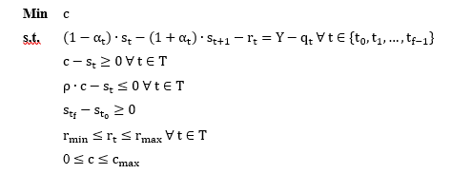
Linear Programming
Find the minimum capacity that can fulfill the following subject functions.

Slide 21
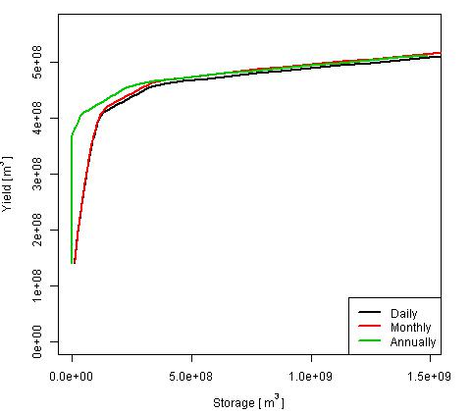
Sensitivity analysis on temporal resolution
No substantial differences

Slide 22
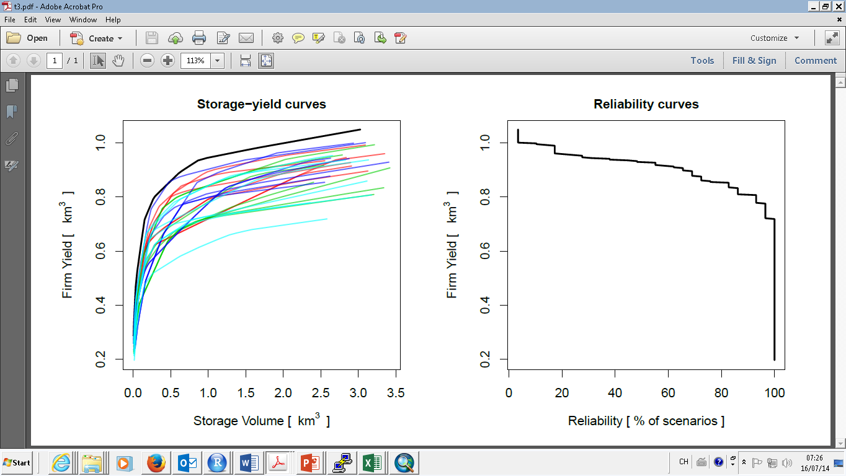
Compute reliability
Run the analysis for multiple years and RCPs
Compute reliability indicator

Slide 23
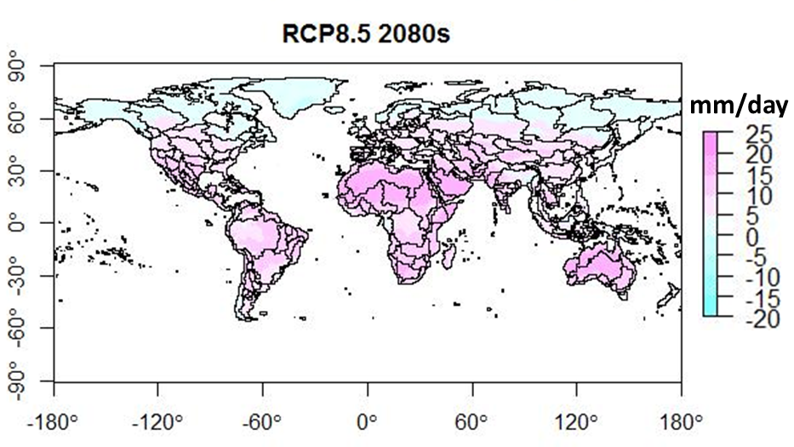
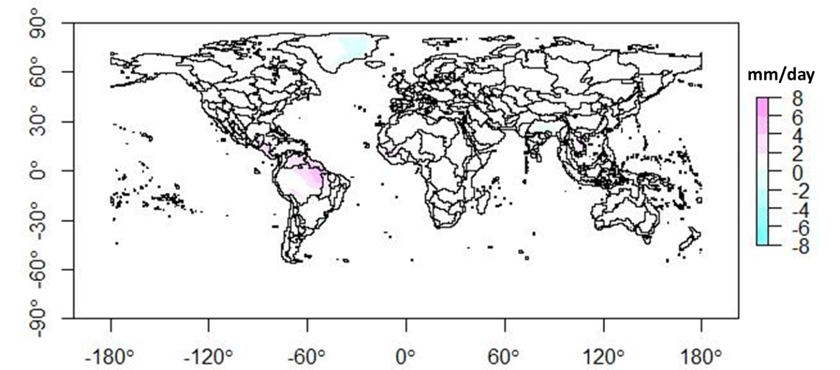
Net evaporation in mm/day in the 2080s under RCP8.5 scenario
Difference of net evaporation loss in the 2080s between RCP8.5 and RCP2.6

Slide 24
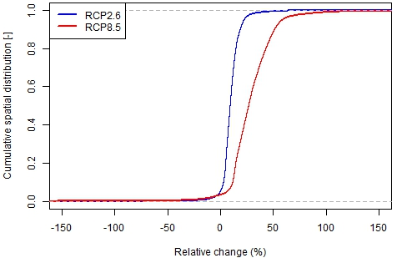
Cumulative spatial distribution of change of net evaporation in the 2080s relative to historical period under RCP2.6 and RCP8.5.

Slide 25
Future directions for this work
The ability to adapt
  Where are we currently on the curve?
  How much additional storage is there?
The need to adapt
  Is there water scarcity?
  How much does it cost?
Social potential to adapt
  Strength of government
  Economic-institutional capacity

Slide 26
Possible improvements
Evaporation from reservoirs
  Should reflect excluded areas
Area-volume relationship
  More robustness
Exclusion zones
  Digital Elevation Model
  Decision criteria
Environmental flow
  Varies by season and geographic location

