Slide 1
Citizen science data in peer-reviewed publications:
The Geo-Wiki experience
Steffen Fritz, Dilek Fraisl
Earth Observations Systems Research Group
Email: fritz@iiasa.ac.at fraisl@iiasa.ac.at

Slide 2
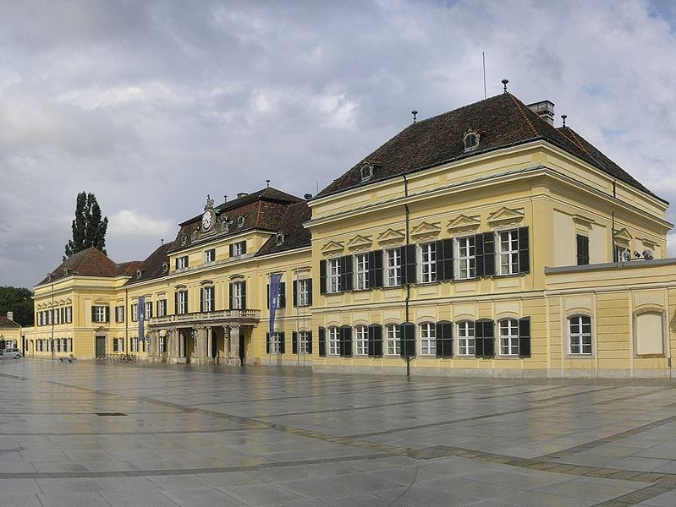
International Institute for Applied Systems Analysis - IIASA

Slide 3

Center for Earth Observation & Citizen Science What we do?
Uncovering the potential of citizen science for Land Use & Land Cover (LULC) & Earth Observation (EO)
Lowering cost and extending in-situ data collection methods
Creating and improving tools for engaging citizens in environmental monitoring
Investigating the potential of CS and EO for SDG monitoring and implementation to address the greatest challenges facing humanity
Notes:
The first point basically means that we invest in building and testing citizen science approaches to reduce uncertainties in the land cover and land use data, and help produce improved land cover information/maps.
What is also important is to reduce costs, while addressing this issue.

Slide 4




How we do it?
Crowd-driven tools
Expert validation tool
1
2
3
4
Geo-Wiki Engagement Platform
Picture
Pile
FotoQuest
GO
LACO-Wiki Validation Platform
«indoor»
«indoor»
«outdoor»
«indoor»

Slide 5

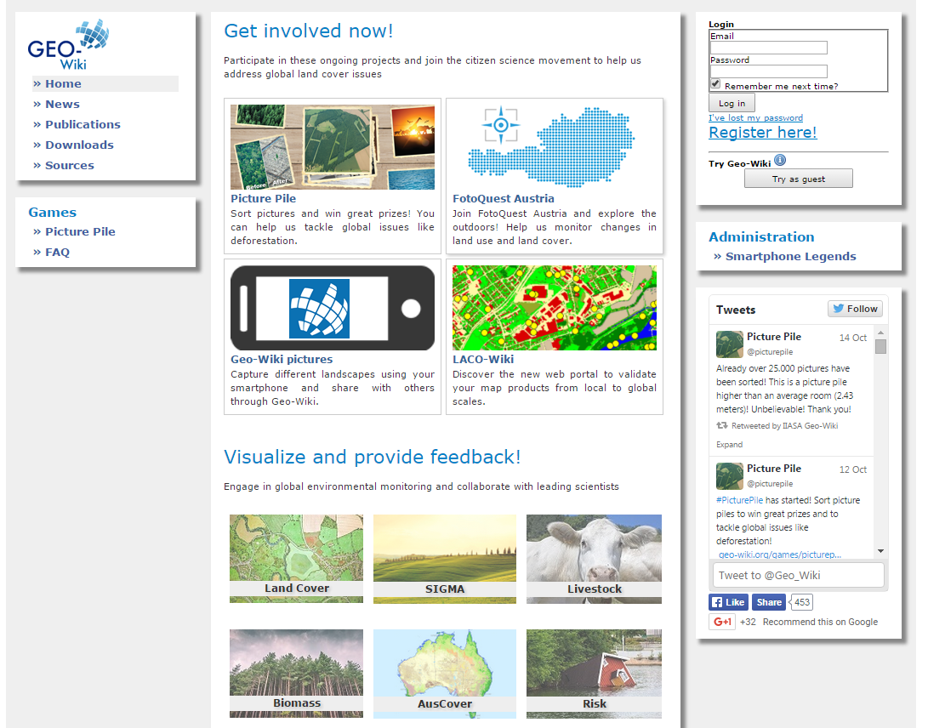


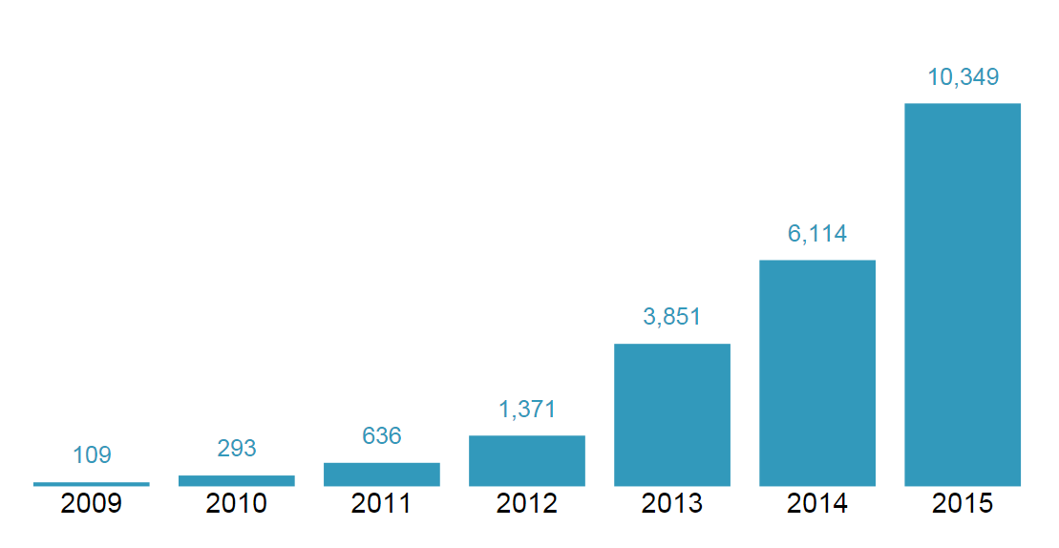
Geo-Wiki Engagement Platform
Geo-Wiki is an open platform that provides citizens with the means to engage in environmental monitoring by providing feedback on existing spatial information overlaid on satellite imagery or by contributing entirely new data.
http://www.geo-wiki.org/
15,000+
Registered users
Notes:
Registered volunteers can sign up for campaigns to validate land cover and land use.
These data are used in combination with existing land-based products to produce improved maps of global land cover.

Slide 6
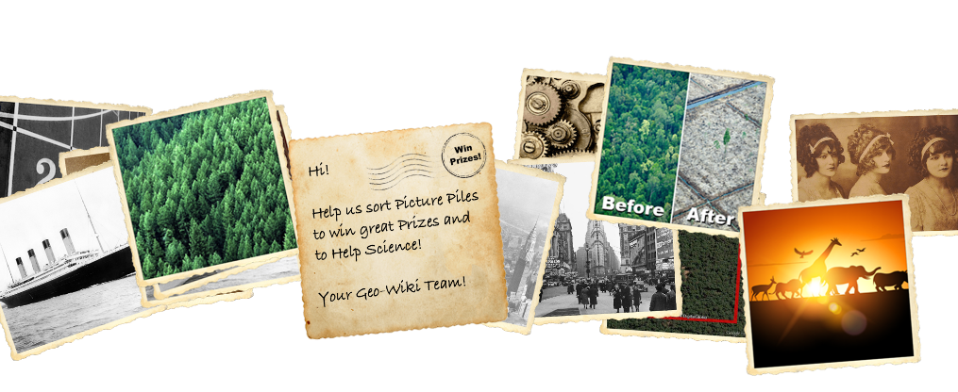

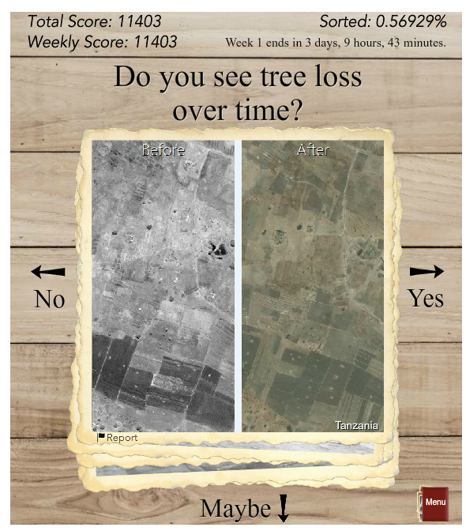
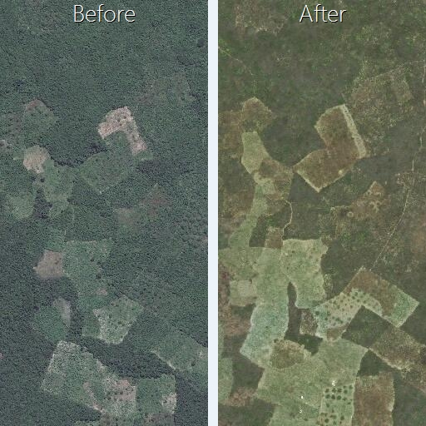

Picture Pile
http://geo-wiki.org/games/picturepile
Notes:
Picture Pile is a game that has been developed to map deforestation initially
Rapid image assessment
Designed to be generic and flexible so that we can customize it to different domains, such as post disaster assessment

Slide 7



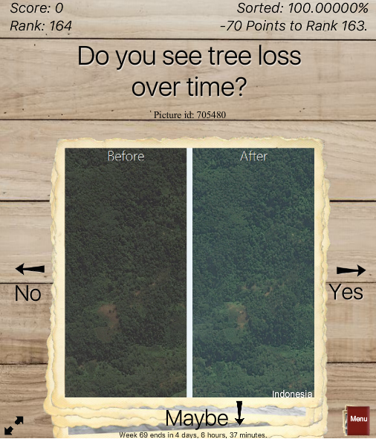

Picture Pile
October, 2015
November, 2016
Deforestation Pile
1656
Players
5,592,422
Classifications
200,000
Unique images
90%
< 5 seconds
http://www.geo-wiki.org/games/picturepile

Slide 8
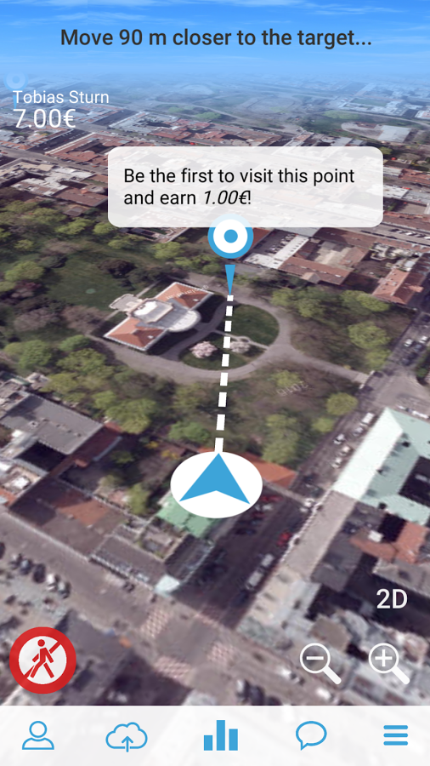
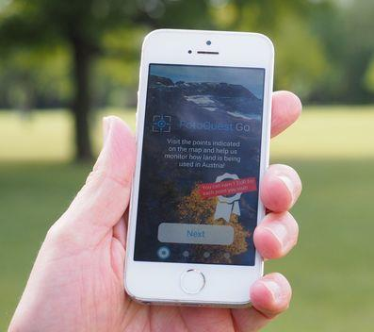
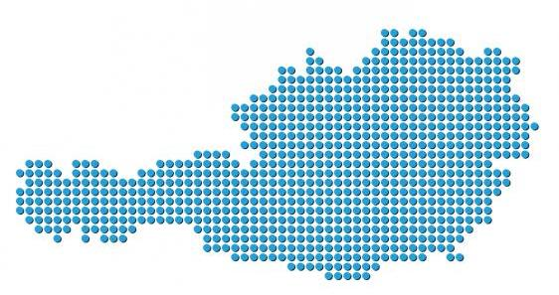
FotoQuest GO
Mobile application for in-situ (on the ground) data collection to promote community-based LULC awareness and monitoring.
http://fotoquest-go.org/
Spring Campaign will launch soon!
Notes:
150,000 square meters of soil are turned into business, living, recreation or traffic areas. We need to be able to track the effect of these changes in the environment.

Slide 9

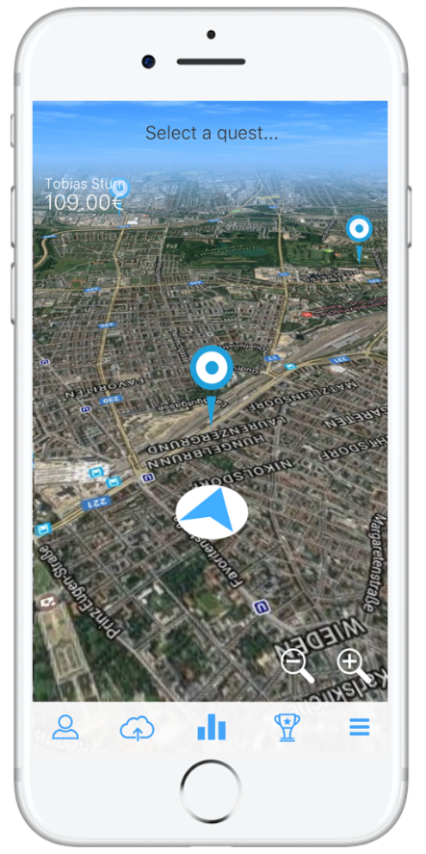
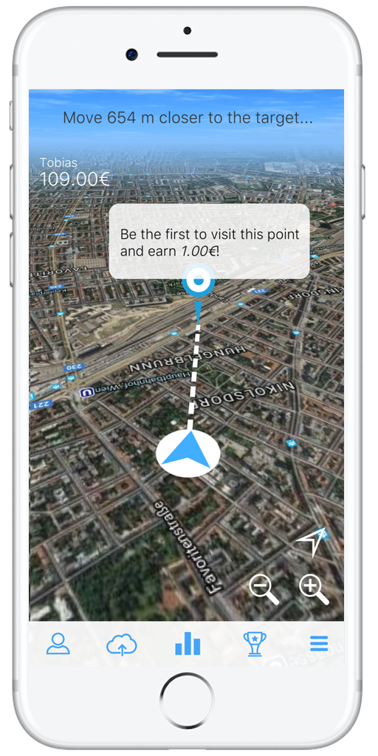
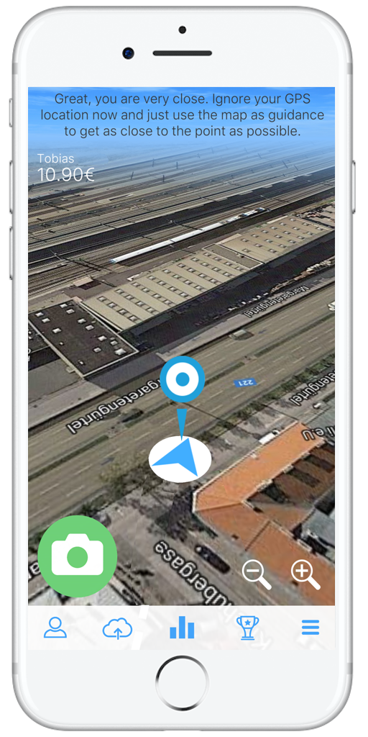
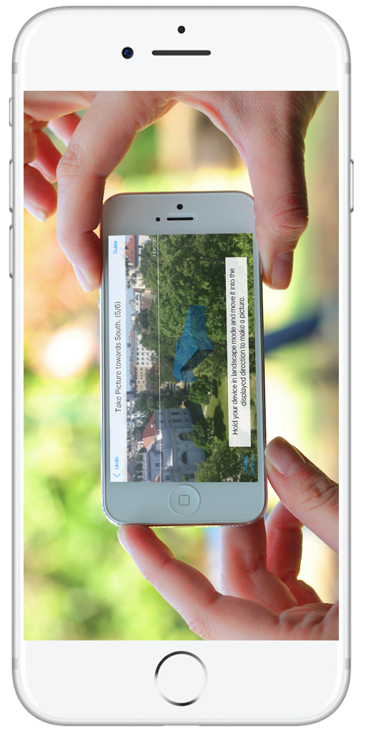
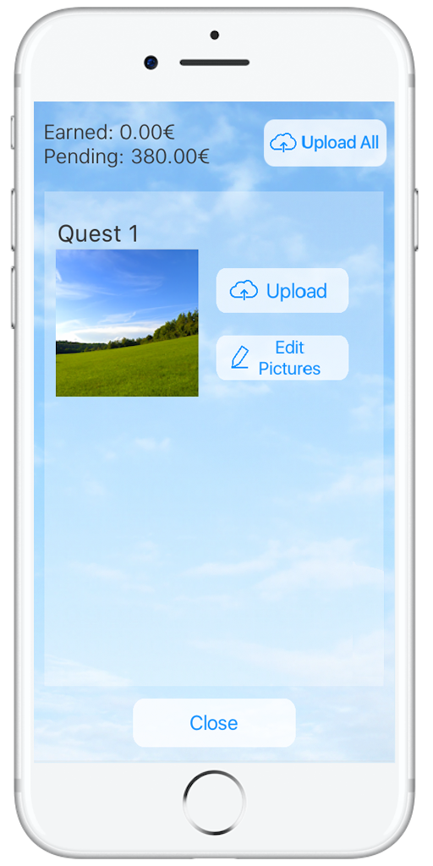
FotoQuest Go
Notes:
FotoQuest GO aims to complement data gathered through the EU Land Use and Coverage Area frame Survey (LUCAS). These data are expensive to gather, and it only takes place every three years.
It is mainly about investigating whether citizens can produce good quality data.
The feedback tool for data quality assurance that helps us make real comparisons between the data collected by the experts and the citizens

Slide 10

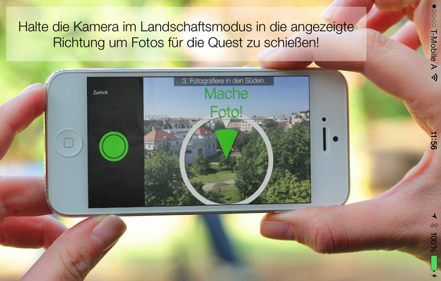
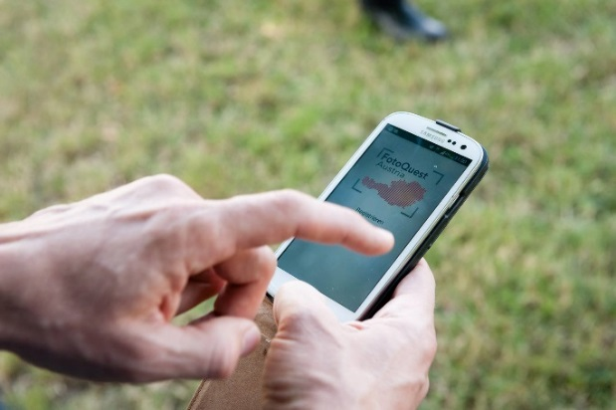
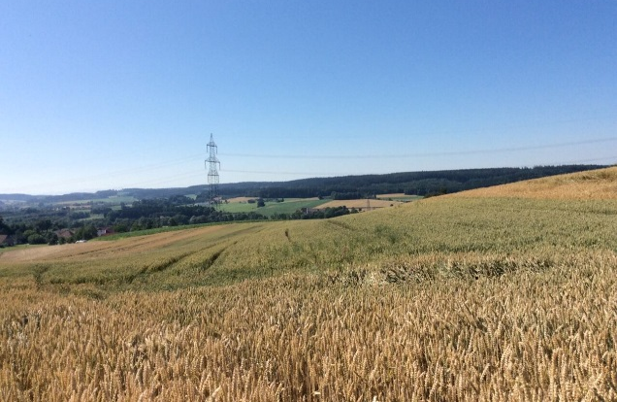
FotoQuest Go
July, 2015
December, 2017
480+
Players
5500+
Quests
28,000+
Photos

Slide 11
Examples - Peer-reviewed publications
Publications on the analysis of citizen-generated data
  Salk C., Sturn T., See L. and Fritz S. (2015). Assessing quality of volunteer crowdsourcing contributions: lessons from the Cropland Capture game. International Journal of Digital Earth. http://dx.doi.org/10.1080/17538947.2015.1039609
  Salk C., Sturn T., See L., & Fritz S. (2016). Local knowledge and professional background have a minimal impact on volunteer citizen science performance in a land-cover classification task. Remote Sensing 8 (10): e774. DOI:10.3390/rs8090774
  Salk C., Sturn T., See L., Fritz S. (2016). Limitations of majority agreement in crowdsourced image interpretation. Transactions in GIS. 10.1111/tgis.12194
  Laso Bayas J.C., See L., Perger C., Justice C., Nakalembe C., Dempewolf J., & Fritz S. (2017). Validation of Automatically Generated Global and Regional Cropland Data Sets: The Case of Tanzania. Remote Sensing 9 (8): e815. DOI:10.3390/rs9080815.
  Laso Bayas JC, See L, Fritz S, Sturn T, Perger C, Dürauer M, Karner M, Moorthy I, et al.(2016). Crowdsourcing In-Situ Data on Land Cover and Land Use Using Gamification and Mobile Technology. Remote Sensing 8 (11): e905. DOI:10.3390/rs8110905.
Publications on improving LULC products
  General peer-reviewed publications:
    Fritz S, See L, van der Velde M, Nalepa RA, Perger C, Schill C, McCallum I, Schepaschenko D, et al. (2013). Downgrading recent estimates of land available for biofuel production. Environmental Science & Technology 47 (3): 1688-1694. DOI:10.1021/es303141h.
    Fritz S, See L, McCallum I, Bun A, Moltchanova E, Dürauer M, Perger C, Havlik P, et al.(2015). Mapping global cropland field size. Global Change Biology 21 (5): 1980-1992. DOI:10.1111/gcb.12838.
  Publications in data journals:
    Laso Bayas JC, Lesiv M, Waldner F, Schucknecht A, Duerauer M, See L, Fritz S, Fraisl D, et al. (2017). A global reference database of crowdsourced cropland data collected using the Geo-Wiki platform. Scientific Data 4: e170136. DOI:10.1038/sdata.2017.136.
    Fritz S, See L, Perger C, McCallum I, Schill C, Schepaschenko D, Duerauer M, Karner M, et al.(2017). A global dataset of crowdsourced land cover and land use reference data. Scientific Data 4: p. 170075. DOI:10.1038/sdata.2017.75.

Slide 12
Examples - Peer-reviewed publications
Publications on the analysis of citizen-generated data
  Salk C., Sturn T., See L. and Fritz S. (2015). Assessing quality of volunteer crowdsourcing contributions: lessons from the Cropland Capture game. International Journal of Digital Earth. http://dx.doi.org/10.1080/17538947.2015.1039609
  Salk C., Sturn T., See L., & Fritz S. (2016). Local knowledge and professional background have a minimal impact on volunteer citizen science performance in a land-cover classification task. Remote Sensing 8 (10): e774. DOI:10.3390/rs8090774
  Salk C., Sturn T., See L., Fritz S. (2016). Limitations of majority agreement in crowdsourced image interpretation. Transactions in GIS. 10.1111/tgis.12194
  Laso Bayas J.C., See L., Perger C., Justice C., Nakalembe C., Dempewolf J., & Fritz S. (2017). Validation of Automatically Generated Global and Regional Cropland Data Sets: The Case of Tanzania. Remote Sensing 9 (8): e815. DOI:10.3390/rs9080815.
  Laso Bayas JC, See L, Fritz S, Sturn T, Perger C, Dürauer M, Karner M, Moorthy I, et al.(2016). Crowdsourcing In-Situ Data on Land Cover and Land Use Using Gamification and Mobile Technology. Remote Sensing 8 (11): e905. DOI:10.3390/rs8110905.
Publications on improving LULC products
  General peer-reviewed publications:
    Fritz S, See L, van der Velde M, Nalepa RA, Perger C, Schill C, McCallum I, Schepaschenko D, et al. (2013). Downgrading recent estimates of land available for biofuel production. Environmental Science & Technology 47 (3): 1688-1694. DOI:10.1021/es303141h.
    Fritz S, See L, McCallum I, Bun A, Moltchanova E, Dürauer M, Perger C, Havlik P, et al.(2015). Mapping global cropland field size. Global Change Biology 21 (5): 1980-1992. DOI:10.1111/gcb.12838.
  Publications in data journals:
    Laso Bayas JC, Lesiv M, Waldner F, Schucknecht A, Duerauer M, See L, Fritz S, Fraisl D, et al. (2017). A global reference database of crowdsourced cropland data collected using the Geo-Wiki platform. Scientific Data 4: e170136. DOI:10.1038/sdata.2017.136.
    Fritz S, See L, Perger C, McCallum I, Schill C, Schepaschenko D, Duerauer M, Karner M, et al.(2017). A global dataset of crowdsourced land cover and land use reference data. Scientific Data 4: p. 170075. DOI:10.1038/sdata.2017.75.

Slide 13
Publications on the analysis of citizen-generated data
Fotoquest go

Slide 14
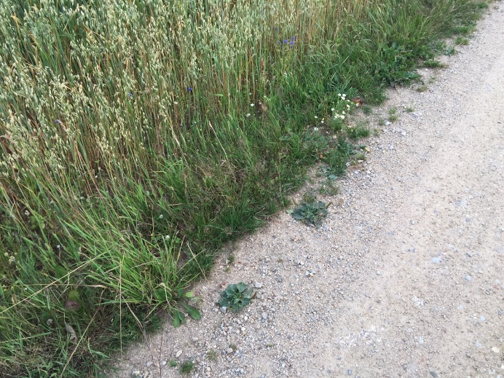
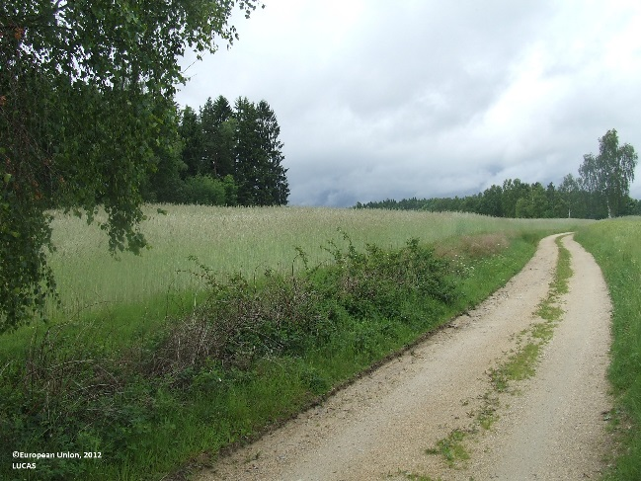
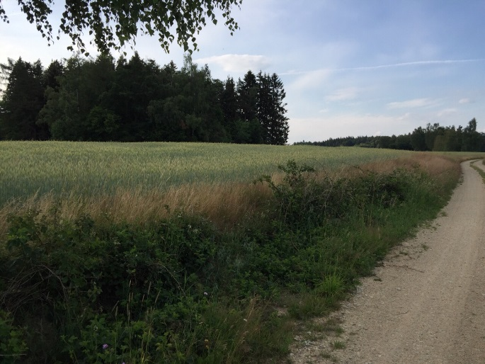
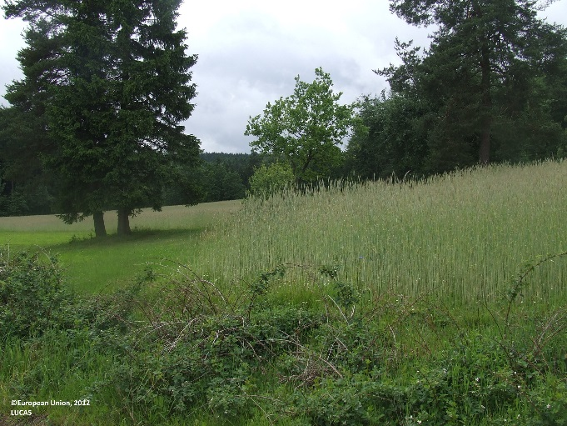
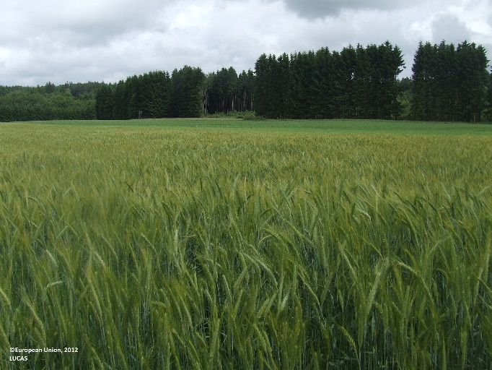
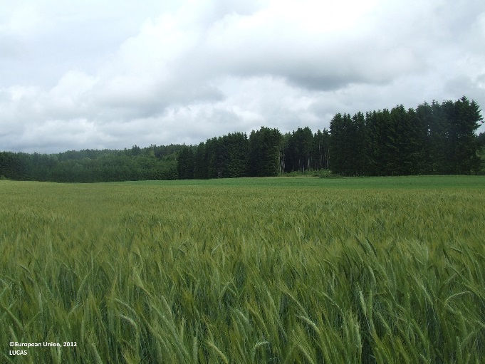
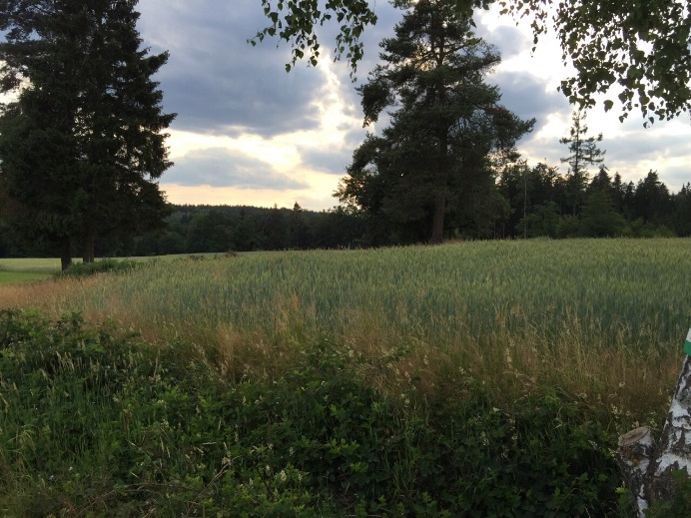
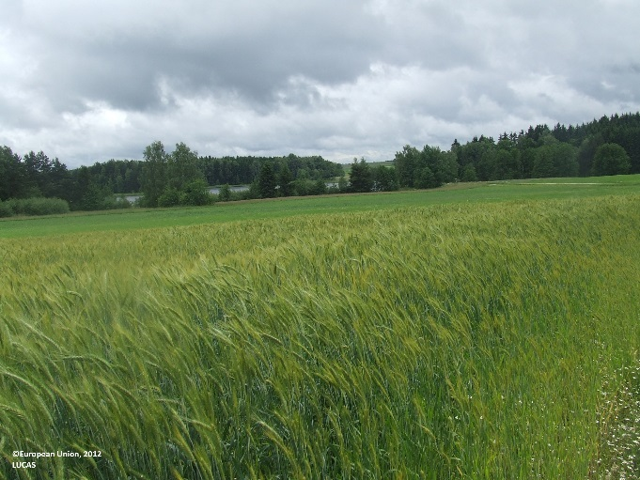
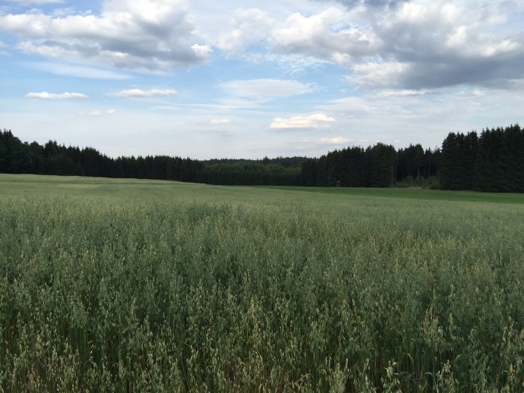
LUCAS
photographs

Slide 15
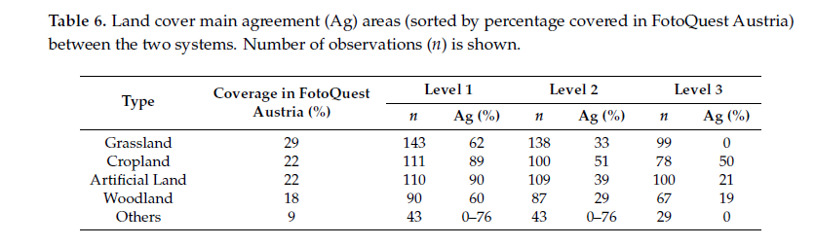

Slide 16
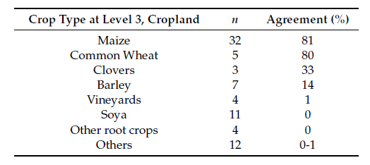

Slide 17
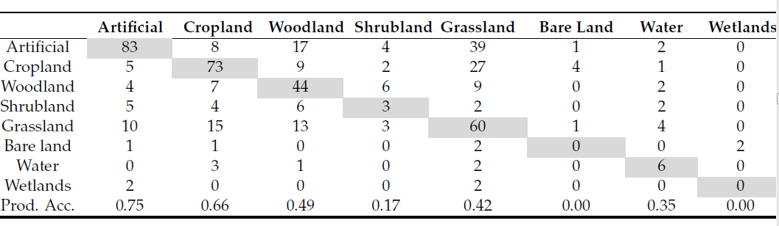

Slide 18
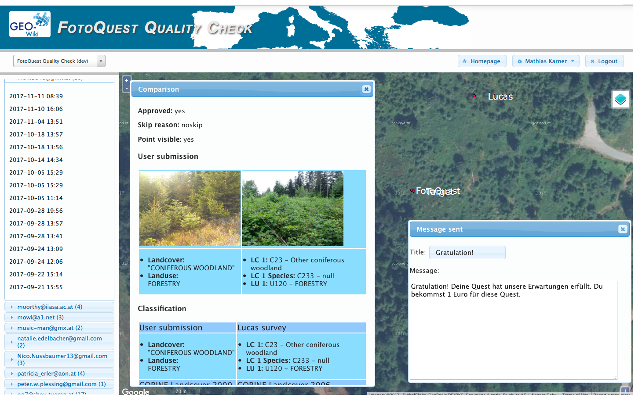
FotoQuest directly on the point,
LUCAS surveyor is far off

Slide 19
FotoQuest Go Quality Check
First 1 Euro locked
Every submission needs to be approved
Users get feedback on where to improve
Feedback via app and email
We get a better idea of the causes of error
Examples:

Slide 20
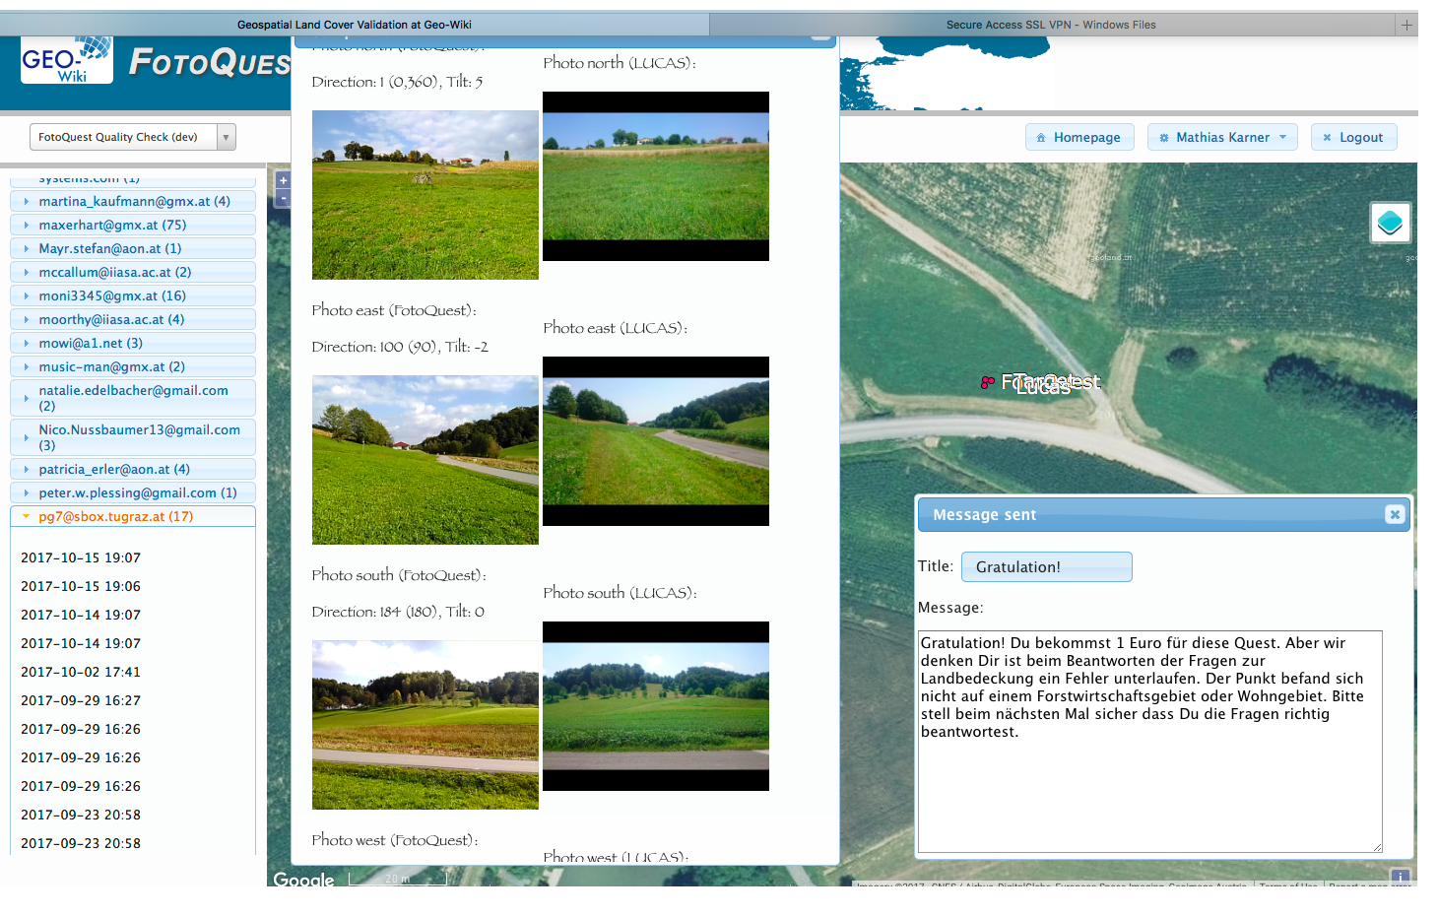
Well comparable pictures to LUCAS, mistake on landuse (user chose forestry)

Slide 21

FotoQuest Go Questionnaire
I find the app user friendly: 4.1
Using this app, I am happy to contribute to scientific research: 4.7
Using this app I can discover new landscapes: 4.3
I have fun while using the app: 4.2
I have a strong interest in nature: 4.5
I find this project interesting: 4.6
I enjoy being in the outdoors: 4.6
I am excited by the possibility of winning a prize: 4.1

Slide 22
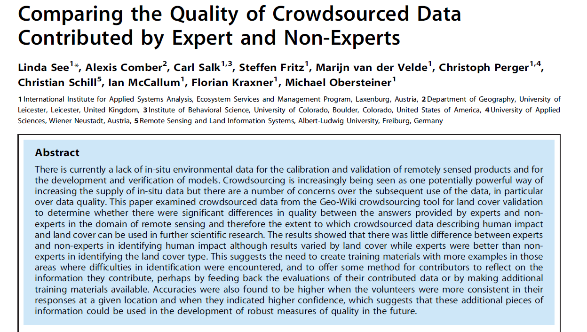

Slide 23
Publications on improving LULC products
General peer-reviewed publications:

Slide 24
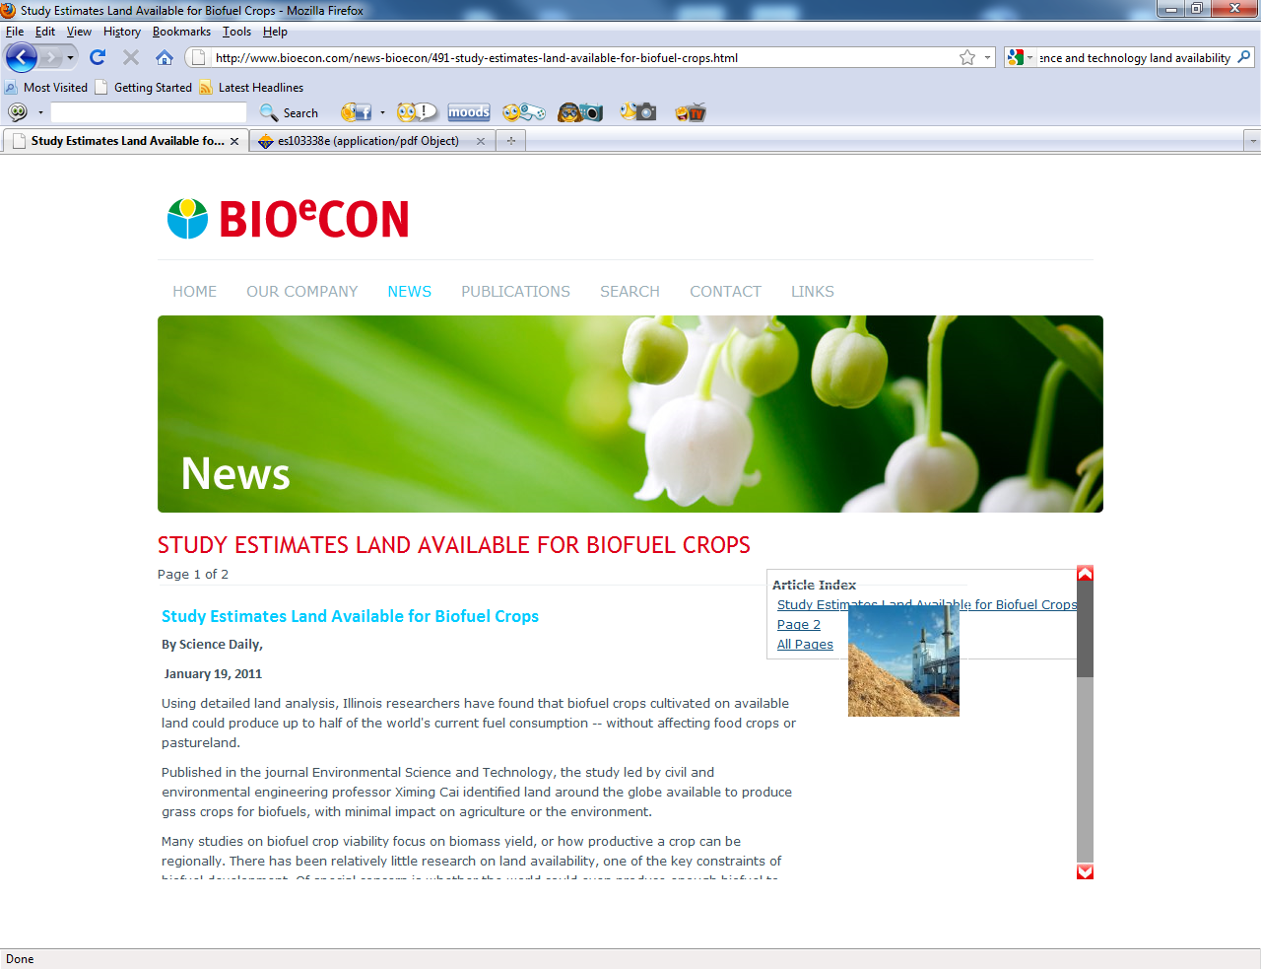

Slide 25
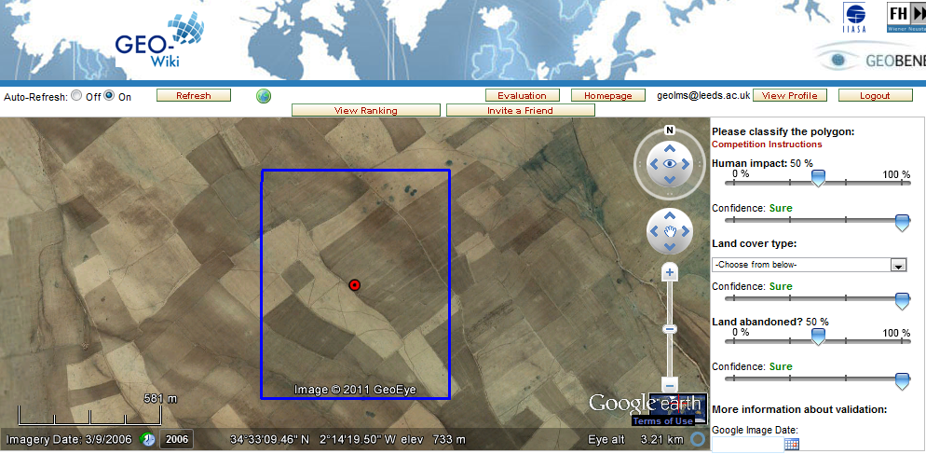

Slide 26
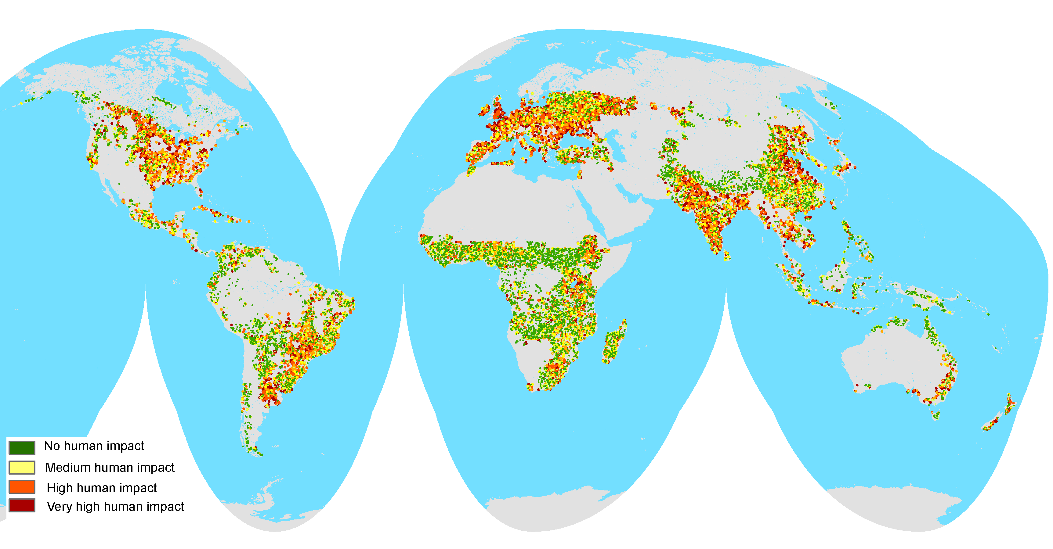
Cai et al., 2011
1107 mil. hectares
Downgrading recent estimates of
land availability using crowdsourcing
Fritz et al.
375 mil. hectares
Fritz et al, 2013, Environmental Science and technology
Notes:
We have collected more than 250 000 global land cover validation points. We use the points for clreating global hybrid maps. In a recent publication we used geo-wiki to downgrade recent estimates of land availability for biofuel production.

Slide 27
  Publications on improving LULC products b) Publications in data journals

Slide 28
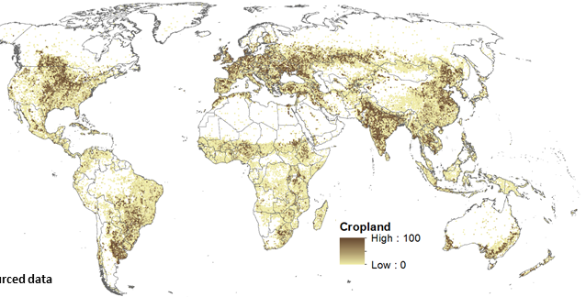


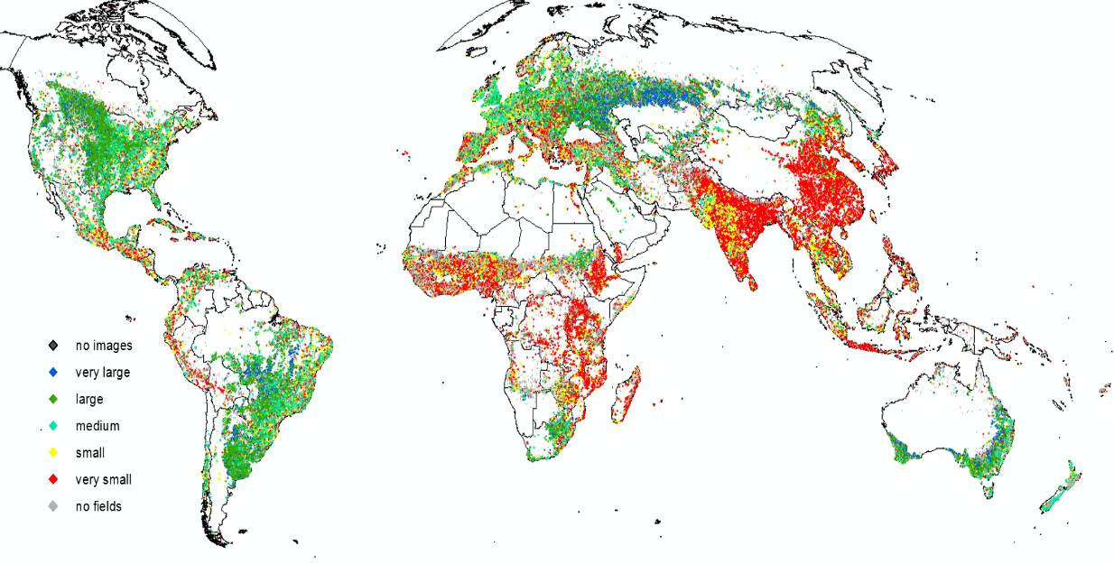
v
80
volunteers
Global Cropland Validation
144K
validations
Laso Bayas et al., (2017) A global reference database of crowdsourced cropland data collected using the Geo-Wiki platform. Nature, Scientific Data (in press)
v
130
volunteers
Global Field Size
390K
validations

Slide 29
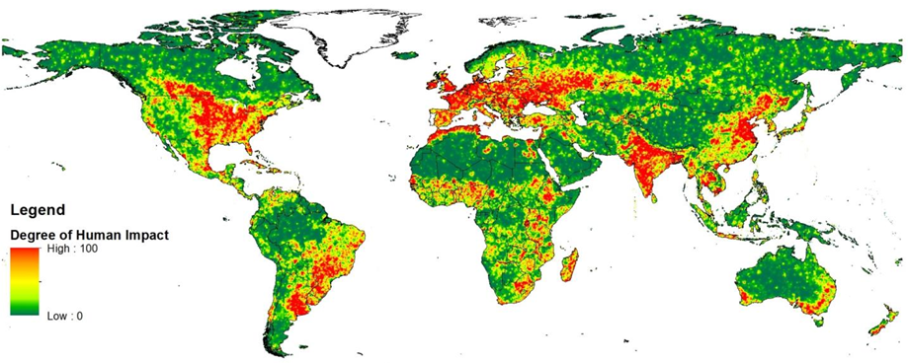
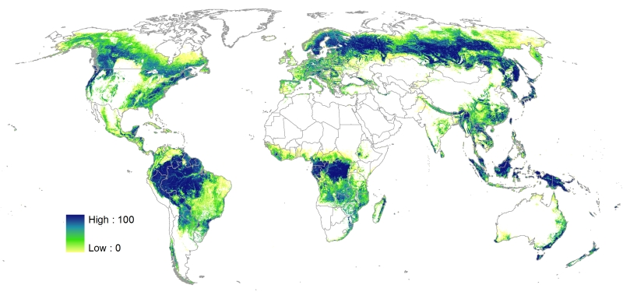
Geo-Wiki Engagement Platform
Field Size
Wilderness
Fritz et al. (2015) in Global Change Biology
See et al. (2015) in Technological Forecasting and Social Change
Forest Cover
Hybrid Land Cover
Schepaschenko et al. (2015) in Remote Sensing of Environment
See et al. (2014) in ISPRS Photogrammetry and Remote Sensing

Slide 30
Thanks!
Steffen Fritz: fritz@iiasa.ac.at
Dilek Fraisl: fraisl@iiasa.ac.at
Earth Observations Group
Ecosystems Service and Management (ESM)

