Slide 1
Future energy, food, and water trade-offs in the Zambezi river basin: A model analysis of Zambia
Amanda Palazzo*¹, Petr Havlík¹, Michiel van Dijk^{1,2}
1 Ecosystem Services and Management program (IIASA, Austria)
2 Wageningen Economic Research, (Netherlands)
Global Food Security Conference | 3-6 December 2017
* palazzo@iiasa.ac.at

Slide 2
Introduction and Motivation
Global population may increase by 2 billion people by 2050
  75-95 million in Zambezi river Basin
To achieve universal energy access, generation needs to double
Food demands are expected to double by 2050
With increasing energy and food demands, water demands are expected to rise by 55 percent
Up to 40 percent of the world’s population will live in severe water stressed regions
Irrigated agriculture may reduce yield gaps (due to climate change) but projects to transfer water are expensive and the environmental impacts of water diversion and extraction may be significant
Siloed approaches/strategies to reaching goals may have unintended consequences in reaching other goals

Slide 3
Nexus approach
Food/Land Use System
ON
Biomass,
crop residues, biofuel, land cover, energy demand for irrigation, fertilizer demand
Land cover, irrigation water requirement, livestock water demand, pollution, flood protection
Fertilizer prices, fuel, processing, transportation, hydropower water demand
Surface and groundwater availability and runoff, drinking water and food processing water demand
Water availability, delivery, treatment; desalination
Energy System
Water System
Hydropower,
plant cooling, extraction, (bio)fuels

Slide 4


Integrated Solutions for Water, Energy, and Land (ISWEL)
3 year project funded by IIASA and Global Environmental Facility (GEF) and implemented by UNIDO
  Cross-cutting project involving about 30 researchers from three programs
Tools for identifying synergies and tradeoffs (such as scenario exploration, projections on water, energy and land use requirements)
Context specific possible solutions to achieve water, energy and food security
Capacity strengthening at global level and regional case studies in universities, ministries, transboundary organizations and financing institutions.
Partnership:

Slide 5
Methods
Global pathways and trends
  Socioeconomic and climate
  Hotspots analysis
Integrated impact assessment modeling at global level and case study regions
  Energy: Energy Economic Model (MESSAGE)
  Water: Community Water Model (CWatM)
  Land: Global Biosphere Management Model (GLOBIOM)
Engagement with stakeholders in case study regions to develop regional scenarios of WEL challenges and futures improve/share the modeling tools

Slide 6
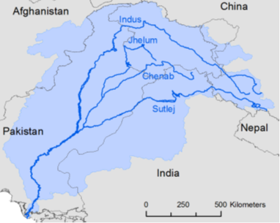
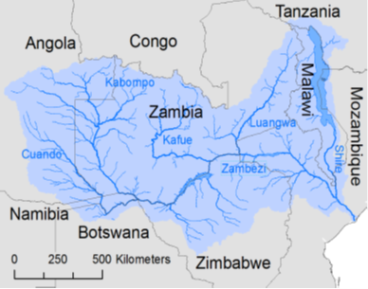
Regional Basin Case Studies
Indus
Zambezi
Area: 1.100.000 km²
Countries: Pakistan, India, China, Afghanistan
Population: 257 Mio. people
Projection 2050 (SSP1-5): 370-440 Mio. people
Main land cover: [%]
Cropland: 30 Irrigated cropland: 24
Forest: 0.4
GDP per cap. [US$]: 700 (Afghanistan) - 7600 (China)
Main challenges:
Climate Change glacier melting
flood & drought risk
Water security water scarcity
agricultural pollution
Energy security potential of hydropower
energy access
Food security irrigation
groundwater exploitation
Socioeconomic population growth
urbanization
economic growth
Ecosystems loss of biodiversity
Area: 1.332.000 km²
Countries: Zambia, Angola, Zimbabwe, Mozambique,
Malawi, Tanzania, Botswana, Namibia
Population: 38 mio. people
Projection 2050 (SSP1-5): 70-95 Mio. people
Main land cover: [%]
Cropland: 20 Irrigated cropland: 0.1
Forest: 4
GDP per cap. [US$]: 950 (Zimbabwe) - 5400 (Angola)
Main challenges:
Climate Change flood & drought risk
Water security water infrastructure
water scarcity
urban, industrial pollution
Energy security potential of hydropower
energy access
Food security potential of irrigation
soil degradation
Socioeconomic population growth
urbanization
economic growth
Ecosystems loss of biodiversity

Slide 7
Stakeholder Engagement
Basin Scientists
Basin Stakeholders
ISWEL
Team
jointly
Frame the most pressing Nexus problems, that require system analysis
Develop storylines for plausible futures of the Zambezi basin
Co-design policies and investment strategies
based on modeling input

Slide 8
Ongoing stakeholder engagement in Zambezi Basin
Zambezi Water Course Commission (ZAMCOM) 2nd Stakeholder Meeting in Lusaka, Zambia (October 2017)
  Hosted interactive session to identify challenges and opportunities within the Zambezi Basin
World Bank Climate Smart Investment Plan (CSIP-Zambia) in Lusaka, Zambia (Oct 2017)
  Technical workshop to identify strategies and goals for Zambia under the CSA pillars
  Provide country level model to examine agricultural pathways of Zambia and test strategies to reach CSA goals
  Provide land use modeling visualization tool to examine the pathways and scenario results

Slide 9
Conceptual Framework for Land Use Modeling
Shared Socioeconomic Pathways:
GDP, population, consumer preferences, irr. efficiency, tech. progress for crops and livestock
General Circulation models:
Temp.,
Radiative Forcing,
Precip.
Global hydrological model:
Runoff and environmental flows requirement
Water demand for industry and households
Partial Equilibrium Model:
GLOBIOM
Crop area, production, bilateral trade, prices
Net wat. avail
Biophysical crop model: EPIC
Crop yields and input requirements for crop production systems

Slide 10

Global Biosphere Management Model (GLOBIOM)
Global scale model based detailed spatial resolution (>200k cells)
Partial equilibrium
  Agricultural, wood and bioenergy markets
  30 world regions
  Bilateral trade flows based on spatial equilibrium approach
Bottom-up approach
  Explicit description of production technologies a la Leontief
  Technologies specified by production system and grid cell
Linear programming approach
  Maximization of consumer + producer (incl. trade costs) surplus
  Non linear expansion costs
  Optimization constraints
Base year: 2000
Time step: 10 years
Time horizon: 2030/2050, but also 2100

Slide 11
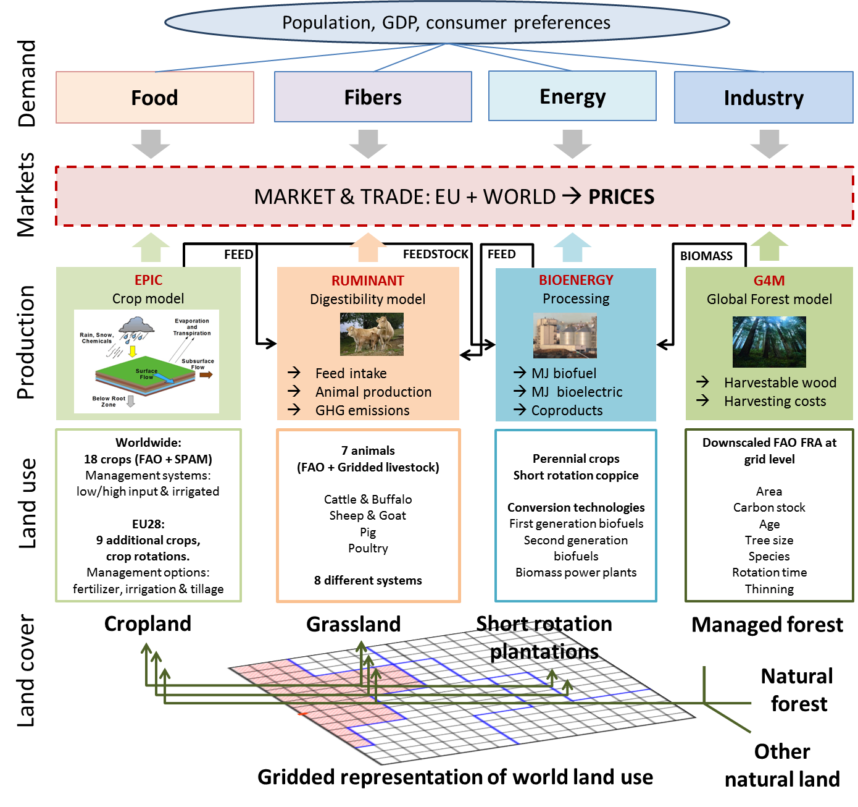

Water demand by for Agriculture
Monthly water demand for crops by EPIC
Irrigated/rainfed
crop yields
Water available for Agriculture
Share supplied by groundwater
Share supplied by
surface water

Slide 12
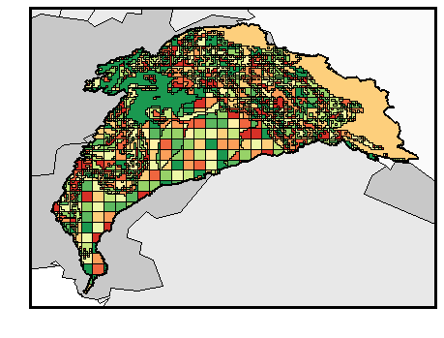
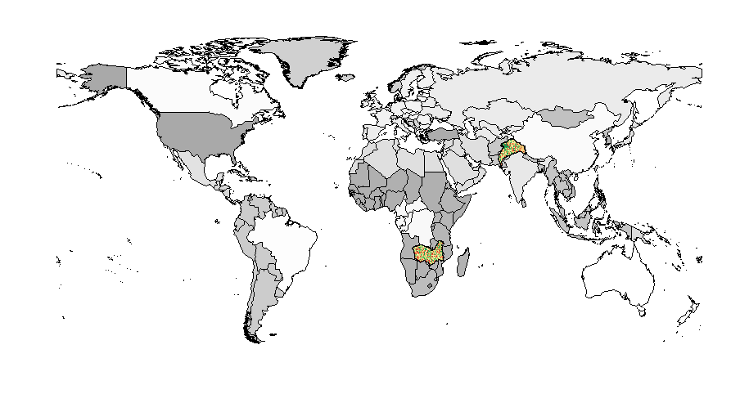
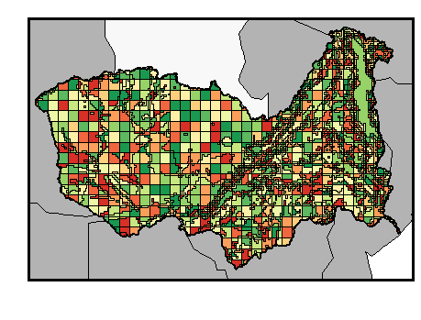
Basin modelling in GLOBIOM
GLOBIOM: 42 main regions
Zambezi: 2,951 simulation units
Indus: 2,206 simulation units

Slide 13
Representing irrigation as a crop production system
Irrigation water demand by crop and system
    Crop water requirement calculated by EPIC
      Climate change: change in precipitation, temperature → irrigation requirement (5 GCMs)
  Monthly water demand based on crop calendar by EPIC
  Irrigation systems: Basin, furrow, sprinkler, drip
    Differentiated by cost, efficiency, and crop and biophysical suitability (Sauer et al. 2010)
  Irrigated cropland area from SPAM (IFPRI) and calibrated with FAO statistics
Biophysical scarcity
  Water use is physically limited by water available by source at the land unit
    Water Sources:
      Surface water; LPJmL monthly availability
      Groundwater (Siebert et al 2010: share of land supplied by groundwater)
    Demand for water from other sectors:
      Domestic and industry (such as water for power plant cooling) (Wada et al. 2016: WFaS)
      Required environment flows (Pastor et al 2014: VFM)

Slide 14
Crops - EPIC
Processes
Weather
Hydrology
Erosion
Carbon sequestration
Crop growth
Crop rotations
Fertilization
Tillage
Irrigation
Drainage
Pesticide
Grazing
Manure
Major outputs:
Crop yields and input requirements, environmental effects (e.g. soil carbon, nitrogen leaching)
20 crops (>75% of harvested area)
4 management systems: High input, Low input, Irrigated, Subsistence

Slide 15
Model drivers for initial exploratory scenarios for Zambezi Basin
Socioeconomic drivers
  GDP and Population
  Technical progress in crop production livestock feeding efficiencies
  Technical improvement in irrigation water application efficiency
  Demand for water user from other sectors

Slide 16
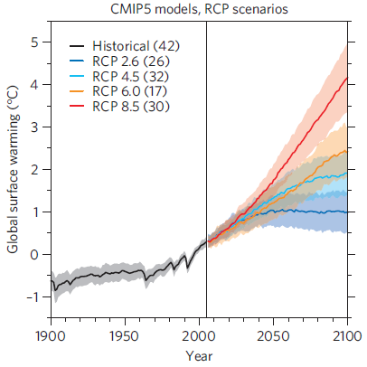
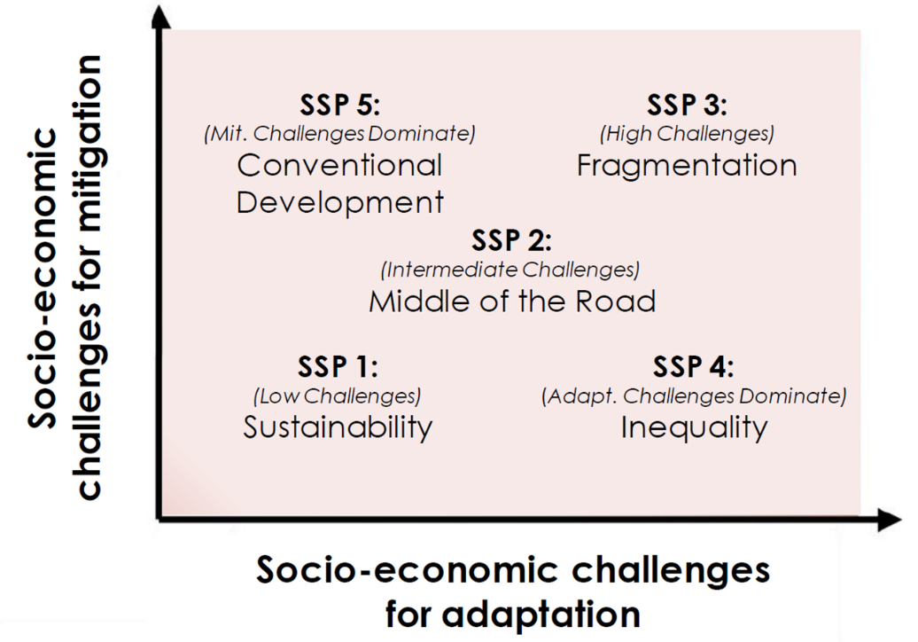
Shared Socioeconomic pathways (SSPs)
Notes:
For the two basins, the SSPs and RCPs provide the context to define the regional specific change pathways, and it is expected that these scenarios can be refined (e.g. by including important regional factors) and improved (e.g. incorporating better information datasets) in collaboration with the stakeholders.

Slide 17
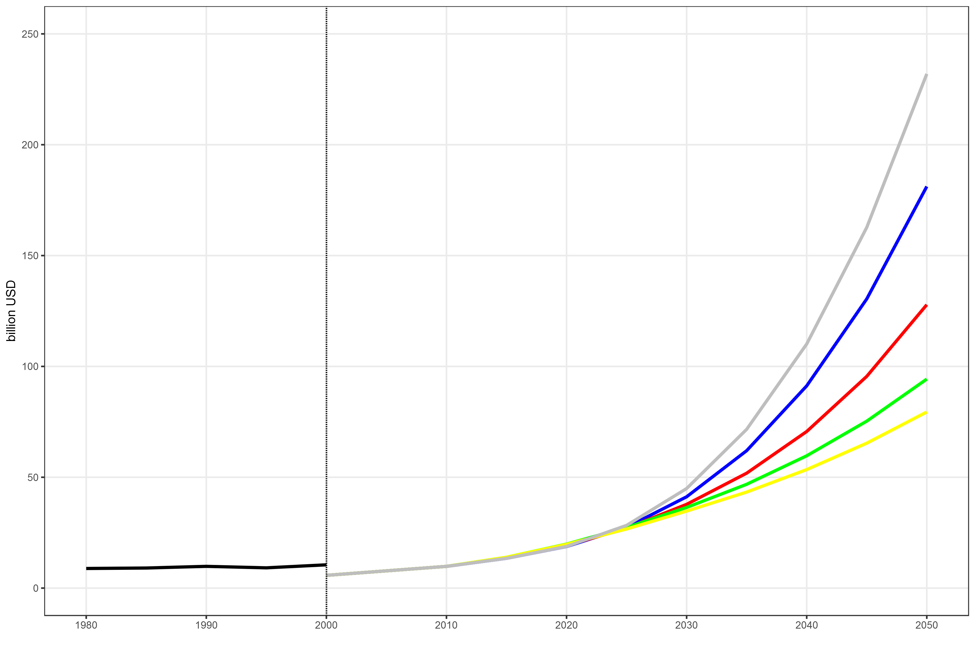
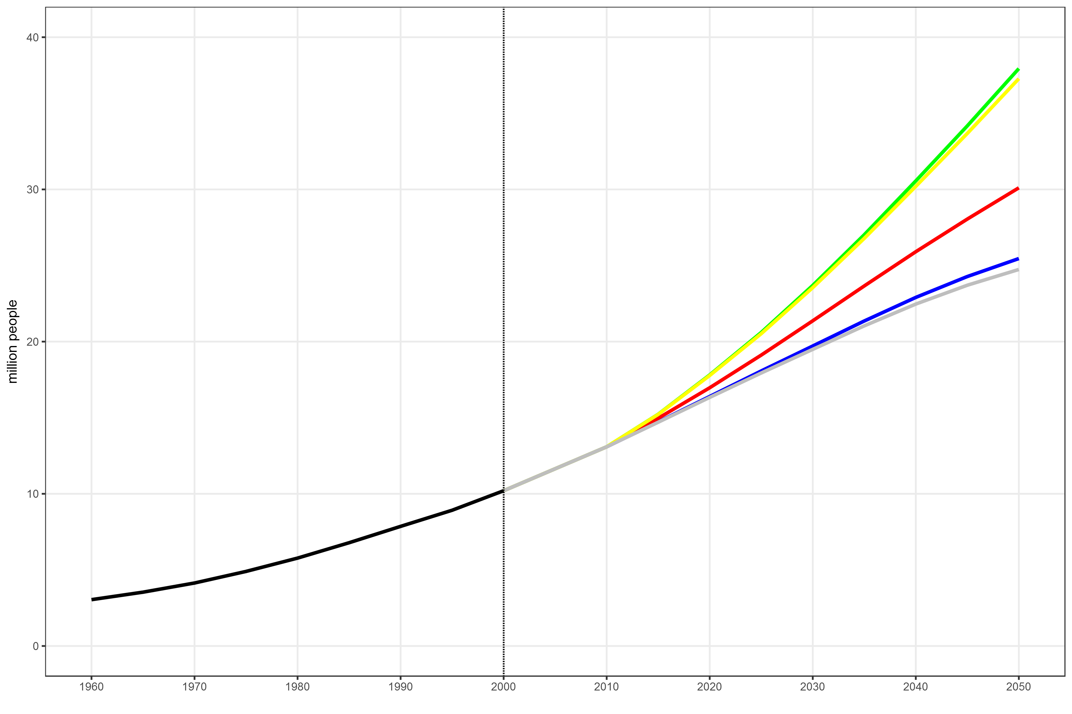
Socioeconomic drivers: GDP and population growth
GDP growth (billions USD)
Population growth (millions of people)
Source: IIASA SSP database

Slide 18
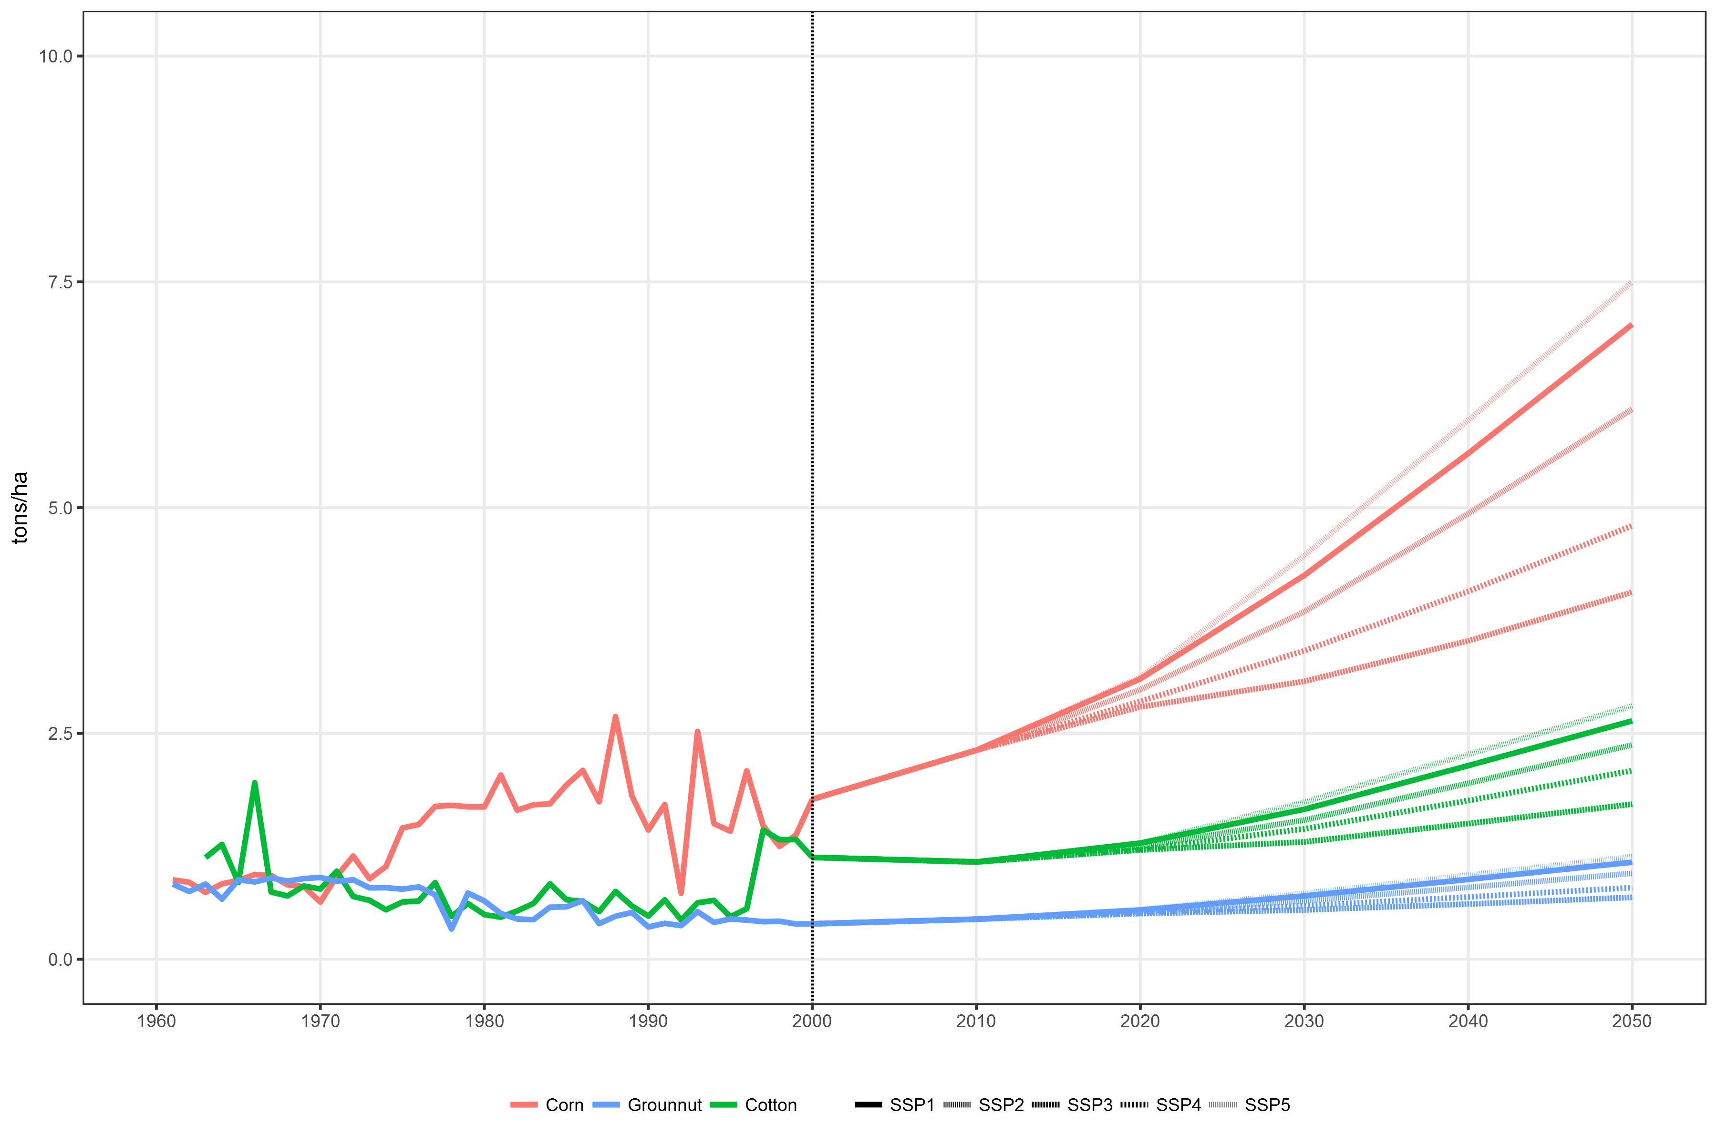
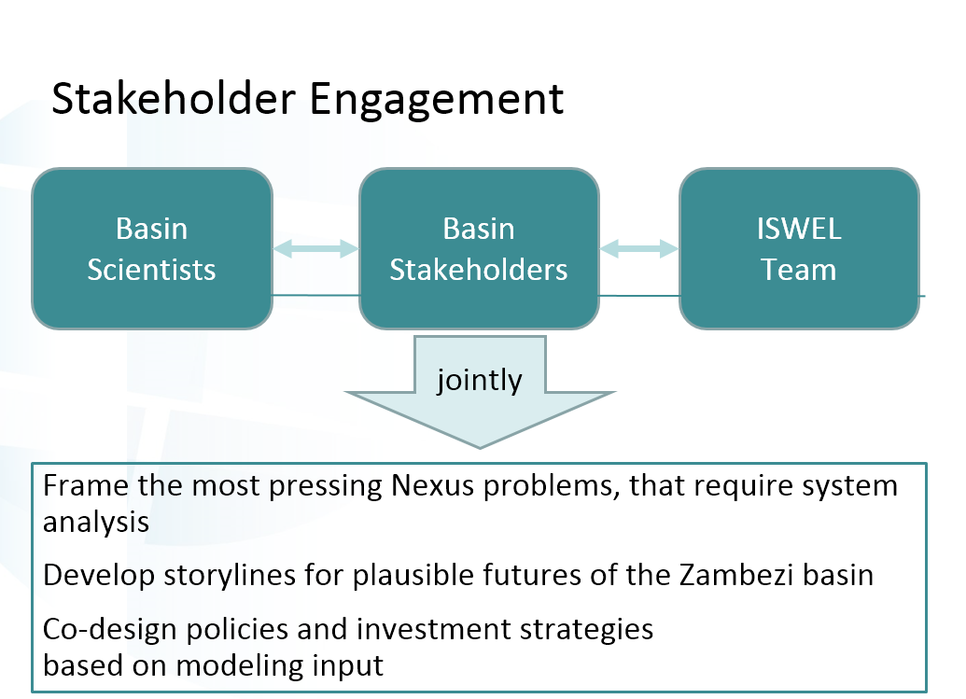
Crop Yields (tons/ha)
Future storylines to be co-developed
Notes:
Based on an econometric relationship of historic yield growth, investment in agriculture and GDP growth

Slide 19
Demand from other users (000 km³)
Future storylines to be co-developed
Source: PRCRGLOB projections (Wada et a. 2016)
Notes:
Demand for water from other users: SSP2 in results shown here but SSP3 has most significant increase in water demand, will be refined with stakeholders working in the sectors

Slide 20
Results of exploratory scenarios (SSPs) for use in stakeholder engagement
Agricultural Production
  Crop
  Livestock
  Land use change
Water use by sector and source
Food Security
  Calories per capita food availability
  Trade balance

Slide 21
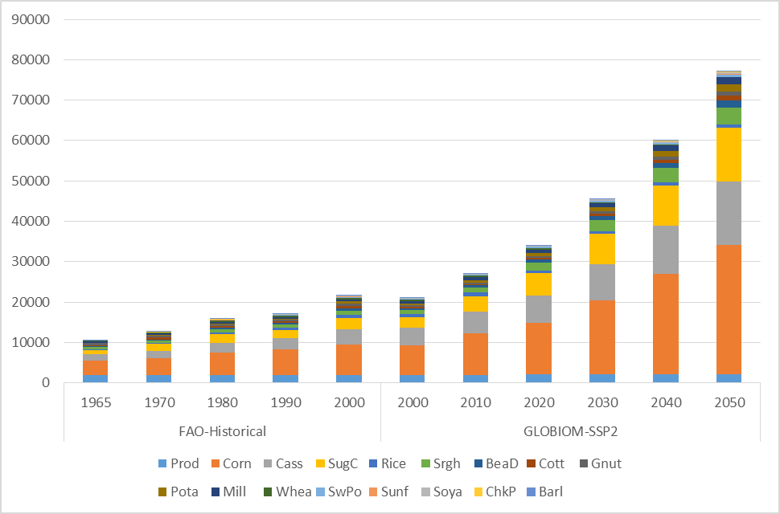
Agricultural production (Zambezi Basin)
Crop production (000 dm t)

Slide 22
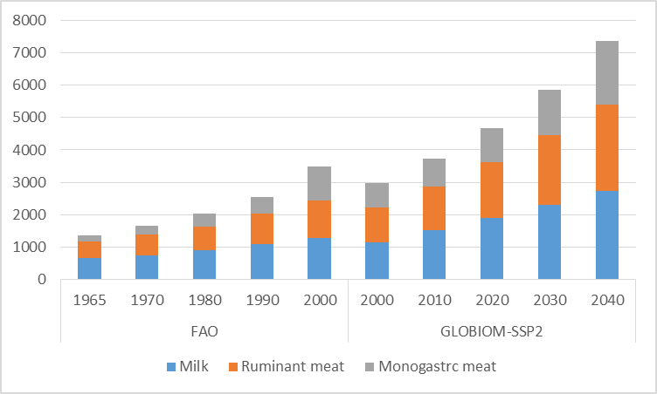
Agricultural production (Zambezi Basin)
Livestock production by livestock type (gigacaolories)

Slide 23
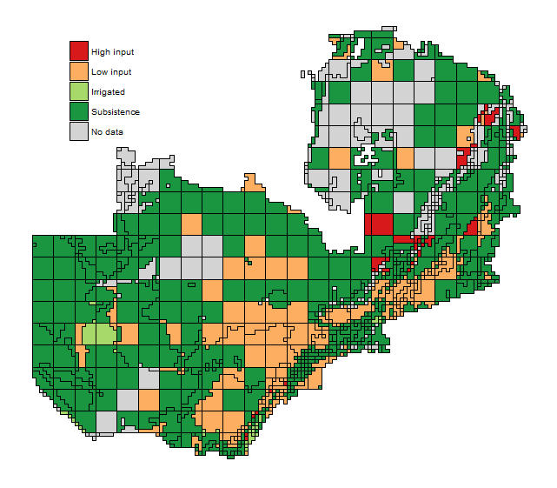
Land use change in Zambezi region
Total cropland area increases 32 percent
  Irrigated area expands by almost 45% by 2050
  Rainfed area increases by 32% by 2050
    Most in low input rainfed area
12 m ha of forest area in Zambezi countries is converted
Pasture land declines slightly (~1%)
Cropland cover in 2000 for Zambia

Slide 24
Zambezi region change in water demand (Indexed to yr 2000)

Slide 25
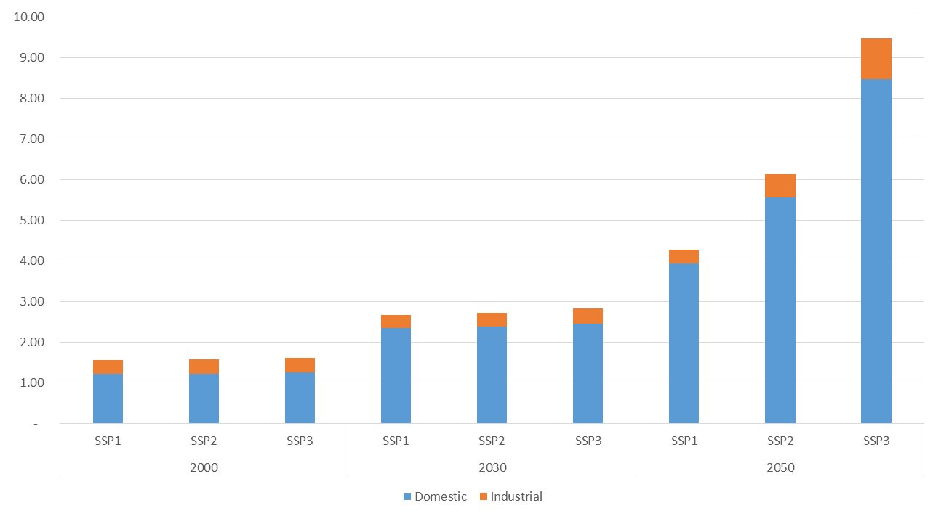
Zambezi region share of water use by sector and source
In 2050, irrigation water will use > 80% of surface water withdrawals
Water demand for irrigation increases by 50%, but other sectors grow by 400%

Slide 26
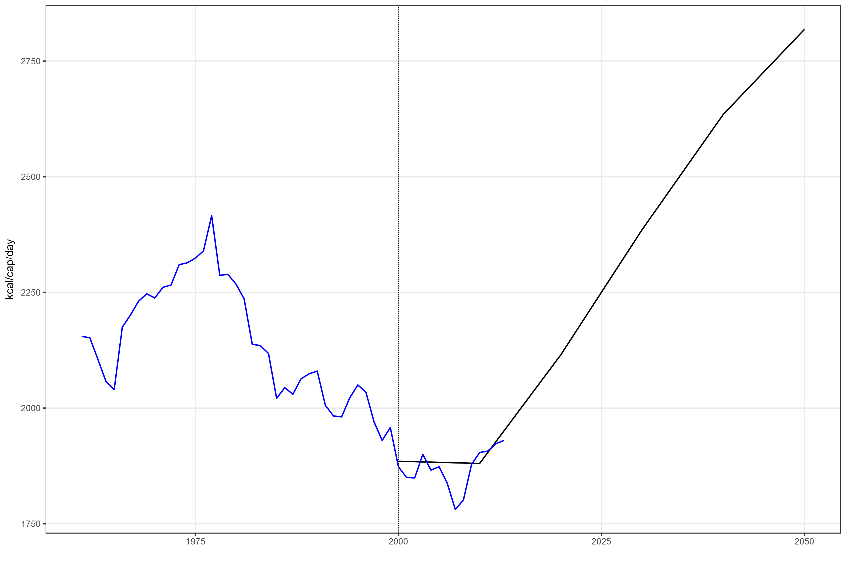
Food security in the Zambezi Region
Kilocalorie availability per capita per day
Net import of calories (gigacaolories)
Calories produced – calories demanded

Slide 27
Conclusions
Per capita GDP growth may be optimistic for the future (compared with historic trends) of the region and implies food security could improve by 2050, but dependence on imports will continue
Ag production continues to grow (through productivity growth and cropland area expansion).
  Cropland dominated by low input rainfed agriculture though irrigated area grows
Agriculture will still be the major user of water by 2050, though future water demand from other sectors may be underestimated
  Stakeholder scenarios can offer plausible projections

Slide 28
Next Steps
Improve current land cover using household survey data
Include planned basin activities: irrigation expansion plans and hydropower dams
Validation of exploratory scenarios with regional stakeholder
Examine climate impacts on crop production and water availability

Slide 29
Thank you!
Amanda Palazzo (palazzo@iiasa.ac.at)
Research Scholar, Ecosystems Services and Management Program
ISWEL
Integrated Solutions for Water-Energy-Land
Partnership:

Slide 30
References
Flörke, M., Kynast, E., Bärlund, I., Eisner, S., Wimmer, F., and Alcamo, J. (2013): Domestic and industrial water uses of the past 60 years as a mirror of socio-economic development: A global simulation study, Global Environ. Change, 23, 144–156, doi:10.1016/j.gloenvcha.2012.10.018.
McCollum D, Gomez Echeverri L, Riahi K, & Parkinson S (2017). SDG7: Ensure Access to Affordable, Reliable, Sustainable and Modern Energy for All. In: A guide to SDG interactions: from science to implementation. Eds. Griggs, D.J., Nilsson, M., Stevance, A. & McCollum, D., pp. 127-173 International Council for Science, Paris. DOI:10.24948/2017.01.
Pastor, A. V., Ludwig, F., Biemans, H., Hoff, H., and Kabat, P. (2014). Accounting for environmental flow requirements in global water assessments, Hydrol. Earth Syst. Sci., 18, 5041-5059, doi:10.5194/hess-18-5041-2014
Pastor A, Palazzo A, Havlík P, Biemans H, Wada Y, Obersteiner M, Kabat P, Ludwig F. In review. Balancing food security and water for the environment under global change
Obersteiner M, Walsh B, Frank S, Havlik P, Cantele M, Liu J, Palazzo A, Herrero M, et al. (2016). Assessing the land resource-food price nexus of the Sustainable Development Goals. Science Advances 2 (9): e1501499. DOI:10.1126/sciadv.1501499.
Wada Y, Flörke M, Hanasaki N, Eisner S, Fischer G, Tramberend S, Satoh Y, van Vliet M, Yillia P, Ringler C, Burek P & Wiberg D (2016). Modeling global water use for the 21st century: Water Futures and Solutions (WFaS) initiative and its approaches. Geoscientific Model Development, 8: 6417–6521

Slide 31
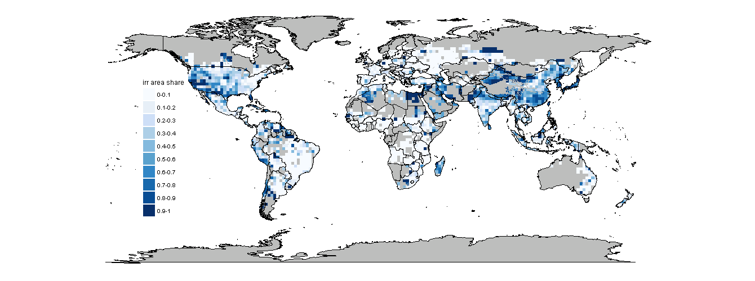
Share of irrigated area/total cropland area
(yr 2000): IFPRI SPAM data

