Slide 1
Hotspots in land and water resource uses on the way toward achieving the Sustainable Development Goals
Amanda Palazzo*¹, Petr Havlík¹, David Leclere¹, Michiel van Dijk^{1,2}, Andre Deppermann¹
1 Ecosystem Services and Management program (IIASA, Austria)
2 Wageningen Economic Research, (Netherlands)
Impacts World 2017 Conference | 11-13th October 2017
* palazzo@iiasa.ac.at

Slide 2
Introduction and Motivation
The world’s population is growing, becoming richer, and changing their food preferences
Irrigated agriculture has the potential to produce more on less land
70% of water withdrawals come from irrigated agriculture
Demands from other sectors will increase (WFaS)
What are the goals of the SDGs?
  Can we identify tradeoffs among goals that focus on water for human and environmental uses?

Slide 3
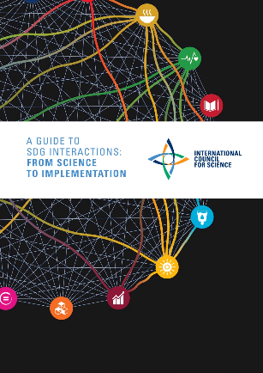
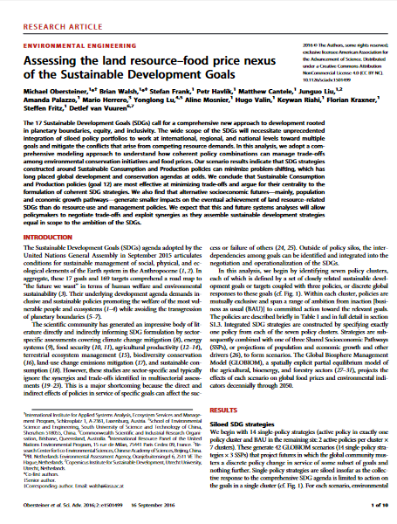
Approaches to examining the SDG linkages and trade-offs

Slide 4





Water: Good to the last drop and used to the last drop

Slide 5

Land: produce more with less inputs and with less impact

Slide 6
Methods

Slide 7
Conceptual Framework
Shared Socioeconomic Pathways:
GDP, population, consumer preferences, irr. efficiency, tech. progress for crops and livestock
General Circulation models:
HADGEM
ISPSL
RCP 8.5
Temp.,
Radiative Forcing,
Precip.
Global hydrological model:
LPJmL
Runoff and environmental flows requirement
Water demand for industry and households:
WaterGAP
PCR-GLOBWB
Partial Equilibrium Model:
GLOBIOM
Crop area, production, bilateral trade, prices
Net wat. avail
Biophysical crop model: EPIC
Crop yields and input requirements for crop production systems

Slide 8

Global Biosphere Management Model (GLOBIOM)
Global scale model based detailed spatial resolution (>200k cells)
Partial equilibrium
  Agricultural, wood and bioenergy markets
  30 world regions
  Bilateral trade flows based on spatial equilibrium approach
Bottom-up approach
  Explicit description of production technologies a la Leontief
  Technologies specified by production system and grid cell
Linear programming approach
  Maximization of consumer + producer (incl. trade costs) surplus
  Non linear expansion costs
  Optimization constraints
Base year: 2000
Time step: 10 years
Time horizon: 2030/2050, but also 2100

Slide 9
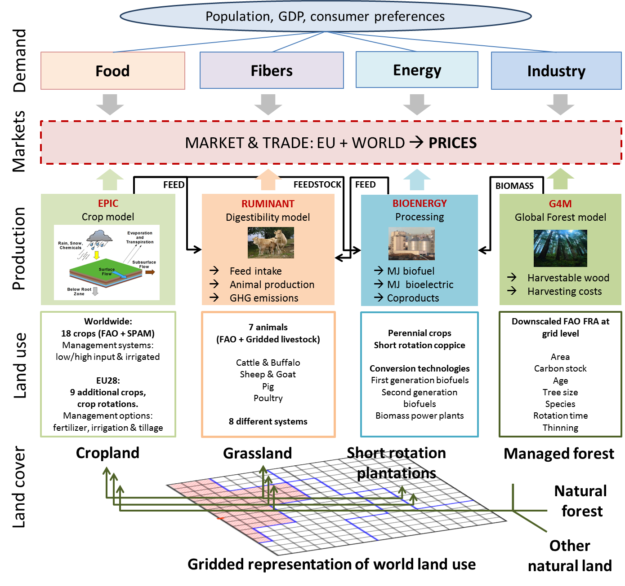

Water demand by for Agriculture
Monthly water demand for crops by EPIC
Irrigated/rainfed
crop yields
Water available for Agriculture
Share supplied by groundwater
Share supplied by
surface water

Slide 10
Representing irrigation as a crop production system
Irrigation water demand by crop
    Crop water requirement calculated by EPIC
      Climate change: change in precipitation, temperature → irrigation requirement (5 GCMs)
    Monthly water demand based on crop calendar by EPIC
  Irrigated cropland area from SPAM (IFPRI) and calibrated with FAO statistics
Irrigation by systems
  Basin, furrow, sprinkler, drip
  Differentiated by cost, efficiency, and crop and biophysical suitability (Sauer et al. 2010)
    Suitability at simulation unit and homogenous response unit level

Slide 11
Representing biophysical and economic scarcity
Biophysical scarcity
  Water use is physically limited by water available by source at the land unit
    Water Source: source of irrigation supply: surface and groundwater (Siebert et al 2010: share of land supplied by groundwater)
    Surface water availability from LPJmL
      LU level (200 x 200 km); monthly availability
      IIASA’s CWM (IS-WEL)
    Demand for water from other sectors:
      WaterGap and PCR-GLOBWB: domestic, industry (water for power plant cooling is included) for SSP2 (Wada et al. 2016: WFaS)
      Environment flows (Pastor et al 2014: VFM)
Economic Scarcity
  Increase in the demand/use of surface water increases the water price at the regional level
    IIASA’s ECHO model (IS-WEL)
  Irrigation demand aggregated and calibrated to Aquastat (year 2000 at country level)
  Shifted proportionally to changes in biophysical availability for future projections

Slide 12
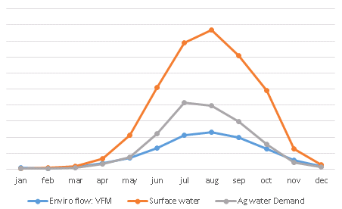
Representing temporal characteristic of water
km^3

Slide 13
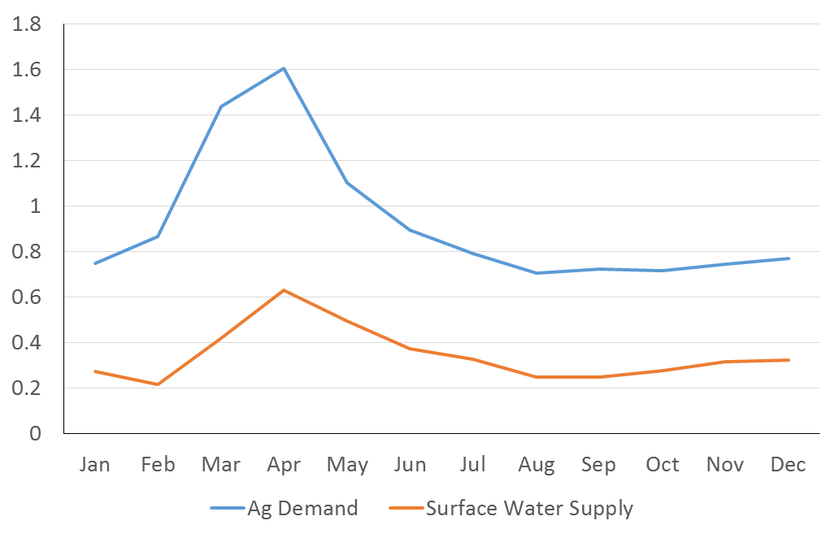
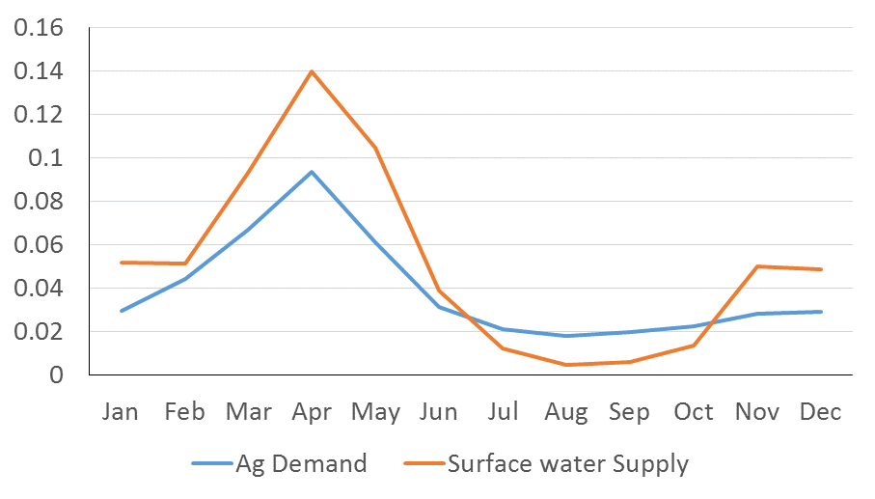
Why do we care about the monthly time step?

Slide 14
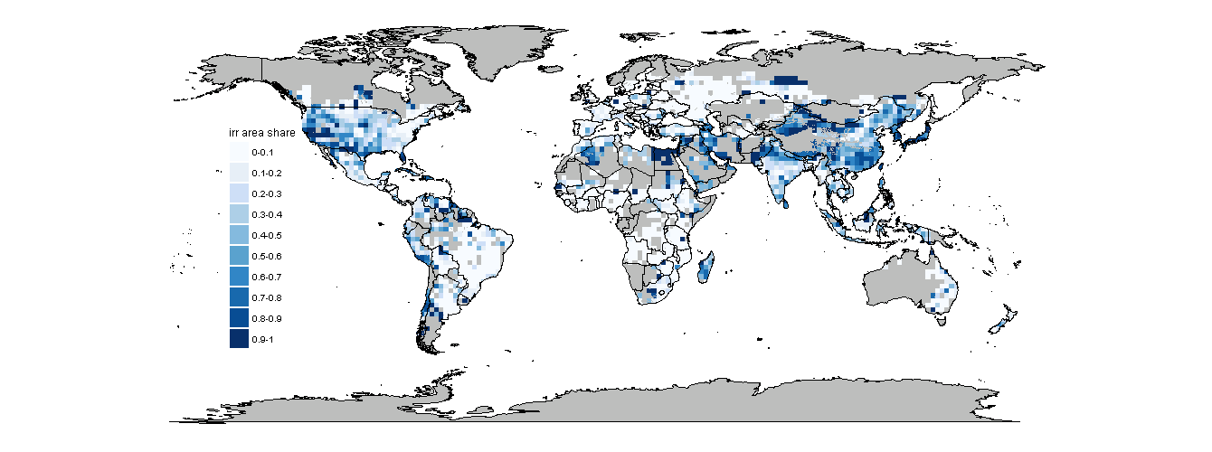
Share of irrigated area/total cropland area
(yr 2000): IFPRI SPAM data

Slide 15
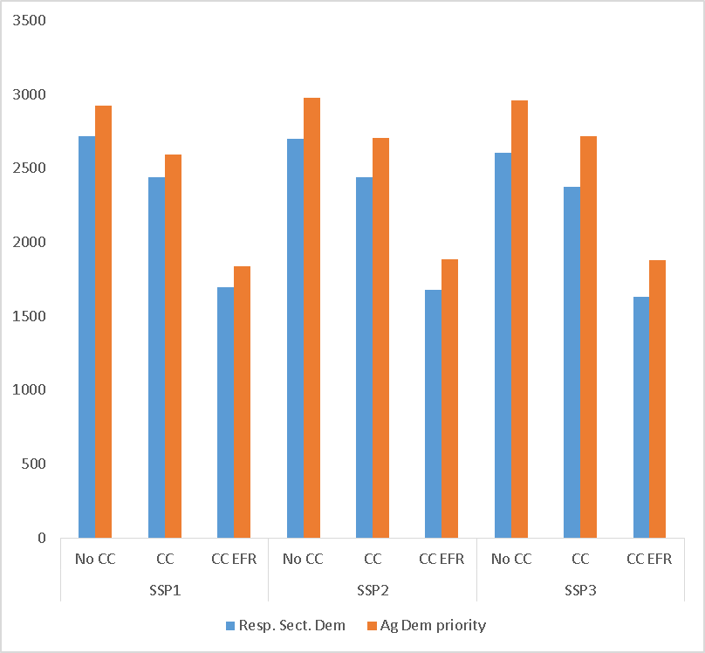
Ag (irrigated) production unlimited by water demand from other sectors

Slide 16
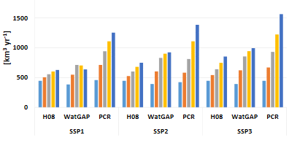
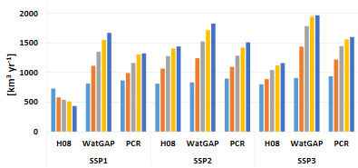
Water demand from other sectors (domestic, industry) is growing and in some cases exceeds the surface water available

Slide 17
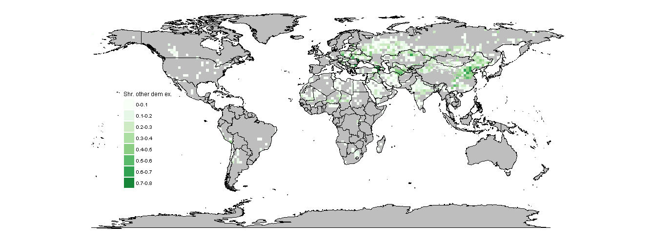
Share of other sector demands exceeding monthly availability in 2050 (SSP1)

Slide 18

Share of other sector demands exceeding monthly availability in 2050 (SSP3)

Slide 19
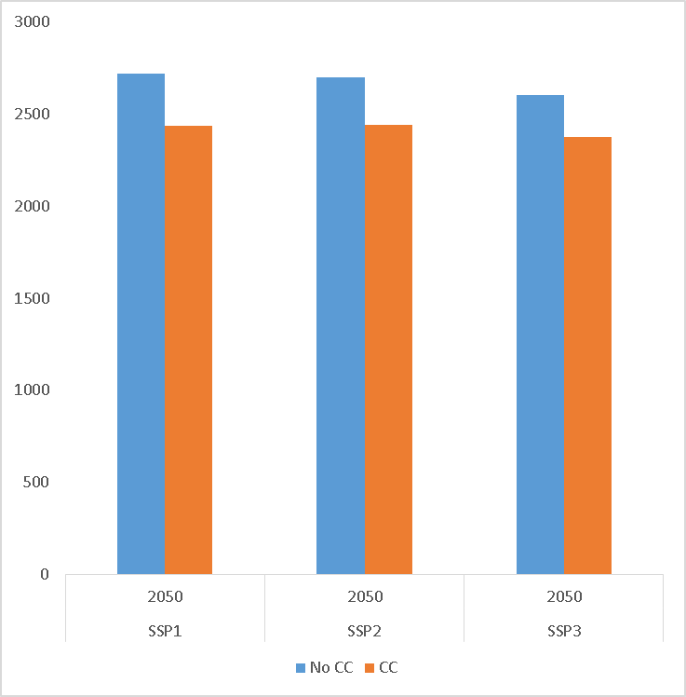
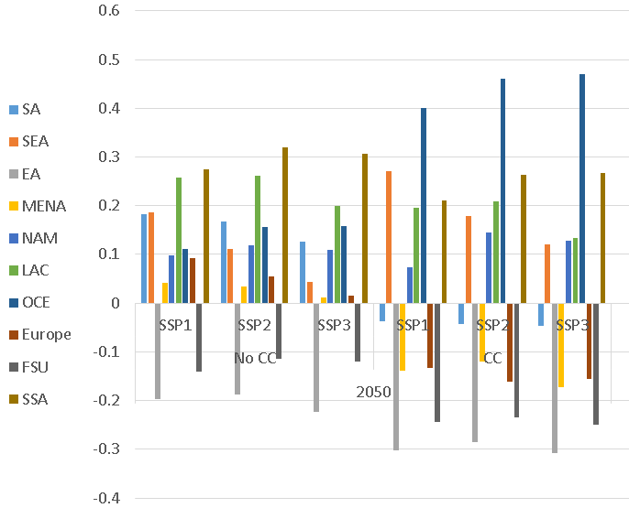
Water demand for irrigation may follow similar global patterns, however water is local
Water demand for irr from in 2050 (km^3)
Change in water demand for irr from 2000 to 2050
2000

Slide 20
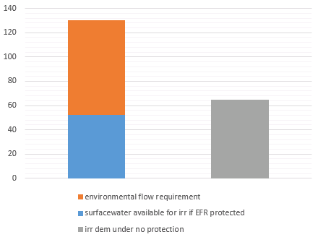
Water Exploitation Index: highlighting where ag exceeds environmental flow requirements
Surfacewater Available
Water cosumed by Ag if EFRs are not protected

Slide 21
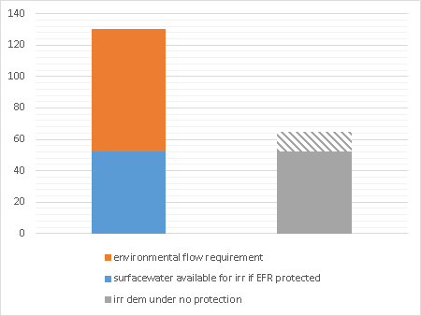
Water Exploitation Index: highlighting where ag exceeds environmental flow requirements
Water consumed in excess of the EFRs

Slide 22
Water Exploitation Index: highlighting where ag exceeds environmental flow requirements
WEI: ~ 0.17

Slide 23
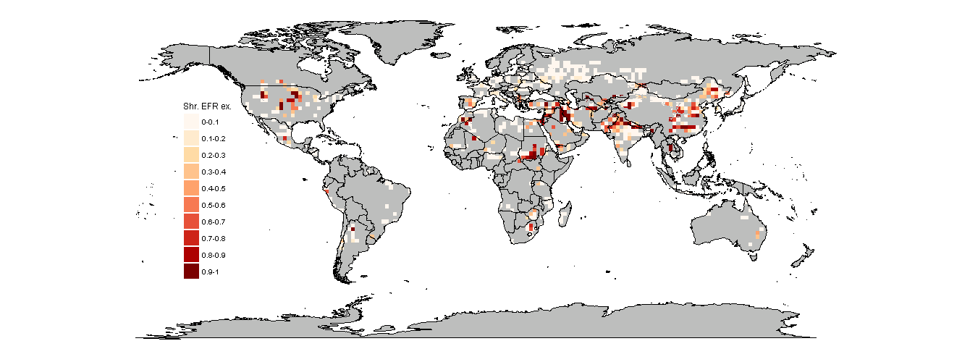
Ag (irrigated) production limited to residual water after domestic and industry but no EFR
Yr 2000

Slide 24
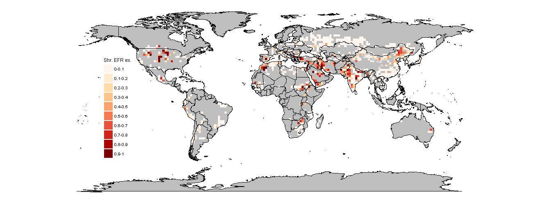
Ag (irrigated) production limited to water left after domestic and industry but no EFR
SSP1, NoCC, 2050, Preliminary Results

Slide 25
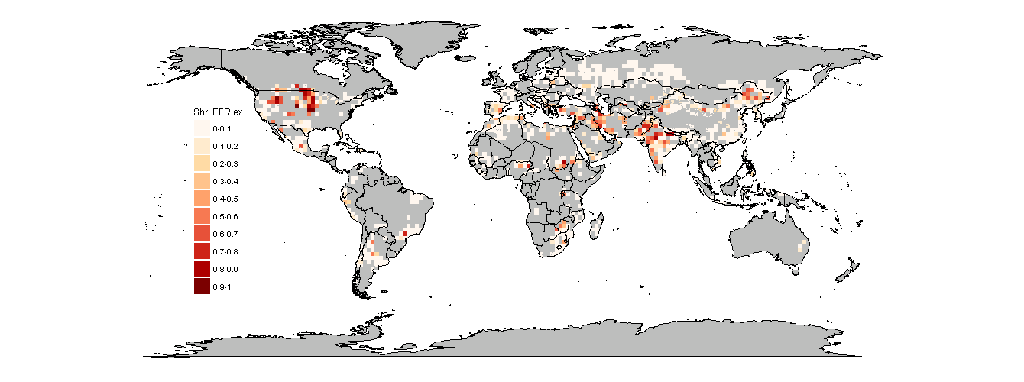
Ag (irrigated) production limited to water left after domestic and industry but no EFR
SSP1, GCM1, 2050, Preliminary Results

Slide 26
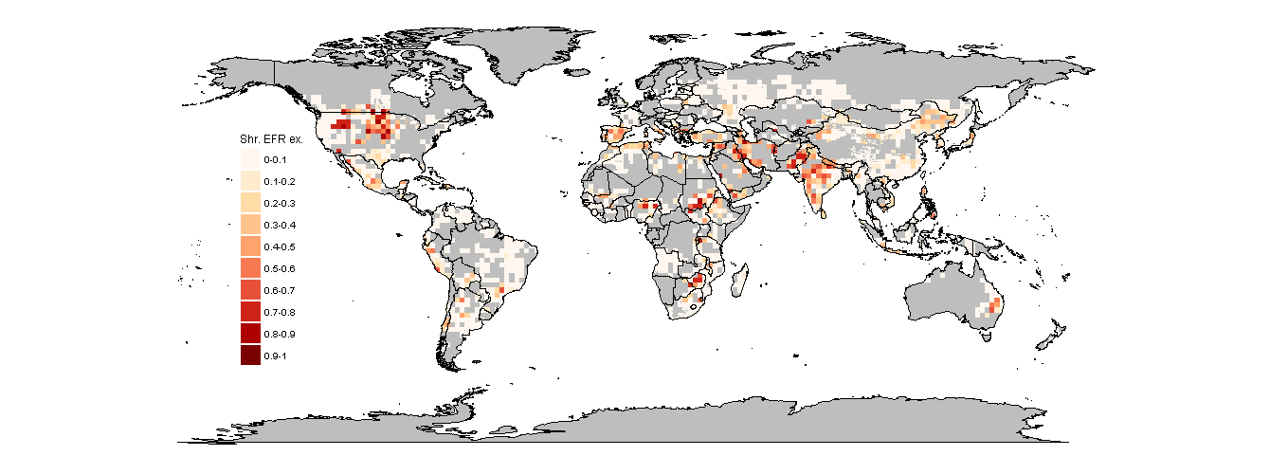

Ag (irrigated) production limited to water left after domestic and industry but no EFR
SSP2, NoCC, 2050, Preliminary Results

Slide 27
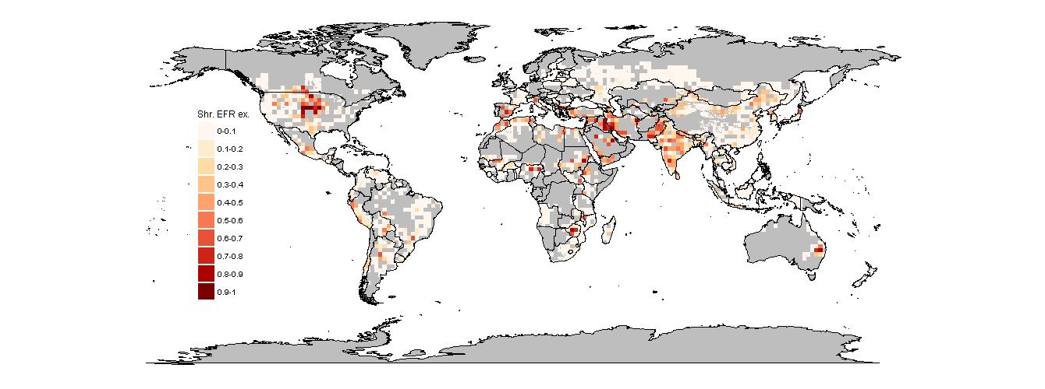
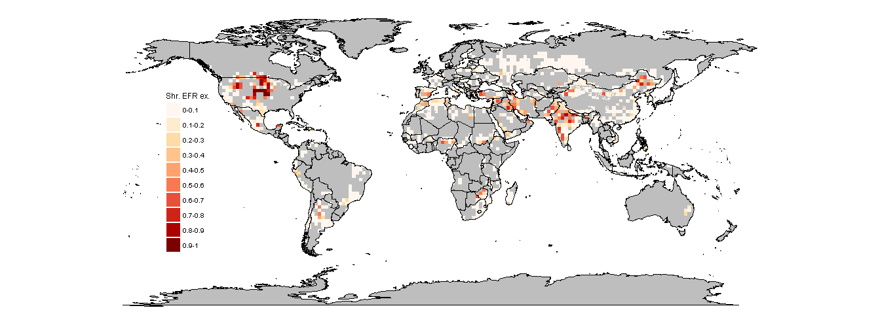
Ag (irrigated) production limited to water left after domestic and industry but no EFR
SSP2, GCM1, 2050, Preliminary Results

Slide 28

Ag (irrigated) production limited to water left after domestic and industry but no EFR
SSP3, NoCC, 2050, Preliminary Results

Slide 29

Ag (irrigated) production limited to water left after domestic and industry but no EFR
SSP3, GCM1, 2050, Preliminary Results

Slide 30
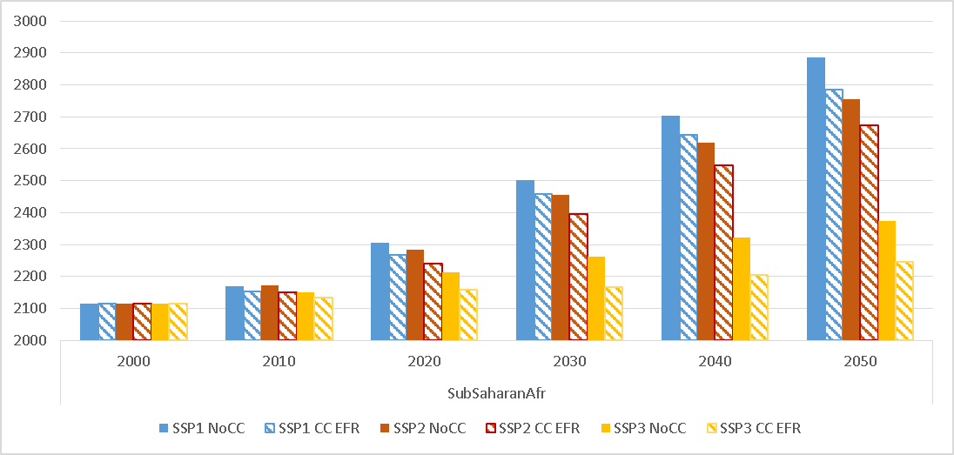
Ag (irrigated) production limited by water demand from all other sectors and protection of the EFRs:
Food Security

Slide 31
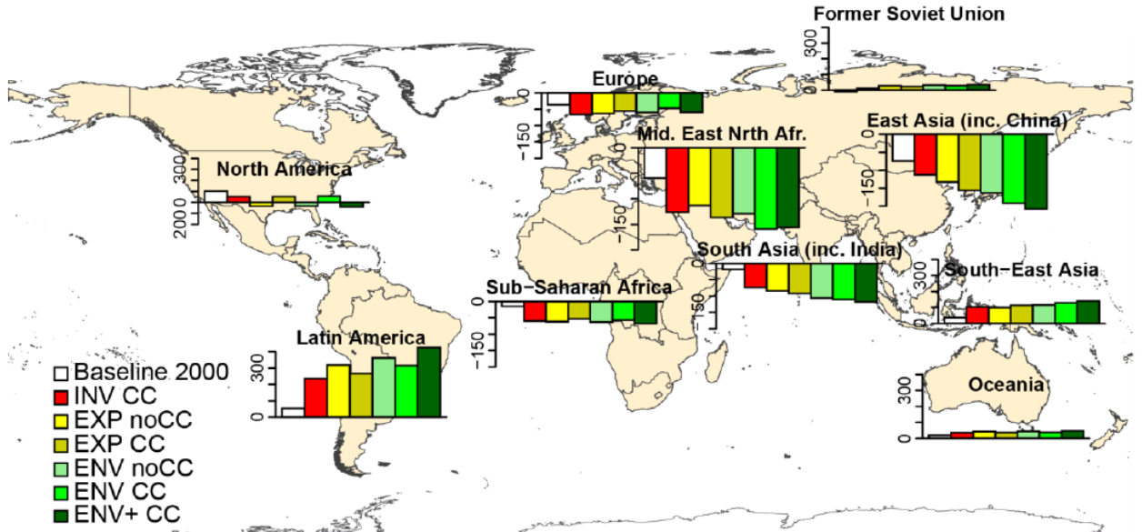
Irrigation and environmental flows: trade as a mitigation option
Pastor A, Palazzo A, Havlík P, Biemans H, Wada Y, Obersteiner M, Kabat P, Ludwig F. In review.
Balancing food security and water for the environment under global change
Notes:
Climate change will have an effect on precip and temperature, and using crop models to simulate the way in which crops grow, we can see the effect in those changes in terms of crop yields. Irrigation as an adaptation strategy to climate change, large variability in the share of irrigated area under different GCMs.

Slide 32
Conclusions
Future climate change may make more water available in but not always when it can be utilized by agriculture
  Temporal issues matter for the environment and agriculture
Demand for water from other sectors will increase in places where there is already water scarcity
  Increasing the competition with agriculture
Protections of environmental streamflows can have consequences on food availability
  Though to some extent trade can mitigate these consequences
Next steps and limitations
  water supply costs (IIASA’s ECHO model)
  Further testing with ISIMIP GHMs under wider range of GCMs
  Dynamic crop calendar
  Water storage (IIASA’s CWM)

Slide 33


Thank you!
Amanda Palazzo (palazzo@iiasa.ac.at)
Research Scholar, Ecosystems Services and Management Program
ISWEL
Integrated Solutions for Water-Energy-Land
Partnership:

Slide 34
References
Flörke, M., Kynast, E., Bärlund, I., Eisner, S., Wimmer, F., and Alcamo, J. (2013): Domestic and industrial water uses of the past 60 years as a mirror of socio-economic development: A global simulation study, Global Environ. Change, 23, 144–156, doi:10.1016/j.gloenvcha.2012.10.018.
McCollum D, Gomez Echeverri L, Riahi K, & Parkinson S (2017). SDG7: Ensure Access to Affordable, Reliable, Sustainable and Modern Energy for All. In: A guide to SDG interactions: from science to implementation. Eds. Griggs, D.J., Nilsson, M., Stevance, A. & McCollum, D., pp. 127-173 International Council for Science, Paris. DOI:10.24948/2017.01.
Pastor, A. V., Ludwig, F., Biemans, H., Hoff, H., and Kabat, P. (2014). Accounting for environmental flow requirements in global water assessments, Hydrol. Earth Syst. Sci., 18, 5041-5059, doi:10.5194/hess-18-5041-2014
Pastor A, Palazzo A, Havlík P, Biemans H, Wada Y, Obersteiner M, Kabat P, Ludwig F. In review. Balancing food security and water for the environment under global change
Obersteiner M, Walsh B, Frank S, Havlik P, Cantele M, Liu J, Palazzo A, Herrero M, et al. (2016). Assessing the land resource-food price nexus of the Sustainable Development Goals. Science Advances 2 (9): e1501499. DOI:10.1126/sciadv.1501499.
Wada Y, Flörke M, Hanasaki N, Eisner S, Fischer G, Tramberend S, Satoh Y, van Vliet M, Yillia P, Ringler C, Burek P & Wiberg D (2016). Modeling global water use for the 21st century: Water Futures and Solutions (WFaS) initiative and its approaches. Geoscientific Model Development, 8: 6417–6521

