Slide 1
Generating high-resolution national crop distribution maps: Combining statistics, gridded data and surveys using an optimization approach
30th International Conference of Agricultural Economists (ICAE), 1st August, 2018, Vancouver, British Columbia, Canada
Michiel van Dijk (in cooperation with Liangzhi You, Aline Mosnier, Petr Havlik and Amanda Palazzo)

Slide 2
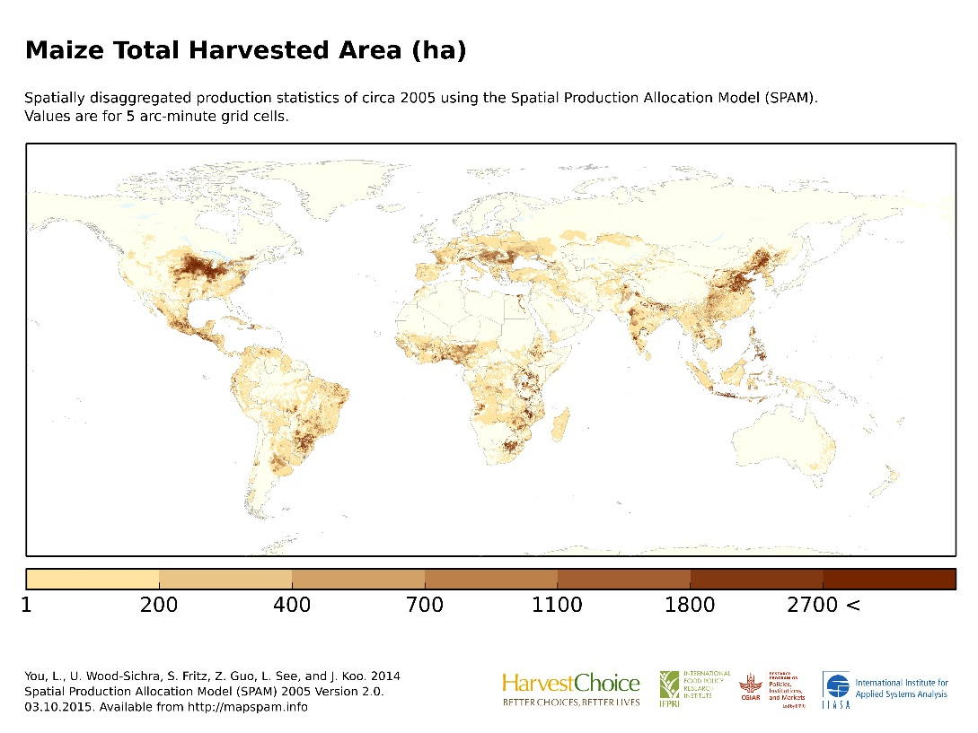
Problem
Where are crops grown?
Background
Builds on the Spatial Allocation Model (SPAM) (You and Wood 2006; You et al. 2009; You et al. 2014)
Aim
Develop detailed high-resolution (1x1 km) crop distribution maps for country and regional studies

Slide 3
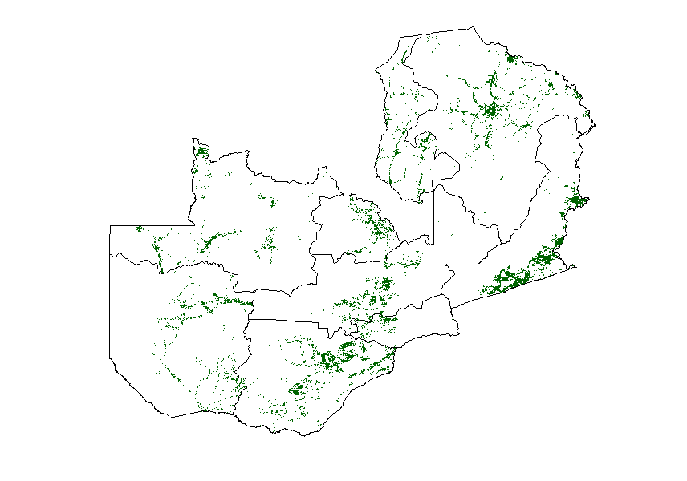
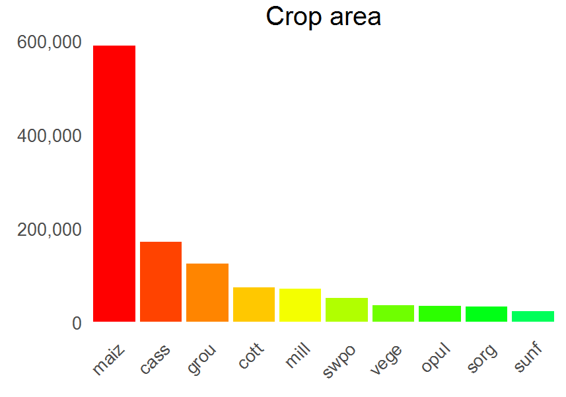
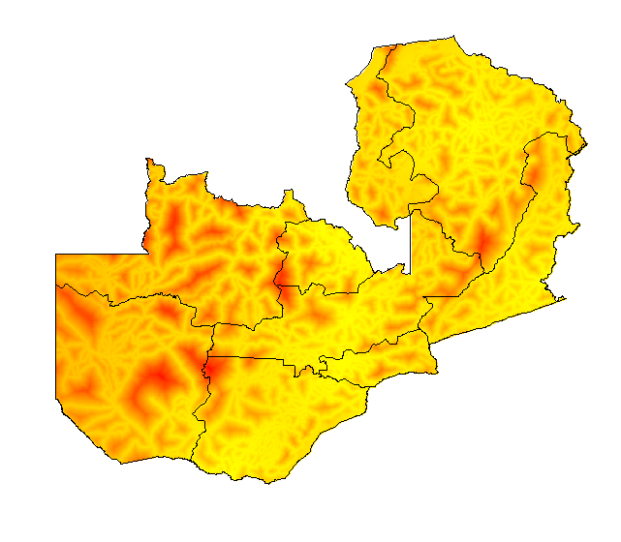
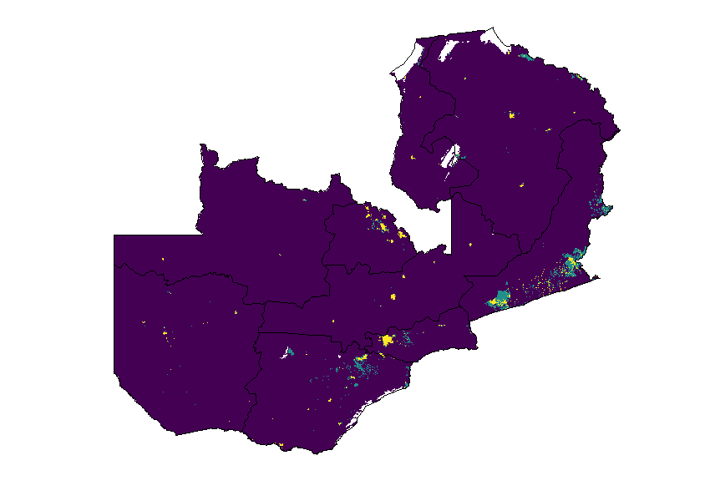
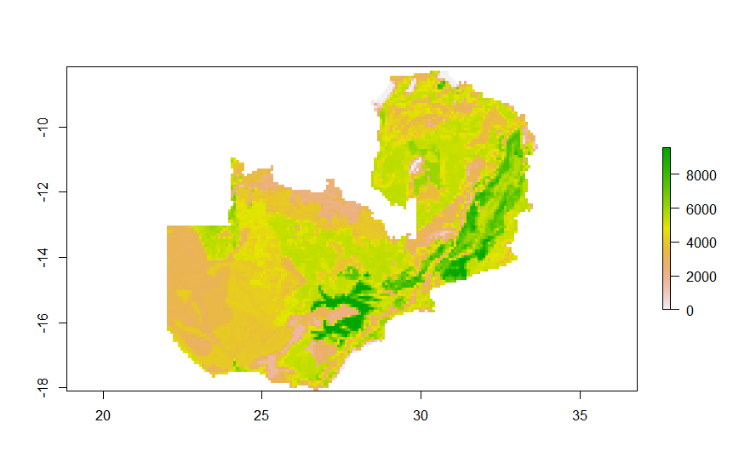
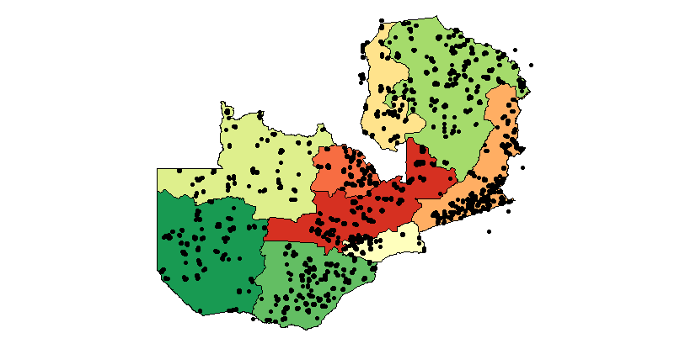
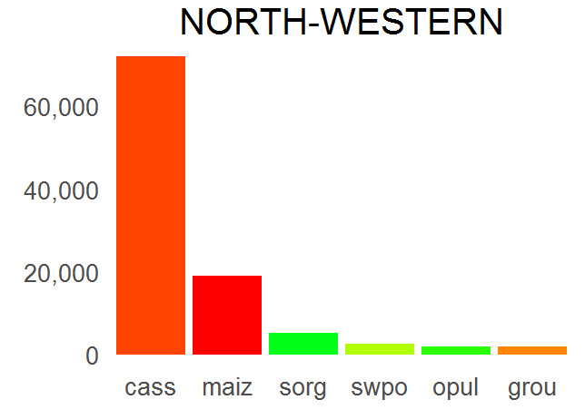
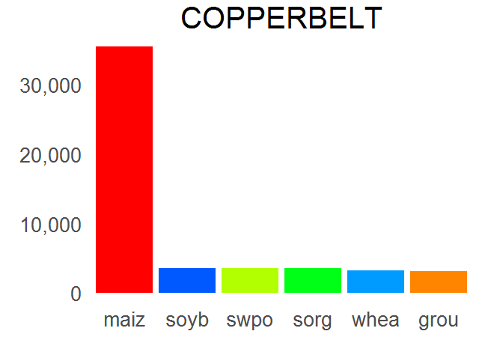
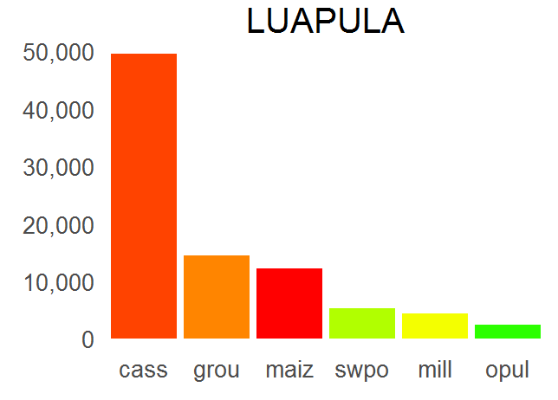
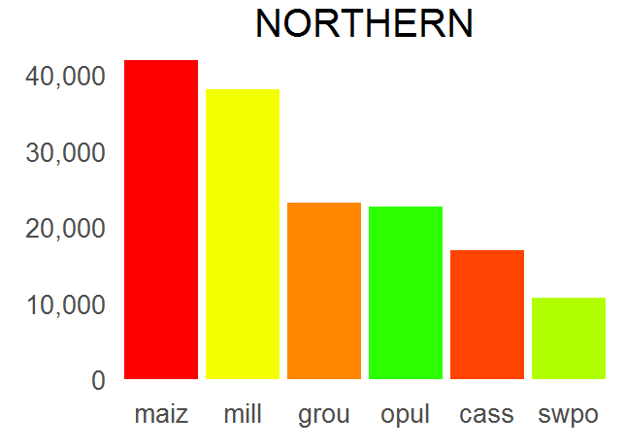
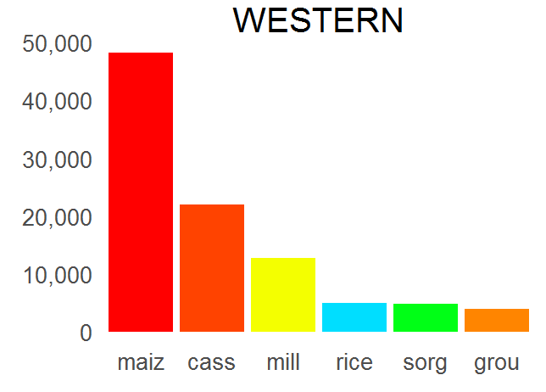
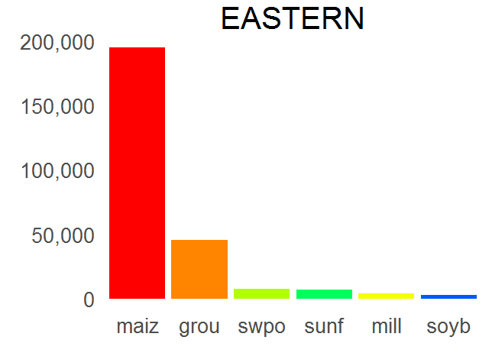
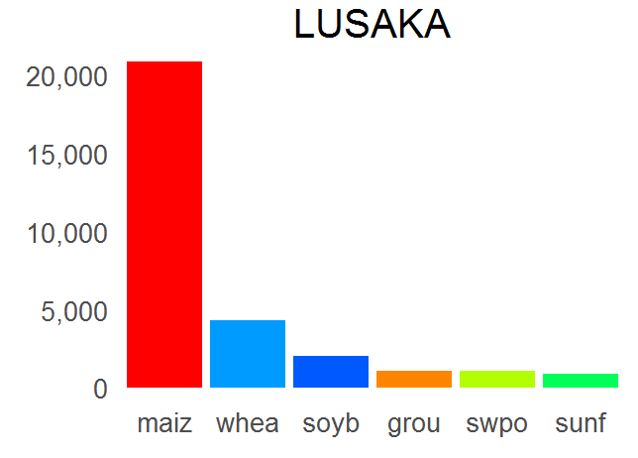
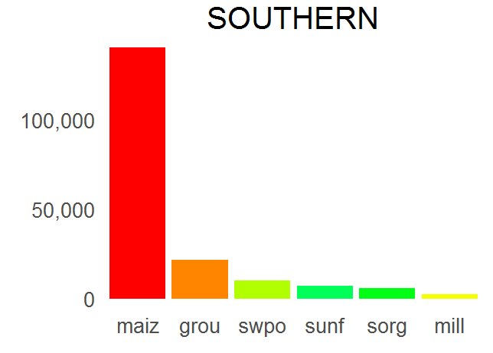
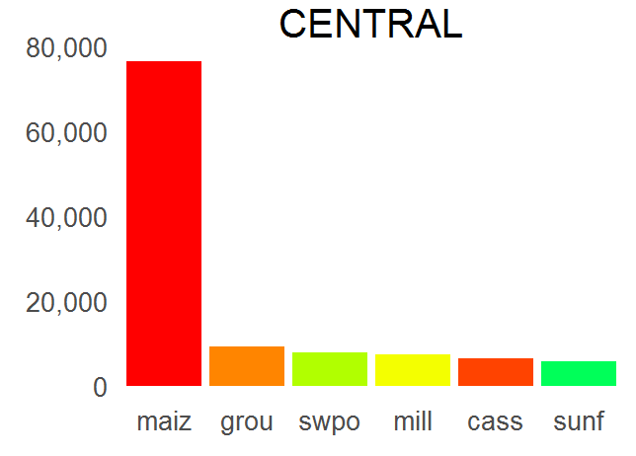
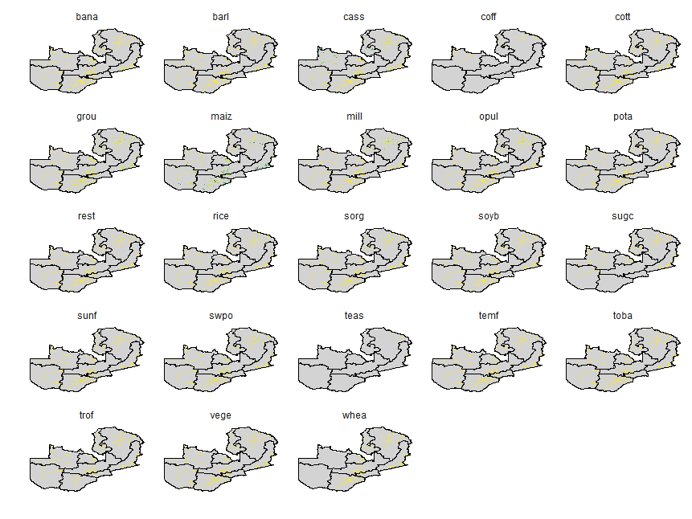
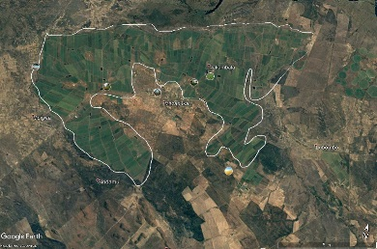
Methodology
Crop statistics
Crop cover map
Priors
National crops statistics
Sub-national crops statistics
Spatial allocation model
Crop distribution maps
Spatially explicit data

Slide 4
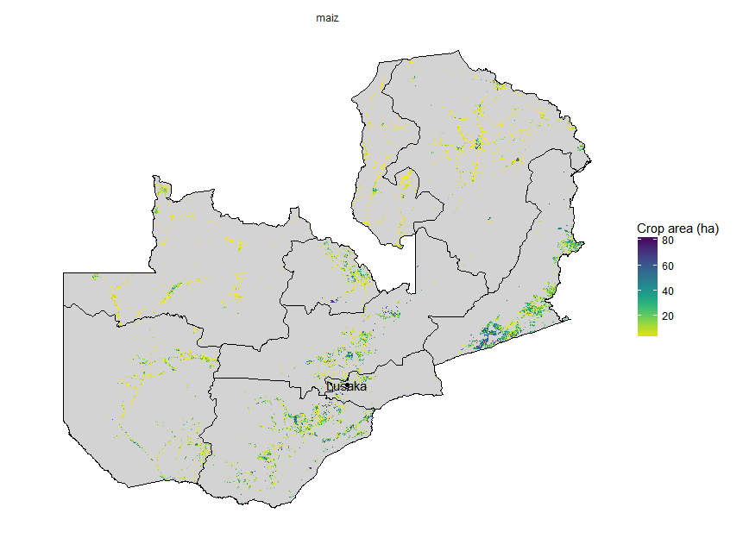
Results: Location of maize in Zambia

Slide 5
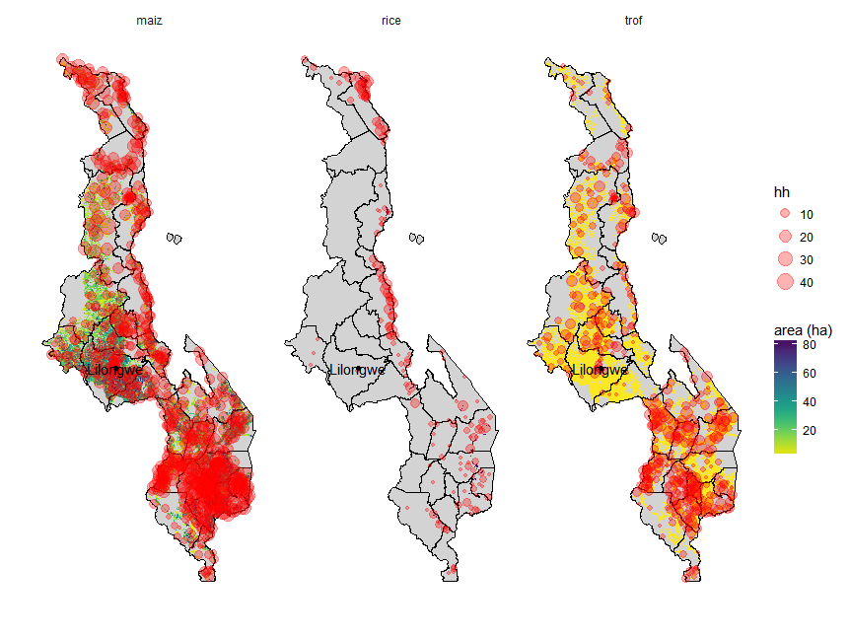
Next steps
Add data on plantations from Open Street Map
Use Bayesian statistical model to improve priors
Validation of results using household survey data
Apply the model to five Southern African countries

Slide 6


