Slide 1

Carbon budgets based on new climate projections of the SSP scenarios and observations
Yann Quilcaille, Thomas Gasser, Philippe Ciais, Franck Lecocq, Michael Obersteiner
EGU, Vienna, 08 Apr 2019
Session CL3.03/BG1.24

Slide 2
Carbon budgets based on new climate projections of the SSP scenarios and observations
Representative Concentration Pathways: RCPs
    4 scenarios run by a large number of Earth system models (ESMs)
Shared Socio-economic Pathways: SSPs
    Socioeconomic storylines, under which Integrated Assessment Models (IAMs) produce scenarios that reach the RCPs by 2100
→ 103 SSP scenarios produced by IAMs, 8 used by ScenarioMIP
SSP?
RCP?
VanVuuren et al, 2014
Climate projections of all SSP scenarios calculated in the reduced-form Earth system model OSCAR
SSP public database extended: Land-Use and F-Gases
OSCAR v2.3
  Mimic the behavior of models of higher complexity
  Probabilistic framework
  CO₂ emissions from Land Use Change endogenously calculated
  Permafrost thaw
Ok, then?
Carbon budgets under contrasted scenarios

Slide 3
Carbon budgets based on new climate projections of the SSP scenarios and observations
observations
IPCC Special Report 1.5°C Ch2
Observations to compensate for the bias of the models
Drastic increase of the budget, even more than SR 1.5°C: since 01/01/2018, to avoid 2°C,
690-1160 GtCO₂ | 1500 GtCO₂ | 1910 GtCO₂
IPCC AR5 WG3 | IPCC Special Report 1.5°C | This presentation
Impact of the timescale of CO₂ emissions on the difference in-between exceedance and avoidance budgets.

Slide 4
About the RCP and SSP scenarios
RF
4 Representative
Concentration Pathways
time
Earth System
Models
VanVuuren et al, 2014
8 scenarios
O’Neill et al, 2016
125 scenarios
Earth System
Models
ScenarioMIP:
incoming!
Collins et al (2018): IPCC AR5 WG1 Ch12
08 Apr 2019

Slide 5
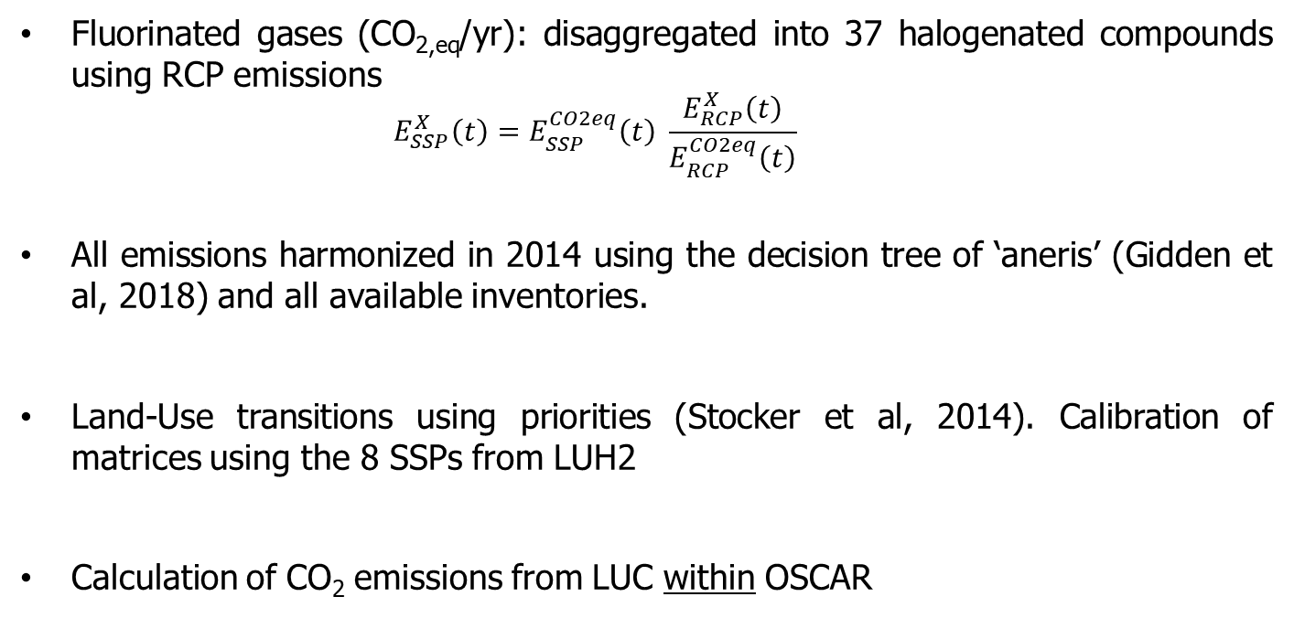
Extension of the SSP public database
Version 2018 → 2019
Fluorinated gases (CO_{2,eq}/yr): disaggregated into 37 halogenated compounds using RCP emissions
  $$E_{SSP}^{X}\left(t\right)=E_{SSP}^{CO2eq}\left(t\right) \frac{E_{RCP}^{X}\left(t\right)}{E_{RCP}^{CO2eq}\left(t\right)}$$
All emissions harmonized in 2014 using the decision tree of ‘aneris’ (Gidden et al, 2018) and all available inventories.
Land-Use transitions using priorities (Stocker et al, 2014). Calibration of matrices using the 8 SSPs from LUH2
Calculation of CO₂ emissions from LUC within OSCAR

Slide 6
OSCAR v2.2
Reduced-form Earth system model: lower resolution, but faster calculation
Every module mimics the behavior of models of higher complexity
Probabilistic framework possible through the coupling of these behaviors
Advantage of OSCAR: book-keeping module for Land-Use and feedbacks
Appropriate for large ensemble of scenarios and when dealing with uncertainties
Emissions and Land-Use scenarios
Compact Earth system model: OSCAR
Land Use
Land Use Change, Harvest, Shifting
Carbon cycle
CO₂: Ocean, Land
Climate change
Radiative Forcings, Temperatures, Precipitations, …
Greenhouse Gases
CO₂, CH₄, N₂O, halogenated
Emissions
CO₂, CH₄, N₂O, halogenated
NO_{X}, CO, VOC, SO₂, NH₃, BC, OC
Atmospheric chemistry
Other drivers
Volcanoes, Solar activity, Contrails
Short Lived
O₃, SO₄, POA, SOA, BC, NO₃

Slide 7
Observational constraints and Monte-Carlo
Change in global surface temperature since 1880-1900…
… and trend over 1991-2010
(BerkeleyEarth, HadCRUT4, GISTEMP, NOAA, Cowtan et al, 2014)
Change in atmospheric concentrations of CO₂, CH₄ and N₂O since 1750
(SIO/AGAGE, NOAA)
Probabilistic framework over:
Modelling of the Earth system
Driving datasets for the historical period
Weighting by the likelihood of every member of the Monte-Carlo ensemble
In this presentation: average and 90% confidence interval showed.

Slide 8
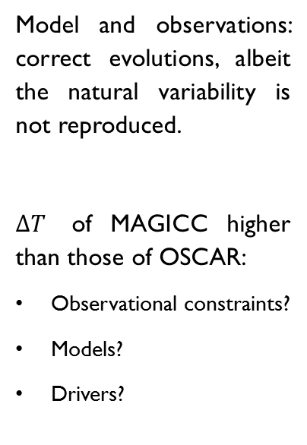
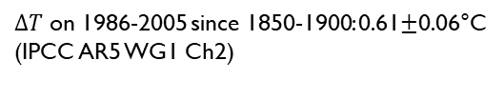
Increase in global surface temperature
Model and observations: correct evolutions, albeit the natural variability is not reproduced.
$∆T$ of MAGICC higher than those of OSCAR:
Observational constraints?
Models?
Drivers?
observations
$∆T$ on 1986-2005 since 1850-1900: 0.61$±$0.06°C
(IPCC AR5 WG1 Ch2)

Slide 9
Radiative forcing
RF in 2100 of the SSP/RCP may be different from the one of the RCP: consistent with MAGICC
RF of MAGICC higher than OSCAR by 0.5W/m² for some SSP.

Slide 10
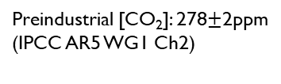
Atmospheric concentration of CO₂
No SSP under 400ppm in 2100 (here, no SSP-1.9!)
In SSP4 and SSP5, less differentiated pathways.
To meet a given target of RF, compensating effects by non-CO₂ RF.
observations
Preindustrial [CO₂]: 278$±$2ppm
(IPCC AR5 WG1 Ch2)

Slide 11
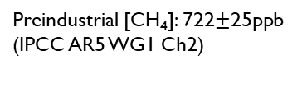
Atmospheric concentration of CH₄
Strong reductions, even below 1500 ppb.
Compared to CO₂, less differentiated pathways.
To meet a given target of RF, trade-offs in-between non-CO₂ RFs (eg SSP4).
Preindustrial [CH₄]: 722$±$25ppb
(IPCC AR5 WG1 Ch2)

Slide 12
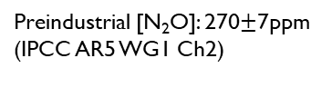
Atmospheric concentration of N₂O
In 2100, N₂O not lower than 340 ppm.
Compared to CO₂ and CH₄, pathways even less differentiated.
To meet a given target of RF, trade-offs in-between non-CO₂ RFs (eg SSP4).
Preindustrial [N₂O]: 270$±$7ppm
(IPCC AR5 WG1 Ch2)

Slide 13
Ocean sink of CO₂
In 2100, the ocean sink may go beyond 6 GtC/yr, or almost become neutral.
Saturation of the oceans and climate change may reduce its potential to absorb carbon.

Slide 14
Land sink of CO₂
In 2100, the land sink may go beyond 5 GtC/yr, and may even reemit carbon previously stored.
Climate change reduce the potential of vegetation to capture carbon.

Slide 15
Transient Climate Response to Cumulative Emissions of CO₂
SSP scenarios as simulated by OSCAR,
under different levels of observational constraints
Rogelj et al (2018): IPCC SR 1.5°C Ch2
Model-only carbon budgets underestimated $⟹$ Use of observational constraints.

Slide 16
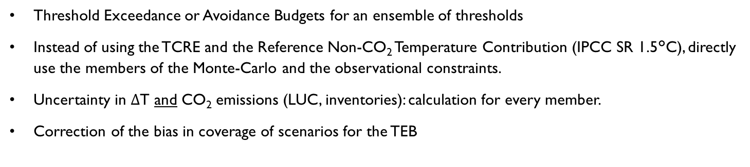
Calculation of carbon budgets
Threshold Exceedance or Avoidance Budgets for an ensemble of thresholds
Instead of using the TCRE and the Reference Non-CO₂ Temperature Contribution (IPCC SR 1.5°C), directly use the members of the Monte-Carlo and the observational constraints.
Uncertainty in $Δ$T and CO₂ emissions (LUC, inventories): calculation for every member.
Correction of the bias in coverage of scenarios for the TEB
19

Slide 17
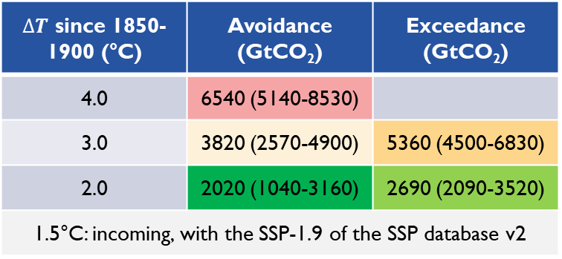
Carbon budgets
Budgets since 2015 for threshold exceeded or avoided with 50% of probability, showing average and 5-95% range
$∆T$ since 1850-1900 (°C) | Avoidance (GtCO₂) | Exceedance (GtCO₂)
4.0 | 6540 (5140-8530)
3.0 | 3820 (2570-4900) | 5360 (4500-6830)
2.0 | 2020 (1040-3160) | 2690 (2090-3520)
1.5°C: incoming, with the SSP-1.9 of the SSP database v2
IPCC AR5 WG3 (10-90%)
(800-1270)
Friedlingstein et al, 2014 (5-95%)
1450 (1050-1850)
Deduced budgets are much higher than those of AR5!
Discrepancies in the projections of the Earth system models (see TCRE): warming overestimated, budgets solely based on ESM models underestimated
Correction by observations: ~1500 GtCO₂ for 2°C since 2015 (Millar et al, 2017)
Here, the observational constraints respect the consistency of the model.
IPCC SR 1.5°C: 1500 GtCO₂ (1170-2030 for the 33-67% range) for 2°C since 2018
Consistent increase of the carbon budgets thanks to the use of observations, although higher than those of Millar et al, 2017 and the SR 1.5°C.
110 GtCO2 for 2015-2017 (GCP)

Slide 18
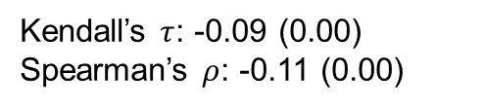
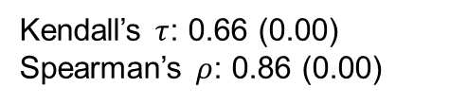
Dependencies of carbon budgets
Hypothesis: the differences in-between TEB and TAB is due to the timescales of CO₂ emissions, and not non-CO₂ emissions (Rogelj et al, 2016).
Monotonous statistical dependency in-between the differences in-between TEBs and TABs and the difference in CO₂ radiative forcings
No statistical dependency with the difference in non-CO₂ radiative forcings
Statistical dependency of two observations
Kendall’s $τ$: 0.66 (0.00)
Spearman’s $ρ$: 0.86 (0.00)
Kendall’s $τ$: -0.09 (0.00)
Spearman’s $ρ$: -0.11 (0.00)
Monotony of the eventual relationship

Slide 19
New version, data soon released
The results presented in this presentation stem from a previous assessment using the v1 of the SSP public database.
The SSP public database v2 has been released in December 2018, including new mitigation pathways. A new version of this work will be published in 2019.
New scenarios (1.9 W/m²): 103 → 125 SSP scenarios
  Budgets 1.5°C
Transition historical / SSP: 2010 → 2014
Thawing permafrost accounted
Improvement of the extension in Land-Use
The data that will be released will encompass all of the aspects of the Earth system: climate system, carbon cycle, atmospheric chemistry,…

Slide 20
Conclusions and take-home message
Carbon budgets solely based on ESMs or their TCRE underestimate the carbon budgets.
Observations have been used while respecting the modelling of the Earth system.
The budget increases drastically: since 01/01/2018, to avoid 2°C,
  IPCC AR5 WG3: 690-1160 GtCO₂
  IPCC Special Report 1.5°C: 1500 GtCO₂
  This presentation: 1910 GtCO₂
Statistical monotonous dependency of the difference in-between exceedance and avoidance budgets, and the differences in the radiative forcing of CO₂.
Soon, publication & release of climate projections for all SSP scenarios, with endogenous CO₂ emissions from LUC and accounting for thawing permafrost.

Slide 21
Thank you for your time!
Questions?
yann.quilcaille@iiasa.ac.at
Yann Quilcaille
IIASA/ESM
yann.quilcaille@iiasa.ac.at

Slide 22
References
Doucet, A., De Freitas, N. and Gordon N. Sequential Monte Carlo Methods in Practice. Springer, New York, 2001
Collins, M., et al, 2013: Long-term Climate Change: Projections, Commitments and Irreversibility. In: Climate Change 2013: The Physical Science Basis. Contribution of Working Group I to the Fifth Assessment Report of the Intergovernmental Panel on Climate Change Cambridge University Press, Cambridge, United Kingdom and New York, NY, USA.
Gasser, T., Ciais, P., Boucher, O., Quilcaille, Y., Tortora, M., Bopp, L., and Hauglustaine, D. The compact Earth system model OSCAR v2.2: Description and first results. Geoscientific Model Development, 10, 271–319, 2017. doi: 10.5194/gmd-10-271-2017
Gidden, M. J. et al, 2018, Global emissions pathways under different socioeconomic scenarios for use in CMIP6: a dataset of harmonized emissions trajectories through the end of the century. Geoscientific Model Development Discussions. 1-42, 2018. doi:10.5194/gmd-2018-266
Rogelj, J., Schaeffer, M., Friedlingstein, P., Gillett, N. P., Van Vuuren, D. P., Riahi, K., Allen, M., and Knutti, R. Differences between carbon budget estimates unravelled. Nature Climate Change, 6, 245–252, 2016b. doi: 10.1038/nclimate2868
Rogelj, J. et al, 2018, Mitigation pathways compatible with 1.5°C in the context of sustainable development. In: Global warming of 1.5°C. An IPCC Special Report on the impacts of global warming of 1.5°C above pre-industrial levels and related global greenhouse gas emission pathways, in the context of strengthening the global response to the threat of climate change, sustainable development, and efforts to eradicate poverty. In Press.
O’Neill, B. C., Tebaldi, C., Van Vuuren, D. P., Eyring, V., Friedlingstein, P., Hurtt, G., Knutti, R., Kriegler, E., Lamarque, J. F., Lowe, J., Meehl, G. A., Moss, R., Riahi, K., and Sanderson, B. M. The Scenario Model Intercomparison Project (ScenarioMIP) for CMIP6. Geoscientific Model Development, 9, 3461–3482, 2016. doi: 10.5194/gmd-9-3461-2016
Van Vuuren, D. P., Kriegler, E., O’Neill, B. C., Ebi, K. L., Riahi, K., Carter, T. R., Edmonds, J., Hallegatte, S., Kram, T., Mathur, R., and Winkler, H. A new scenario framework for Climate Change Research: Scenario matrix architecture. Climatic Change, 122, 373–386, 2014. doi: 10.1007/s10584-013-0906-1.

Slide 23
Supplementary slides
O’Neill et al, 2016

Slide 24
Supplementary slides
Rogelj et al (2018): IPCC SR 1.5°C Ch2

