Slide 1
New tendencies in Drilling Processes Automation and Optimization: a focus on the Brazilian Pre-salt
5th World Congress & Expo on Oil, Gas &
Petroleum Engineering
Andreas Nascimento
Research Group: Petroleum Engineering, Energy and Environment (GPEPEM)
Affiliation: International Institute for Applied System Analysis / Department Petroleum Eng. - Montanuniversität Leoben / Federal Uni. of Espirito Santo
29/03/2019

Slide 2
Outline
Contextualization
Pre-salt operational issues
Industrial problems and general possible solutions
Pre-salt research areas:
Re-engineering design
Automated pre-operational tests
Operational performances analysis
Final discussion
29/03/2019
2/25 A.N.

Slide 3
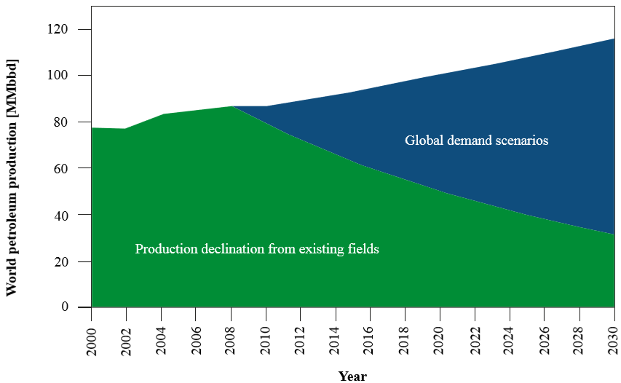
Contextualization (energy market)
~ Δ85
Source: (PETROBRAS, 2009).
Gap of 85 [MMbd] in 2030;
Needs of placing new viable reserves in the market (pre-salt).
29/03/2019
3/25 A.N.

Slide 4
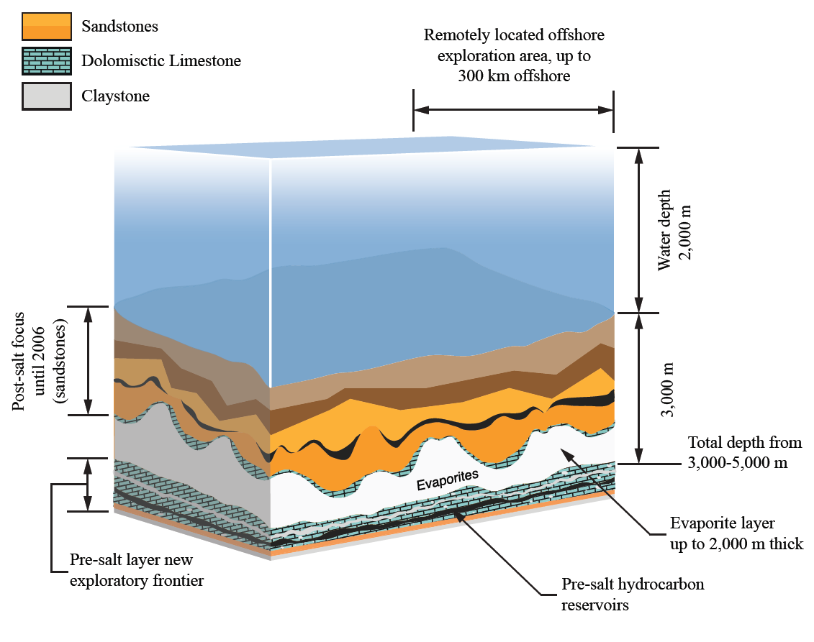
Contextualization (pre-salt)
7 km deep;
Thick salt layer;
Pre-salt Carbonates: formation with silica nodes;
Slow and expensive.
Source: (Adapted from FRAGA et al., 2015; PINHEIRO et al., 2015).
29/03/2019
4/25 A.N.

Slide 5
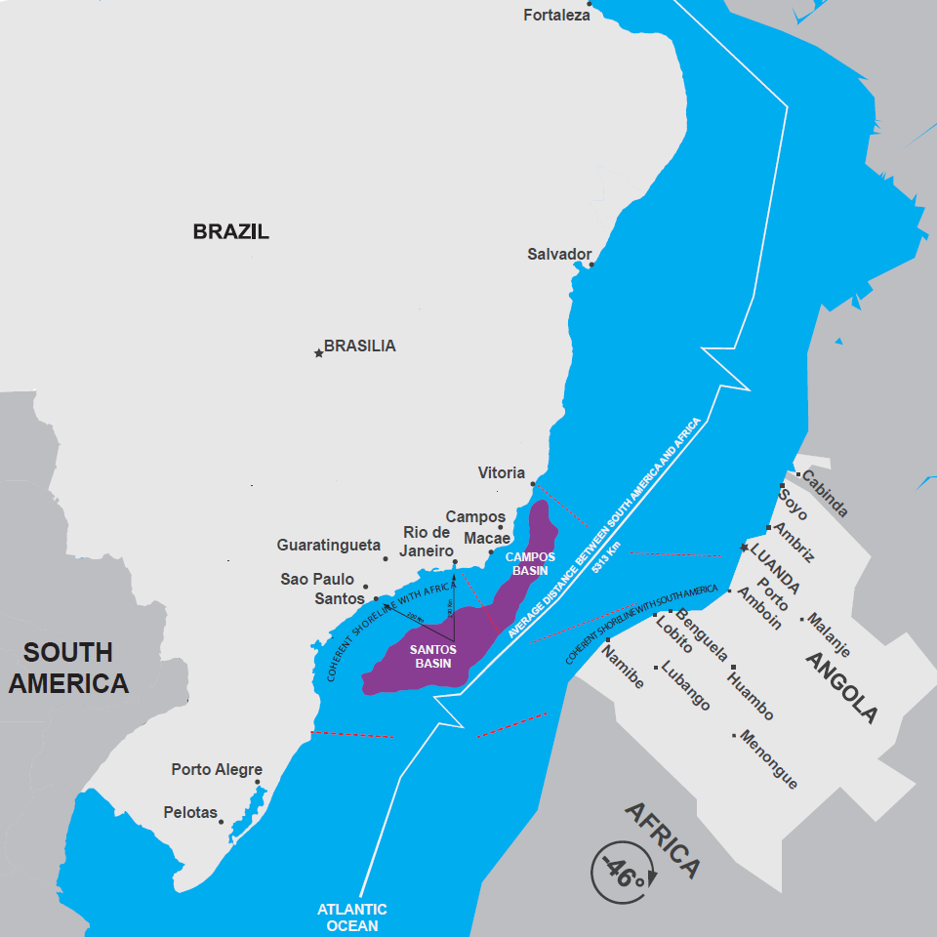
Contextualization (pre-salt)
South Atlantic Ocean coasts;
Similarity: pre-salt of Angola and Brazil.
29/03/2019
5/25 A.N.
Source: (Adapted from KONING, 2015).

Slide 6
Pre-salt operational issues
Source: (HABAIEB et al., 2013).
Drilling efficiency average of 28,5 [m/ day]:
(NASCIMENTO, 2016).
Pre-salt drilling operational costs:
- ranging from 641.985,00 to 1.374.755,00 [USD/ day].
- ranging from 22.525,00 to 48.237,00 [USD/ m].
(NASCIMENTO, 2016).
29/03/2019
6/25 A.N.

Slide 7
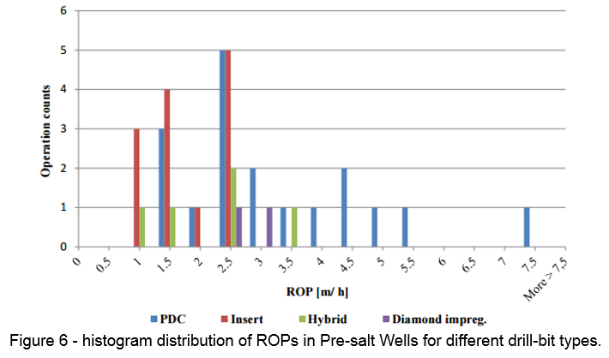
Pre-salt operational issues
Source: (NASCIMENTO, 2016).
29/03/2019
7/25 A.N.

Slide 8
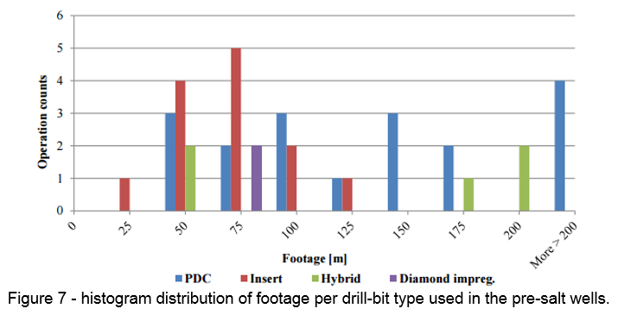
Pre-salt operational issues
39 run with 8 pre-salt drilled wells (Brazil and Angola).
29/03/2019
8/25 A.N.
Source: (NASCIMENTO, 2016).

Slide 9
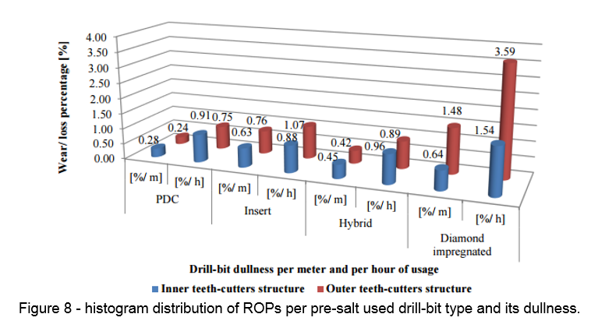
Pre-salt operational issues
39 run with 8 pre-salt drilled wells (Brazil and Angola).
29/03/2019
9/25 A.N.
Source: (NASCIMENTO, 2016).

Slide 10
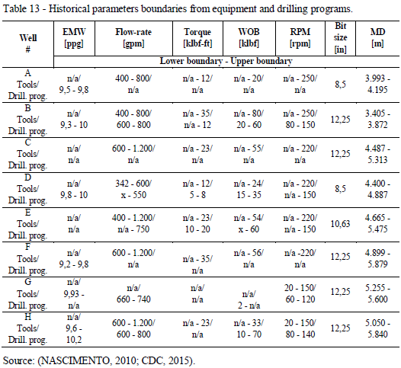
Pre-salt operational issues
- Drilling mechanics parameters set in the drilling programs beyond the limitation of the downhole tools. Any failure have a negative impact to operational efficiency.
- Drilling mechanics parameters limited to a value too low compared to tool limitations.
Flow changes could have improved drilling efficiency.
D
29/03/2019
10/25 A.N.
Source: (NASCIMENTO, 2016).

Slide 11
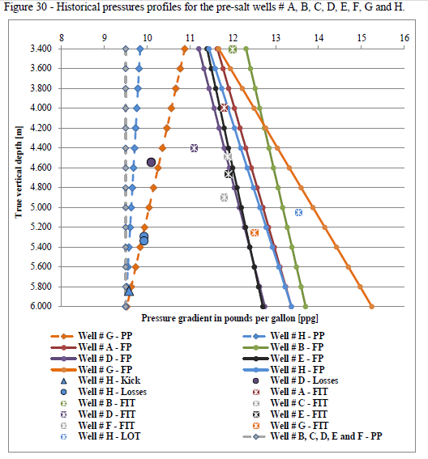
Pre-salt operational issues
- Too short geo-pressure window in pre-salt carbonates. Necessity of closely check drilling mechanics parameters in real-time.
- Flow and RPM accurate determination (influence ECD) in real-time is key in avoiding mud losses in these formations and also can have considerable positive impact in ROP.
Source: (NASCIMENTO, 2016).
29/03/2019
11/25 A.N.
Source: (NASCIMENTO, 2016).

Slide 12
Industrial problems: automation/drillopt.
Problematic 1 (one):
Many activities developed in a drilling environment are subjected to human's perception and interpretation, which are, consequently, subjected to misunderstanding, miscommunication and even delay in reaction.
Problematic 2 (two):
Information from drilling related reports are not well combined in a digitally and analyzable manner, in order to allow efficient seeking and fast comparison, in real-time, for specific and important decisions making for operational tasks.
Problematic 3 (three):
Many drilling rig personnel are still not educated to use small software tools for the sake of their own help in decisions making, relying, sometimes, mostly in opinions or past experiences, and lastly in integrated and specific software systems.
29/03/2019
12/25 A.N.

Slide 13
Industrial problems: automation/drillopt.
Problematic 4 (four):
It is still not common in the petroleum industry to have a collaborative organizational remote database along different countries in order to allow a common share point of historical well and drilling mechanics data consultation.
Problematic 5 (five):
In the drilling optimization discipline, there is still a notable lack of dynamic and user-friendly helpful tools for real-time and prompt in-time decision making, to be used in the operational level.
Problematic 6 (six):
Different design of bottom-hole assembly and drill-bits are still to be developed in order to better fit the necessities of the industry. Different combination of different equipment can still be analyzed in order to better understand they fit for the purpose of specific wells or fields aiming drilling optimization.
29/03/2019
13/25 A.N.

Slide 14
General possible solutions
More precise and legible information, improving the delay in human’s perception and in-time response.
Implementation of automated and seek-able drilling reports, with minimum human inputs, helping in precision, information processing and delivery speed. Allow decisions with technical-scientifically treated information in hands.
Historical data combined with user-friendly software tools for directing final decisions in operational level. Dynamic and Automated pre-operational drilling tests.
Re-design of drilling engineering related equipment (bottom-hole assemblies in general, drill-bits, reamers, among others) based in statistical analysis and mathematical models.
29/03/2019
14/25 A.N.

Slide 15
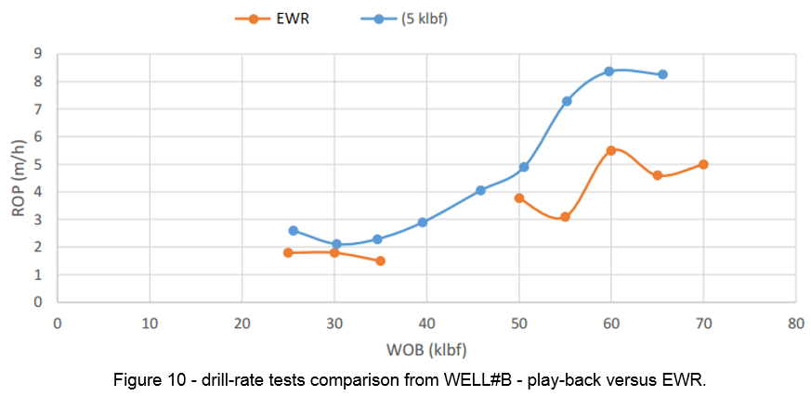
Automated pre-op-tests
Manual drill-rate test with possible human-errors.
Source: (NASCIMENTO, 2016).
End of well report - EWR.
Played-back from raw drilling mechanics ASCII - 5 [klbf].
29/03/2019
15/25 A.N.

Slide 16
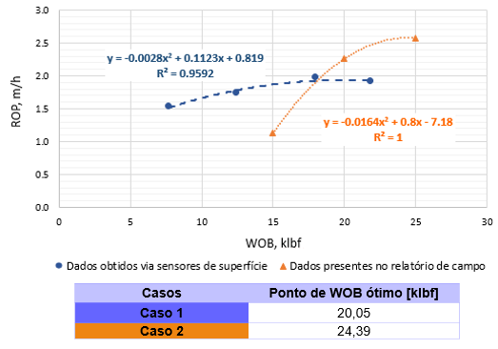
Automated pre-op-tests
Manual drill-rate test with possible human-errors.
Source: (NASCIMENTO, 2016).
End of well report - EWR. Optimum WOB at ~24 klbf (in inefficient area).
Played-back from ASCII. Optimum WOB at ~20 klbf.
29/03/2019
16/25 A.N.

Slide 17
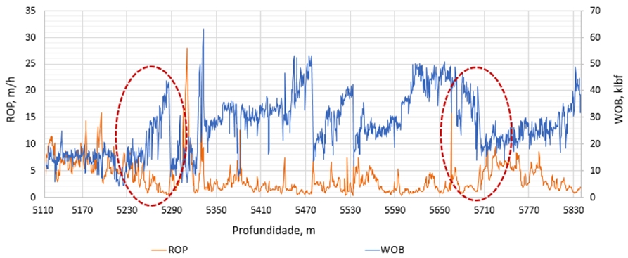
Pre-op-tests: operating inneficient
Manual drill-rate test with possible human-errors.
Source: (NASCIMENTO, 2016).
It is possible to visualize that to gain a positive response in ROP, just increasing WOB may not help, and decreasing it may give the opportunity to operate efficient.
It shows how important it is to have a permanent update, dynamically, and graph determining the best set of parameters in Real-time.
29/03/2019
17/25 A.N.

Slide 18
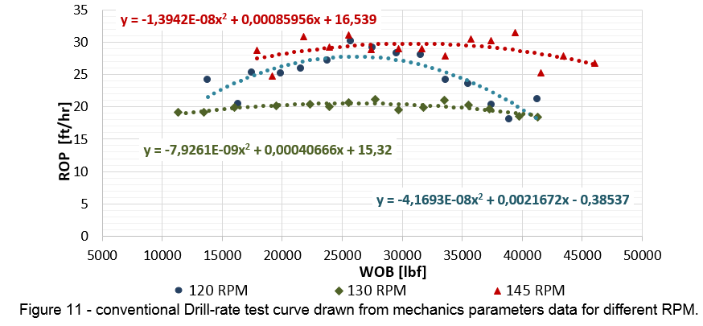
Pre-op-tests: ROP x WOB vs. MSE x WOB
Common drill-rate test (ASCII played-back) ROP x WOB versus MSE x WOB.
Source: (NASCIMENTO, 2016).
From the 3x grouped RPMs, 120 and 145 [RPM] allows achieving highest ROP.
145 RPM and 33 [lkbf] allow highest ROP (~30 [ft/hr]), while 120 RPM and 27 [klbf] allow achieving ~27 [ft/hr].
Does it make sense to overload the machinery in 25 [RPM] and 6 [klbf] just for a gain in 3 [ft/hr]? MSE versus WOB analysis respond this right away.
29/03/2019
18/25 A.N.

Slide 19
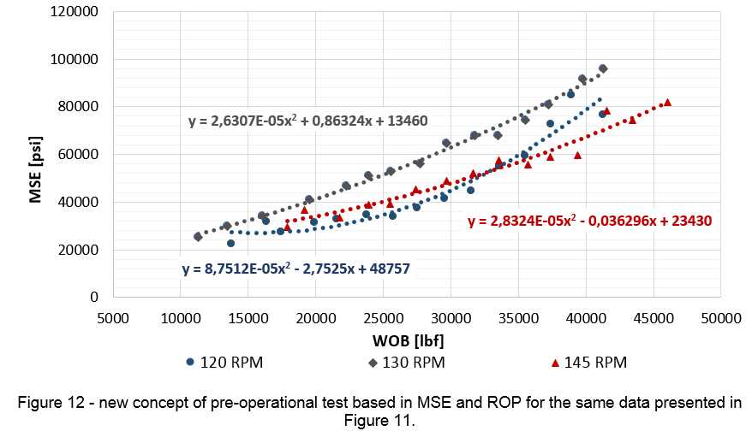
Pre-op-tests: ROP x WOB vs. MSE x WOB
Common drill-rate test (ASCII played-back) ROP x WOB versus MSE x WOB.
Source: (NASCIMENTO, 2016).
A tendency in drilling is to have the lowest mechanic specific energy in place.
MSExWOB shows that 120 [RPM] with 27 [klbf] would be the best choice.
29/03/2019
19/25 A.N.

Slide 20
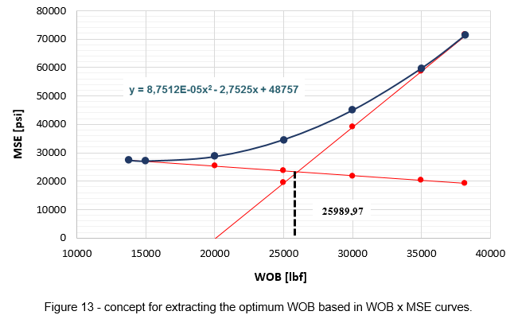
Pre-op-tests: ROP x WOB vs. MSE x WOB
Extracting the best optimum WOB from proposed MSE x WOB curves.
Source: (NASCIMENTO, 2016).
It is possible to extract best set of parameters from MSE x WOB curves.
Why not to implement these new concepts in Pre-operational Drilling tests?
29/03/2019
20/25 A.N.

Slide 21
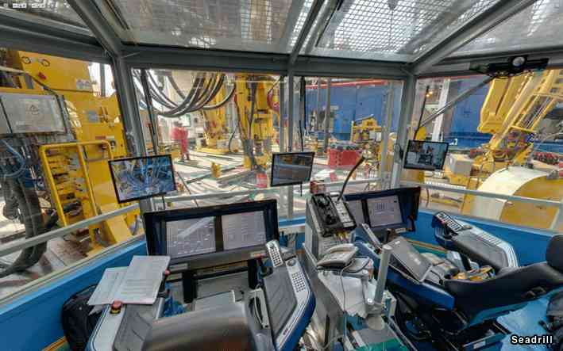
Automated pre-op-tests
29/03/2019
21/25 A.N.

Slide 22
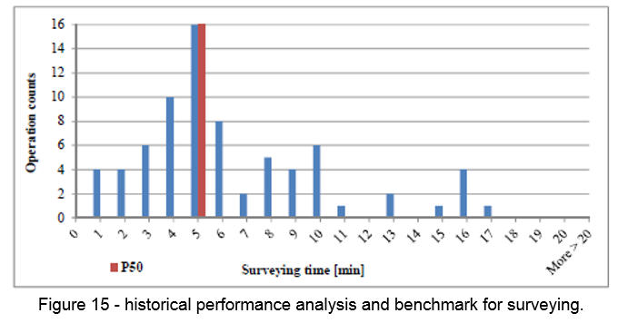
Performance efficiency
Pre-salt operational performances.
29/03/2019
22/25 A.N.
Source: (NASCIMENTO, 2016).

Slide 23
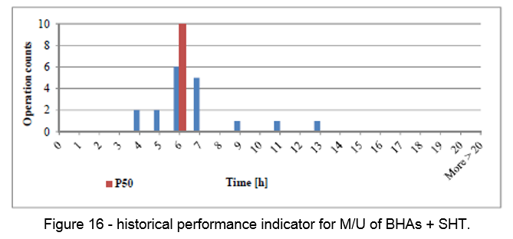
Performance efficiency
Pre-salt operational performances.
Source: (NASCIMENTO, 2016).
29/03/2019
23/25 A.N.

Slide 24
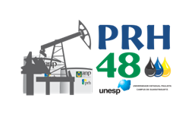
Conclusion and Acknowledgment
29/03/2019
24/25 A.N.

Slide 25
THANK YOU!
Andreas Nascimento
DETEC / UFES - Brazil
International Institute for Applied Systems Analysis – IIASA
Department Petroleum Engineering – DPE/MUL
Federal University of Espirito Santo – UFES
andreas.nascimento@ufes.br
nascimento@iiasa.ac.at
andreas.nascimento@gmail.com
29/03/2019
25/25 A.N.

