Slide 1
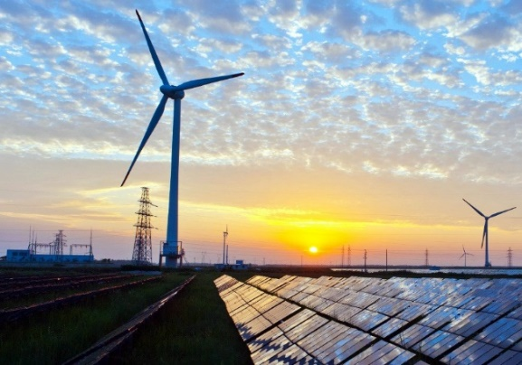
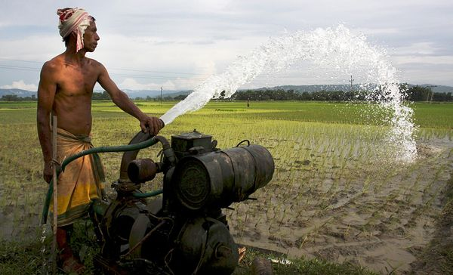
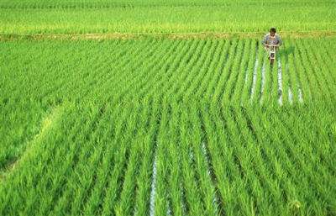




Achieving Climate-Land-Energy-Water Sustainable Development Goals in the Indus Basin
Adriano Vinca, Simon Parkinson, Edward Byers, Peter Burek and colleagues
April 10, 2019
International Institute for Applied Systems Analysis (IIASA)
Laxenburg, Austria

Slide 2
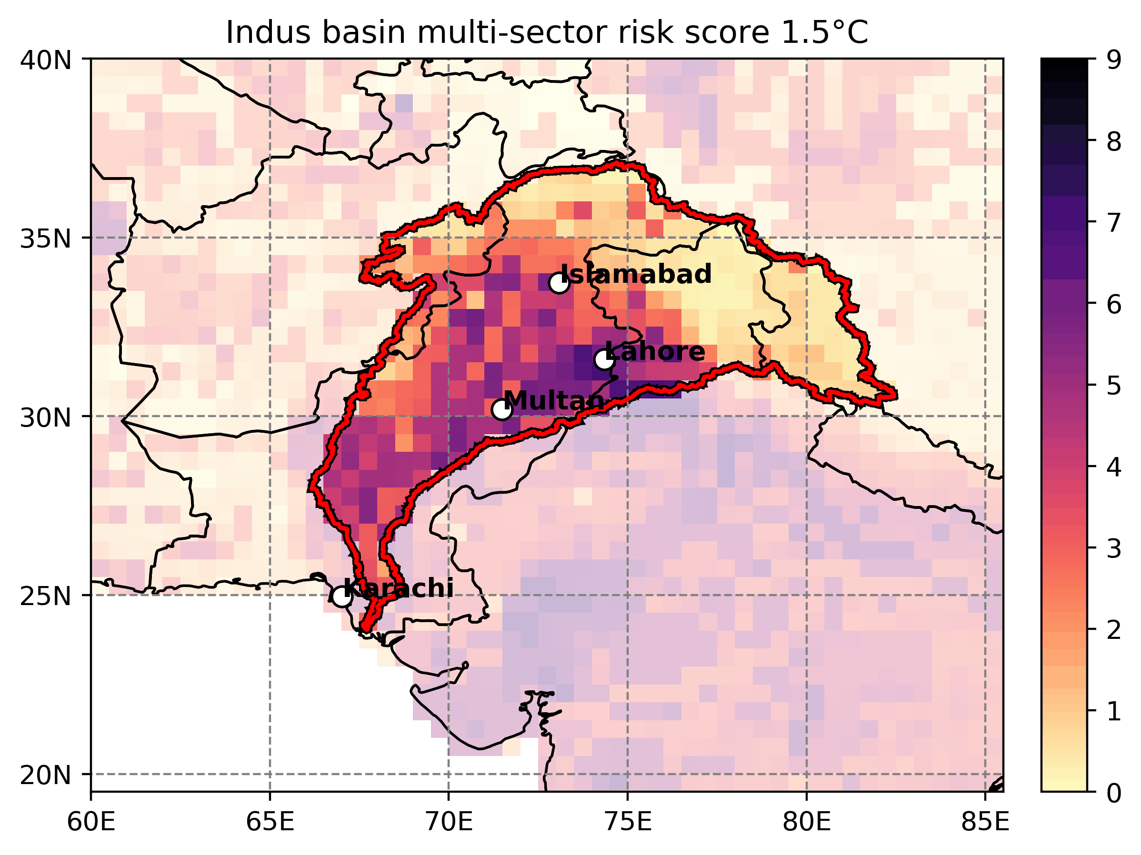
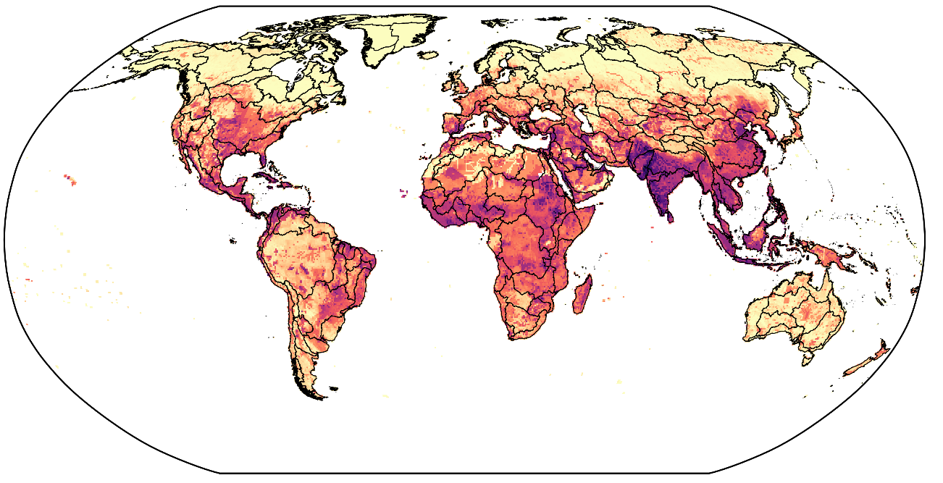
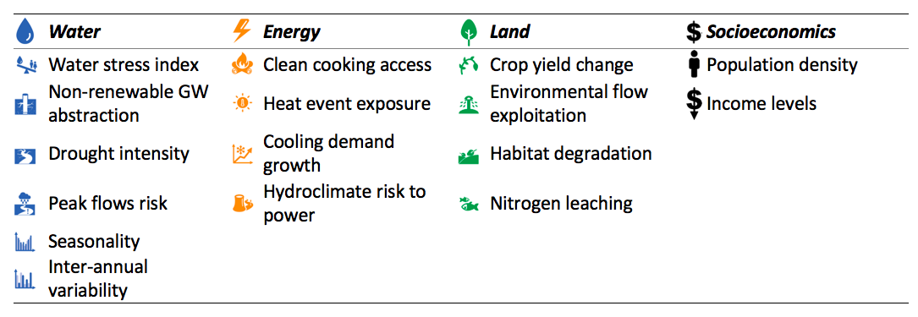
Water stress and other challenges
Combined indicator of vulnerability hotspots in water, energy and land
Challenges
Water and land
Complex canal and irrigation system
Groundwater depletion and water storage
Very little flow reaches the sea
Lack of wastewater treatment
Food self-dependence
Burning of crops leads to air pollution
Energy systems
Electricity can be unreliable
Air pollution and GHGs increasing
Hydropower generation
Byers el al. (2018),ERL

Slide 3


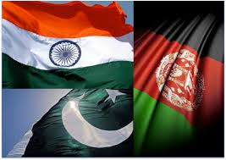


Integrated Policy Analysis
How to strike a balance between objectives and challenges?
… and at what cost?
SDGs
Transboundary Agreements
India
Afghanistan
Pakistan

Slide 4
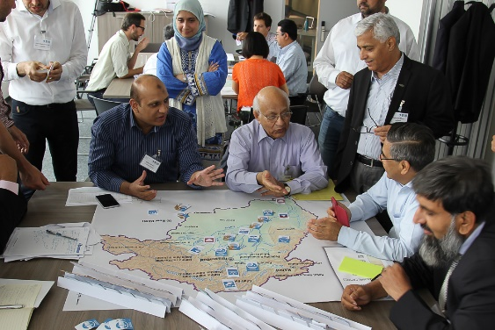

Stakeholder engagement
Vienna, May 2018
First round of meetings (2018)
Identifying challenges
Collecting regional data
Generating stakeholders’ pathways, possible future scenarios
Second round of meetings (later this year)
Round of results checking and discussion
Capacity building
Notes:
MENTION THE LIMITATIONS> assumption on hydro potential, water availability in lower indus region, boundary conditions

Slide 5
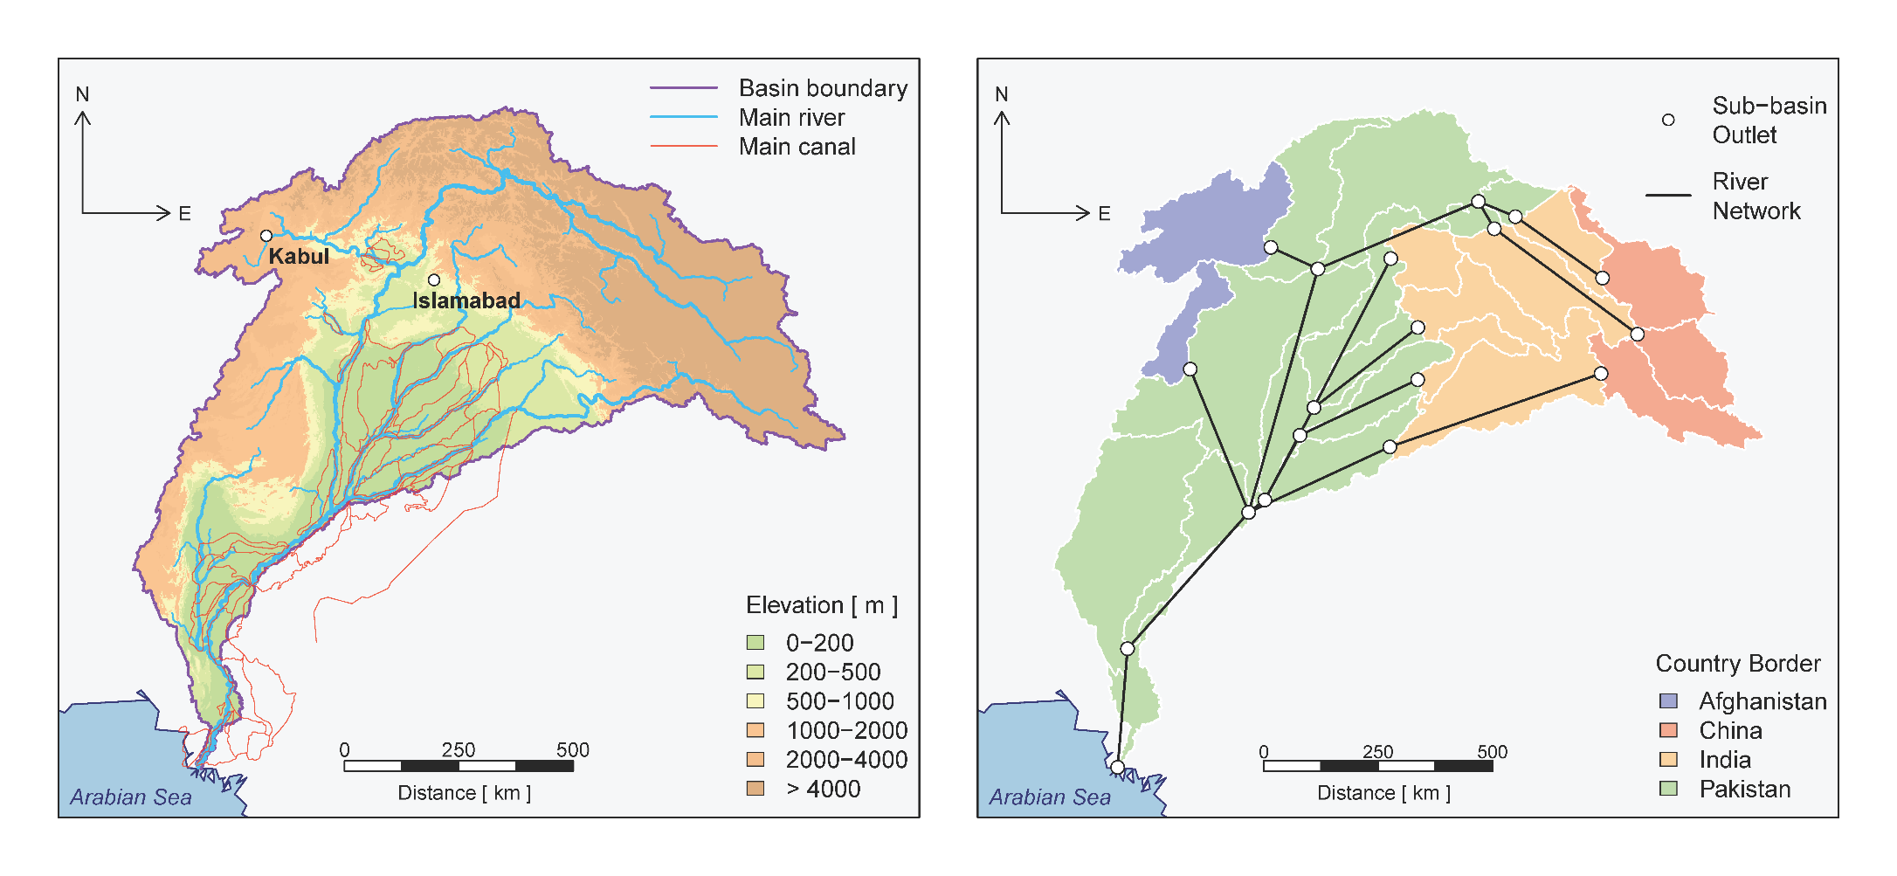
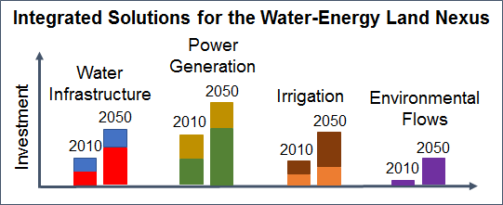
The core model
NExus Solutions Tools (NEST)
Distributed Hydrology
Community Water Model (CWatM)
(Burek et al., 2018)
Infrastructure Planning
MESSAGEix
(Huppmann et al., 2018)
CWaTM
MESSAGE
Upscaling
Potential ET
Effective precipitations
Runoff availability
Water
Techs
Land
Techs
Energy
Techs
Downscaling
Water and
land-use
Minimize total system cost
Vinca et al., (forthcoming)

Slide 6
Water
W
a
t
er
de
m
an
d
W
a
t
er
di
s
t
r
i
b
uti
o
n
R
e
tu
r
n
f
l
ows
*
U
r
b
an
*
(
a
nd
i
n
dus
t
ri
a
l
P
u
mpi
n
g
)
U
r
b
a
E
n
l
ect
r
ic
i
t
y
Data:
SSP-RCP water demand scenarios
Surface water availability
Current river flow, canals
Fossil groundwater, aquifer recharge
Storage, current and planned reservoir capacity
Water supply, diversion and treatment technologies
Indus water treaty allocations
recharge from rivers, canals and crop field
R
u
ral
*
D
e
sal
i
na
t
io
n
R
u
ra
l
E
n
e
r
g
y
s
e
c
t
o
r
Groundwater
+
W
a
t
er
diversion
L
a
nd
s
ec
t
o
r
W
a
t
er
di
s
t
r
i
b
u
S
e
-
awa
t
e
r
t
i
o
n
w
a
s
t
e
w
a
t
e
r
t
r
eat
m
en
t
a
n
d
r
e
c
y
c
l
e
I
n
t
e
r
n
al
s
u
r
fa
c
e
w
a
t
er
+
S
u
r
fa
c
e
w
a
t
e
r
E
l
ect
r
ic
i
t
y
E
n
vi
r
o
nm
e
nta
l
fl
o
w
S
s
t
ora
g
e
W
a
t
er
r
e
t
u
r
n
f
l
ows
f
r
o
m
e
n
e
r
g
y
s
e
c
t
o
r
H
y
d
r
o
e
le
c
tri
c
p
o
t
en
t
ia
l
R
i
v
er
ne
t
w
or
k
n
o
de
u
p
n
o
d
n
o
de
d
ow
n
e
*
e
x
o
ge
n
ou
s
+
lim
i
nt
s
a
r
e
im
p
os
e
d
b
a
se
d
on
in
f
o
r
m
a
tio
n
f
r
om
h
y
d
r
olo
c
ia
l
mo
d
e
l

Slide 7
Energy
P
o
w
er
pl
a
nt
s
P
o
w
er
tr
a
nsm
i
ssi
o
n
E
l
ect
r
ic
i
ty
d
ema
n
d
F
o
ssi
l
(
n
atu
r
W
al
a
t
er
fo
r
g
a
s,
c
o
a
l
, o
i
c
l,
o
oli
n
g
c
c
s
)
U
Data:
Solar, wind and hydropower potential
SSP electricity sectoral demand
Transmission and distribution networks
Power and cooling technology
r
b
an
*
(
a
T
nd
r
ans
m
is
s
ion
H
V
i
n
dus
t
ri
a
l
(
)
t
o o
t
he
r
no
d
es
)
N
u
cle
a
r
D
i
st
r
i
bu
t
io
n
R
u
ral
(
*
i
n
t
e
r
na
l
)
B
i
o-f
u
el
^
(e
t
han
o
l
B
i
oma
s
o
s
&
r
so
l
id
bio
m
ass
)
c
o
-fi
r
in
g
W
a
t
er
se
c
t
o
io
r
R
n
u
ral
ge
n
era
R
t
e
tun
fl
o
w
s
D
i
ese
l
g
e
ner
a
t
o
r
L
a
nd
s
ec
t
o
S
r
S
m
all
P
V
o
lar
&
W
in
d
E
t
han
o
l
g
ene
r
a
t
o
r
H
y
d
r
o
e
le
c
tri
c
H
y
d
r
o
e
le
c
tri
c
B
i
o-f
u
el
^
(e
t
han
o
p
o
l
t
en
t
ia
l
o
r
so
l
id
bio
m
ass
)
CO₂ and other emissions
*
e
x
o
ge
n
ou
s
^
c
r
o
p
r
e
sid
u
es
c
an
be
t
ra
n
spo
r
t
e
d
as
sol
i
d
b
iom
a
ss
or
c
on
v
e
r
t
e
d
i
n
e
t
h
an
o
l,
t
e
c
h
n
ol
g
ie
s
n
o
t
r
e
p
r
e
s
en
t
ed
h
e
r
e

Slide 8
Land
C
r
op
s
Data:
Land use/ availability maps
SSP-RCP crop yields
SSP crop products demand
Irrigation technologies
I
r
r
ig
a
t
e
d
C
r
op
p
r
o
d
uct
s
d
e
man
d
E
*
l
ect
r
ic
i
ty
f
r
om
I
r
r
ig
a
ti
o
n s
y
s
t
e
m
s
C
r
op
p
r
oduct
s
b
y
co
u
nt
r
g
y
r
id
o
r
l
oca
l
g
e
ner
a
t
o
r
s
F
l
oo
d
W
a
t
er
fo
r
S
r
ink
l
e
r
r
rig
a
ti
o
i
n
T
ota
l
land
L
a
nd
a
v
a
i
lab
i
lit
y
D
§
r
i
I
p
r
rig
a
ti
o
n
cons
t
raint
s
l
o
sse
s
R
a
inf
e
d
o
nl
y
C
H
₄,
o
th
e
r
e
m
is
s
io
n
s
,
w
a
t
er
po
l
l
ut
a
nt
s
C
r
op
r
esidue
s
B
i
oma
s
W
s
a
t
er
fo
r
E
n
e
r
g
y
sec
t
o
t
r
r
ans
p
o
r
t
a
b
ti
o
n/
i
o-f
u
el
c
o
n
v
e
r
si
o
n
p
r
odu
c
ti
o
n
*
e
x
o
ge
n
ous
.
§
t
ot
a
l
a
v
ai
l
abl
e
a
r
ea
f
or
agr
i
cu
l
tu
r
e
b
a
s
ed
on
h
is
t
ori
c
al
dat
a

Slide 9
Scenarios
Scenario |  | Description | Implementation
Common assumptions to all scenarios |  | SSP2. RCP 6.0. Indus Water Treaty allocations. Planned hydropower projects in 2030. Current renewable energy policies. Maximum electricity imports fixed to baseline Limited fossil groundwater extraction. | Set of different constraints, present also in the baseline (with the exception of those that refer to the baseline)
SDG 2, Achieve food security and promote sustainable agriculture scenarios |  | SDG 2.4 By 2030, 100% implementation of modern so-called smart irrigation technologies that increase productivity and production relative to 2015 | SDG 2.4: No flood irrigation (except for rice) after 2030. Smart irrigation is available. Baseline: no smart irrigation technologies adopted before 2030
SDG 6 Water sector development scenarios |  | SDG 6.6 By 2020, protect and restore water-related ecosystems, including mountains, forests, wetlands, rivers, aquifers and lakes SDG 6.3 By 2030, improve water quality by reducing pollution, halving the proportion of untreated wastewater and substantially increasing recycling and safe reuse globally | SDG 6.6 Minimum of 20% of natural flow left in rivers and aquifers by 2030. SDG 6.3 Treat half of return flows treated by 2030, recycle one quarter of return flows. Baseline: no targets
SDG 7 Clean and Affordable Energy Development Scenarios |  | SDG 7.2 By 2030, 50% By 2030 the share of renewable energy in the global energy mix = 50% SDG 7.b By 2030, expand infrastructure and upgrade technology for supplying modern and sustainable energy services for all | SDG 7.2 Target on share of renewables (wind, solar, geothermal). Phase out of coal SDG 7.b Phase out of once-through cooling, imposing capacity constraint. Baseline: no targets
SDG 13 Climate action |  | SDG 13.a Implement the commitment undertaken by to the United Nations Framework Convention on Climate Change | SDG 13.a Ghg emission budget and climate scenario accordingly. Baseline: no emission targets

Slide 10
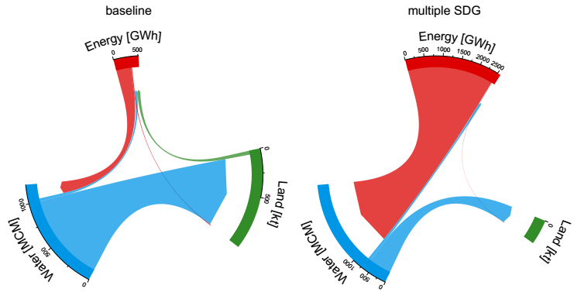
Preliminary results
Comparing baseline with preliminary SDG 2+ 6 + 7 + 13 scenario
Average yearly costs for the entire basin (2020-2050)
Average yearly cross-sectoral energy, water and biomass flows
Low carbon tech and wastewater distribution and treatment.
Use of more efficient, but costly irrigation technologies.
Higher land requirements
Less water used in agriculture
Much more energy required for pumping, treating, water infrastructure, power plants
Notes:
Mention that hydro potential is very high also in the baseline

Slide 11
Single SDG, multi sector
If positive: ☹ ☹ ☹ ☹ 😐 ☺ 😐
SDG2: no significant changes
SDG6: water constraints, more fossil fuel than in baseline
higher cost for water distribution
SDG7 and 13 similar even though targets are different
Sum (cost, emissions, energy) or average (others) between 2020 and 2050

Slide 12
SDG6 (water)
Average yearly costs for the entire basin
Yearly land allocation for agriculture
Less water available for various uses, more groundwater
Rain-fed agriculture, where land is available
Land sector more stressed when multiple SDG are achieved (nuclear water consumption)

Slide 13
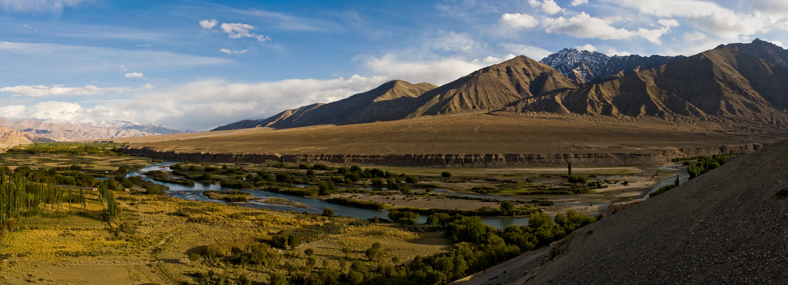
Conclusions
Environmental flow constraint strongly affect available surface water for energy and agriculture.
SDG7 and 13 have a clear overlap as mitigation strategy, although different costs and advantages
Rain-fed agriculture to adapt to water scarcity, more efficient irrigation technologies when the available land is limited.
Indus Valley near Leh, Wikipedia
Next steps:
Re-discussing critical assumptions with stakeholders (i.e. groundwater, environmental flows, demand projections)
Multi-criteria optimization,
exploring different scenarios and questions:
national interests, reservoir expansion, hydropower

Slide 14

















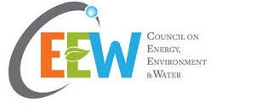












Thank you very much for your attention!
Adriano Vinca
Energy Program
International Institute for Applied Systems Analysis (IIASA)
Laxenburg, Austria
vinca@iiasa.ac.at

Slide 15
SDG7 (energy) and SDG13 (climate)
Average yearly costs for the entire basin
Very high hydro potential in Pakistan
Solar, Wind, geothermal, more expensive than nuclear, less water intensive
Hydro and nuclear, more water consumption
Yearly electricity generation
SDG 7 and 13 presnt two alternative pathways to carbon neutrality, SDG7 is more costly

Slide 16
Sensitivity analysis
baseline scenario, different SSPs, climate models and climate scenarios (RCP 2.6 and 6.0)
Cost
Internal runoff
from CWATM same for all SSP
Groundwater extraction
MESSAGEix outputs
CO2eq emission
Water use:
Most noticeable differences among models and scenarios, rather than SSPs
Need to continue testing on the SDG scenario

Slide 17
Integrated solution framework
Water-energy-land/food and climate
River basin scale, up to 2050
Hard linked integrated optimization
  Include non-linearities across sectors
  Integrate multi-sector social/distributional aspects (i.e. clean water/food/energy access)
  Limited detail compared to single sector models
  Time, effort, expertise for new development
MESSAGEix framework
  Open source framework
  ixmp toolbox
The nexus: interlinkages across resources and the SDGs
Source: Bleischwitz et al. 2018, Nature Sustainability
Notes:
Nexus concept, always under expansion/revision. Recent paper highlighted new interations, the importance to relation with SDG and variety of tool/model for assessment that strongly depend on the scale

