Slide 1
Pathways towards clean air in India
Pallav Purohit
IIASA Air Quality and Greenhouse Gases Program
EGU 2019
Vienna, April 11, 2019

Slide 2
Fine particulate matter (PM_{2.5}) concentration in Indian cities
NAAQS
WHO guideline
Source: WHO (2018)

Slide 3

The study tools
The GAINS (Greenhouse gas - Air Pollution INteractions and Synergies) and GCAM-IIMA models
GCAM/IIMA
Energy activity projections
Decision making on air quality management
National emission ceilings
Buildings
Emission control options: ~1000 measures,
co-control of 10 air pollutants and 6 GHGs)
Industry
Transport
Emissions
Costs
Optimization
Atmospheric dispersion
Health, ecosystems and climate impact indicators
Policy targets

Slide 4
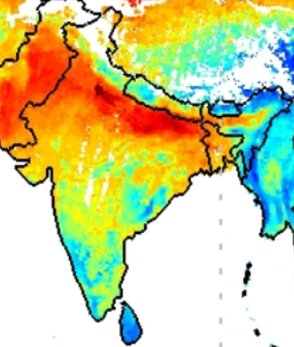
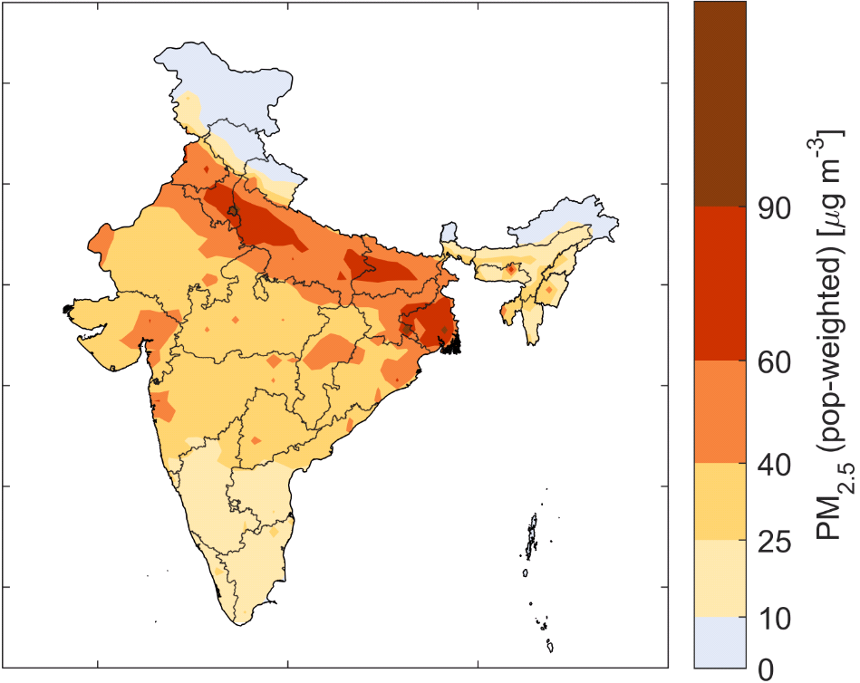
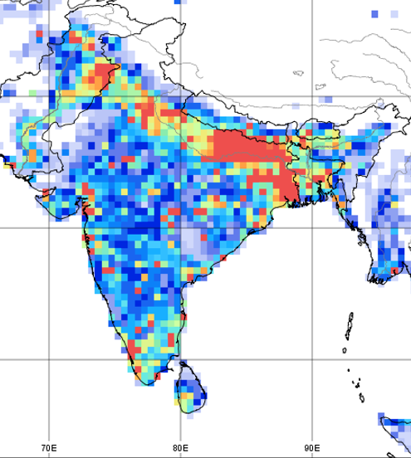
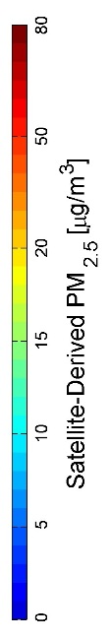
Air quality management needs to address urban and rural areas
Satellite-derived PM_{2.5}
Computed ambient levels of PM_{2.5}
Emission densities of PM_{2.5}, 2015
PM_{2.5} (kt/year)
Source: NASA
Source: IIASA/GAINS
Source: IIASA/GAINS
While current ambient PM_{2.5} monitoring in India reveals high levels in urban areas, remote sensing, comprehensive air quality modelling and emission inventories suggest large-scale exceedances of the NAAQS also in rural areas.
Household fuel combustion, small industries, burning of garbage and agricultural waste, etc., cause high emissions in rural areas too.
Pollution from rural areas is transported into the cities (and vice versa), where it constitutes a significant share of pollution.

Slide 5
Effective solutions require regional cooperation between cities and States
Origin of (population-weighted) PM_{2.5} concentrations in ambient air 2015
A large share of PM_{2.5} in ambient air originates from sources outside of cities
and from other States, which are beyond
the immediate jurisdictions of cities.
(Cost-)effective strategies require
regionally coordinated approaches,
and need to address urban and rural emission sources.
Source: IIASA/GAINS

Slide 6
Effective solutions must address all sources that contribute to PM_{2.5} formation
A significant share of emissions still originates from sources associated with poverty and underdevelopment (i.e. solid fuel use in households and waste management practices).
Any effective reduction of PM_{2.5} levels in ambient air and the resulting health burden needs to balance emission controls across all these source sectors.
A focus on single sources alone will not deliver effective improvements and is likely to waste economic resources to the detriment of further economic and social development.
Source: IIASA/GAINS
*Secondary particles formed in the atmosphere from agricultural NH₃ emissions through
chemical reactions with SO₂ and/or NO_{x} emissions; **Including Telangana

Slide 7
Macro-economic development and energy consumption
Source: CEEW/IIASA

Slide 8
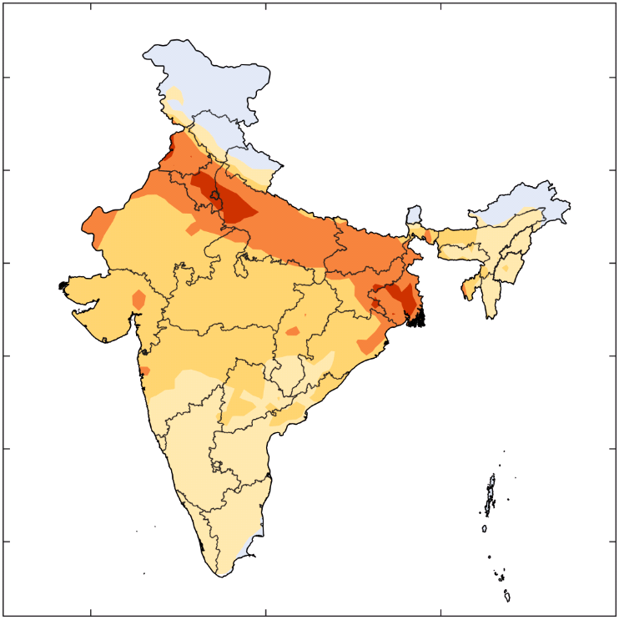
Compliance with current legislations will be essential for stabilizing pollution levels as the economy grows
Computed ambient levels of PM_{2.5}
2015
2030 with
current
legislations
Source: IIASA/GAINS
Current emission controls are effective, but their impacts are compensated by rapid economic growth.
By 2030, effective implementation and enforcement of the 2018 legislation could allow a three-fold increase in GDP
without further deteriorating air quality.

Slide 9

Policies and measures are available that could bring air quality more in compliance with the NAAQS
-Advanced Emission Control Technology Scenario
Computed ambient levels of PM_{2.5}
2015
2030 with
current
legislations
2030 with
advanced controls
Source: IIASA/GAINS
Advanced technical emission controls can deliver additional air quality improvements, but will not be sufficient to achieve the NAAQS everywhere
  NAAQS-compliant air quality to 60% of the Indian population

Slide 10
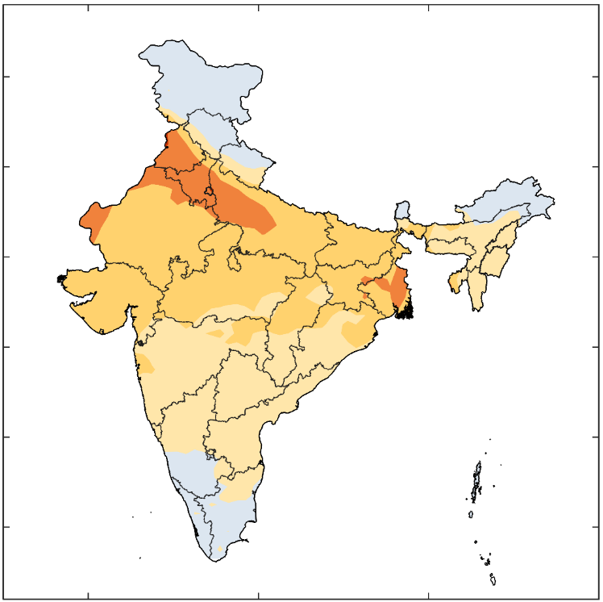
Policies and measures are available that could bring air quality more in compliance with the NAAQS
-Sustainable Development Scenario
Computed ambient levels of PM_{2.5}
2030 with
current
legislations
2015
2030 with
development
measures
Source: IIASA/GAINS
A package of development measures that are usually taken for other policy priorities can deliver significant co-benefits on air quality.
  NAAQS-compliant air quality to about 85% of the Indian population.

Slide 11
Air pollutant emission control costs
Air pollution emission control costs accounted for about 0.7% of the GDP in 2015. This share will increase to 1.4-1.7% of GDP in 2030. More than 80% of total costs emerged for mobile sources.
In 2050, with an almost 10-fold increase in GDP, air pollution controls will consume 1.1-1.5% of the GDP.
Source: IIASA/GAINS

Slide 12
Sustainable development measures can deliver a wide range of benefits
In the sustainable development scenario, India’s CO₂ emissions would be about 60% lower in 2050 than in the baseline case.
Even without dedicated measures focused on methane, CH₄ emissions would be 40% lower in 2050 compared to the baseline case.
Black carbon emissions would decline by 80% in the development scenario in 2050 compared to 2015.
Source: IIASA/GAINS

Slide 13
Priority measures
Access to clean fuels and technologies for cooking (e.g., promotion of LPG/electric stoves)
Effective implementation of current policy measures (e.g., FGD in power plants, BS-VI from 2020)
Improved waste management and agricultural production practices
Substituting coal with natural gas and renewables (solar/wind) in power generation and industry
Improvements in energy efficiency (power, industry, transport and residential/commercial)
Advanced emission controls (e.g., HED and ESP Stage-II for PM and SCR for NOx control in power plants)
Enhanced public transport (e.g., metro) and increased incentives for greater adoption of electric vehicles
Emission control on non-industrial sources (e.g., road dust)
Coordination of urban, rural and inter-State responses

Slide 14


GAINS India: A productive CEEW-IIASA cooperation
  Markus Amann
  Jens Borken-Kleefeld
  Gregor Kiesewetter
  Adriana Gomez-Sanabria
  Zbigniew Klimont
  Pallav Purohit
  Peter Rafaj
  Robert Sander
  Wolfgang Schöpp
  Vaibhav Chaturvedi
  Hem H. Dholakia
  Poonam Nagar Koti

Slide 15

The GAINS-South Asia tool is available online to explore cost-effective strategies that maximize multiple benefits
Access on the Internet: http://gains.iiasa.ac.at
Thank you! purohit@iiasa.ac.at

