Slide 1

Impacts of Climate Change and Socio-economic Development on Future Nitrogen Export a
A Comparative Study of Three Large River Basins
Ting Tang*, Mengru Wang, Maryna Strokal, Peter Burek, David Leclere,
Tamás Krisztin, Carolien Kroeze, Simon Langan, Yoshihide Wada
*tangt@iiasa.ac.at
Notes:
D2-AM2: 11:00 AM - 12:30 PM, Tuesday, July 30, 2019

Slide 2
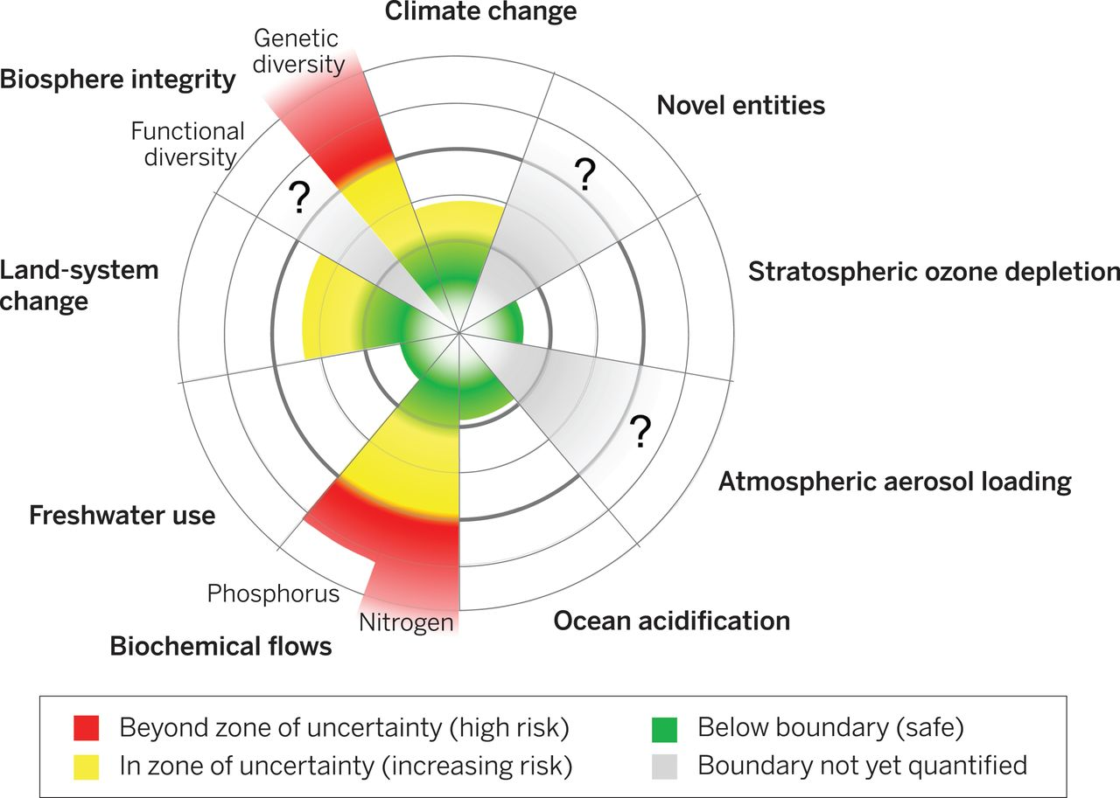

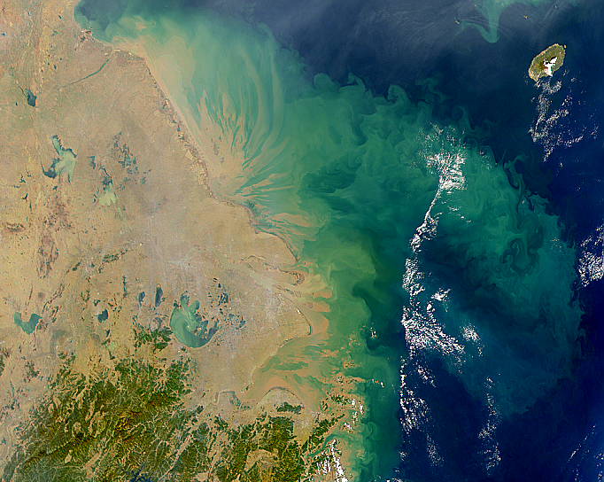
Anthropogenic perturbation levels of biogeochemical
N flows have exceeded the proposed planetary boundary.
Water Hyacinth in Ithezhi Tezhi Reservoir
Source: Environmental Council of Zambia.
Eutrophication of Yangtze lakes and seas
Source: NASA Visible Earth
Steffen et al., 2015 Science

Slide 3
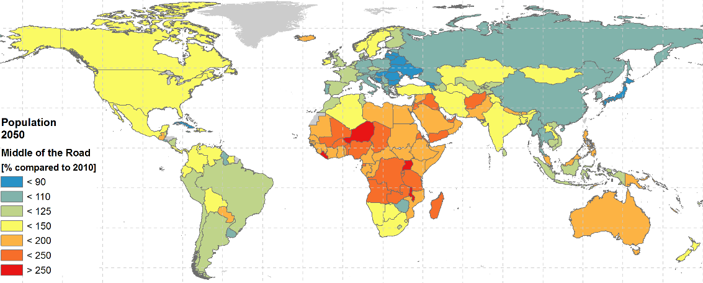
Population and socio-economic development continues.
Asia
Pop: x 1.3
GDP: x 5
GDP pc: x 4
Africa
Pop: x 2
GDP: x 7
GDP pc: x 3.5
Middle of the Road future
  33% more people by 2050 compared to 2010 globally (6.8 billion to 9.1 billion)

Slide 4
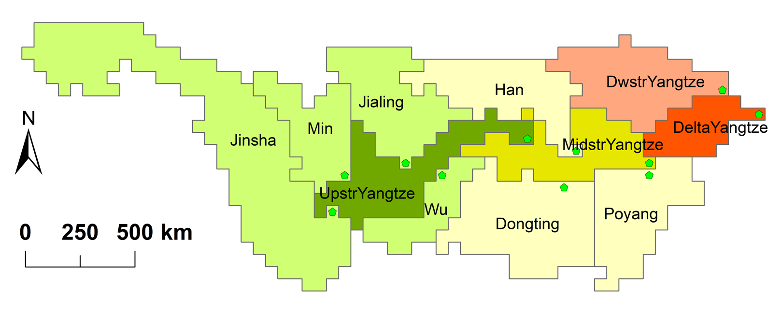
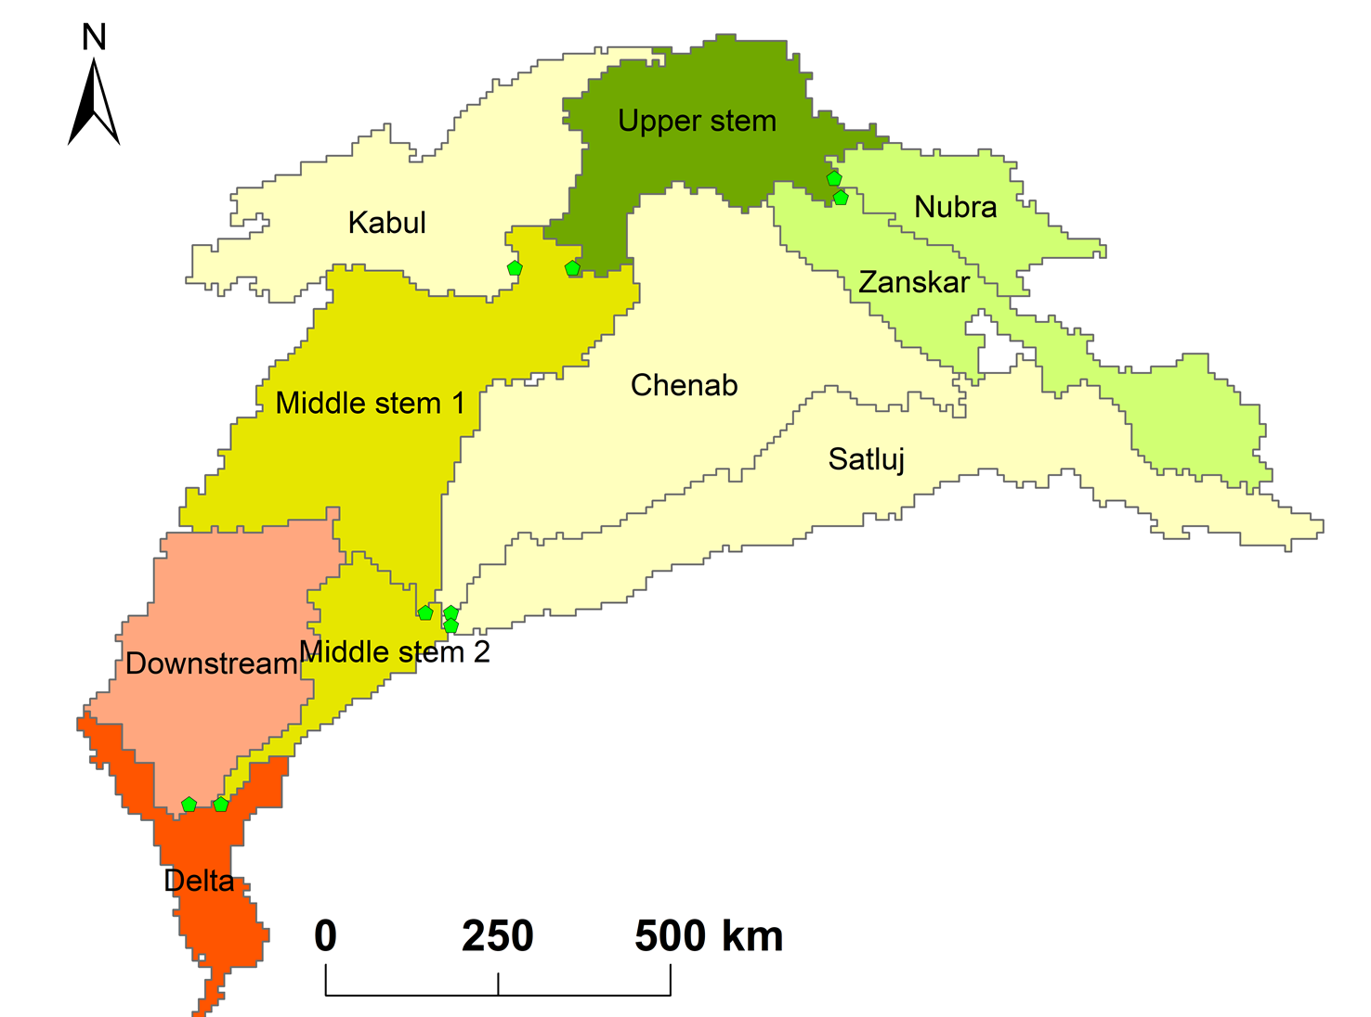
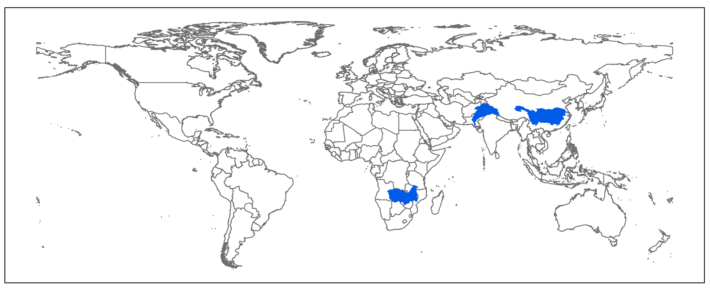
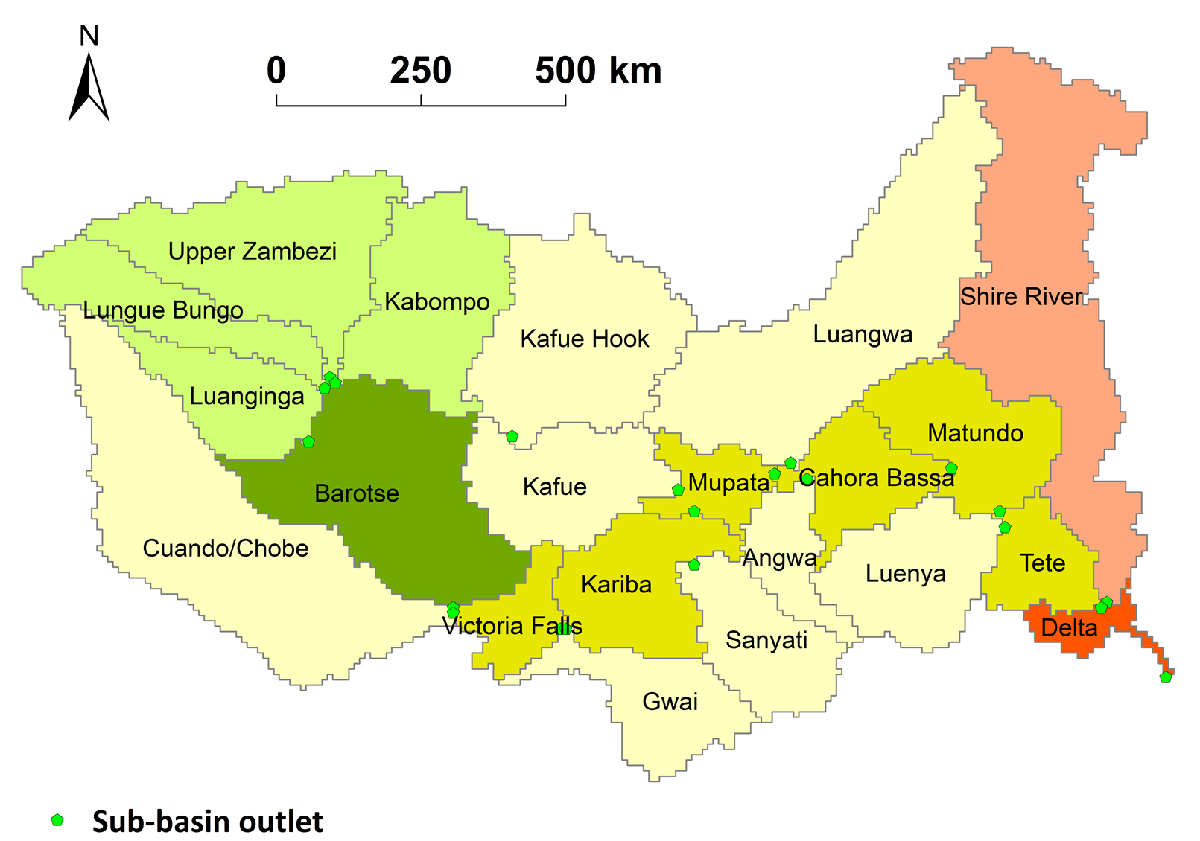
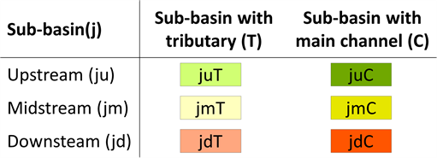
Objective: to analyze the long-term trends of the sources and river export of nitrogen (N)
Based on Wang et al., (2019, STOTEN)
As influenced by socio-economic development, N management and climate change
Based on Tang et al. (under preparation)
Notes:
Objective
Zambezi
Lake Kariba: world’s biggest reservoir by volume
Lake Malawi: 6 deepest lake in the world

Slide 5
The three basins have wide range of developmental status.
Based on Wang et al., (2019, STOTEN)
 | Yangtze | Indus | Zambezi
Area (mil km²) | 1.92 | 0.84 | 1.37
No. of countries | 1 | 4 | 8
Population (2010, mil) | 494 | 180 | 37
% Agricultural land (2010, inc. pasture) | 49% | 44% | 35%
Based on Tang et al. (under preparation)
Notes:
Objective
Zambezi
Lake Kariba: world’s biggest reservoir by volume
Lake Malawi: 6 deepest lake in the world

Slide 6


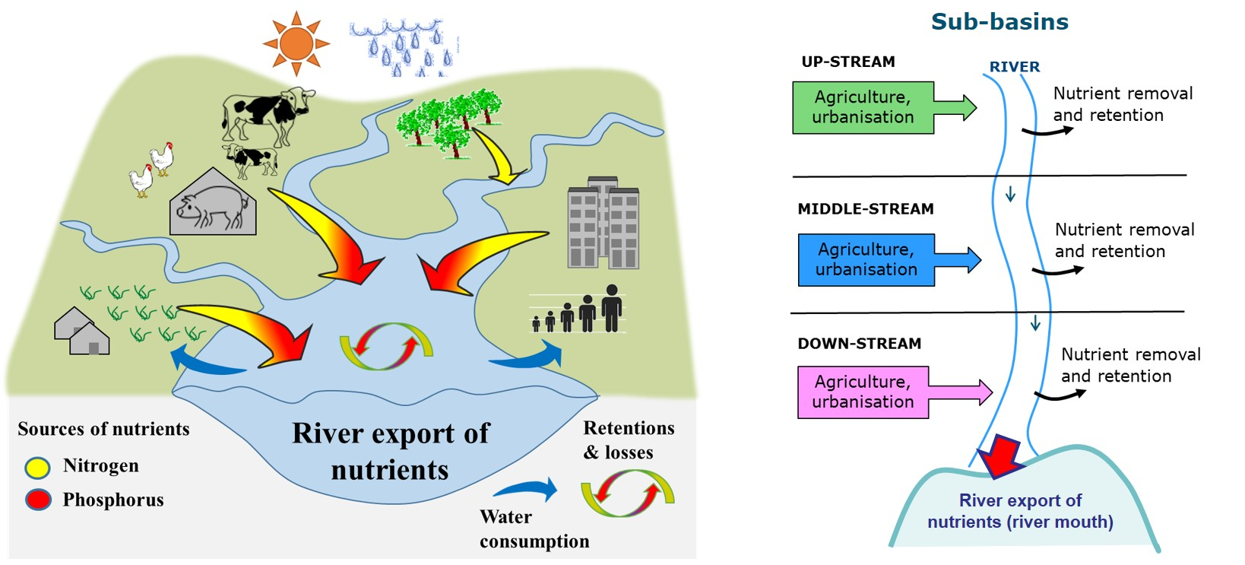
N export modeling by linking IIASA in-house models
Modeling Framework
External data
  Socioeconomic data (GDP, population)
  Nitrogen deposition & fixation
  Sewer connection
GLOBIOM for land use, land use change & diffuse nitrogen sources
(Valin et al., 2013; Byers et al., 2018)
MARINA (Model to Assess River Inputs of Nutrients to seAs) for N export to rivers & sea (Strokal et al.,2016)
CWATM for hydrology & water demand (Burek et al., 2017)
2010s → 2050s with Global climate and socioeconomic projections

Slide 7

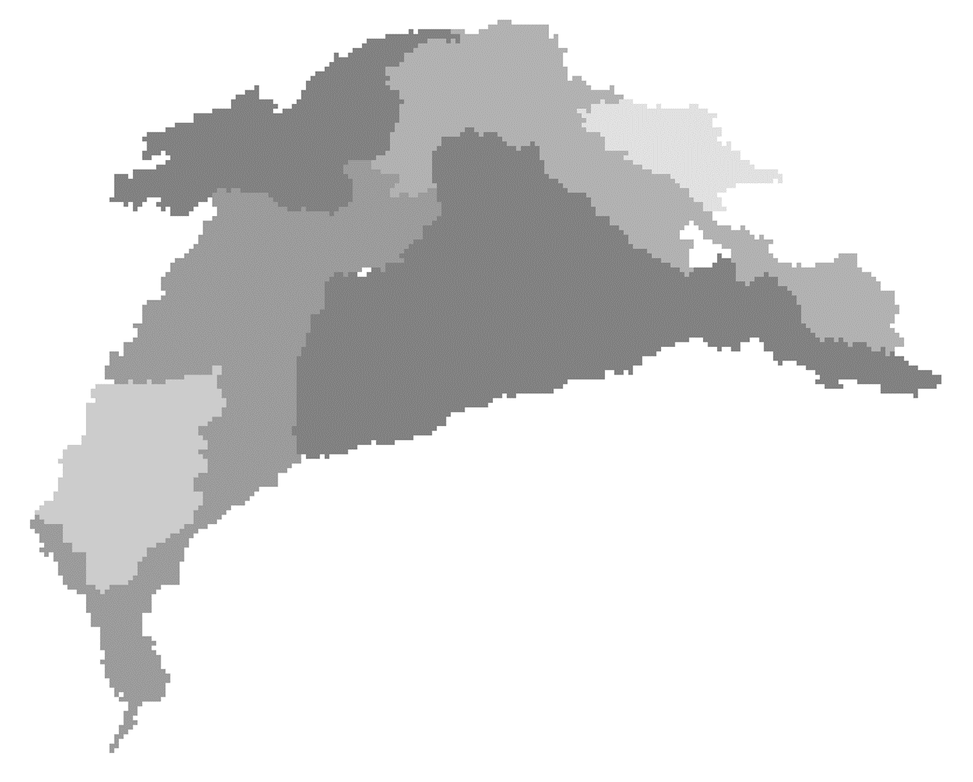
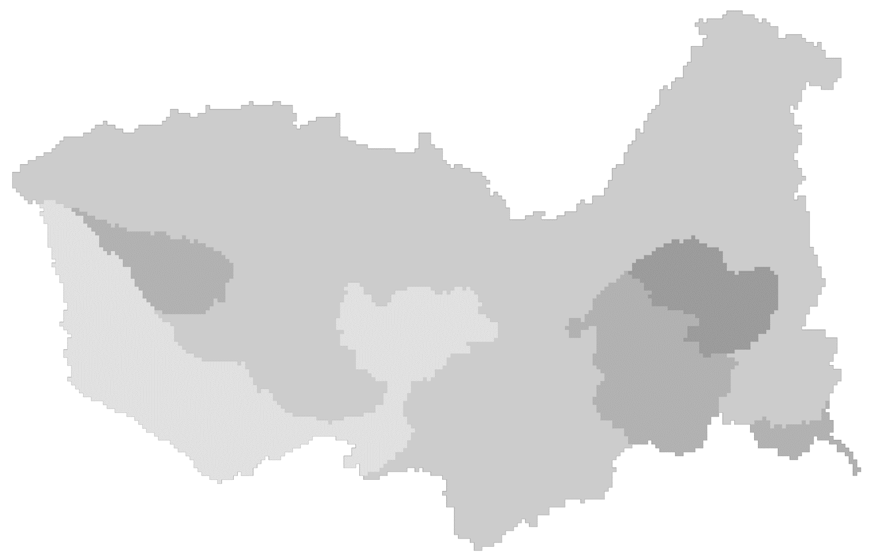
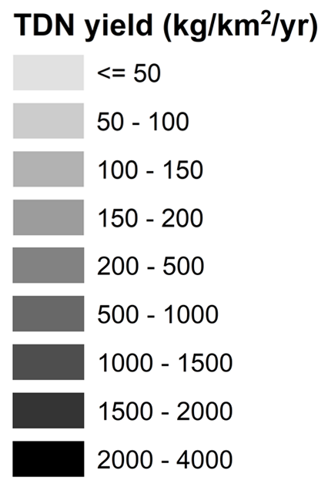
Considerable variations in
N yields and their spatial distribution among basins
Total dissolved N (TDN) yield in 2010s: amount exported to sea per unit area by subbasin
Yangtze
Indus
Zambezi
High Low
Range: 215-3824 46-339 13-189 (kg/ha/yr)
Underlying reasons:
  Population: human wastewater
  Agricultural inputs: fertilizer and manure
Notes:
Current: Source attribution + yield → link to population and agricultural area

Slide 8
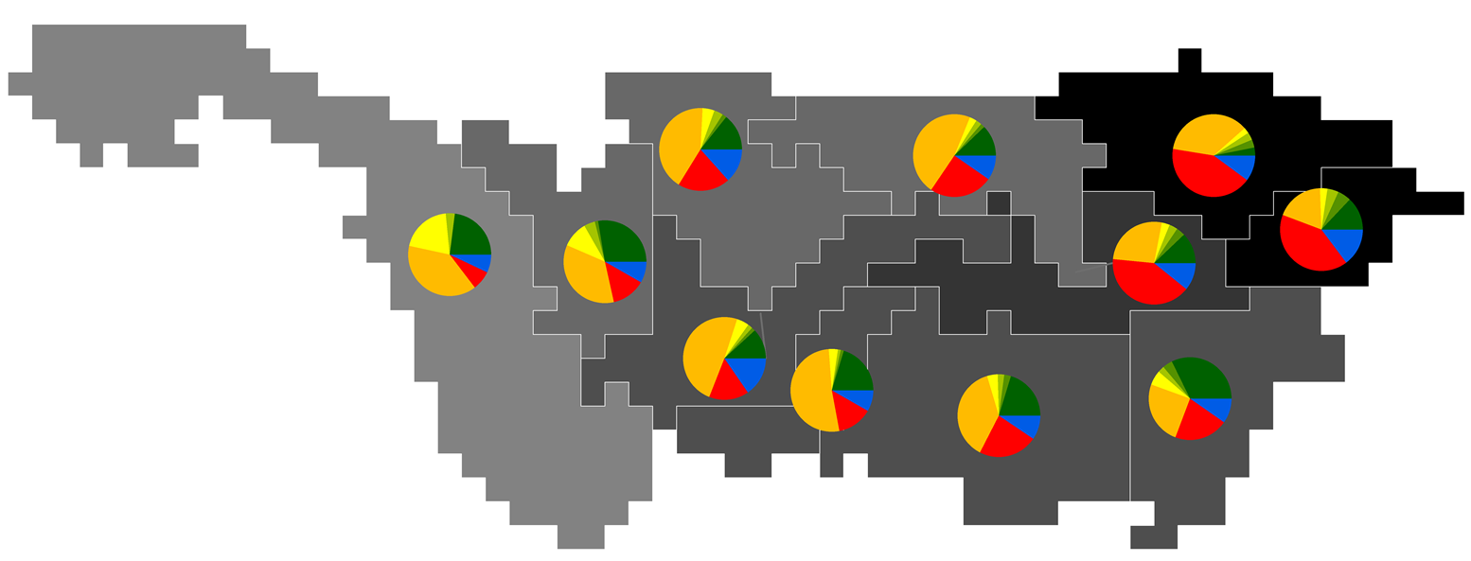
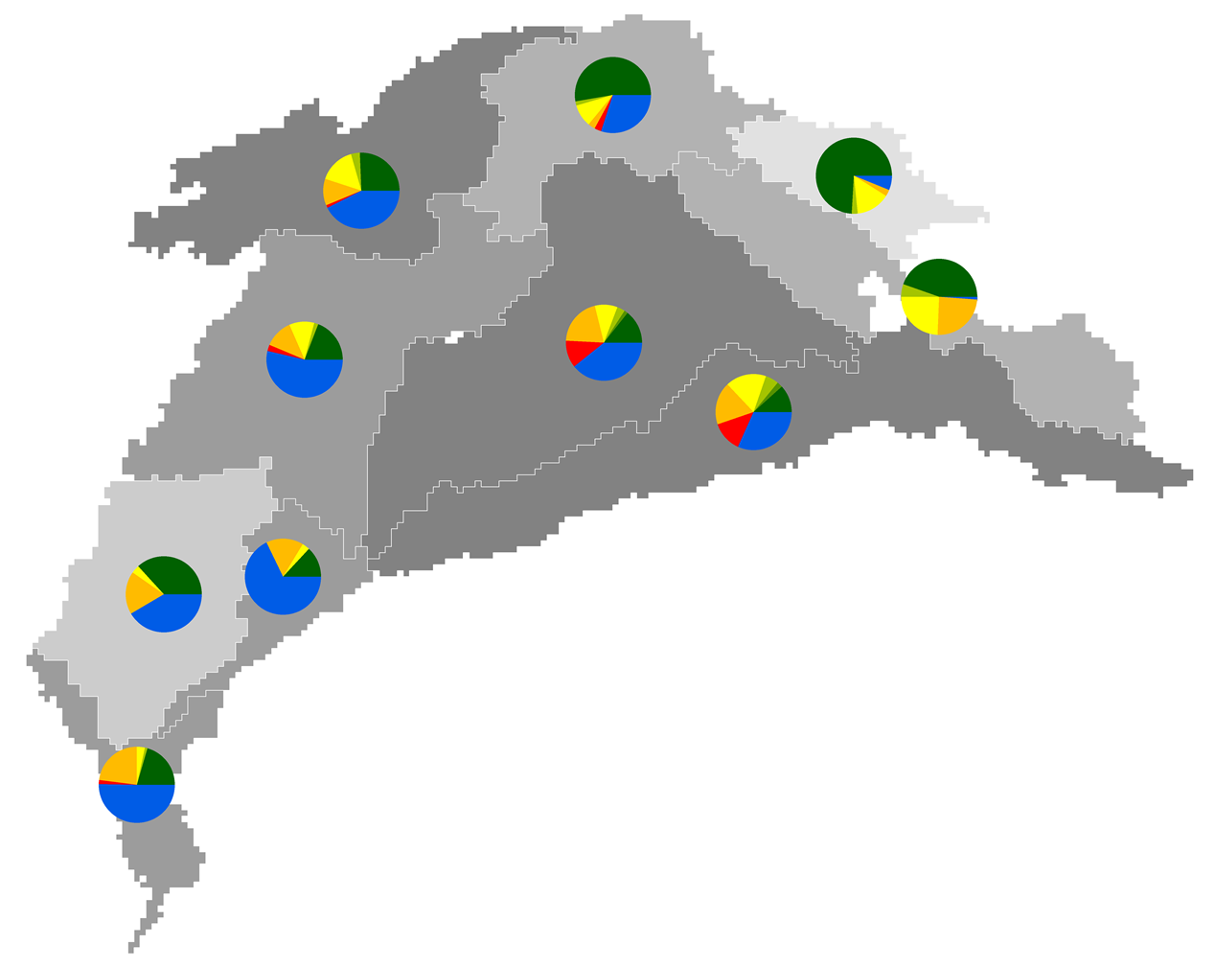
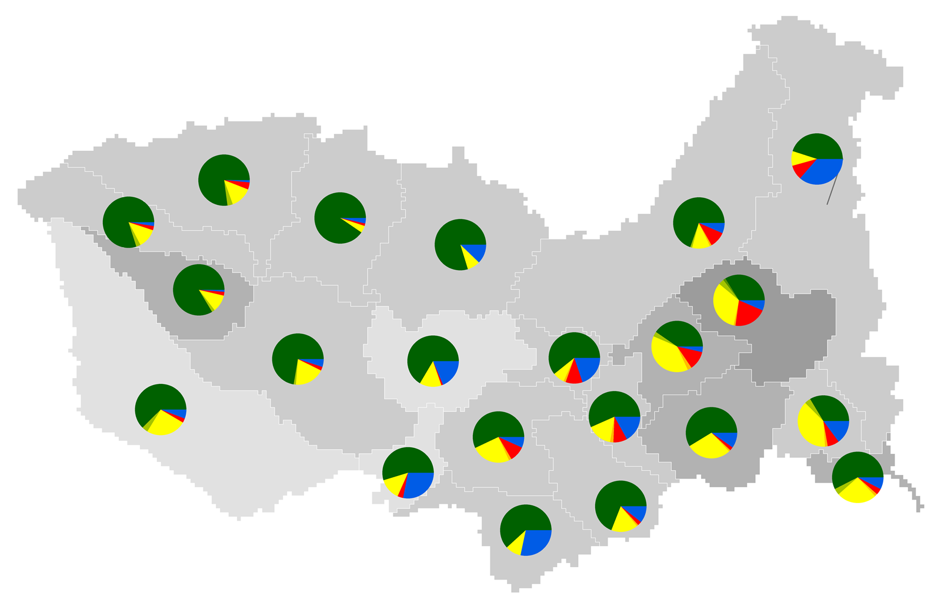
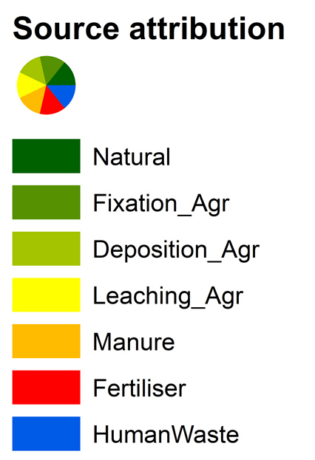
Dominant contribution from human activities to
N export in Yangtze and Indus in 2010s
Yangtze
Indus
Zambezi
Main
sources
Manure + Fertiliser Human waste Natural
Point discharge of animal manure
Overfertilisation
Untreated/insufficiently
Treated human waste
Notes:
Current: Source attribution + yield → link to population and agricultural area

Slide 9
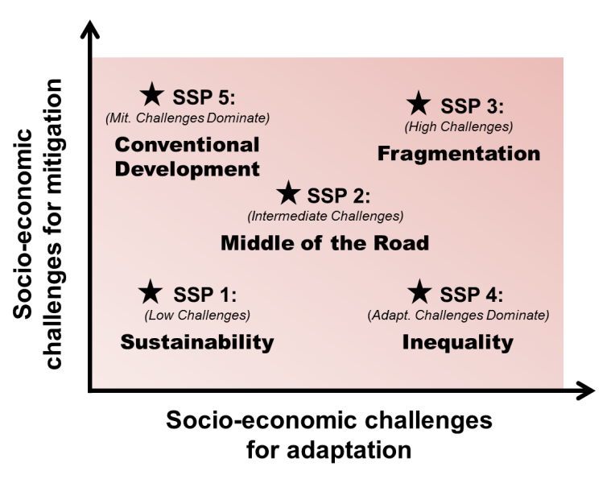
How will things change in the near-term future?
Projections using three scenarios
Global climate projections
  Based on the Representative Concentration Pathways (RCPs, van Vuuren et al. 2011)
  e.g., rainfall, temperature, etc. from 4 GCMs
Global socioeconomic projections
  Based on the Shared Socio-economic Pathways (SSPs, O’Neill et al, 2012)
  e.g. Population, GDP, water/food demand, etc.
Three combined scenarios:
  Sustainable scenario: SSP1-RCP2.6
  Business-as-usual scenario: SSP2-RCP4.5
  High inequality/emission scenario: SSP3-RCP6.0

Slide 10

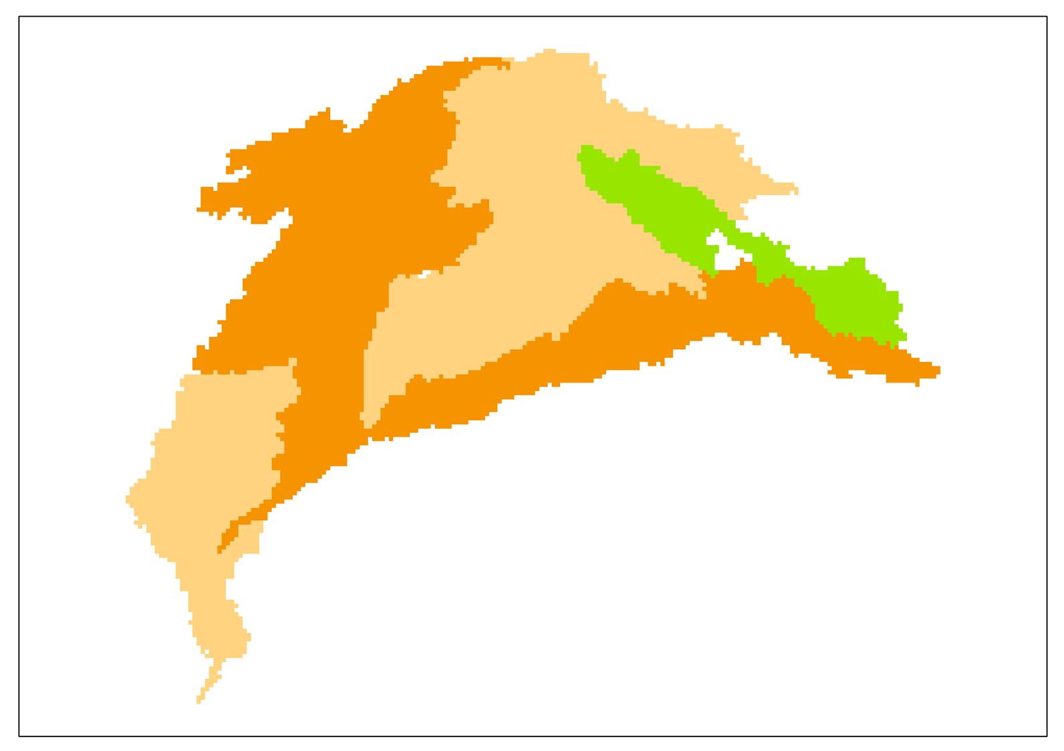
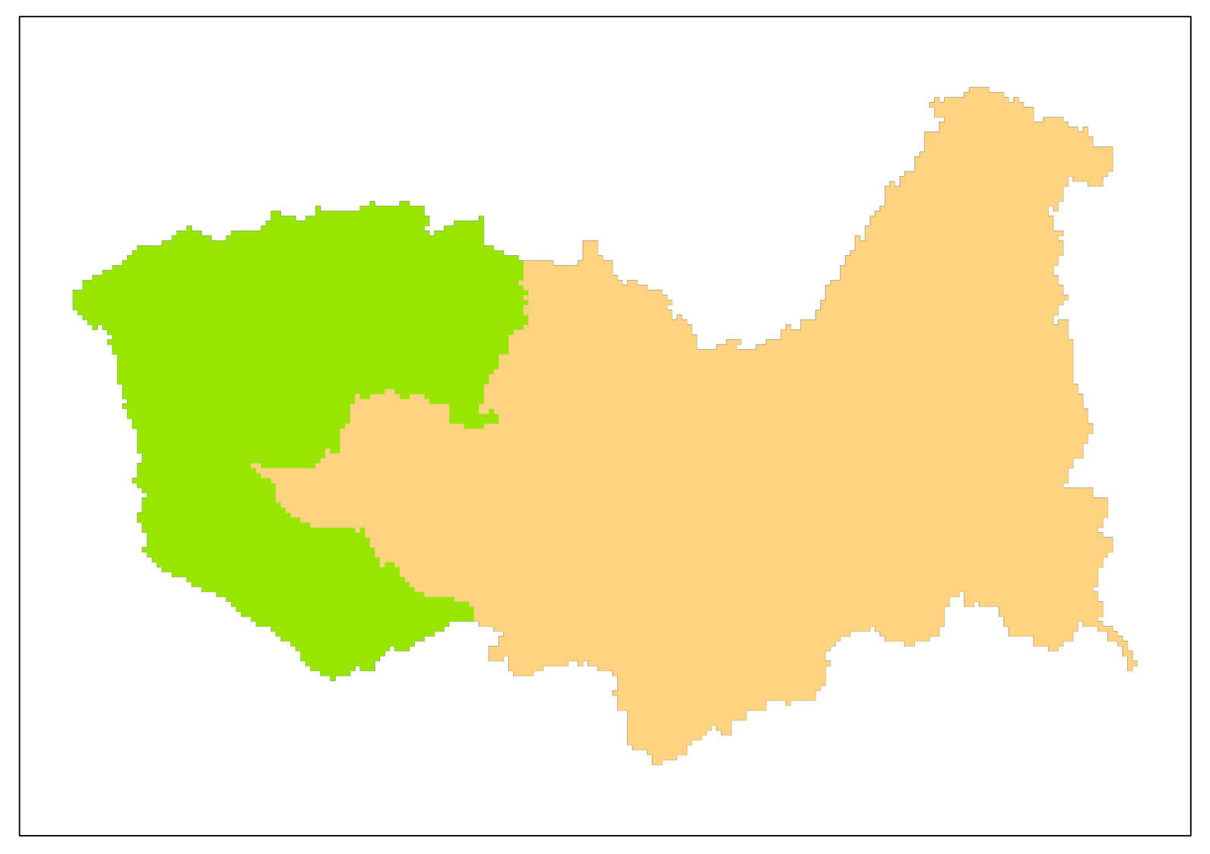
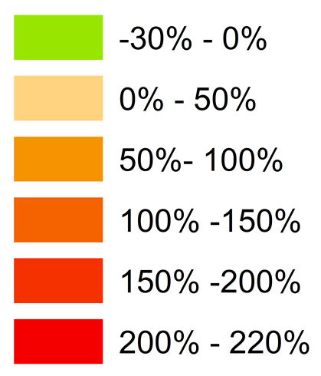

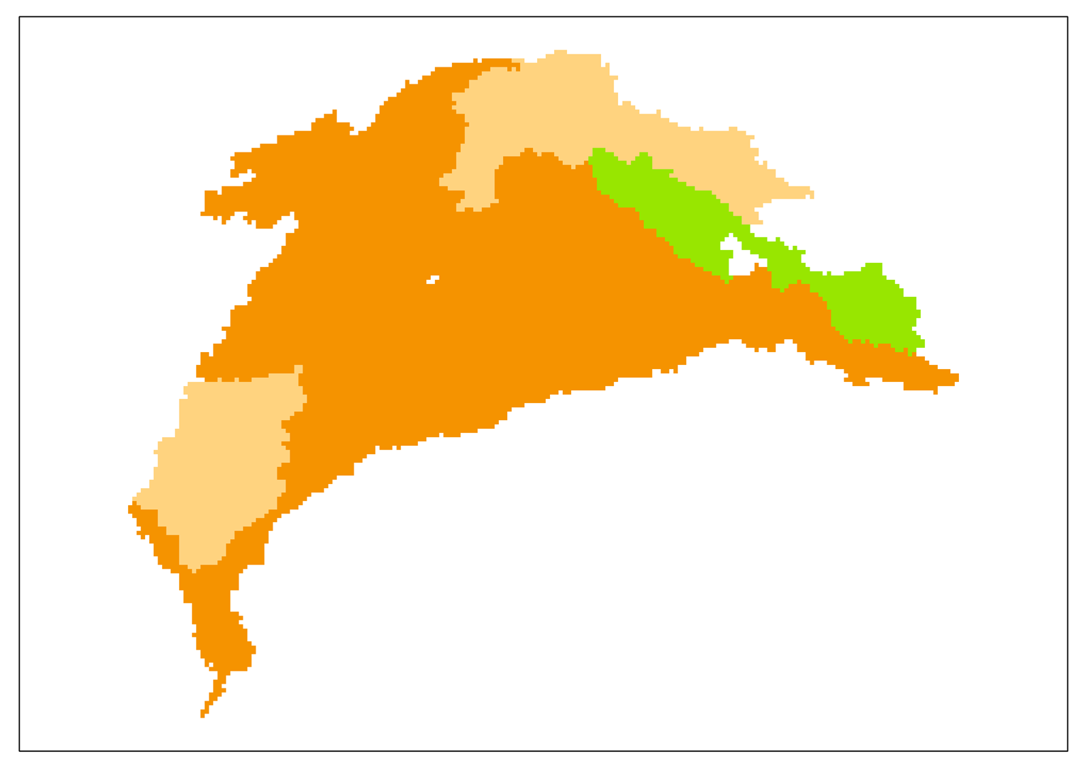
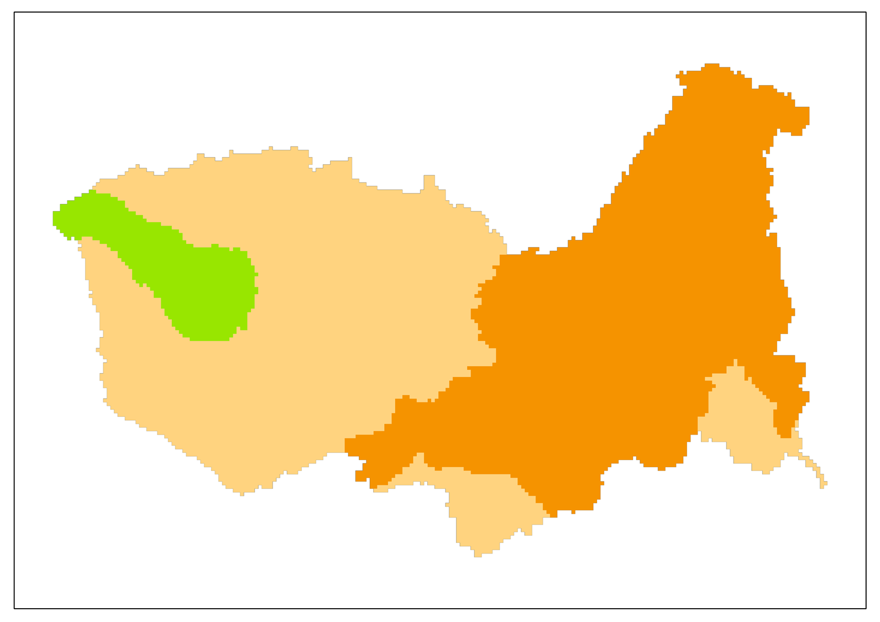
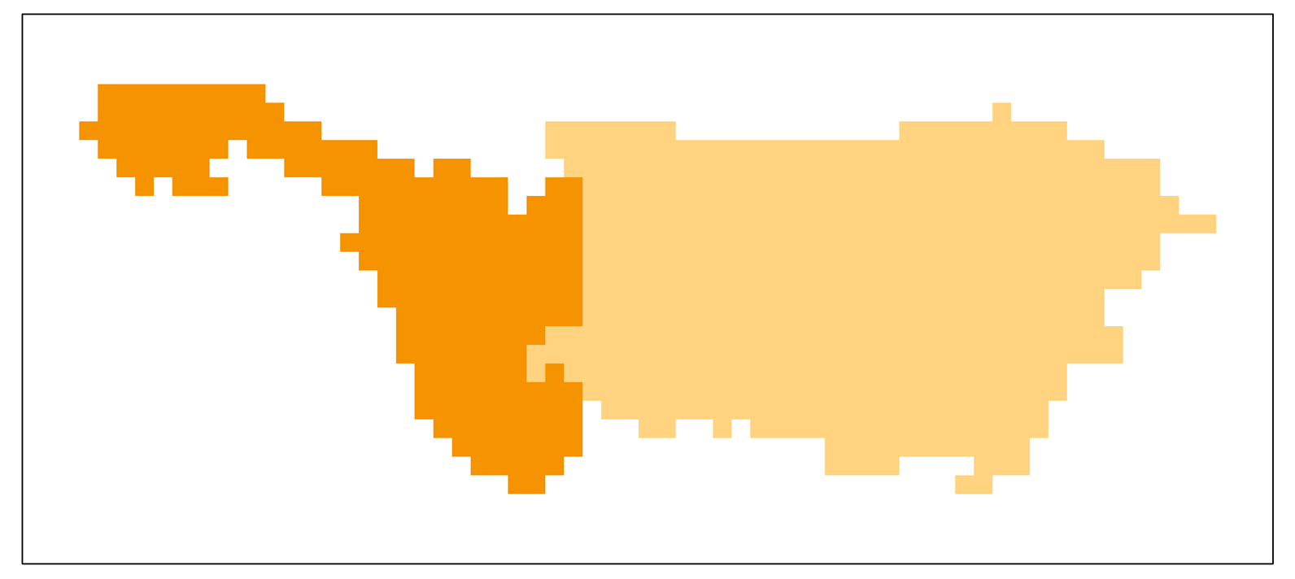
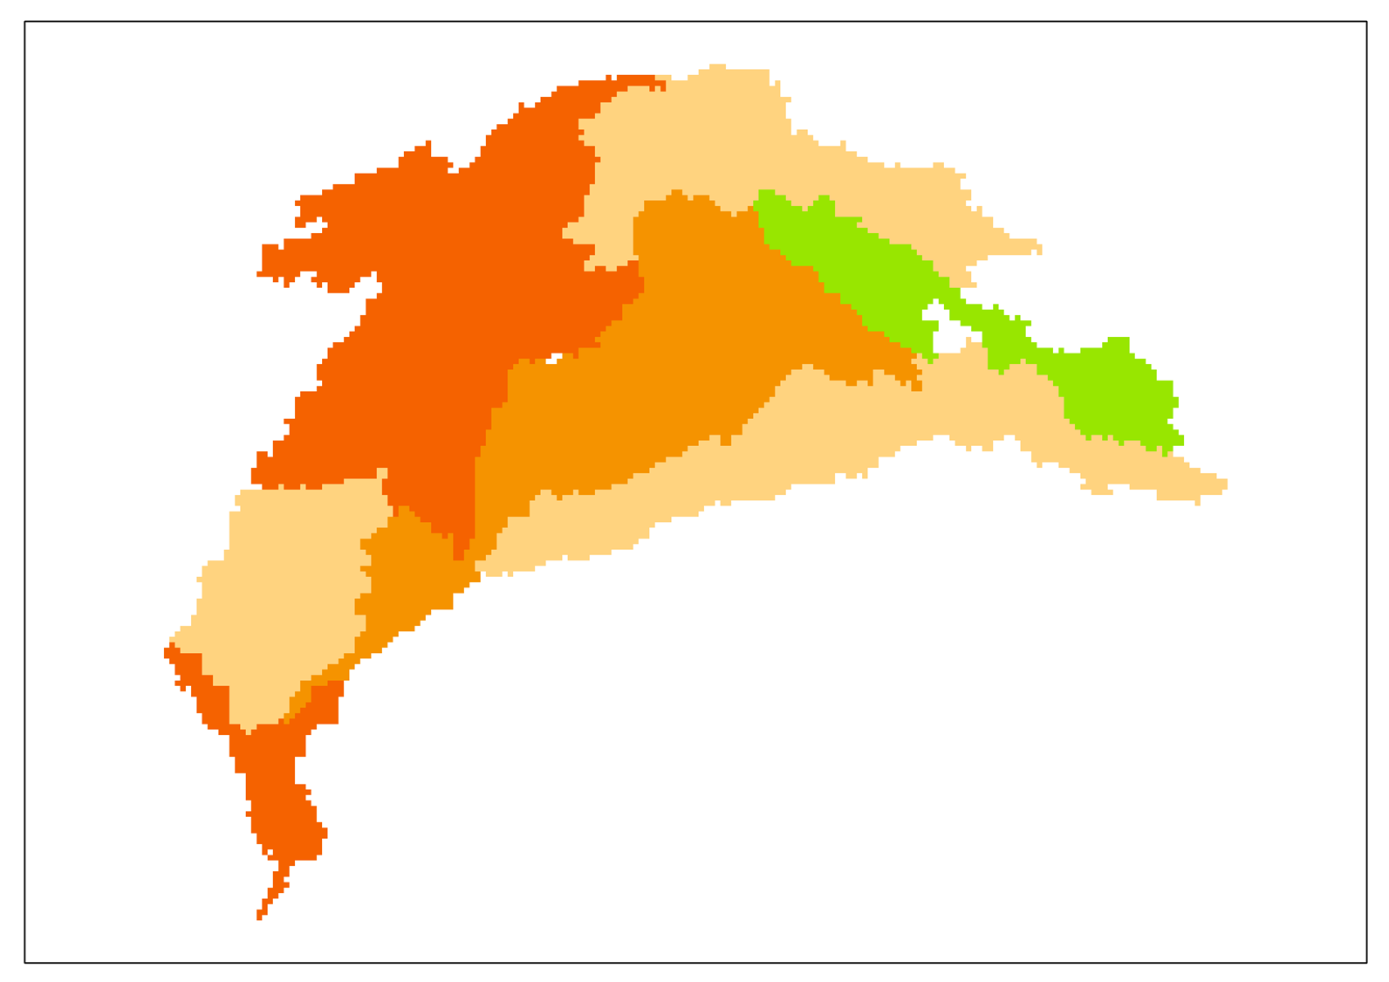
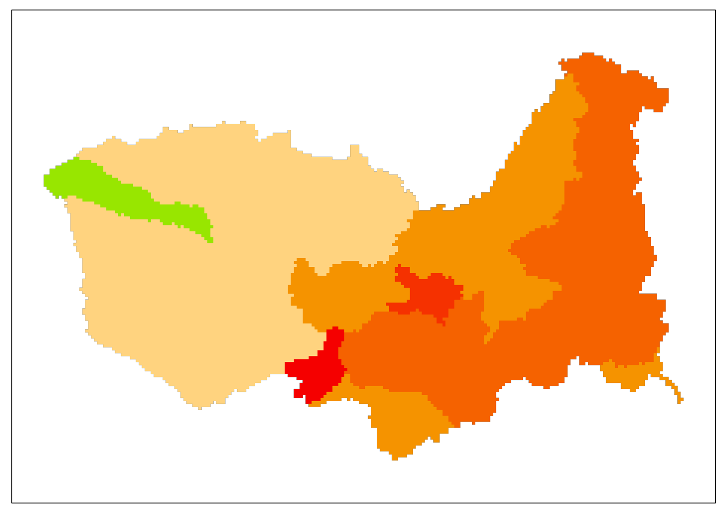
N export to sea in 2050s
In Indus and Zambezi, decrease only in the upstream
  Net increase
  from 2010s
Yangtze
Indus
Zambezi
  SSP1-RCP2.6
  SSP2-RCP4.5
  SSP3-RCP6.0

Slide 11
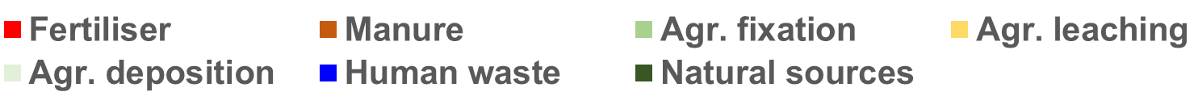
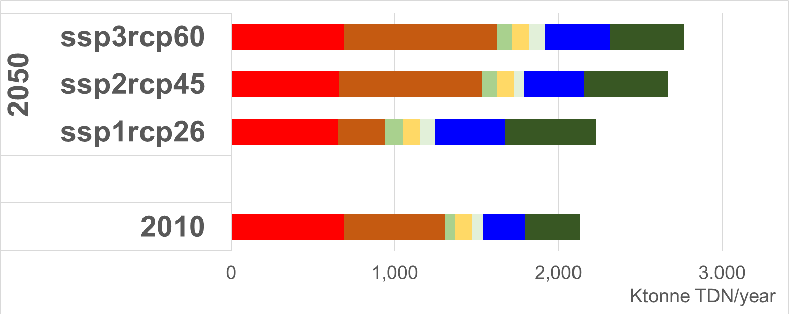
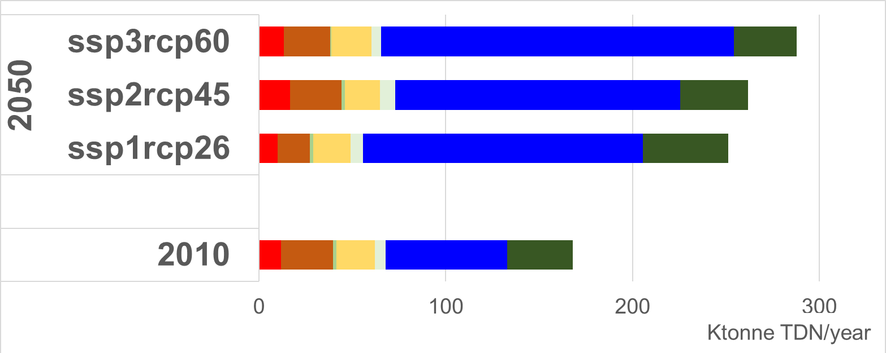
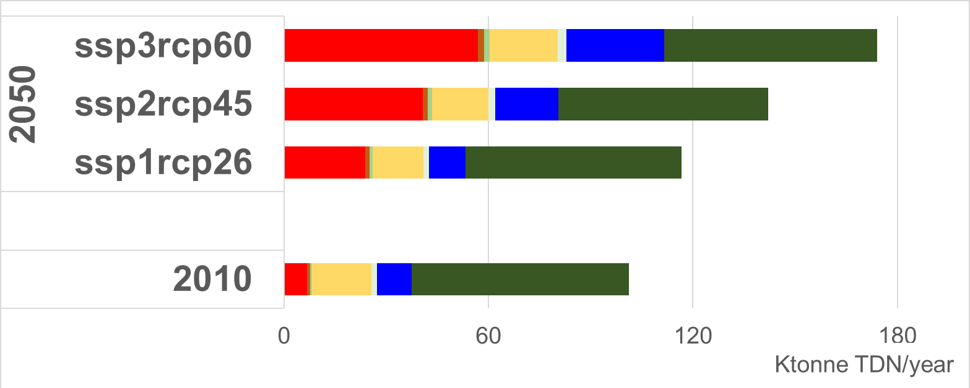
N export to sea in 2050s increases in all basins and all scenarios.
Yangtze
Indus
Zambezi
Range of net
increase from 2010s
5%-30% 50%-71% 15%-72%
Despite strong assumptions (esp. SSP1-RCP2.6) on
Sanitation improvement
N recycling from manure/human waste

Slide 12
Increasing export can be attributed to different anthropogenic sources.
Yangtze
Indus
Zambezi
Sources with highest
change from 2010s
Manure Human waste Fertiliser + Human waste
More ambitious and targeted N management strategies are needed to
reduce (Yangtze) N export or keep it as the current level (Indus and Zambezi).
Notes:
2050: total load comparison increase up to 100% in Indus and Zambezi

Slide 13
Take home messages
There are considerable variations of N yields and their spatial distribution, and dominant sources among basins.
N export to sea is likely to increase in 2050s in all three basins under all three scenarios.
Ambitious and targeted N management strategies will be needed in all three basins.

Slide 14
?
Steffen et al., 2015 Science

Slide 15
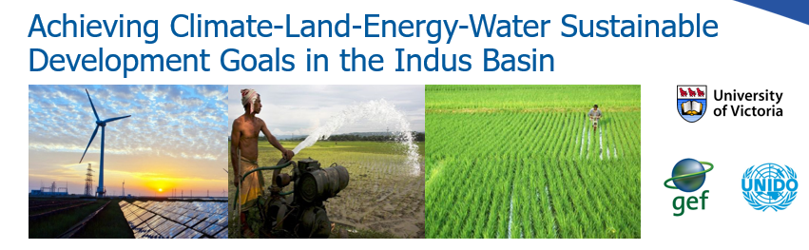


Impacts of Climate Change and Socio-economic Development on Future Nitrogen Export a
A Comparative Study of Three Large River Basins
The study is partly funded by the Global Environment Facility (GEF, Contract No. 6993) as part of the Integrated Solutions for Water, Energy, and Land (IS-WEL) project, and supported by the United Nations Industrial Development Organization (UNIDO).
Ting Tang
Water Program
tangt@iiasa.ac.at
International Institute for Applied System Analysis
Austria

Slide 16
References
Byers E, Gidden M, Leclere D, Balkovic J, Burek P, Ebi K, Greve P, Grey D, Havlik P, Hillers A, et al.: Global exposure and vulnerability to multi-sector development and climate change hotspots. Environ Res Lett 2018, 13:055012.
Burek P, Satoh Y, Greve P, Kahil T, Wada Y: The Community Water Model (CWATM): Development of a community driven global water model. In European Geoscience Union Union General Assembly 2017. . 2017:9769.
Steffen W, Richardson K, Rockström J, Cornell S E, Fetzer I, Bennett E M, Biggs R, Carpenter S R, de Vries W, de Wit C A, et al.: Planetary boundaries: Guiding human development on a changing planet Science 2015 (80-). 347:6223
Strokal M, Kroeze C, Wang M, Bai Z, Ma L: The MARINA model (Model to Assess River Inputs of Nutrients to seAs): Model description and results for China. Sci Total Environ 2016, 562:869–888.
Valin H, Havlík P, Mosnier A, Herrero M, Schmid E, Obersteiner M: Agricultural productivity and greenhouse gas emissions: trade-offs or synergies between mitigation and food security? Environ Res Lett 2013, 8:035019.

Slide 17
Scenario assumptions for 2050 sewer connections and wastewater treatment
Scenarios | Rural and urban population connected to sewage systems | N removal during wastewater treatment | Direct discharge of animal manure*
SSP1-RCP2.6 | Yangtze: level of European countries in 2010; Indus**: level of Yangtze in 2010 | 50% shift from lower to higher classes | Yangtze: as the assumption for China in Wang et al. (2017)
SSP2-RCP4.5 | Average of SSP1 and SSP3 | 30% shift from lower to higher classes | Yangtze: as the assumption for China in Wang et al. (2017)
SPP3-RCP6.0 | As in 2010 | As in 2010 | Yangtze: as the assumption for China in Wang et al. (2017)
Based on Wang et al., (2019) and Tang et al. (under preparation)

