Slide 1
IIASA as a FAIR data hub for energy systems modeling & integrated assessment
Workshop “Big Data and Systems Analysis” Committee on Data (CODATA) International Science Council & IIASA
Laxenburg, February 25, 2020
This presentation is available at pure.iiasa.ac.at/16315 under a Creative Commons License
Daniel Huppmann on behalf of the IIASA Energy Program

Slide 2
The IIASA Energy program as a community data hub
Part 1

Slide 3
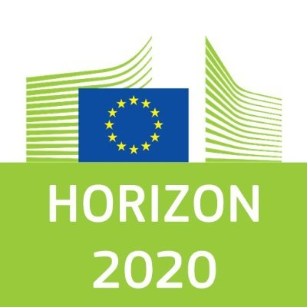
The IIASA Energy program as community data hub
Supporting the modelling community for more than a decade
The role of the IIASA Energy program
Hosting scenario databases to support model comparison projects e.g. Energy Modeling Forum (EMF) organized by Stanford University
Contributing to community processes on data standards & formats e.g., Integrated Assessment Modeling Consortium (IAMC)
“WG on Data Protocols & Management” co-chaired by Dr. Volker Krey
Capacity-building for national teams (e.g., Horizon 2020 “CD-LINKS”)
Selected funding sources for infrastructure development

Slide 4
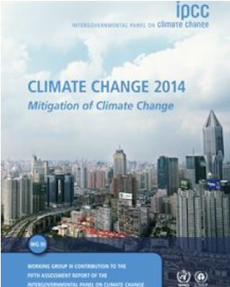
The IIASA Energy program as community data hub
Hosting community databases for dissemination of results
Selection of high-profile public scenario databases
Representative Concentration Pathways (RCPs, 2009)
IPCC AR5 Scenario Database (2014)
Shared Socio-economic Pathways (SSPs, 2018)
Horizon 2020 project “CD-LINKS” (2018-2019)
Bringing together global & national modelling teams
IAMC 1.5°C Scenario Explorer supporting IPCC SR15
More information: https://data.ene.iiasa.ac.at
The IPCC’s Fifth Assessment Report (AR5, 2014) uses an ensemble of more than 1000 scenarios compiled and curated by IIASA. http://ipcc.ch/ar5

Slide 5
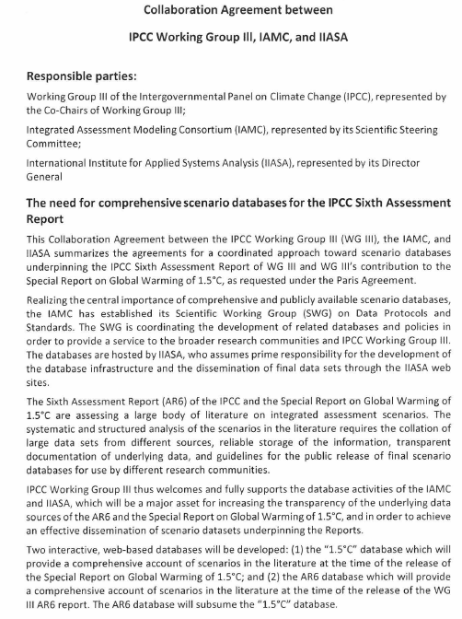
The IIASA Energy program as community data hub
Continuing efforts towards open & FAIR science
Currently ongoing Horizon 2020 projects (selected)
Developing more tools for dissemination, communication and stakeholder engagement
Collaboration with IPCC for 6th Assessment Report
Researchers at the Energy program are currently compiling a scenario ensemble supporting the AR6
A collaboration agreement between the IPCC WGIII, the IAMC and IIASA sets the scope of cooperation for the sixth assessment cycle

Slide 6
Best-practice of FAIR & open science
Part 2

Slide 7
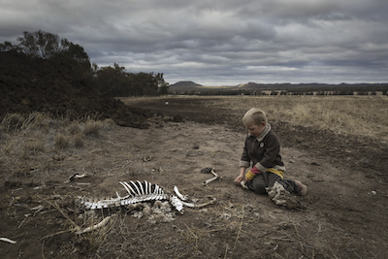
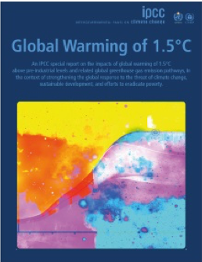
A Special Report on Global Warming of 1.5°C
Analyzing impacts of climate change in the context of the SDGs
The IPCC Special Report on Global Warming of 1.5°C (SR15) was published in the fall of 2018.
[…] To prevent 2.7 degrees of warming, the report said, greenhouse pollution must be reduced by 45 percent from 2010 levels by 2030, and 100 percent by 2050. It also found that, by 2050, use of coal as an electricity source would have to drop from nearly 40 percent today to between 1 and 7 percent. Renewable energy such as wind and solar, which make up about 20 percent of the electricity mix today, would have to increase to as much as 67 percent. […]
Harry Taylor, 6, played with the bones of dead livestock in Australia, which has faced severe drought.
Brook Mitchell/Getty Images
Where do these numbers
come from?
www.nytimes.com/2018/10/07/climate/ ipcc-climate-report-2040.html
www.ipcc.ch/sr15

Slide 8
Diving into the ‘Summary for Policymakers’ (SPM)
The IPCC assessed a large ensemble of emissions pathways
The Summary for Policymakers of the IPCC Special Report on Global Warming of 1.5°C (SR15).
C.1 In model pathways with no or limited overshoot of 1.5°C, global net anthropogenic CO₂ emissions decline by about 45% from 2010 levels by 2030 (40–60% interquartile range), reaching net zero around 2050 (2045–2055 interquartile range). [...] {2.1, 2.3, Table 2.4}

Slide 9
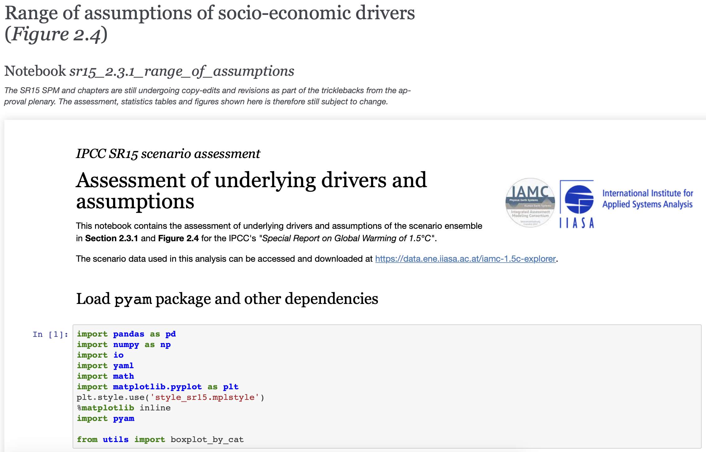
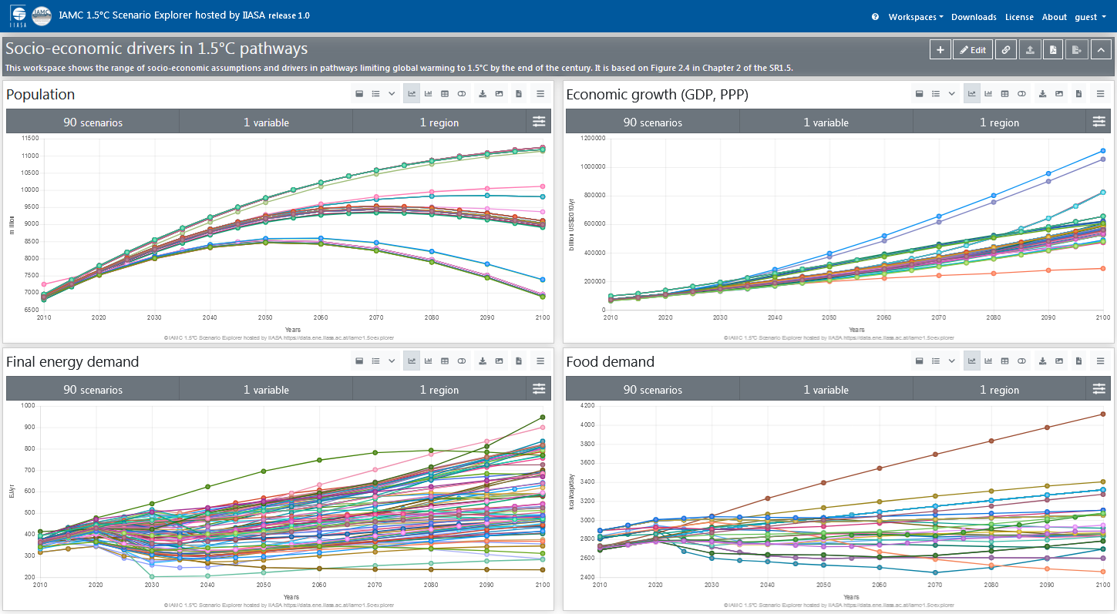
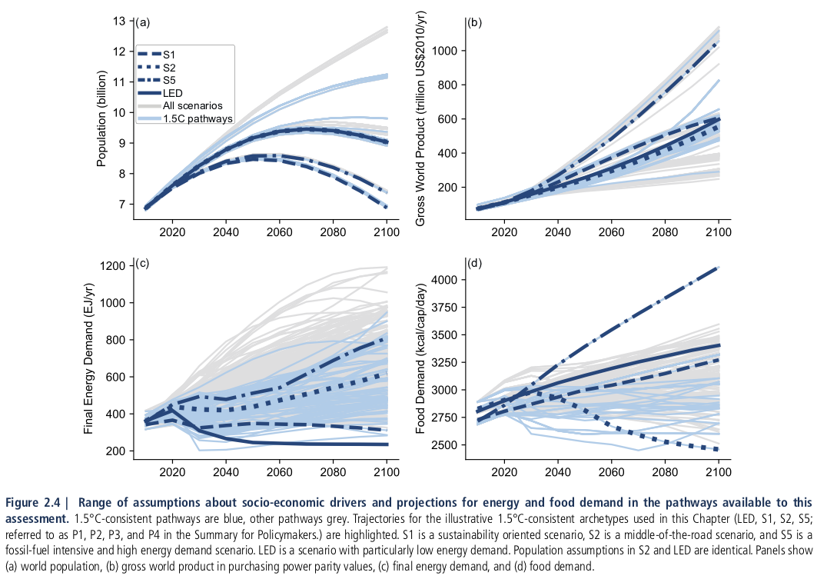
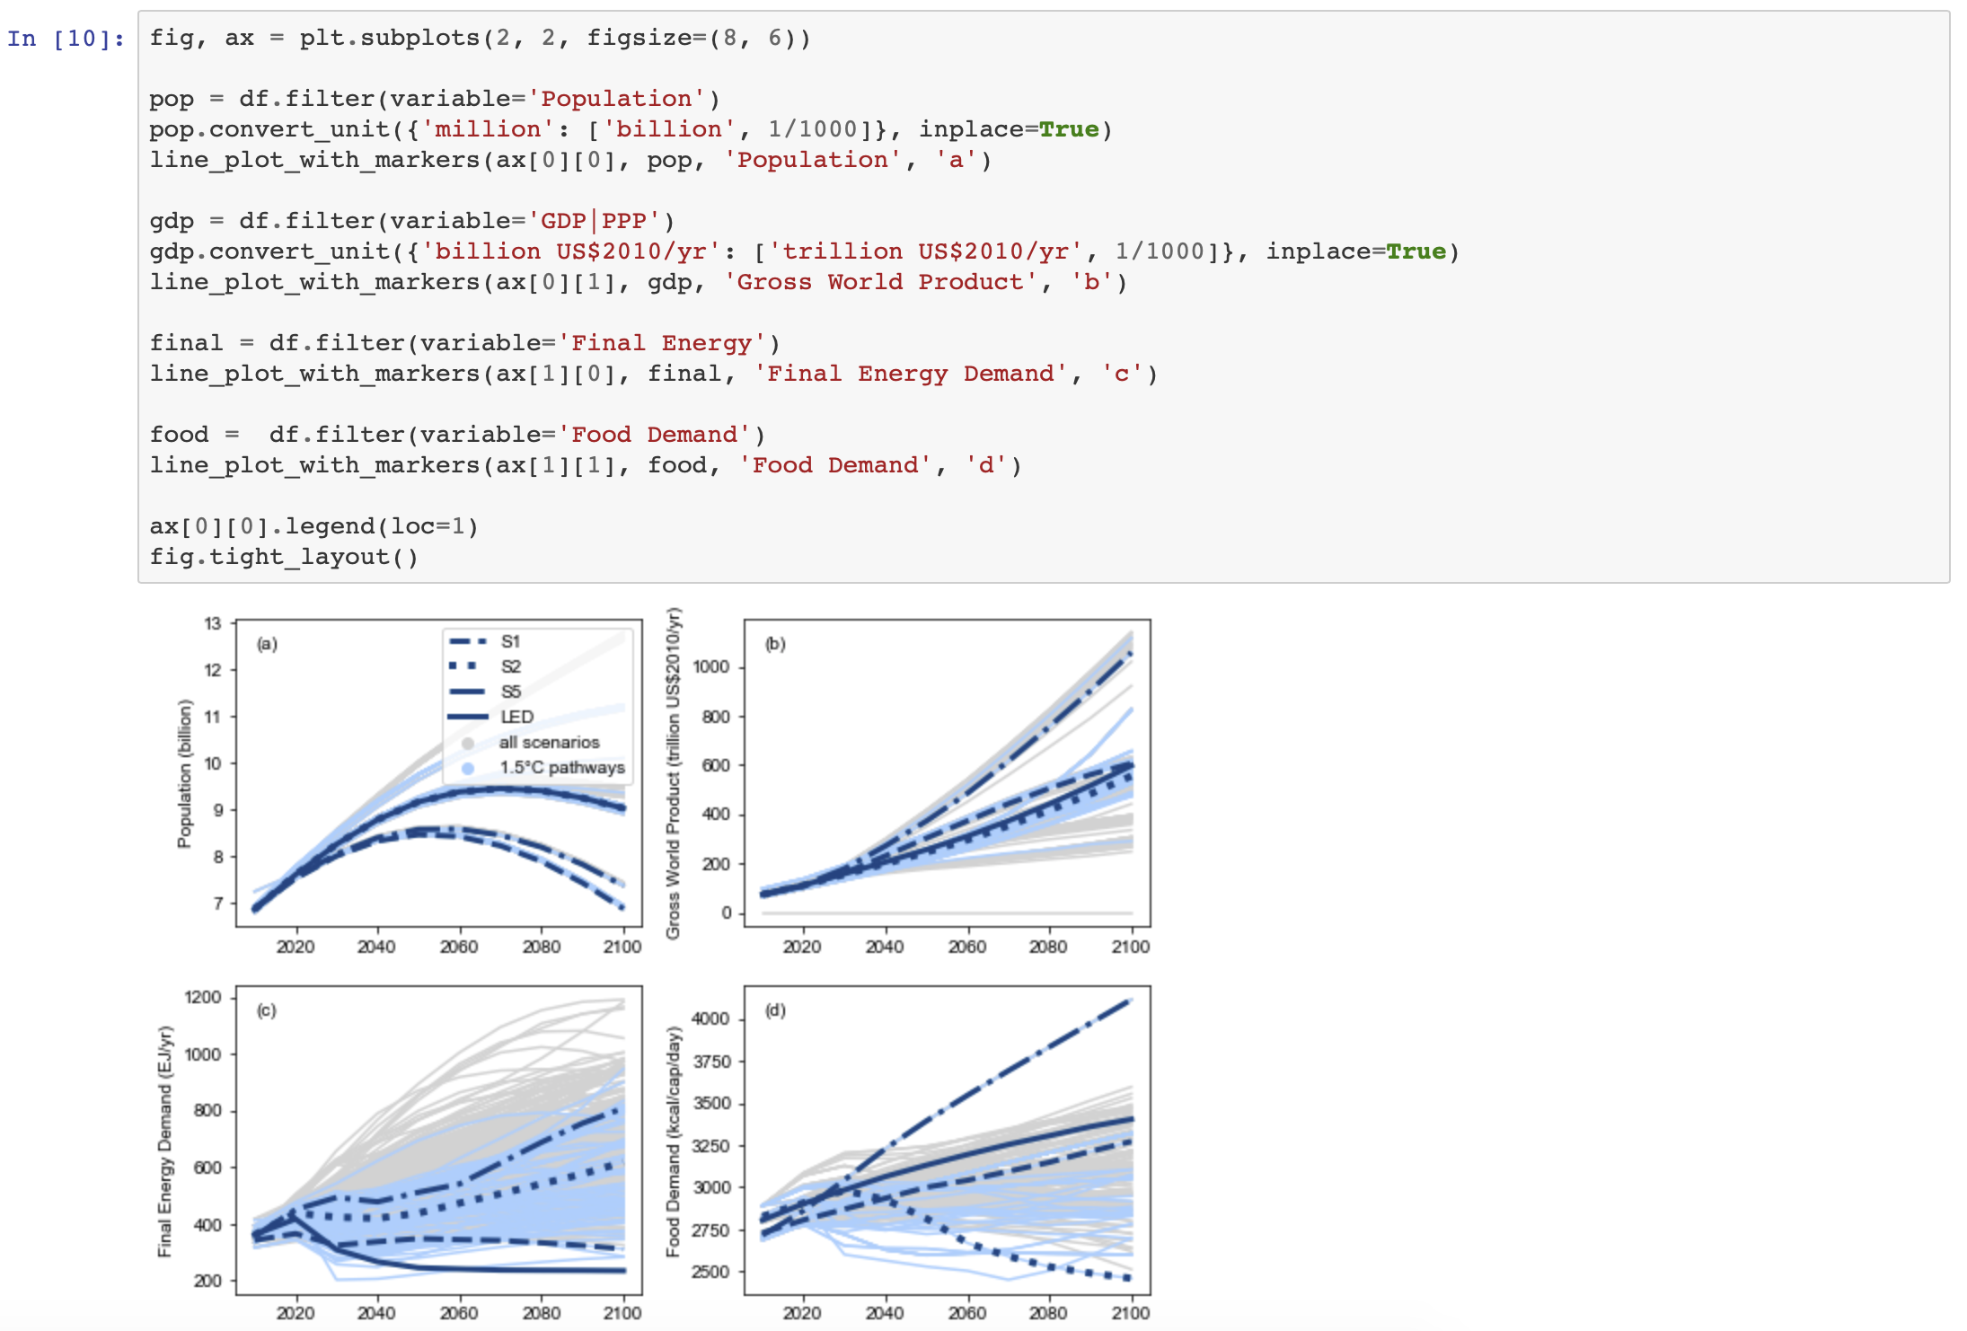
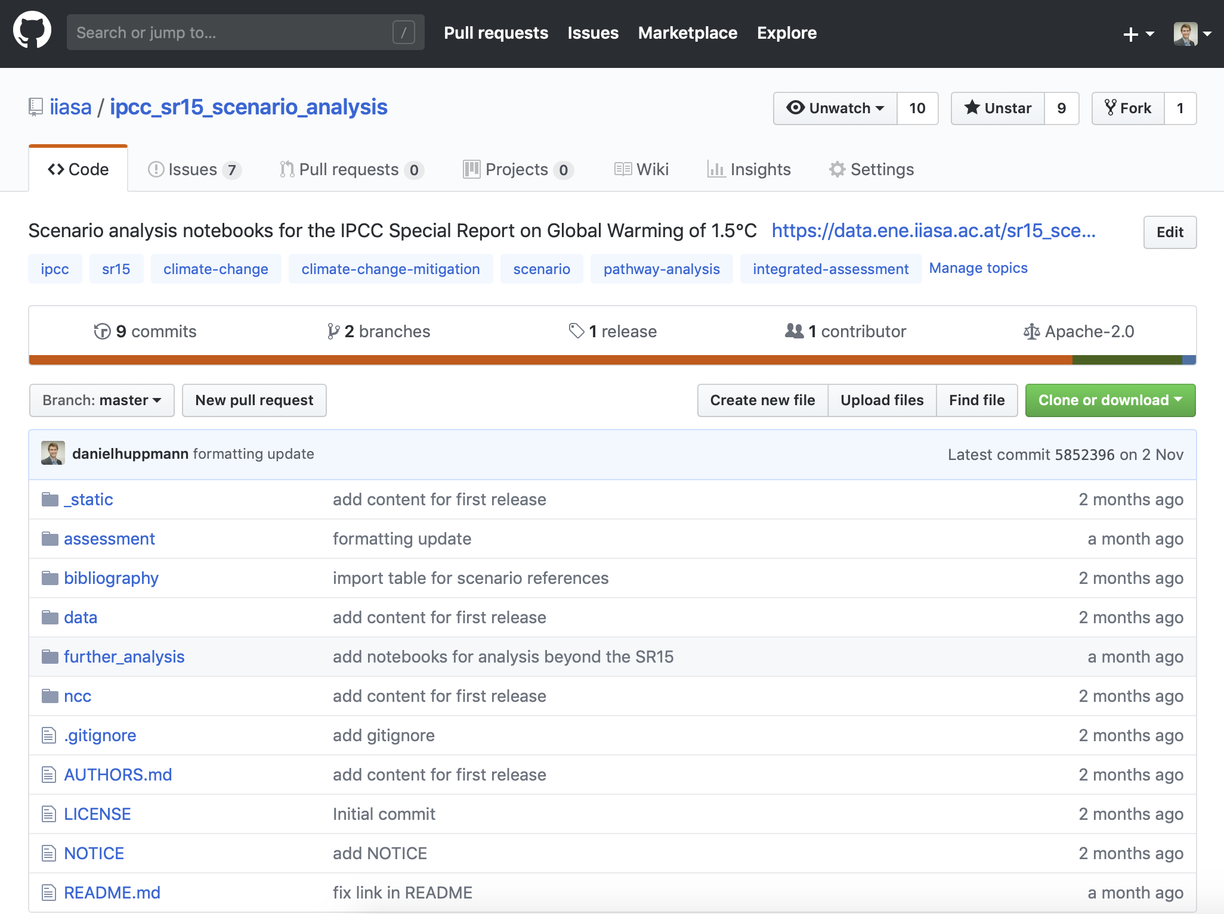
The “line of sight” of the SR15 scenario ensemble
We developed a suite of open tools to dive into the SR15 analysis
Interactive online scenario explorer at data.ene.iiasa.ac.at/iamc-1.5c-explorer
Figure 2.4 as printed in the SR15 (www.ipcc.ch/sr15)
Rendered notebooks to generate figures and tables at data.ene.iiasa.ac.at/sr15_scenario_analysis
$ git clone git@github.com:iiasa/ipcc_sr15_scenario_analysis.git

Slide 10
Increasing the “FAIRness” of the IPCC assessment
Going beyond efforts in AR5, we followed the FAIR principles to increase transparency and reproducibility of the scenario assessment
Goal | Implemented measures
Findable | Use proper recommended references including DOIs for data and notebooks
Accessible | Make data and notebooks available for multiple levels of user sophistication as well as via common machine-readable API’s
Interoperable | Use common data template developed by the IAMC Analysis using open-source Python package pyam
Reusable | Data and assessment notebooks released under licenses that enable follow-up research
Wilkinson, M. D., et al. (2016). Scientific Data 3:160018. doi: 10.1038/sdata.2016.18

Slide 11
Findable
Use appropriate references & metadata for each item
Separate treatment for distinct pieces of the scientific “supply chain”
Scientific assessment: Chapter 2 of the SR15 and Annex
Scenario ensemble (data)
Notebooks for scenario assessment
Scientific software package
Journal manuscript on scenario ensemble compilation and user guidelines
Each item has its own recommended citation and DOI
Use proper versioning for each item (data & software release cycle)
Social Media:
Following an online discussion with @Peters_Glen: use #iamc_15c for scenario ensemble on Twitter (limited success)

Slide 12
Accessible (I) – machine-readable formats
The infrastructure provides multiple entry points & interfaces
Scenario ensemble data:
Downloadable as xlsx and csv
Accessible via a RestAPI from the Scenario Explorer backend
Assessment notebooks
Distributed via GitHub
Also available as rendered notebooks
Scientific software
Maintained on GitHub
Available via conda & pypi
Rendered notebooks to generate figures and tables at data.ene.iiasa.ac.at/sr15_scenario_analysis

Slide 13
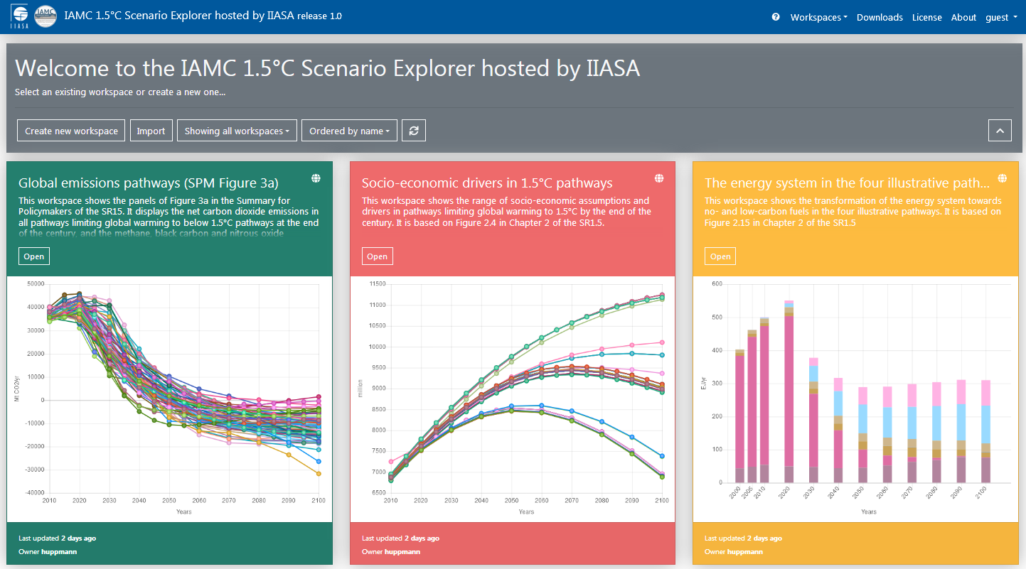
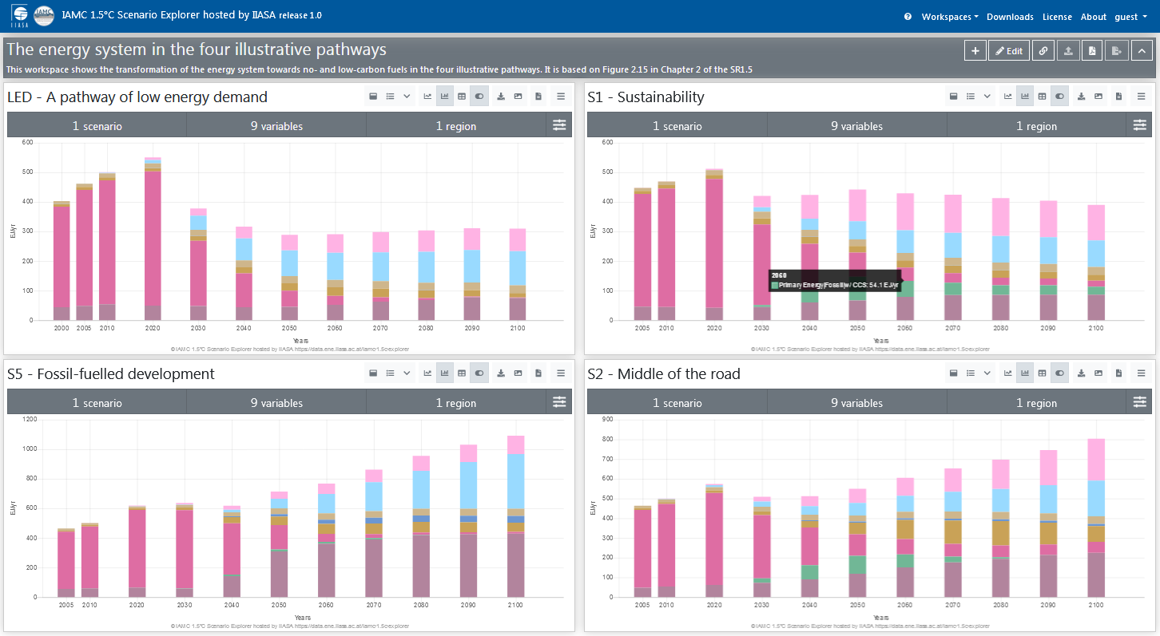
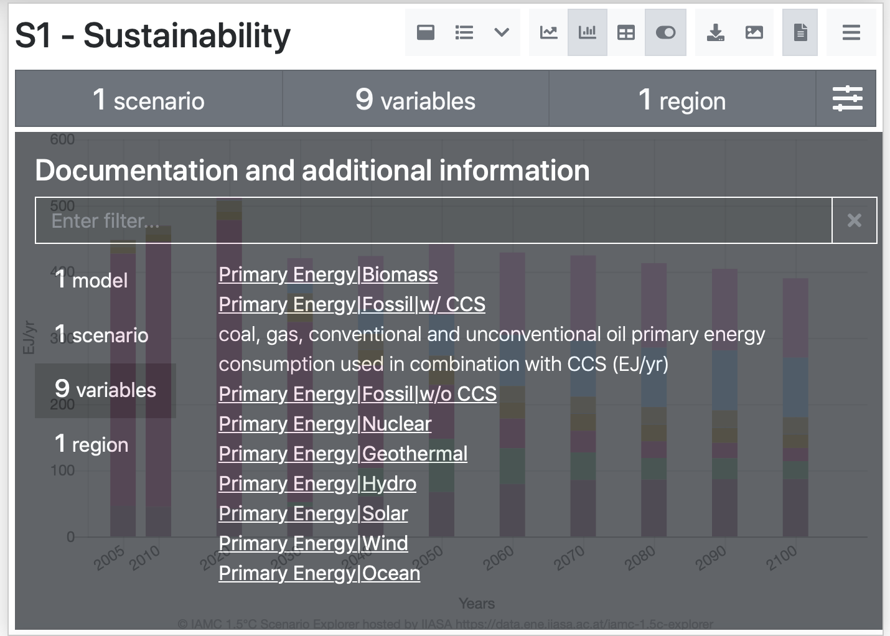
Accessible (II) – for human users
A new “IAMC 1.5° C Scenario Explorer hosted by IIASA”
Using “workspaces” to manage figures & data tables including pre-defined panels replicating SR15 figures
The scenario explorer provides documentation and references for models, scenarios & variables
Visit the IAMC 1.5°C Scenario Explorer at https://data.ene.iiasa.ac.at/iamc-1.5c-explorer

Slide 14
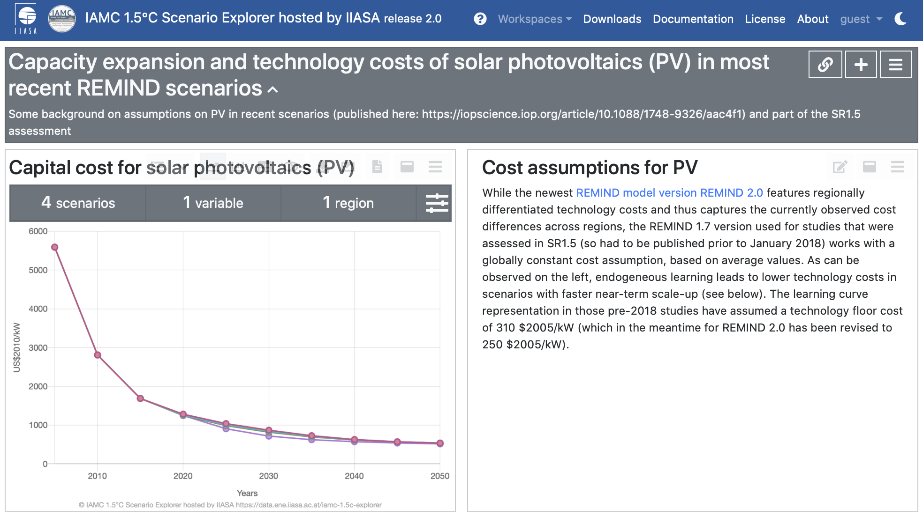
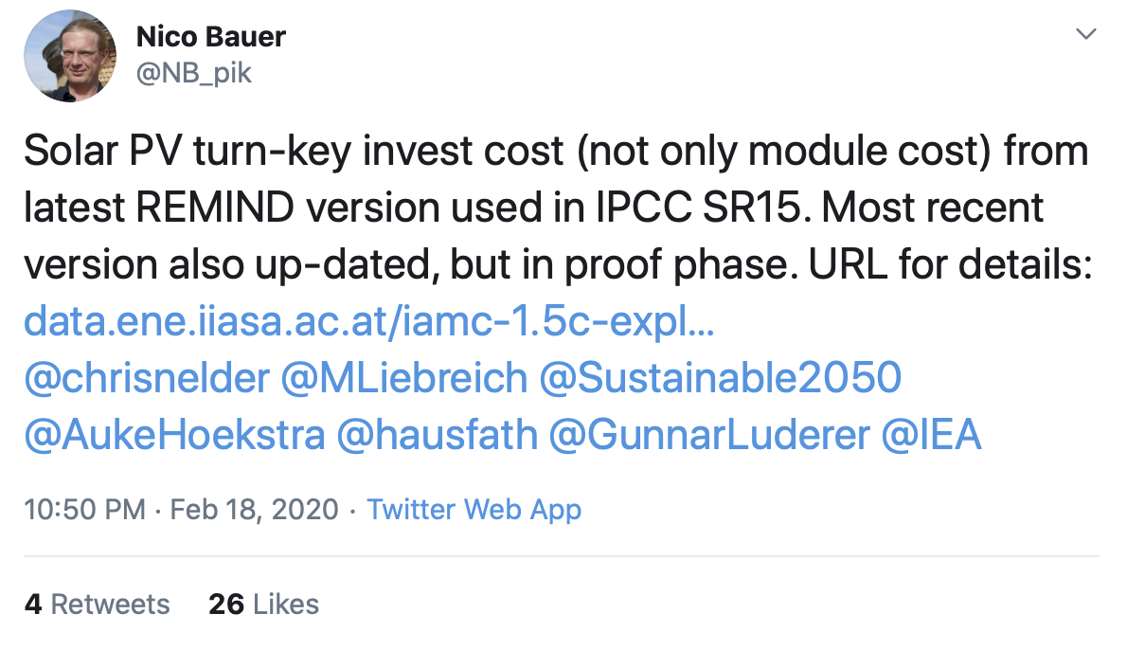
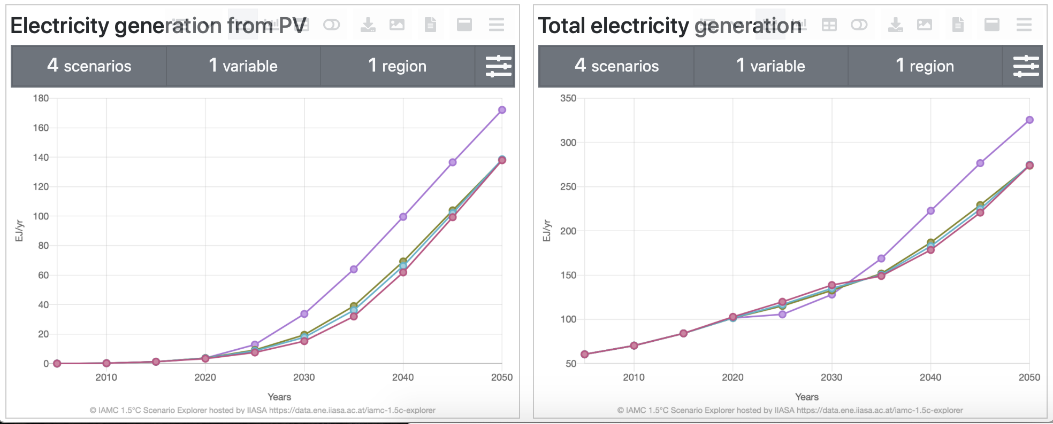
Scenario explorer workspaces “in the wild”
Last week on Twitter...
Discussion in the scientific literature (and on Twitter) about assumptions of PV costs in models used in SR15...
Thread at https://twitter.com/NB_pik/status/...

Slide 15
Interoperable
Apply common data standards and open-source packages
Use common data template developed by the IAMC
High-profile use case: IPCC Reports (AR5, SR15), EMF
Used by ~50 research teams globally
Assessment using an open-source Python package
Scenario analysis & visualization toolbox based on collaborative scientific-software practices
Documentation: pyam-iamc.readthedocs.io
 | A | B | C | D | E | F | G | H
1 | Model | Scenario | Region | Variable | Unit | 2005 | 2010 | 2015
2 | MESSAGE | CD-LINKS 400 | World | Primary Energy | EJ/y | 462.5 | 500.7 | ...

Slide 16
Reusable (I)
All items of the scientific supply chain are released under licenses that enable follow-up research and re-use
Scenario ensemble data:
Custom license modified from Creative Commons CC-BY 4.0
Aim: allow re-use for scientific research and science communication but keep IAMC 1.5°C Scenario Explorer as “gateway” for entire dataset
Why? anticipating updates, we want to avoid multiple out-of-sync versions
Assessment notebooks:
Licensed under Apache 2.0, distributed via GitHub
Scenario ensemble manuscript:
Bound by Springer-Nature policy
But: distribute Readcube link for free access on personal website and social media, share post-print version on IIASA website after embargo period

Slide 17
Reusable (II)
The scenario set is an unstructured “ensemble of opportunity”
The data was compiled from studies & reports addressing various research questions and based on differing scenario designs and underlying assumptions.
A user’s guide to the analysis and interpretation of scenario ensembles
Don’t interpret the scenario ensemble as a statistical sample or as likelihood/agreement. Don’t focus only on the medians, but consider the full range over the scenario set. Don’t cherry-pick individual scenarios to make general conclusions. Don’t over-interpret scenario results and don’t venture too far from the original question. Don’t conclude that the absence of a particular scenario (necessarily) means that this scenario is not feasible or possible.
Based on Box 1, Huppmann et al., Nature Climate Change 8:1027-1030 (2018). doi: 10.1038/s41558-018-0317-4 | paywall-free access: rdcu.be/9i8a

Slide 18
Dealing with data errors (after publication)
Using GitHub “Issues” to track errors in the scenario ensemble
See github.com/iiasa/ipcc_sr15_scenario_analysis/issues and data.ene.iiasa.ac.at/iamc-1.5c-explorer/#/about for more information

Slide 19
Outlook AR6: Integration with stylized climate models
Make entire climate assessment workflow in AR6 open & FAIR
In the IPCC SR15 process, results from integrated-assessment models were passed to stylized climate models to estimate the warming impact
Scenarios categorized by end-of-century temperature and “overshoot”
In the past, this was a “black box” for (energy+) modelling teams
But stylized climate models are becoming open-source tools!
Current discussions:
Develop connections to a suite of climate models via a common open-source Python package (open-scm)
Open the entire emissions harmonization and climate impact workflow
Add provenance information to the workflow

Slide 20
Using the scenario ensemble for SDG analysis
Part 3

Slide 21
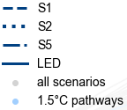
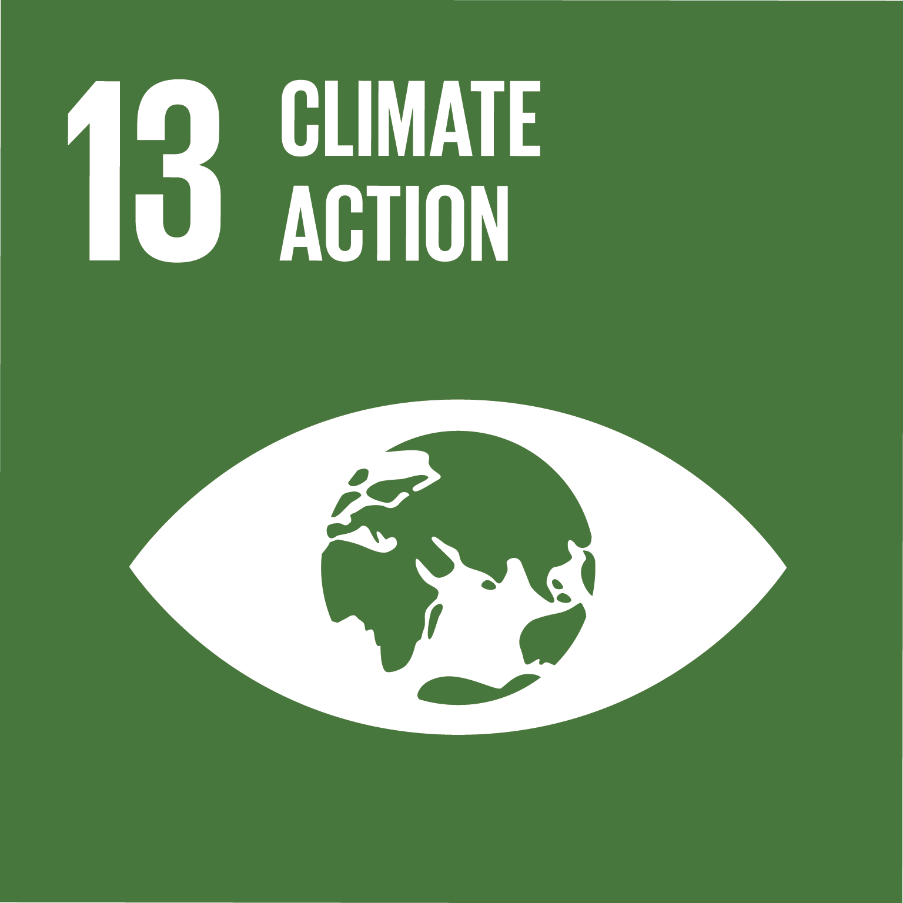
Assumptions & drivers across the scenario ensemble
There are pathways reaching the Paris 1.5°C temperature goal across a broad range of socio-economic development
More information on the scenario ensemble, the SDGs, and open tools supporting the IPCC SR15 at https://pure.iiasa.ac.at/15824
Based on Figure 2.4 IPCC SR15 (2018) Source code to generate this figure available at github.com/iiasa/ipcc_sr15_scenario_analysis

Slide 22
Assumptions & drivers across the scenario ensemble
There are pathways reaching the Paris 1.5°C temperature goal across a broad range of socio-economic development
More information on the scenario ensemble, the SDGs, and open tools supporting the IPCC SR15 at https://pure.iiasa.ac.at/15824
Based on Figure 2.4 IPCC SR15 (2018) Source code to generate this figure available at github.com/iiasa/ipcc_sr15_scenario_analysis

Slide 23
Bioenergy and carbon capture & sequestration (CCS)
Many pathways consistent with the Paris temperature goal use bioenergy in conjunction with CCS – but not all scenarios!
Based on Figure 1, Huppmann et al., Nature Climate Change 8:1027-1030 (2018). Source code to generate this figure github.com/iiasa/ipcc_sr15_scenario_analysis
More information on the scenario ensemble, the SDGs, and open tools supporting the IPCC SR15 at https://pure.iiasa.ac.at/15824
Cumulative carbon sequestration from 2020 until 2100 (in Gt CO₂)

Slide 24
Energy efficiency improvements
All pathways consistent with the ambitious Paris temperature goal exhibit much faster energy efficiency improvements than 2°C scenarios
Huppmann et al., Conference Poster (2019). https://pure.iiasa.ac.at/15824
Source code to generate this figure github.com/iiasa/ipcc_sr15_scenario_analysis
More information on the scenario ensemble, the SDGs, and open tools supporting the IPCC SR15 at https://pure.iiasa.ac.at/15824
Energy efficiency computed as total of final energy per unit of GDP

Slide 25
A zoo of open tools to work with 1.5°C scenarios
Making it easy and FAIR to dive into the SR15 scenario assessment
A new interactive online scenario explorer: data.ene.iiasa.ac.at/iamc-1.5c-explorer
D. Huppmann, E. Kriegler, V. Krey, K. Riahi, J. Rogelj, S.K. Rose, J. Weyant, et al. (2018) IAMC 1.5°C Scenario Explorer and Data hosted by IIASA. doi: 10.22022/SR15/08-2018.15429
Assessment and generation of figures & tables using open-source Jupyter notebooks
Rendered notebooks: data.ene.iiasa.ac.at/sr15_scenario_analysis
GitHub repository: github.com/iiasa/ipcc_sr15_scenario_analysis
Based on open-source package pyam: pyam-iamc.readthedocs.io
D. Huppmann et al. (2018) Scenario analysis notebooks for the IPCC SR15. doi: 10.22022/SR15/08-2018.15428
Description of ensemble compilation and assessment process
D. Huppmann et al. (2018). A new scenario resource for 1.5 °C research. Nature Climate Change, 8:1027-1030. doi: 10.1038/s41558-018-0317-4 paywall-free access: rdcu.be/9i8a
This presentation is available at pure.iiasa.ac.at/16315
It is licensed under a Creative Commons Attribution 4.0 International License
Notes:
DOIs

Slide 26
Dr. Daniel Huppmann
Research Scholar – Energy Program
International Institute for Applied Systems Analysis (IIASA) Laxenburg, Austria
huppmann@iiasa.ac.at
@daniel_huppmann
www.iiasa.ac.at/staff/huppmann
This presentation is available at pure.iiasa.ac.at/16315
It is licensed under a Creative Commons Attribution 4.0 International License

