Slide 1
Towards a unified theory of photosynthesis and hydraulics
Jaideep Joshi, Benjamin Stocker, Ulf Dieckmann, & Iain Colin Prentice

Slide 2
Need a theory to explain plant responses
Don’t forget to see notes for more information.
Decline of GPP with soil moisture (Stocker et al, 2018)
Short term decline of $V_{cmax}$ with soil moisture (Zhou et al 2013, 2014) and subsequent recovery (Zhou et al 2017)
Relative constancy of $Δψ: {ψ_{S}−ψ}_{L}$ under developing water stress (Williams & Araujo, 2002; Johnson et al. 2018)
Long-term plant responses to drought:
Leaf shedding (high $ν_{H}$, $K_{L}$)
growing wider xylem (high $ψ_{50}$), tapered xylem
Differential (trait-dependent) response of different species to soil moisture (Isohydric – Anisohydric spectrum)
Notes:
Water stress affects the photosynthesis rate of plants. While there have been a lot of recent developments in understanding plant hydraulics, few theories exist that can explain diverse and trait dependent plant responses to developing water stress. 1) The CO2 assimilation rate of plants declines with decreasing soil moisture. 2) the Carboxylation capacity of plants also declines with water stress as plants respond by withholding the RuBP regeneration rate. However, in the long term, as plants get acclimated to dry conditions by shedding leaves, the carboxylation capacity recovers. 3) During soil drydown, the soil-to-leaf water potential difference remains relatively constant. 4) Plant responses to drydown differ across timescales, and plants employ strategies such as leaf shedding and growing wider vessels in the long-term. 5) There are multiple strategies that plants employ to cope with drought, depending on their traits, and represented by their position on the isohydric-anisohydric spectrum.

Slide 3
Assimilation and drought response - timescales
Variable
(Regulating process)
Time scale
Stomatal condunctance (g_{s})
Hydraulic Conductivity loss
$g_{s}$, $c_{i}/c_{a}$
(Stomatal regulation)
Seconds - hours
Jmax, Vcmax
(Profit maximization at leaf level)
Based on Choat et al (2018)
Weeks
Stomatal closure
Leaf shedding
Cuticular conductance
Huber Value
(Profit max. at whole plant level)
Water Storage
Months
Decreasing $ψ_{soil}$
Notes:
During the progression of a drought, the first response of plants is to close their stomata, which can occur at a timescale of seconds to hours. This can be quantitatively explained by a leaf-level optimality principle, given the photosynthetic capacities. On a scale of weeks, the photosynthetic capacity acclimates to the prevailing daytime light and water conditions, which can also be explained by a leaf-level profit maximization framework. On even longer timescales, plants respond by shedding leaves, or increasing their Huber Value. This could be predicted by an optimality principle at the whole plant level. While our theoretical framework is applicable at all timescales, the current study focuses on the weekly timescale.

Slide 4
Proposed theory of water limited photosynthesis
Hypotheses (building upon Prentice et al (2014) and Wang et al (2017)):
Stem/leaf hydraulic conductivity declines with decreasing water potential
Water supply from stem equals atmospheric demand from leaves
Carboxylation capacity ($V_{cmax}$) acclimates to equalize $A_{C}$ and $A_{J}$
Plants optimize $J_{max}$ and $Δψ$ such that the net assimilation is maximized
$$K_{s}\left(ψ\right)=K_{s,0}P\left(ψ\right), P\left(ψ\right)={\left(\frac{1}{2}\right)}^{{\left(\frac{ψ}{ψ_{50}}\right)}^{b}}$$
$$E=1.6g_{s}D=−\frac{K_{s,0}ν_{H}}{Hη}\int_{ψ_{s}}^{ψ_{s}−Δψ}{P\left(ψ\right)dψ}$$
=
$$A−αJ_{max}−γ(Δ{ψ/ψ_{50})}^{2}=max$$
Notes:
In this optimality framework, the benefit comes from assimilation, and the costs are those of maintaining the photosynthetic machinery and the hydraulic pathway, including the direct cost of water and the prospective costs of hydraulic failure.
Note that the optimality formulation presented here is different compared to what was mentioned in the abstract. This reflects model development done after submitting the abstract, and the current formulation is simpler and is able to explain observed data in a more effective way.
The exact functional form of the hydraulic costs term could be debated. It is possible to derive the functional form from mechanistic considerations, assuming the aforementioned nature of hydraulic costs. However, with currently available data, it is not possible to disentangle the different contributions to the hydraulic costs. We have tested several different cost terms, and found this quadratic form to provide the best fit of A, gs, and ci/ca to observed data.
For derivation of the transpiration expression, please see additional slides at the end,.

Slide 5
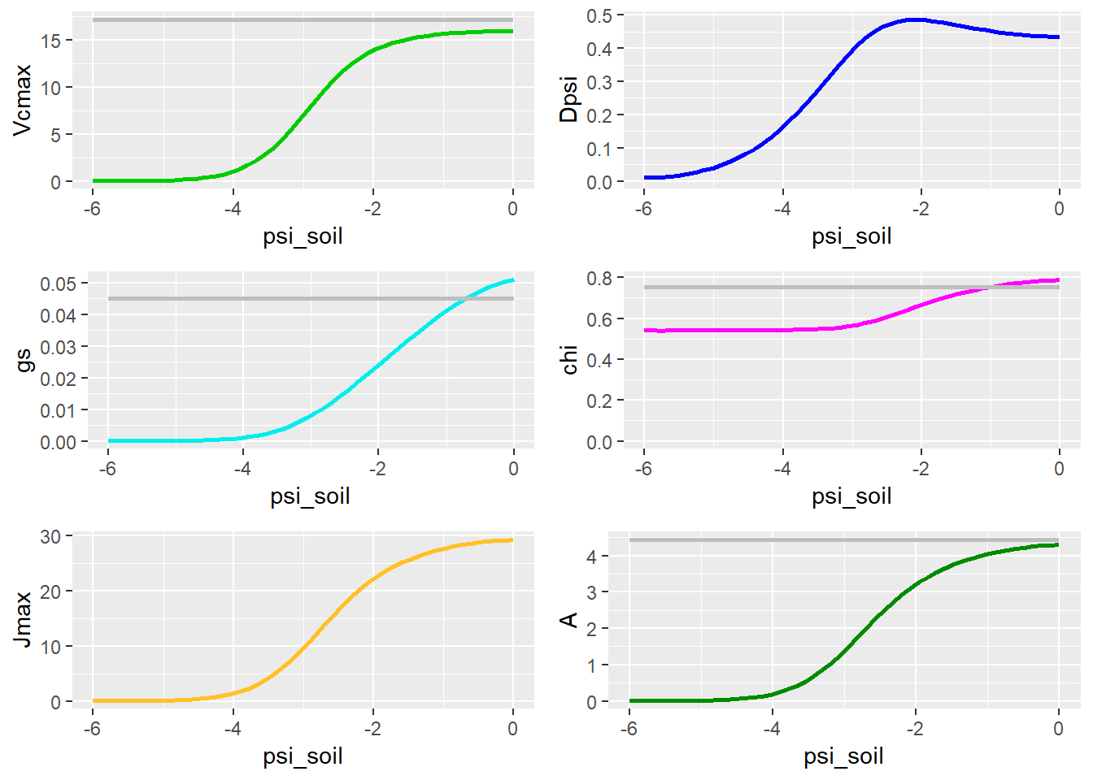
Soil moisture response
Coloured lines: This study, assuming a “prototype plant” with $ψ_{50}=−2$ MPa.
Grey lines: Wang et al (2017), with Jmax limitation.
Vcmax, Jmax, and GPP decrease under drying soil.
Stomatal conductance also decreases, indicating drought-driven stomatal closure.

Slide 6
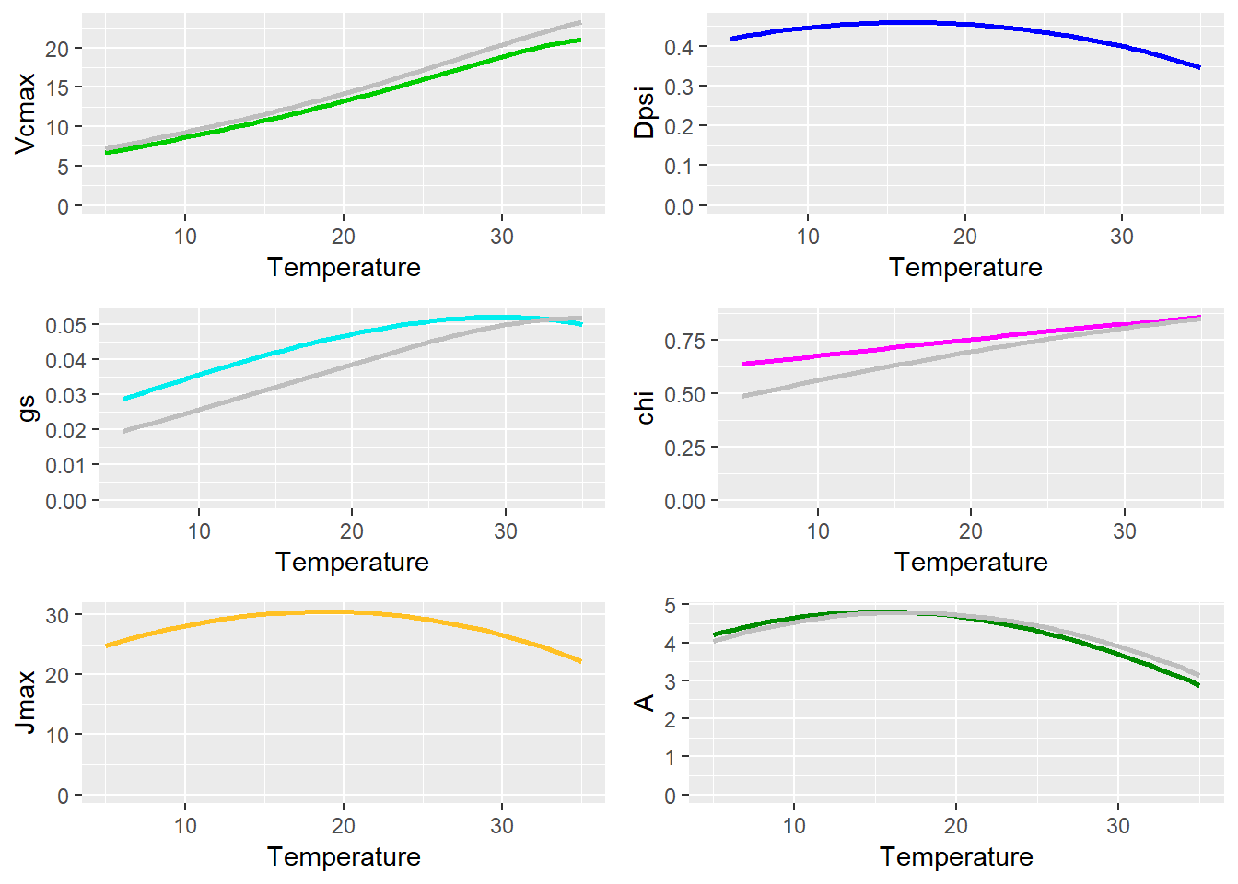
Temperature response
Temperature response is primarily due to temperature responses of photosynthetic variables, such as K, $Γ^{∗}$, and viscosity of water
Our model reproduces the result of Wang et al (2017), which is well validated.

Slide 7
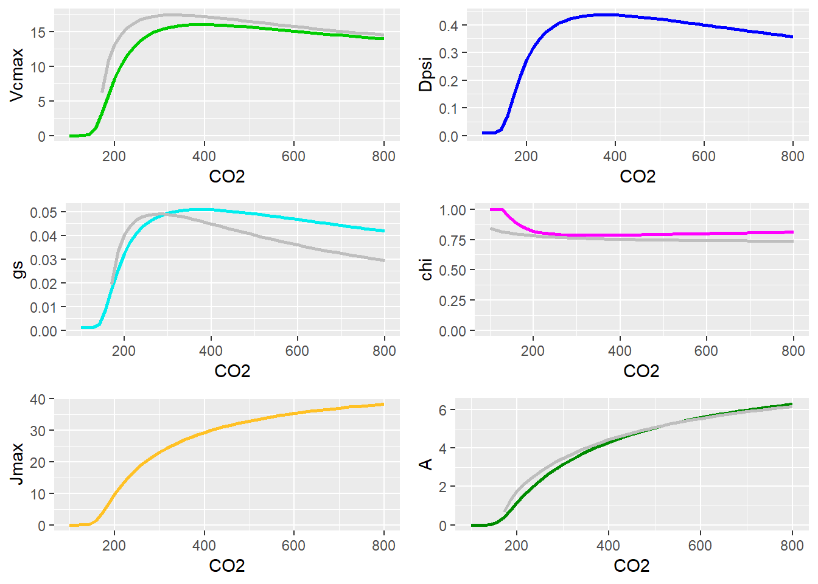
CO2 response
Increasing CO2 concentration leads to an increase in assimilation rate and a decline in Vcmax/Jmax ratio.

Slide 8
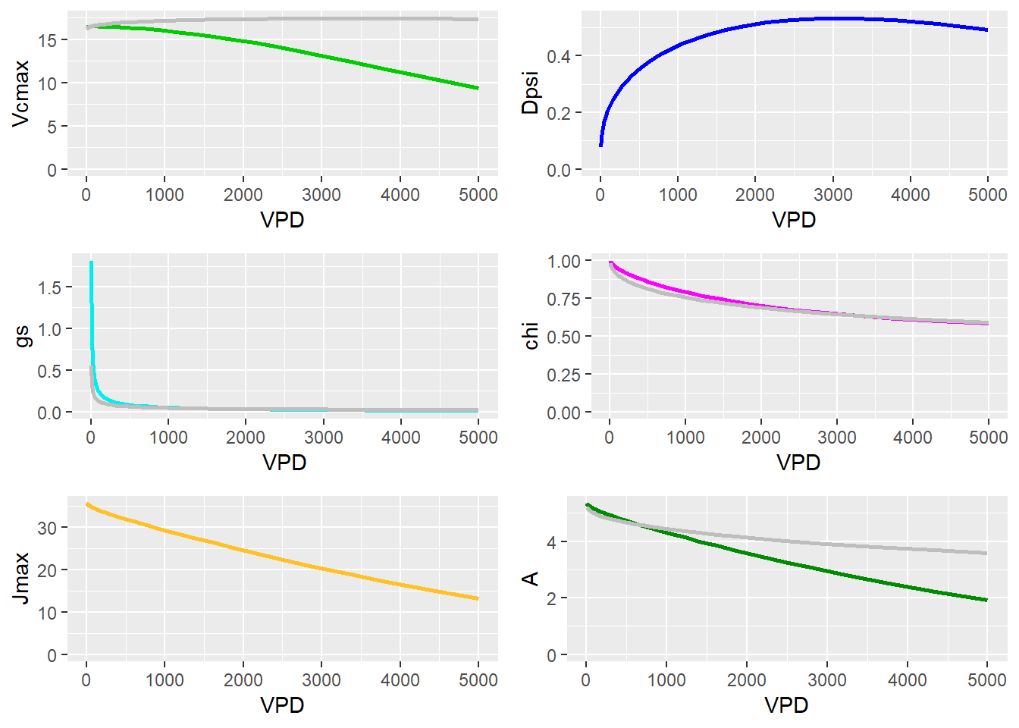
VPD response

Slide 9
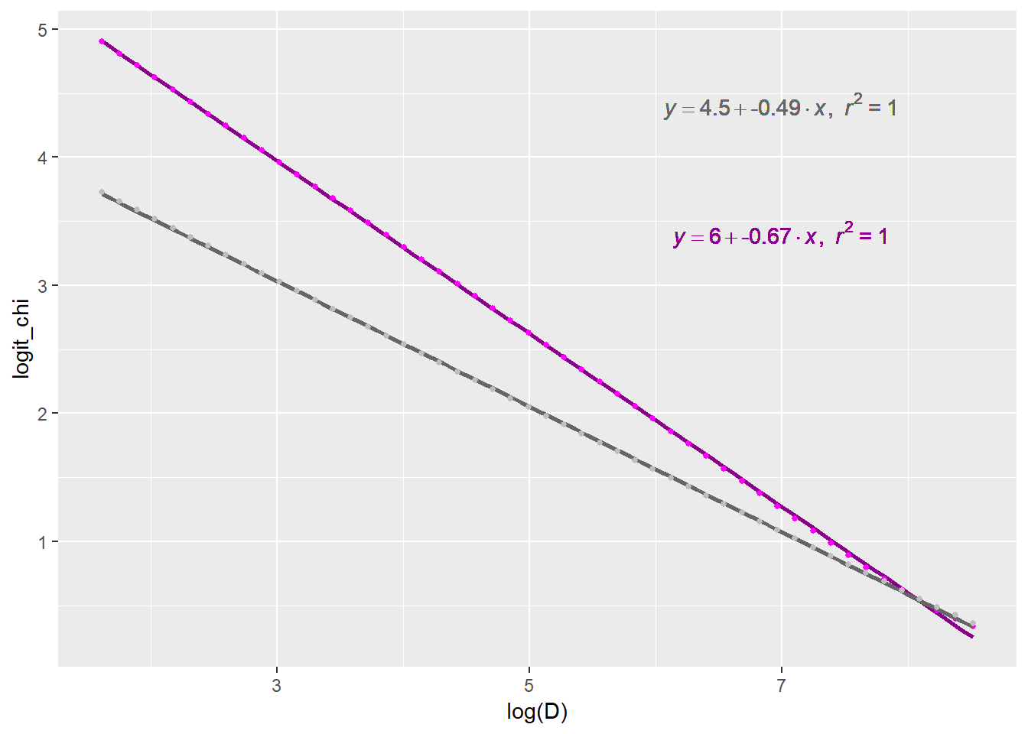
VPD response
In Wang et al (2017), slope of logit($χ$) $\sim$ log(D) remains constant at 0.5
In this work, this slope depends on the plant’s hydraulic characteristics.

Slide 10
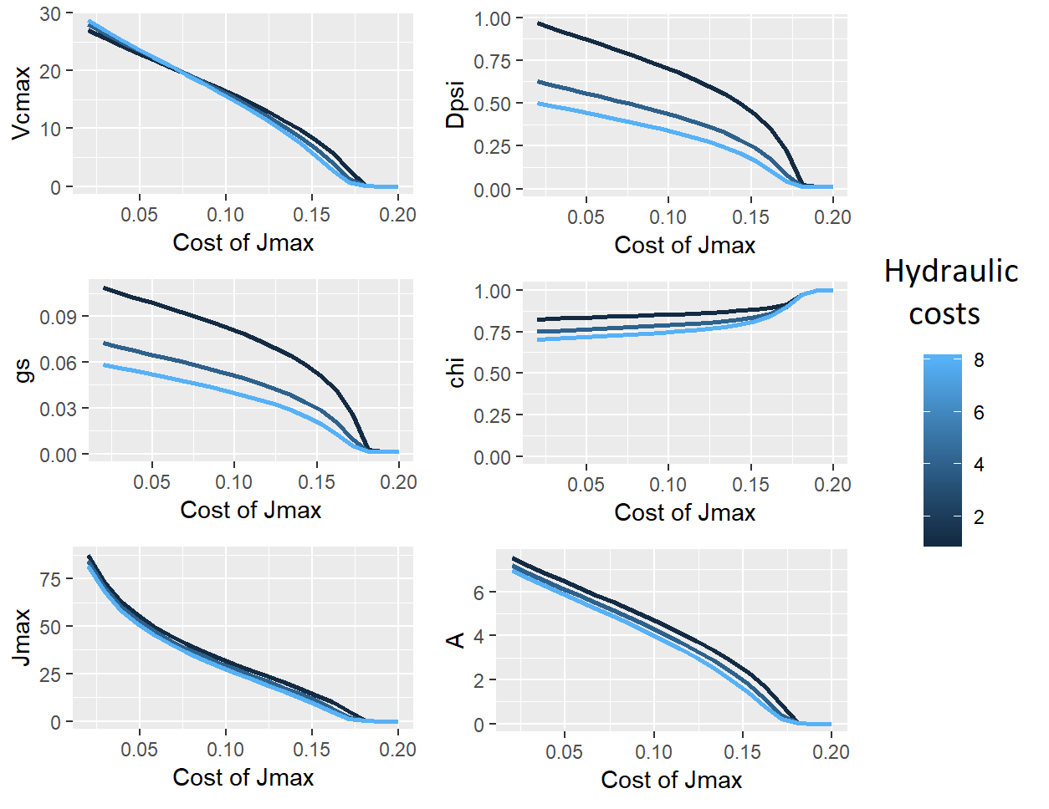
Effect of cost parameters
Cost of Jmax affects all variables, whereas cost of hydraulics affects only leaf water potential and stomatal conductance.

Slide 11
Calibration with drying experiments data
Meta-analysis data of 13 drydown experiments (Zhou et al. 2013)
Measurements of $A$ and $g_{s}$ under drying soil ($A$-$g_{s}$-$ψ_{s}$ triplets)
In 2 studies, measurements of $ψ_{L}$ available
$I_{abs}$ and CO2 specified in most studies
Calibrate model with these variables for different species (A few example species shown in next slides)

Slide 12
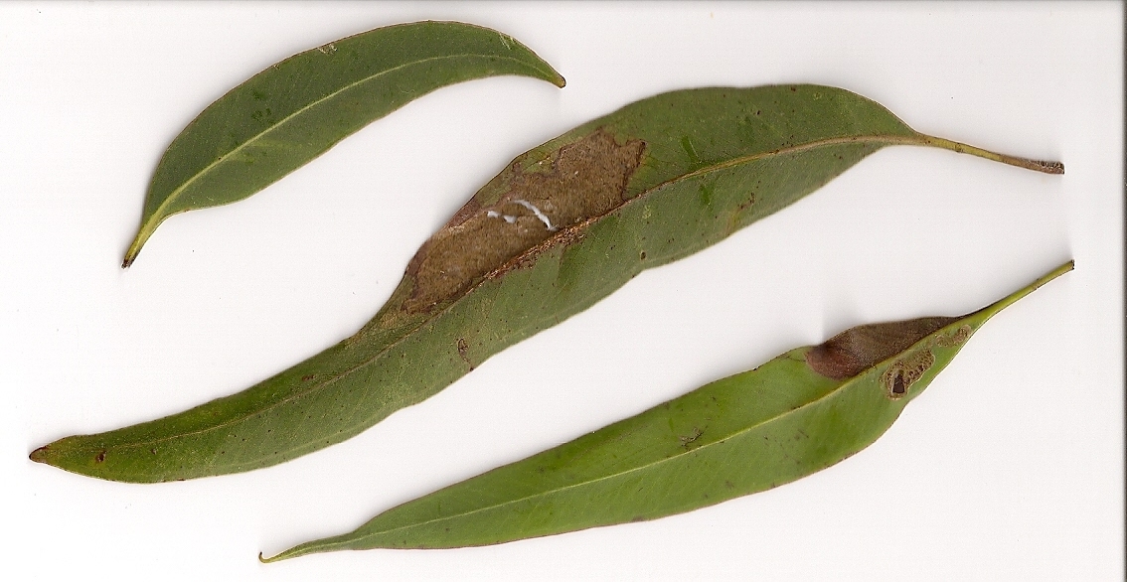
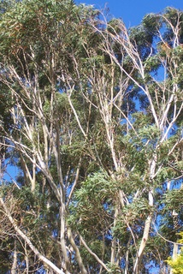
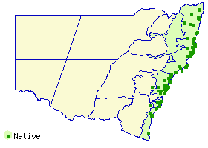
Eucalyptus pilularis
Widespread and often dominant, in wet sclerophyll or grassy coastal forest
(PlantNET)
Peter Woodard

Slide 13
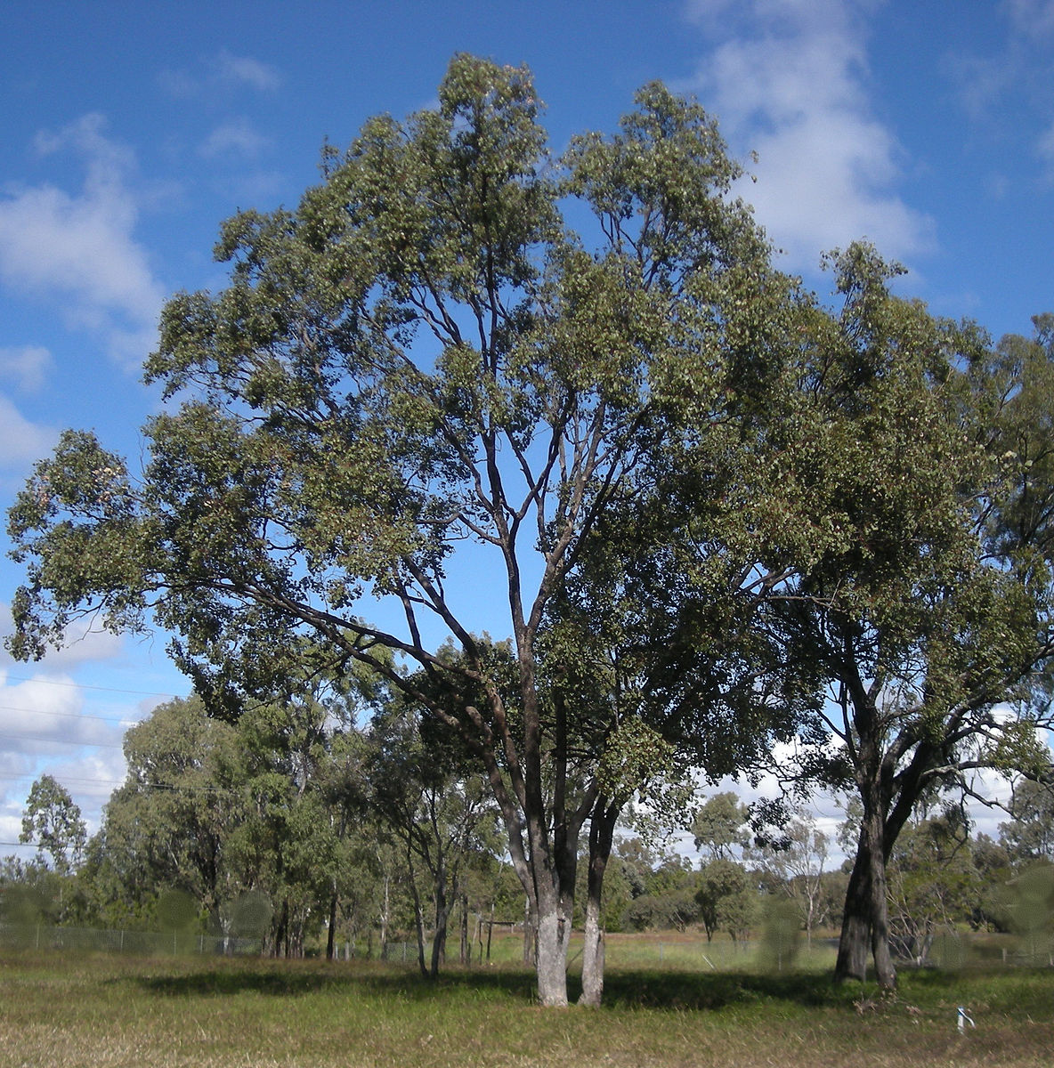
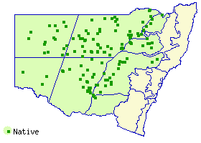
Eucalyptus populnea
Widespread, often dominant, in grassy woodland on moderately fertile loamy soils
(PlantNET)
Ethel Aardvark

Slide 14
Allocasuarina luehmannii

Slide 15
Quercus suber

Slide 16
Summary
We use the optimality framework to develop a unified model of plant photosynthesis and hydraulics
The model requires only two parameters to predict photosynthetic responses to the environment, provided plant characteristics are known
The model accurately predicts responses of assimilation, ci, Vcmax, Jmax, gs, and leaf water potential under a wide range of atmospheric conditions
Next steps: Predict HV, K, P50 via a nested optimality and evolutionary dynamics

Slide 17
Questions?

Slide 18
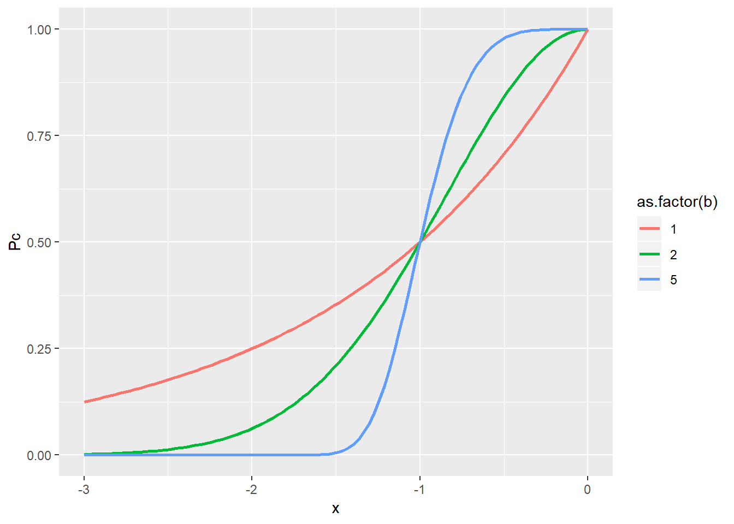
Theory of water transport
Conductivity of xylem decreases with water potential as
$$K_{s}\left(ψ\right)=K_{s,0}P\left(ψ\right)={\left(\frac{1}{2}\right)}^{{\left(\frac{ψ}{ψ_{50}}\right)}^{b}}$$
Assuming an interconnected structure of xylem, conductivity at height h only depends on water potential at height h
$$K_{s}\left(h\right)=K_{s,0}(h)P(ψ\left(h\right))$$

Slide 19
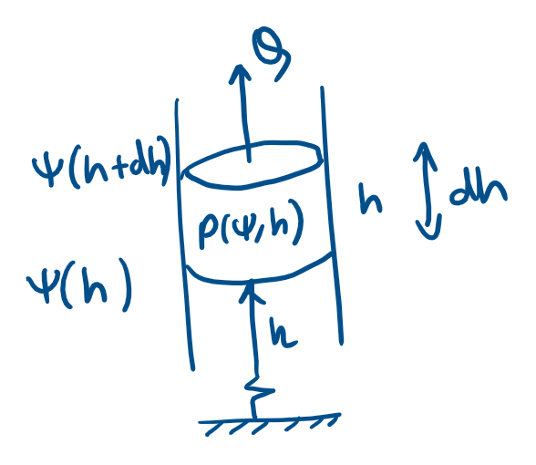
Leaf water balance
$$ψ\left(h+dh\right)=ψ\left(h\right)−ρgdh −\frac{Qηdh}{ν_{H}K_{s}(ψ,h)}$$
$$\frac{dψ}{dh}=−ρg −\frac{Qη}{ν_{H}K_{s,0}\left(h\right)P(ψ,ψ_{50}(h))}$$
Neglecting vessel tapering and gravity
($K_{s}$ and $ψ_{50}$ do not change with $h$):
$$Q= E=−\frac{K_{s}ν_{H}}{Hη}\int_{ψ_{s}}^{ψ_{L}}{P\left(ψ\right)dψ}=1.6g_{s}D$$

