Slide 1
Climate change mitigation & sustainable development Qualitative and quantitative analysis in the IPCC’s “Special Report on Global Warming of 1.5°C”
Young Scientist Symposium Institute of Science and Technology (IST) Austria May 15, 2020
Dr. Daniel Huppmann

Slide 2
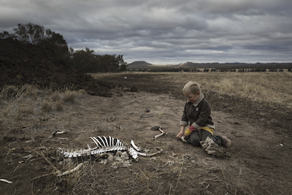
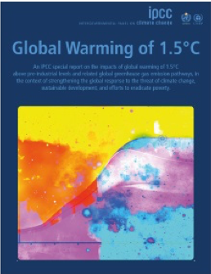
A Special Report on Global Warming of 1.5°C
Assessing climate change in the context of the SDGs
The IPCC Special Report on Global Warming of 1.5°C (SR15) was published in the fall of 2018.
[…] To prevent 2.7 degrees of warming, the report said, greenhouse pollution must be reduced by 45 percent from 2010 levels by 2030, and 100 percent by 2050. It also found that, by 2050, use of coal as an electricity source would have to drop from nearly 40 percent today to between 1 and 7 percent. Renewable energy such as wind and solar, which make up about 20 percent of the electricity mix today, would have to increase to as much as 67 percent. […]
Harry Taylor, 6, played with the bones of dead livestock in Australia, which has faced severe drought.
Brook Mitchell/Getty Images
www.nytimes.com/2018/10/07/climate/ ipcc-climate-report-2040.html
www.ipcc.ch/sr15

Slide 3
A Special Report on Global Warming of 1.5°C
Assessing climate change in the context of the SDGS
The IPCC Special Report on Global Warming of 1.5°C (SR15) was published in the fall of 2018.
Agenda
Introduction to climate change and the Sustainable Development Goals
Qualitative assessment of mitigation options in the SR15
Assessment of quantitative, model-based pathways with a focus on transparency, reproducibility & FAIRness
Using the scenario ensemble to gain insights on the SDGs
Near-term policy outlook
www.ipcc.ch/sr15

Slide 4
A short introduction to climate change and sustainable development
Part 1

Slide 5
A definition of climate change
It’s not only about the mean but also about (increasing) variability
Definitions in the Glossary, Annex 1, Special Report on Global Warming of 1.5°C (SR15)
Climate change Climate change refers to a change in the state of the climate that can be identified (e.g., by using statistical tests) by changes in the mean and/or the variability of its properties and that persists for an extended period, typically decades or longer. Climate change may be due to natural internal processes or external forcings such as modulations of the solar cycles, volcanic eruptions and persistent anthropogenic changes in the composition of the atmosphere or in land use. Note that the Framework Convention on Climate Change (UNFCCC), in its Article 1, defines climate change as: ‘a change of climate which is attributed directly or indirectly to human activity that alters the composition of the global atmosphere and which is in addition to natural climate variability observed over comparable time periods.’

Slide 6
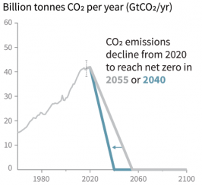
The trajectory of climate change
Cumulative emissions of CO2 and future non-CO2 radiative forcing determine the probability of limiting warming to 1.5°C
Reducing CO2 emissions to net-zero until 2055 or 2040 result in different probability of temperature change.
The ranges are computed from stylized emissions pathways.
Figure 1, Summary for Policymakers, Special Report on Global Warming of 1.5°C (SR15)

Slide 7
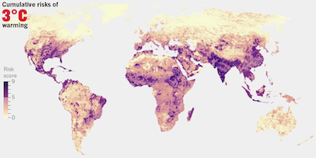
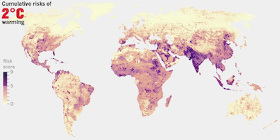
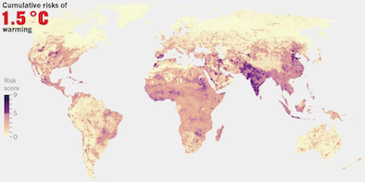
The impacts of climate change
Increasing temperatures expose billions of people to multi-sector risks
People exposed to risks (billion)
Source: “The hard truths of climate change — by the numbers“ (Nature 573:324, September 19, 2019) based on Byers et al. (2019, doi: 10.1088/1748-9326/aabf45)

Slide 8
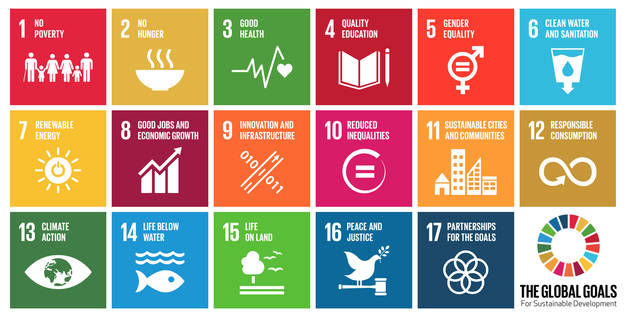
Climate change and sustainable development
Two landmark agreements in 2015 define the policy agenda
The “2030 Agenda for Sustainable Development” was adopted at the UN Sustainable Development Summit on September 25, 2015.
It specifies 17 goals linked to 169 targets and 232 indicators.
The „Paris Agreement“ was adopted at the 21st Conference of the Parties (COP21) of the UNFCCC in Paris on December 12, 2015.
It aims to keep global warming to “well below 2 °C” relative to pre-industrial levels and to "pursue efforts to" limit the temperature increase to 1.5 °C.
An IPCC Special Report on the impacts of global warming of 1.5°C above pre-industrial levels and related global greenhouse gas emission pathways, in the context of strengthening the global response to the threat of climate change, sustainable development, and efforts to eradicate poverty
Notes:
The SDGs comprise 17 Sustainable Development Goals and 169 targets, which are measured with 232 indicators.

Slide 9
Qualitative analysis of climate change mitigation and sustainable development in the SR15
Part 2

Slide 10
A qualitative analysis of climate change mitigation options
Chapter 5 aimed to provide a review of synergies & trade-offs between various mitigation strategies and sustainable development
Dozens of scientific manuscripts and meta-studies were classified according to ...
17 Sustainable Development Goals
23 mitigation options
Grouped in three domains: Energy demand, energy supply, land & oceans
Including efficiency, fuel switch, nuclear, carbon capture & storage (CCS) ...
Indicators for the direction and strength of the interaction
From “Inextricably linked” (+3) to “Makes it impossible to reach” (-3)
Level of confidence (evidence and agreement)

Slide 11
A qualitative assessment of mitigation options & SDGs
Demand-focused mitigation strategies have many synergies and few trade-offs with SDGs
For each combination of mitigation option and SDG, SR15 authors made a detailed assessment based on the literature.
The entire analysis is available as a table in the Supplementary Material.
Figure 5.2. Synergies and trade-offs of individual mitigation options with the SDGs Special Report on Global Warming of 1.5°C (SR15)

Slide 12
An ensemble of quantitative pathways
Part 3

Slide 13
A Special Report on Global Warming of 1.5°C
Assessing climate change in the context of the SDGs
The IPCC Special Report on Global Warming of 1.5°C (SR15) was published in the fall of 2018.
[…] To prevent 2.7 degrees of warming, the report said, greenhouse pollution must be reduced by 45 percent from 2010 levels by 2030, and 100 percent by 2050. It also found that, by 2050, use of coal as an electricity source would have to drop from nearly 40 percent today to between 1 and 7 percent. Renewable energy such as wind and solar, which make up about 20 percent of the electricity mix today, would have to increase to as much as 67 percent. […]
Harry Taylor, 6, played with the bones of dead livestock in Australia, which has faced severe drought.
Brook Mitchell/Getty Images
www.nytimes.com/2018/10/07/climate/ ipcc-climate-report-2040.html
www.ipcc.ch/sr15

Slide 14
Diving into the ‘Summary for Policymakers’ (SPM)
The IPCC assessed a large ensemble of emissions pathways
The Summary for Policymakers of the IPCC Special Report on Global Warming of 1.5°C (SR15).
C.1 In model pathways with no or limited overshoot of 1.5°C, global net anthropogenic CO₂ emissions decline by about 45% from 2010 levels by 2030 (40–60% interquartile range), reaching net zero around 2050 (2045–2055 interquartile range). [...] {2.1, 2.3, Table 2.4}

Slide 15
The scope of integrated assessment models
IAMs (aim to) encompass the entire human & earth systems
(Stylized representation of the) Earth system
Ecosystem (services)
Climate system
Biosphere
Energy system
Forestry
Oceans
Fossil resources
Renewables
Land use
Water
Extraction & Mining
Economy
Transformation
Agriculture
Electricity sector
Air quality
Demand Sector
Food Demand
Human needs
Health & Poverty
Services: Mobility, Light, Heating/Cooling, ...

Slide 16
Where do the “model pathways” come from? (I)
A rigorous assessment of quantitative, model-based pathways requires more information than what is available in the publication
The IPCC assesses available scientific, technical and socio-economic literature relevant to understanding the scientific basis of climate change
Published in peer-reviewed journals or eligible grey literature (e.g., IEA, industry reports)
In most cases, it is sufficient to extract relevant insights from manuscripts or reports
But relying only on published manuscripts & supplementary material for quantitative scenarios across studies and projects is challenging
Numerical model results are not presented in the same data format
Only a selection of numerical results presented in manuscript and supplements e.g., only indicators of interest in relation to the specific research question
Definitions and units differ across models and studies

Slide 17
Where do the “model pathways” come from? (II)
We conducted a “call for scenarios” to collect an ensemble of pathways to facilitate the quantitative assessment
The “Integrated Assessment Modeling Consortium” (IAMC), the IPCC and IIASA launched a systematic community effort
Building on the process used for the Fifth Assessment Report (AR5)
To provide SR15 authors with a curated set of internally consistent and validated scenarios
Increase transparency & reproducibility of the assessment
Figure 1, Huppmann et al., Nature Climate Change 8:1027-1030 (2018). doi: 10.1038/s41558-018-0317-4

Slide 18
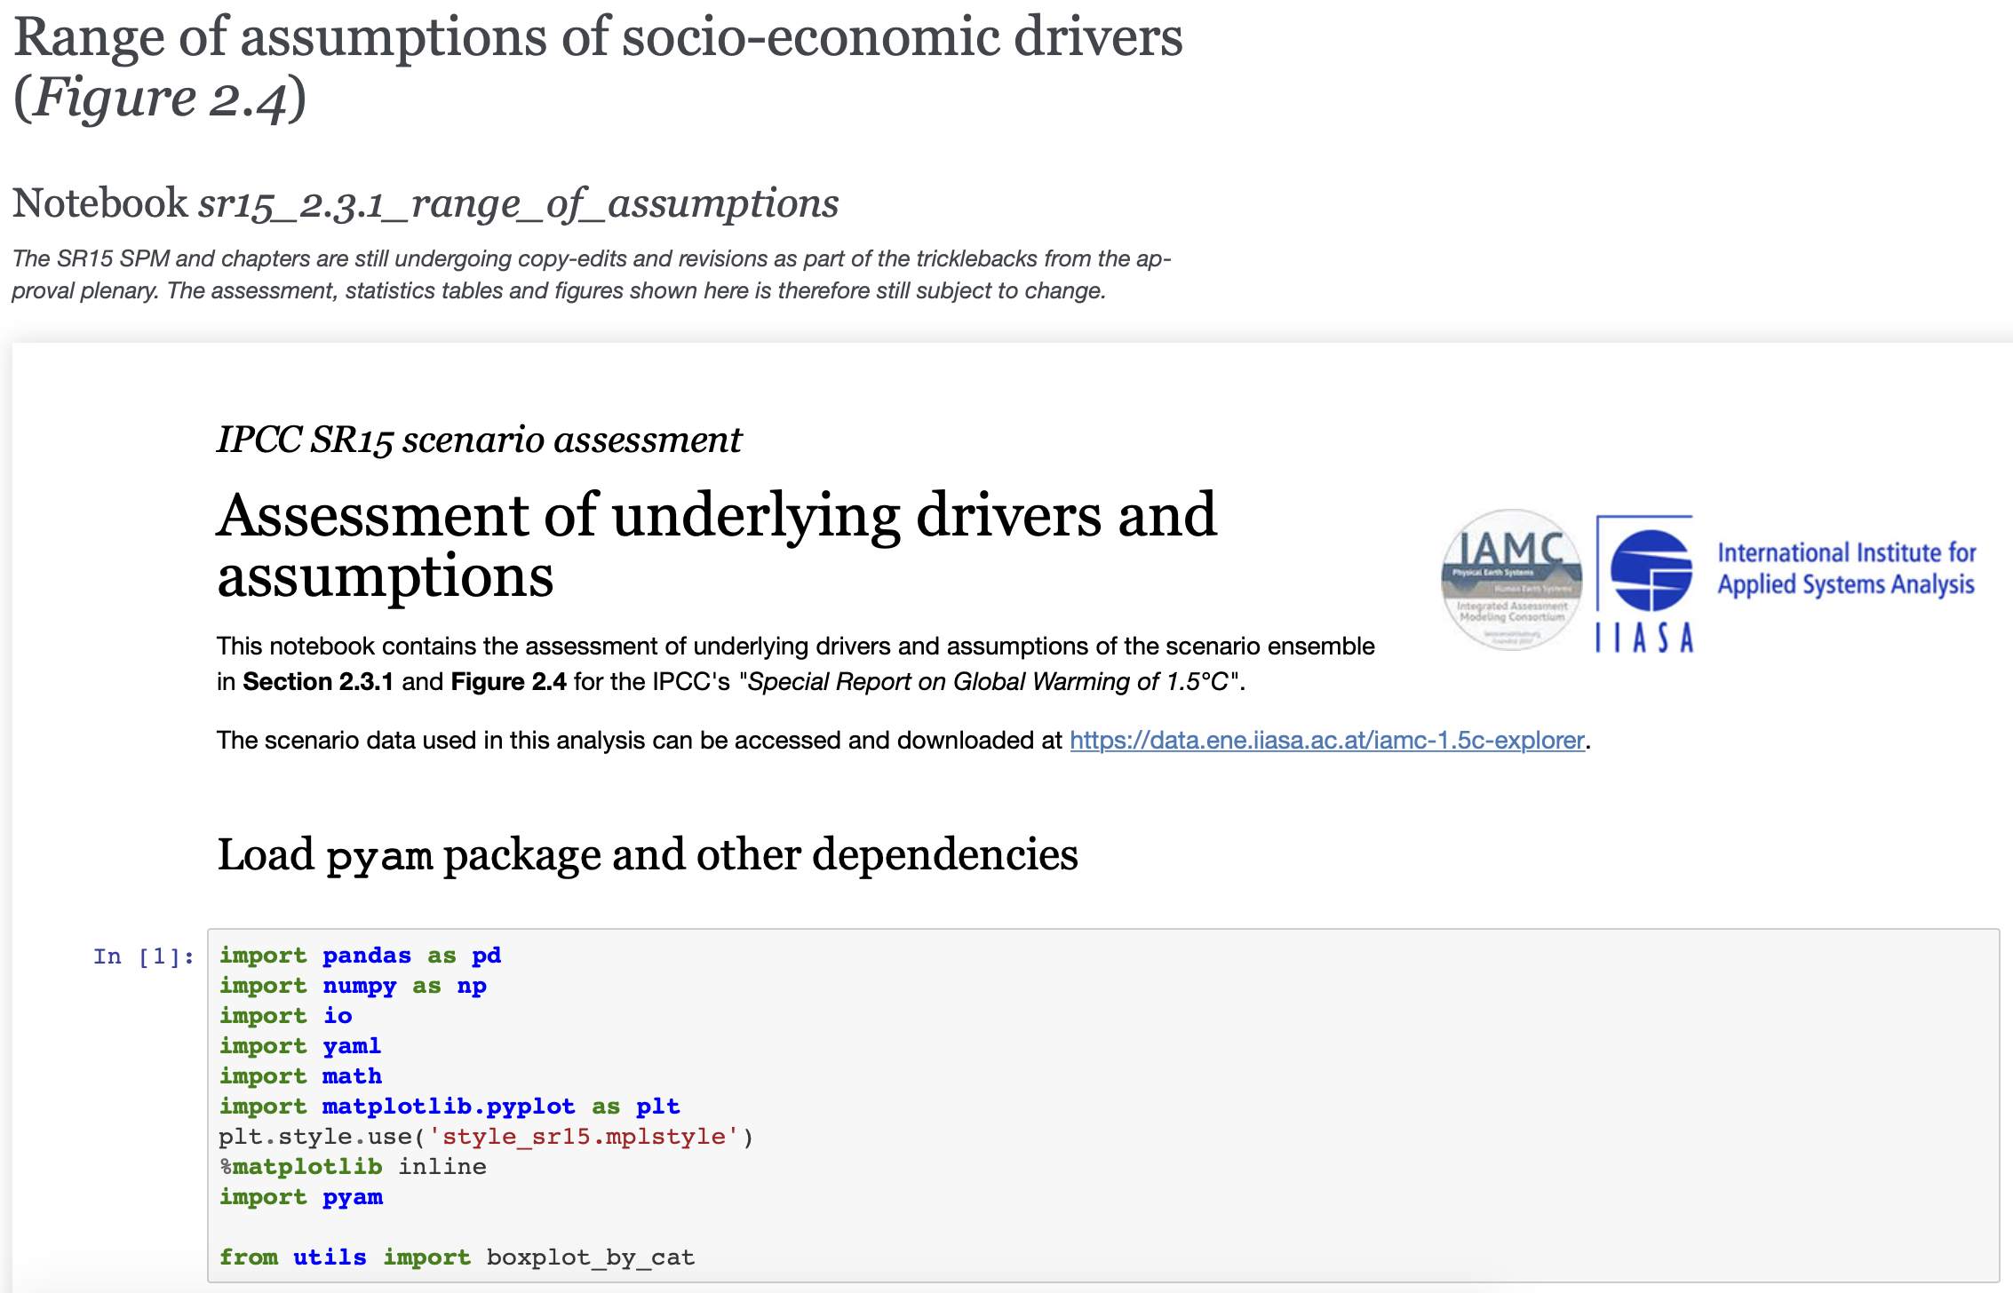
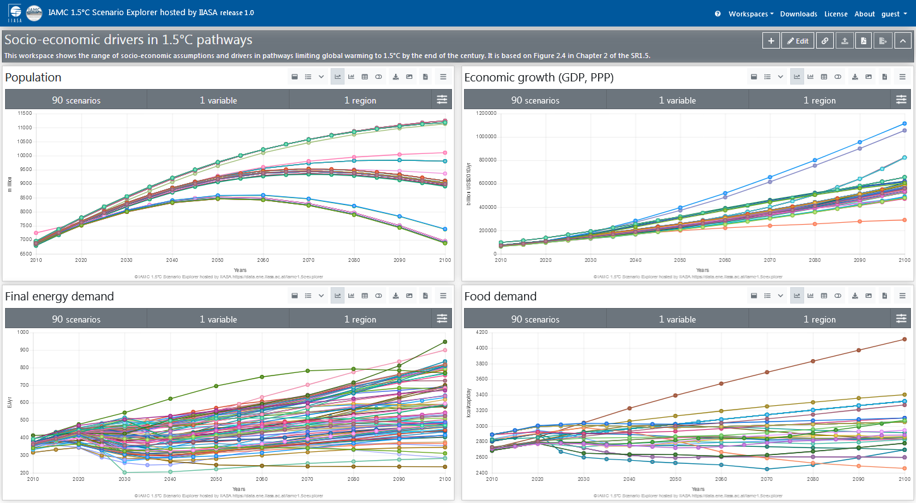
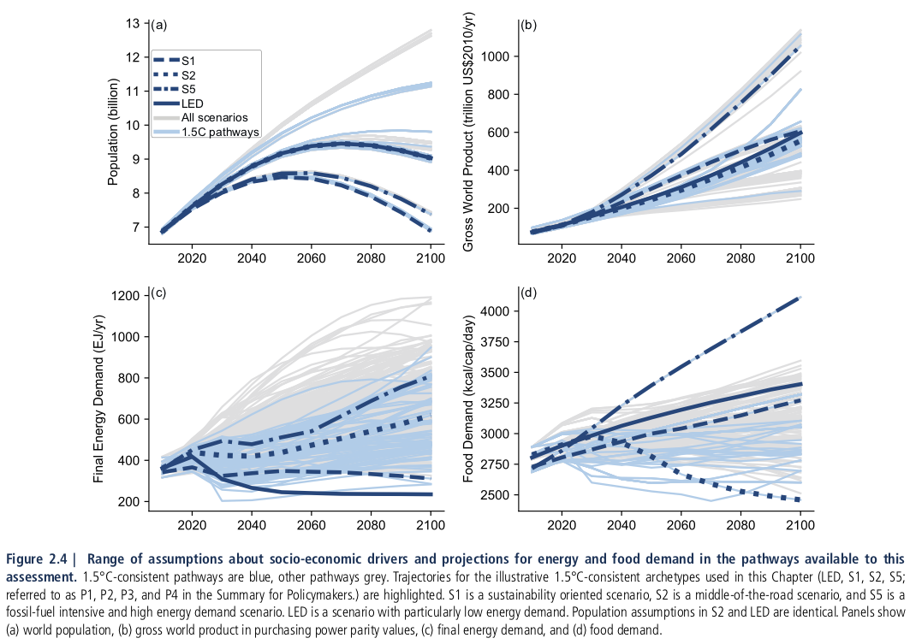
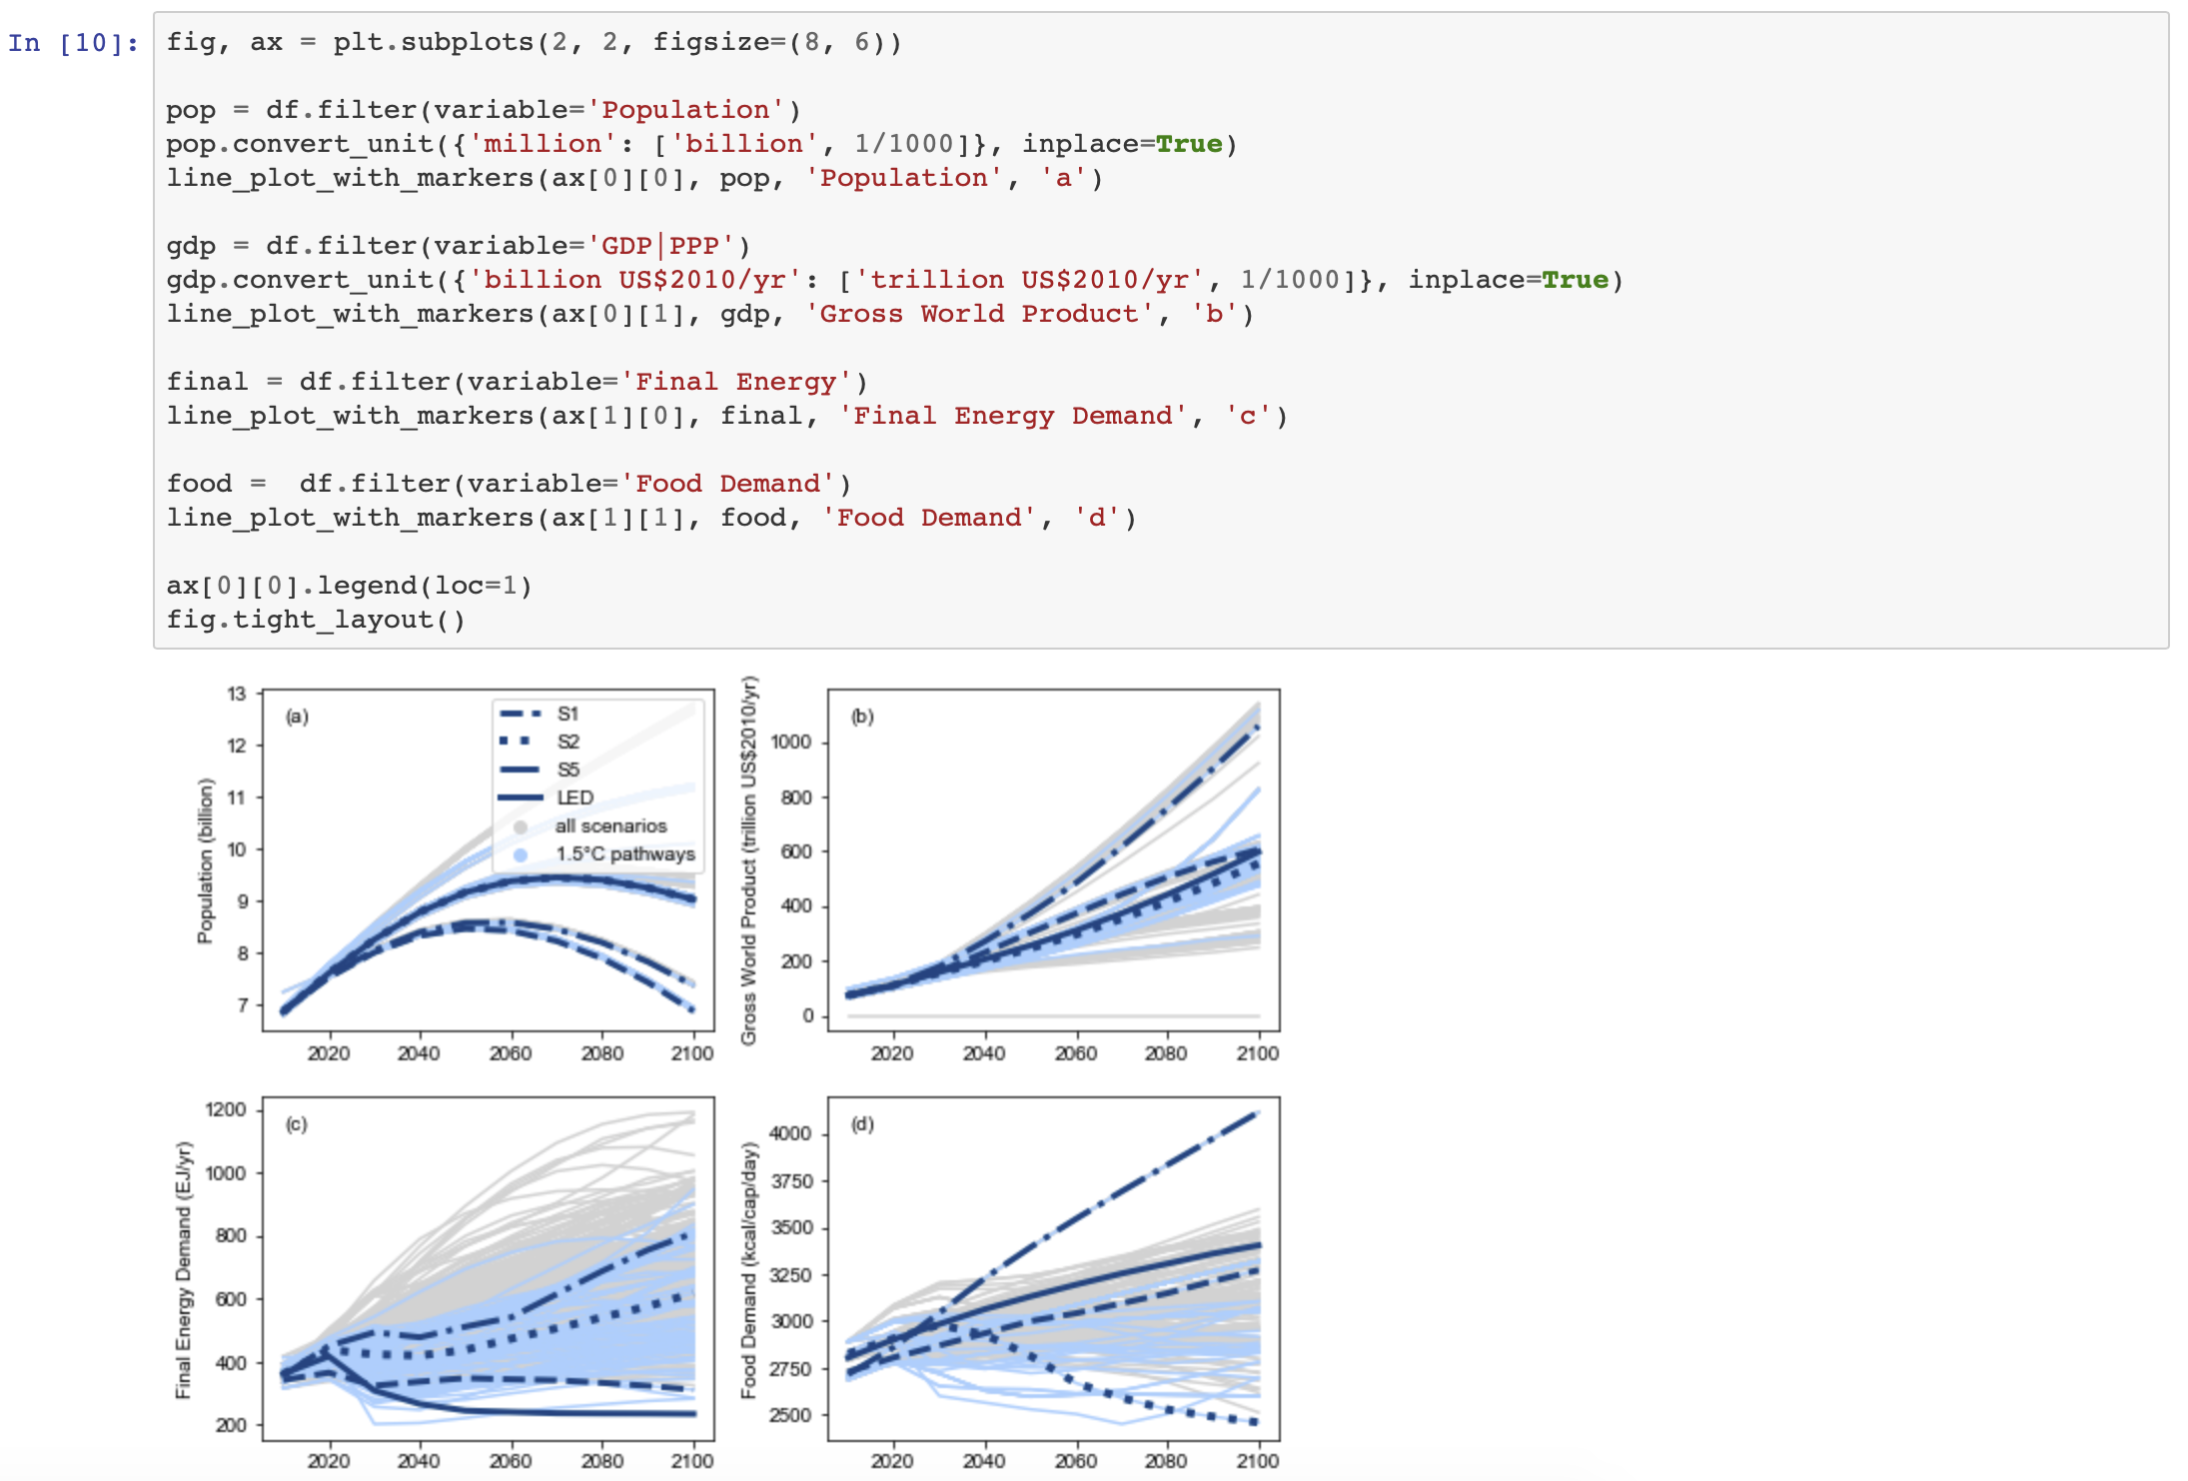
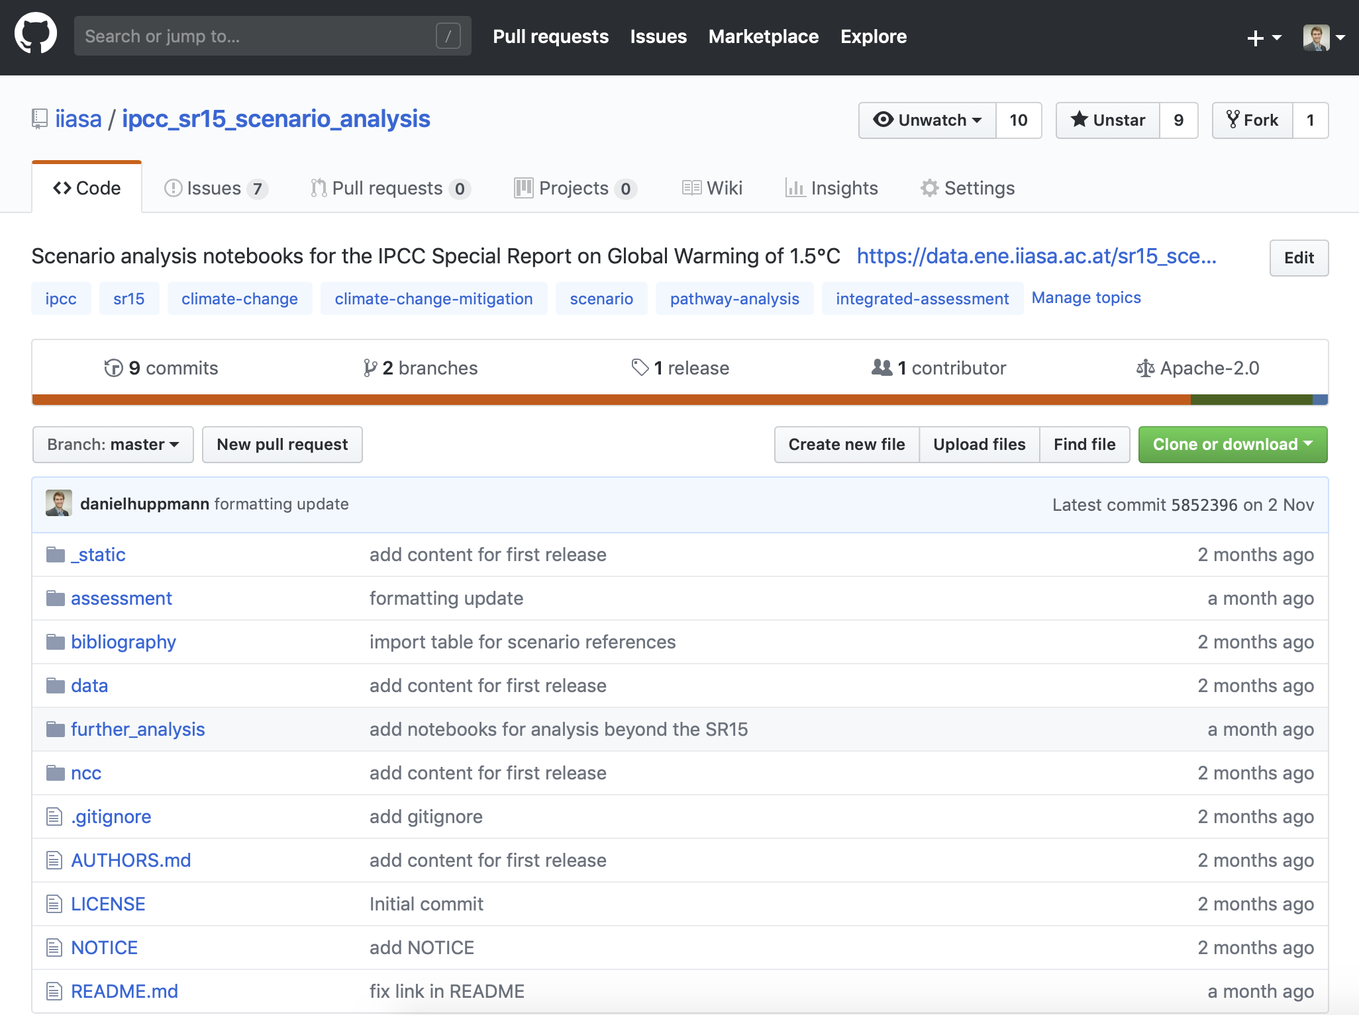
The “line of sight” of the SR15 scenario ensemble
We developed a suite of open tools to dive into the SR15 analysis
Interactive online scenario explorer at data.ene.iiasa.ac.at/iamc-1.5c-explorer
Figure 2.4 as printed in the SR15 (www.ipcc.ch/sr15)
Rendered notebooks to generate figures and tables at data.ene.iiasa.ac.at/sr15_scenario_analysis
$ git clone git@github.com:iiasa/ipcc_sr15_scenario_analysis.git

Slide 19
Increasing the “FAIRness” of the IPCC assessment
Going beyond efforts in AR5, we followed the FAIR principles to increase transparency and reproducibility of the scenario assessment
Goal | Implemented measures
Findable | Use proper recommended references including DOIs for data and notebooks
Accessible | Make data and notebooks available for multiple levels of user sophistication as well as via common machine-readable API’s
Interoperable | Use common data template developed by the IAMC Analysis using open-source Python package pyam
Reusable | Data and assessment notebooks released under licenses that enable follow-up research
Wilkinson, M. D., et al. (2016). Scientific Data 3:160018. doi: 10.1038/sdata.2016.18

Slide 20
Findable
Use appropriate references & metadata for each item
Separate treatment for distinct pieces of the scientific “supply chain”
Scientific assessment: Chapter 2 of the SR15 and Annex
Scenario ensemble (data)
Notebooks for scenario assessment
Scientific software package
Journal manuscript on scenario ensemble compilation and user guidelines
Each item has its own recommended citation and DOI
Use proper versioning for each item (data & software release cycle)

Slide 21
Accessible (I) – machine-readable formats
The infrastructure provides multiple entry points & interfaces
Scenario ensemble data:
Downloadable as xlsx and csv
Accessible via a RestAPI from the Scenario Explorer backend
Assessment notebooks
Distributed via GitHub
Also available as rendered notebooks
Scientific software
Maintained on GitHub
Available via conda & pypi
Rendered notebooks to generate figures and tables at data.ene.iiasa.ac.at/sr15_scenario_analysis

Slide 22
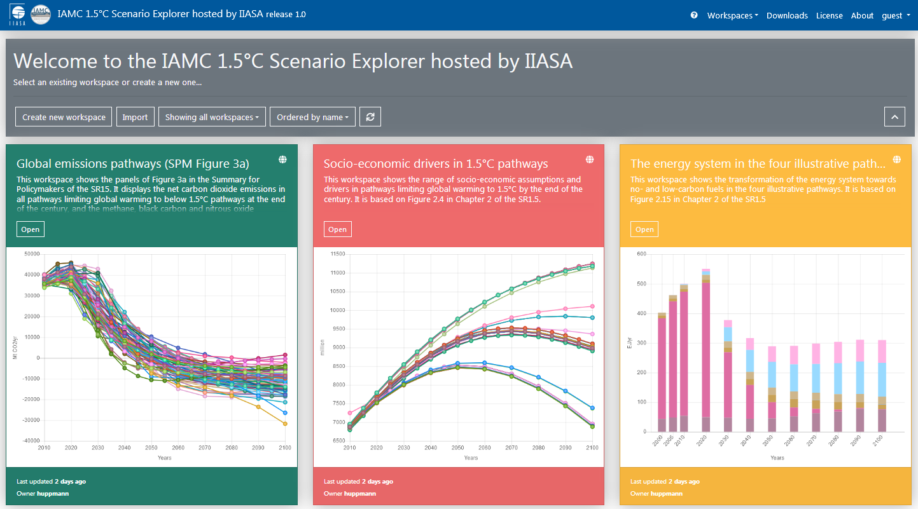
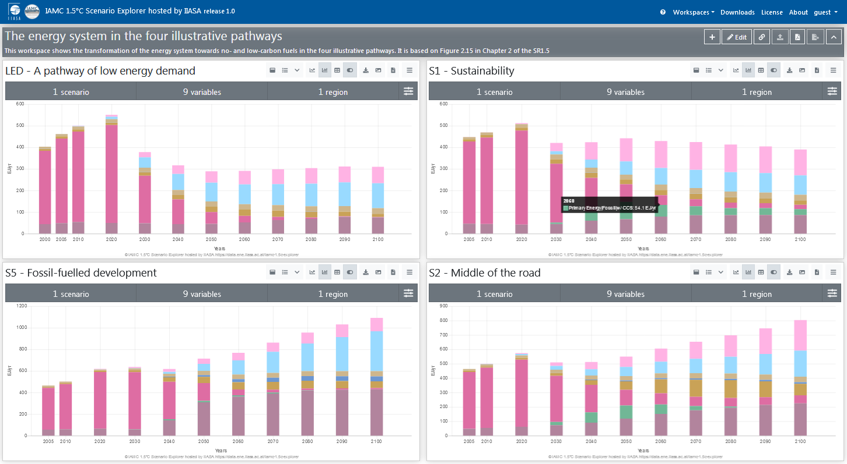
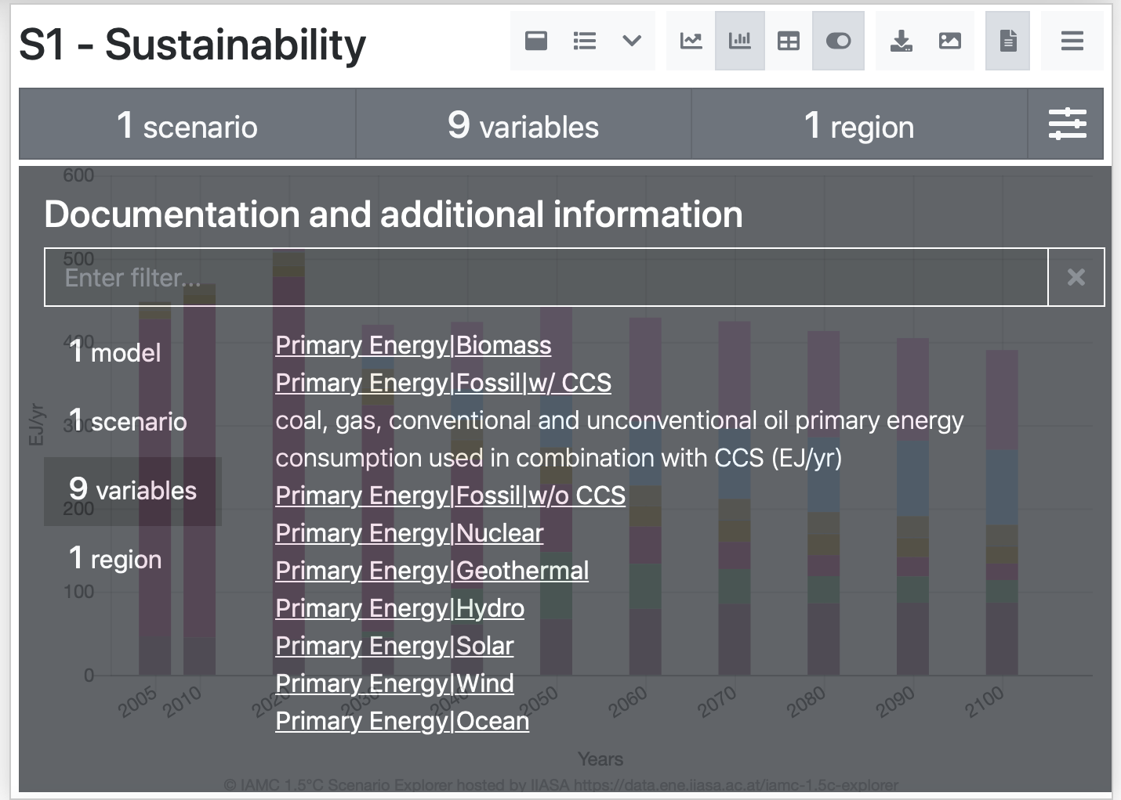
Accessible (II) – for human users
A new “IAMC 1.5° C Scenario Explorer hosted by IIASA”
Using “workspaces” to manage figures & data tables including pre-defined panels replicating SR15 figures
The scenario explorer provides documentation and references for models, scenarios & variables
Visit the IAMC 1.5°C Scenario Explorer at https://data.ene.iiasa.ac.at/iamc-1.5c-explorer

Slide 23
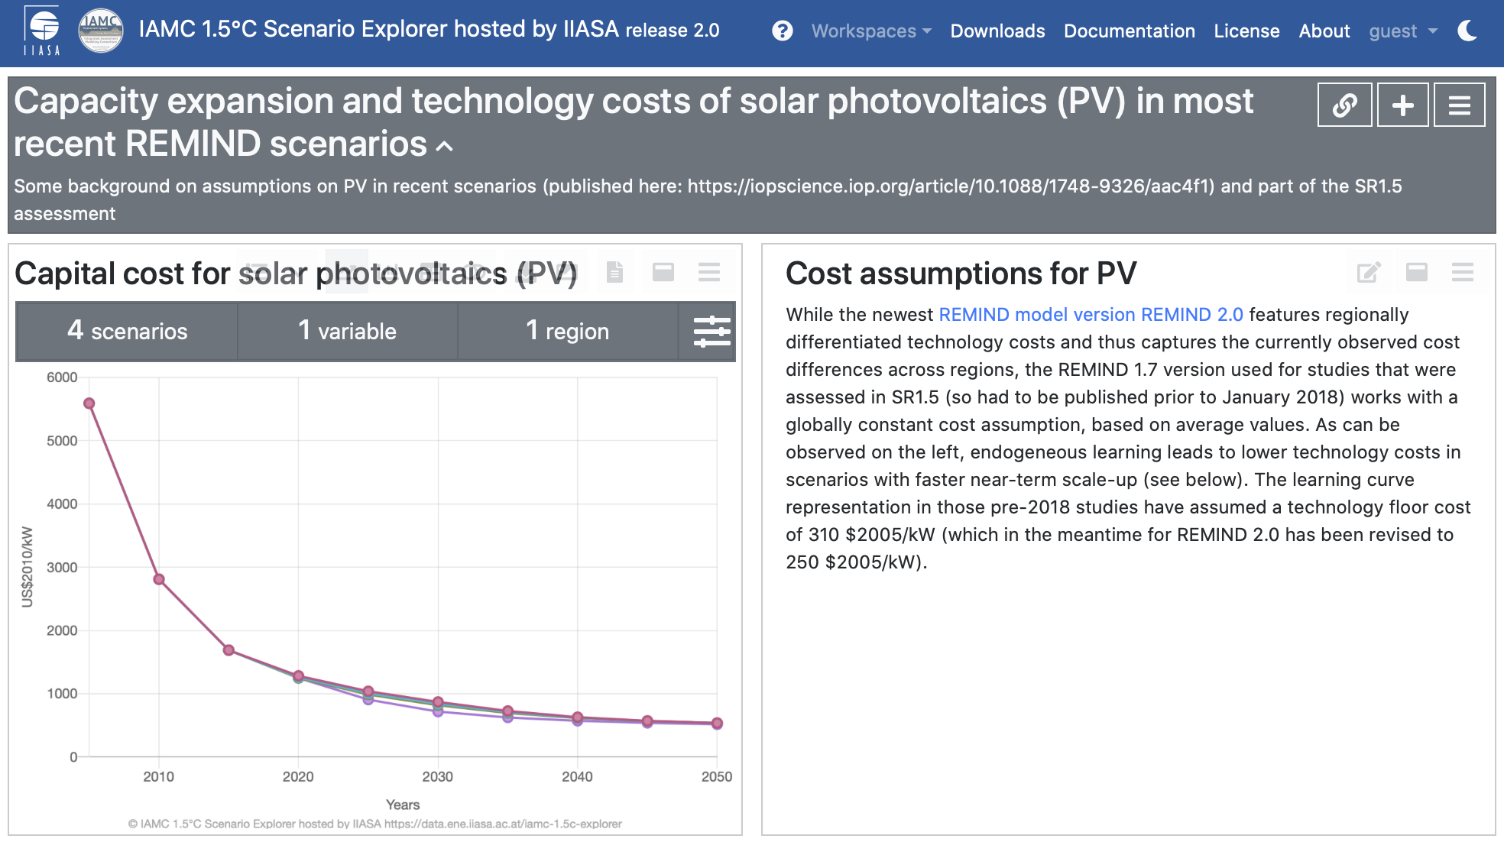
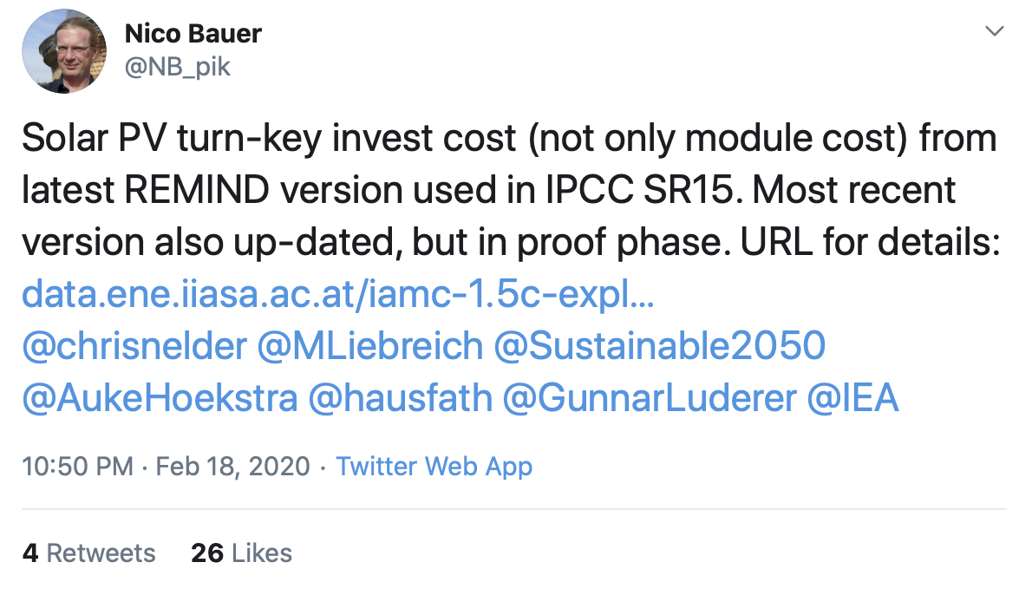
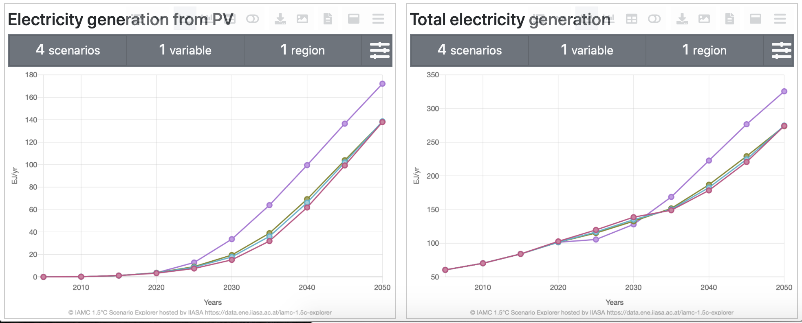
Scenario explorer workspaces “in the wild”
A few weeks ago on Twitter...
Discussion in the scientific literature (and on Twitter) about assumptions of PV costs in models used in SR15...
Thread at https://twitter.com/NB_pik/status/...

Slide 24
Interoperable
Apply common data standards and open-source packages
Use common data template developed by the IAMC
High-profile use case: IPCC Reports (AR5, SR15), EMF
Used by ~50 research teams globally
Assessment using an open-source Python package
Scenario analysis & visualization toolbox based on collaborative scientific-software practices
Documentation: pyam-iamc.readthedocs.io
 | A | B | C | D | E | F | G | H
1 | Model | Scenario | Region | Variable | Unit | 2005 | 2010 | 2015
2 | MESSAGE | CD-LINKS 400 | World | Primary Energy | EJ/y | 462.5 | 500.7 | ...

Slide 25
Reusable (I)
All items of the scientific supply chain are released under licenses that enable follow-up research and re-use
Scenario ensemble data:
Custom license modified from Creative Commons CC-BY 4.0
Aim: allow re-use for scientific research and science communication but keep IAMC 1.5°C Scenario Explorer as “gateway” for entire dataset
Why? anticipating updates, we want to avoid multiple out-of-sync versions
Assessment notebooks (Licensed under Apache 2.0, distributed via GitHub)
Scenario ensemble manuscript:
Bound by Springer-Nature policy
But: distribute Readcube link for free access on personal website and social media, share post-print version on IIASA website after embargo period

Slide 26
Reusable (II)
The scenario set is an unstructured “ensemble of opportunity”
The data was compiled from studies & reports addressing various research questions and based on differing scenario designs and underlying assumptions.
A user’s guide to the analysis and interpretation of scenario ensembles
Don’t interpret the scenario ensemble as a statistical sample or as likelihood/agreement. Don’t focus only on the medians, but consider the full range over the scenario set. Don’t cherry-pick individual scenarios to make general conclusions. Don’t over-interpret scenario results and don’t venture too far from the original question. Don’t conclude that the absence of a particular scenario (necessarily) means that this scenario is not feasible or possible.
Based on Box 1, Huppmann et al., Nature Climate Change 8:1027-1030 (2018). doi: 10.1038/s41558-018-0317-4 | paywall-free access: rdcu.be/9i8a

Slide 27
Dealing with data errors (after publication)
Using GitHub “Issues” to track errors in the scenario ensemble
See github.com/iiasa/ipcc_sr15_scenario_analysis/issues and data.ene.iiasa.ac.at/iamc-1.5c-explorer/#/about for more information

Slide 28
Using the scenario ensemble to gain insights on the SDGs
Part 4

Slide 29
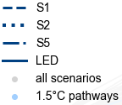
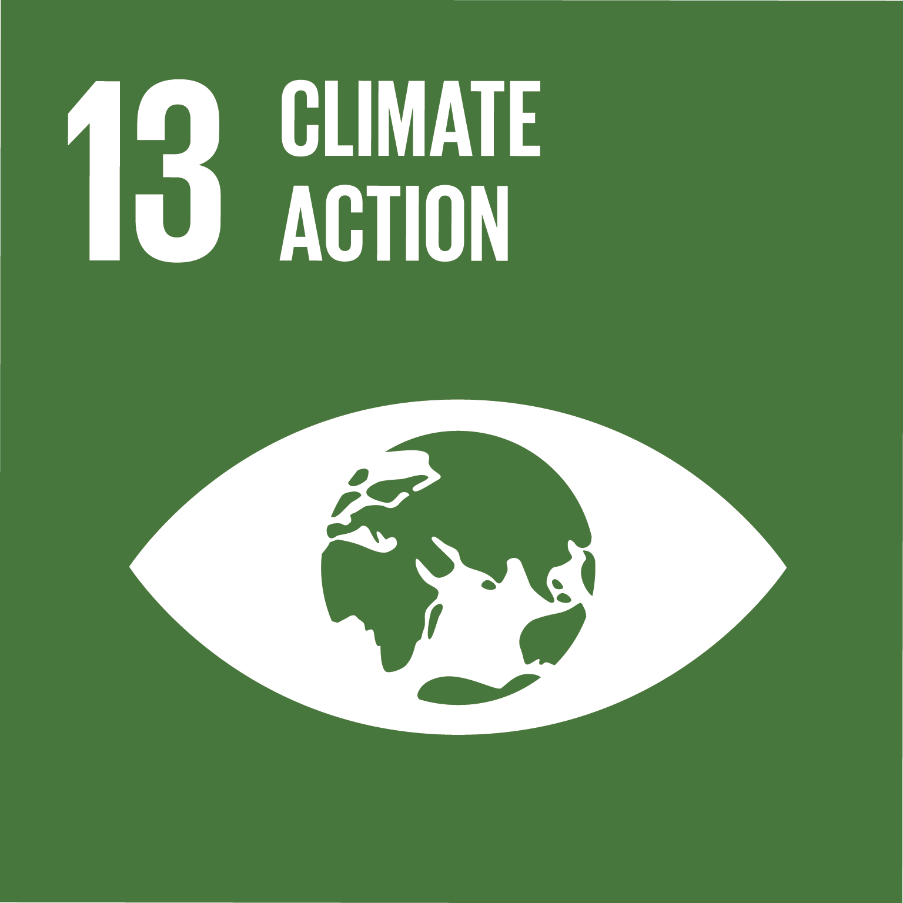
Assumptions & drivers across the scenario ensemble
There are pathways reaching the Paris 1.5°C temperature goal across a broad range of socio-economic development
Based on Figure 2.4 IPCC SR15 (2018) Source code to generate this figure available at github.com/iiasa/ipcc_sr15_scenario_analysis
More information on the scenario ensemble, the SDGs, and open tools supporting the IPCC SR15 at https://pure.iiasa.ac.at/15824

Slide 30
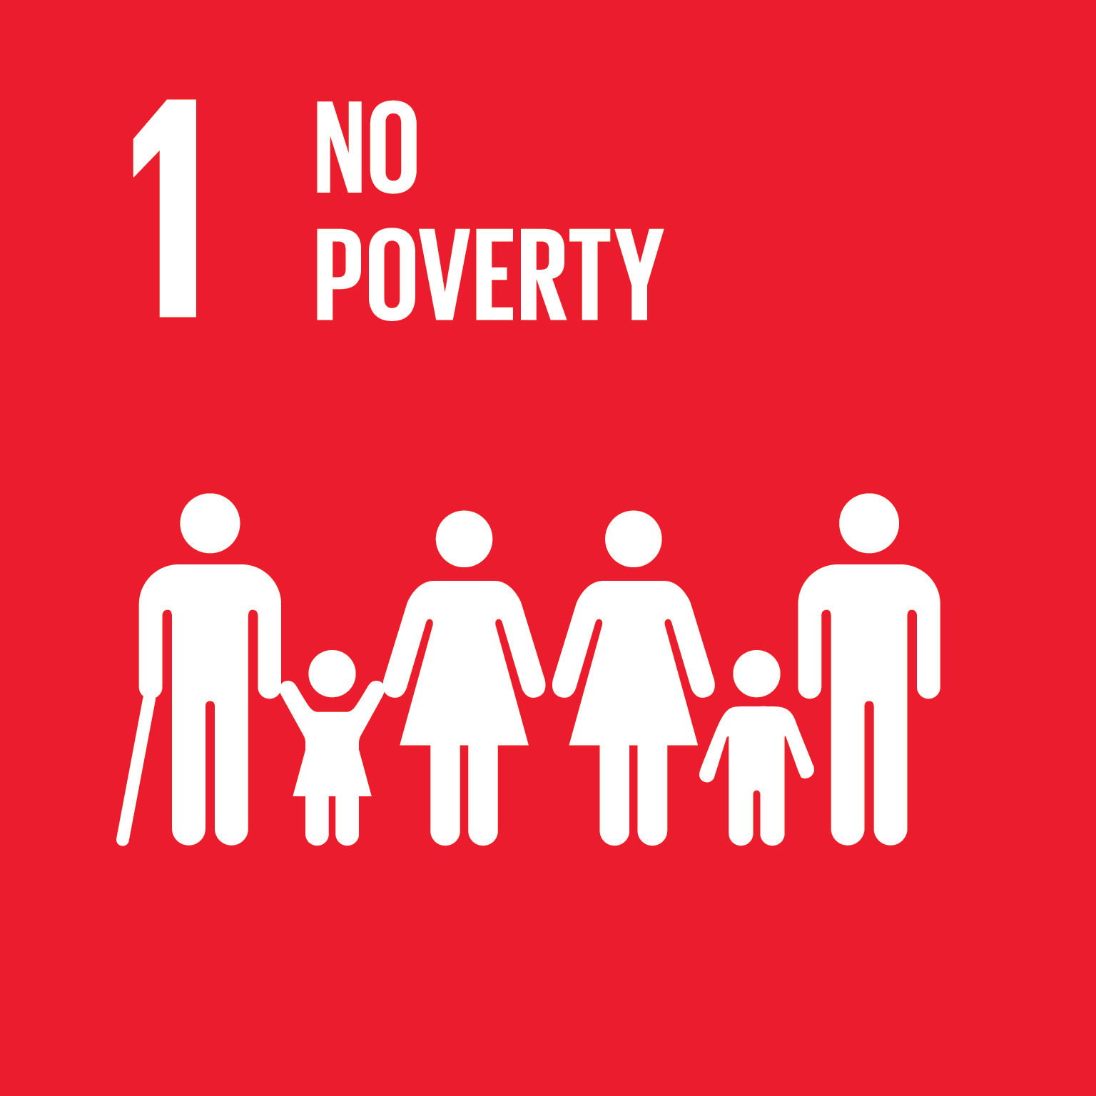
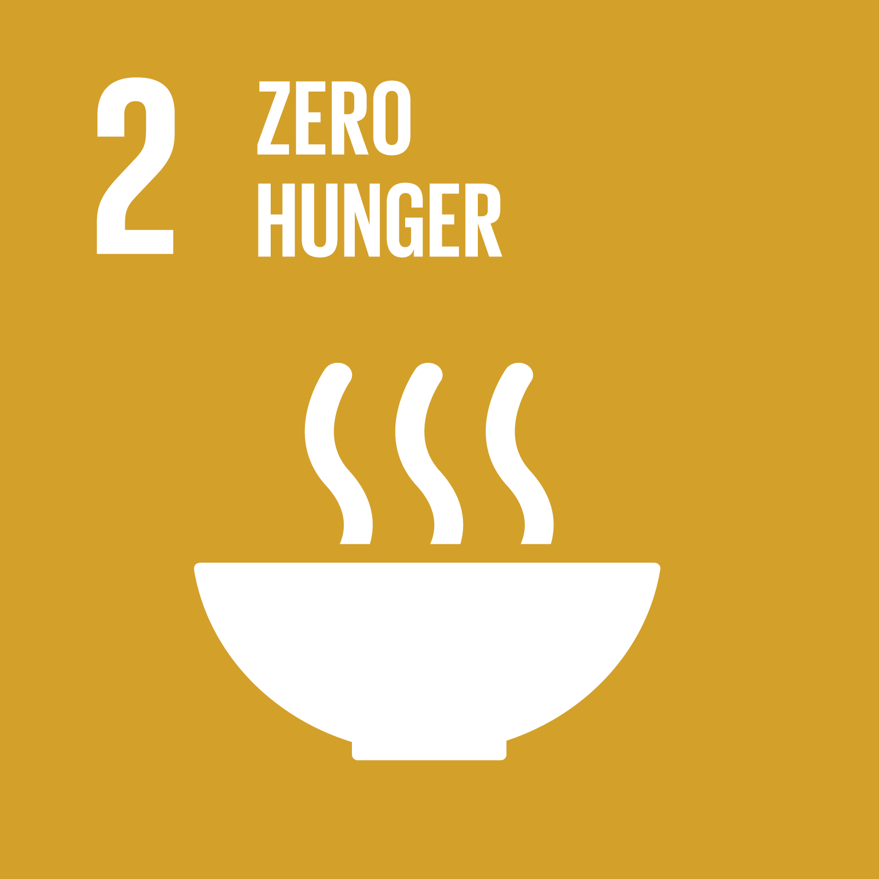
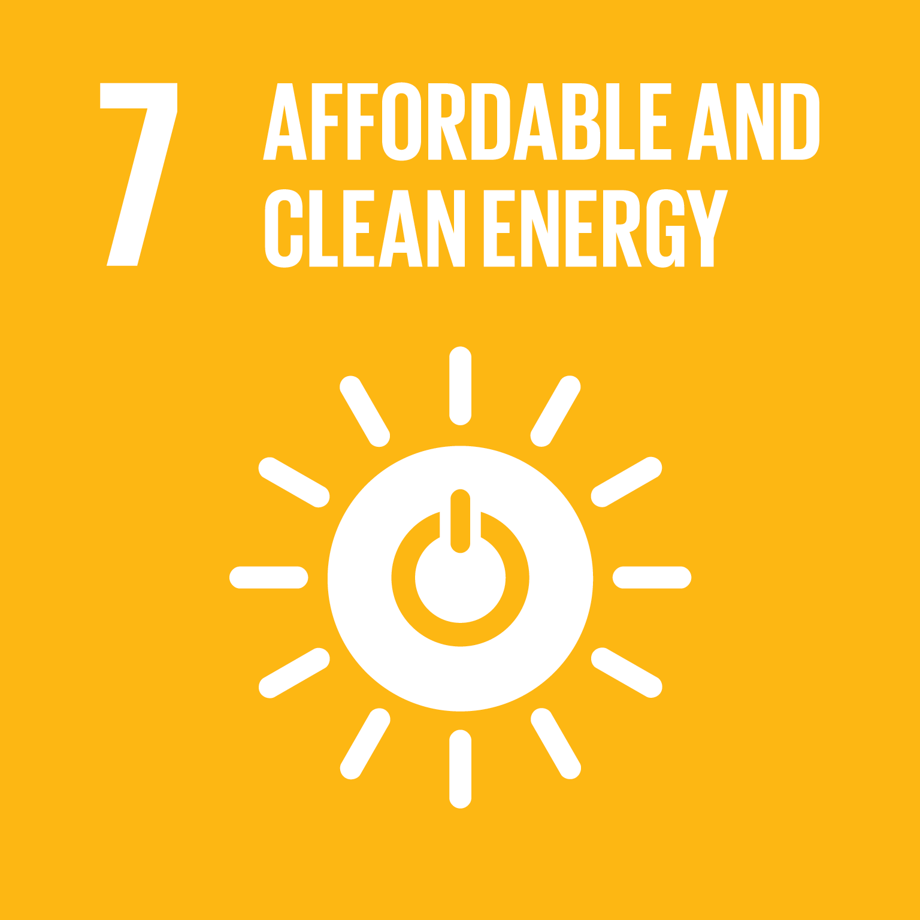
Assumptions & drivers across the scenario ensemble
There are pathways reaching the Paris 1.5°C temperature goal across a broad range of socio-economic development
Based on Figure 2.4 IPCC SR15 (2018) Source code to generate this figure available at github.com/iiasa/ipcc_sr15_scenario_analysis
More information on the scenario ensemble, the SDGs, and open tools supporting the IPCC SR15 at https://pure.iiasa.ac.at/15824

Slide 31
Bioenergy and carbon capture & sequestration (CCS)
Many pathways consistent with the Paris temperature goal use bioenergy in conjunction with CCS – but not all scenarios!
Based on Figure 1, Huppmann et al., Nature Climate Change 8:1027-1030 (2018). Source code to generate this figure github.com/iiasa/ipcc_sr15_scenario_analysis
More information on the scenario ensemble, the SDGs, and open tools supporting the IPCC SR15 at https://pure.iiasa.ac.at/15824
Cumulative carbon sequestration from 2020 until 2100 (in Gt CO₂)

Slide 32
Energy efficiency improvements
All pathways consistent with the ambitious Paris temperature goal exhibit much faster energy efficiency improvements than 2°C scenarios
Huppmann et al., Conference Poster (2019). https://pure.iiasa.ac.at/15824
Source code to generate this figure github.com/iiasa/ipcc_sr15_scenario_analysis
More information on the scenario ensemble, the SDGs, and open tools supporting the IPCC SR15 at https://pure.iiasa.ac.at/15824
Energy efficiency computed as total of final energy per unit of GDP

Slide 33
Near-term policy outlook
Part 5

Slide 34
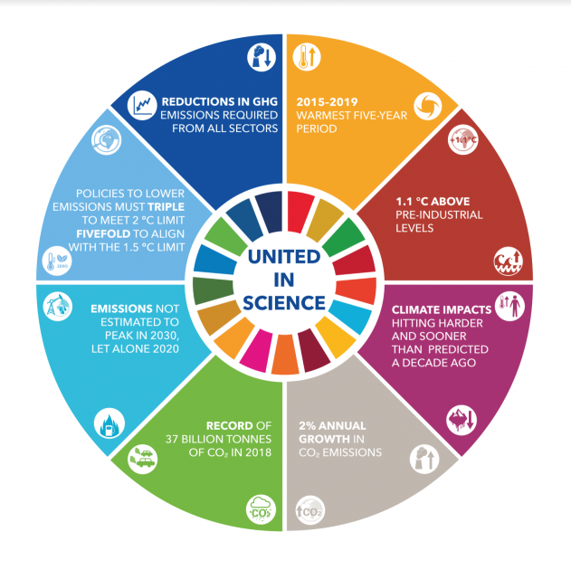
Policy implications for near-term developments
We need fundamental socio-economic transformation in key sectors to avert dangerous global temperature increase with potentially irreversible impacts
Current policies are insufficient to meet 2°C target
More ambitious climate pledges are needed as part of the “ratcheting up” process
Specific short-term measures:
Increase efficiency
Electrify
Decarbonise power
Replace residual fuels
“United in Science” high-level synthesis report of latest climate science by the Science Advisory Group of the UN Climate Action Summit 2019
public.wmo.int/en/resources/united_in_science

Slide 35
PSA: The Young Scientist Summer Program at IIASA
Every summer, dozens of PhD students spend three months in Laxenburg to work on their dissertation – supported and mentored by IIASA researchers!
If...
... you are a PhD student and
... working on a dissertation topic related to the SDGs (or methodologies that can be applied in that context)
Visit iiasa.ac.at/yssp and mark your calendars to apply for summer 2021
Deadline: January 11, 2021
Reach out to researchers at IIASA well before the deadline to receive feedback on your ideas!

Slide 36
Dr. Daniel Huppmann
Research Scholar – Energy Program
International Institute for Applied Systems Analysis (IIASA) Laxenburg, Austria
huppmann@iiasa.ac.at
@daniel_huppmann
www.iiasa.ac.at/staff/huppmann
This presentation is licensed under a Creative Commons Attribution 4.0 International License

Slide 37
Supplementary slides
Appendix

Slide 38
A suite of open tools to work with 1.5°C scenarios
Making it easy and FAIR to dive into the SR15 scenario assessment
A new interactive online scenario explorer: data.ene.iiasa.ac.at/iamc-1.5c-explorer
D. Huppmann, E. Kriegler, V. Krey, K. Riahi, J. Rogelj, S.K. Rose, J. Weyant, et al. (2018) IAMC 1.5°C Scenario Explorer and Data hosted by IIASA. doi: 10.22022/SR15/08-2018.15429
Assessment and generation of figures & tables using open-source Jupyter notebooks
Rendered notebooks: data.ene.iiasa.ac.at/sr15_scenario_analysis
GitHub repository: github.com/iiasa/ipcc_sr15_scenario_analysis
Based on open-source package pyam: pyam-iamc.readthedocs.io
D. Huppmann et al. (2018) Scenario analysis notebooks for the IPCC SR15. doi: 10.22022/SR15/08-2018.15428
Description of ensemble compilation and assessment process
D. Huppmann et al. (2018). A new scenario resource for 1.5 °C research. Nature Climate Change, 8:1027-1030. doi: 10.1038/s41558-018-0317-4 | paywall-free access: rdcu.be/9i8a
More information on the scenario ensemble, the SDGs, and open tools supporting the IPCC SR15 at https://pure.iiasa.ac.at/15824
Notes:
DOIs

Slide 39
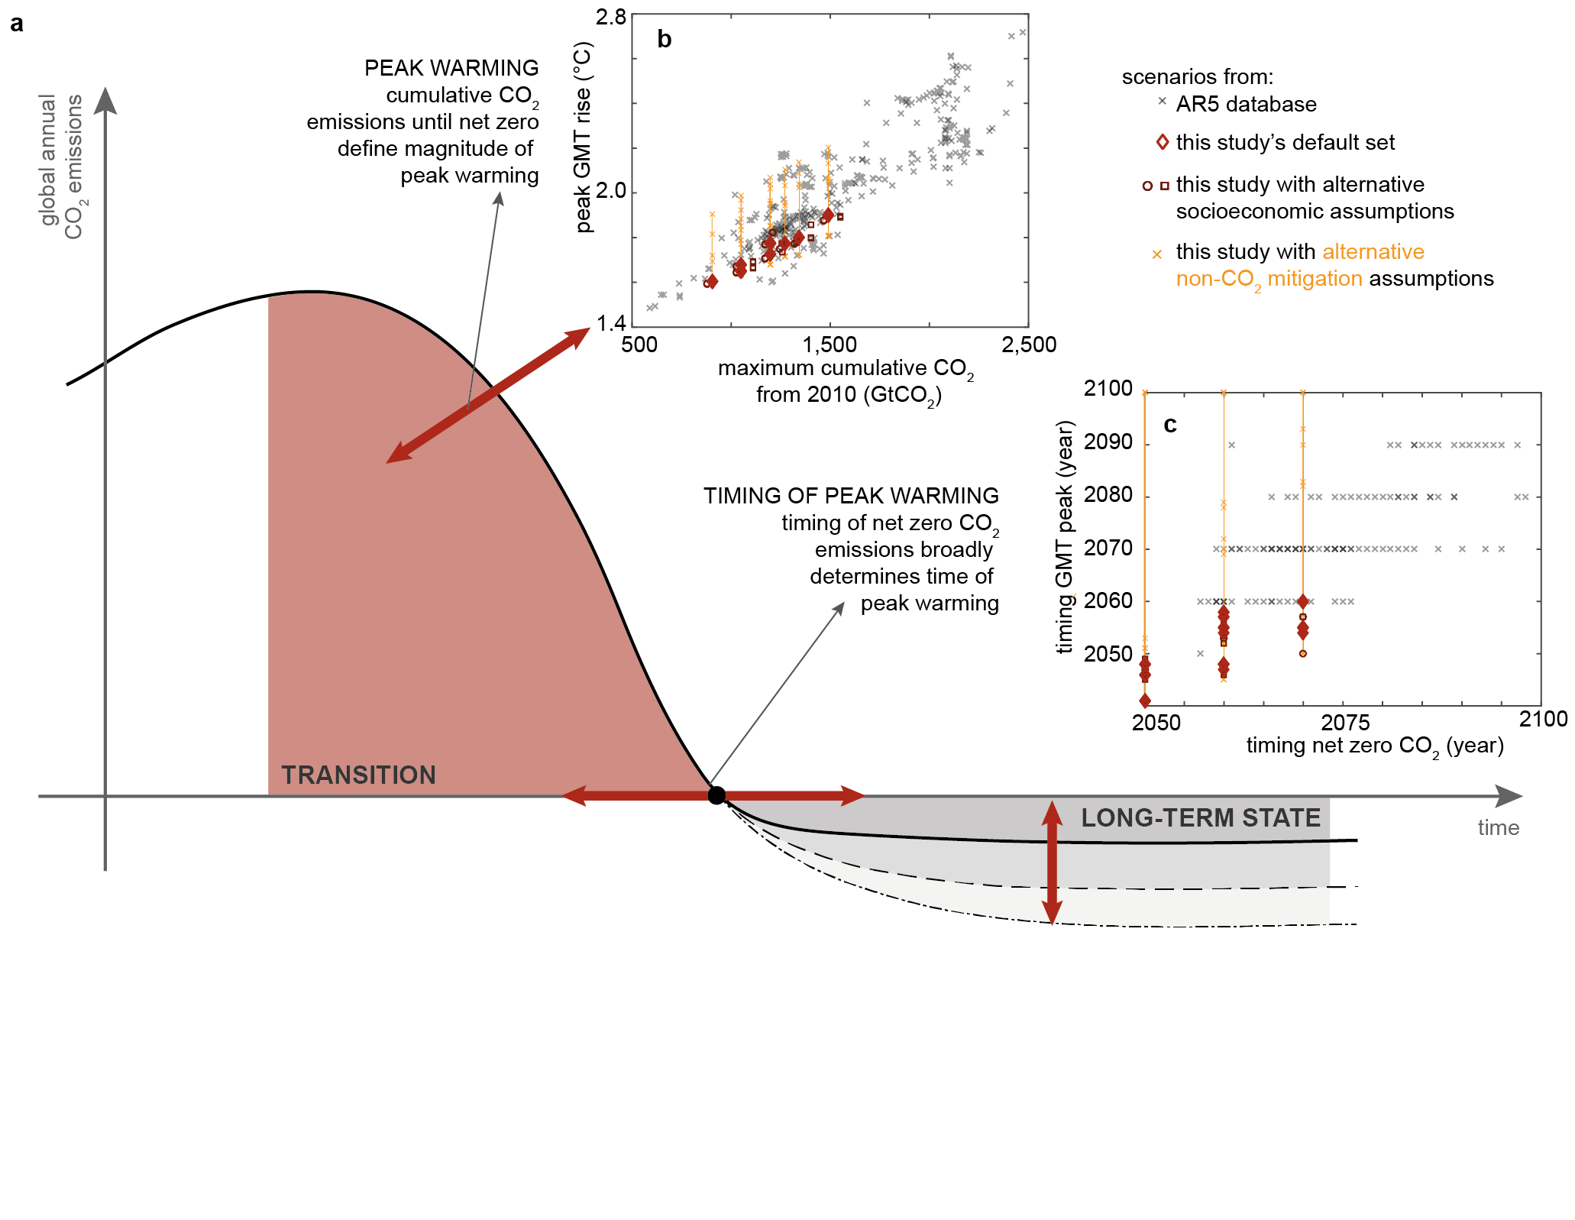
A new scenario logic for the Paris long-term temperature goal
Going beyond bounds on cumulative emissions to specific policy choices
Previously, many IAM studies used a constraint on cumulative GHG emissions.
This emphasised end-of-century warming and it puts a lot of (implicit) weight on discount rates, future technology availability, CDR, BECCS, etc.
We propose a new scenario logic closely following the text of the Paris Agreement.
Policy choice | Corresponding to
Year of net-zero | Year of peak warming
Ambition until net-zero | Level of peak warming
Long-term CO2 removal | Temperature reduction rate
Rogelj, Huppmann, et al. (2019). Nature 573(7774):357-363. doi: 10.1038/s41586-019-1541-4 paywall-free: rdcu.be/bRpWa

