Slide 1
Robust food-energy-water-environmental security management: linking distributed sectorial and regional models
Yuri Ermoliev
Tatiana Ermolieva
Petr Havlik
Elena Rovenskaya
EU Conference on Modelling for Policy Support
26-27 November, 2019

Slide 2
Motivation
Energy Production
Water Resource Allocation
Food Production
Water, energy and food are essential element for human being.
Independent plans for:
  Energy production
  Food production
  Water resource allocation
How the sectors are linked?
Notes:
Currently, the government make the plans for energy production, food production and water resource allocation independently.

Slide 3
Advanced Analysis of Interdependencies, Systemic Threats,
Multi-Dimensional Systemic risks, and Systemic Security
Growing demand vs environmental standards (SDGs); electricity infrastructure innovations and investments; systemic security; increasing returns vs sunk costs;
climate change and uncertainty; strategic- and operational planning; long- vs short-term decisions; competition for resources, etc
Energy Security
Food Security
Energy security and water security; supply standards; Energy & water prices; Diversification of energy supply;
Ex-ante and ex-post risk management; electricity supply security;
global and local threats to electricity supply systems; endogenous risks; cyberattacks;
protection of critical infrastructure
Nested multi-model welfare analysis and systemic security management
Incomes; economic and population growth; demand changes; life and nutrition standards; prices;
Impacts of energy prices on food prices; Dependencies between agricultural and energy markets through bio-fuels; Agricultural subsidies; renewables subsidies, etc.
Water Security
Socio -Economic Security
Control of water resources; reliability vs. disasters; Monitoring of infrastructure reliability; monitoring of water resources vulnerability and accessibility;
Monitoring & control of water contamination;
Notes:
Three fundamental elements (energy) security: ―Physical supply: availability and accessibility; ―Economic: affordability; ―Environmental sustainability: acceptability. Most important factor determining the energy system is risks, which depend on how the system is considered as a whole
emphasis on a systemic approach to risk management: regulating the system as a whole, not just its individual components
Systemic risks is risks in a complex “network” driven by supply-demand-price relations
Framework that can be scaled to capture the key components and relationships at different levels
A tool which helps identify regional energy security gaps and self-sufficiency levels depending on various other factors and areas of priority
A tool which allows to set the priorities and initiate a discussion with decision-makers
International (traditional) energy security frameworks were developed primarily following the crude oil supply disruptions of the 1970s
Significant changes in energy markets over the last 40 years
•Increased diversification of the fuel mix, with oil use displaced by increasing use of coal and natural gas.
•A shift in consumption patterns towards non-OECD emerging economies.
•Changes in the structure of the international crude oil market, from vertically integrated market of the 1970’s to the current segmented and highly specialised market.
•The move from long term contracts to an increasing share of spot transactions and the emergence of oil futures and derivatives markets, increasing the depth and liquidity of the market.
•New causes of imbalance between supply and demand beyond geopolitical shocks to crude oil supply. For example, refinery shutdowns (e.g. Hurricane Katrina 2005), demand surges (e.g. Asia 2013) and the loss of specific types of crude (Libya 2011

Slide 4
New threats, new risks, new challenges:
Risk-Based Decision Making
Standard risks
  Generated by exogenous events
  Historical observations characterise risks by probability distributions
  Risk assessment is used for risk management
  Statistical decision theory, expected utility theory, cost-benefit analysis, levelized costs, annualization of profits or losses, etc.
  …
Unknown (systemic) risks
  Catastrophic risks, missing observations
  Interdependencies
Unknowable (systemic) threats, risks, and security management
  New interdependent systems, missing observations
  Endogenous risks
  Risks generated by decisions of agents
    Blackouts of energy system due to natural disasters, triggered by rains, hurricanes, and earthquakes in combination with inappropriate land use planning, maintenance of flood protection systems and behavior of various stake holders
    High GHG goals, energy prices and volatility, global climate change concerns create high demand for biomass
The need to design new systems, which are robust against possible “unknown and unknowable” risks

Slide 5
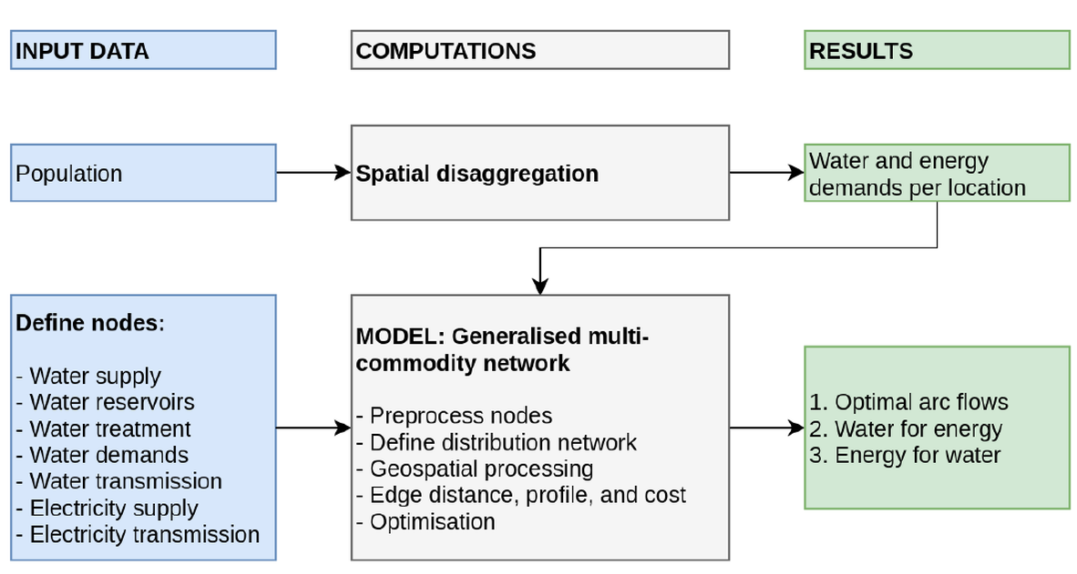
Examples of linkages: representation of the energy-water nexus, UK
A. Majid, T. Ermolieva, Y. Ermoliev et al., 2018-2019

Slide 6
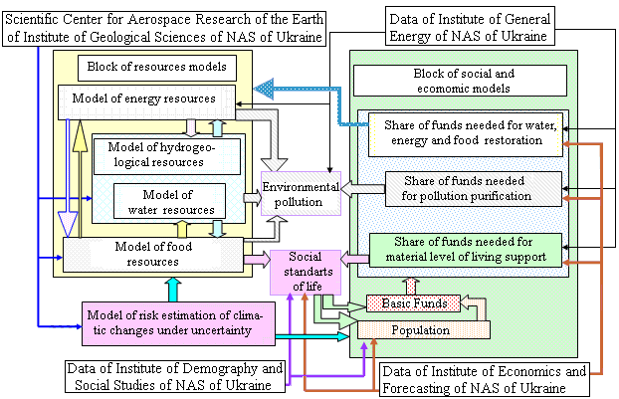
Example of distributed models linkage: a robust distributed local-global network system, IIASA-NASU FWEES Security Project

Slide 7
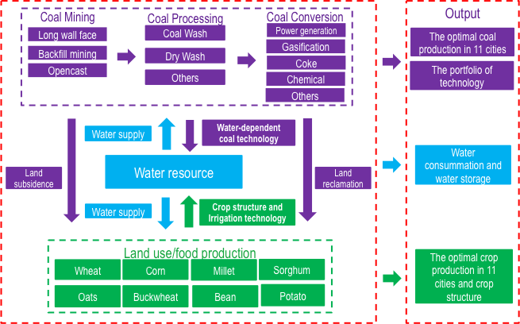
Linkage of distributed energy-agriculture-water models
Coal related industry
Cooling technology
Power
dry quenching
coke
Waste water treatment
reuse
Power
Water resource
Quantity
Coal Mining
Waste water treatment
Water resource
Quality
Coal quantity
Dry/reuse of water
Drainage water
Agriculture
Crop stucture
crop quantity
Air Pollution

Slide 8
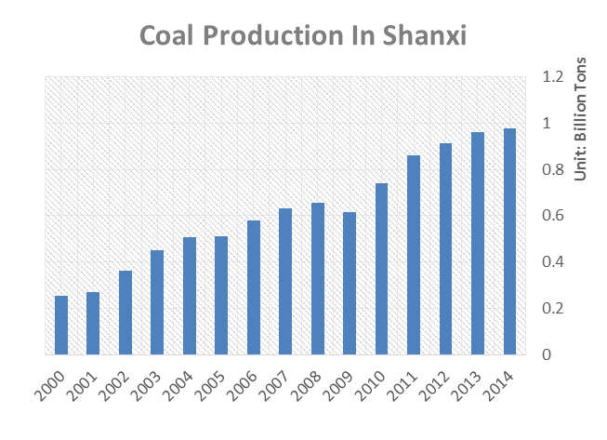
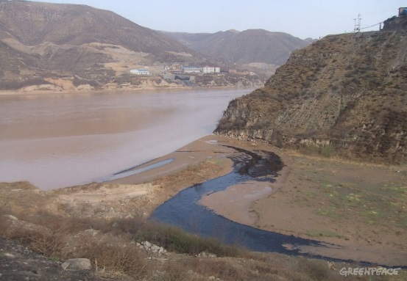
Coal in China
Energy security
67% of total consumption in China
Shanxi produce 26% coal in 2012
About 64% coal exported to other provinces (5.8/9.1)
About 80% GDP from coal related industry in Shanxi
Serious environmental, social, and economic impacts
Unsustainable development

Slide 9
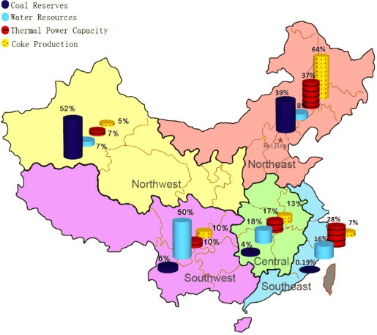
Water shortage
83% of China’s coal lies in water scarce and water stressed regions.
Geographical mismatch between water availability and coal industry
Source: Pan, Y., et al. (2012)
Notes:
As we all know china is lack of water, the per capita water resource in china is just one quarter of the world level, what makes things worse is geographical mismatch between water availability and coal industry. From the pic we can easily see it The light blue bar is on behalf of the water resources, the dark blue bar is on the behalf of coal reserves. We can see most of coal industries in the north of china where the water is short. Up to 83% of China’s coal lies in water scarce and water stressed regions. And coal industry is water intensive activity, in some coal production area, the people don’t have water to take a shower, they can’t access to water every time. Above all, we know coal industry has brought those negative impact in China , However if there is no regulation from the government to control it, the coal industry could continue to develop like before.

Slide 10
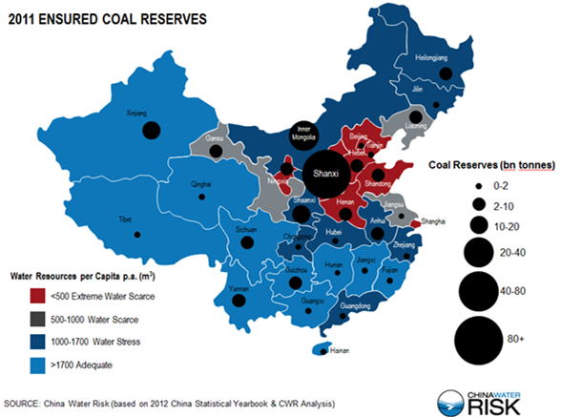
Energy-water-food security, Shanxi province, China
Xu, X., Gao, J., Cao, G.-Y., Ermoliev, Y., Ermolieva, T., Kryazhimskiy, A.V. and Rovenskaya, E. (2015): Modeling water-energy-food nexus for planning energy and agriculture developments: case study of coal mining industry in Shanxi province, China. IIASA Interim Report 15-020
Coal (energy) vs. crops
Tight water constraints
11 locations (prefectures)
Sector-specific constraints on production
Demand – supply equilibrium
Stochastic agro-energy demand
Stochastic water supply
Joint constraints on water consumption and land use
Stochastic water supply

Slide 11

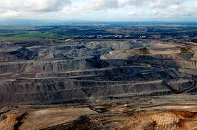
Iterative algorithms for ML of robust distributed systems:
Distributed systems linkage with SQG iterative learning for robust decisions
Model of sector/region A
Model of sector/region E
Minimizing costs
Constraints on volume of production
Constraints on available resources (land, water, etc.)
☹
☹
Can be separated for simplicity but in reality are inter-linked!
☺ ☺ ☺

Slide 12
“Naïve” approach: direct iterative exchange between models
Notes:
This is not very clear now, should be discussed

Slide 13
“Naïve” approach: example – dependence on the initial condition!
Notes:
Here there should be an example

Slide 14
Hard linking approach: minimization of the overall welfare function
Implementation may be challenging – computing time, needs to re-code etc.

Slide 15
Linking models via a central “hub” under uncertainty and asymmetric information
Notes:
\nu_A, \nu_E – are the solutions to the max problem or given dual variables???

Slide 16
Convergence theorem
Let
Then
where
Yuri Ermoliev (1988), Yuri Ermoliev et al. ( 2017, 2019) for Deterministic and stochastic cases

