Slide 1
Quality Criteria Citizen Science Resources
Dilek FRAISL, Gerid HAGER
International Institute for Applied Systems Analysis (IIASA)
fraisl@iiasa.ac.at
@dilekfraisl1
www.iiasa.ac.at
ECSA 2020 – 8 September 2020

Slide 2
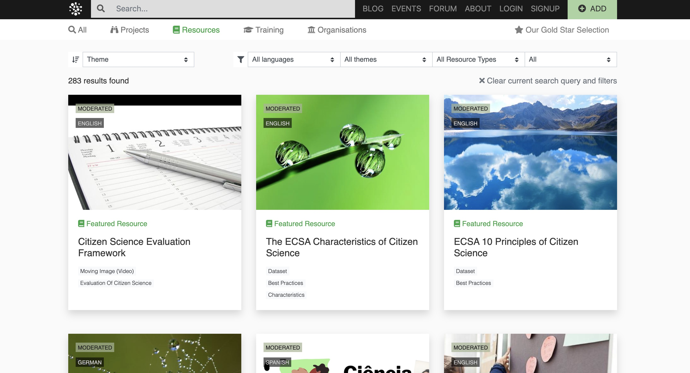

Slide 3
An integrated top-down and bottom-up approach
Top-down:
Step 1: 3 Overarching criteria
Step 2: 9 Specific criteria + 4 Supporting Criteria
Bottom-up:
Community uploading resources they find useful
Rate and feedback on resources available on the platform

Slide 4
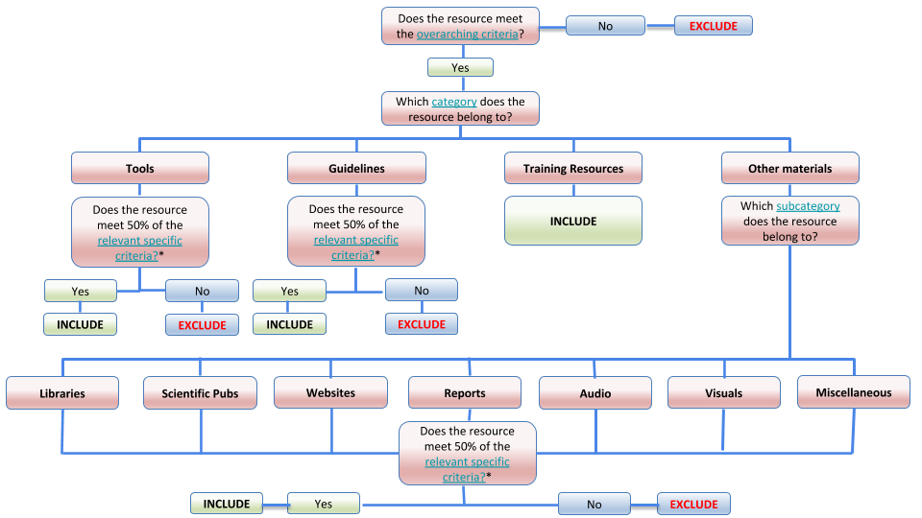
Decision Tree & Resource Categories

Slide 5
Quality + a living, well balanced and sustainable high quality repository
Addresses the diverse needs and expectations of different target groups and empowers the community to take ownership of the process
Might carry an important function of guiding and influencing how new resources are developed in line with these criteria.
Making it transparent to provide a basis and guidance to other existing and emerging platforms at the local, national and global levels.

Slide 6
Challenges
Complexity of implementation
Sustainability of the approach
Complexity of citizen science as an emerging field
Quality is a subjective concept, difficult to turn the process into a standardized methodology.

Slide 7
Next Steps
Resources Gaps Analysis
Review of the Criteria Framework

Slide 8
Thank You!
Dilek Fraisl
fraisl@iiasa.ac.at
@dilekfraisl1
www.iiasa.ac.at
www.eu-citizen.science – mail@eu-citizen.science

