Slide 1
Teaching best-practice of open-source collaborative scientific software development
Panel 3: “Educating Future Macro-Energy Systems Researchers“
Macro-Energy Systems Workshop hosted by Stanford Energy
Daniel Huppmann
September 18, 2020

Slide 2

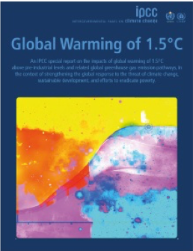
Background
Starting a new course from scratch…
Two years ago, I was asked to create a new course at TU Wien
on “open-source energy system modelling”…
Overview and teaching goals:
  Introduction to scientific programming:
  open-source software & FAIR data
    What is it, why do we it, how do we do it?
  Assessment of climate change & sustainable development
    How can scenarios be used for analysis in line with open science?
  Development of a stylized national energy system model
    How can we develop our own scenarios to analyse policy measures?
The second part of the lecture is based on my work for the IPCC Special Report
on Global Warming of 1.5°C
www.ipcc.ch/sr15
Not the topic of this talk…

Slide 3
Best practice in scientific software development
Concepts that should be familiar to any macro-energy modeller
Overview of concepts discussed in the course (part 1)
  Open-source licenses
  FAIR principles: Findable, Accessible, Interoperable, Reusable
  Git version control & code review (using Github or similar services)
  Style guides and documentation
  Semantic versioning
  Testing and “continuous integration“
Homework assignment (for part 1):
  Student uses some code snippet from her/his prior work
  Add continuous-integration features (unit testing and style guide validation)

Slide 4

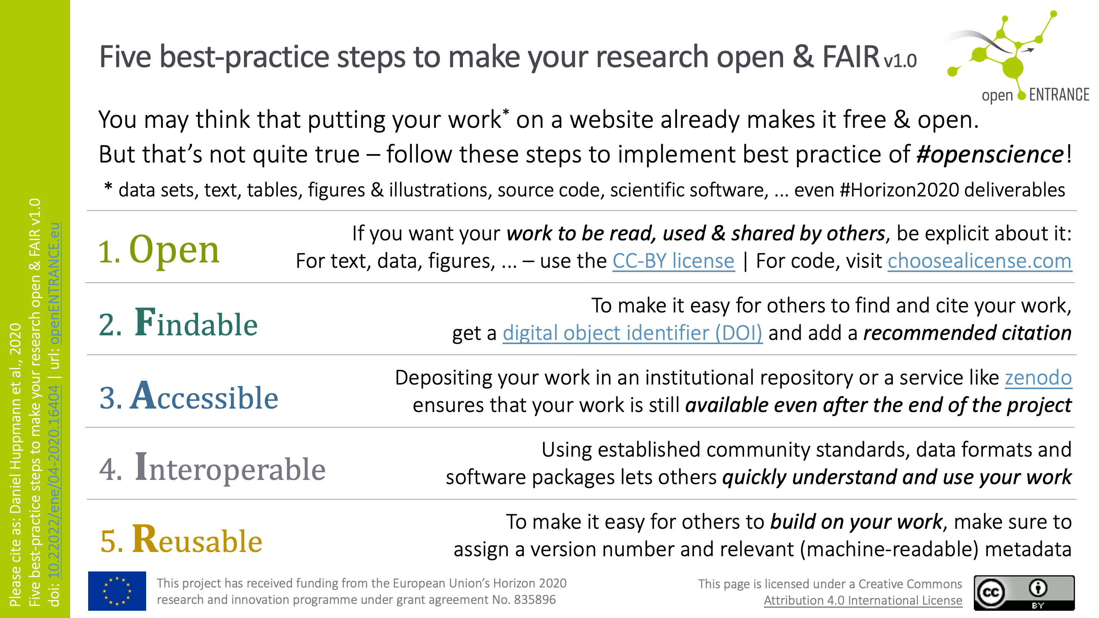
A one-slide guide to open & FAIR research
Even accomplished researchers aren’t always up to speed…
DOI:
10.22022/ene/04-2020.16404

Slide 5


Rationale for open-source research
One can only stand on the shoulders of giants if they let you…
Science has to be built on transparency and reproducibility
Describing methods/algorithms with words is a sub-optimal way to share ideas
Evolution of sharing & openness in the energy modelling community:
  🙄 “Available upon reasonable request”
  😐 Dumping the final version of a model or scientific software
  on an institutional server or a service like GitHub or Zenodo
  🤩 Separating the model or scientific software into several modules
  and making parts open-source as early as possible,
  writing comprehensive documentation & tutorials, etc.

Slide 6
Rationale for best-practice scientific programming
Following best-practice principles in your work
will give you more time to do better research
Modelling and scientific analysis is usually a “constant prototyping” exercise
  ”Just adding one more feature” often breaks existing functionality
  Dependencies (open-source packages) change over time
  Models and tools are too complex to immediately notice changed behaviour
Who has not yet experienced the panic & stress
from a model not solving shortly before a deadline…?
Following best-practice principles…
  Guards against models and tools failing to work (as expected)
  Helps you to understand your own thinking a few months later

Slide 7
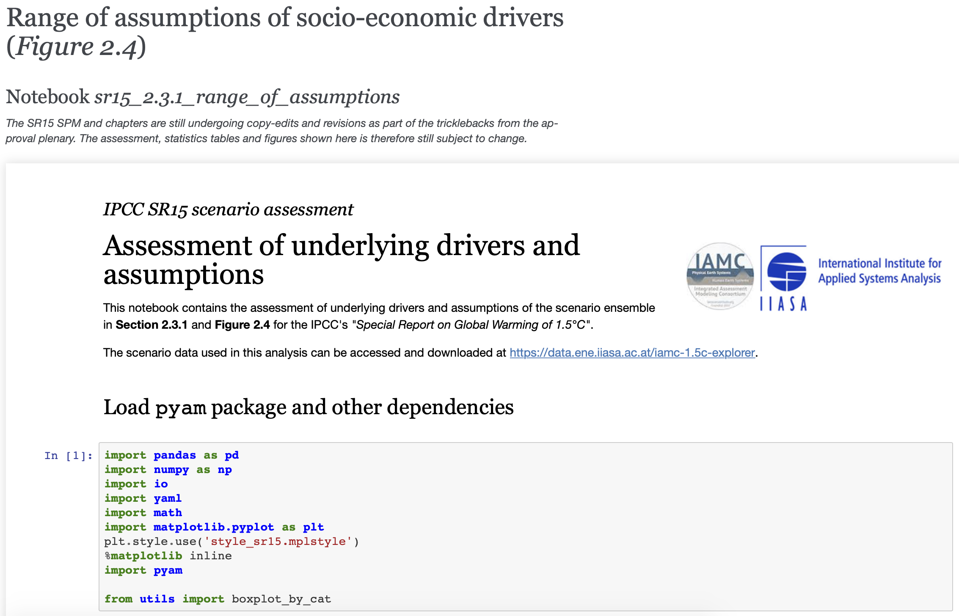
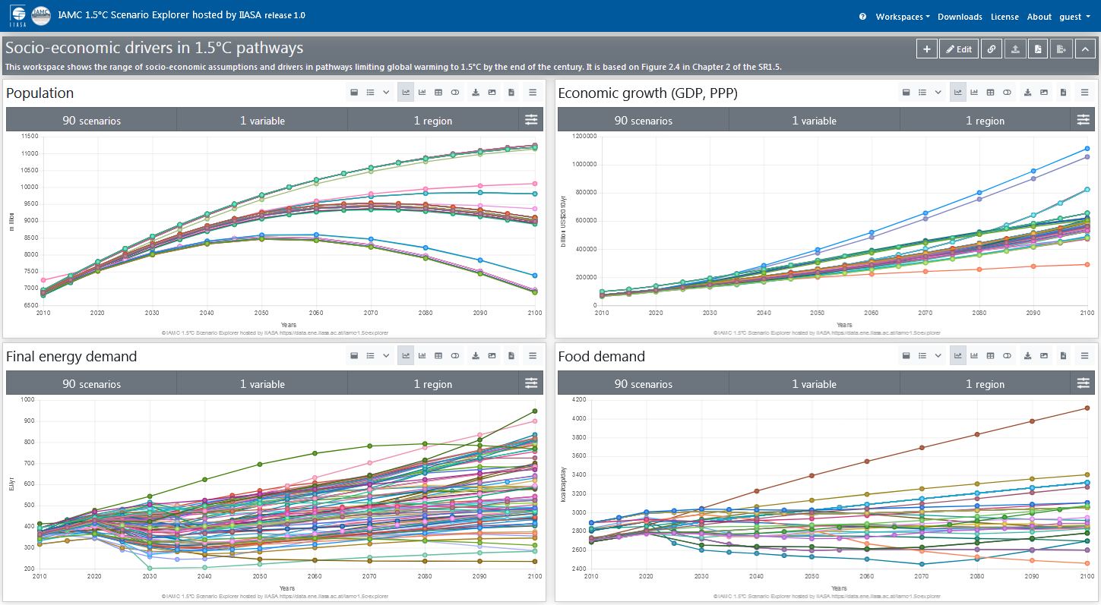
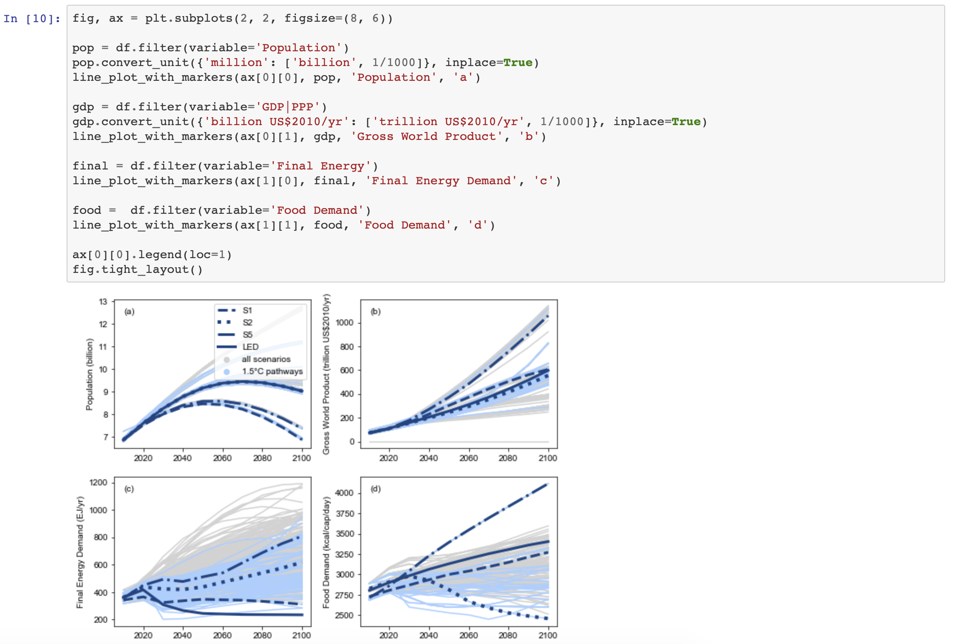
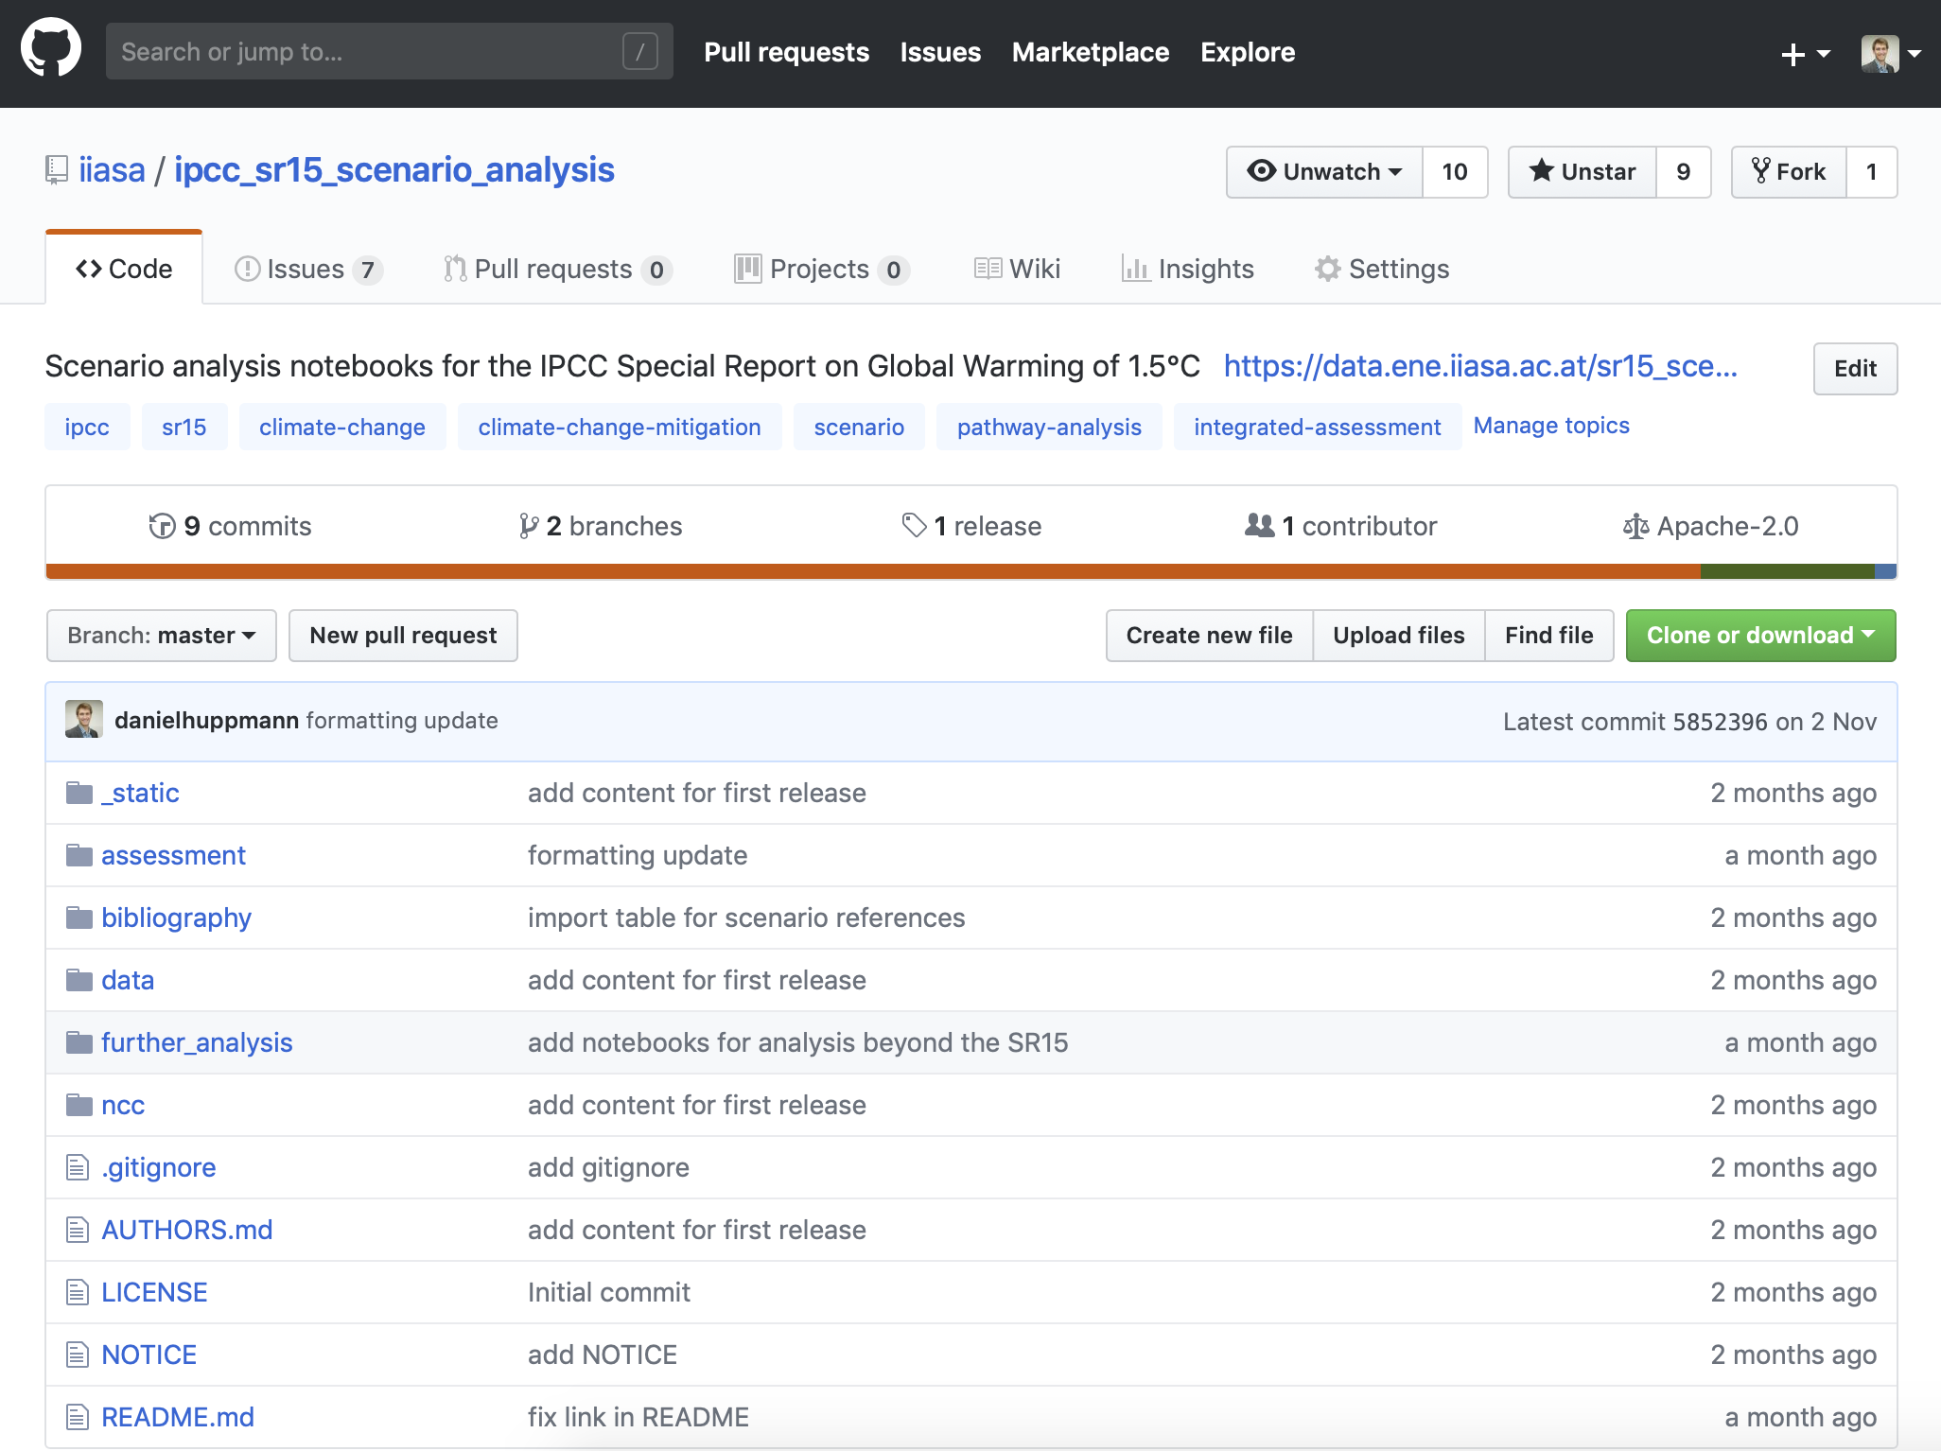

An example of open & FAIR science
The IPCC SR15 as a case study of open & FAIR scenario analysis
Interactive online scenario explorer at data.ene.iiasa.ac.at/iamc-1.5c-explorer
Figure 2.4 as printed in the SR15 (www.ipcc.ch/sr15)
Rendered notebooks to generate figures and tables at data.ene.iiasa.ac.at/sr15_scenario_analysis
$ git clone git@github.com:iiasa/ipcc_sr15_scenario_analysis.git

Slide 8


The road ahead for macro-energy research
Open science has to go beyond open source…
In an IIASA nexus blog post published today,
I discuss how open-source scientific software and
FAIR data can bring us one step closer to a community of open science.
  https://blog.iiasa.ac.at/
More information on my course at TU Wien (VU 370.062)
  https://tiss.tuwien.ac.at
  https://data.ene.iiasa.ac.at/teaching (including recording of some lectures)
My plea to the audience of this workshop
  Make teaching resources openly available!
#freethelectures

Slide 9
Dr. Daniel Huppmann
Research Scholar – Energy Program
International Institute for Applied Systems Analysis (IIASA)
Laxenburg, Austria
huppmann@iiasa.ac.at
@daniel_huppmann
http://www.iiasa.ac.at/staff/huppmann

Slide 10
Backup slides (for IPCC SR15 analysis)

Slide 11




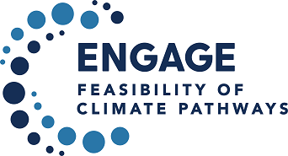

The IAMC template for timeseries data
A community standard for compiling scenario results
The integrated-assessment community (IAMC)
developed a tabular scenario data format for energy systems, SDG dimensions, …
  Used in IPCC Reports (AR5, SR15), Horizon 2020 projects, EMF, …
  Adopted by ~50 teams globally
Current and recent projects:
 | A | B | C | D | E | F | G | H
1 | Model | Scenario | Region | Variable | Unit | 2005 | 2010 | 2015
2 | MESSAGE | CD-LINKS 400 | World | Primary Energy | EJ/y | 462.5 | 500.7 | ...

Slide 12

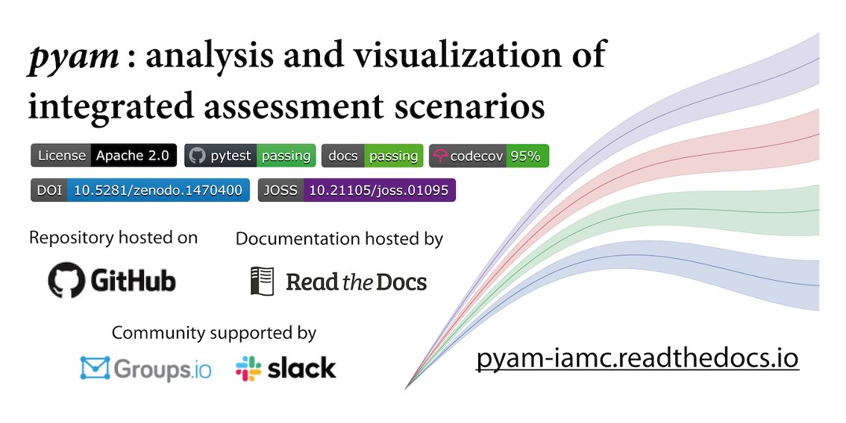
pyam: a Python package for scenario analysis
An open-source package to facilitate streamlined processing,
validation and assessment of scenario results
Aim: develop a package of useful functions for scenario analysis & visualization
following best practice of collaborative scientific software development
Features:
  Scenario processing workflow (I/O, units, …)
  Analysis & validation
  Categorization & quantitative indicators
  Visualization features & plotting library
More information:
  Documentation: pyam-iamc.readthedocs.io
  Scientific reference: M. Gidden and D. Huppmann (2019).
  Journal of Open Source Software 4(33):1095. doi: 10.21105/joss.01095
#pyam_iamc

