Slide 1
A common nomenclature for assessing low-carbon transition pathways in Europe and tools supporting an integrated modelling platform
Daniel Huppmann, Sandrine Charousset, Erik Francisco Álvarez Quispe, Sebastian Zwickl-Bernhard, Thorsten Burandt, Volker Krey, and the openENTRANCE consortium
Video-Poster at the Energy Modelling Platform for Europe (EMP-E) 2020
This project has received funding from the European Union’s Horizon 2020 research and innovation programme under grant agreement No. 835896
This presentation and the recording are licensed under a Creative Commons Attribution 4.0 International License

Slide 2
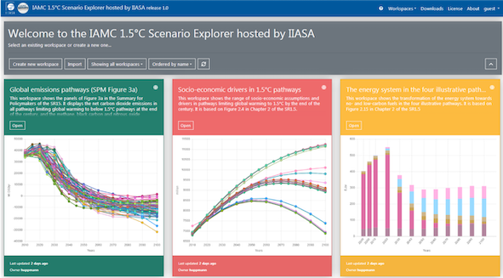
Aim: a modelling platform for the European energy transition
The openENTRANCE project aims at developing a transparent & integrated modelling platform for assessing low-carbon transition pathways in Europe.
The project links macro-economic & energy system models, and provides economic & human behavioural data relevant for understanding the energy transition.
The IIASA Scenario Explorer infrastructure serves as a central data hub to integrate models across spatial & sectoral scales.
The IIASA Scenario Explorer was developed to provide access to the quantitative data supporting the IPCC Special Report on Global Warming of 1.5° C. It is now further expanded into a versatile hub for model integration and data comparison.
software.ene.iiasa.ac.at/ixmp-server/

Slide 3
The key components for model integration (1/3)
Three ingredients to connect models via a central data hub:
A common data format
We adapt the format developed by the Integrated Assessment Modeling Consortium (IAMC) used by the IPCC WG III and numerous Horizon 2020 & other projects.
In openENTRANCE, we extend the format to work with subannual time resolution.
 | A | B | C | D | E | F | G | H
1 | Model | Scenario | Region | Variable | Unit | 2015 | 2020 | 2025
2 | GENeSYS-MOD | Societal Commitment | Europe | Primary Energy | EJ/y | 69.9 | 65.7 | ...
Notes:
We use a simple tabular datat format developed by the „Integrated Assessment Modeling Consortium” over the past decade,
And we extend it to cover subannual time resolution, because this

Slide 4
The key components for model integration (2/3)
A common nomenclature (naming conventions, definitions, list of regions)
We need a common understanding across all modelling teams on the naming of key variables, regional (dis)aggregation and temporal resolution
We started a collaborative process on GitHub to facilitate an open discussion and a clear history of changes.
The nomenclature is implemented as yaml-format dictionary files to strike a balance between (human) readability vs. (machine) processability.
Final Energy: description: Total final energy consumption by all end-use sectors and all fuels, excluding transmission/distribution losses unit: EJ/yr
Link to the Github repo: github.com/openENTRANCE/nomenclature

Slide 5
The key components for model integration (3/3)
Shared workflow scripts, processing tools, and analysis/visualization packages
The nomenclature comes with a simple, installable Python package providing validation tools and utility functions for conforming to the common data format and definitions
The openENTRANCE data format can fully utilize the open-source Python package pyam for scenario processing, analysis & visualization
More information: pyam-iamc.readthedocs.io
Note: the Python packages are intended as a useful resource for modelling teams, but it is not mandatory that they are used in the openENTRANCE project!

Slide 6
Related event at EMP-E
Join the EMP-E 2020 Focus Group 5 on infrastructure for model integration and open science (Thursday Oct 8) co-organized with our partner projects
Dr. Daniel Huppmann
Research Scholar – IIASA Energy Program www.iiasa.ac.at/staff/huppmann | huppmann@iiasa.ac.at
@daniel_huppmann
This presentation is licensed under a Creative Commons Attribution 4.0 International License

