Slide 1
We don’t need any more open-source models!
Energy Modelling Seminar Series, October 21, 2020
Aalto University
Daniel Huppmann
This presentation and the recording are licensed under
a Creative Commons Attribution 4.0 International License

Slide 2

Introduction: a typical modelling project
Open-source tools (can) increase the efficiency of
modelling, scenario development, analysis, and writing
Time allocated for scenario development and analysis
Coding a toy problem
More coding
Collecting data
Collecting more data
Calibrating a baseline
More calibrating
Developing scenarios
Working on scenarios
Analysis & writing
Quality of code review, documentation, etc. over project duration

Slide 3
Problems with open-source scientific software
There are many concerns that open-source projects
deliver sub-par quality compared to closed-source tools
List of drawbacks:
…?
…?
…?
  It’s just a question of committed resources…
  Overall, the downsides & risks are (pretty much) the same
  as a close-source (commercial or academic) project

Slide 4
Actual issues of open-source scientific software
If the quality of open-source projects depends on resources,
how do we make sure that projects get adequate support?
A few ideas on how to improve collaboration:
  Make open-source required by funding agencies
  Change the expectation in the community
  Look around for existing projects rather than start from scratch…
Challenges
  In particular for early-career researchers,
  how to get recognition for contributions to other projects?
  Open-source doesn’t mean high-quality scientific software

Slide 5
Rationale for best-practice scientific programming
Following best-practice principles in your work
will give you more time to do better research
Modelling and scientific analysis is usually a “constant prototyping” exercise
  ”Just adding one more feature” often breaks existing functionality
  Dependencies (open-source packages) change over time
  Models and tools are too complex to immediately notice changed behaviour
Who has not yet experienced the panic & stress
from a model not solving shortly before a deadline…?
Following best-practice principles…
  Guards against models and tools failing to work (as expected)
  Helps you to understand your own thinking a few months later

Slide 6

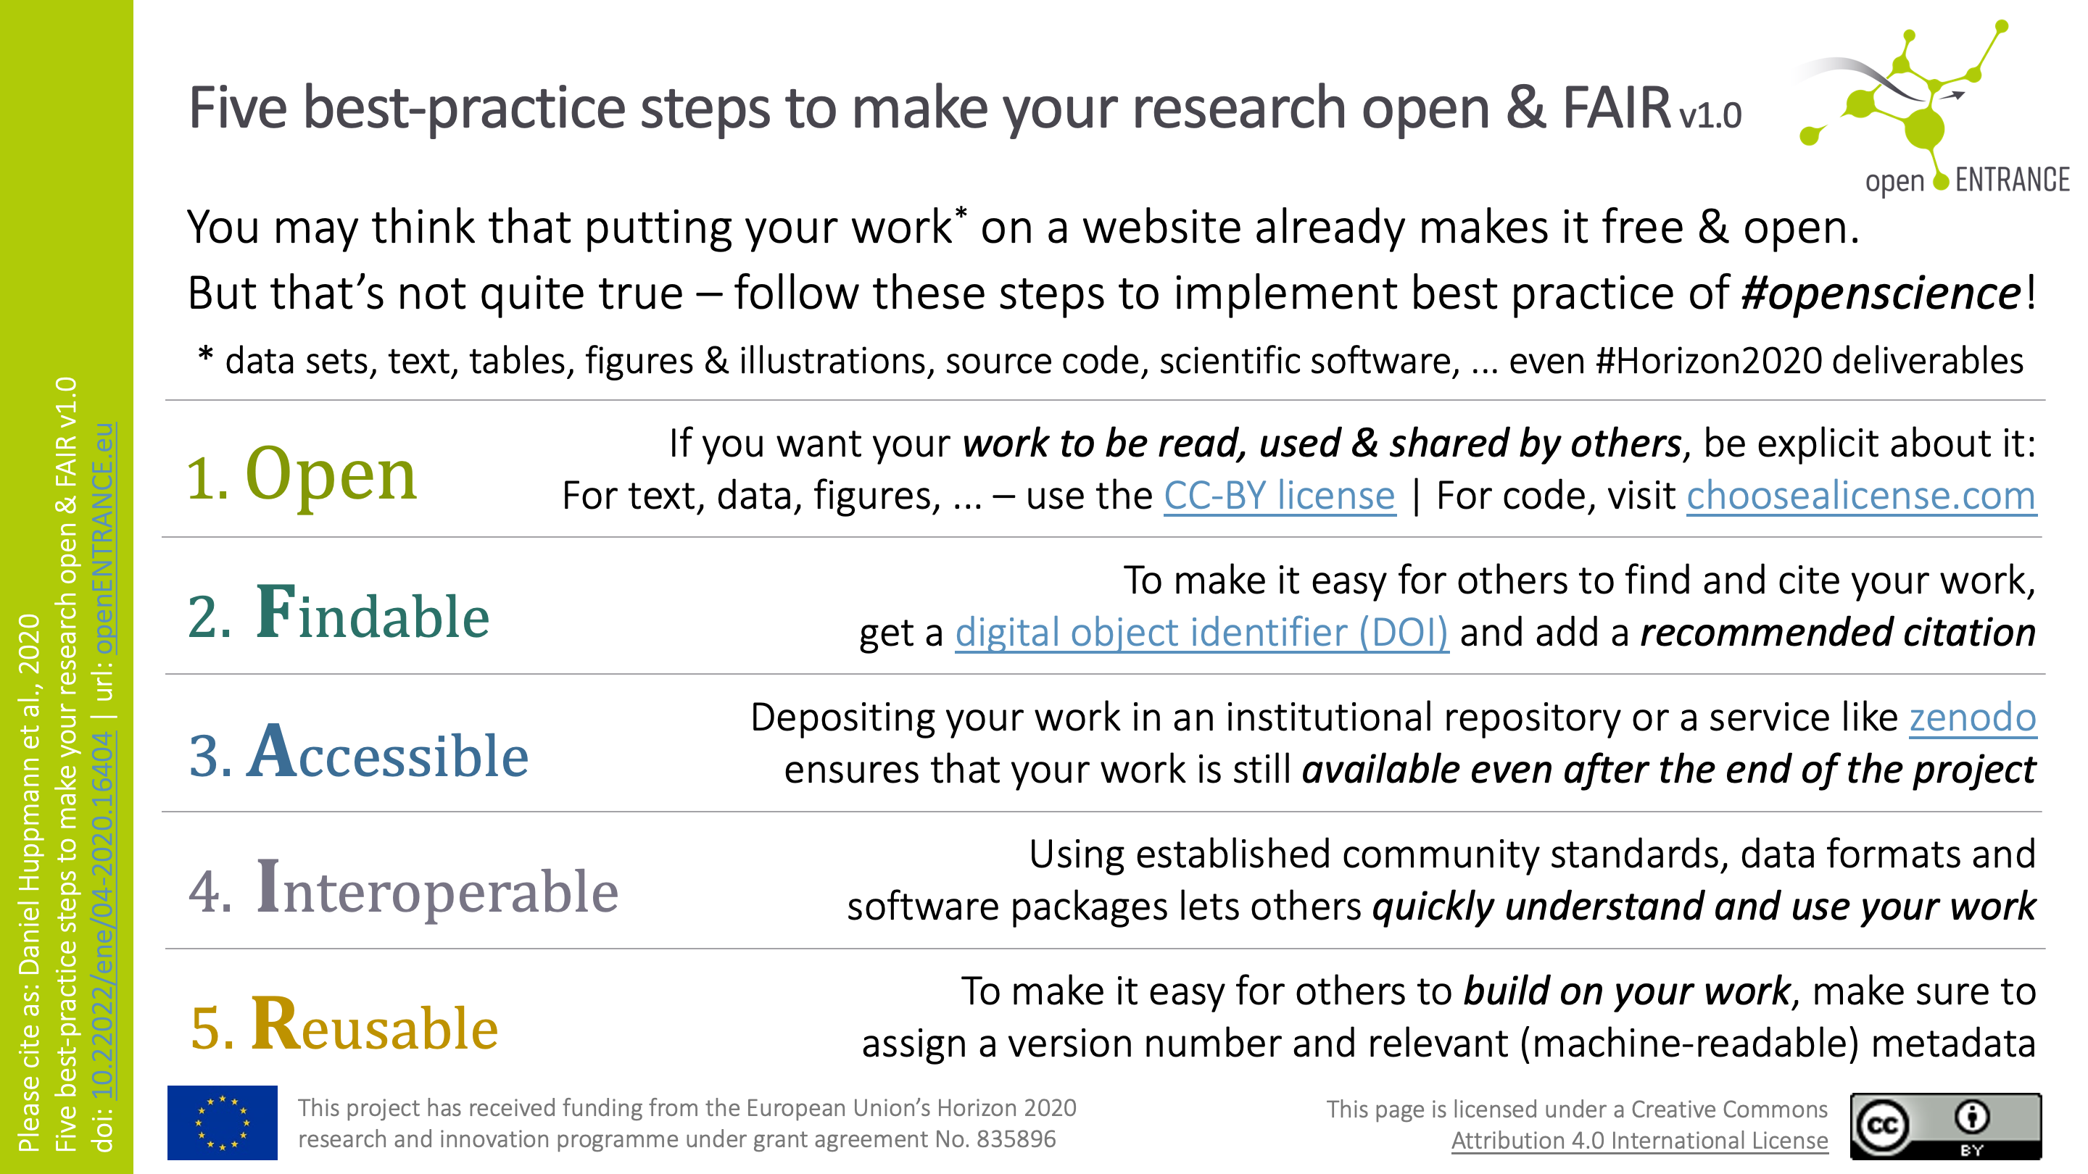
A one-slide guide to open & FAIR research
Even accomplished researchers aren’t always up to speed…
DOI:
10.22022/ene/04-2020.16404
More about the FAIR principles:
www.go-fair.org/fair-principles/

Slide 7
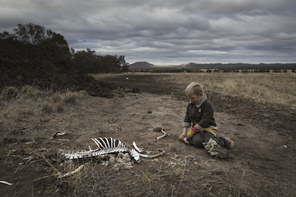
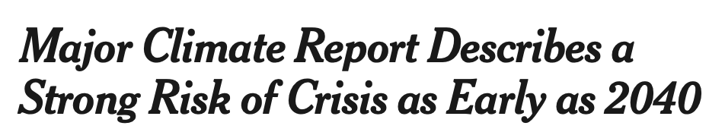
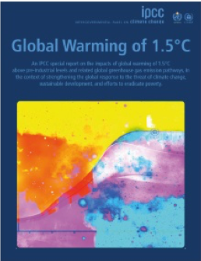
A Special Report on Global Warming of 1.5°C
Analyzing impacts of climate change in the context of the SDGs
The IPCC Special Report on Global Warming of 1.5°C (SR15)
was published in the fall of 2018.
[…] To prevent 2.7 degrees of warming, the report said, greenhouse pollution must be reduced by 45 percent from 2010 levels by 2030, and 100 percent by 2050. It also found that, by 2050, use of coal as an electricity source would have to drop from nearly 40 percent today to between 1 and 7 percent. Renewable energy such as wind and solar, which make up about 20 percent of the electricity mix today, would have to increase to as much as 67 percent. […]
Harry Taylor, 6, played with the bones of dead livestock
in Australia, which has faced severe drought.
Brook Mitchell/Getty Images
Where do these numbers
come from?
www.nytimes.com/2018/10/07/climate/
ipcc-climate-report-2040.html
www.ipcc.ch/sr15

Slide 8
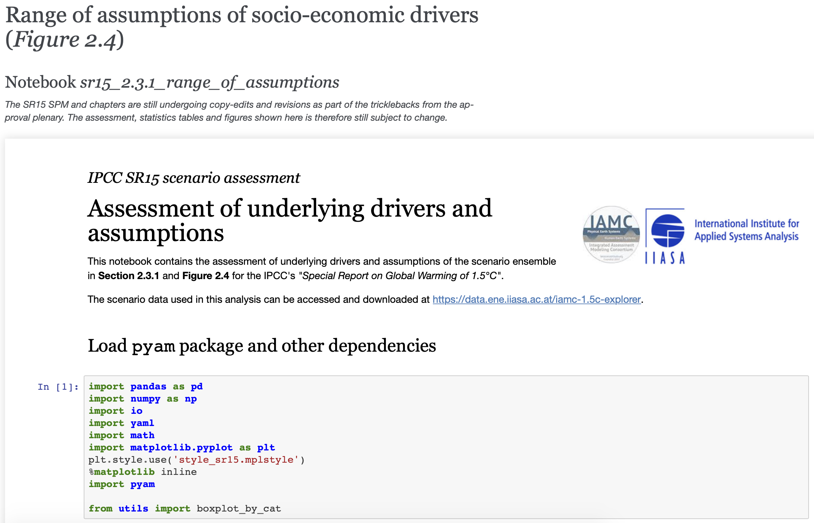
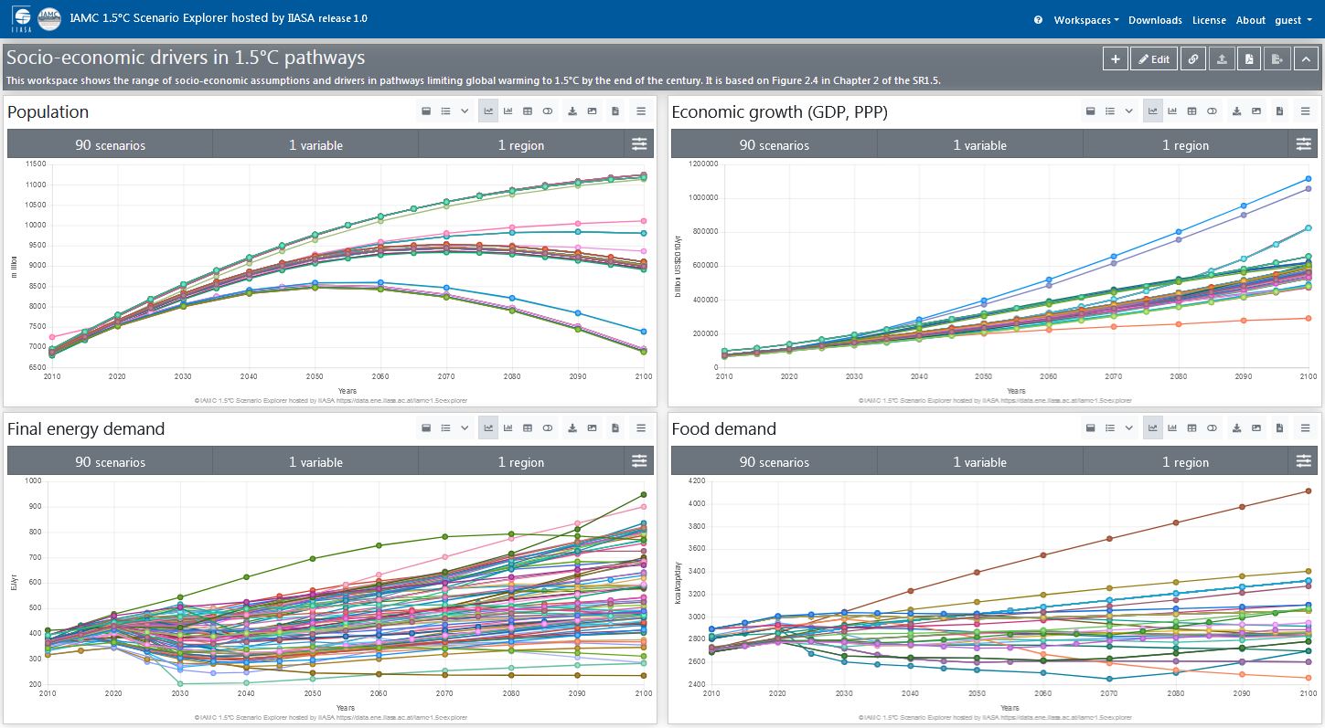
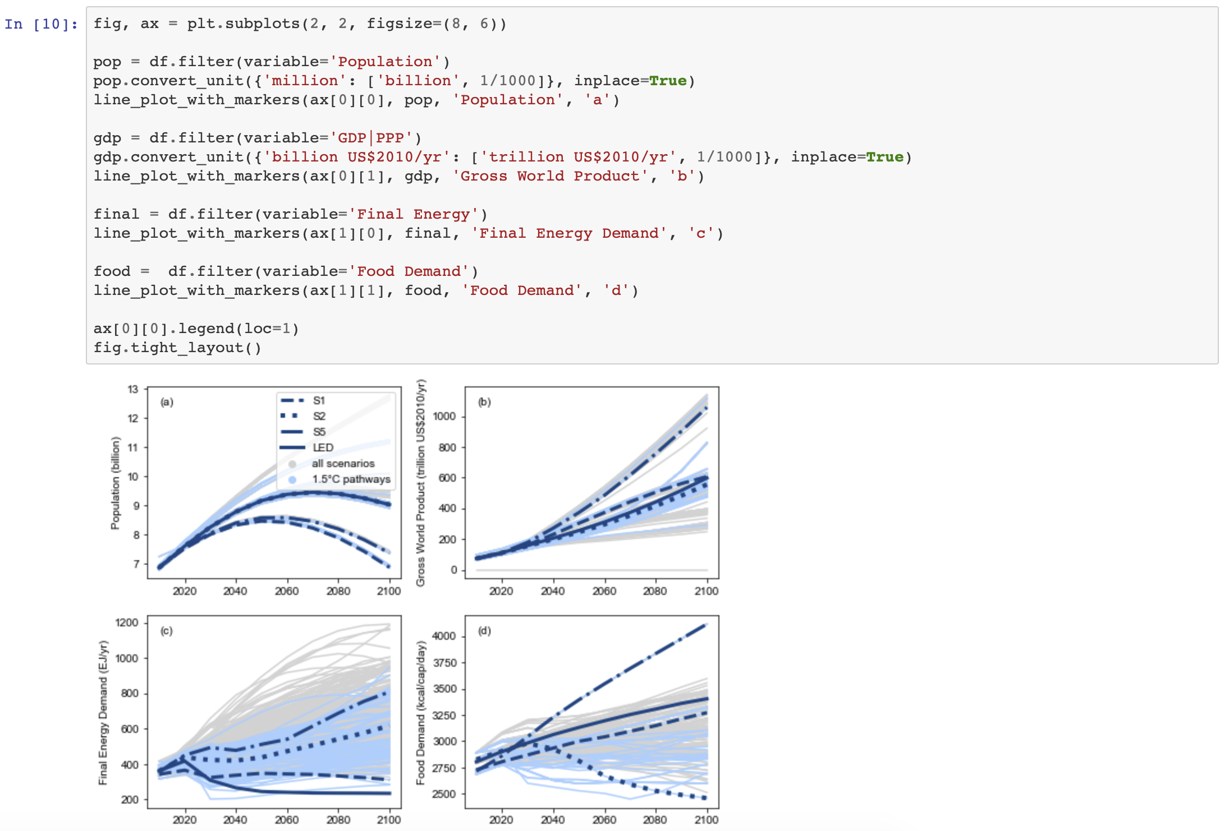
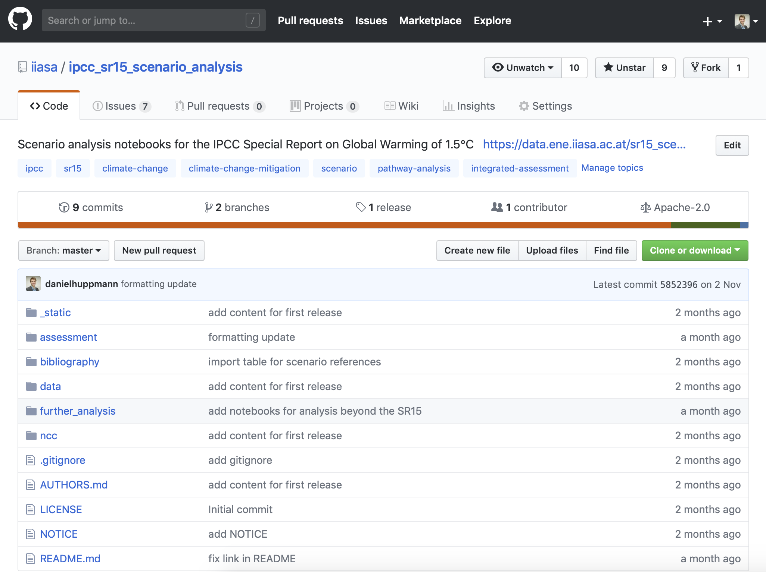
An example of open & FAIR science
The IPCC SR15 as a case study of open & FAIR scenario analysis
Interactive online scenario explorer at data.ene.iiasa.ac.at/iamc-1.5c-explorer
Figure 2.4 as printed in the SR15 (www.ipcc.ch/sr15)
Rendered notebooks to generate figures and tables at data.ene.iiasa.ac.at/sr15_scenario_analysis
$ git clone git@github.com:iiasa/ipcc_sr15_scenario_analysis.git

Slide 9
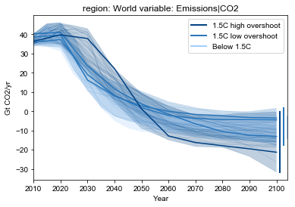
A toolbox for scenario analysis & visualization
The pyam package enables streamlined processing of results
as well as versatile exploration, analysis and visualization tools
Requirement 1:
  Standardized, scripted, version-controlled, unit-tested workflow
  to efficiently get from raw model output to processed results
  e.g., aggregate over sectors & regions using context-specific methods
  (sum, weighted average, min/max)
  Validation and consistency checking
Requirement 2:
  Exploration and analysis of results
  in a reproducible & transparent manner
Carbon dioxide emissions across 1.5°C pathways
SPM 3a, IPCC SR15 | doi: 10.22022/SR15/08-2018.15428
url: https://data.ene.iiasa.ac.at/sr15_scenario_analysis/

Slide 10

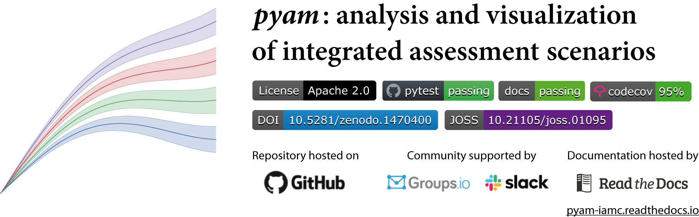

pyam: a Python package for scenario analysis
To facilitate the validation and assessment of scenario results,
we developed a dedicated open-source package
Aim: develop a package for scenario analysis & visualization
following best practice of collaborative scientific software development
Features:
      Analysis & validation
      Categorization & indicators
      Visualization features
      Statistics package
More information:
    Documentation: pyam-iamc.readthedocs.io
    Scientific reference: M. Gidden and D. Huppmann (2019).
    Journal of Open Source Software 4(33):1095.
    doi: 10.21105/joss.01095
#pyam_iamc

Slide 11
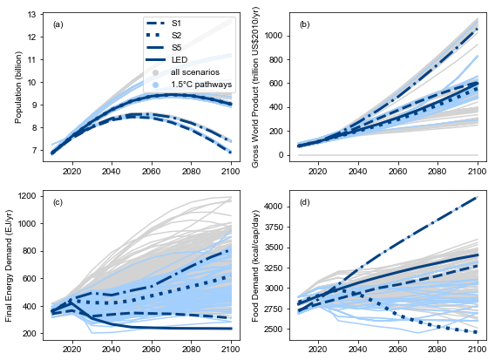

pyam: supporting the IPCC SR15 assessment
Many figures & tables in the SR15 were created with pyam
Check out the open-source notebooks – transparent & reproducible!
The IPCC Special Report on Global Warming of 1.5°C
Range of assumptions about socio-economic drivers
and projections for energy and food demand
More information on open tools & resources
supporting the IPCC SR15
www.ipcc.ch/sr15
Figure 2.4, page 111, SR15

Slide 12


The key components for model integration
In the openENTRANCE project, we aim to develop
an ecosystem of models & tools for decarbonization pathways
Model integration requires a common nomenclature
    i.e., naming conventions, definitions, list of regions
  We started a collaborative process on GitHub
  to facilitate an open discussion and a clear history of changes.
  Implemented as yaml-format dictionary files
  to balance (human) readability vs. machine processability
  Final Energy:
  description: Total final energy consumption by all end-use sectors and all fuels,
  excluding transmission/distribution losses
  unit: EJ/yr
  More info github.com/openENTRANCE/nomenclature

Slide 13


My view on the road ahead for energy modelling
Open science has to go beyond open source…
In an IIASA nexus blog post published a few weeks ago…
  I discuss how open-source scientific software and
  FAIR data can bring us a step closer to a community of open science
    https://blog.iiasa.ac.at/
More information on my lectures at TU Wien (VU 370.062)
    https://data.ene.iiasa.ac.at/teaching (including recording of some lectures)
My plea to the audience of this seminar
  Contribute to other work rather than develop new models!
  Follow best-practice of scientific software dev & FAIR principles!

Slide 14
Curious about the pyam package?
Read the docs on pyam-iamc.readthedocs.io
Want to learn more about the IPCC SR15
scenario ensemble & assessment?
Read our commentary in Nature Climate Change
at https://rdcu.be/9i8a
Dr. Daniel Huppmann
Research Scholar – Energy Program
International Institute for Applied Systems Analysis (IIASA)
Laxenburg, Austria
huppmann@iiasa.ac.at
@daniel_huppmann
http://www.iiasa.ac.at/staff/huppmann

Slide 15




The IAMC template for timeseries data
A community standard for compiling scenario results
Over the past decade, the integrated-assessment community (IAMC)
developed a tabular data format for model inter-comparison projects
  High-profile use case: IPCC Reports (AR5, SR15)
  Used by ~50 research teams globally
It’s not a great standard...
  No direct metadata, no sub-annual time resolution (yet), scalability issues, ...
  But it’s easy to work with for non-experts, across platforms,
  and there is plenty of existing infrastructure to work with this format
 | A | B | C | D | E | F | G | H | I
1 | Model | Scenario | Region | Variable | Unit | 2005 | 2010 | 2015 | 2020
2 | MESSAGE | CD-LINKS 400 | World | Primary Energy | EJ/y | 454.5 | 479.6 | ... | ...
Notes:
FAIR: Interoperable

Slide 16
The “variable” column
The IAMC data format uses the “variable” column
to implement a semi-hierarchical structure
The “variable” column can be used to implement a hierarchical tree
      Aggregate: Primary Energy
      Subcategory: Primary Energy|Coal
      Further detail: Primary Energy|Coal|w/CCS
  The pyam package offers many tools to work with such hierarchical trees
    df.filter(variable=‘Primary Energy*’, level=1)
    df.aggregate(variable=‘Primary Energy’)
Read the docs for more information:
  https://pyam-iamc.readthedocs.io/en/stable/data.html

Slide 17
Good practice for scenarios ensemble analysis
As part of the effort supporting the IPCC SR15 assessment,
we wrote a list of “do’s and don’ts” for model/scenario comparison
A user’s guide to the analysis and interpretation of (unstructured) scenario ensembles
Don’t interpret the scenario ensemble as a statistical sample or as likelihood/agreement. Don’t focus only on the medians, but consider the full range over the scenario set. Don’t cherry-pick individual scenarios to make general conclusions. Don’t over-interpret scenario results and don’t venture too far from the original question. Don’t conclude that the absence of a particular scenario (necessarily) means that this scenario is not feasible or possible.
Based on Box 1, Huppmann et al., Nature Climate Change 8:1027-1030 (2018).
doi: 10.1038/s41558-018-0317-4 | open-access version: https://rdcu.be/9i8a

