Slide 1






LACO-Wiki: An Online Tool for Land Cover Validation and Area Estimation
Linda See, Christoph Perger, Christoper Dresel, Juan Carlos Laso Bayas, Steffen Fritz and Jürgen Weichselbaum

Slide 2
LACO-Wiki
Aims:
Provide an open land cover validation platform for users
Make it as simple, yet powerful as possible and offer guidance and reproducibility
Build an open database for training and validation to improve future land cover and land use maps
http://www.laco-wiki.net/

Slide 3
Potential Users of LACO-Wiki
Scientific research
  Many land cover maps published
  Many PhD students creating maps as part of their research
Education
Map production
  Potential for sharing of maps/reference data in areas of data sparsity
Map validation
  Recommended for use by EEA member countries in validating local layers

Slide 4
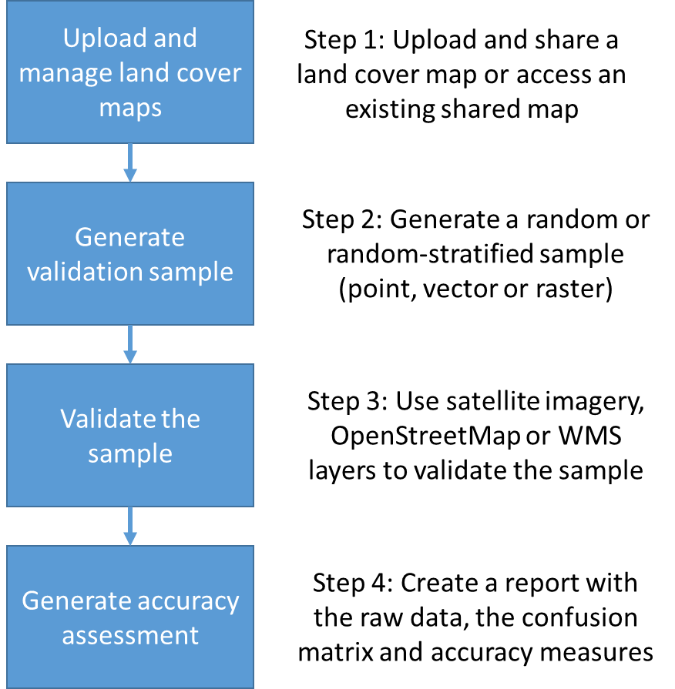
Basic Validation Workflow

Slide 5
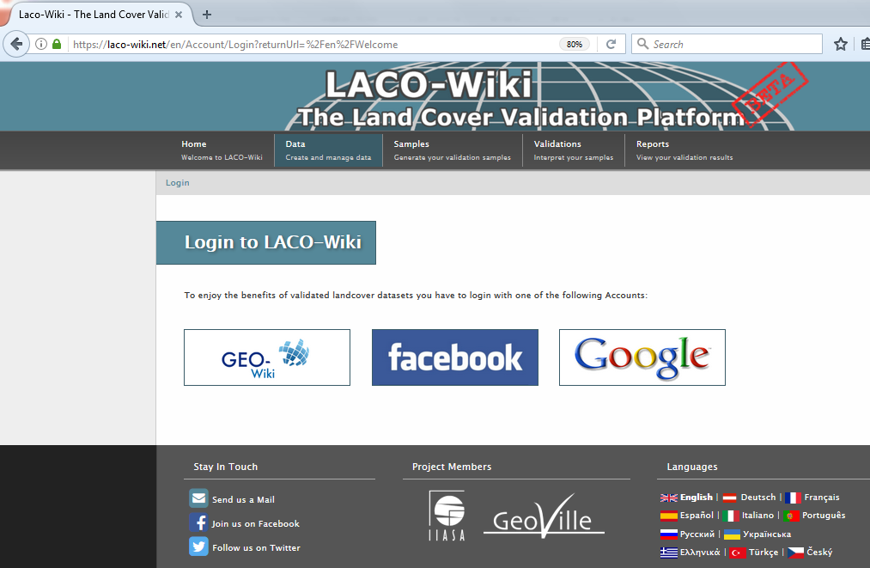
Logging in / Languages

Slide 6
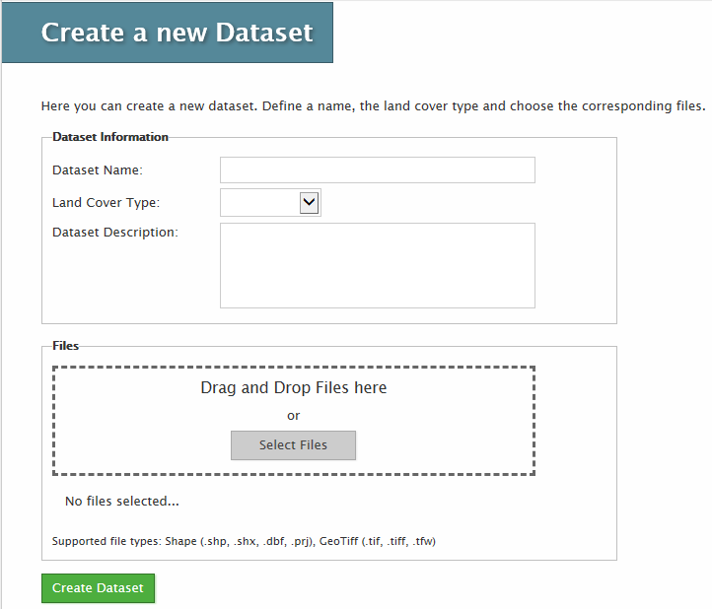
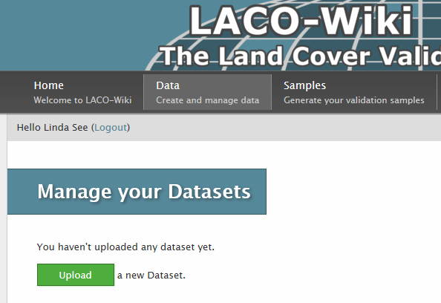
Step 1: Data Upload/Management

Slide 7
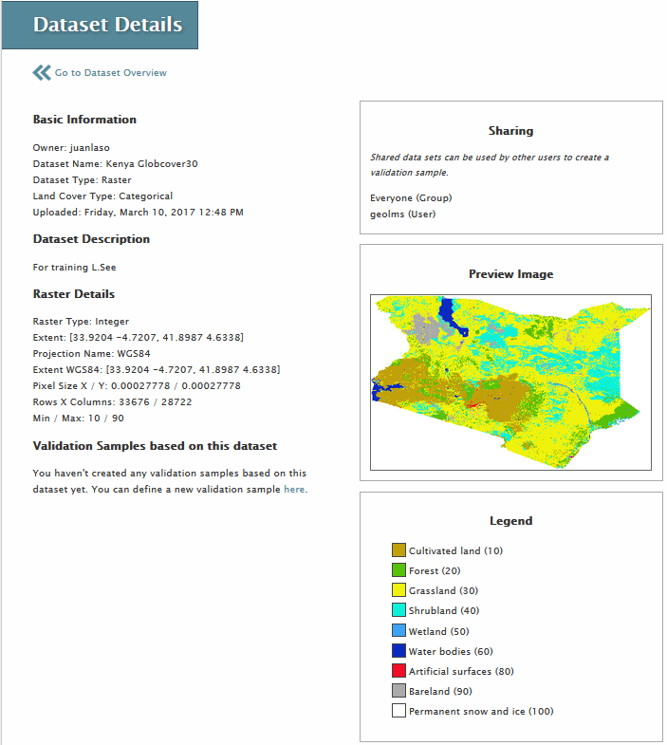
Sharing feature
Preview of the map
Legend

Slide 8
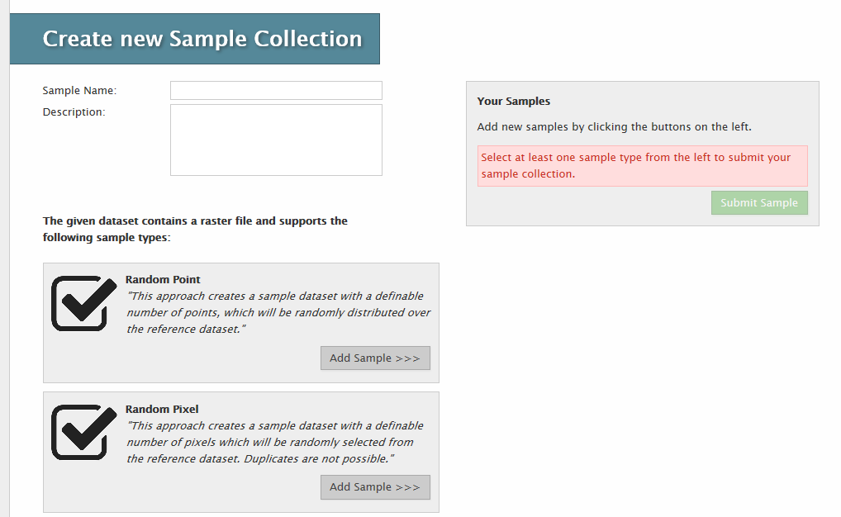
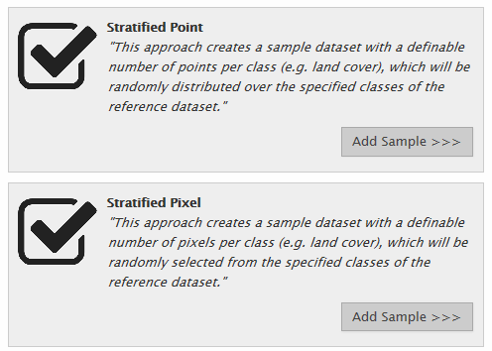
Step 2: Generate Samples

Slide 9
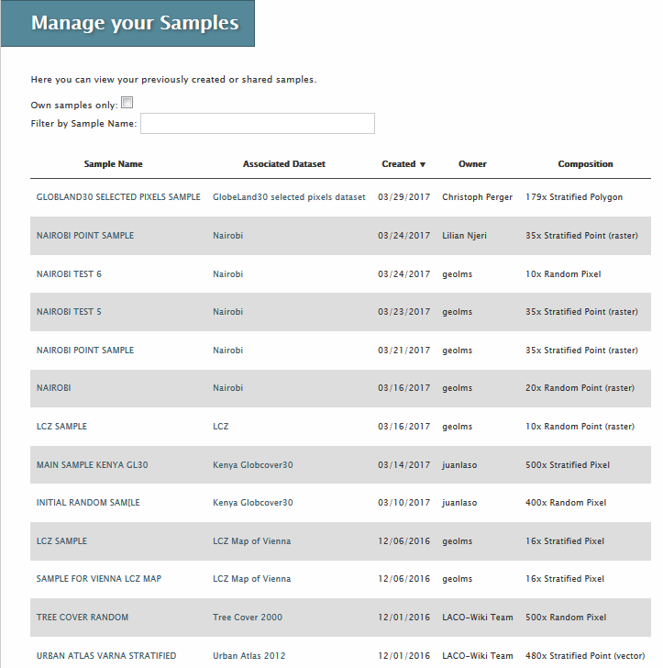
Show only your samples and filter by name

Slide 10
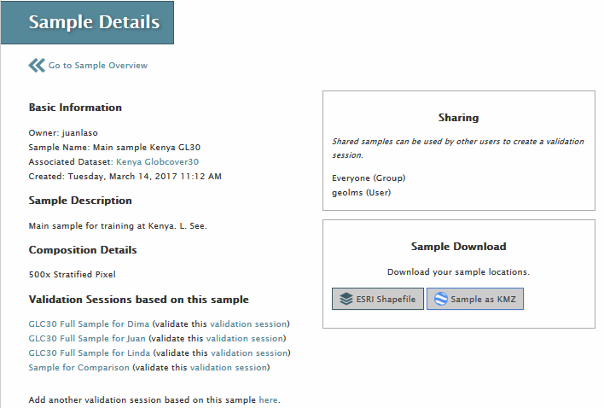
Sharing feature
Sample download
Create a validation session

Slide 11
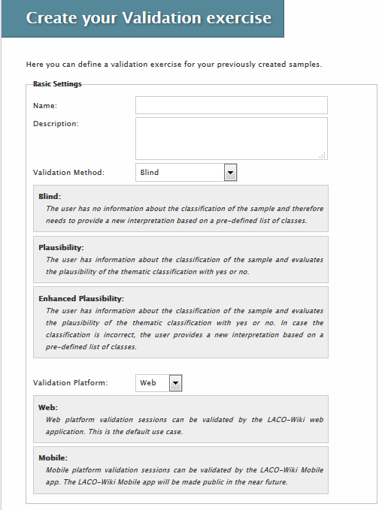
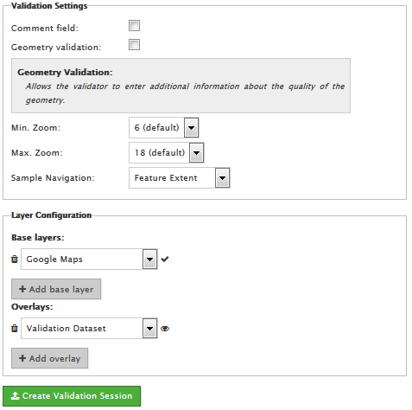
Step 3: Validate

Slide 12
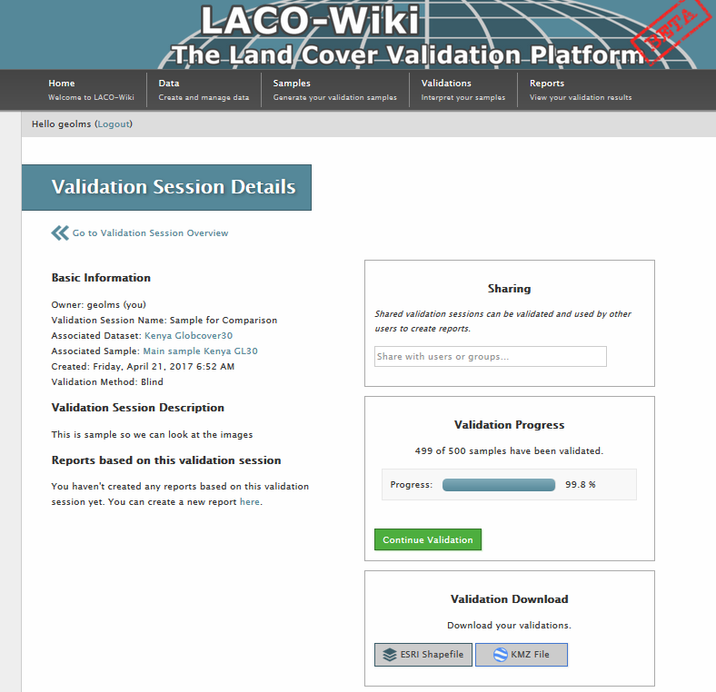
Sharing feature
Progress bar
Validation download

Slide 13
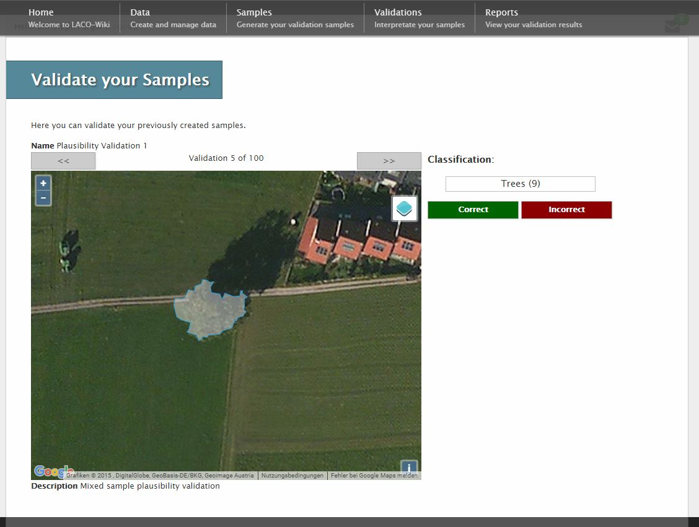

Slide 14
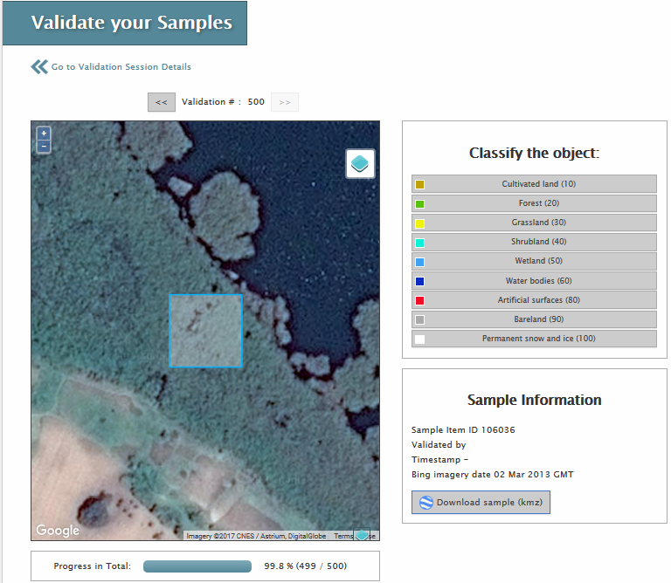
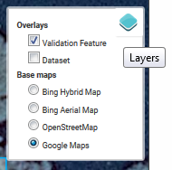
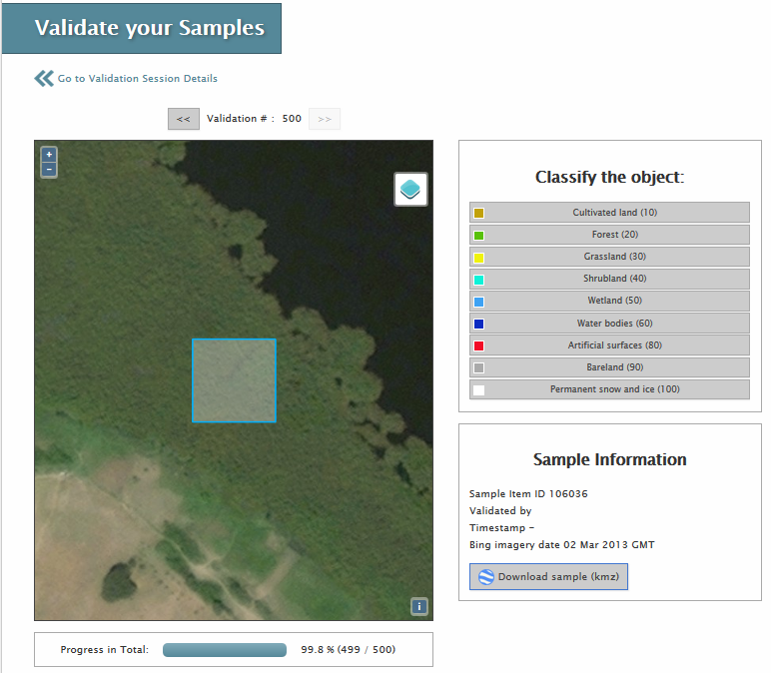

Slide 15
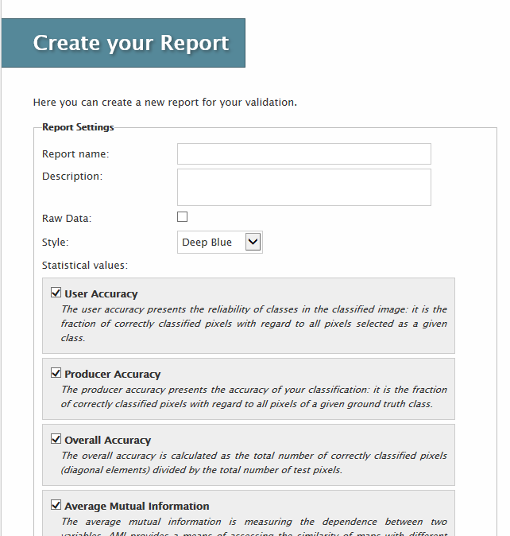
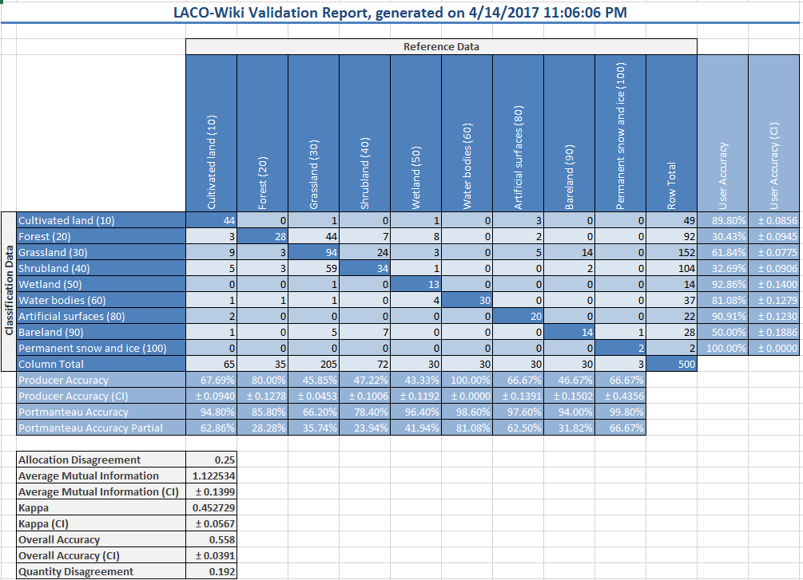
Step 4: View Results

Slide 16
Accuracy Assessment
Raw data / confusion matrix
Overall accuracy / errors of omission and commission
Kappa
Average Mutual Information (AMI)
Quantitative and Allocation Disagreement (Pontius and Millones, 2011)
We can add others based on user needs

Slide 17
New Features added Recently
ETRS1989 LAEA Support
Stratified vector sampling
RGB imagery upload and external WMS
Configurable validation sessions
KMZ export
Improved usability, more languages

Slide 18
Validation of GlobeLand30 for Kenya
Part of a larger validation of GlobeLand30 by GEO member states with NGCC
Two sample sets:
  Sample 1: LCSI clustering method and random sampling globally with 179 sample units in Kenya – upload existing sample
  Sample 2: Stratified random sample of 500 sample units – created in LACO-Wiki

Slide 19
Validation of GlobeLand30 for Kenya
3 interpreters, independently validated
Final samples were based on consensus
Summary | Sample 1 | Sample 2
Complete agreement between interpreters | 43.0% | 54.6%
2 out of 3 interpreters agreed | 49.7% | 41.0%
Complete disagreement | 7.3% | 4.4%
% of samples with 2 choices | 12.8% | 12.2%
% samples with Landsat resolution only | 17.8% | 17.8%
% samples within 2 years of 2010 | 83.7% | 85.1%

Slide 20
Dealing with Difficulties
Temporal:
  Recorded dates
  Used the historical archive in Google Earth
Spatial:
  Recorded presence/absence of Bing
  Recorded Landsat or similar resolution
Thematic
  used NDVI profiles to differentiate between Bareland and Grassland
Geometric Accuracy:
  Validated 3X3 pixels

Slide 21
Results for Sample 1
 |  | Interpreters
 |  | Artificial surfaces | Bareland | Cult. land | Forest | Grassland | Shrubland | Water bodies | Wetland | User. Acc. | +/- CI
GlobeLand30 | Artificial surfaces | 6 | 0 | 0 | 0 | 2 | 0 | 0 | 0 | 0.75 | 0.32
 | Bareland | 0 | 16 | 0 | 1 | 4 | 2 | 0 | 0 | 0.70 | 0.19
 | Cult. land | 0 | 0 | 13 | 4 | 5 | 1 | 0 | 0 | 0.57 | 0.21
 | Forest | 0 | 0 | 1 | 22 | 1 | 1 | 0 | 0 | 0.88 | 0.13
 | Grassland | 0 | 3 | 0 | 9 | 23 | 7 | 0 | 0 | 0.55 | 0.15
 | Shrubland | 0 | 5 | 0 | 8 | 3 | 25 | 0 | 0 | 0.61 | 0.15
 | Water bodies | 0 | 0 | 0 | 0 | 0 | 0 | 7 | 0 | 1.00 | 0.00
 | Wetland | 0 | 3 | 0 | 4 | 0 | 0 | 0 | 3 | 0.30 | 0.30
 | Prod Acc. | 1.00 | 0.59 | 0.93 | 0.46 | 0.61 | 0.69 | 1.00 | 1.00
 | +/- CI | 0.00 | 0.15 | 0.13 | 0.09 | 0.13 | 0.13 | 0.00 | 0.00
Overall accuracy = 0.64 ± 0.068

Slide 22
Results for Sample 2
 |  | Interpreters
 |  | Artificial surfaces | Bareland | Cult. land | Forest | Grassland | P. snow and ice | Shrubland | Water bodies | Wetland |  | User Acc. | +/- CI
GlobeLand30 | Artificial surfaces | 22 | 0 | 1 | 1 | 5 | 0 | 1 | 0 | 0 |  | 0.73 | 0.16
 | Bareland | 0 | 26 | 0 | 0 | 3 | 0 | 1 | 0 | 0 |  | 0.87 | 0.12
 | Cult. land | 2 | 0 | 45 | 3 | 9 | 0 | 5 | 1 | 0 |  | 0.69 | 0.11
 | Forest | 0 | 0 | 0 | 30 | 3 | 0 | 1 | 0 | 1 |  | 0.86 | 0.12
 | Grassland | 0 | 6 | 1 | 37 | 105 | 0 | 54 | 0 | 2 |  | 0.51 | 0.07
 | P. snow and ice | 0 | 1 | 0 | 0 | 0 | 2 | 0 | 0 | 0 |  | 0.67 | 0.65
 | Shrubland | 0 | 6 | 0 | 4 | 20 | 0 | 42 | 0 | 0 |  | 0.58 | 0.11
 | Water bodies | 0 | 0 | 0 | 0 | 0 | 0 | 0 | 30 | 0 |  | 1.00 | 0.00
 | Wetland | 0 | 0 | 0 | 6 | 1 | 0 | 0 | 4 | 19 |  | 0.63 | 0.18
 | Prod Acc. | 0.25 | 0.52 | 0.97 | 0.41 | 0.77 | 1.00 | 0.40 | 0.88 | 0.25
 | +/- CI | 0.26 | 0.14 | 0.05 | 0.07 | 0.06 | 0.00 | 0.07 | 0.17 | 0.22
Overall accuracy = 0.60 ± 0.046 and weighted by area

Slide 23
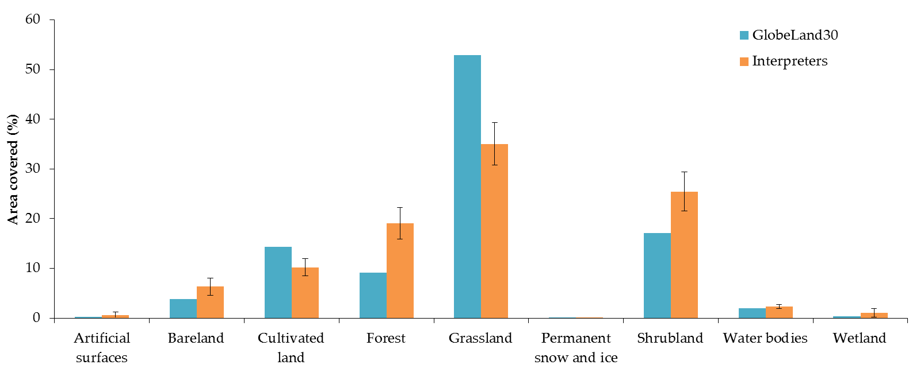
Area Estimates (Sample 2)

Slide 24
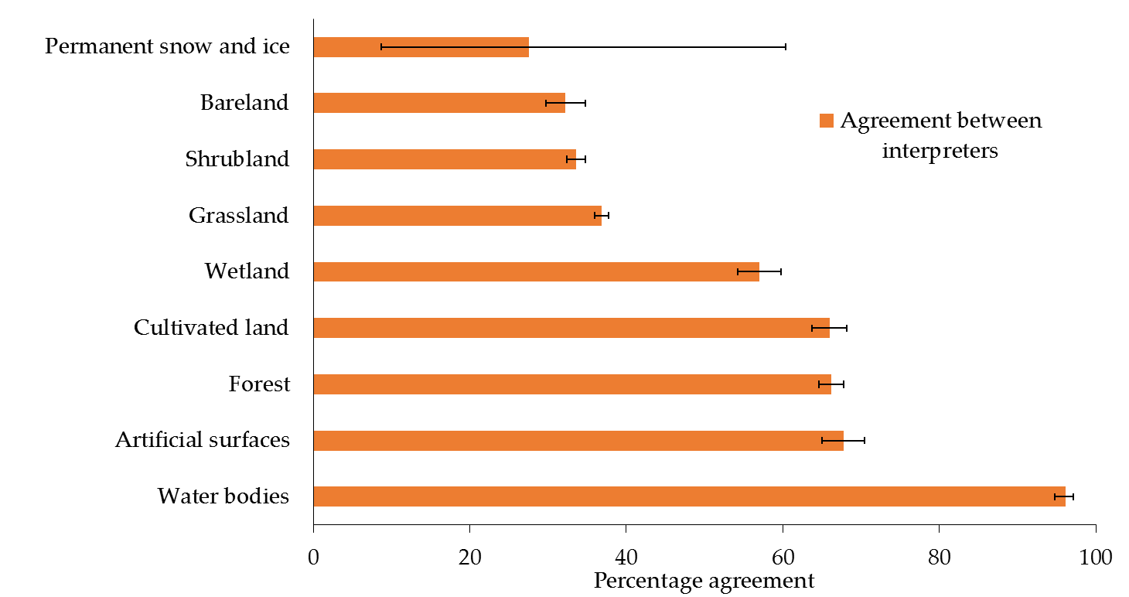
Agreement between Interpreters
Agreement = f(land cover type, sample, very high res imagery, year of the imagery)
Local knowledge?

Slide 25
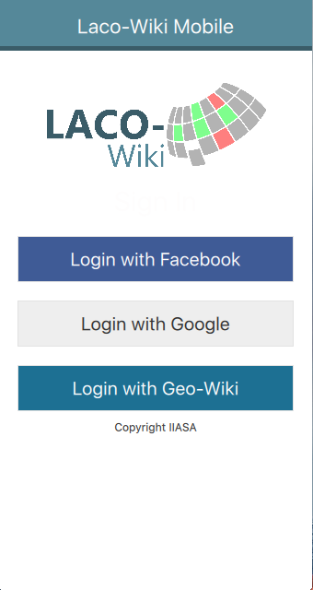
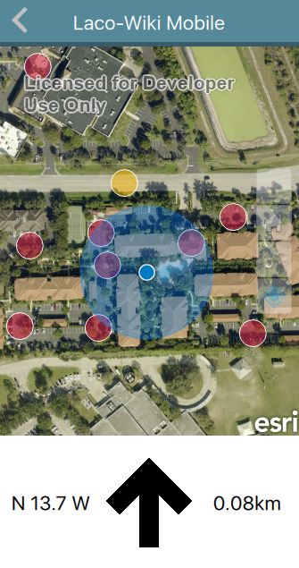
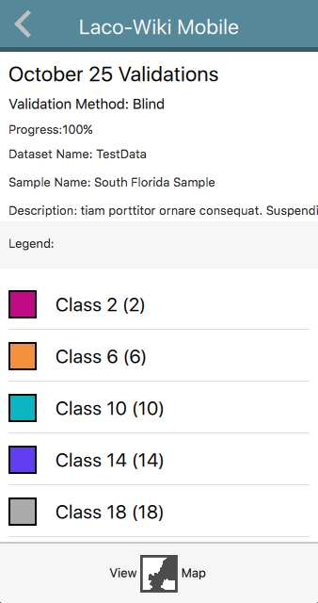
In-situ component – LACO-Wiki Mobile
Based on the idea of FotoQuestGo

Slide 26
Ongoing and Future Work
Systematic sampling / area of interest sampling and area estimation
NDVI tool
Additional layers from which samples can be created, e.g. global land cover maps
Additional features such as geo-tagged photographs
Campaign functionality (LandSense project)
Features required by users

Slide 27
Thank you!
http://www.laco-wiki.net/
see@iiasa.ac.at
fritz@iiasa.ac.at

