Slide 1



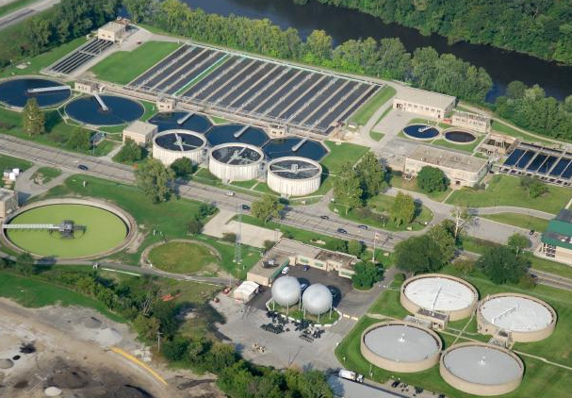
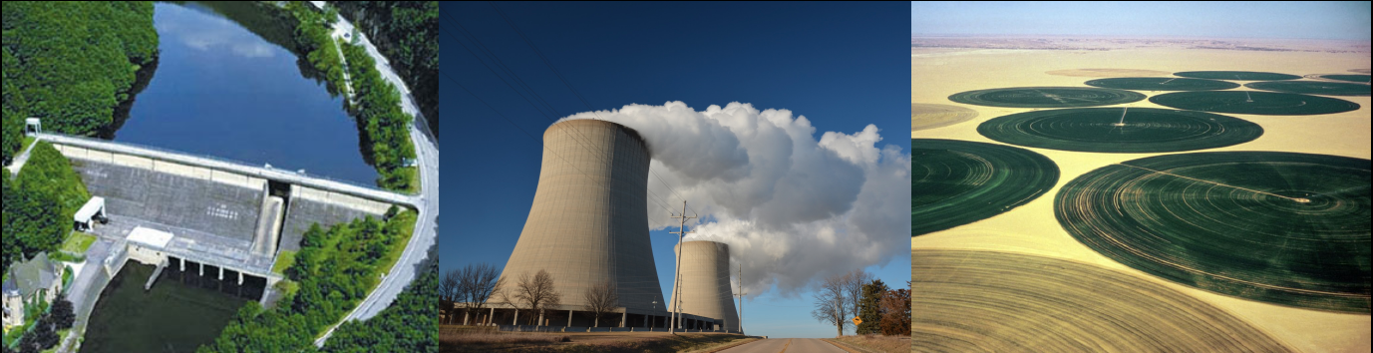
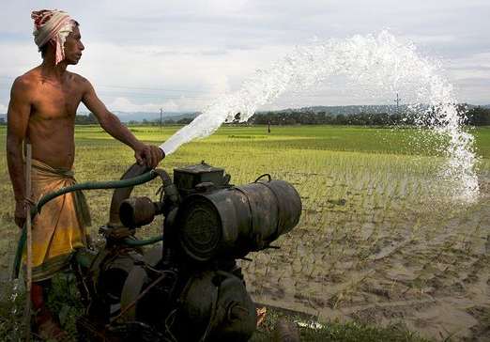
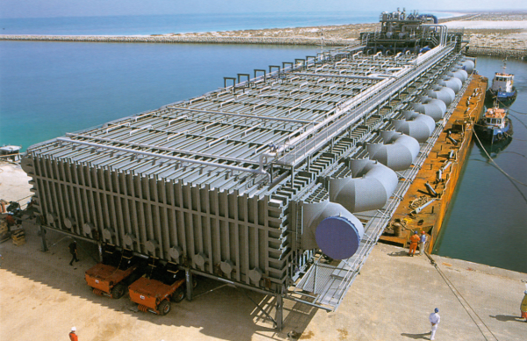
Integrated assessment of water-energy-land nexus solutions for the Indus River Basin
Lahore University of Management Sciences
Simon Parkinson, Adriano Vinca, Ansir Ilyas, and Edward Byers
INFORMS 2018 Annual Meeting (Invited Presentation)

Slide 2


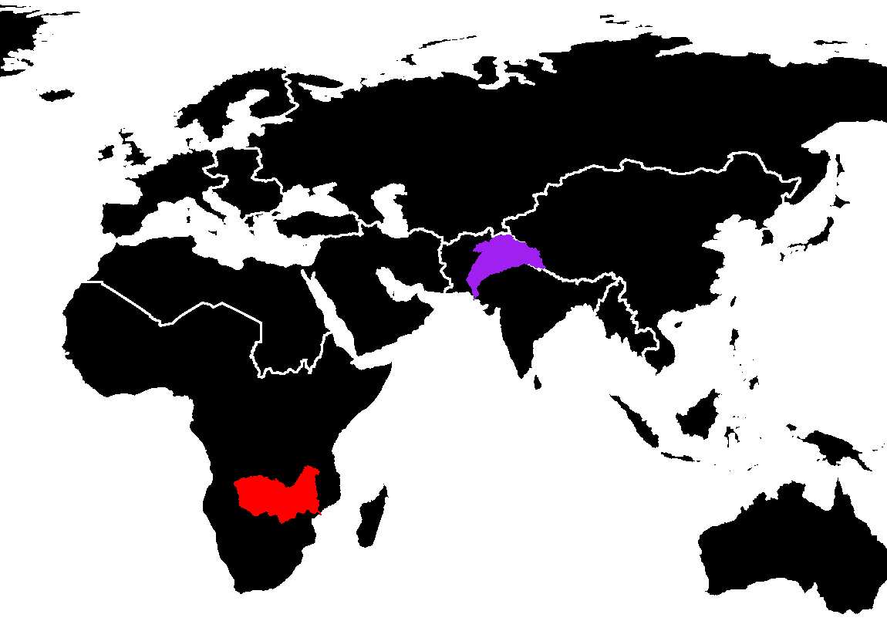
Context:
Integrated Solutions for the Water-Energy Land Nexus Project
3-year initiative funded by GEF and UNIDO (1-year remaining)
Focus on model development, stakeholder engagement and capacity building
Case studies in the Indus and Zambezi basins
Indus
Zambezi

Slide 3
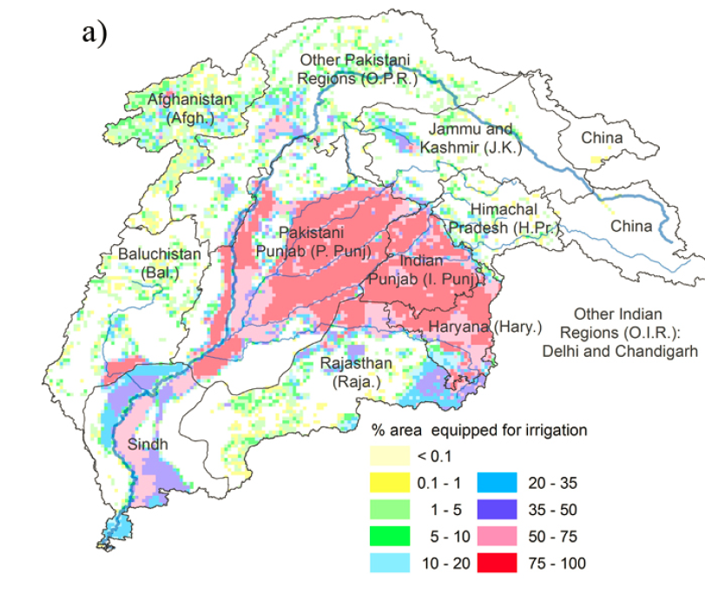
Nexus challenges for the Indus basin
Water, land and ecosystems
Transboundary disputes
Complex canal and irrigation system
Very little flow reaches the sea
Groundwater depletion and water storage
Lack of wastewater treatment
Energy systems
Electricity can be unreliable
Electricity can be too cheap
Planned expansion of coal
Hydropower generation
Livelihoods
Transformations and employment impacts
Laghari and others (2012)

Slide 4


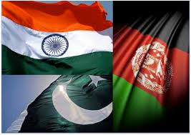


Integrated Policy Analysis
How to strike a balance between objectives?
… and at what cost?
SDGs
Transboundary Agreements
India
Afghanistan
Pakistan

Slide 5
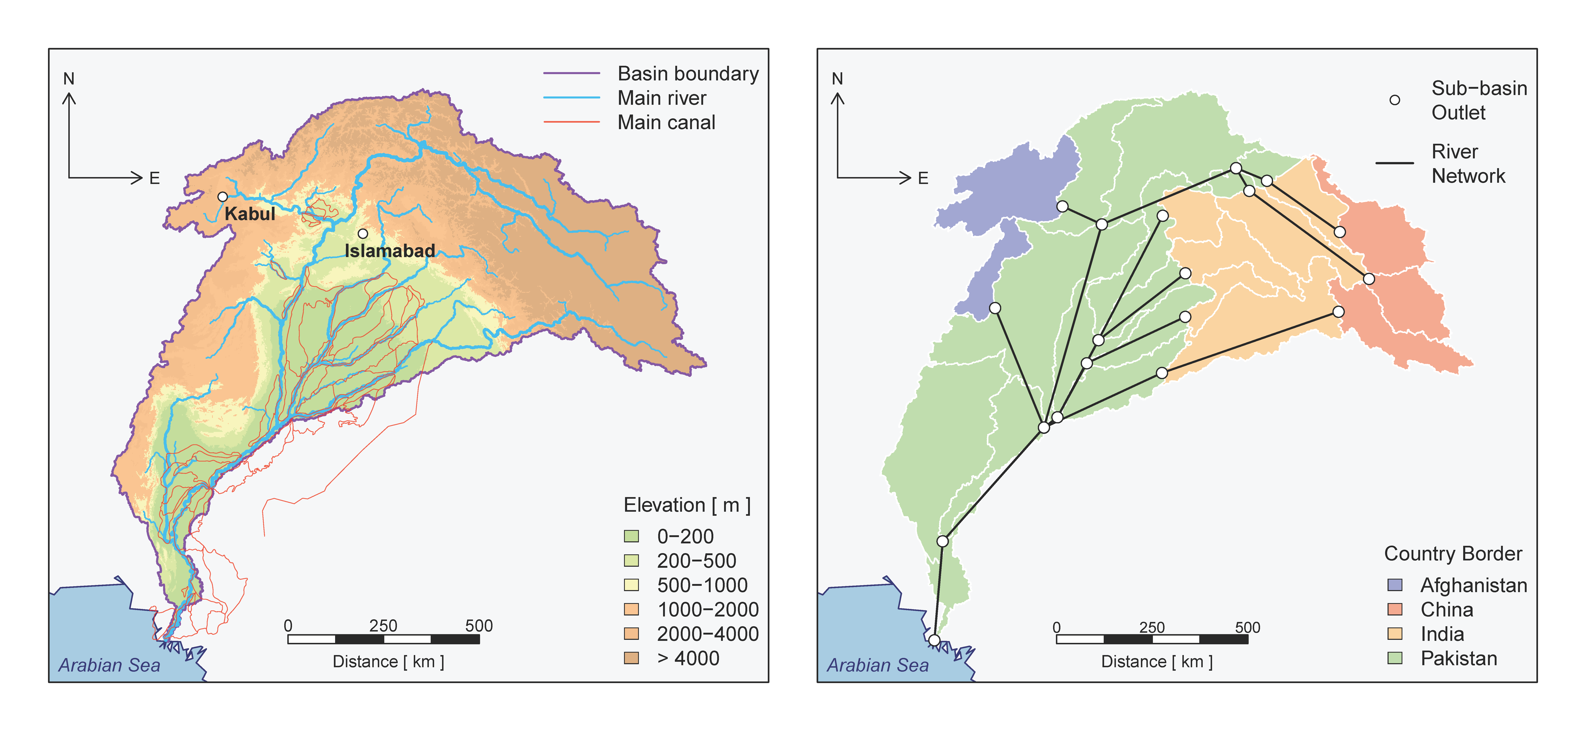
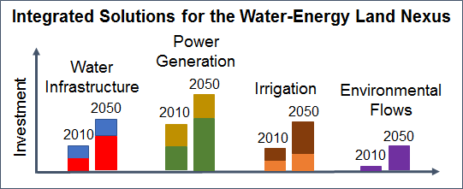
Multi-scale modeling for transforming systems
CWaTM
NExus Solutions Tools (NEST)
MESSAGE
Distributed Hydrology
Community Water Model (CWatM)
(Burek et al., 2018)
Surface and groundwater availability
Irrigation water requirements
Climate change impacts
Infrastructure Planning
MESSAGEix
(Huppmann et al., 2018)
Resource consumption
Infrastructure expansion
Economic and policy impacts
Upscaling
Water
Techs
Within each
spatial unit
Water constraints
Land
Techs
Energy
Techs
Minimize total system cost
Downscaling
Water and
land-use
Vinca et al., (forthcoming)

Slide 6
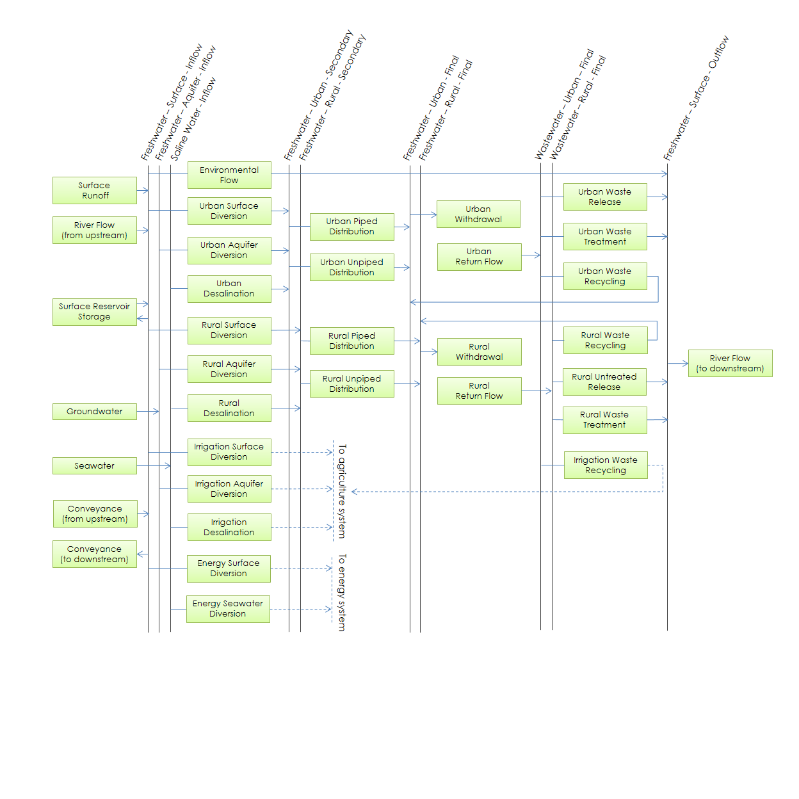
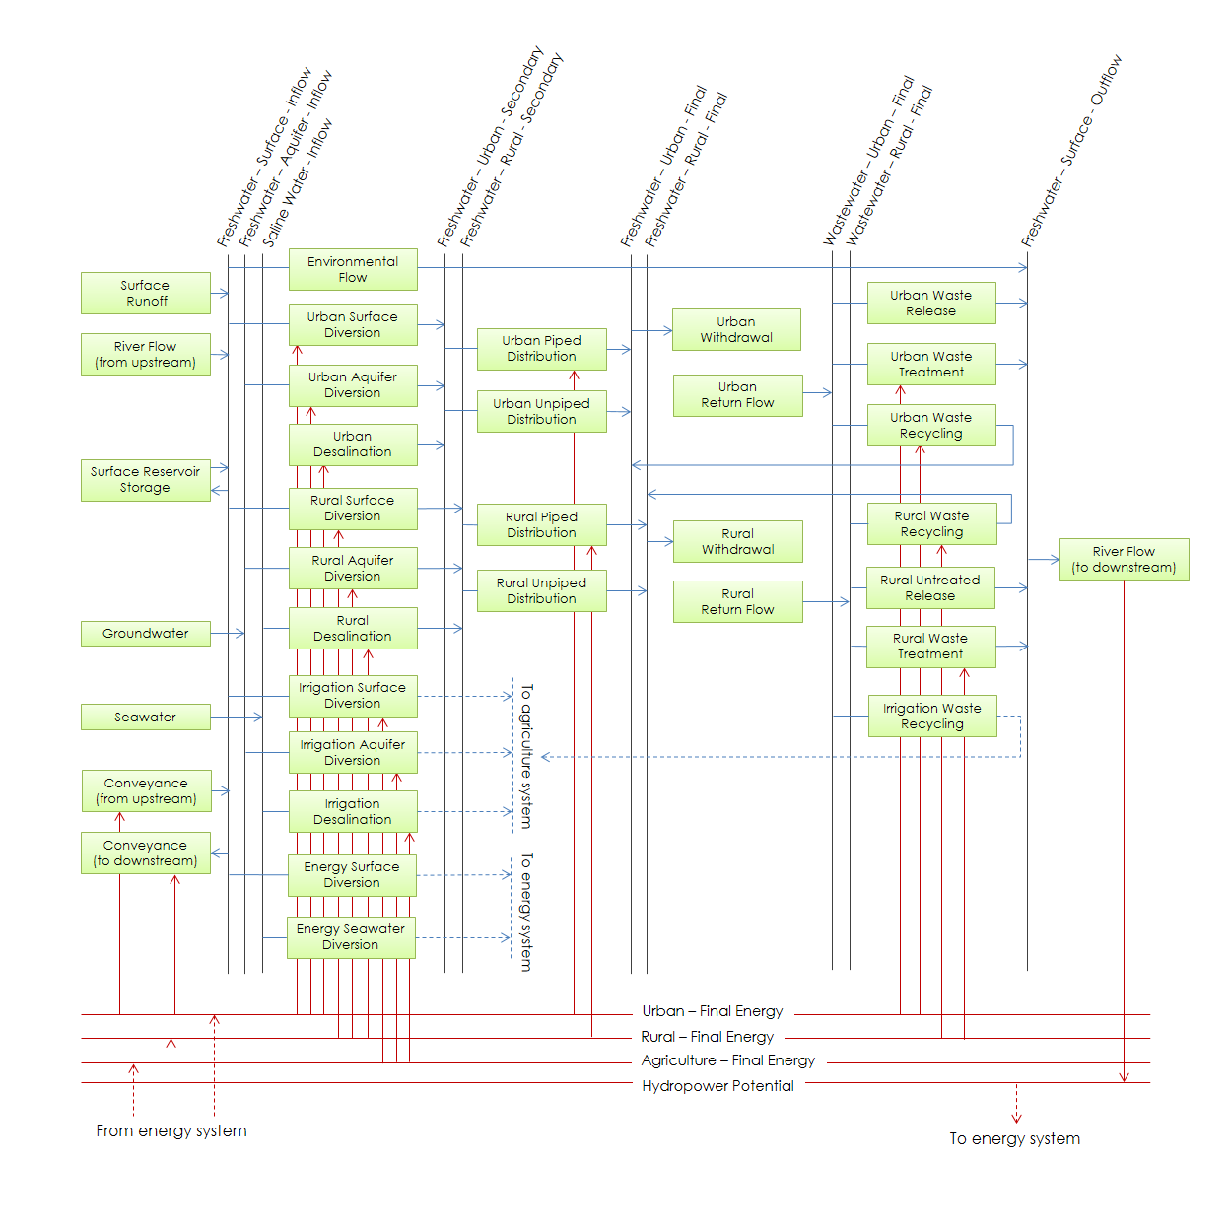
Water
System
Vinca et al., (forthcoming)

Slide 7
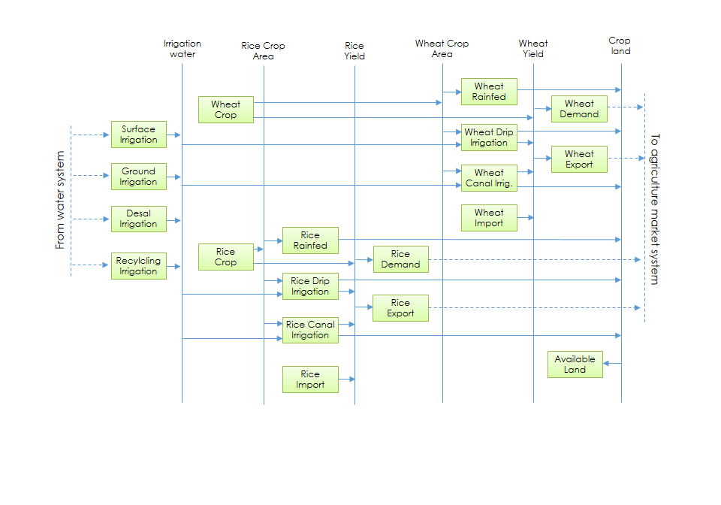
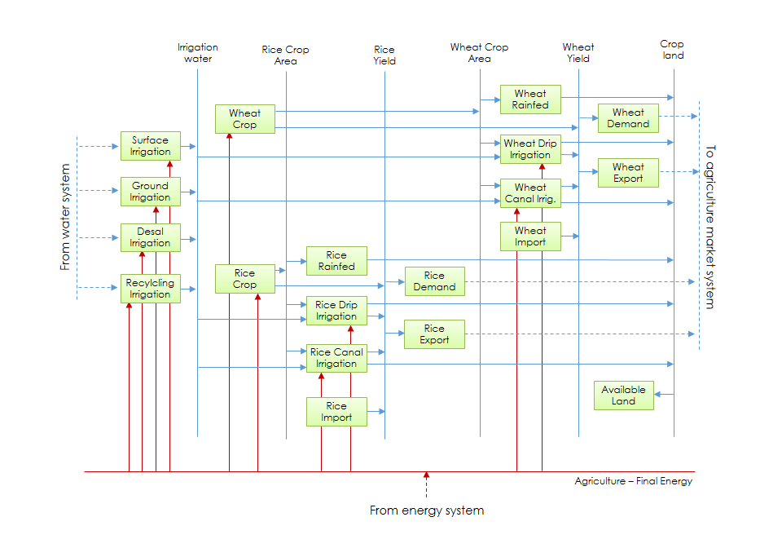
Crop
System
Vinca et al., (forthcoming)

Slide 8
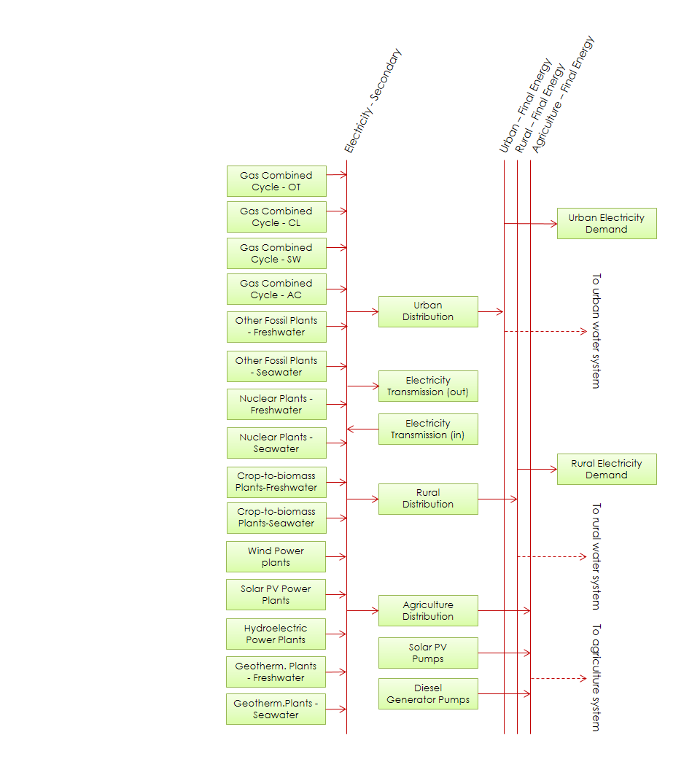
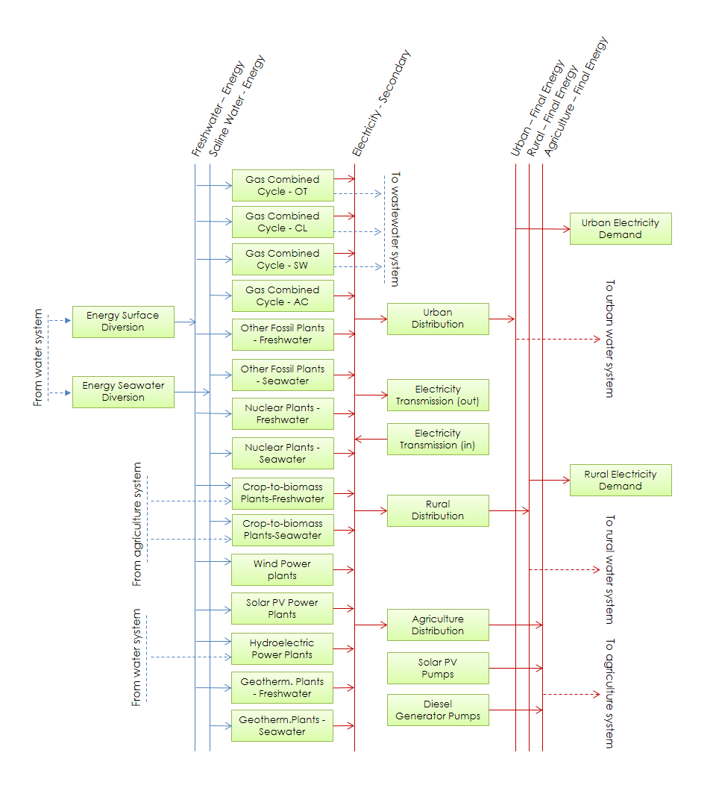
Energy
System
Vinca et al., (forthcoming)

Slide 9
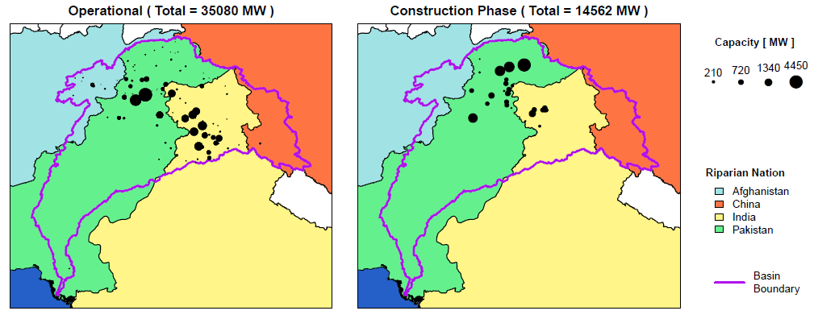
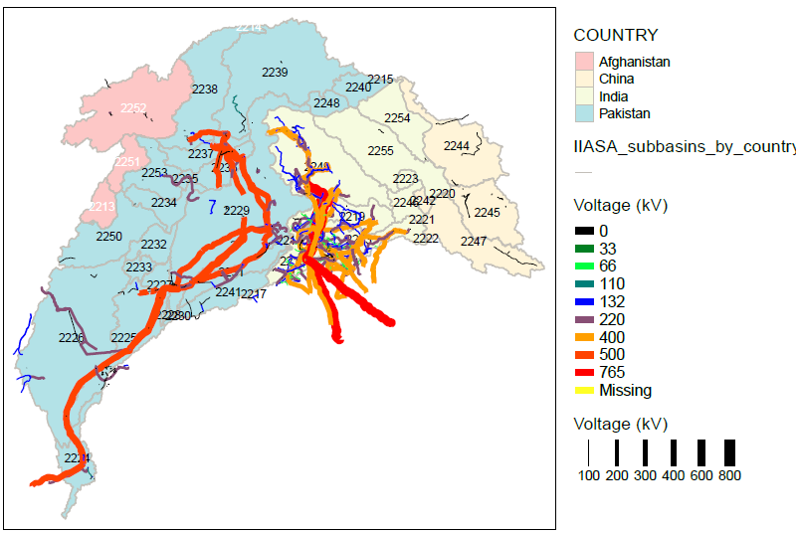
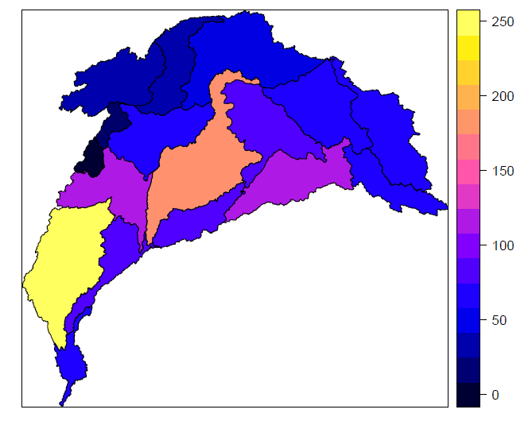
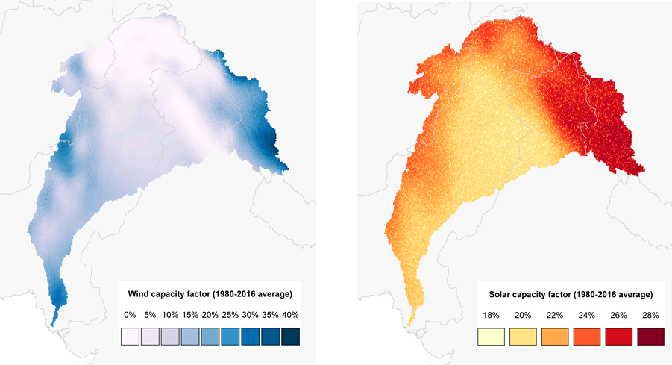
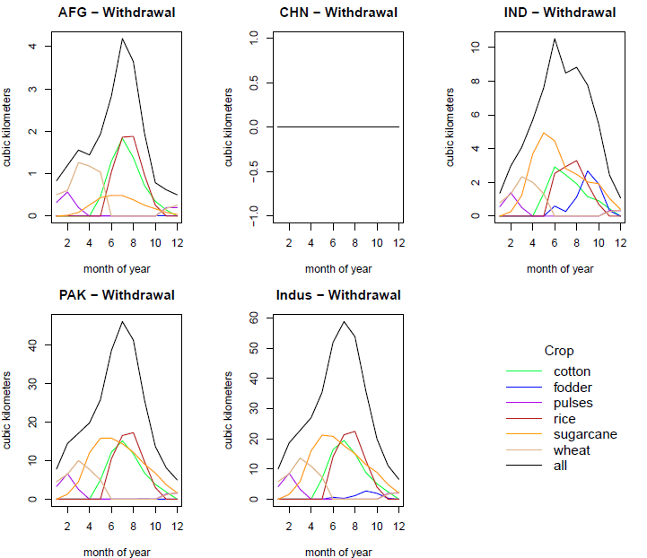
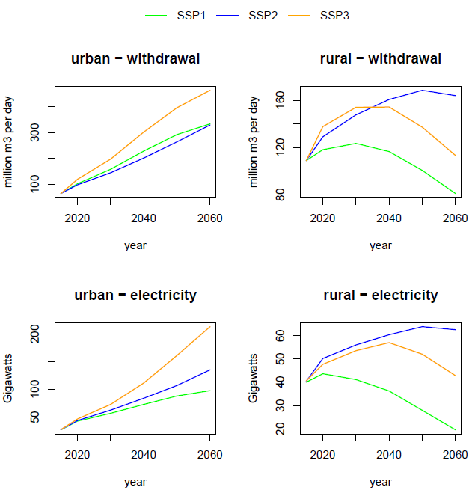
Preliminary results: do not cite or quote
Input data
Mapping infrastructure, potentials and policies
Power generation (existing and planned)
Transmission and road networks
Groundwater pumping capacity
Wind, PV and hydropower potentials
Urbanization pathways
Irrigation intensity
Indus water treaty allocations
Reservoirs (existing and planned)
Urban water transfers (e.g., Karachi)
Algorithms for model integration
Installed Hydropower Capacity
Wind and PV average capacity factor (based on hourly data)
Installed Transmission Capacity
Groundwater Pumping in 2010 [ billion cubic meters per year ]
Monthly irrigation withdrawals calibrated for 2015
Urban and rural water withdrawal and electricity demand

Slide 10
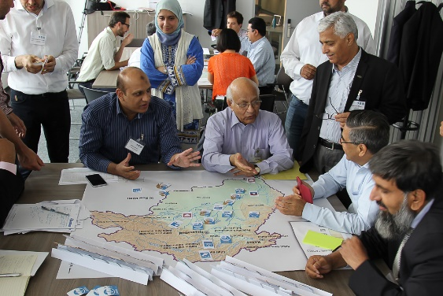





























Stakeholder Engagement
Events in Delhi, Lahore and Vienna

Slide 11
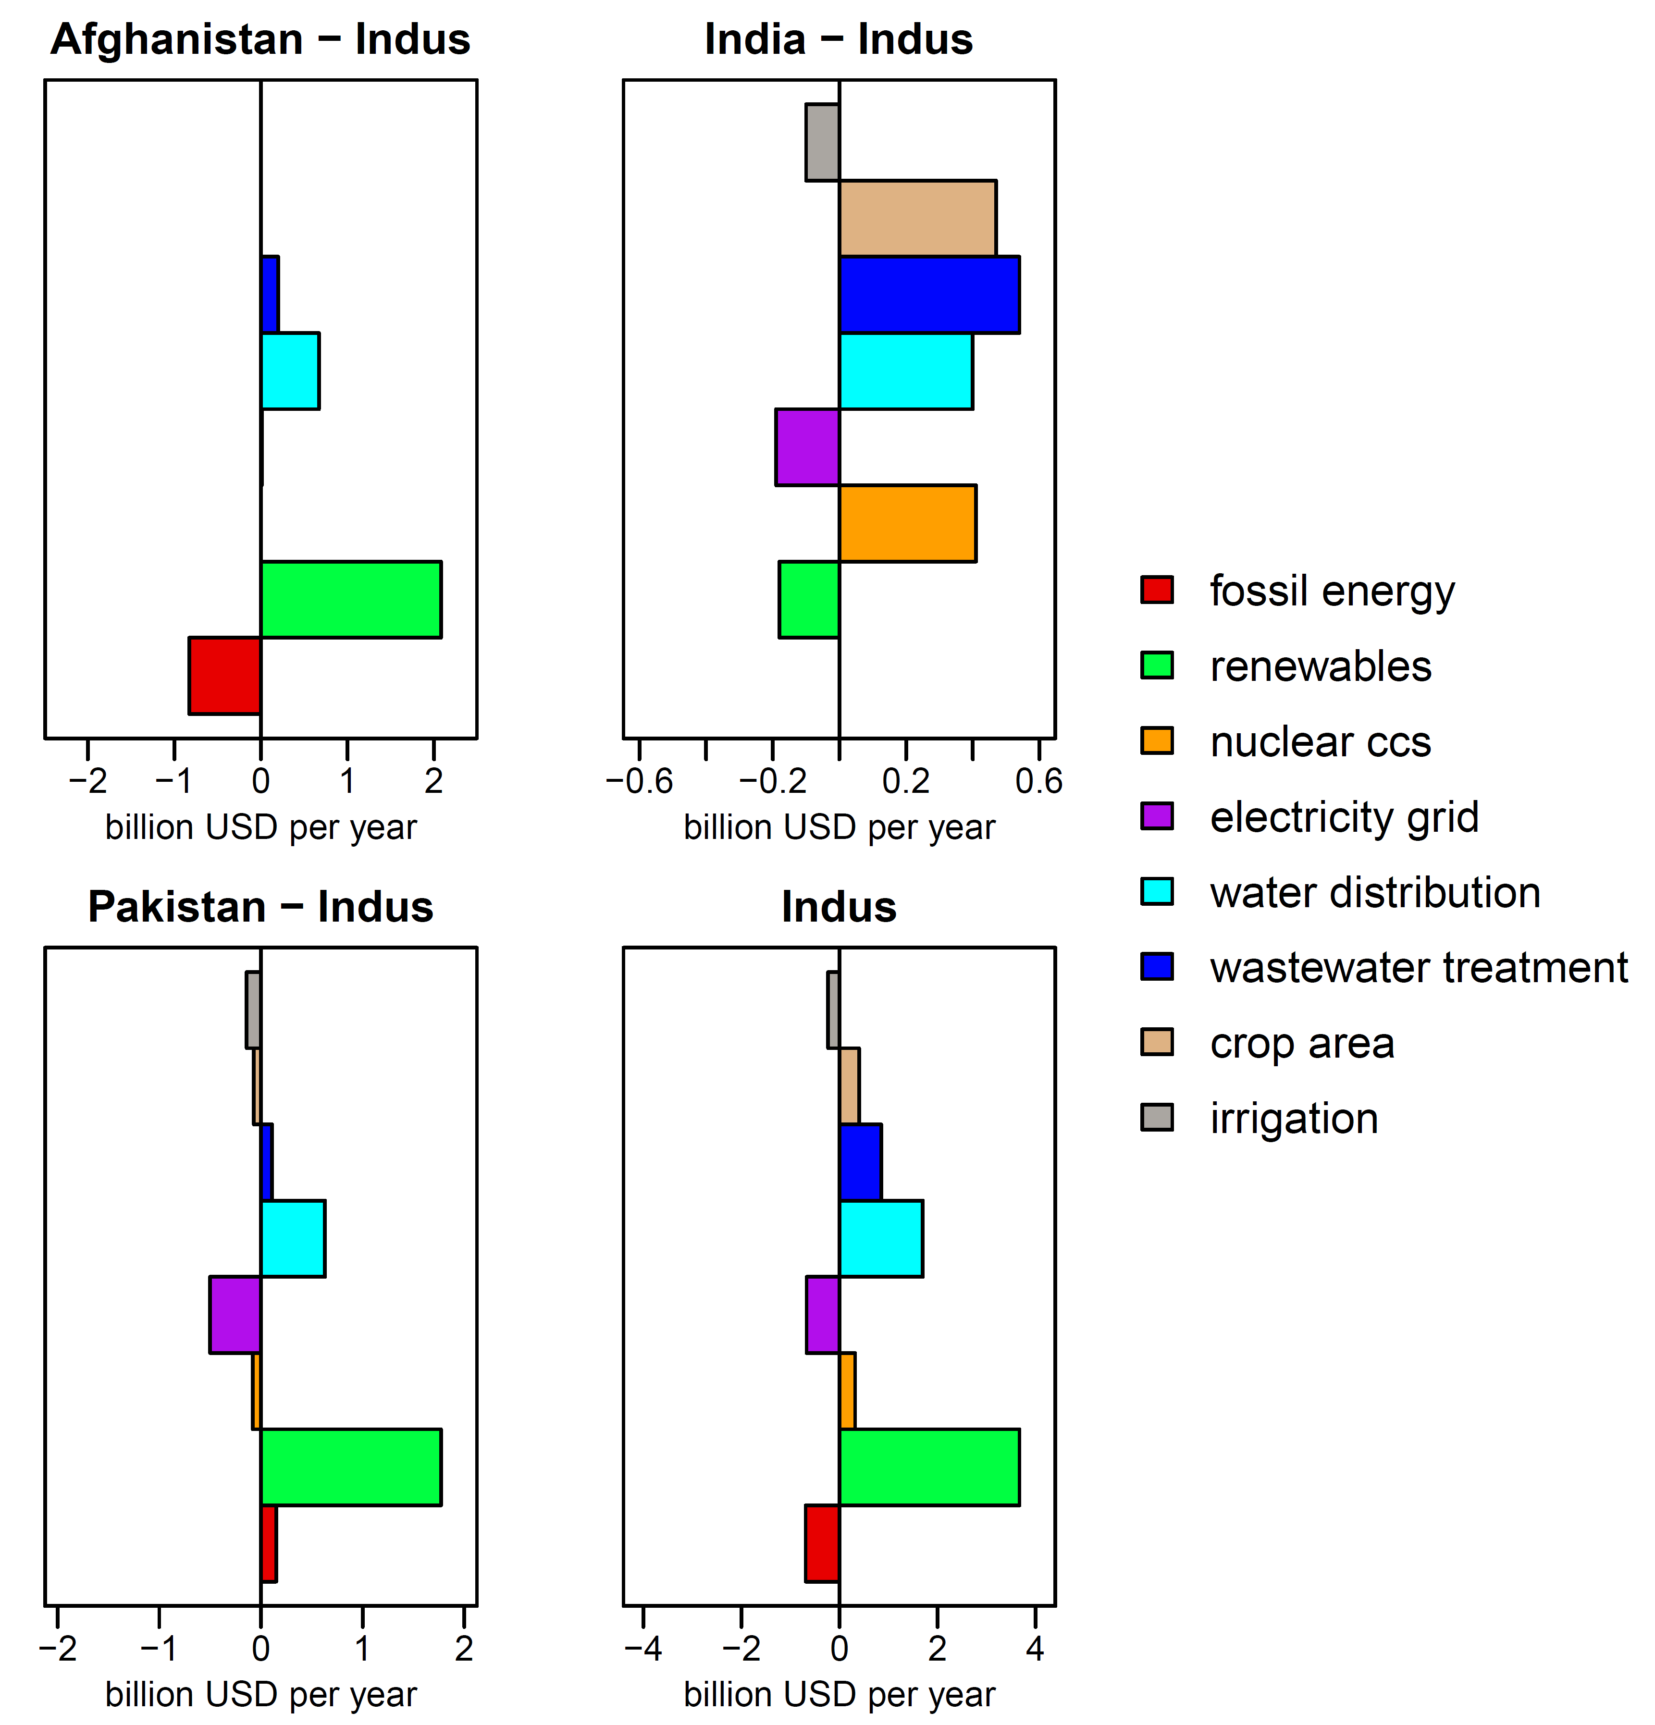
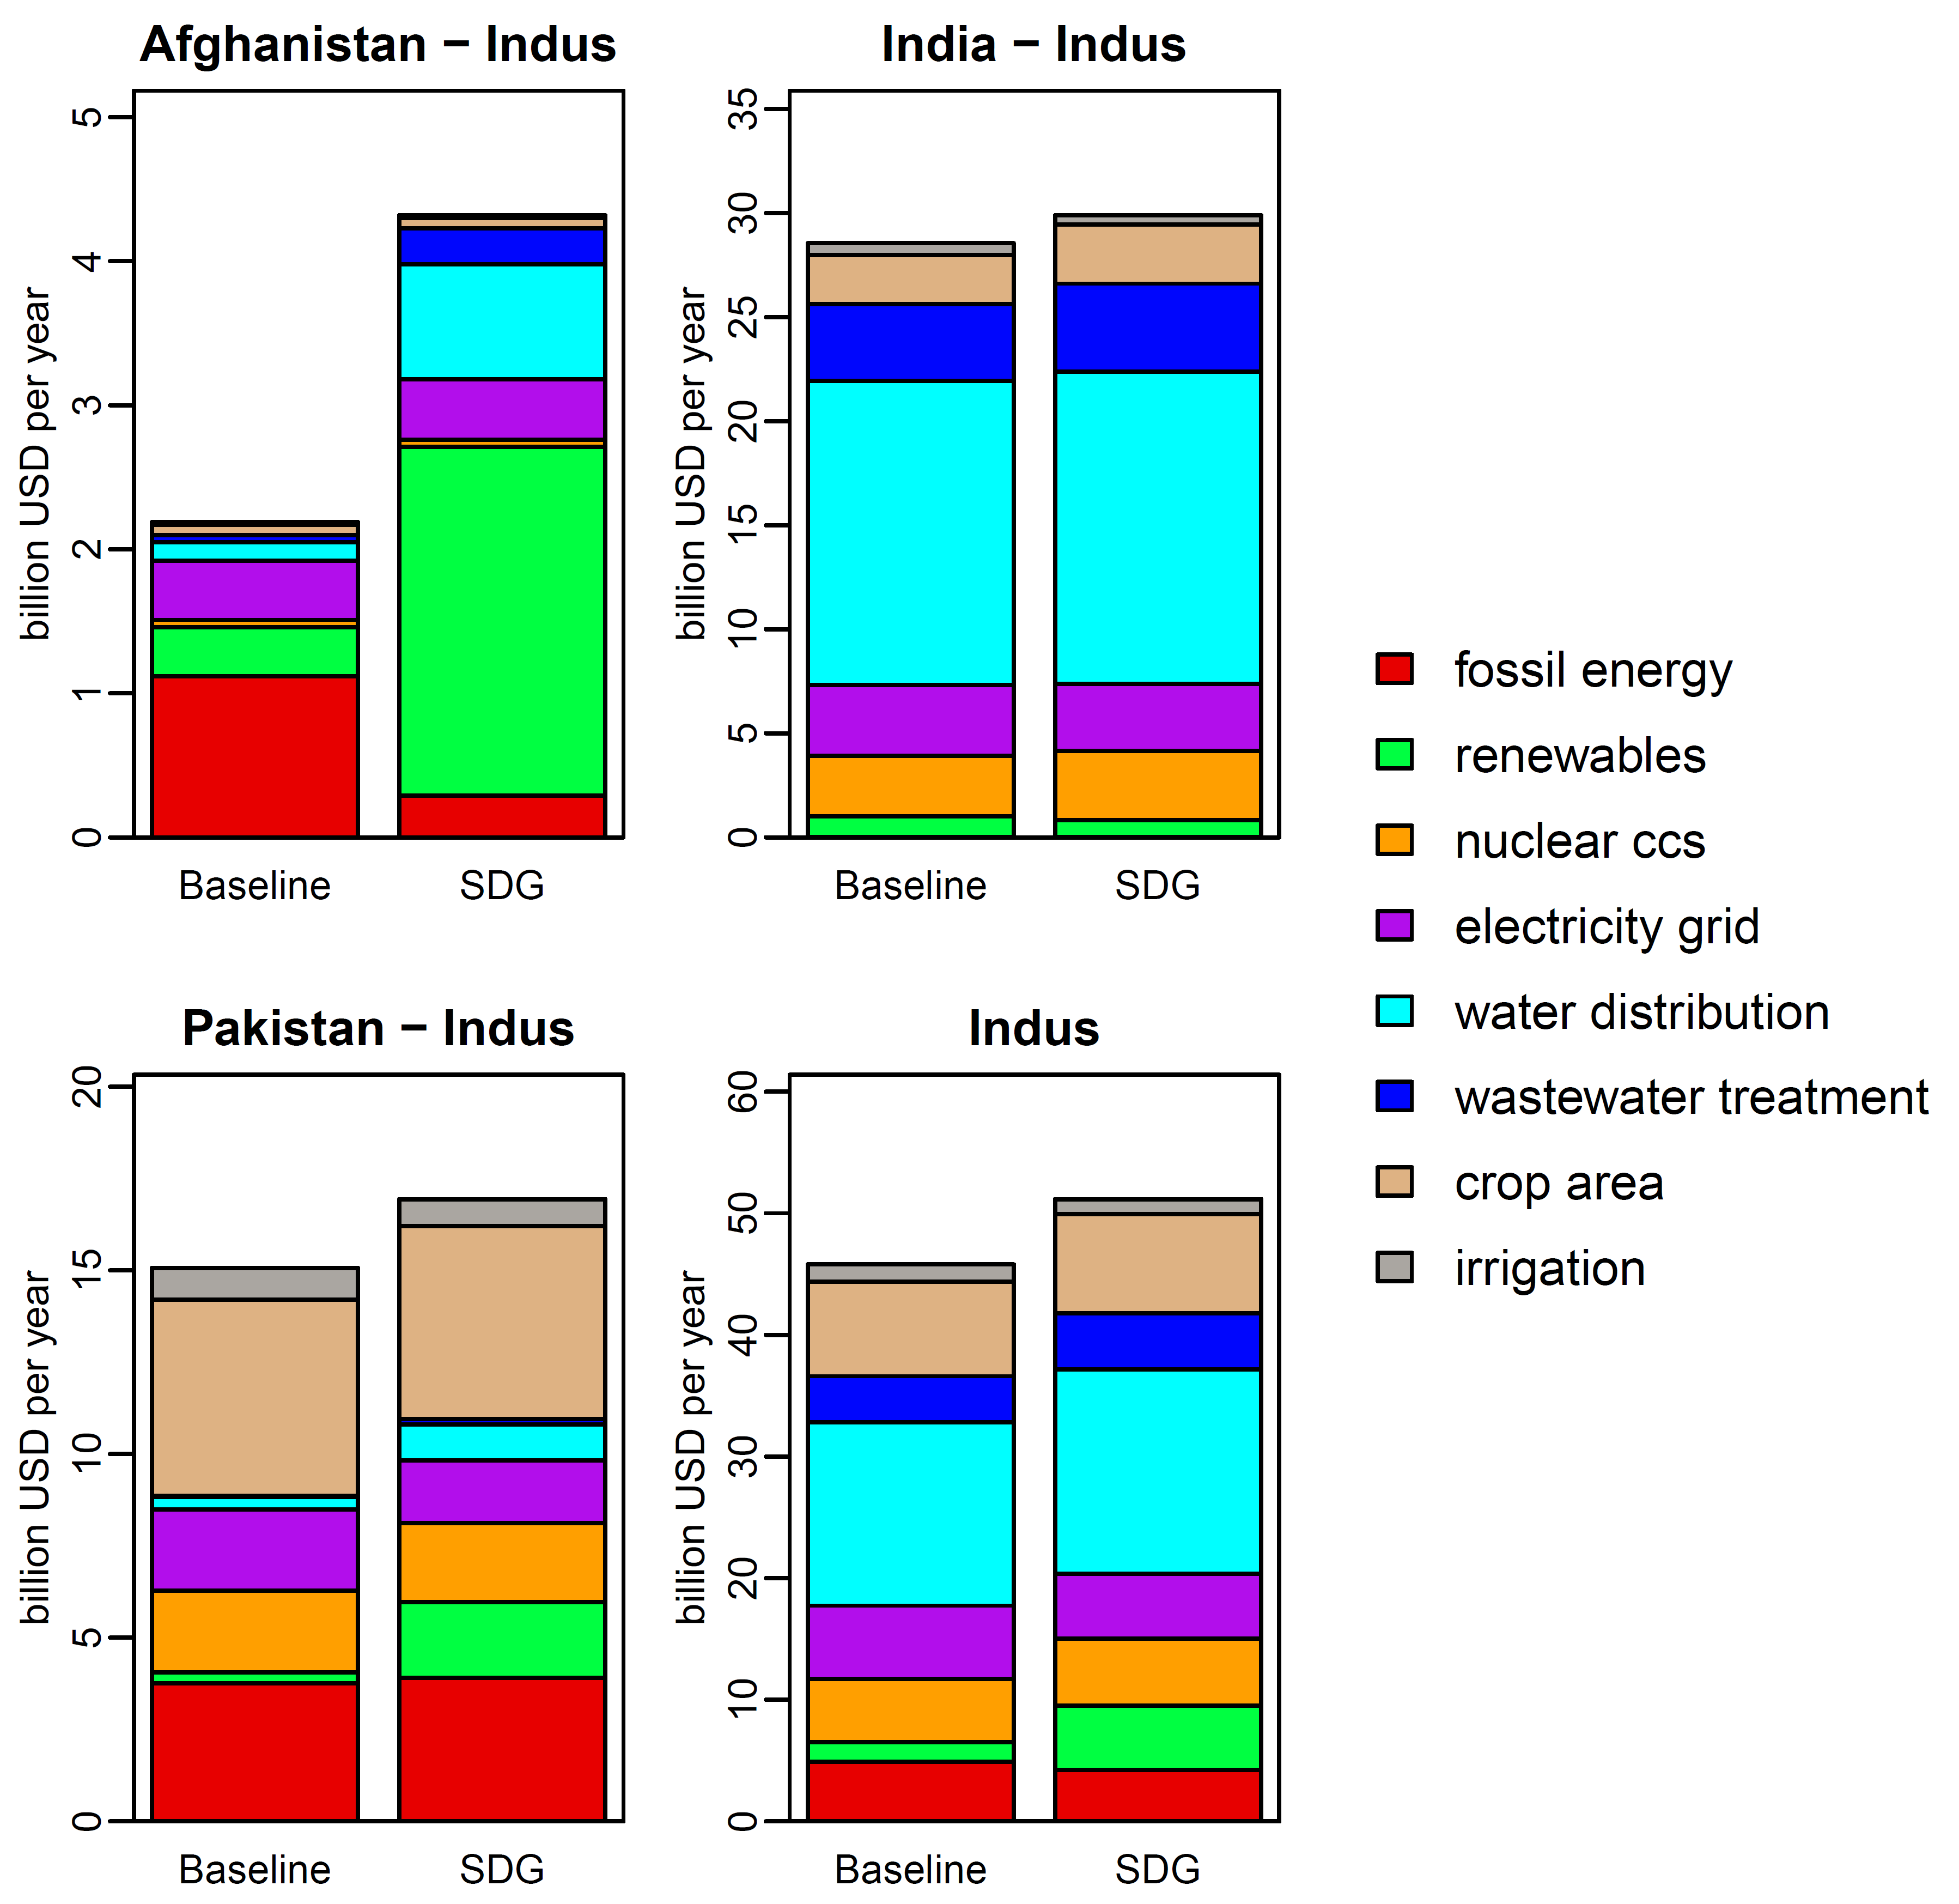
Results
Tracking average water-energy-land investments under different SDG objectives: 2015 to 2040
Investment change: SDG relative to Baseline scenario
Preliminary results: do not cite or quote

Slide 12
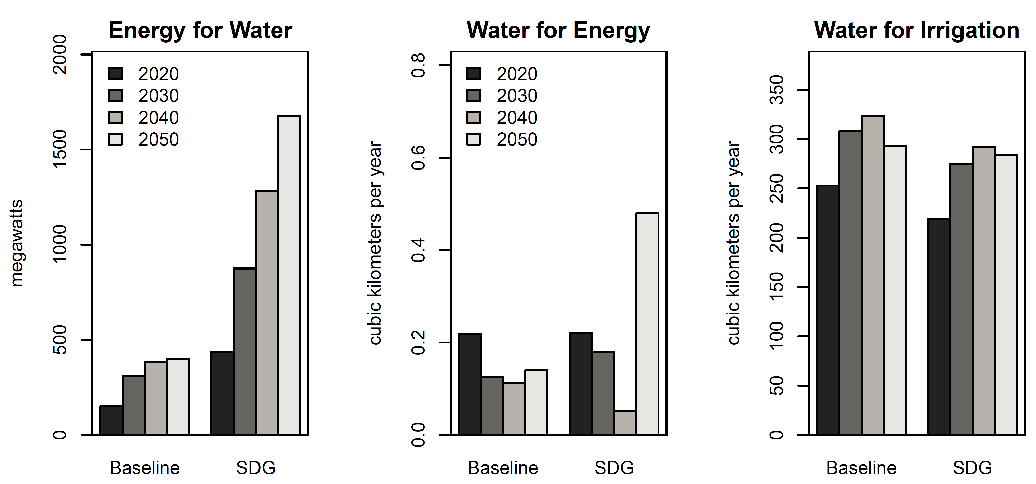
Results
Quantifying nexus interactions
Preliminary results: do not cite or quote

Slide 13
Next Steps
Expanded results and building capacity
Upcoming stakeholder workshops
  Elicit feedback on model scenarios
  Provide training with tools
Online knowledge platform
  Results explorer
  Model code and input data

Slide 14
Conclusions
NEST is a new state-of-the-art tool for water-energy-land nexus analysis
  Transformation pathways
  Joint optimization of the nexus
Application to the Indus Basin
  Investment costs to achieve multiple SDGs
  New insights into adaptive measures across sectors

Slide 15









Collaborators from around the world
Thank you!

