Slide 1


Recommendations on Electronic Information Tools: Using citizen science effectively within the Aarhus context
The European Citizen Science Association

Slide 2
Outline
This side event will introduce citizen science within the Aarhus context
Co-production of environmental information
Examples within international efforts: Sustainable Development Goals, UN Environment Assembly, UNESCO guidance on open science, and the role of coordinating organisations

Slide 3
Speakers and topics
Prof Muki Haklay, University College London: Introduction to citizen science within environmental data collection
Dr Sven Schade, European Commission, Joint Research Centre (JRC): The integration of citizen science in environmental policy
Ms Dilek Fraisl, International Institute for Applied Systems Analysis (IIASA): The use of citizen science to address data gaps in the SDGs
Prof Francois Grey/Rosy Mondardini, SDG solution space, University of Geneva/CS Zurich: Providing the training, skills, and tools for citizen science for SDG
Mr Martin Brocklehurst, European Citizen Science Association: The integration of citizen science within the UN Environment Assembly (UNEA) & international collaboration

Slide 4
Speakers and topics
Prof Uta Wehn, IHE Delft Institute for Water Education & University of Gothenburg: The integration of citizen science within UNESCO Recommendation on open science
Dr Barbara Kieslinger, European Citizen Science Association: The role of citizen science associations and international cooperation in training and capacity building and the EU-Citizen.Science platform
Dr Anna Berti Suman, European Commission, Joint Research Centre (JRC): Citizen sensing from a legal perspective and the procedural and substantive rights recognised within the Aarhus context
Q&A and an open discussion

Slide 5
The use of citizen science to address data gaps in the SDGs
Dilek Fraisl, IIASA
International Institute for Applied Systems Analysis (IIASA)
fraisl@iiasa.ac.at
Twitter: dilekfraisl1
www.iiasa.ac.at

Slide 6
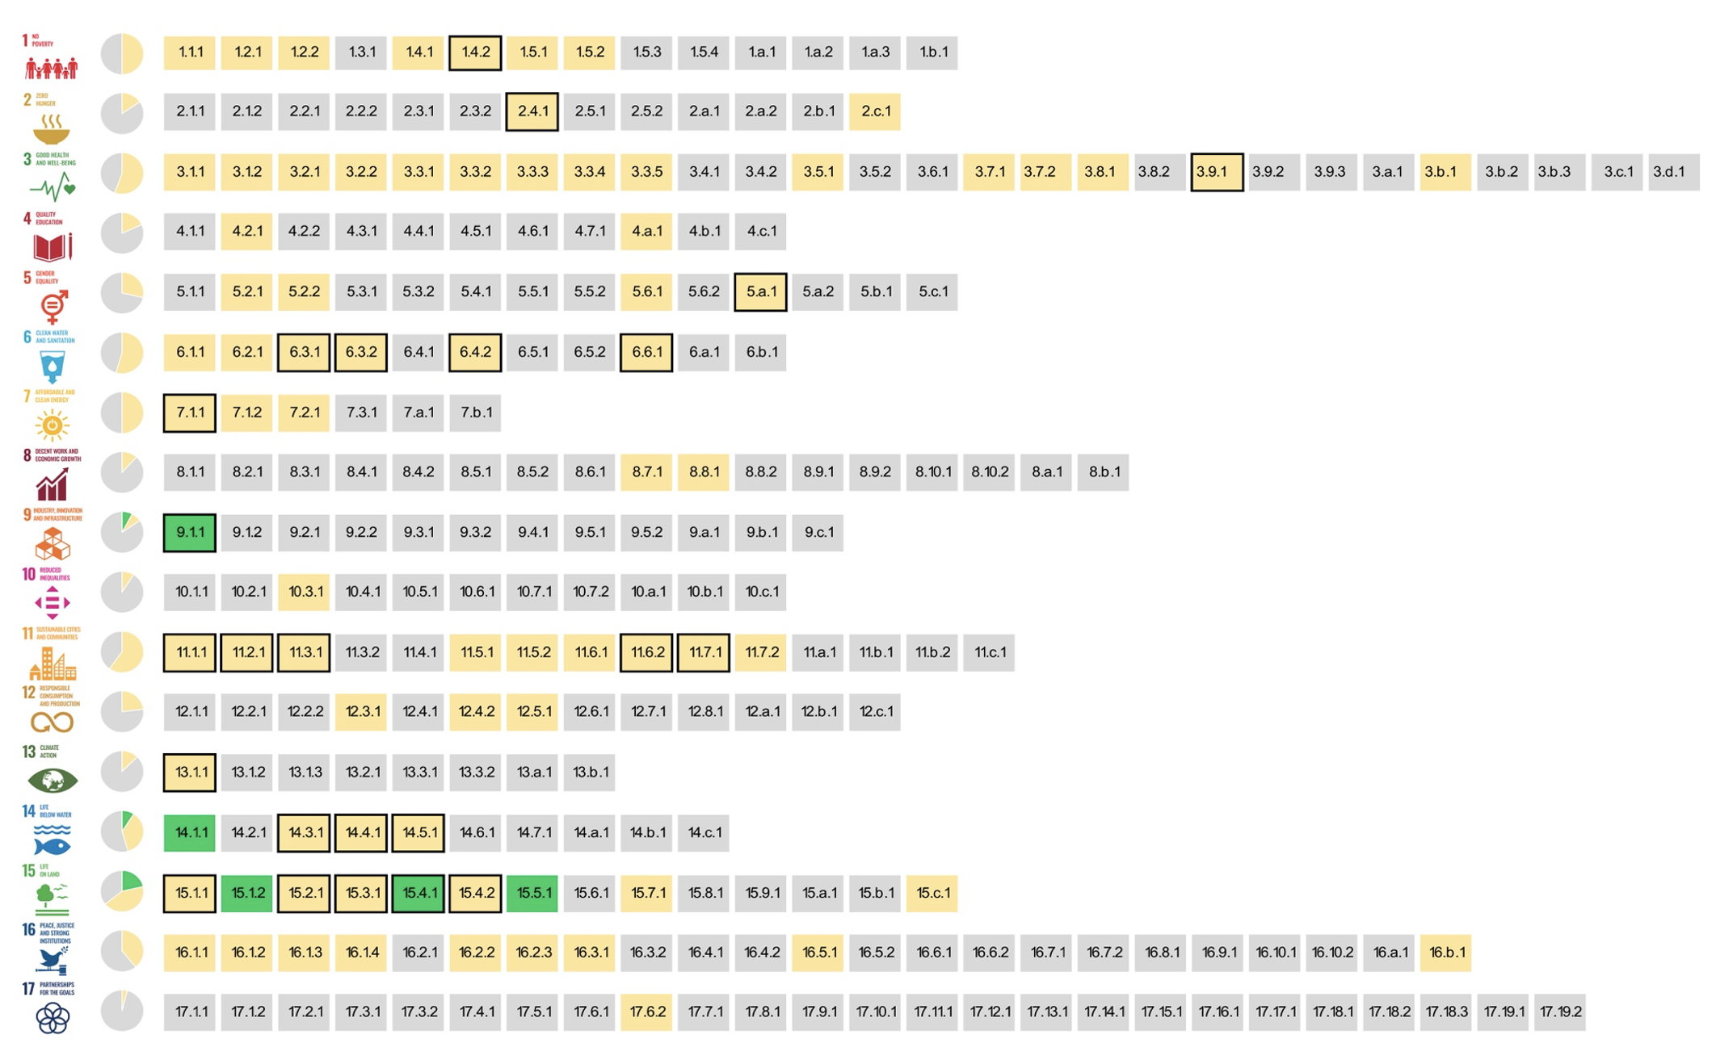
The potential of citizen science to fill data gaps
The SDG indicators where citizen science projects are ‘already contributing’ (GREEN), ‘could contribute’ (YELLOW) to SDG monitoring or where there is ‘no alignment' (GREY)
Fraisl, D., Campbell, J., See, L. et al. Mapping citizen science contributions to the UN sustainable development goals. Sustain Sci 15, 1735–1751 (2020). https://doi.org/10.1007/s11625-020-00833-7

Slide 7
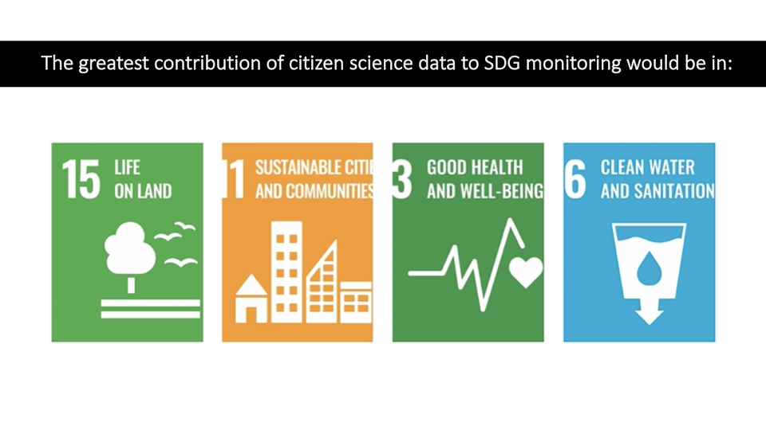

Slide 8
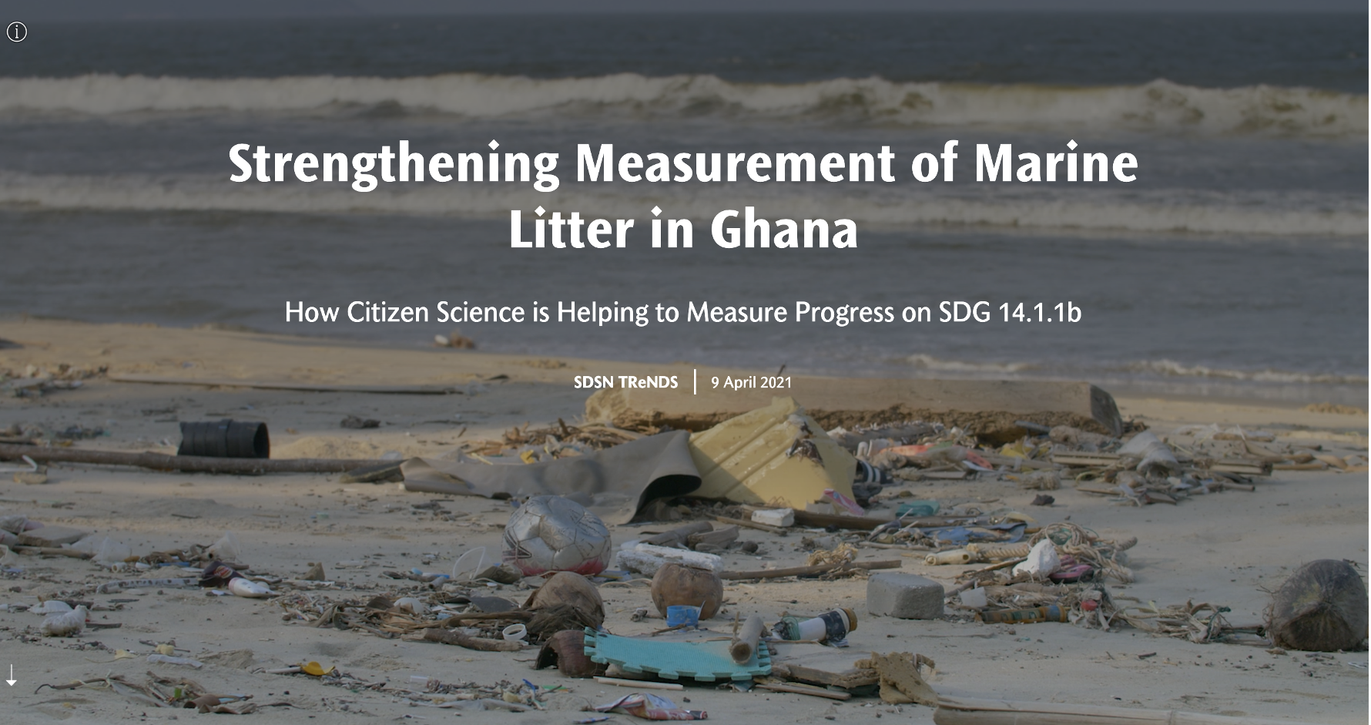
Citizen Science for the SDGs StoryMap: https://dataforchange.net/strengthening-measurement-of-marine-litter-in-Ghana

Slide 9
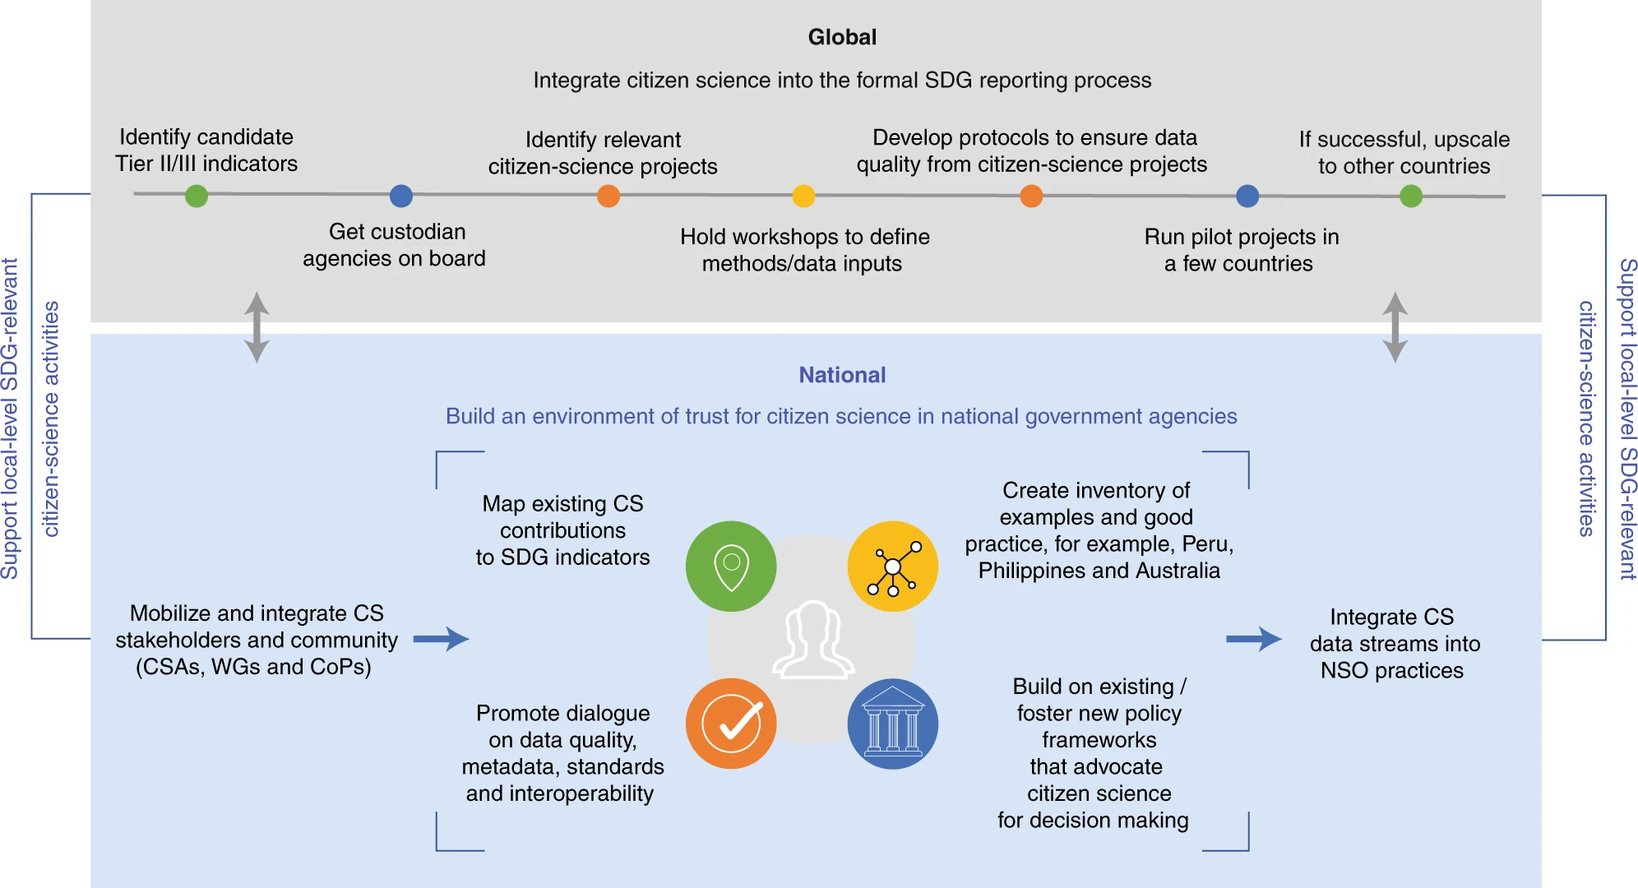

Progress towards the integration of citizen science in the SDG framework
Fritz, S., See, L., Carlson, T. et al. Citizen science and the United Nations Sustainable Development Goals. Nat Sustain 2, 922–930 (2019). https://doi.org/10.1038/s41893-019-0390-3

Slide 10

Q&A and a discussion

