Slide 1
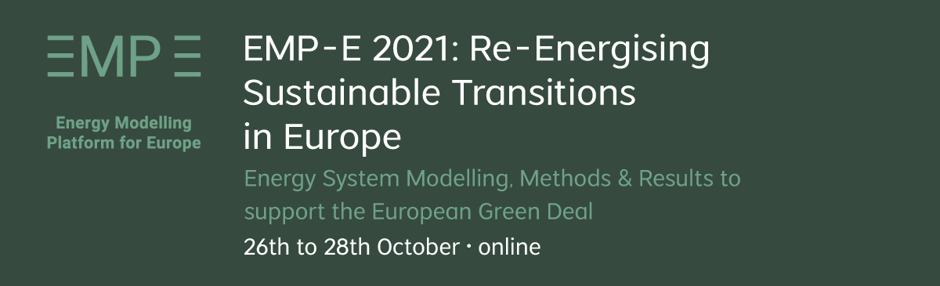
Developing tools for model linkage & cross-sectoral scenario analysis Lessons learned in the openENTRANCE project
Dr. Daniel Huppmann Plenary III: Collaborative Modelling in Practice October 28, 2021
This project has received funding from the European Union’s Horizon 2020 research and innovation programme under grant agreement No. 835896
This presentation is licensed under a Creative Commons Attribution 4.0 International License

Slide 2
Background
What did we aim to do, and what did we learn on the way
The Horizon 2020 project openENTRANCE…
… aims at developing, using and disseminating an open, transparent and integrated modelling platform for assessing low-carbon transition pathways in Europe.
Observations and insights:
Most modellers have understood that open-source work is the “new normal”…
But knowledge of open-source, collaborative development is not as widespread as it should be
Modellers like to work on their models…
And they often wait too long to develop the model-linkage workflows necessary for projects like openENTRANCE

Slide 3
Adopting open & FAIR practices
A one-slide guide to apply better-practices in research
Daniel Huppmann et al., 2020 10.22022/ene/04-2020.16404

Slide 4
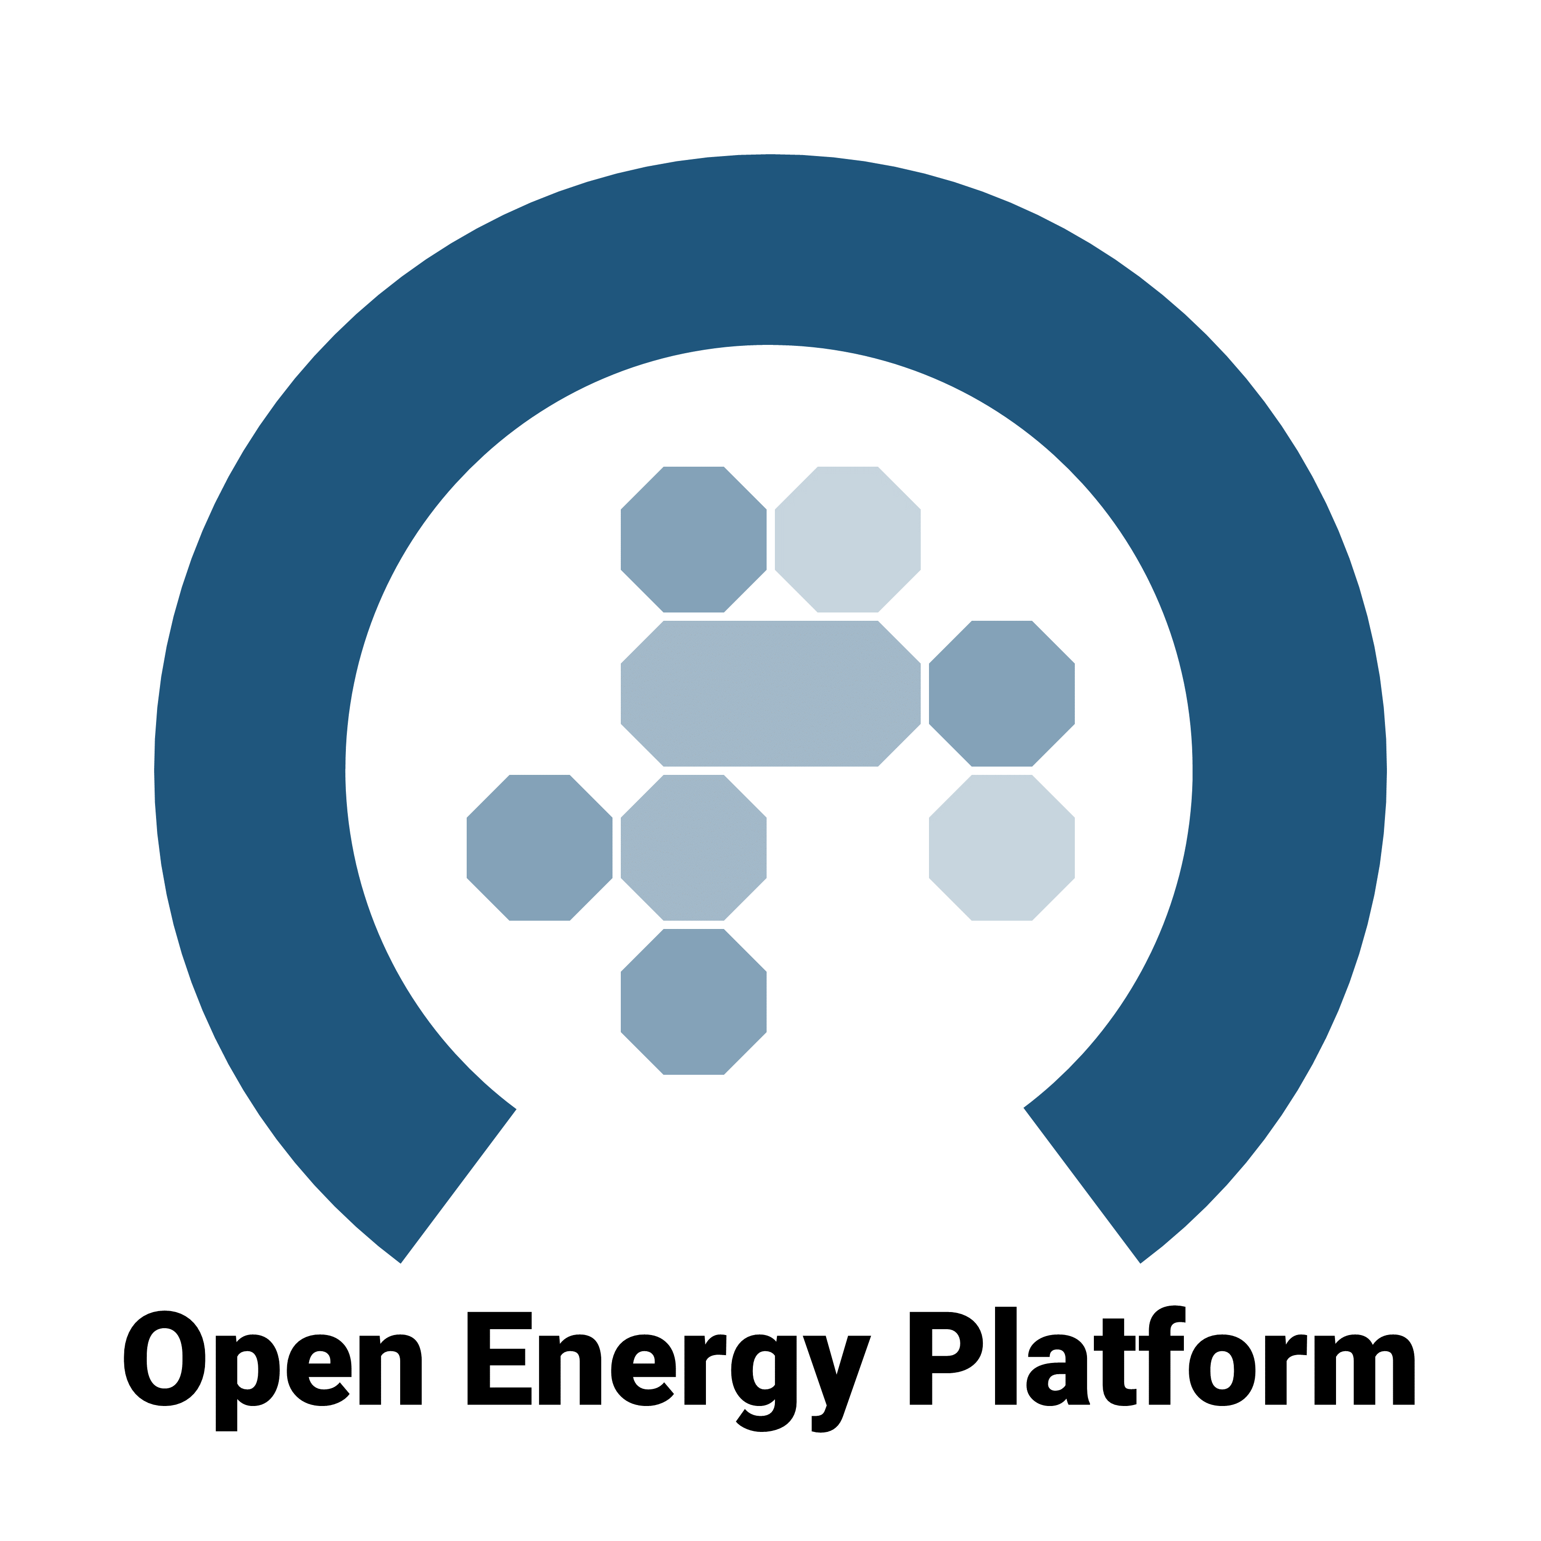
Three approaches to develop model linkages
Comparing approaches chosen by three projects: Data formats, a common language and workflows for model linkage
The holistic approach: The Open Energy Ontology
Develop a comprehensive ontology of the entire energy modelling domain including physical and social concepts
https://openenergy-platform.org/ontology/
The software-tool-based approach: The SENTINEL “friendly data” package
Provide a solution to convert model-specific formats to common standards
https://sentinel-energy.github.io/friendly_data/
The dictatorial approach: The openENTRANCE nomenclature and data format
Require modelling teams to follow well-specified data format
Develop common language as we proceed in the project

Slide 5
The IAMC template for timeseries data
A community standard for compiling scenario results
The integrated-assessment community (IAMC) developed a tabular scenario data format for data exchange
Used in IPCC Reports (AR6, SR15), Horizon 2020 projects, …
Adopted by ~50 teams globally
The Horizon 2020 project openENTRANCE is implementing an extension to cover sub-annual time resolution.
 | A | B | C | D | E | F | G | H
1 | Model | Scenario | Region | Variable | Unit | 2005 | 2010 | 2015
2 | MESSAGE | CD-LINKS 400 | World | Primary Energy | EJ/y | 462.5 | 500.7 | ...

Slide 6
A common nomenclature across research domains
In the openENTRANCE project, we are developing a nomenclature across sectoral models based on the IAMC template
Aim: develop a nomenclature in a structure that is intuitive and versatile
Approach & features:
Maintained on GitHub: native tools for discussion & version control
Based on yaml text files: human-readable and easy to use in scripts & workflows
Provides some additional features that are useful to researchers across domains (e.g., ISO2/ISO3-to-country mappings, NUTS hierarchy mappings)
Includes an installable Python package nomenclature with useful features for validation, mapping-dictionaries, etc.
Check out github.com/openENTRANCE/nomenclature for details!

Slide 7
The pyam package
A community package for scenario processing, analysis & visualization following best practice of collaborative scientific software development
Use cases and features
Data processing Aggregation, downscaling, unit conversion, I/O to xlsx, csv & frictionless datapackage…
Validation Checks for completeness of data, internal/external consistency, numerical plausibility …
Analysis & visualization Categorization and statistics of scenario ensembles, plotting library, …
Huppmann et al. pyam: Analysis and visualisation of integrated assessment and macro-energy scenarios. Open Research Europe 2021, 1:74 (https://doi.org/10.12688/openreseurope.13633.2)
#pyam_iamc
pyam-iamc.readthedocs.io
Notes:
The

Slide 8
Design principles of the pyam package
We aimed to create a community package that is useful – and that can serve as a best-practice example of open-source, collaborative work
Intended users include modellers, researchers & analysists irrespective of Python knowledge
Tutorials and a full-fledged documentation (and even a tutorial for R users)
Two published manuscripts (2019, 2021) plus DOI’s of each release via Zenodo
Several active communication channels: a mailing list, Slack channel, GitHub repository, social media
Based on the widely used pandas package for data analysis
Supporting multiple data formats, file types, reference data sources, …
Adopt best-practice of open-source, collaborative scientific software development including continuous integration (test coverage ~ 95%) and release management
Ambition: relying on a well-maintained, structured package instead of ad-hoc scripts will free up researchers’ time to do more research!

Slide 9
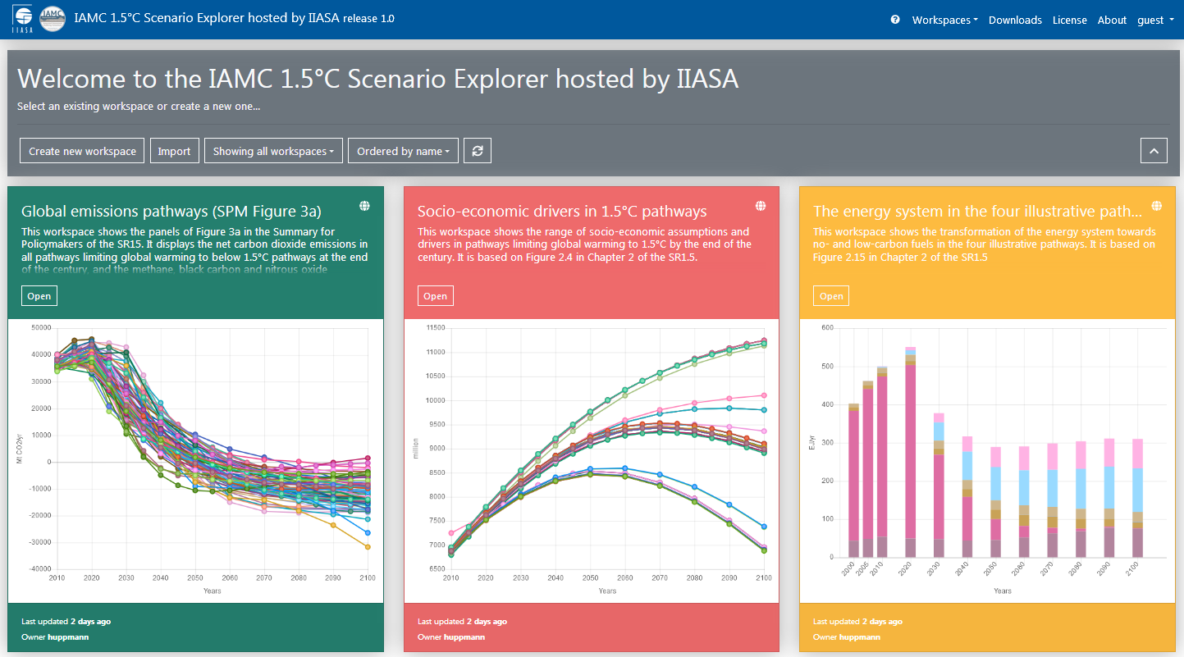
The IIASA Scenario Explorer
An interactive, versatile web user interface for model comparison projects and dissemination of results to researchers, policymakers & stakeholders
Scope and features
Make scenario results accessible including documentation
Manage scenario results in model comparison projects
Facilitate “post-processing” of scenario results
Currently used in various projects
The Scenario Explorer was initially developed for the IPCC’s Special Report on 1.5°C. Visit the IAMC 1.5°C Scenario Explorer https://data.ece.iiasa.ac.at/iamc-1.5c-explorer

Slide 10
Opening up the openENTRANCE Scenario Explorer
We are inviting modelling teams to use the openENTRANCE Scenario Explorer as a central data repository for dissemination of their results
As part of our mission to promote open science and transparency, the openENTRANCE project enables any modelling team working on European decarbonization scenarios to use the public openENTRANCE Scenario Explorer for dissemination of their results.
Advantages:
Make your data available via a state-of-the-art web user interface
Compare results between openENTRANCE pathways and your studies
Use the IIASA database infrastructure and related tools for further work
Read more about the “Data Submission” Terms of Use on https://data.ece.iiasa.ac.at/openentrance
Feedback? Are modellers interested in this offer?

Slide 11
Re-using the openENTRANCE infrastructure in the ECEMF project
The just-starting project ECEMF will build on the openENTRANCE tools
The Horizon 2020 project ECEMF started in May 2021, bringing together a consortium of modelling teams
Similar aims to openENTRANCE:
Develop scenarios of European decarbonization policy and carbon neutrality
Implement new tools for data analysis, visualization and model linkage
Facilitate a community of European modelling activities
Implementation strategy for tools and database infrastructure:
Build on solutions implemented by openENTRANCE rather than re-invent the wheel…
Visit https://www.ecemf.eu for more information

Slide 12
This project has received funding from the European Union’s Horizon 2020 research and innovation programme under grant agreement No. 835896

