Slide 1
Iterative solution procedure for nonsmooth nondifferentiable stochastic optimization: linking distributed models for food, water, energy security nexus management
Yuri M. Ermoliev, Anatoliy G. Zagorodniy , Vyacheslav L. Bogdanov , Tatiana Y. Ermolieva , Petr Havlik, Elena Rovenskaya, Nadejda Komendantova, Michael Obersteiner
EURO21 ATHENS 2021, Athens, GREECE
11-14 July, 2021

Slide 2
Advanced Analysis of Interdependencies, Systemic Threats,
Multi-Dimensional Systemic risks, and Systemic Security
Growing demand vs environmental standards (SDGs); electricity infrastructure innovations and investments; systemic security; increasing returns vs sunk costs;
climate change and uncertainty; strategic- and operational planning; long- vs short-term decisions; competition for resources, etc
Energy Security
Food Security
Energy security and water security; supply standards; Energy & water prices; Diversification of energy supply;
Ex-ante and ex-post risk management; electricity supply security;
global and local threats to electricity supply systems; endogenous risks; cyberattacks;
protection of critical infrastructure
Nested multi-model welfare analysis and systemic security management
Incomes; economic and population growth; demand changes; life and nutrition standards; prices;
Impacts of energy prices on food prices; Dependencies between agricultural and energy markets through bio-fuels; Agricultural subsidies; renewables subsidies, etc.
Water Security
Socio -Economic Security
Control of water resources; reliability vs. disasters; Monitoring of infrastructure reliability; monitoring of water resources vulnerability and accessibility;
Monitoring & control of water contamination;
Notes:
Three fundamental elements (energy) security: ―Physical supply: availability and accessibility; ―Economic: affordability; ―Environmental sustainability: acceptability. Most important factor determining the energy system is risks, which depend on how the system is considered as a whole
emphasis on a systemic approach to risk management: regulating the system as a whole, not just its individual components
Systemic risks is risks in a complex “network” driven by supply-demand-price relations
Framework that can be scaled to capture the key components and relationships at different levels
A tool which helps identify regional energy security gaps and self-sufficiency levels depending on various other factors and areas of priority
A tool which allows to set the priorities and initiate a discussion with decision-makers
International (traditional) energy security frameworks were developed primarily following the crude oil supply disruptions of the 1970s
Significant changes in energy markets over the last 40 years
•Increased diversification of the fuel mix, with oil use displaced by increasing use of coal and natural gas.
•A shift in consumption patterns towards non-OECD emerging economies.
•Changes in the structure of the international crude oil market, from vertically integrated market of the 1970’s to the current segmented and highly specialised market.
•The move from long term contracts to an increasing share of spot transactions and the emergence of oil futures and derivatives markets, increasing the depth and liquidity of the market.
•New causes of imbalance between supply and demand beyond geopolitical shocks to crude oil supply. For example, refinery shutdowns (e.g. Hurricane Katrina 2005), demand surges (e.g. Asia 2013) and the loss of specific types of crude (Libya 2011

Slide 3
Modeling Challenges
Many detailed sectoral models are developed independently by different modeling teams (ministries, authorities, modelers, etc.)
The teams are not able to exchange the information about the models (asymmetric information, ASI); Joint resource constraints and supply-demand relations are not accounted for
How to link the detailed models under joint constraints and ASI?
Traditional integrated modeling (IM) is based on developing and aggregating all relevant (sub)models (sectoral, regional) and corresponding data sets into a single integrated linear programming (LP) model
The lack of common information about (LP) submodels makes LP methods inapplicable for integrated LP models
Our approach is based on the linkage of separate sectoral/regional LP models under ASI
Notes:
Currently, the government make the plans for energy production, food production and water resource allocation independently.

Slide 4

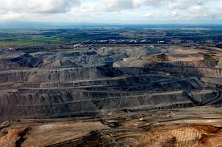
Linkage of distributed sectoral/regional models
Model of sector/region A
Model of sector/region E
Minimizing costs
Constraints on volume of production
Constraints on available resources (land, water, etc.)
☹
☹
Constraints are inter-linked!
Joint resource constraint
☺ ☺ ☺

Slide 5
“Naïve” approach: direct iterative exchange between models
Sequential exchange of “outputs-inputs” between the models
Leads to inconsistent solution dependent on initial condition (starting model)
The procedure does not converge
Notes:
This is not very clear now, should be discussed

Slide 6
Hard linking approach: minimization of the overall welfare function
“Hard linkage” within the same programming code
Often requires reprogramming and harmonization of inputs
Many details of individual models can be lost
Implementation may be challenging – computing time, needs to re-code etc.

Slide 7
Linking models via a central “hub” under uncertainty and asymmetric information
We reformulate the integrated LP model under ASI as a basic equivalent non-smooth optimization model.
For the linkage, the sectorial/regional models don’t need recoding or reprogramming. They also don’t require additional data harmonization tasks.
Instead, they solve their LP submodels independently and in parallel by a specific iterative subgradient algorithm.
The submodels continue to be the same separate LP models.
A social planner (central hub) only needs to adjust the joint resource constraints to simple subgradient changes calculated by the algorithm.
The application of this approach is considered for a case study in Ukraine and China that focuses on the nexus of the agriculture and the energy sectors that are competing for limited water and land resources.

Slide 8
Linking models via a central “hub” under uncertainty and asymmetric information
We reformulate the integrated LP model under ASI as a basic equivalent non-smooth optimization model.
For the linkage, the sectorial/regional models don’t need recoding or reprogramming.
Instead, they solve their LP submodels independently and in parallel by a specific iterative subgradient algorithm.
Linkage variable y: , defines constraint on joint resources
Notes:
\nu_A, \nu_E – are the solutions to the max problem or given dual variables???

Slide 9
Iterative procedure
Individual resource constraint
Joint resource constraint

Slide 10
Iterative procedure

Slide 13
Convergence theorem
Let
Then
where
Yuri Ermoliev (1988), Yuri Ermoliev et al. ( 2017, 2019) for Deterministic and stochastic cases

Slide 14
Iterative procedure

Slide 17
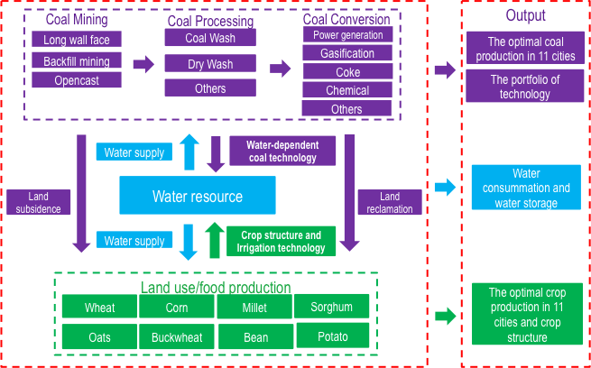
Linkage of distributed energy-agriculture-water models
Coal related industry
Cooling technology
Power
dry quenching
coke
Waste water treatment
reuse
Power
Water resource
Quantity
Coal Mining
Waste water treatment
Water resource
Quality
Coal quantity
Dry/reuse of water
Drainage water
Agriculture
Crop stucture
crop quantity
Air Pollution

