Slide 1
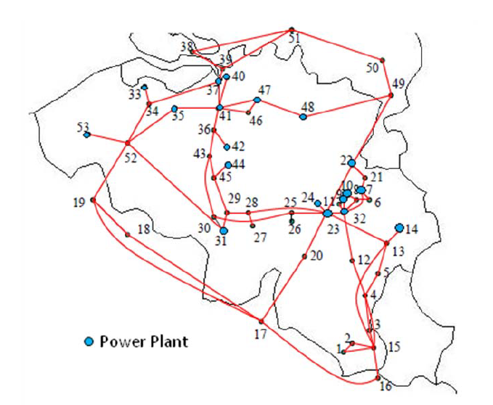
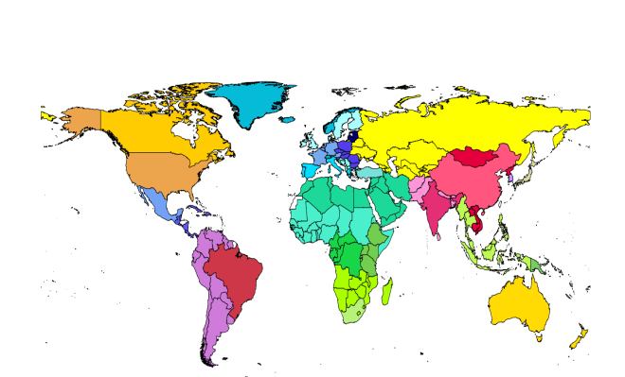
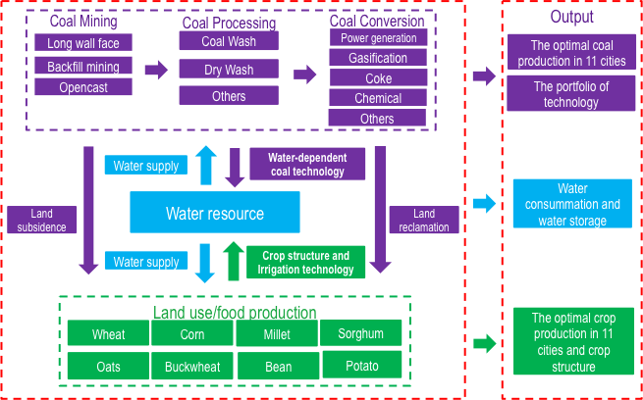
Two-stage STO for robust management of systemic risks and FWEE security in interdependent systems
EURO2021 Athens, Greece
    Tatiana Ermolieva
    Petr Havlik, Yurii Ermoliev, Taher Kahil, Elena Rovenskaya, Michael Obersteiner, Pavel S. Knopov, Olena M. Borodina, Vasyl M. Gorbachuk, Olexandr V. Bogdanov
    International Institute for Applied Systems Analysis
    Laxenburg, Austria
    National Academy of Sciences, Ukraine

Slide 2
Preliminary remarks
Systemic risks in interdependent FWE systems are the risks of a subsystem (a part of the system)
threatening the sustainable performance and achievement of FWE security goals within the whole system
Sectoral, regional and national FWE systems/models are linked through supply-demand relations:
trading, cooperation and integration options, pollution and emission control targets, ...
Systemic risks emerge due to critical supply-demand imbalances and exceedance of thresholds because
of policy interventions or shocks which can trigger a disruption in the network of FWE systems
Policy formulations and assessments are often done by disconnected teams and models without
accounting for sectoral and international links, supply-demand relations and joint resource constraints
Prediction of systemic risks in interdependent policy-driven FWE systems is impossible
The main issue is robust management of the risks at all levels by equipping the systems
with precautionary and adaptive measures enabling the systems sufficient flexibility and robustness
to maintain sustainable performance and fulfill joint FWE security goals under the shocks
Modeling and management of systemic risks, security, robustness, stability are all interconnected issues
requires approaches to integrated modeling through
  Developing procedures for distributed models’ linkages,
  Developing and using quantile-based security/reliability/resilience indicators,
  Developing strategic-adaptive two-stage STO models to design robust sets of interconnected
  precautionary and adaptive measures

Slide 3
Examples of robust interconnected
strategic and adaptive decisions
Land use and agricultural systems management
  Strategic: Preparation and allocation of irrigated land, land conversion
  Adaptive: Revision of land allocation depending on water availability
Investments in energy technologies
  Strategic: investments in new energy technologies (generation and storage)
  Adaptive: management energy loads (depending on weather profiles)
Water infrastructure investments
  Strategic: multi-purpose water reservoir capacity, water channels
  Adaptive: water releases and distribution, infrastructure maintenance, environ flows
Food infrastructure
  Strategic: production, processing, retailing, waste management facilities
  Adaptive: operation of facilities depending on real-time conditions
Coping with epidemics
  Strategic: Investments in infrastructure, sufficient hospitals and equipment
  Adaptive: Allocation and management of patients flows
Strategic (long-term): ensure sufficient capacities, upgrade and new capacities
Adaptive (operational): help to operate str.dec. within each scenario

Slide 4
Challengies of modeling and managing systemic interactions and risks
Systemic interactions between large-scale distributed optimization models:
  Joint resource constraints and supply-demand relations
  Nonsmooth iterative optimization
Systemic interactions between global and local, strategic and adaptive models:
  Strategic costly irreversible decisions
  Adaptive operational decisions
  Long-term vs short-term decisions
Systemic interactions between risks and decisions (decision-driven risks):
  Endogenous decision-dependent risks
  Iterative revision of decisions (and risks) towards safety constraints
Robust decisions - interdependent two-stage strategic ex-ante and adaptive ex-post
decisions that minimize imbalances and keep systems resilient to shocks of all kinds

Slide 5
Systemic interdependencies: land use model GLOBIOM
Notes:
Modeling of internal and external schocks

Slide 6
Robust interconnected two types decision-making:
minimizing imbalances in the face of uncertain future
“
“
Supply (x) = demand ( ), random scenarios ,
=
θ
θ= (θ₁ , θ₂, ..., θ_{N})
x
θ
Deterministic model: x* = E - standard average solution
(θ)
Scenario analysis: what is optimal production once demand is simulated?
Worst case minimax solution x= max ( ) can be too costly
x₁ = θ₁
x₁ = θ₂
x_{N} = θ_{N}
θ
Problem: planning supply x before θ_{i} is observed
Imbalance defines adaptive solution
y⁻
(θ
)
=
θ
−
x
x
<
θ
Imbalance defines adaptive solution
y⁺
(θ
)
=
x
−
x
>
θ
θ
Notes:
Here we illustrates how the concept of a two-stage stochastic optimization and robust strategic-adaptive decisions can assist robust decision analysis and system’s security management. Consider a basic model, which may correspond to a problem of a decision maker (regional planner) concerned with investments into agricultural production technologies (irrigation, storage), bio-based electricity production facility, water reservoir infrastructure or any other long-term and costly project associated with possible irreversibility costs. Assume there is only one producer (region) operating in uncertain environment and this producer needs to satisfy some demand. One of the variables (or both variables) can be stochastic. In this section let us consider a very simple relation between the production capacity x and the stochastic demand $ω$.
The imbalance between the demand and supply can induce an exceedance of a vital systemic threshold and, as a result, a systemic failure. Planning production $x$ before exact information on the level of stochastic demand $ω$ is available can result in two situations: a) If the production is lower than the demand, then the producer can potentially fulfill the demand by storage withdrawal (“borrowing”) at price ${α>c}_{}^{}$. If the demand is lower than the production $x$, the producer can store the excess production at price $β<c$. The shortage and the excess production indicate systemic imbalances and risks, which require additional actions and costs for borrowing and storing. In general, costs

Slide 7
Robust estimation problem
Notes:
Here we illustrates how the concept of a two-stage stochastic optimization and robust strategic-adaptive decisions can assist robust decision analysis and system’s security management. Consider a basic model, which may correspond to a problem of a decision maker (regional planner) concerned with investments into agricultural production technologies (irrigation, storage), bio-based electricity production facility, water reservoir infrastructure or any other long-term and costly project associated with possible irreversibility costs. Assume there is only one producer (region) operating in uncertain environment and this producer needs to satisfy some demand. One of the variables (or both variables) can be stochastic. In this section let us consider a very simple relation between the production capacity x and the stochastic demand $ω$.
The imbalance between the demand and supply can induce an exceedance of a vital systemic threshold and, as a result, a systemic failure. Planning production $x$ before exact information on the level of stochastic demand $ω$ is available can result in two situations: a) If the production is lower than the demand, then the producer can potentially fulfill the demand by storage withdrawal (“borrowing”) at price ${α>c}_{}^{}$. If the demand is lower than the production $x$, the producer can store the excess production at price $β<c$. The shortage and the excess production indicate systemic imbalances and risks, which require additional actions and costs for borrowing and storing. In general, costs

Slide 8
Robust estimation problem

Slide 9
Robust interconnected two types decision-making:
minimizing imbalances in the face of uncertain future
“
“
Supply (x) = demand ( ), random scenarios ,
=
θ
θ= (θ₁ , θ₂, ..., θ_{N})
x
θ
Deterministic model: x* = E - standard average solution
(θ)
Scenario analysis: what is optimal production once demand is simulated?
Worst case minimax solution x= max ( ) can be too costly
x₁ = θ₁
x₁ = θ₂
x_{N} = θ_{N}
θ
Problem: planning supply x before θ_{i} is observed
Imbalance defines adaptive solution
y⁻
(θ
)
=
θ
−
x
x
<
θ
Imbalance defines adaptive solution
y⁺
(θ
)
=
x
−
x
>
θ
θ
Notes:
Here we illustrates how the concept of a two-stage stochastic optimization and robust strategic-adaptive decisions can assist robust decision analysis and system’s security management. Consider a basic model, which may correspond to a problem of a decision maker (regional planner) concerned with investments into agricultural production technologies (irrigation, storage), bio-based electricity production facility, water reservoir infrastructure or any other long-term and costly project associated with possible irreversibility costs. Assume there is only one producer (region) operating in uncertain environment and this producer needs to satisfy some demand. One of the variables (or both variables) can be stochastic. In this section let us consider a very simple relation between the production capacity x and the stochastic demand $ω$.
The imbalance between the demand and supply can induce an exceedance of a vital systemic threshold and, as a result, a systemic failure. Planning production $x$ before exact information on the level of stochastic demand $ω$ is available can result in two situations: a) If the production is lower than the demand, then the producer can potentially fulfill the demand by storage withdrawal (“borrowing”) at price ${α>c}_{}^{}$. If the demand is lower than the production $x$, the producer can store the excess production at price $β<c$. The shortage and the excess production indicate systemic imbalances and risks, which require additional actions and costs for borrowing and storing. In general, costs

Slide 10

Robust decision-making: strategic and adaptive solutions
Robust solution minimizes expected value of a trade-off function
θ
θ
θ
θ
θ
Model combines robust interdependent anticipative and adaptive decisions
a solution x is selected ex-ante, demand is observed and then x is
adjusted with cost
θ
(VaR) F(x^{rob}) = CVaR
Quantile is defined by slopes ,

Slide 11
Irreversibility of decisions: simple example
Assume, that we need to prepare land for irrigation before we know the exact water supply. Therefore, we prepare hectares before learning the exact value of land which can be irrigated and depends on water supply ω.
x
+
x
θ
≥
θ
(
)
1
2
Decision can be revised by decision after learning exact scenario ω. Assume, for each there exists .
Goal is to minimize :
Subject to:
Optimal second period decision depends on irreversible decision :
Then, the goal is to minimize .
Cross-period interactions depend on C₁ and C₂
Notes:
Why it is so important to consider interdependencies between strategic and adaptive models and decisions
Because inconsistent strategic and adaptive decisions can lead to irreversibility and lock-in situations.
Many sectoral and multi-sectoral exclude operational adaptive decisions and ignore consideration of uncertainties
They only design long-term strategic decisions, e.g. land transformations to land use management types, energy production facilities (windmills or solar panels, etc. )
However, in the presence of stochastic operational conditions, the need to operational adaptive decisions becomes more clear
Accounting for irreversibility of strategic decisions

Slide 12
Interactions between decisions depend on irreversible costs C₁ of strategic decisions and adaptation costs C₂ of operational decision
-- Safety constraints

Slide 13
Interactions between risks and decisions

Slide 14
Safety constraint
Explicit introduction of safety constraint introduces a
tradeoff between cost-effectiveness and risk. The optimal risk-based solution
may be greater or less than or depending on safety
requirement , the ratio C₁ /C₂ , and the probability distribution of uncertainty

Slide 15
Two sectors or two regions model
Deterministic, not accounting for risks: Two sectors or regions with production costs: c₁ < c₂ < b; joint constraint on demand (food or energy security) d
minimize
solution
Stochastic, accounting for risks: a₁ and a₂ are random shocks/(yields) to production
minimize
?
Also other constraints, e.g. on emissions, water supply, water pollution, biofuel targets, etc.
Notes:
Production conditions are naturally uncertain – weather events, markets instabilities, interdependencies among sectors which bring additional uncertainties. However production policies are often adopted without accounting for uncertainties and interdependencies.

Slide 16
Emergence of systemic risks and risk sharing
Safety constraint:
minimize
where is the expected storage/import cost if demand exceeds the supply
If only Region 1 is at risk (yield a₁ is stochastic), the production of
the risk-free Region 2 depends on the stochasticity of Region 1,
costs, trade price, demand security, ….
can be chosen to satisfy the safety constraint with required probability, ,
i.e. for a percentage (percentile) of scenarios.
Notes:
New system with trade or/and storages! Ex ante strategic land allocation decisions x, ex post adaptive scenario-specific trade or storage decisions

Slide 17
Systemic interdependencies: land use model GLOBIOM
Notes:
Modeling of internal and external schocks

Slide 18
Stochastic GLOBIOM: goal function
Maximize welfare:
Consumer and
producer surplus -
transportation costs -
production costs -
“environmental” costs,
etc.
Land allocation, irrigation capacities, etc., are strategic long-term variables
Demand, trade flows, storage withdrawals, etc., are stochastic scenario-dependent operational (adaptive) variables
Production
balance
Food security
Environmental security
Bio-energy security

Slide 19
maximize
Advantages of robust percentile-based solutions in GLOBIOM:
a. allow to treat systemic risks by a proper combination of strategic long-term
decisions and short-term adaptive decisions
b. robustness of solution towards different shocks: diversified risk sharing solution
c. minimize the “reversibility” costs of decisions
d. reduction of price variability: new shock does not affect much the robust solution
e. reduction of prices of high-demand commodities under strict targets
f. introduction financial (insurance, credits) mechanisms for high impact rare scen.
f. avoids “high-pressure” of inconsistent policy measures,
e.g. relax burden of high environmental (CO2) or biofuel targets
g. …

Slide 22
-- Safety constraints

Slide 24
Optimal and robust portfolio of interdependent measures for climate change management
Yield shocks
Food-feed-biofuel security constraint
Through joint constraint, less risky region becomes more risk-exposed
Changed structure of CAP subsidies effects costs and prices
Production allocation

Slide 26
Figure 2a: Grain yields, in percentage change, Figure 2b: Grain yields, in percentage change,
from “historic” to “robust” subsidies. from “flat” to “robust” subsidies.
Figure 3a: Grain area, in percentage change, Figure 3b: Grain area, in percentage change,
from “historic” to “robust” subsidies. from “flat” to “robust” subsidies

Slide 27
Figure 4a: Irrigated area, percentage change, Figure 4b: Irrigated area, percentage change,
from “robust” to “historic” subsidies. from “robust” to “flat” subsidies.
Figure 5a: Water demand, percentage change, Figure 5b: Water demand, percentage change,
from “historic” to “robust” subsidies. from “flat” to “robust” subsidies.

Slide 28
Example of robust solutions: planning regional food security
Dry season – crop A;
Wet season – crop B.
Next season may be dry or wet.
Exact prediction of next season ?
Robust solution is to take a combination of A and B,
or take (design) crop C.
In deterministic models only one scenario:
Season is either dry or wet, i.e., only crop A or B
Design of robust solutions cannot rely on deterministic
(average) models/indicators

