Slide 1


Radiative forcing and climate feedbacks explain the cause of the suppressed late 20th century warming in CMIP6 models
Chris Smith^{1,2}, Piers Forster¹, Hege-Beate Fredriksen³
1. Priestley International Centre for Climate, University of Leeds, UK
2. International Institute for Applied Systems Analysis, Laxenburg, Austria
3. Department of Physics and Technology, UiT the Arctic University of Norway, Tromsø, Norway
c.j.smith1@leeds.ac.uk
@chrisroadmap
Based on a paper in Geophysical Research Letters
https://doi.org/10.1029/2021GL094948

Slide 2
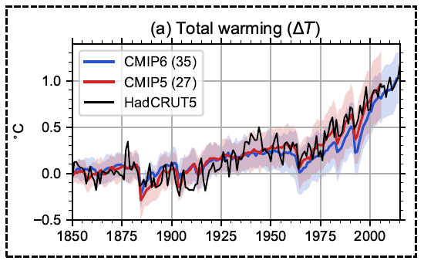
Suppressed late-20th century warming
CMIP6 models show less warming than CMIP5 models from around 1950, with the differences most pronounced around 1960-2000.
Whereas CMIP5 models are doing a good job of tracking the observed warming, CMIP6 models as a group are too cool.
Several studies (Flynn & Mauritsen 2020; Dittus et al. 2020; Andrews et al. 2020; Gillett et al. 2021) have hypothesised that the aerosol forcing in this period is too strong.

Slide 3
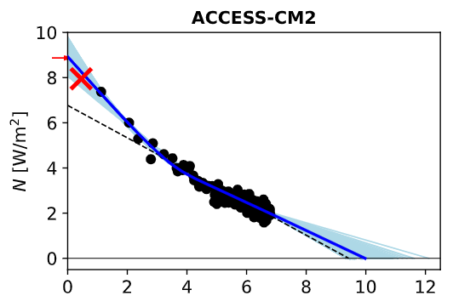
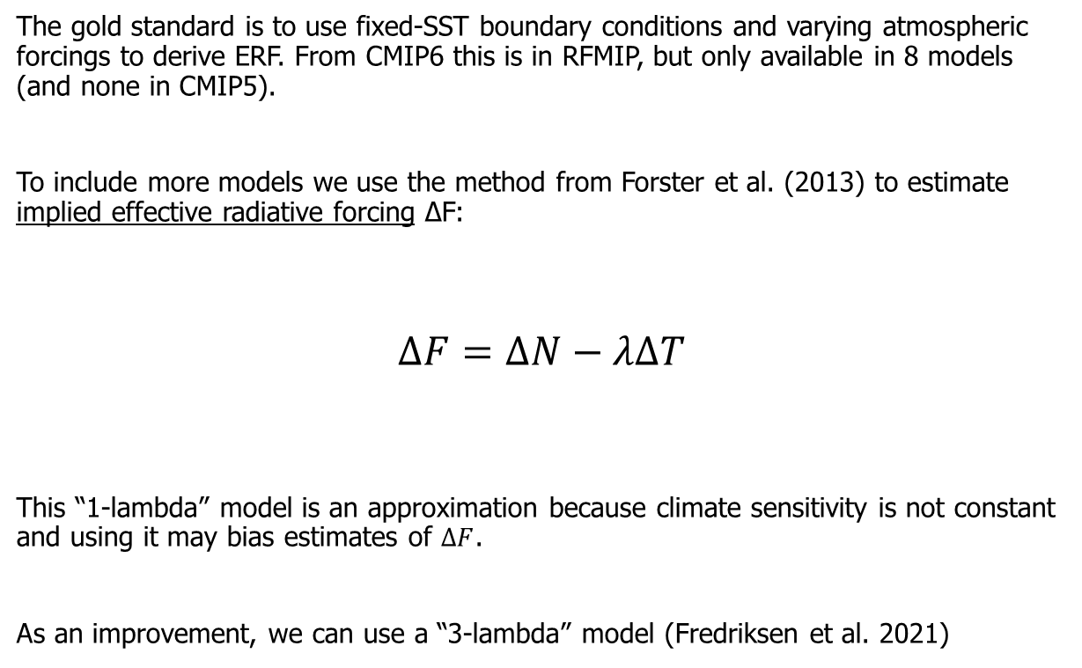
Estimating historical radiative forcing
The gold standard is to use fixed-SST boundary conditions and varying atmospheric forcings to derive ERF. From CMIP6 this is in RFMIP, but only available in 8 models (and none in CMIP5).
To include more models we use the method from Forster et al. (2013) to estimate implied effective radiative forcing ΔF:
$$ΔF=ΔN−λΔT$$
This “1-lambda” model is an approximation because climate sensitivity is not constant and using it may bias estimates of $ΔF$.
As an improvement, we can use a “3-lambda” model (Fredriksen et al. 2021)
1-lambda
3-lambda
Slope of Gregory regression in 150-year 4xCO2 experiment
Transient historical temperature anomaly
Transient historical TOA energy imbalance
T [K]
Fredriksen et al., in preparation

Slide 4
3-lambda implied typically outperforms 1-lambda compared to RFMIP fixed-SST forcing

Slide 5
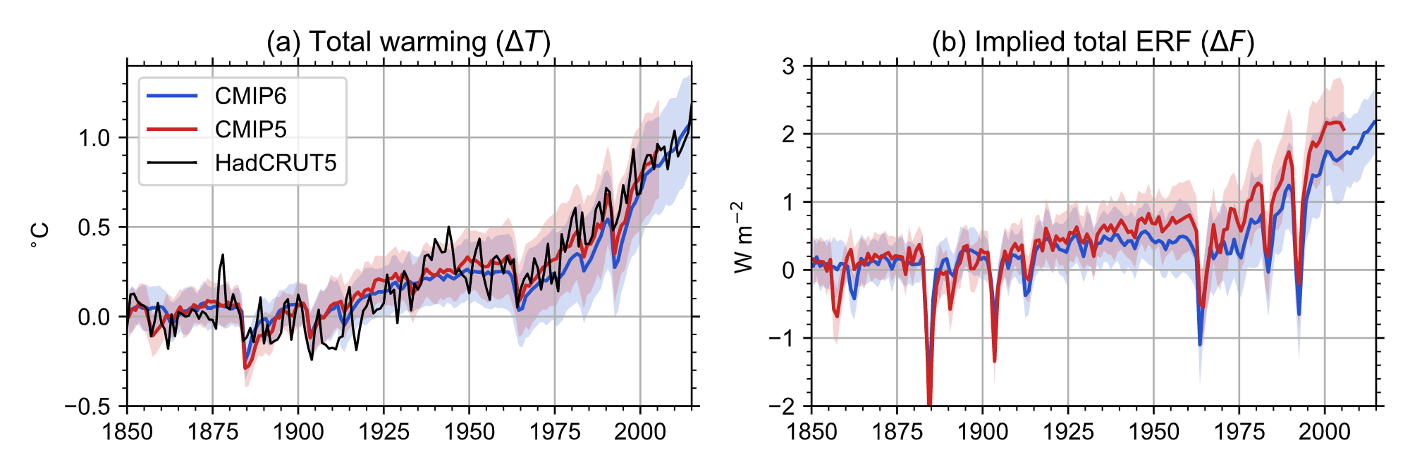
Implied ERF is weaker in CMIP6 than in CMIP5

Slide 6
Attribution of forcing and temperature differences using DAMIP experiments
GHG forcing: CMIP6 is slightly cooler than CMIP5 after 1950, but difference in implied ERF is larger
Other anthropogenic forcing (mainly aerosol): CMIP6 is marginally cooler than CMIP5, with similar implied ERF
Overall, differences in forcing between CMIP5 and CMIP6 are affected by the differences in climate feedbacks: CMIP6 models as a group are more sensitive (higher ECS)

Slide 7
Summary
CMIP6 models are systematically cooler than CMIP5 models over the 1960-2000 period
Differences in aerosol forcing are small, but differences in greenhouse gas forcing are larger, and is amplified by how these forcings translate to warming through differing climate feedback strengths in CMIP5 and CMIP6.
Using a 3-lambda model for estimating implied ERF provides estimates that are closer to RFMIP in most models
In future, we also call for more models running historical fixed-SST experiments as part of RFMIP.

