Slide 1

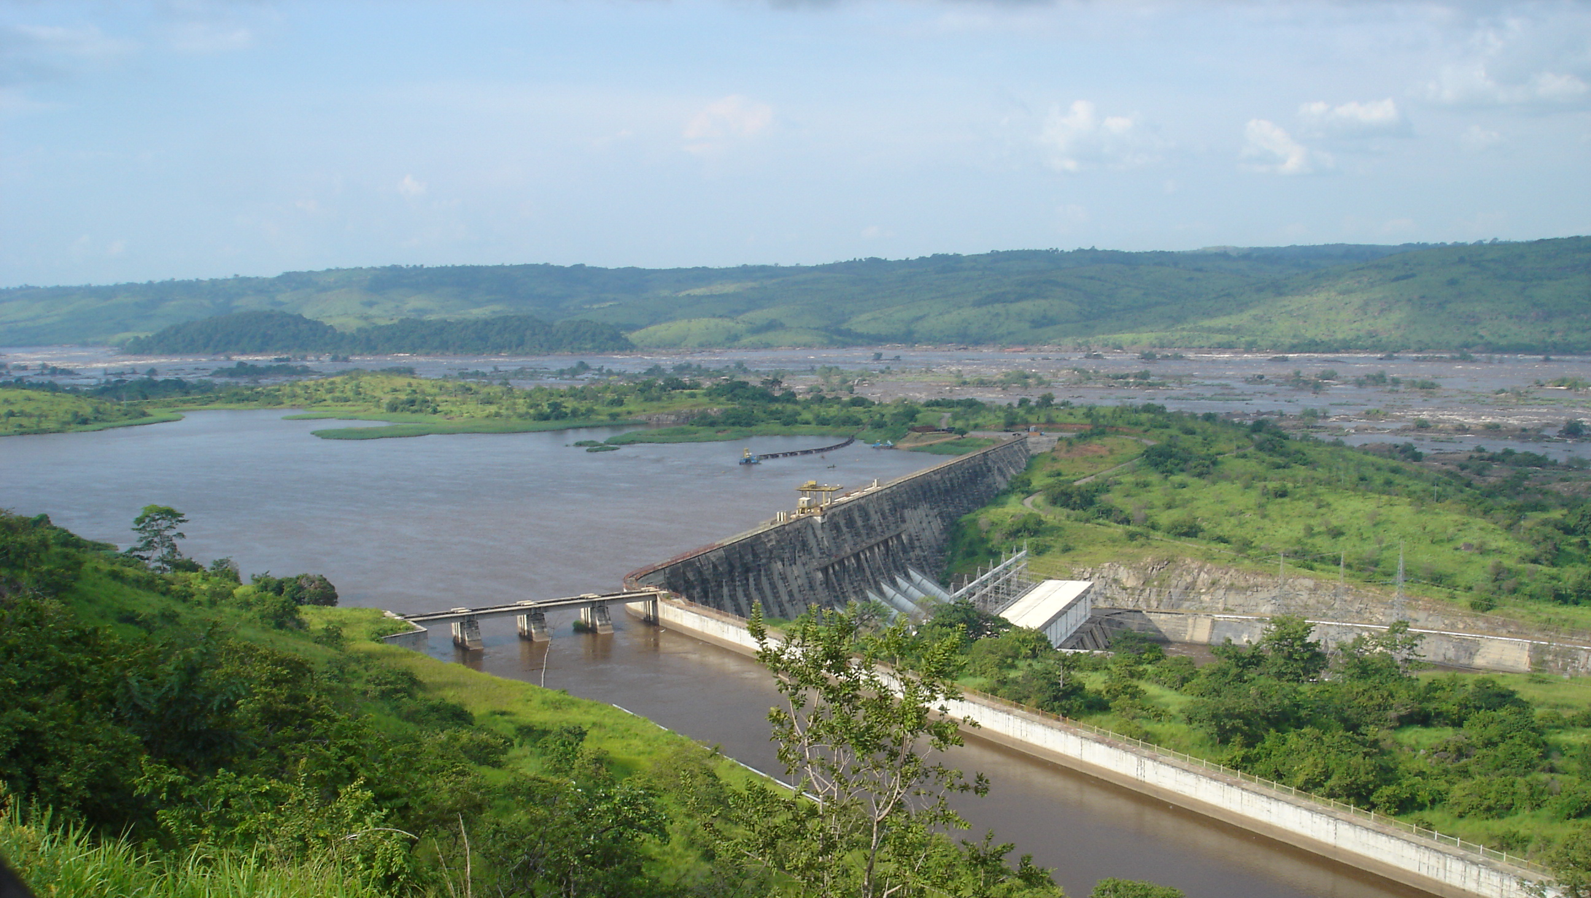




Hydropower capacity expansion
in the African continent under different
socio-economic & climate policy scenarios
Angelo Carlino, Matthias Wildemeersch, Matteo Giuliani, Andrea Castelletti
Notes:
https://upload.wikimedia.org/wikipedia/commons/thumb/3/3a/Barrage_Inga_%284028379271%29.jpg/640px-Barrage_Inga_%284028379271%29.jpg

Slide 2
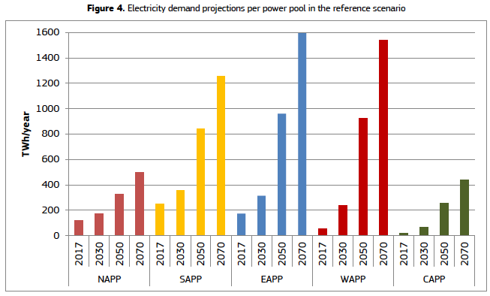
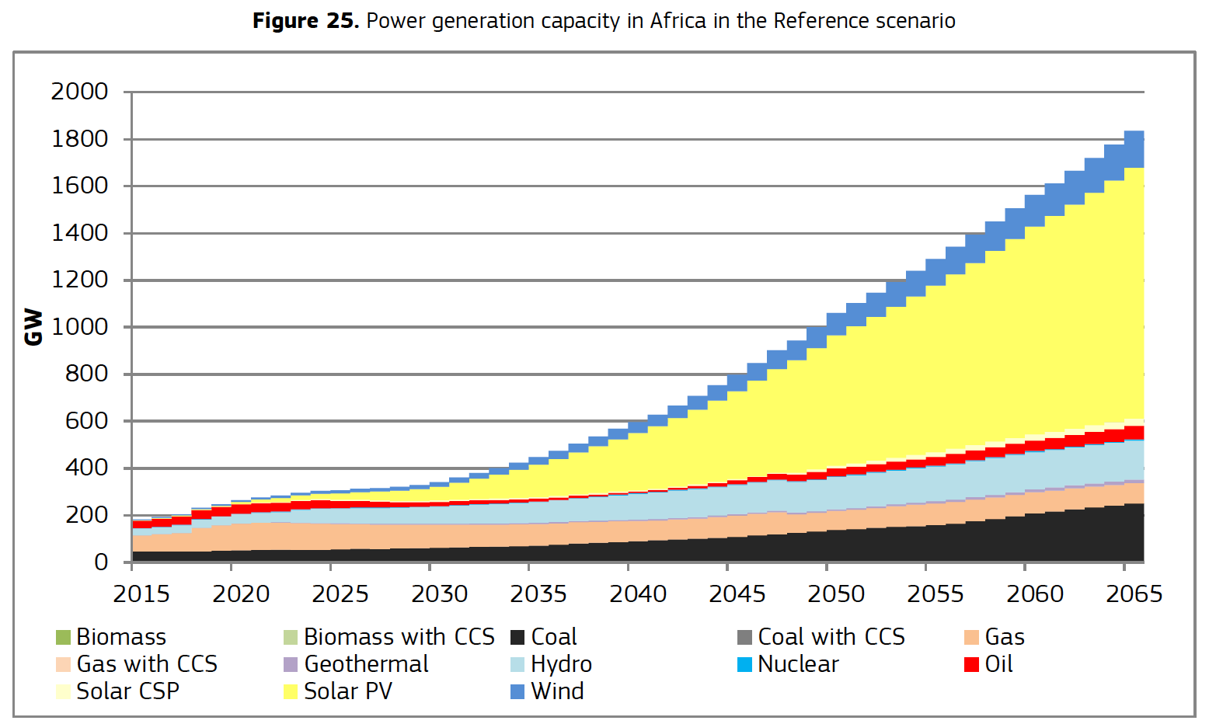
AFRICAN ENERGY & POWER SYSTEM
FUTURE ENERGY DEMAND AND HYDROPOWER CAPACITY EXPANSION
From 40 GW (2020) to 132 / 156 / 166 GW (2050)
+ 93 / 107 / 117 GW (increase) (Pappis et al., 2019)
Notes:
Future energy demand in Africa will be increasing as a result of increasing population and energy access. Even though the final energy demand remains uncertain, model-based studies expect around 100 additional GW of hydro in 2050

Slide 3
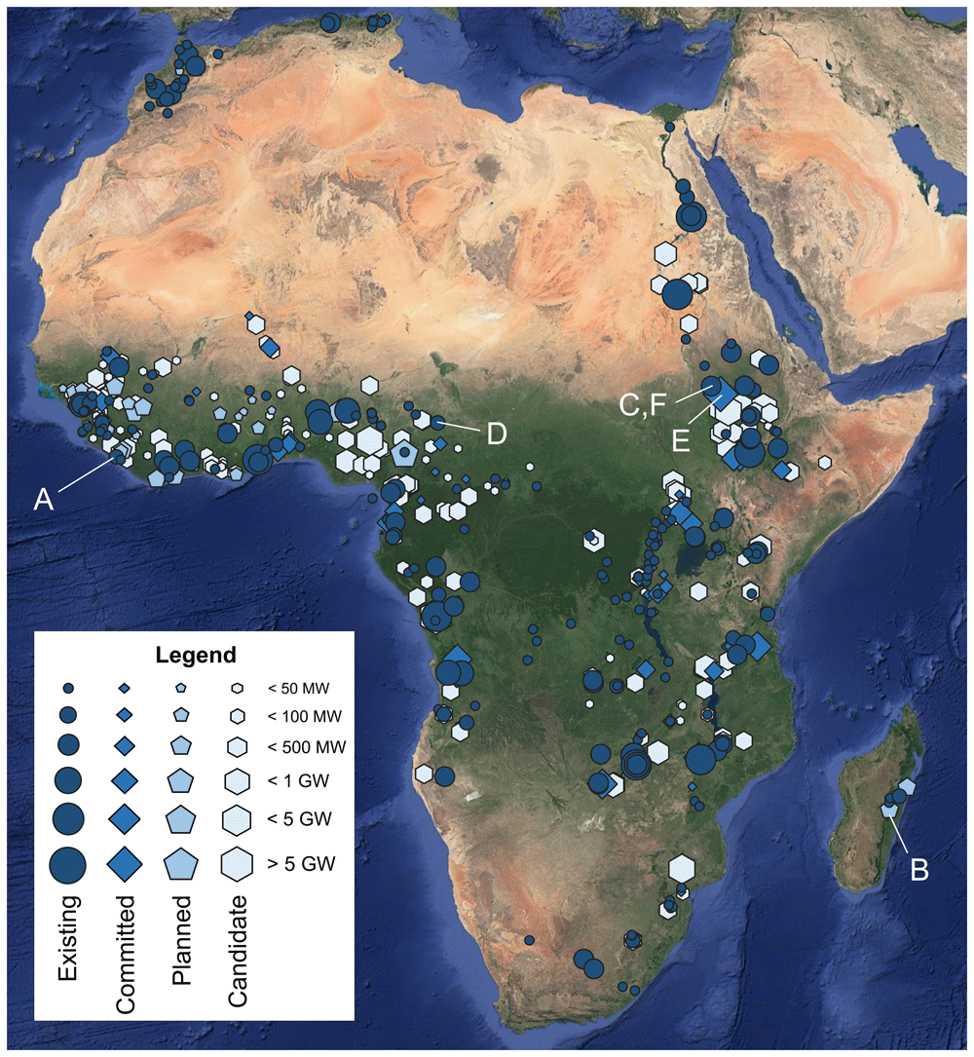
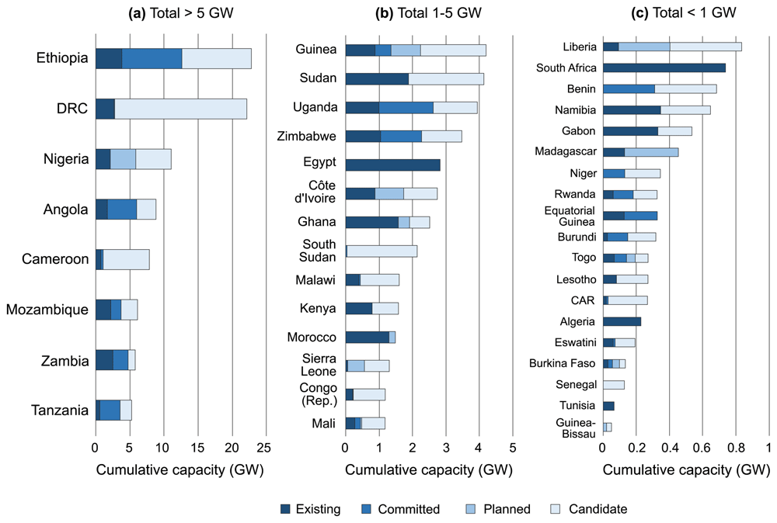
AFRICAN HYDROPOWER ATLAS
MORE THAN 300 NEW HYDROPOWER PROJECTS FOR 100GW (Sterl et al., 2021)
Notes:
This is consistent with the capacity of future hydropower projects reported in the AHA, which includes also information about capacity, generation and expected first year of operation. Yet, energy system models usually consider hydropower as a technology aggregated at the country level. Here we explore the effect of including this information to study 3 research questions

Slide 4
RESEARCH QUESTIONS
What is the role of hydropower projects within future energy portfolios?
What are the trade-offs behind large-scale hydropower capacity expansion?
Which river basins should prioritize new hydropower projects?

Slide 5
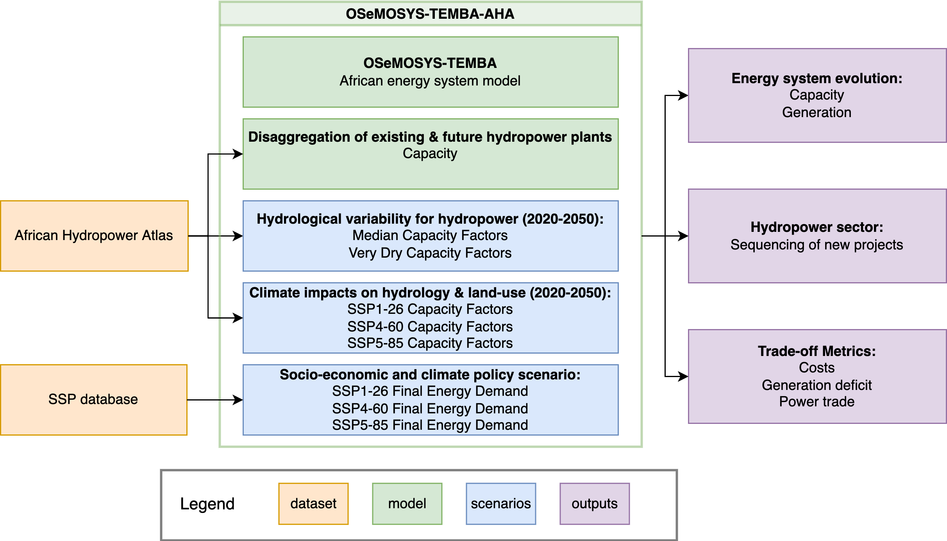
OSEMOSYS-TEMBA-AHA Model
LARGE-SCALE MULTISECTORAL HYDROPOWER CAPACITY EXPANSION MODEL
Notes:
We expand the osemosys model disaggregating hydropower using nominal capacity of each project. capacity factors account for future climate impacts, land use and hydrological variability based on ISIMIP2b scenarios. These scenarios are consistent with final energy demands obtained from the SSP database which account for socio-economic and climate policy projections. Climate policy is also considered adding emission caps aligned with the target temperature of 2C for the SSP1-26 scenario.
This model allows us to study the energy system evolution, with a focus on hydropower expansion, and collect different metrics of interest to evaluate the strategies examined.

Slide 6
CURRENT HYDRO EXPANSION PLAN
CONSTRAINED TO CURRENT HYDROPOWER CAPACITY EXPANSION PLANS
Added hydropower capacity: 100 GW
Notes:
As for capacity, under current plans more than 100 gw are concentrated in the 2020-2035 period

Slide 7
OPTIMal SEQUENCING OF HYDRO PROJECTS
FROM AHA PLANS TO OPTIMAL HYDRO EXPANSION UNDER MEDIAN HYDROLOGY
Added hydropower capacity: 48-63 GW
Notes:
Here we optimize also hydropower sequencing under median hydrology and report differences in capacity expansion with respect to the AHA constrained power expansion. Hydro (blue) is largely reduced mostly in favor of solar (yellow) across all SSPs examined. 2020-2035 is reporting the largest reduction while some hydro should have been already built in the past or should be moved to the future.

Slide 8
ROBUST HYDRO EXPANSION
FROM MEDIAN TO VERY DRY HYDROLOGY: FOCUS ON ROBUSTNESS
Added hydropower capacity: 38-45 GW
Notes:
We also optimize under very dry hydrology and report differnces with median hydrology expansion, hydro is further reduced in favor of solar. Reduction is larger in SSP1-26 scenario and more pronounced in similar across periods.

Slide 9
COSTS, DEMAND DEFICIT, & ENERGY FLOWS
RELIABILITY COMES WITH MODEST COST INCREASE BUT REQUIRES LARGE POWER FLOWS BETWEEN COUNTRIES
Notes:
The different capacity expansion scenarios examined are examined across total trade flows (x axis), total costs (y axis) and demand deficit (color) under the different hydrological regimes (the two rows). AHA (tringles) results in slightly higher costs under median hydrology but produces a deficit in dry scenario. Optimal capacity expansion under median hydrology results in deficit as well in the dry scenario. The robust solution results in contained costs but requires larger trade flows than the optimal one . Is it safe to rely on trade?

Slide 10
PRIORITIES & RISKS FOR HYDRO INVESTMENTS
WEST AFRICA TO BE PRIORITIZED, UNCERTAIN DEVELOPMENT IN SAPP & EAPP
Notes:
Finally we report hydro expansion in the four major river basin and smaller river basins:
Black line considers current plans, solid lines consider median hydrology while dashed report expansion under very dry hydrology. The colors report the different SSP scenarios.
Niger should prioritize development of many hydropower projects anticipating most of them.
Zambezi, Nile & smaller river basin might be risky investments as final optimal capacity is largely dependent on the scenario and the hydrology

Slide 11
SUMMARY
Around 34-62 % of planned hydropower is needed in order to satisfy energy demand and achieve climate policy targets.
Reliability comes at similar costs but requires higher power flows.
Regions of interest for hydropower development:
  Niger (West Africa) is a basin to prioritize
  Risky investments in Nile, Zambezi & smaller river basins
Notes:
Summarising:

Slide 12

acknowledgements
Sebastian Sterl Wim Thiery
James Chelray Chawanda Ann van Griensven

Slide 13
Angelo Carlino
angelo.carlino@polimi.it

