Slide 1
Machine learning and meteorological data for spatio-temporal prediction of tropospheric parameters
Laura Crocetti - lcrocetti@ethz.ch, B. Soja, G. Kłopotek, M. Awadaljeed, M. Rothacher, L. See, R. Weinacker, T. Sturn, I. McCallum, V. Navarro
27th May 2022, EGU22

Slide 2
Motivation
GNSS
Global Navigation Satellite System (GNSS) – a suitable tool for studies on the atmosphere
Radio signals transmitted by GNSS propagate through the atmosphere – atmospheric parameters can be estimated
atmosphere
Laura Crocetti – lcrocetti@ethz.ch

Slide 3
Motivation
GNSS
Global Navigation Satellite System (GNSS) – a suitable tool for studies on the atmosphere
Radio signals transmitted by GNSS propagate through the atmosphere – atmospheric parameters can be estimated
Make use of thousands of GNSS stations
model tropospheric parameters based on meteorological data using Machine Learning (ML)
atmosphere
Laura Crocetti – lcrocetti@ethz.ch

Slide 4
Motivation
Global Navigation Satellite System (GNSS) – a suitable tool for studies on the atmosphere
Radio signals transmitted by GNSS propagate through the atmosphere – atmospheric parameters can be estimated
Make use of thousands of GNSS stations
model tropospheric parameters based on meteorological data using Machine Learning (ML)
Longitude
Latitude
Zenith Wet Delay (ZWD)
Laura Crocetti – lcrocetti@ethz.ch

Slide 5
Motivation
Time
Global Navigation Satellite System (GNSS) – a suitable tool for studies on the atmosphere
Radio signals transmitted by GNSS propagate through the atmosphere – atmospheric parameters can be estimated
Make use of thousands of GNSS stations
model tropospheric parameters based on meteorological data using Machine Learning (ML)
Longitude
Latitude
Zenith Wet Delay (ZWD)
Laura Crocetti – lcrocetti@ethz.ch

Slide 6
Data
Zenith Wet Delay (ZWD)
Source: Nevada Geodetic Laboratory (NGL)
More than 19.000 GPS stations available
Temporal resolution: 5 min → hourly resolution
Spatial resolution: stations distributed globally
Time span: year 2019
Meteorological data
Source: ECMWF ERA5
Temporal resolution: hourly
Spatial resolution: 0.25°
Time span: year 2019
Several variables:
Specific humidity
Relative humidity
Temperature
Surface pressure
Total precipitation
Geopotential
Wind speed
Laura Crocetti – lcrocetti@ethz.ch

Slide 7
Data
TARGET
Meteorological data
Source: ECMWF ERA5
Temporal resolution: hourly
Spatial resolution: 0.25°
Time span: year 2019
Several variables:
Specific humidity
Relative humidity
Temperature
Surface pressure
Total precipitation
Geopotential
Wind speed
Zenith Wet Delay (ZWD)
Source: Nevada Geodetic Laboratory (NGL)
More than 19.000 GPS stations available
Temporal resolution: 5 min → hourly resolution
Spatial resolution: stations distributed globally
Time span: year 2019
FEATURES
Latitude
Longitude
Height
Time
Laura Crocetti – lcrocetti@ethz.ch

Slide 8
Data
TARGET
Meteorological data
Source: ECMWF ERA5
Temporal resolution: hourly
Spatial resolution: 0.25°
Time span: year 2019
Several variables:
Specific humidity
Relative humidity
Temperature
Surface pressure
Total precipitation
Geopotential
Wind speed
Zenith Wet Delay (ZWD)
Source: Nevada Geodetic Laboratory (NGL)
More than 19.000 GPS stations available
Temporal resolution: 5 min → hourly resolution
Spatial resolution: stations distributed globally
Time span: year 2019
FEATURES
Aim: predict ZWD in space (and time) using ML algorithms
Latitude
Longitude
Height
Time
Laura Crocetti – lcrocetti@ethz.ch

Slide 9
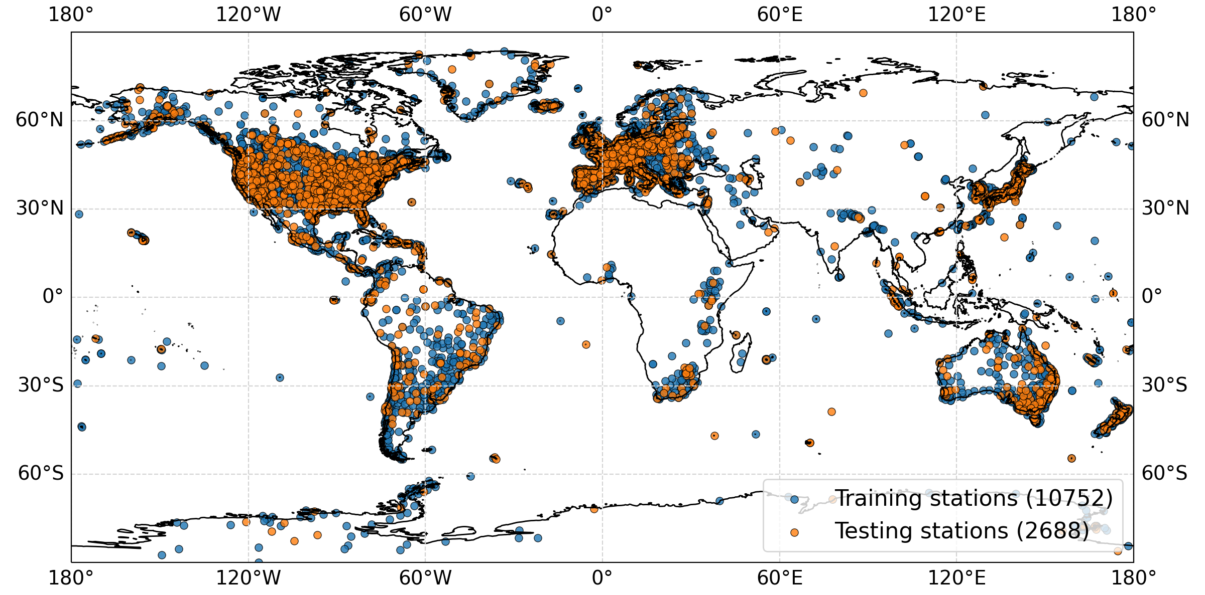
Set up
Global model for year 2019
DATA
Distribution of training and test stations for all available stations (2019)
TRAINING DATA - 80%
ZWD (y_train)
features (X_train)
TESTING DATA - 20%
ZWD (y_test)
features (X_test)
ML ALGORITHM
standardize features
hyperparameter optimization
cross-validation
train model
EVALUATION
Make ZWD predictions for testing data (y_test_pred)
calculate performance metrics
RMSE
R2
output: ML model
ML algorithm: XGBoost, Random Forest
Laura Crocetti – lcrocetti@ethz.ch

Slide 10
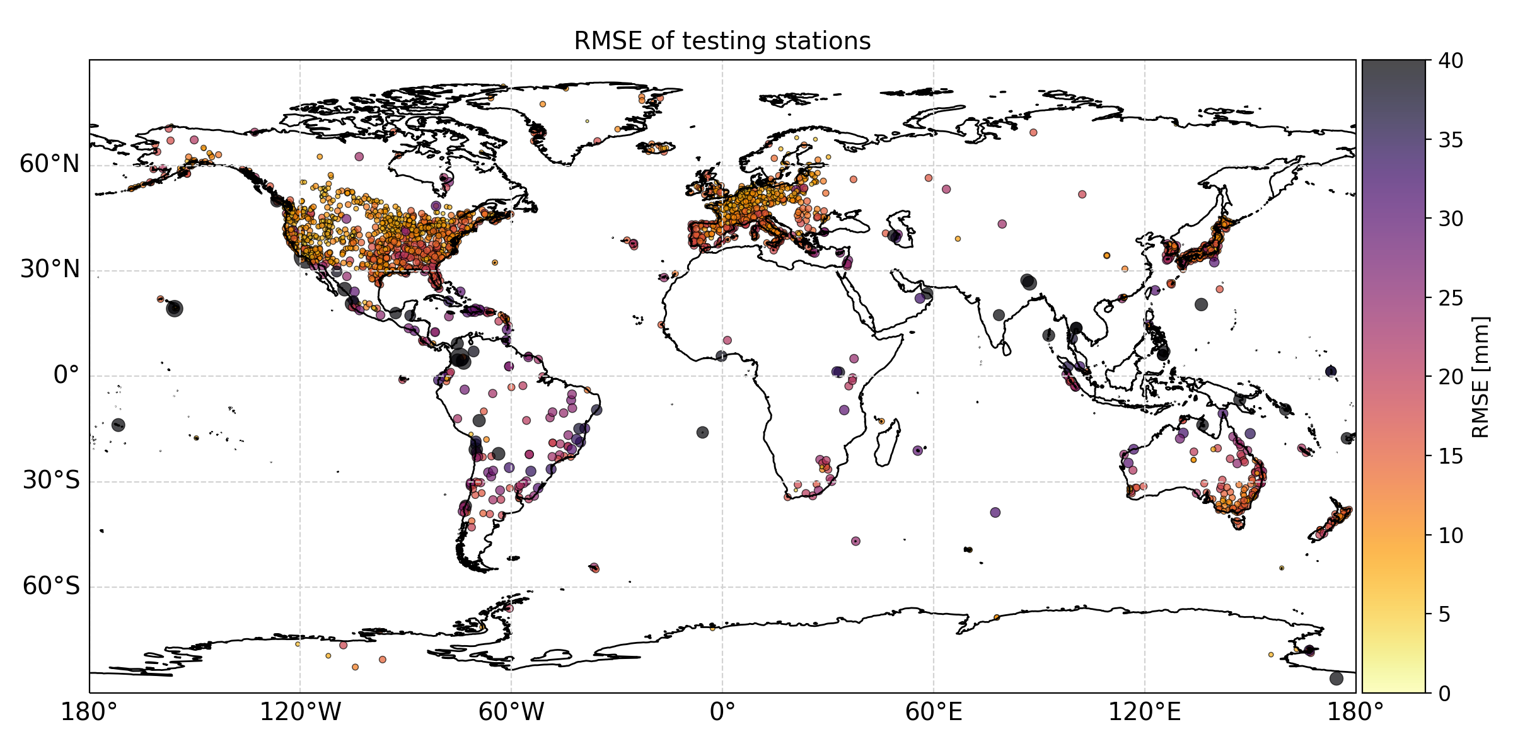
Performance of individual test stations
Laura Crocetti – lcrocetti@ethz.ch

Slide 11
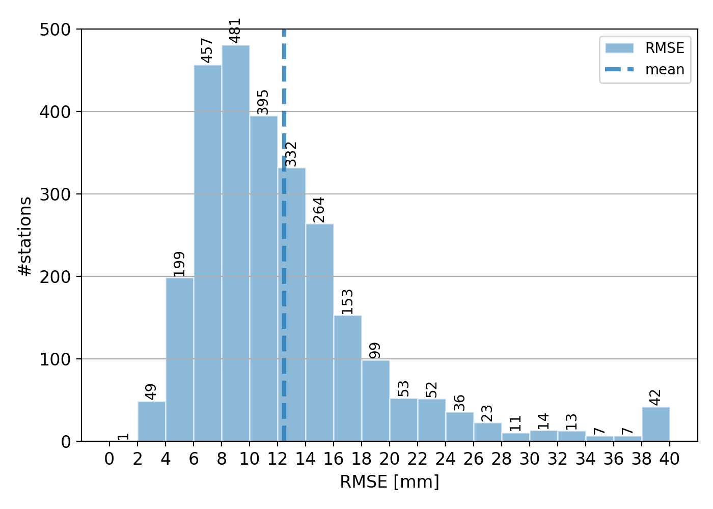
Performance of individual test stations
mean = 12.47 mm
Laura Crocetti – lcrocetti@ethz.ch

Slide 12
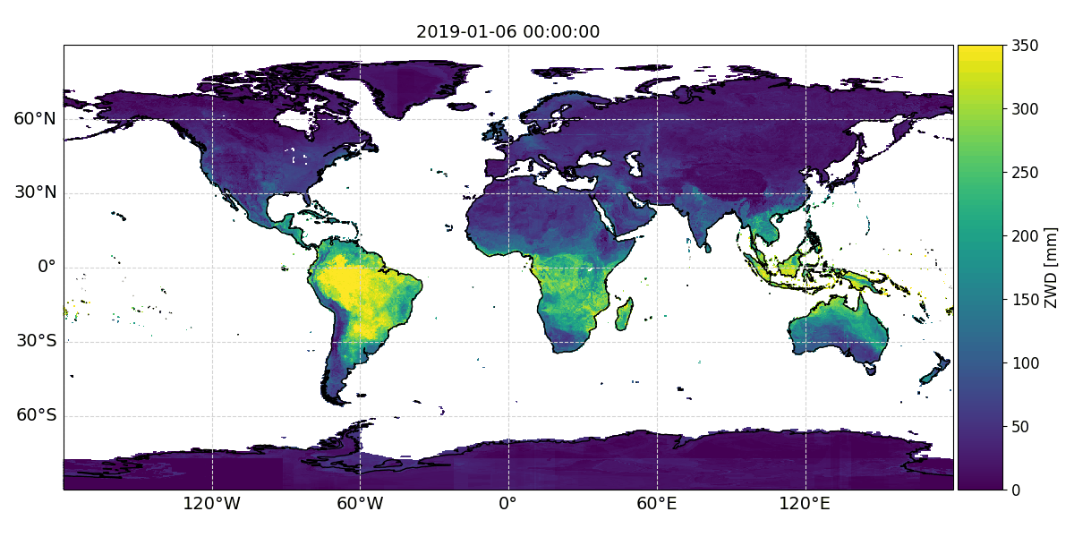
ZWD predictions for 2019
Laura Crocetti – lcrocetti@ethz.ch

Slide 13
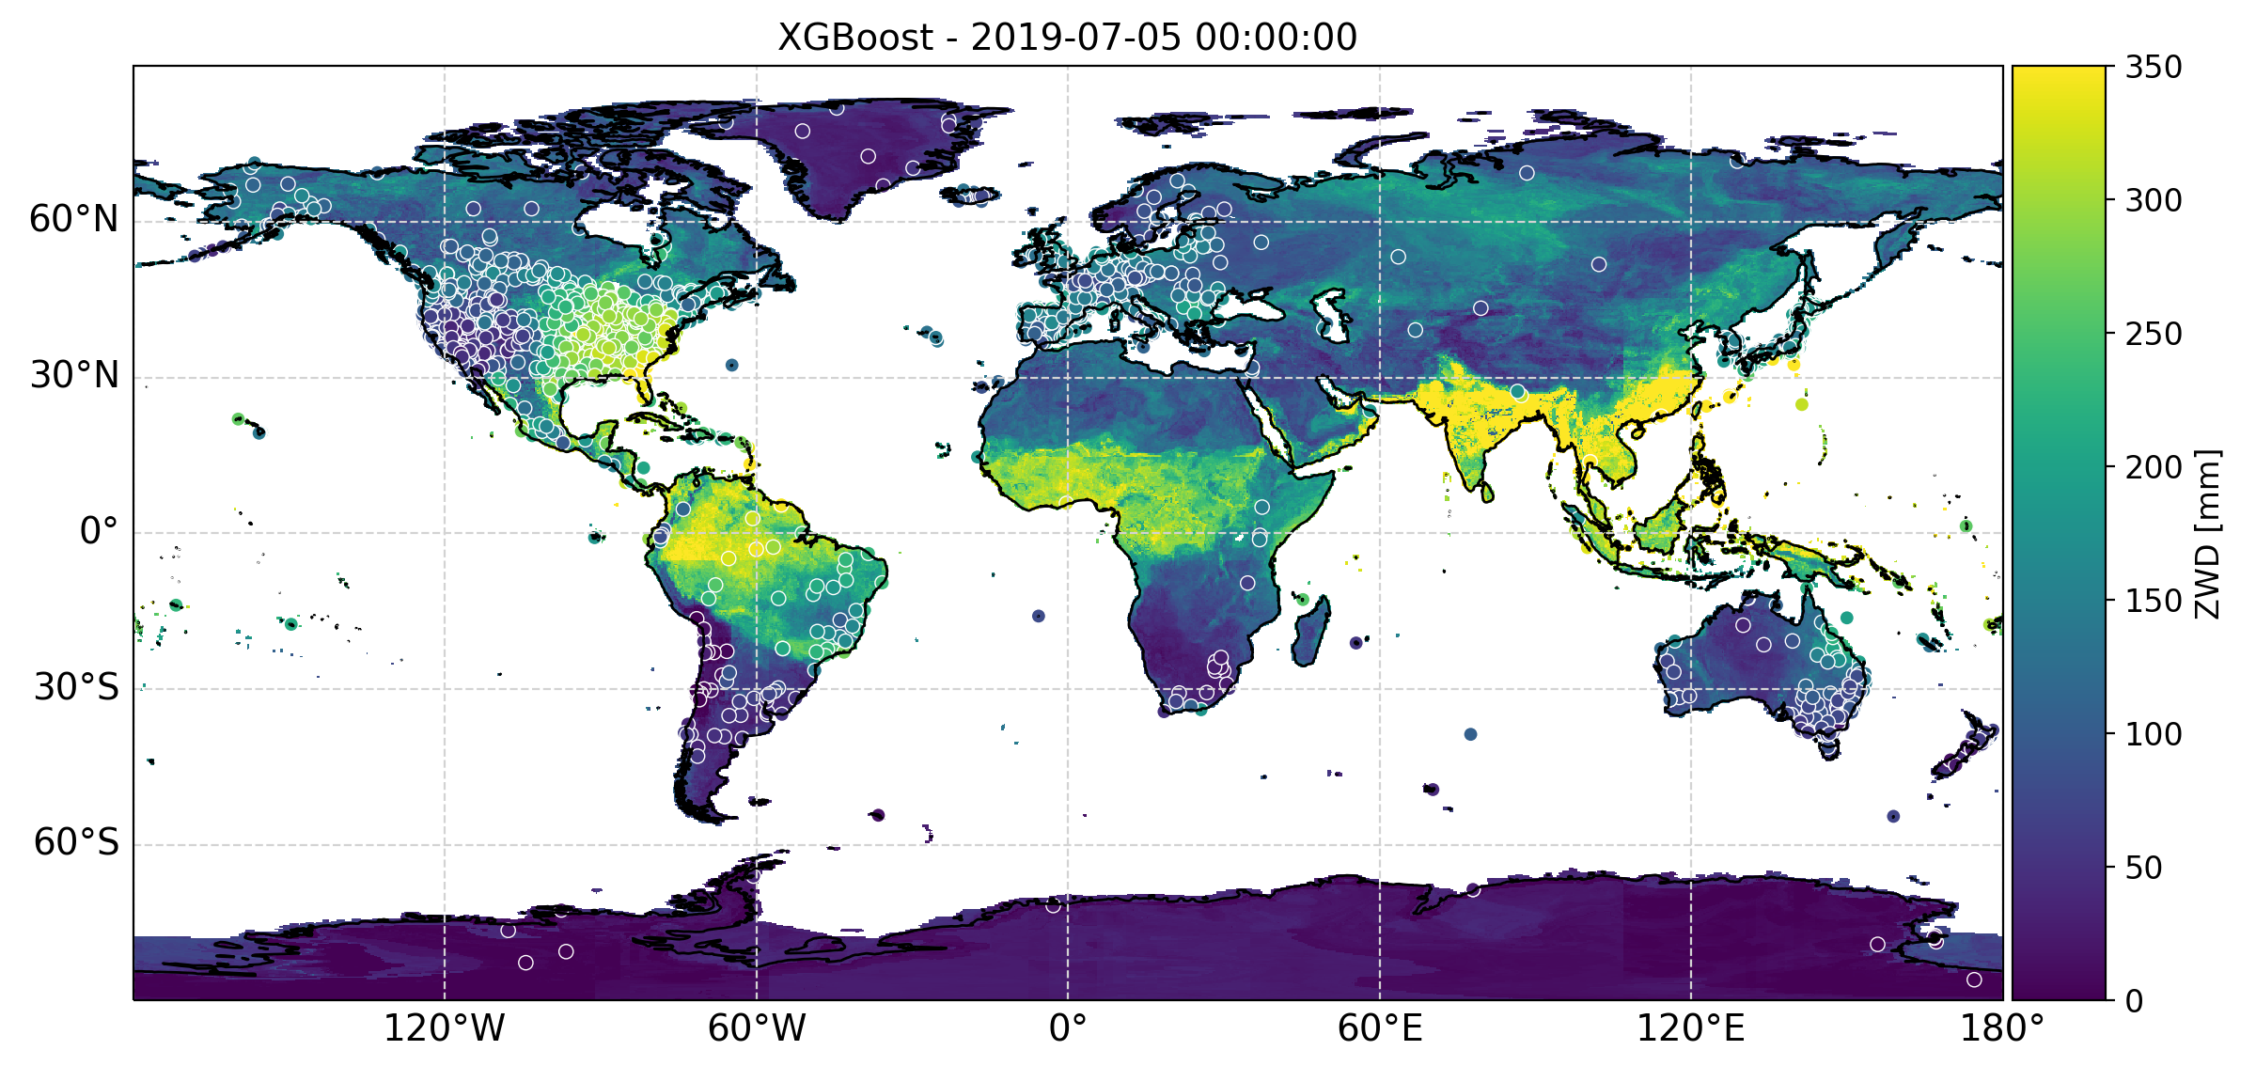
Summary
Global ML-based ZWD model based on meteorological data
Can make predictions of ZWD for every point on Earth (assuming meteorological data is available)
Achieves an average RMSE of 12.47 mm
ML algorithms: XGBoost and Random Forest
atmosphere
Laura Crocetti – lcrocetti@ethz.ch

Slide 14
Laura Crocetti lcrocetti@ethz.ch
ETH Zurich
Space Geodesy Group
Institute of Geodesy and Photogrammetry
Zurich, Switzerland
www.space.igp.ethz.ch

