Slide 1
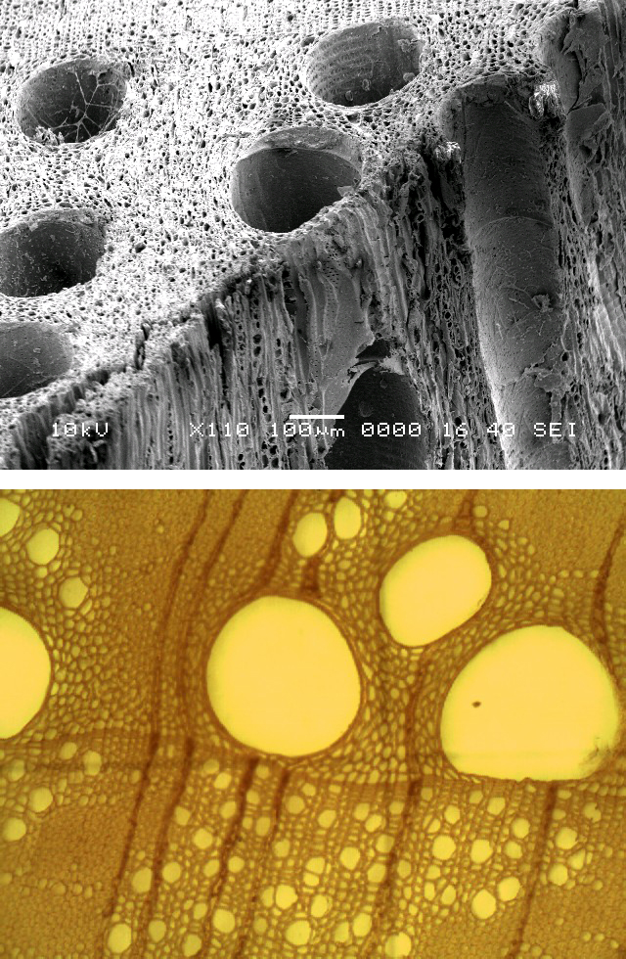
Optimal xylem conductivity and safety or
Why are trees so sensitive to drought?
Oskar Franklin^{1,2}, Peter Fransson², Florian Hofhansl¹, Jaideep Joshi¹
¹IIASA
² Swedish University of Agricultural Sciences
Supported by Knut and Alice Wallenberg Foundation
Notes:
A hypothesis to explain the drought sensitivity of plants

Slide 2
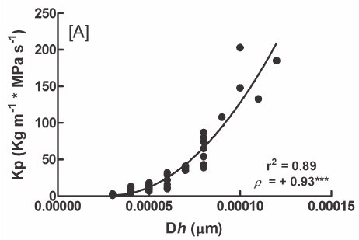
What determines xylem conductivity and safety?
Actual conductivity = Potential conductivity * Conductivity loss
Conductivity loss = cavitation = embolism
Due to low xylem pressure (ψ)
Sensitivity defined by ψ₅₀
Potential conductivity depends on vessel diameter, K ≈ D⁴
Figure from Venturas et al. 2017
Journal of Integrative Plant Biology
Notes:
Two factors: the potential conductivity of fully functional conduits, and the fraction of embolized conduits. Negative pressure => conductivity loss, sensitivity defined in terms of p50

Slide 3
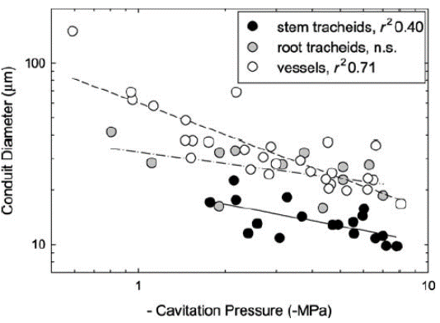
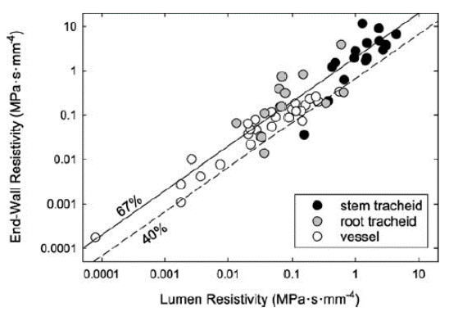
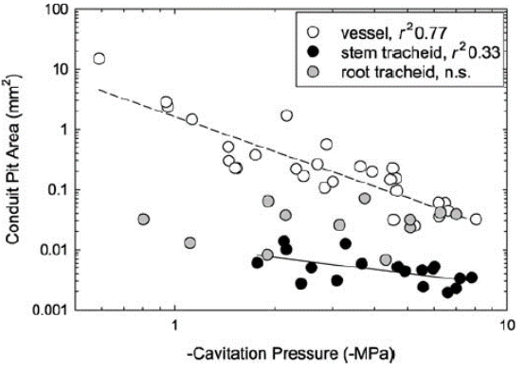
Which xylem traits determine conductivity and safety?
K
D
D
ψ₅₀
Figures from Sperry et al. 2006. American Journal of Botany
1/K
Figure from Venturas et al. 2017
Journal of Integrative Plant Biology
1/K
ψ₅₀
Xylem functional traits are strongly coordinated (as expected!)
Notes:
I said D, but the pit experts say no its not D, its the pits. We say its all coordinated. Mean D can work as a proxy

Slide 4
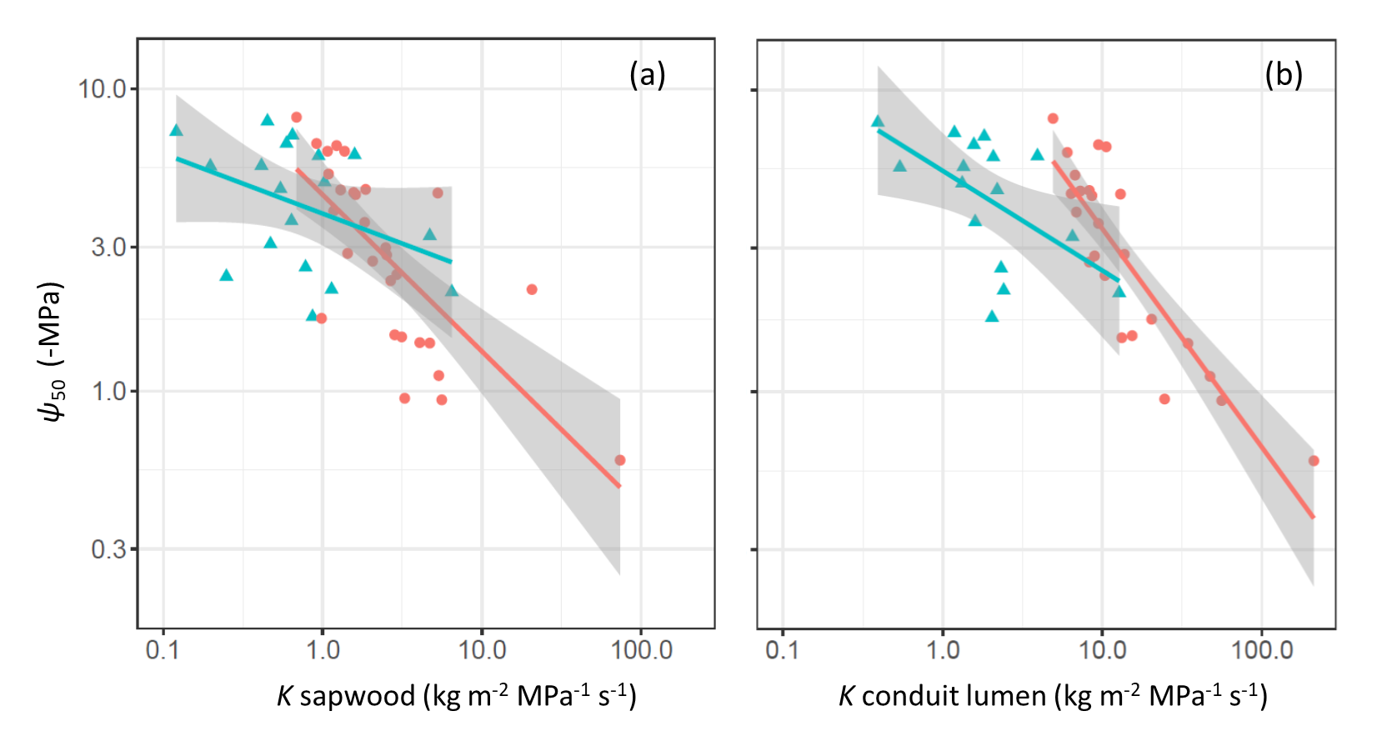
A tradeoff between xylem conductivity (K) and safety (ψ₅₀) at the coduit level
Larger conduit diameter => higher K but lower ψ₅₀
Data from Sperry et al. 2006. American Journal of Botany
Notes:
Most interesting aspect of the trait correlations is the tradeoff. This has has also been debated but we find a signifcant tradeoff at the level of individual conduits. At the whole sapwood it is weakened by varation in conduits number per area

Slide 5
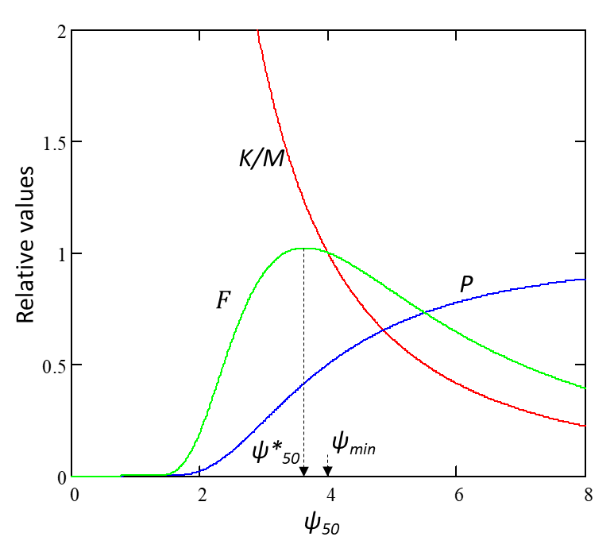
What is the optimal xylem ψ₅₀ ?
Hypothesis: Maximal conductivity per biomass * minimal conductivity loss at low ψ
Model decribed in:
O Franklin, P Fransson, F Hofhansl, J Joshi. 2022. Optimal balancing of xylem efficiency and safety explains plant vulnerability to drought. bioRxiv 2022.05.16.491812
Potential
conductivity per biomass
Remaining fraction
conductivity
Notes:
Based on this tradeoff we made an optimality model. Hypotheis... Higher neagtive p50 and smaller conduit diameters....

Slide 6
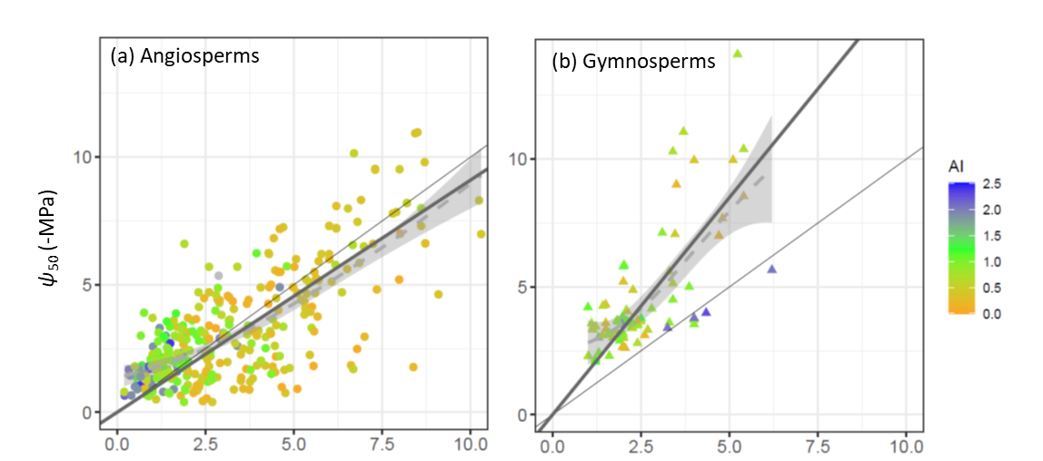
Results
Data from Liu et al. 2019. Science Advances 5(2): eaav1332.
ψ_{min}
Contact: franklin@iiasa.ac.at
Notes:
Applied to a large number of species and sites with differnt aridity. Optimal models gives a linear relationship with a slope very close to observations for Angio. For gymnosperms we had to invoke additional damage accumulation.

