Slide 1
Perceptions on intolerable climate-related risks and limits to adaptation in Austria
Veronica Karabaczek, Thomas Schinko, Linda Menk, Stefan Kienberger
25.05.2022

Slide 2
TransLoss – adaptation limits in Austria?
Methodology
Initial stakeholder identification and mapping
Semi-structured interviews (n=26) with experts from research (19%), administration (42%), public institutions (31%) and the private sector (8%)
Qualitative Content Analysis (Mayring, 2010) of interviews in NVivo
Adaptation limits: The point at which an actor’s objectives (or system needs) cannot be secured from intolerable risks through adaptive actions (IPCC, 2019)
Intolerable risks: Those which “exceed a socially negotiated norm (e.g. the availability of clean drinking water) or a value (e.g. the continuity of a way of life) despite adaptive action” (Dow et al., 2013, p. 385)
“Values […] frame how societies develop rules and institutions to govern risk, and to manage social change and the allocation of scarce resources” (Adger et al., 2009, p. 338 based on Ostrom, 2005).
They are not the same across stakeholder groups. Competing values necessitate trade-offs in prioritizing adaptation action (Klein et al., 2014)

Slide 3
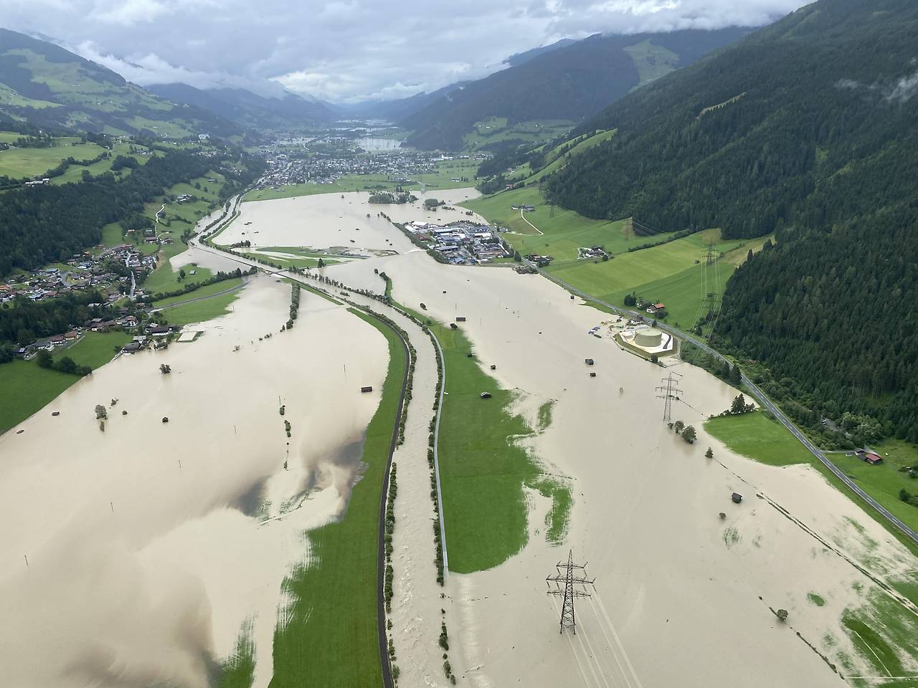
Results
Most important concerns: increasing temperatures and more frequent precipitation extremes (→higher flood and drought risks)
Potential adaptation constraints:
Responsibility for individual risk reduction very low
Low sense of urgency among the population and decision-makers, e.g. caused by lacking knowledge on future conditions and “limits of imagination”
Low risk awareness leads to construction of infrastructure in risk zones with insufficient protective measures
Interconnected or “systemic” risks currently not widely discussed despite high potential of leading to adaptation limits
Flooding in Pinzgau, Salzburg, in July 2021. Copyright: Land Salzburg/Franz Wieser

Slide 4
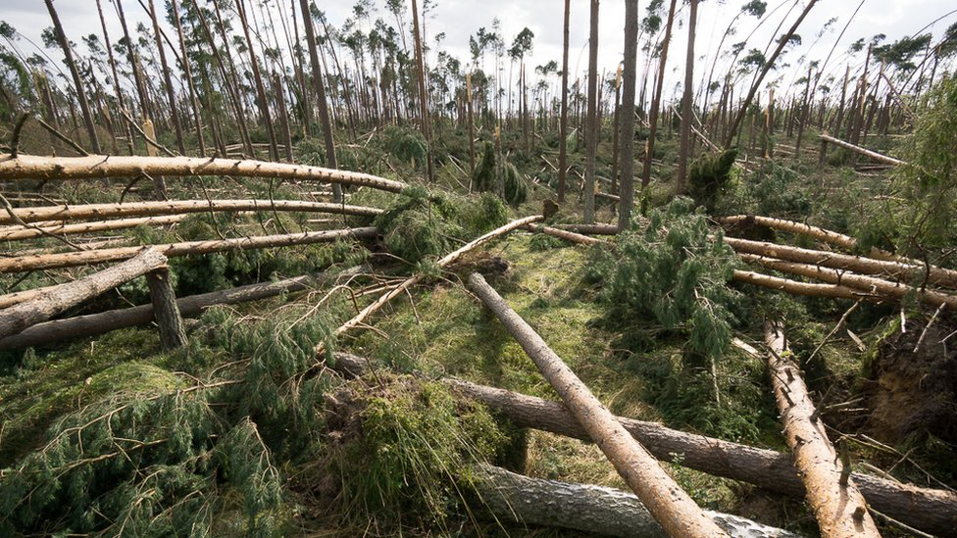
Results (II)
Discussed measures to overcome adaptation constraints:
More responsibility for individuals for own risk reduction
More education on climate change and disaster risks at schools, universities and companies
More restrictive and coordinated spatial planning
More participatory processes involving the population
Destroyed forest after a storm. Copyright: Mateusz Stopinski

Slide 5
Conclusions
Currently, there are no concerns regarding adaptation limits at national scale, but at individual or local levels
More awareness for and knowledge of possible impacts from climate change are needed to proactively plan and implement effective adaptation measures and to identify potential adaptation limits
More frequent and intense hazard events will lead to discussions on values and preferences:
“What is this building, this activity, worth? How much are we willing to pay for it?”
The involvement of relevant stakeholders and the general population is necessary to identify societal values and needs and will increase the understanding of adaptation limits and the acceptance of (transformative) adaptation measures.

Slide 6
Thank you.
Questions?
Veronica Karabaczek Equity and Justice (EQU) Research Group karabaczek@iiasa.ac.at

Slide 7
References
Adger, W. N., Dessai, S., Goulden, M., Hulme, M., Lorenzoni, I., Nelson, D. R., Naess, L. O., Wolf, J., & Wreford, A. (2009). Are there social limits to adaptation to climate change? Climatic Change, 93(3–4), 335–354. https://doi.org/10.1007/s10584-008-9520-z
Dow, K., Berkhout, F., & Preston, B. L. (2013). Limits to adaptation to climate change: A risk approach. In Current Opinion in Environmental Sustainability (Vol. 5, Issues 3–4, pp. 384–391). Elsevier. https://doi.org/10.1016/j.cosust.2013.07.005
IPCC, 2019: Annex I: Glossary [Weyer, N.M. (ed.)]. In: IPCC Special Report on the Ocean and Cryosphere in a Changing Climate [H.-O. Pörtner, D.C. Roberts, V. Masson-Delmotte, P. Zhai, M. Tignor, E. Poloczanska, K. Mintenbeck, A. Alegría, M. Nicolai, A. Okem, J. Petzold, B. Rama, N.M. Weyer (eds.)].
Klein, R.J.T., G.F. Midgley, B.L. Preston, M. Alam, F.G.H. Berkhout, K. Dow, and M.R. Shaw, 2014: Adaptation opportunities, constraints, and limits. In: Climate Change 2014: Impacts, Adaptation, and Vulnerability. Part A: Global and Sectoral Aspects. Contribution of Working Group II to the Fifth Assessment Report of the Intergovernmental Panel on Climate Change [Field, C.B., V.R. Barros, D.J. Dokken, K.J. Mach, M.D. Mastrandrea, T.E. Bilir, M. Chatterjee, K.L. Ebi, Y.O. Estrada, R.C. Genova, B. Girma, E.S. Kissel, A.N. Levy, S. MacCracken, P.R. Mastrandrea, and L.L. White (eds.)]. Cambridge University Press, Cambridge, United Kingdom and New York, NY, USA, pp. 899-943.
Ostrom, E. (2005) Understanding institutional diversity. Princeton University Press, Princeton

