Slide 1
Regional variability and driving forces behind the forest fires in Sweden
Reinis Cimdins (University of Eastern Finland)
Florian Kraxner (IIASA)
Andrey Krasovskiy (IIASA)
ICFBR2022; Alghero (ITA); 04.05.2022
Notes:
Include recent papers for fin and swe, although problem of forest fires are are minor compared to portugal, spain. Still there is an interest and we want to compare those countries.

Slide 2
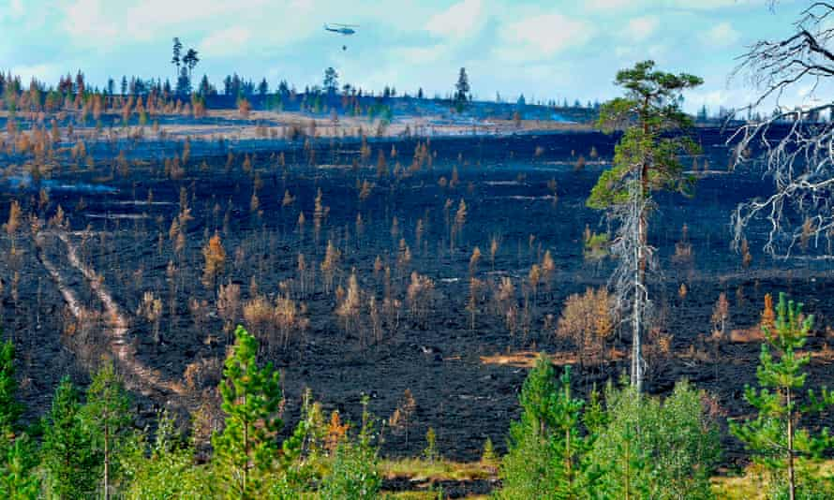
Large boreal forest fires usually take place in Russia and Canada, but significant fire events have occurred in Fennoscandia in recent years.
Forest fires, especially mega fires, are always perceived as a threat for boreal forest regions, with millions of hectares burned annually, causing huge social, environmental, and economical costs.
The objective of our study is to understand the wildfire vulnerability of forest areas in Sweden by analyzing spatially explicit historical burned areas and their connection to weather, landscape and fire-related socioeconomic factors.
Forest fires in Sweden. Author: Maja Suslin
Notes:
Include recent papers for fin and swe, although problem of forest fires are are minor compared to portugal, spain. Still there is an interest and we want to compare those countries.

Slide 3
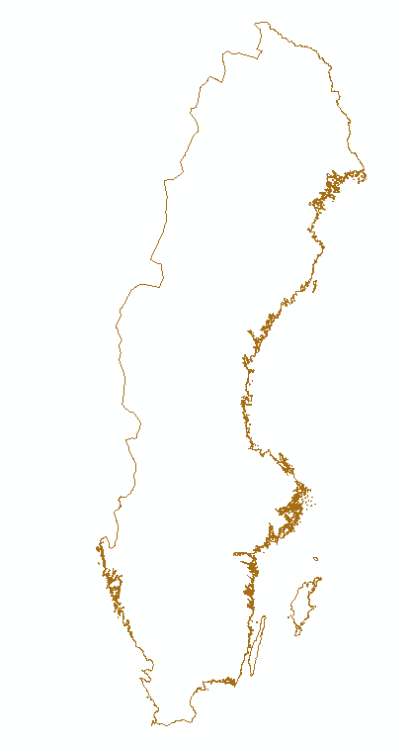
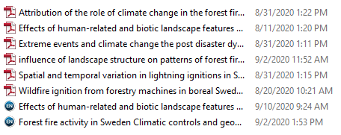
Literature review
Sweden :
Annual BA: 1,000 – 2,000 ha/year
2014(>10,000 ha)
2018(~25,000 ha)
Notes:
Include recent papers for fin and swe, although problem of forest fires are are minor compared to portugal, spain. Still there is an interest and we want to compare those countries.

Slide 4
Main factors for forest fire modelling
Weather
drought
high temperature
low relative Humid
wind
soil moisture
Ignition
Anthropogenic
campings
road density
population density
Natural (lightnings)
Fuel
biomass
litter
deadwood
Fire propagation
slope
weather
lakes
Fire suppression
road density
population density
fire intensity

Slide 5
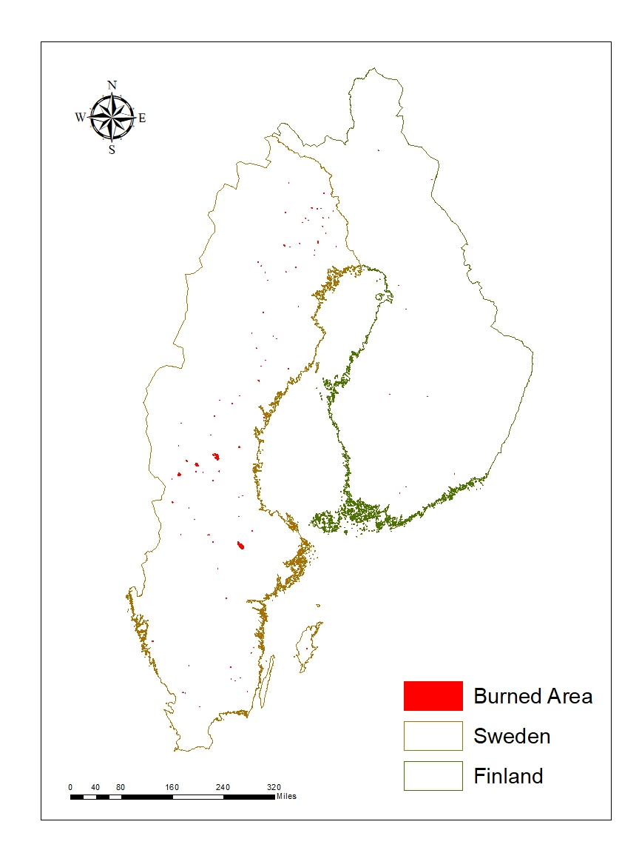
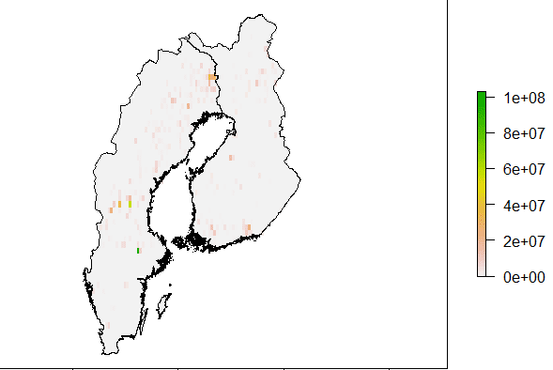
Burned area products
MODIS Burned Area:
Grid ( 0.25-degrees) ~27.75 km
Pixel (250m) LC (land cover)
EFFIS Burned Forest Land:
Resolution: 250m
Too less data for Finland (2017,2018)
GFED (Global Fire Emission Database) spatial data 2000-2016
Notes:
Add title

Slide 6
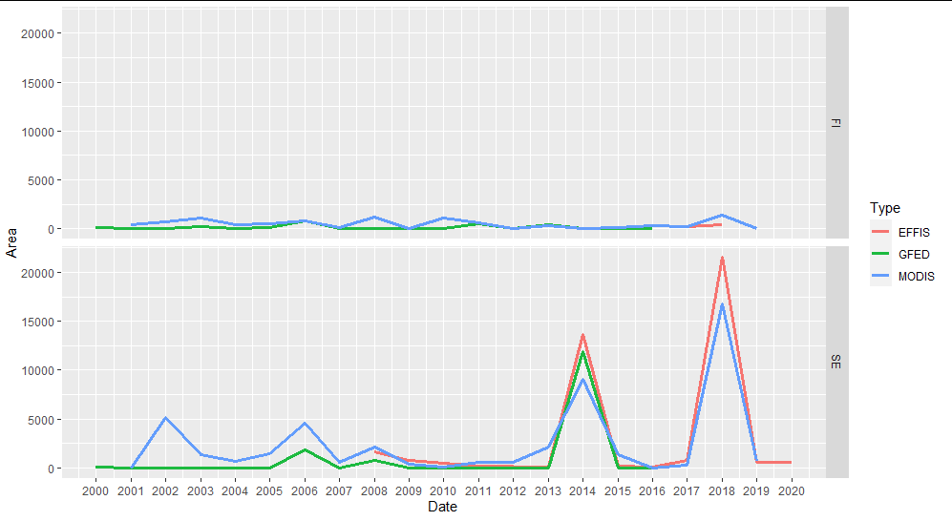
Annual burned forest area
​Finland
​Sweden
Notes:
Compare burned area, we checked 3 sources, growing burned area in recent years. Does all data types burned area is calculated using land cover classes (forest)?
Main focus on Sweden because of small number of fires

Slide 7
Weather impacts on burned area
FFMC: Fine Fuel Moisture Code
Temperature
Relative humidity
Wind speed
Precipitation
AI: Angström sub-daily index
Temperature (at 13:00)
Relative humidity
The wildFire cLimate impacts and Adaptation Model (FLAM)
FFMC is part of Canadian fire weather information system and used worldwide and Angström index was developed in Sweden.

Slide 8
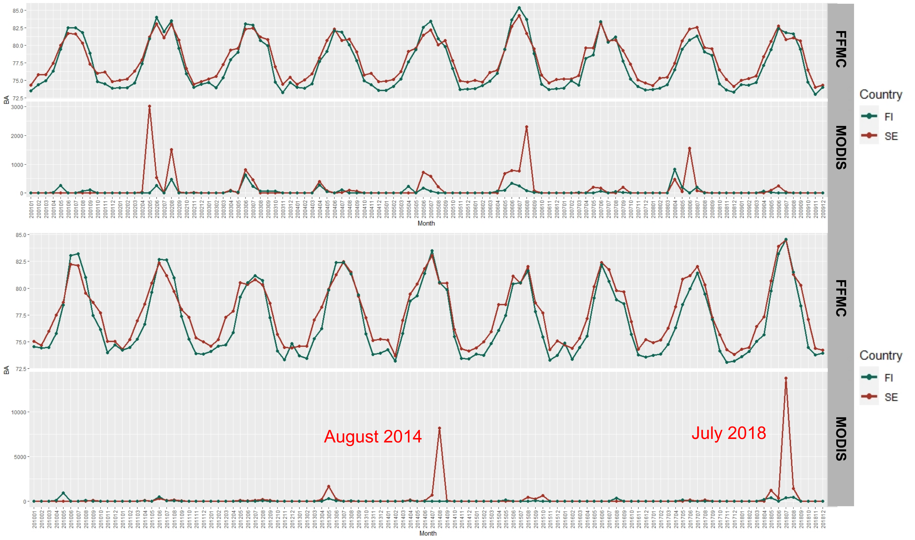
Comparison between FFMC and MODIS burned forest area (Average country wise values)
Notes:
Highlight 2014 and 2018 in swe, how it interacts, show the deviation in july, arrows etc, add some lines to visualize peaks

Slide 9
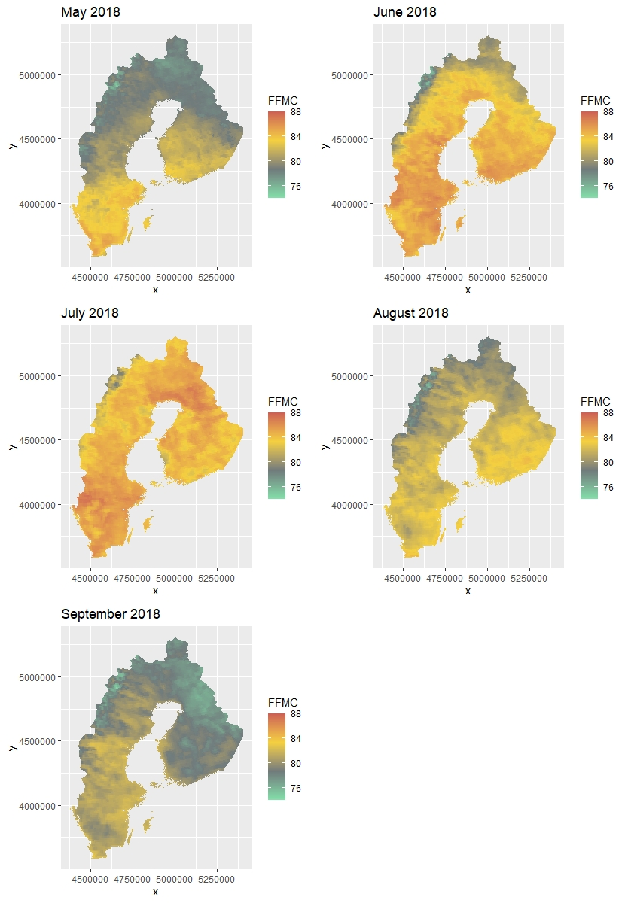
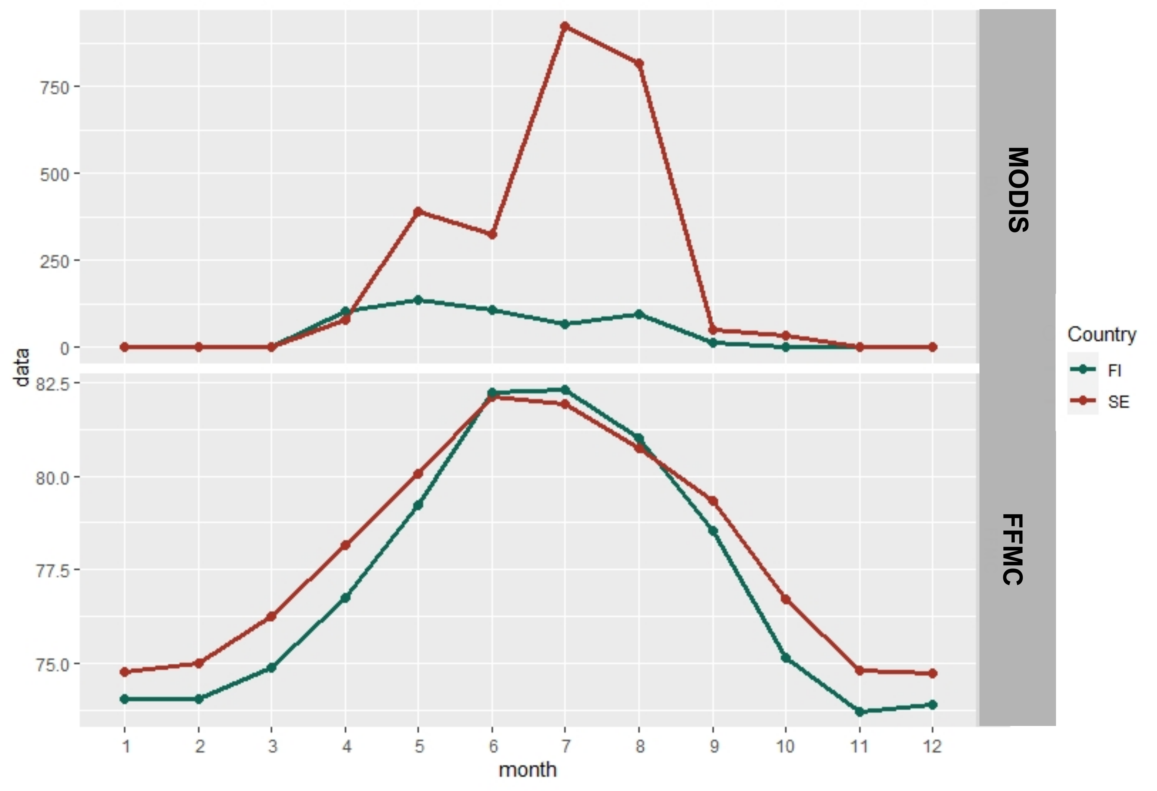
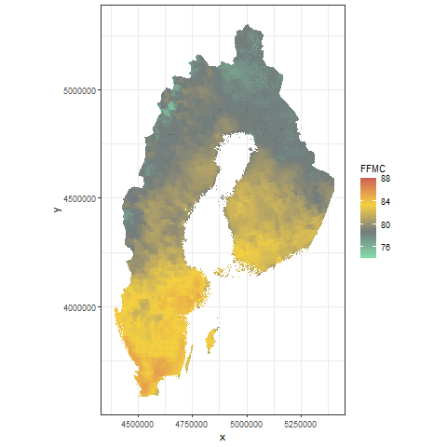
FFMC maps from May to September 2018
Average monthly FFMC VS. MODIS burned forest area
Notes:
Weather conditions were similar, but greater area burned in Sweden
Add threshold and mention about average values

Slide 10
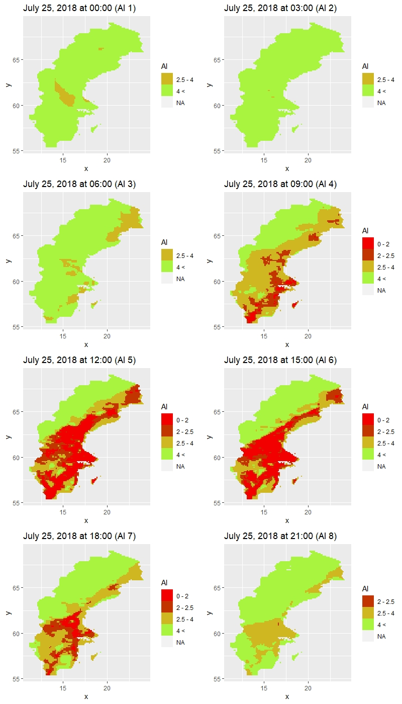
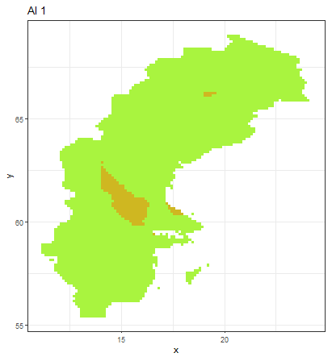
Sub daily weather indices
Angström index (AI) maps for every 3 hours in July 25, 2018
The Angström index is interpreted as follows:
Angström index, using sub-daily HARMONIE weather data.
The highest fire risk is between 12:00 – 15:00
Notes:
Maps

Slide 11
Modelling database
Latitude | Campings | Population | Roads | Lakes | Managm. | Stand vol. | Decidous vol. | Stand age | DEM max | DEM avg | Slope | Aspect | Lightning | FFMC | MODIS
Each database row includes all modelling parameters and represents 1x1 km pixel using ETRS89 LAEA Europe metric coordinate system (EPSG:3035).
Latitude - pixel location
Campings - voluntary mapped shelters and bonfire places per cell (vindskydskartta).
Population data 2015 - population density with resolution of 1x1 km was collected from NASA.
Roads - road vector layer was rasterized to 20x20 m and then sum of road pixels were aggregated to 1x1 km grid (Open Street Maps).
Lakes - Corine land classification (100x100 m) was reclassified to binary values 0 - non lakes and 1 – lakes. Then mean value of lakes for 1x1 km grid was calculated (Copernicus).
Managm. - global forest management map with resolution 100x100 m was classified to binary values and aggregated as mean value to 1x1 km grid (Lesiv et.al 2020).
Stand vol; Decidous vol; Stand age - National forest inventory stand volume data (25x25 m) was aggregated as mean value to 1x1 km grid (SLU).
DEM_max; DEM_avg; slope; aspect - digital elevation model (DEM) maximum, average, mean slope and mean aspect values were calculated from 25x25 m resolution JAXA space product and aggregated to 1x1 km pixels (JAXA).
Monthly forest lightning data - monthly lightning data from Swedish Meteorological and Hydrological Institute.
Monthly FFMC values - monthly FFMC rasters (1 km) were calculated using GFWED model weather inputs
Monthly MODIS data - monthly MODIS FireCCI_5_1 rasters (250x250 m) were reclassified leaving only forest related fires and clipped for Sweden Then raster data were aggregated to yearly 1x1 km forest fires maps (MODIS).
Notes:
Which spatial features make difference for these countries

Slide 12
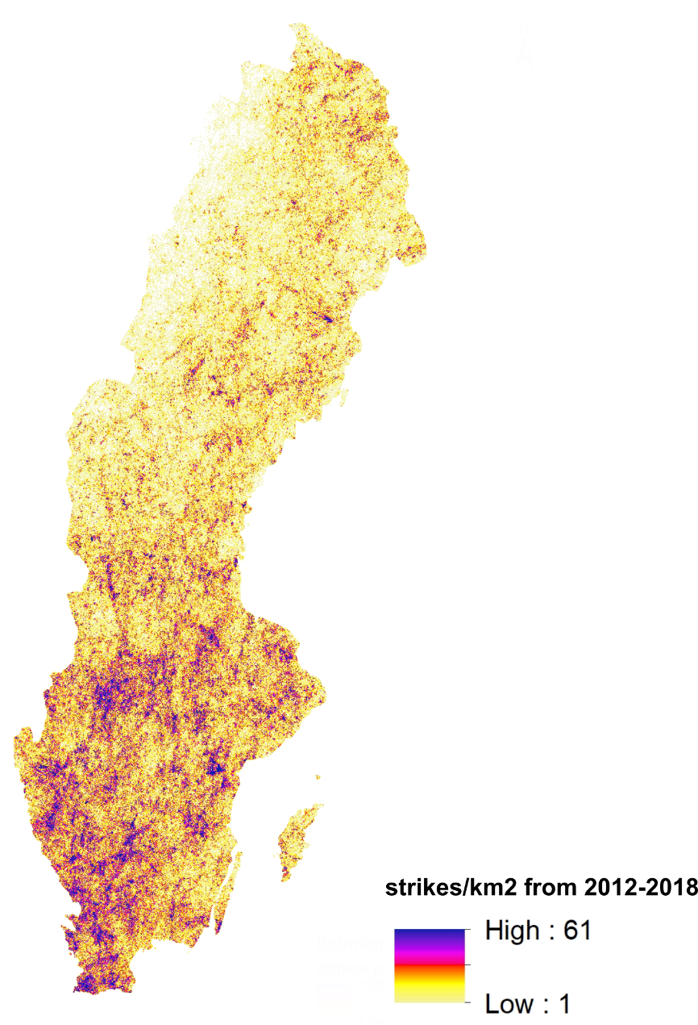
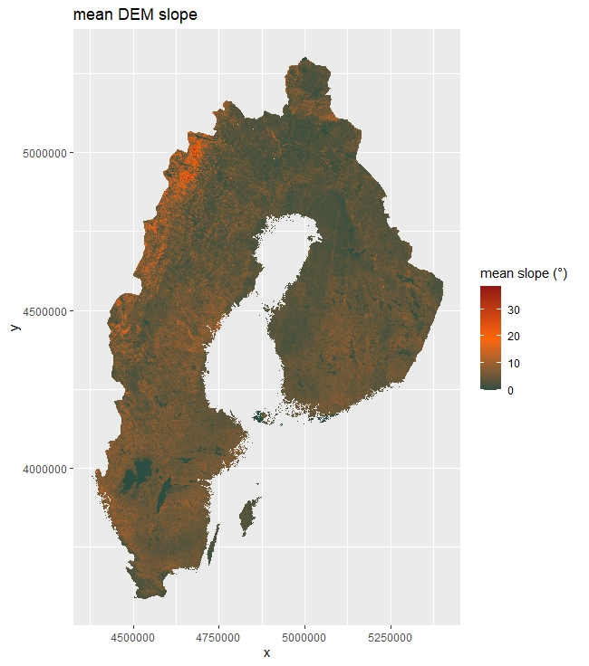
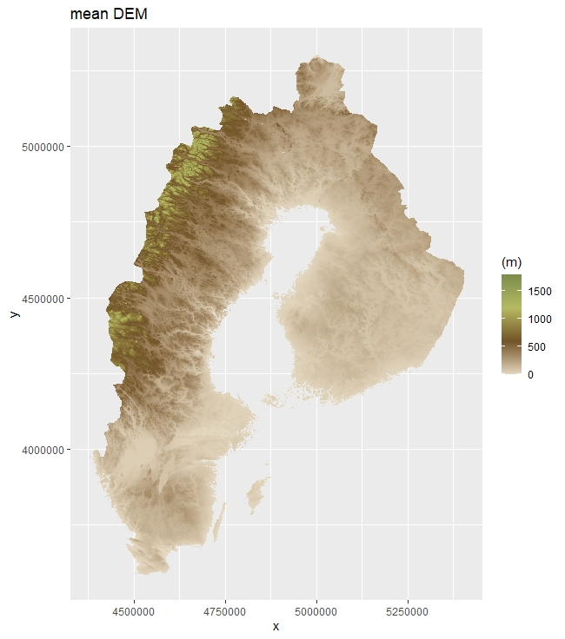
Database maps
C) Lightning frequency
A) Mean DEM slope
B) Mean DEM
Sources:
A, B) JAXA, ALOS Global Digital Surface Model
C) Swedish Meteorological and Hydrological Institute

Slide 13
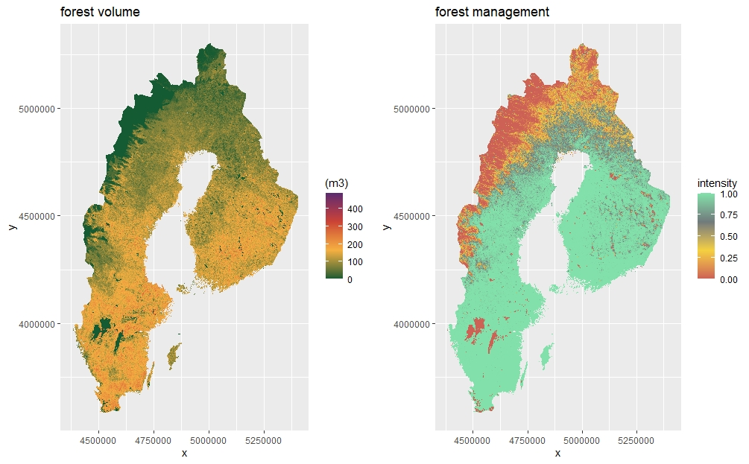
D) Forest volume
E) Forest management
F) Population density
Sources:
D) SLU, National Forest Inventory
E) Lesiv et al. 2020. Global forest management map
F) NASA, Municipal level population density

Slide 14
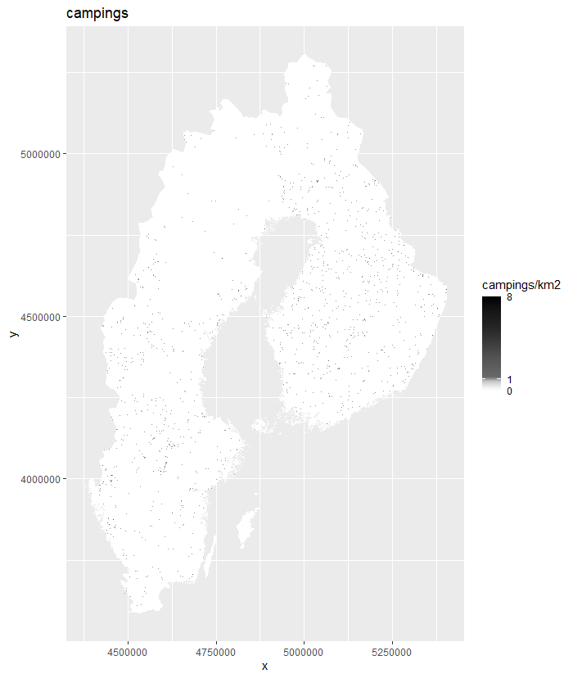
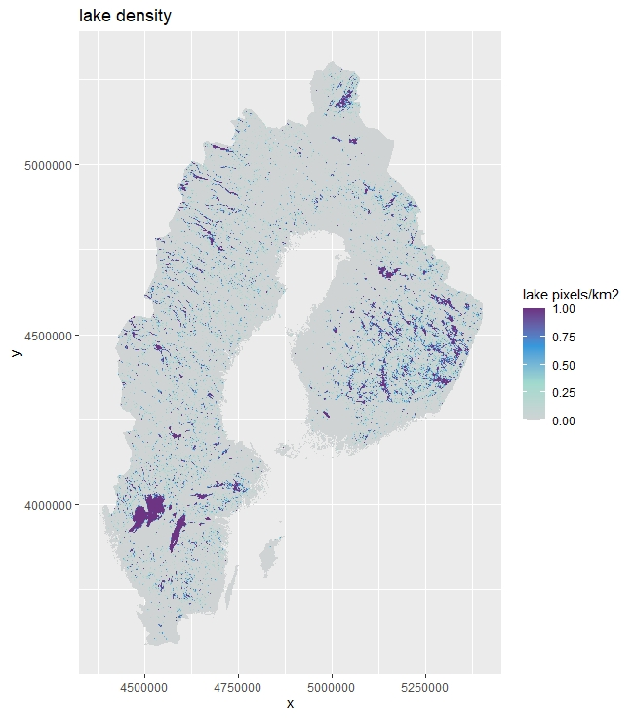
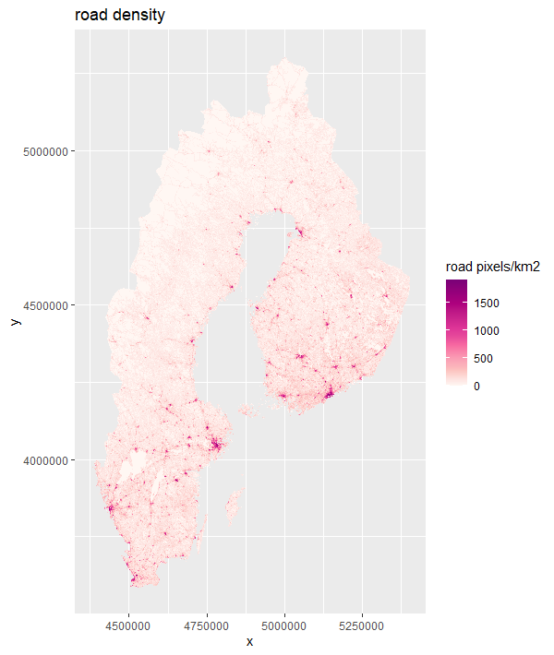
G) Lake density
H) Road density
I) Number of campings
Sources:
G) CORINE Land Cover data , National Forest Inventory
H) Open Street map data
I) Vindskyddskartan, Voluntary mapped camping sites, shelters and bonfire sites
Notes:
Lakes and roads are important factors for fire spread and suppression efficiency, but camping distribution influence fire ignition probability

Slide 15
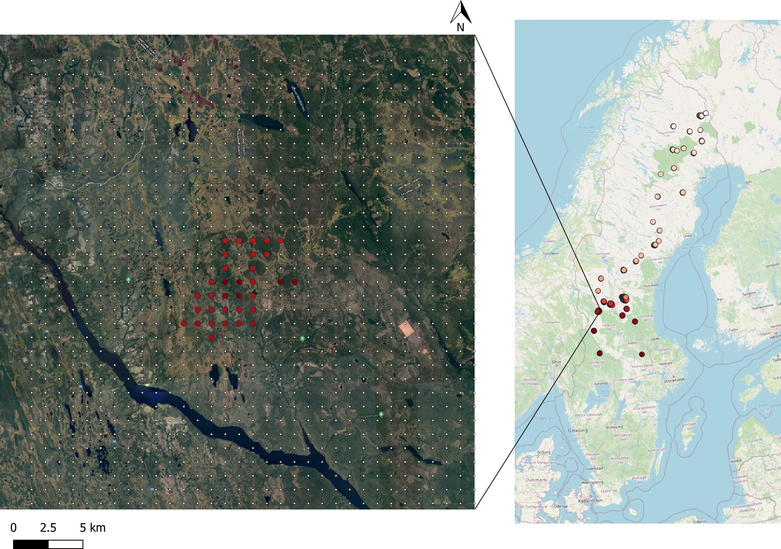
MODIS data about burned forest area (example of Sweden, 2018)
Notes:
Zoomed pixels with basemap under it , visual evaluation

Slide 16
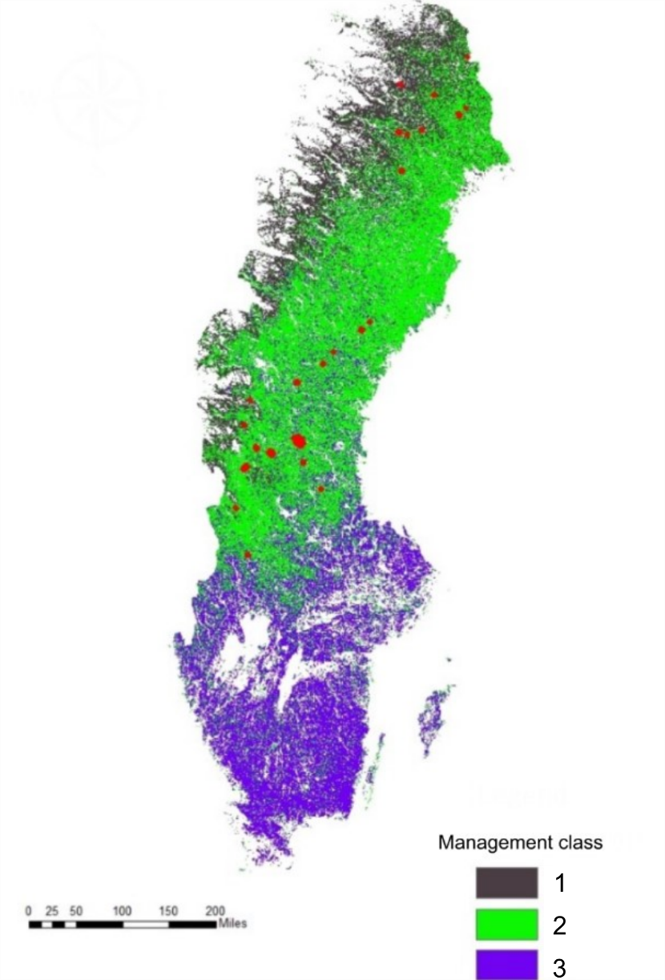
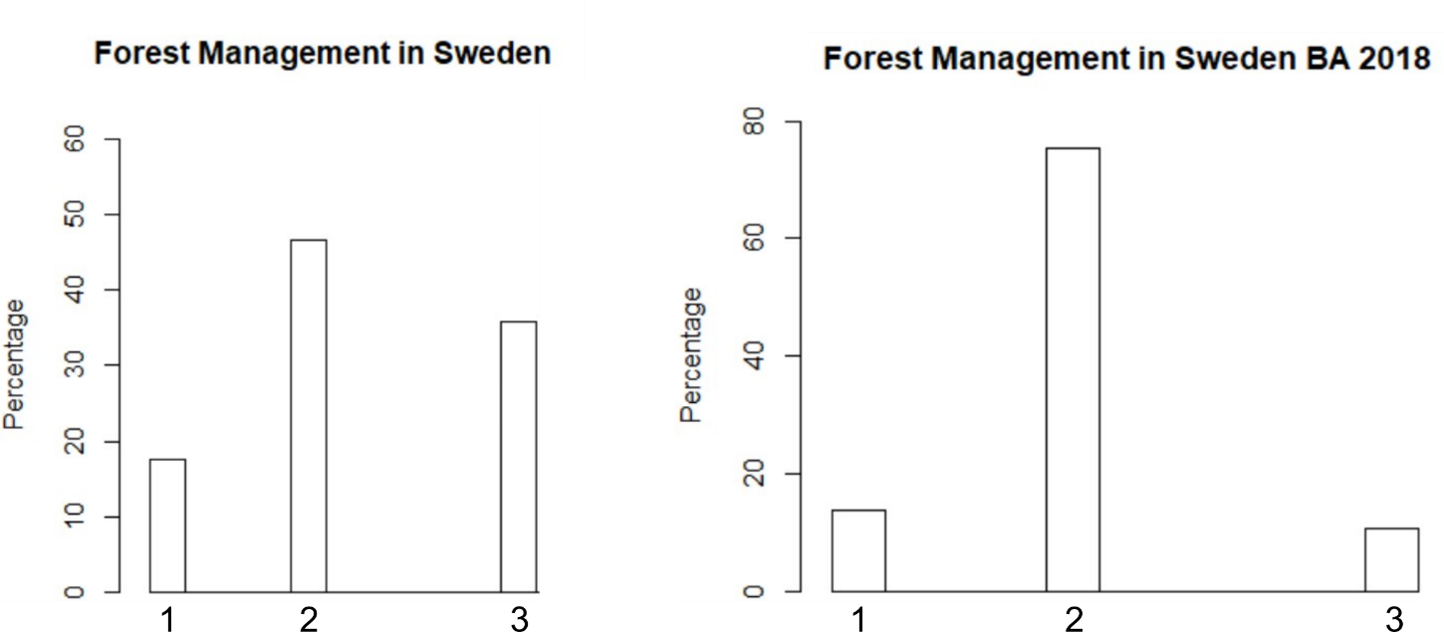
Fire relation to forest management
Value | Class
1 | Naturally regenerating forest without any signs of human activities (e.g., primary forests)
2 | Naturally regenerating forest with signs of human activities, e.g., logging, clear cuts, etc.
3 | Planted forest
Notes:
Make coding as 1,2,3. Remove 53. Draw diagram with 1,2,3. Add map. Change frequency to thousands. Is it for 2018.
Sorry Andrey, I didn’t manage to change the values, but I present the histogram in percentage, and I think it’s clearer

Slide 17
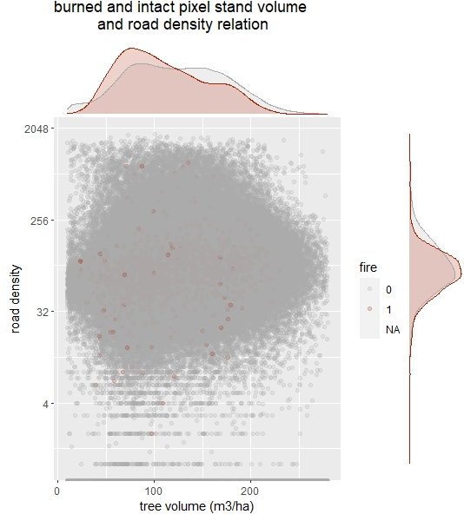
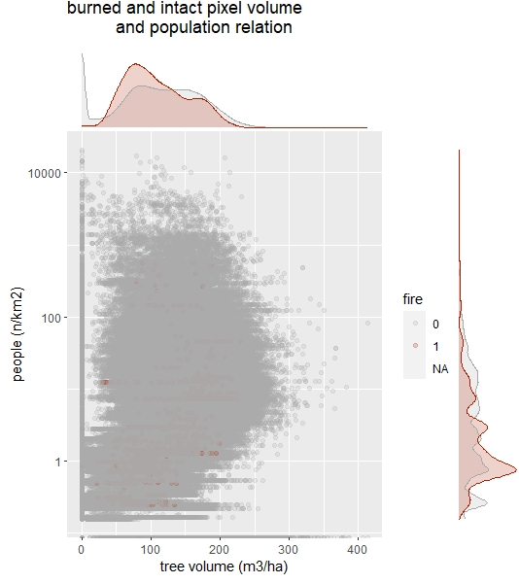
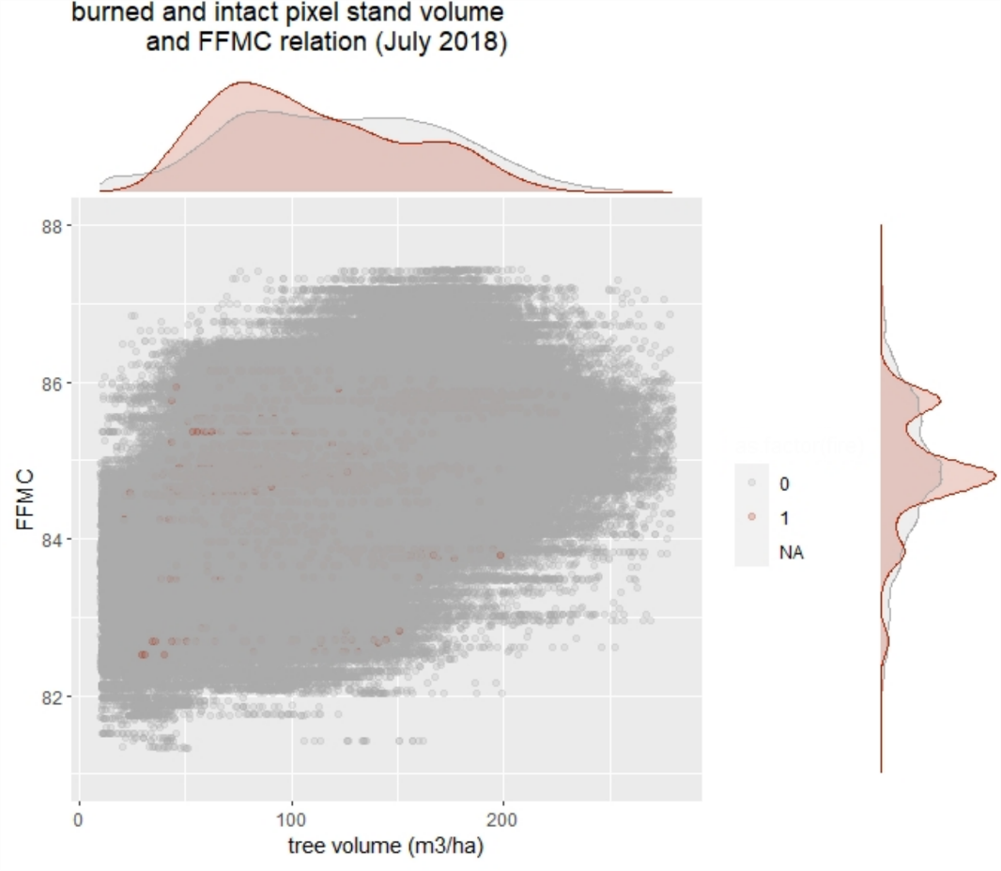
Preliminary data analysis

Slide 18
Importance of lightning strikes
Source: MSB:s statistik- och analysverktyg IDA

Slide 19
Monthly lightning activity across Sweden
Source: post-processed data from SMHI - Sveriges meteorologiska och hydrologiska institut

Slide 20
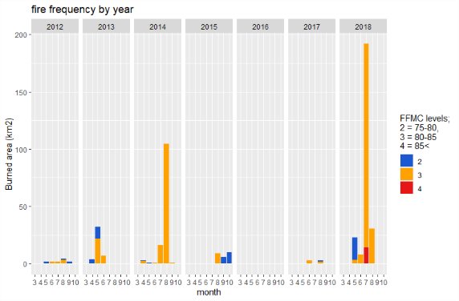
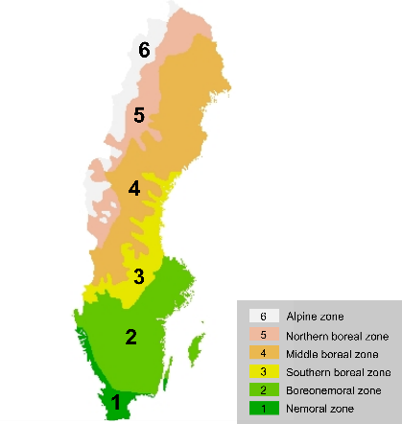
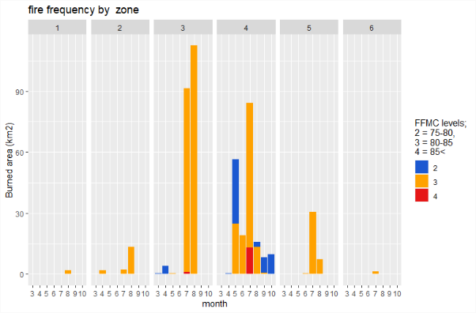
Fire occurrence in Sweden
Modelling zones
Fire statistics within the study period
Notes:
Sweden has a latitudinal fradient of 1500 km, making different climatic, topographic and climate conditions.
the percentage that the prediction error increases when the variable is removed

Slide 21
Random Forest accuracy
Random Forest accuracy in each zone
 | Area Under the Curve (AUC)
 | VALIDATION | ALL
ZONE 1 | 0.875 | 0.961
ZONE 2 | 0.999 | 0.999
ZONE 3 | 0.990 | 0.997
ZONE 4 | 0.903 | 0.951
ZONE 5 | 0.950 | 0.983
ZONE 6 | 1.000 | 1.000
Modelling zones
Notes:
Sweden has a latitudinal fradient of 1500 km, making different climatic, topographic and climate conditions.
the percentage that the prediction error increases when the variable is removed

Slide 22
Random Forest confusion matrix
default 0.5
F1/2 (F1 score, accuracy measure)
max sensitivity
Youden index
Zone 4
threshold value 0.5 |  | obs | pred | count
default = f1/2 |  | 0 | 0 | 13 001 357
 |  | 1 | 0 | 784
 |  | 0 | 1 | 7
 |  | 1 | 1 | 464
threshold value 0.35 |  | obs | pred | count
max sensitivity |  | 0 | 0 | 13 001 308
 |  | 1 | 0 | 614
 |  | 0 | 1 | 56
 |  | 1 | 1 | 634
threshold value 0.12 |  | obs | pred | count
Youden index |  | 0 | 0 | 13 000 586
 |  | 1 | 0 | 388
 |  | 0 | 1 | 778
 |  | 1 | 1 | 860
Zone 3 threshold value 0.5 |  | obs | pred | count
default = f1/2 |  | 0 | 0 | 3 947 461
 |  | 1 | 0 | 173
 |  | 0 | 1 | 17
 |  | 1 | 1 | 517
threshold value 0.44 |  | obs | pred | count
max sensitivity |  | 0 | 0 | 3 947 459
 |  | 1 | 0 | 150
 |  | 0 | 1 | 19
 |  | 1 | 1 | 540
threshold value 0.24 |  | obs | pred | count
Youden index |  | 0 | 0 | 3 947 396
 |  | 1 | 0 | 73
 |  | 0 | 1 | 82
 |  | 1 | 1 | 617
Notes:
Sweden has a latitudinal fradient of 1500 km, making different climatic, topographic and climate conditions.
the percentage that the prediction error increases when the variable is removed
Z3 10 and 11 for overdetected
Z4 31 not det,

Slide 23
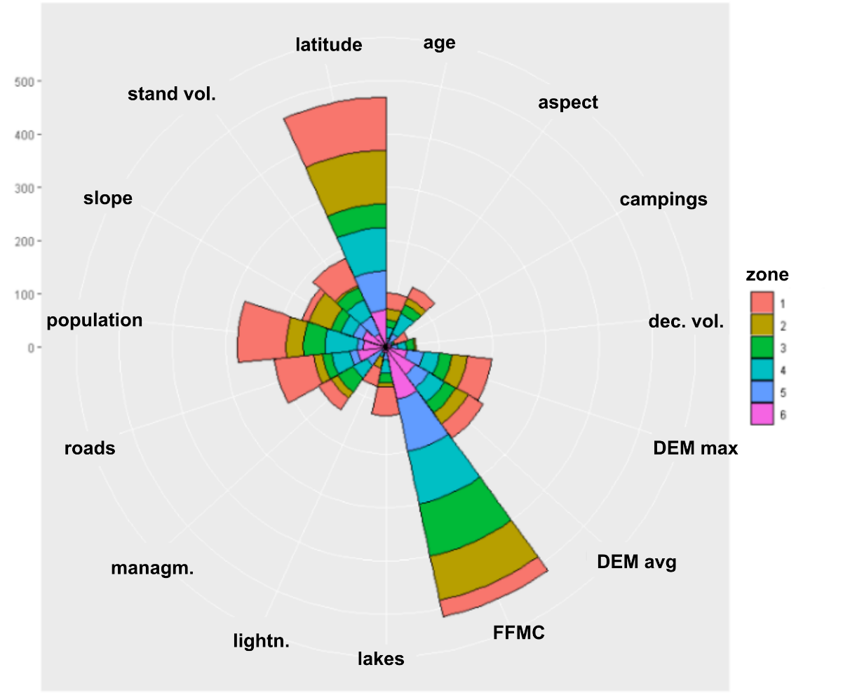
Random Forest variable importance
Random Forest variable importance for each zone
 | VARIABLE IMPORTANCE RANK (TOP 3)
 | 1st |  | 2nd |  | 3rd
ZONE 1 | latitude | 100.0 | population | 91.3 | roads | 73.9
ZONE 2 | latitude | 100.0 | FFMC | 84.6 | slope | 44.1
ZONE 3 | FFMC | 100.0 | latitude | 44.7 | population | 39.8
ZONE 4 | FFMC | 100.0 | latitude | 81.0 | population | 60.3
ZONE 5 | FFMC | 100.0 | latitude | 72.4 | stand vol. | 36.1
ZONE 6 | FFMC | 100.0 | latitude | 70.8 | DEM avg | 64.2
Random Forest variable importance for each zone
Notes:
the percentage that the prediction error increases when the variable is removed

Slide 24
Take away messages
Model overall performance has meaningful explanatory power, but its has an underestimation error.
Weather (FFMC) is the most important factor in this Random Forest wildfires modelling study.
Fuel management is important aspect, but that should be better quantified in the modelling.
More attention should be paid to lightning ignitions in boreal forests.
Under climate change forest fires are expected to occur more frequent in Sweden, but in most cases because of high suppression efficiently they won’t develop as extreme fire events.
Notes:
Zoomed pixels with basemap under it , visual evaluation

Slide 25
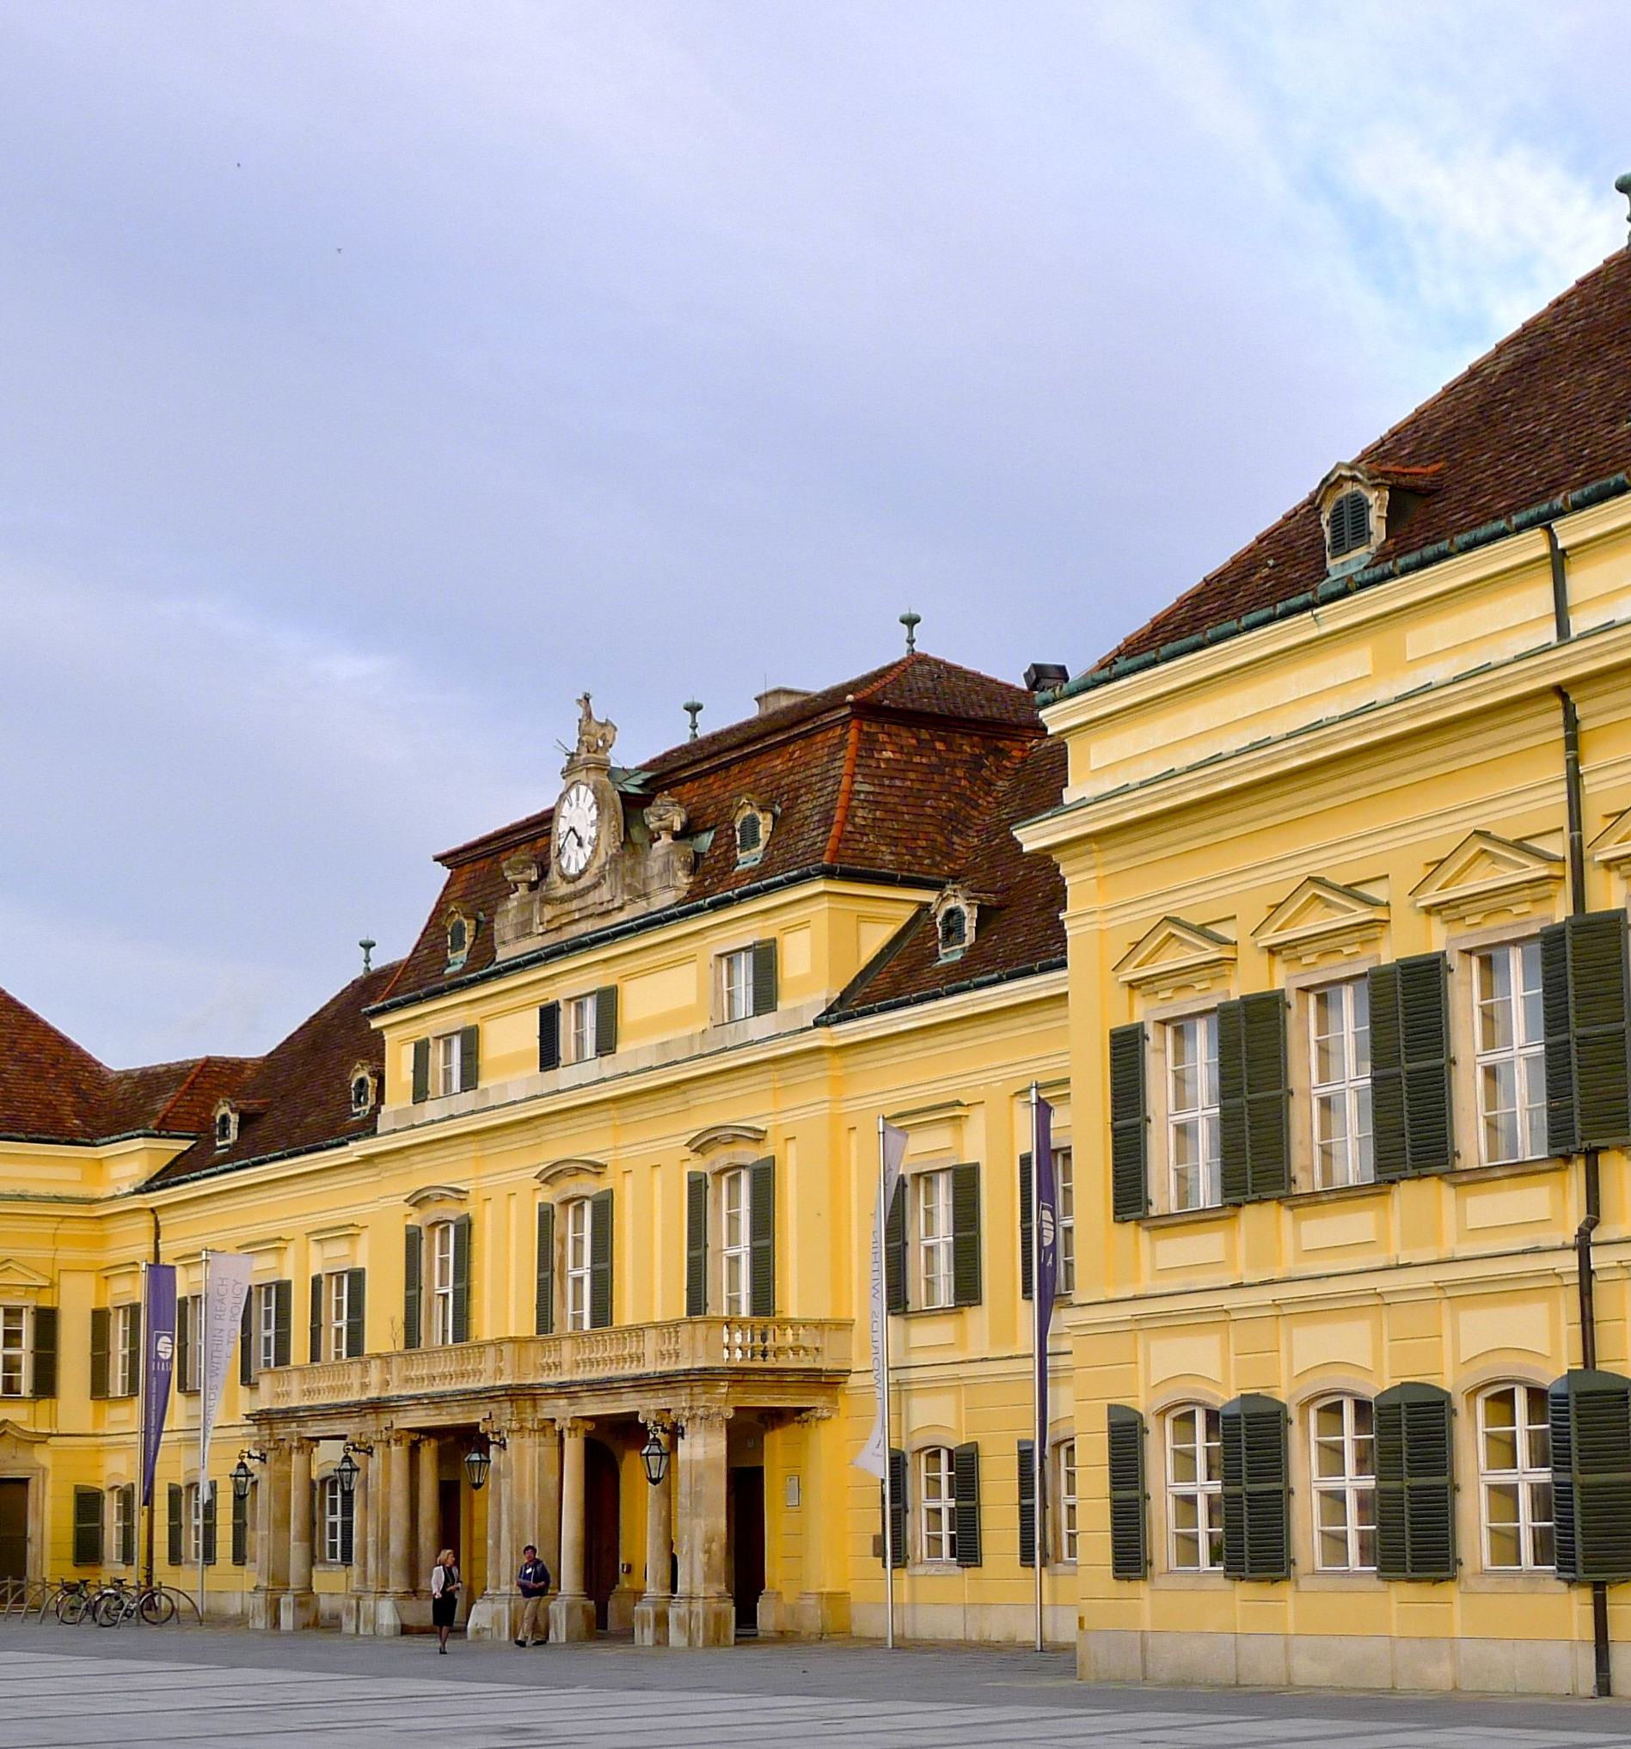
Regional variability and driving forces behind the forest fires in Sweden
Authors:
Reinis Cimdins (UEF); reinis.cimdins@gmail.com
Florian Kraxner (IIASA)
Andrey Krasovskiy (IIASA)
ICFBR2022; Alghero (ITA); 04.05.2022

