Slide 1


Citizen Science in support of the SDGs
Dilek Fraisl, Steve MacFeely, Maciej Truszczynski
Dilek Fraisl
Email: fraisl@iiasa.ac.at
Twitter: @dilekfraisl1
Web: www.iiasa.ac.at
www.geo-wiki.org

Slide 2

Program
Intro to the session
Measuring the SDGs – Dr Steve MacFeely, Director of Data and Analytics, WHO
New sources of data – Mr Maciej Truszczynski, Chief Advisor, Statistics Denmark
Citizen science and the SDGs – Dr Dilek Fraisl, Research Scholar, IIASA
Group work
Q&A
Closing

Slide 3

What is your level of knowledge on citizen science?

Slide 4

What is your level of knowledge on the SDGs?

Slide 5

What is your level of knowledge on the SDG monitoring mechanisms or how the SDGs are measured?

Slide 6

Are you involved in a citizen science project that you think the data would be helpful for SDG monitoring or for official monitoring in general?

Slide 7
Session Objectives
How can we help leverage citizen science data for SDG monitoring?
What are the challenges of integrating citizen science data into official statistics?
How can we overcome these challenges?
From the perspective of:
citizen science researchers and practitioners
global actors such as UN agencies,
National Statistical Offices and governments
citizen scientists

Slide 8
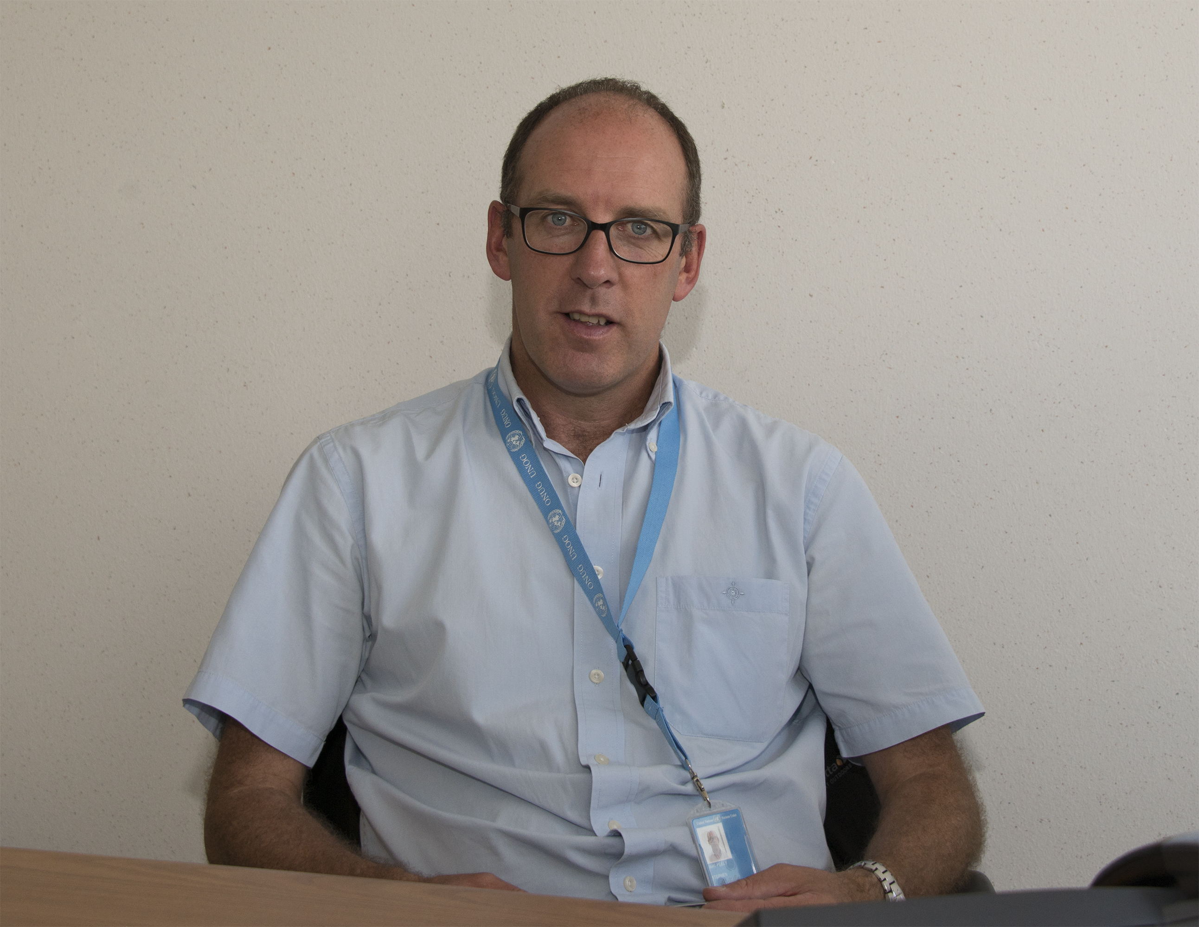

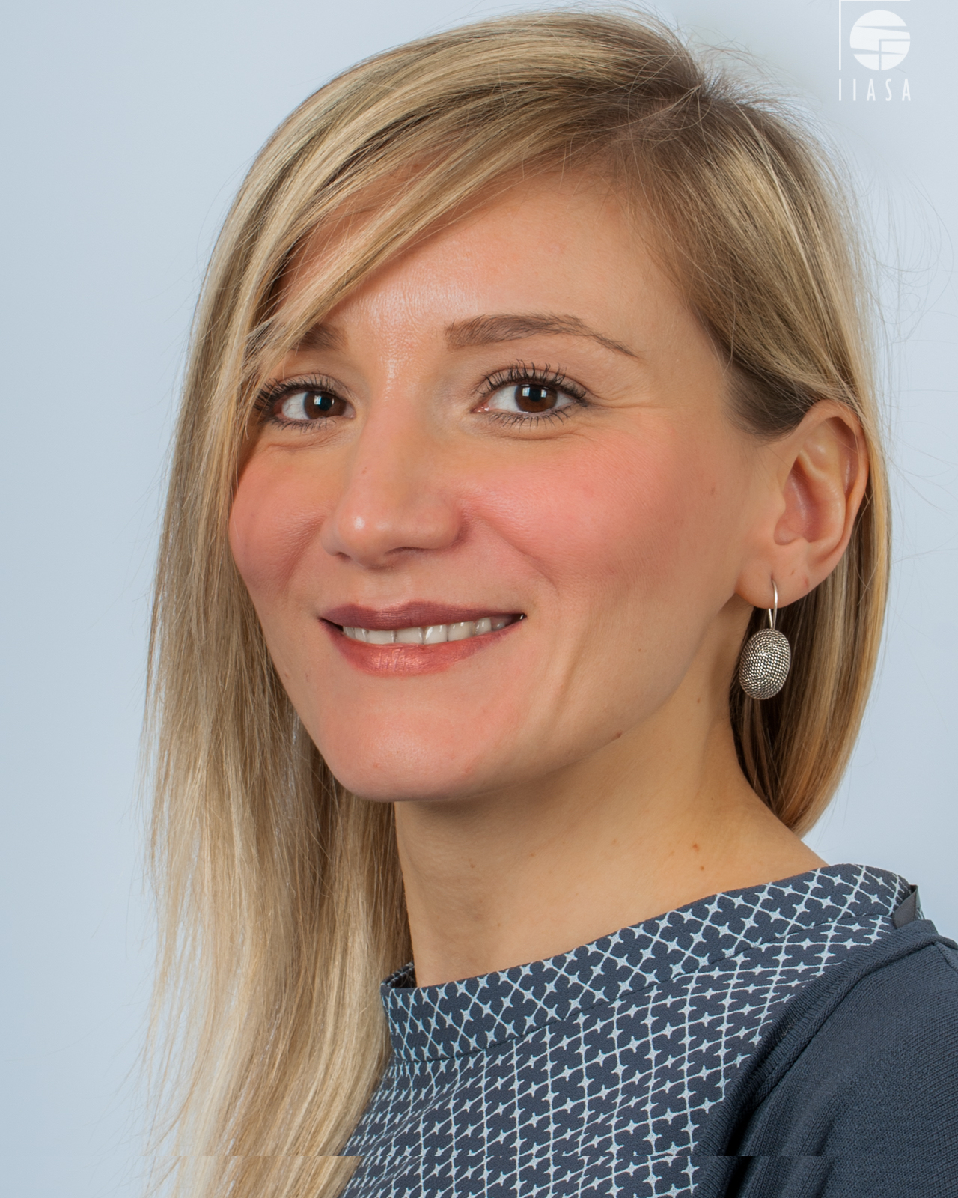
Steve MacFeely, PhD
Director of Data and Analytics, WHO
Maciej Truszczynski
Chief Advisor, Statistics Denmark
Dilek Fraisl, PhD
Research Scholar, IIASA

Slide 9
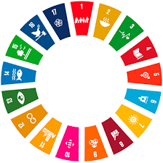

Measuring
the
SDGs
Steve MacFeely
Director of Data and Analytics

Slide 10
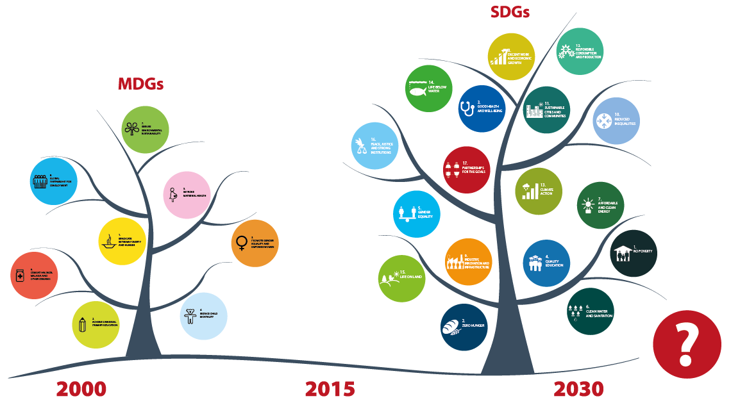

Slide 11

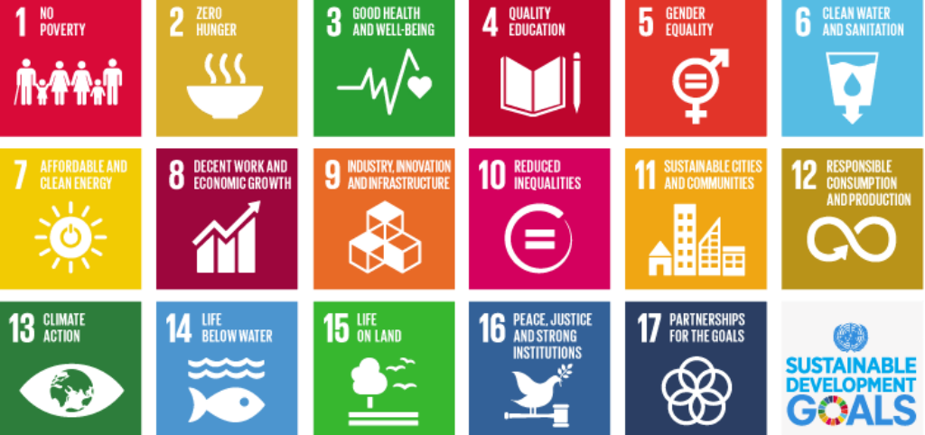
From MDGs to SDGs
An “unprecedented statistical challenge”
Mogens Lykketoft
President 70th session UNGA

Slide 12

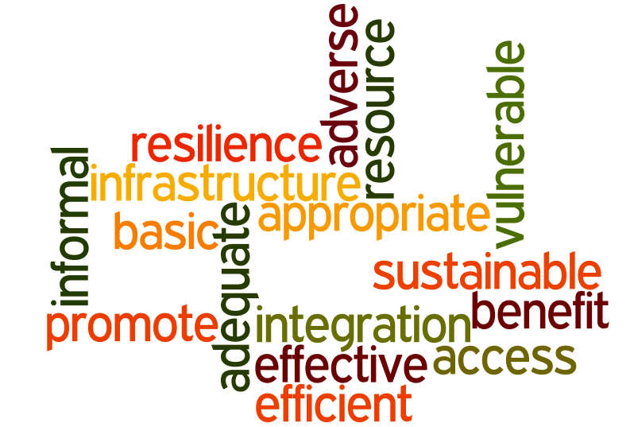
unclear definitions and inconsistent use of terminology
- sustainable
- macro economic stability
- basic services
- new technologies
Decoding
the
SDGs

Slide 13
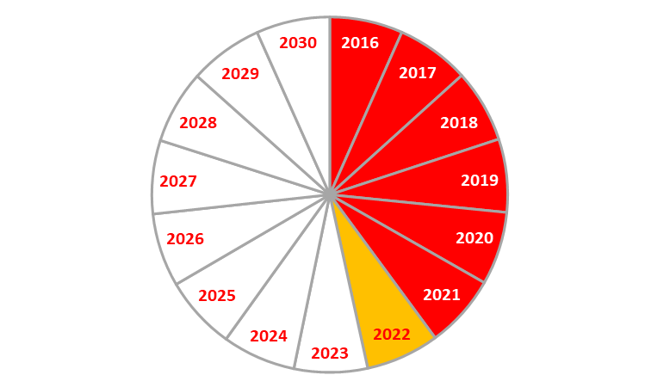
The 2030 Agenda - Time elapsed

Slide 14
SDG Global Indicator Framework –
Quantifying the challenge

Slide 15

‘the data demands for the 2030 Agenda require urgent new solutions that leverage the power of new data sources and technologies through partnerships between national statistical authorities and the private sector, civil society, and the academia and other research institutions’
Dubai Declaration [52: para,71]
2018 UN World Data Forum

Slide 16
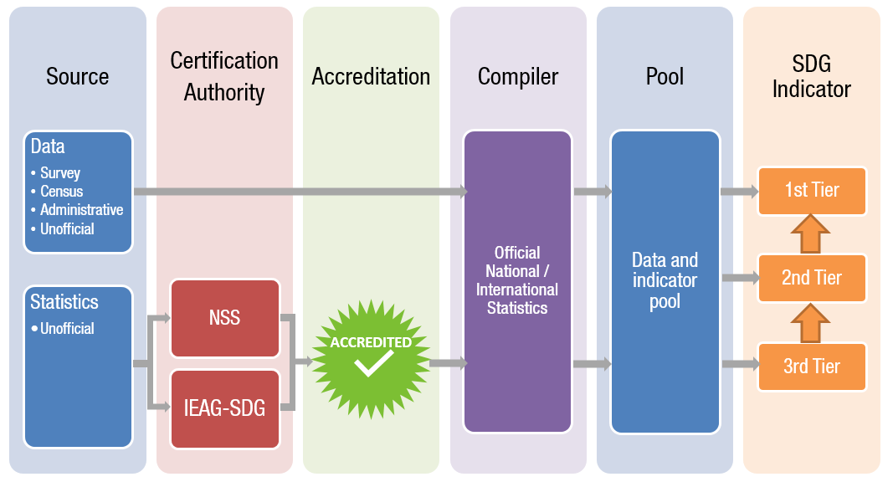
A proposed future:
Using unofficial data and statistics to compile SDG indictors

Slide 17


Slide 18
Citizen generated data – a way to improving statistics?
Maciej Truszczynski, Statistics Denmark
25 April 2022
ENGAGING CITIZEN SCIENCE CONFERENCE

Slide 19
A not so new crossroads
New demands for statistics on a general scale.
2030 Agenda and Sustainable Development indicators.
Discussion on how to complement existing statistics and data collection methods with ‘non-traditional’ data.
  Big data
  Geo data
  (administrative data)
  Citizen generated data

Slide 20
Non-traditional data – a labyrinth of information
Difficult to navigate in the landscape of data possibilities, as the aspect of self-promotion is not to be overseen.
Promoting a specific form of improvement of data coverage/statistics does not always correspond to reality
….lots of noise
  Lack of coordination (a truism) – many institutions are concentrating on their own ‘silver bullets’. Countries (and national statistical offices) are presented with different systems to describe a seemingly same phenomena – difficult if not impossible to relate to (regular, legislation bound, statistics is still to be produced).

Slide 21
Perspective of a statistical institute
National statistical institutes are subject to various requirements regarding data production and quality.
Different quality frameworks to be complied with: Quality Assurance Framework, European Statistics Code of Practice…
Examples of requirements: professional independence; impartiality and objectivity; coherence and comparability.
Discussions on input vs output harmonization.
Citizen generated data and production of statistics: a possible way forward. However, more analysis and adjustment need to be conducted.
  a need for discussion on how to fill in the SDG data gaps by citizen generated data on an international level. But the realities in individual countries should be taken account of.

Slide 22
Application of non-traditional data
  Statistics Denmark is using the following non-traditional data:
  geospatial data in production of one SDG-indicator (11.2.1 – proportion of population that has convenient access to public transport by sex, age and persons with disabilities),
  scanner data in complementing production of price statistics,
  AIS data,
  Electricity meters.
  Still experimental phase and not regular production

Slide 23
Task team on big data for the SDG
Objectives
To provide concrete examples of the use of Big Data for monitoring the indicators associated with the SDG.
Conduct surveys, research and country pilots on the subject and produce a report on its findings.
Findings
Currently six indicators can be monitored by the use of non-traditional data: 6.6.1, 9.1.1, 9.c.1, 14.3.1, 17.8.1, 14.1.1 (b). However, the calculation method cannot be directly transferred to countries for all of the mentioned indicators.

Slide 24
Thank you

Slide 26
Citizen Science Contributions to the SDGs
Dilek Fraisl, PhD
Email: fraisl@iiasa.ac.at
Twitter: @dilekfraisl1
Web: www.iiasa.ac.at
www.geo-wiki.org

Slide 27
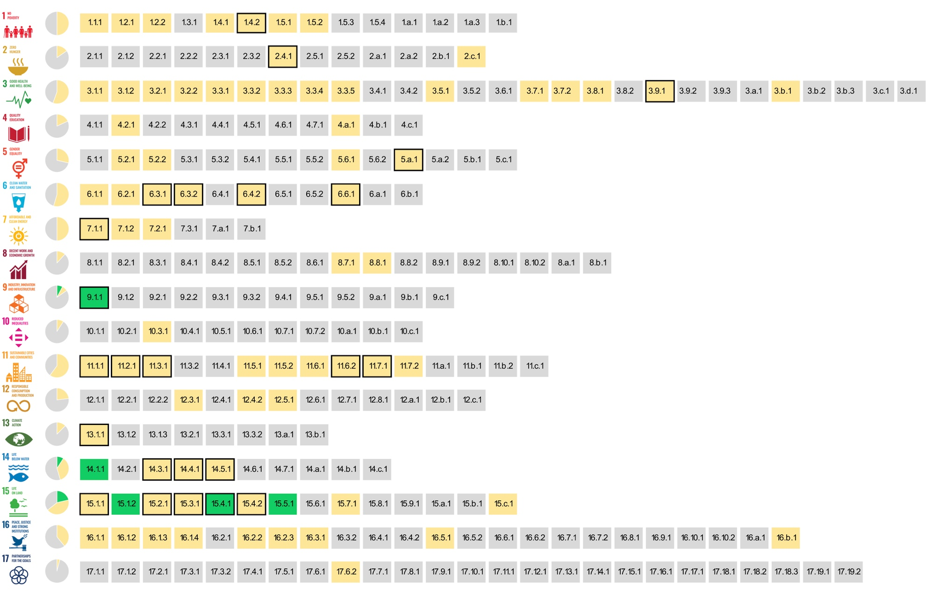
The SDG indicators where citizen science projects are ‘already contributing’, ‘could contribute’ or where there is ‘no alignment'
Fraisl, D., Campbell, J., See, L. et al. Mapping citizen science contributions to the UN sustainable development goals. Sustain Sci 15, 1735–1751 (2020). https://doi.org/10.1007/s11625-020-00833-7

Slide 28
The greatest contribution of citizen science data to SDG monitoring would be in:
Examples:
1.5.2 Direct economiv loss attributed to disasters
6.3.2 Water quality
15.1.2 - 15.4.1 Protected areas
3.3.3 – Malaria incidence
16.1.3 – Phsical/sexual violence

Slide 29

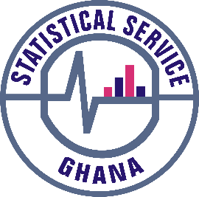





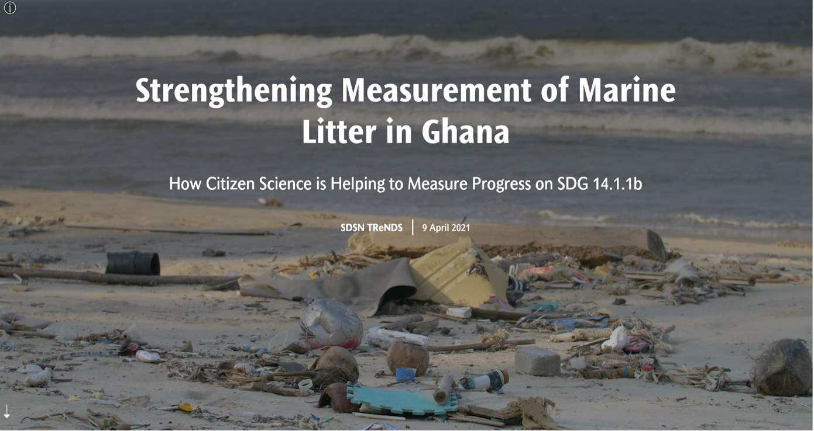
Citizen Science for the SDGs StoryMap: https://dataforchange.net/strengthening-measurement-of-marine-litter-in-Ghana

Slide 30
Citizen Science Data…
…for monitoring beach litter have been integrated into the official SDG monitoring and reporting mechanisms of Ghana in a sustainable way, which makes Ghana the first country to report on SDG indicator 14.1.1b and first country to use citizen science data for that purpose.
…will serve as inputs to Ghana’s Integrated Coastal and Marine Policy, currently under development, as well as other relevant policies to address the marine litter problem.
…has helped to bridge local data collection efforts with global monitoring processes by leveraging the SDG framework.

Slide 31
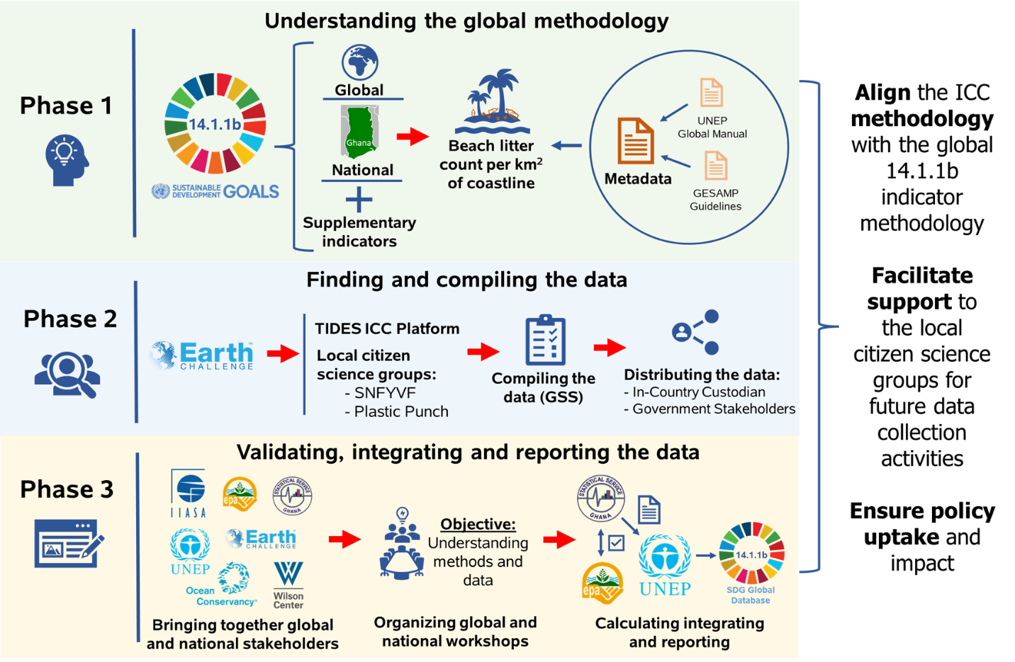
The process of integrating citizen science data on marine litter for SDG indicator 14.1.1b reporting in Ghana
Fraisl, D., et al., Under Review

Slide 32
Lessons
Rather than the time- and resource-intensive process of designing a digital mobile instrument from scratch, using an off-the-shelf solutions such as CleanSwell requires fewer resources to implement and enabled the reuse of historical data.
By tapping into Smart Nature Freaks Youth Volunteers and Plastic Punch, who are already established and sustainable networks, data could be efficiently collected as a by-product of existing activities.
Importance of creating time and spaces for the government, international organisation and CSOs to meet, in order to build trust, common goals and ownership over the result.

Slide 33
UN Statistics Division (UNSD)
InterAgency Expert Group on SDG Indicators (IAEG-SDGs)
Check out the Tier Classification on SDG Indicators:
https://unstats.un.org/sdgs/iaeg-sdgs/tier-classification/
Look at the metadata and methodologies of SDG indicators that are relevant to your project: https://unstats.un.org/sdgs/metadata/
Identify how your data can contribute to the monitoring of identified indicators
Get in touch with relevant national and global partners
Be aware that it’s not an easy process, it requires time, patience, understanding and TRUST

Slide 34
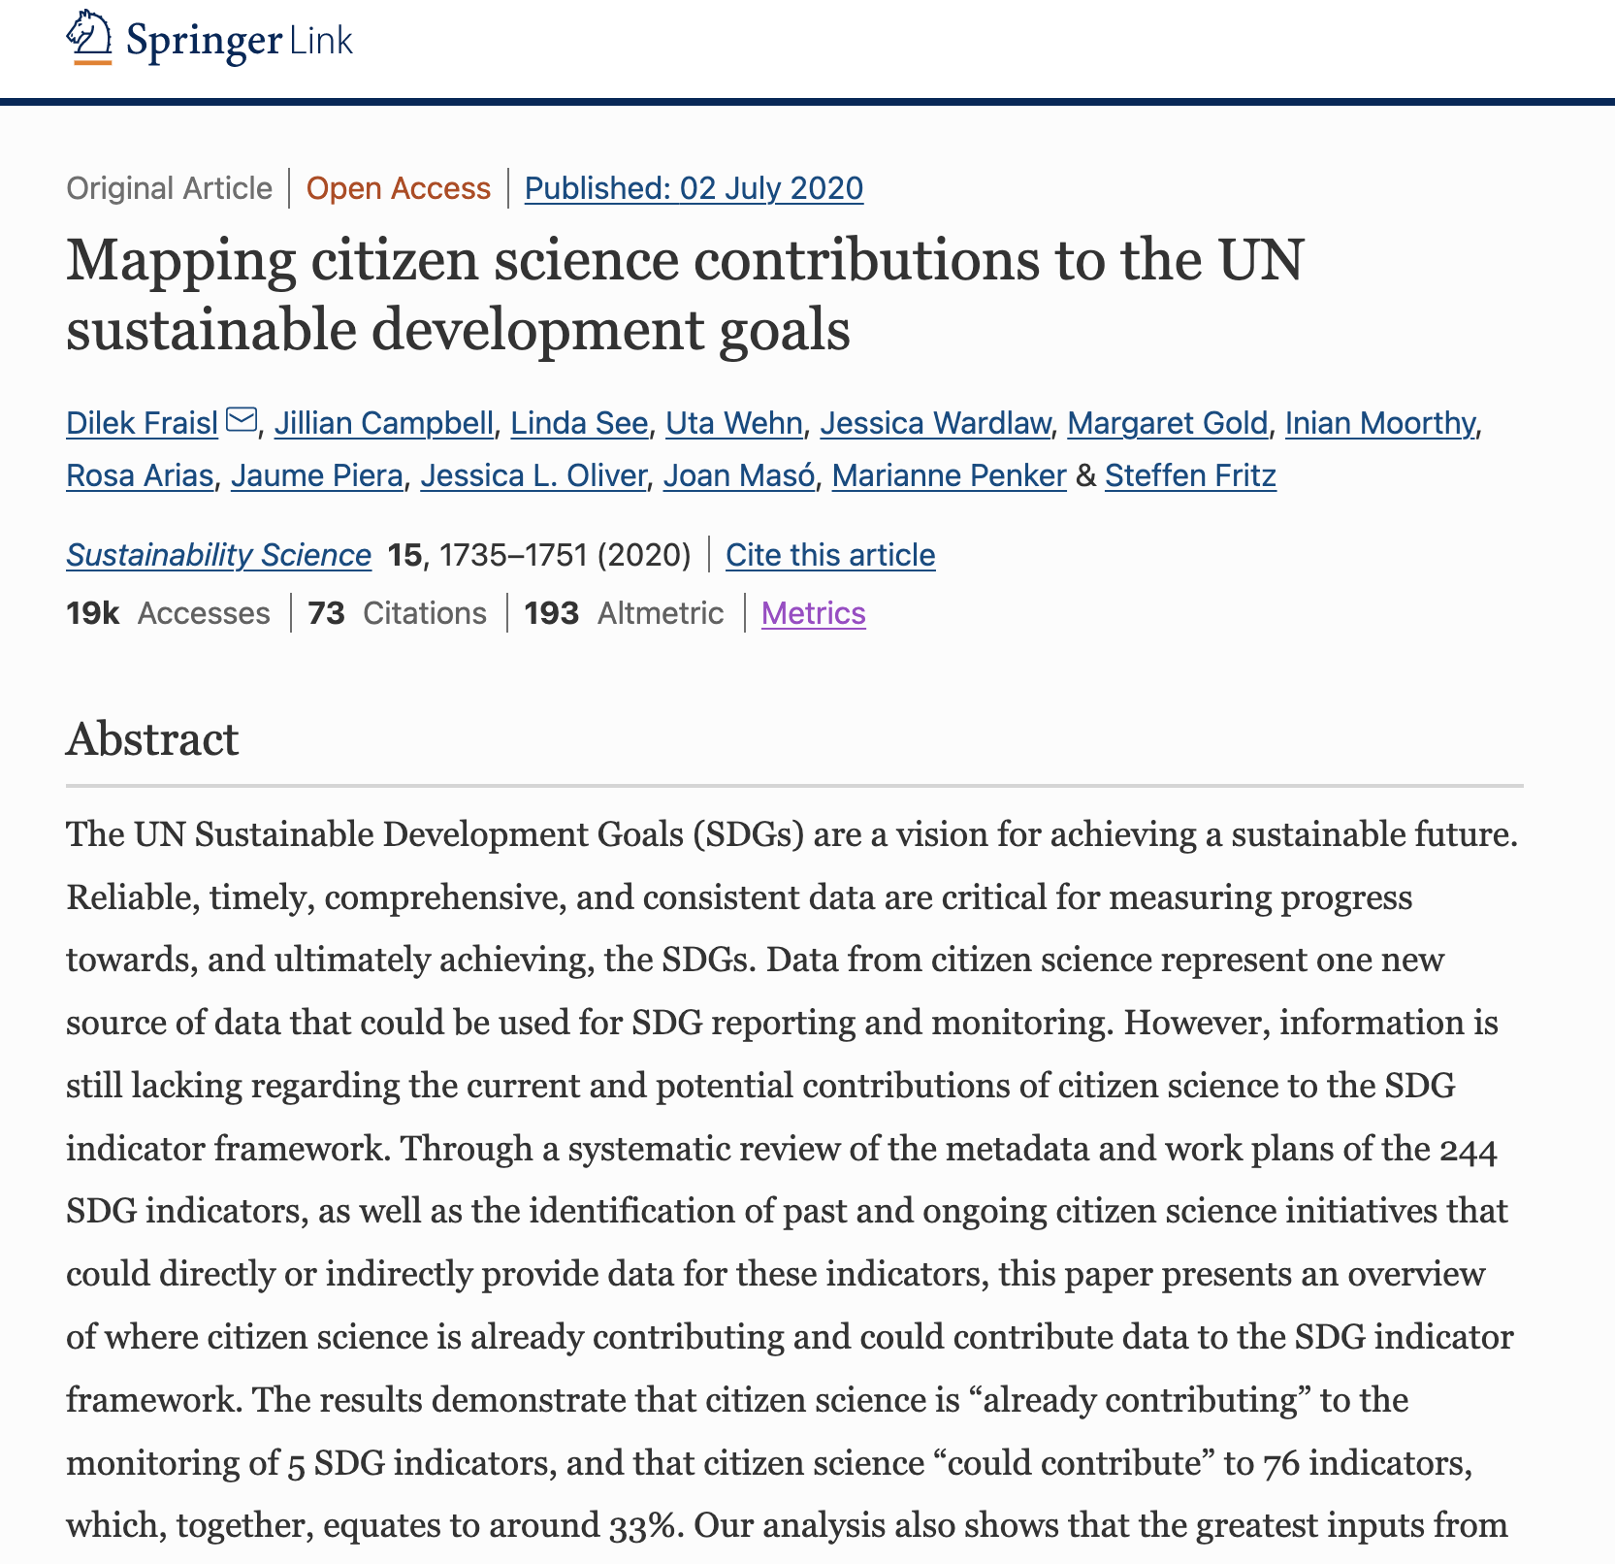
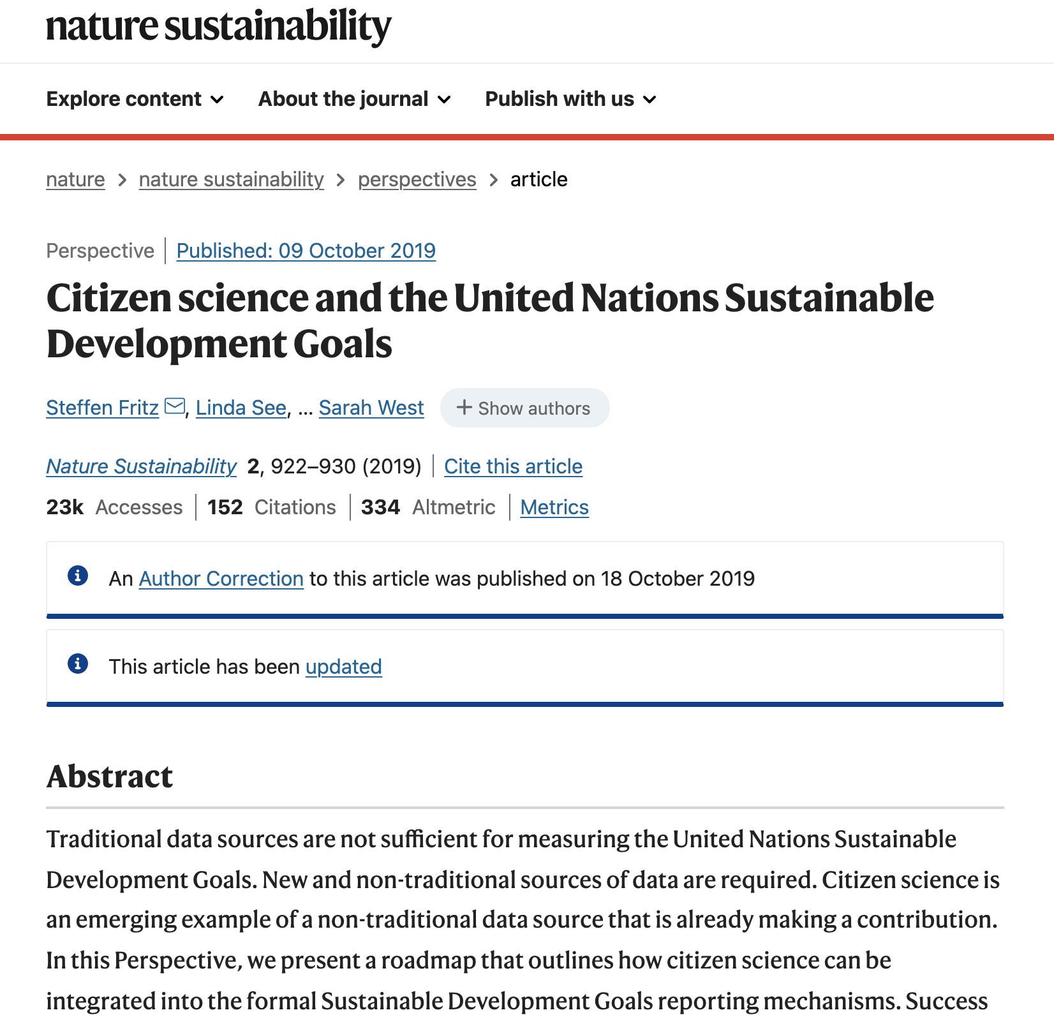
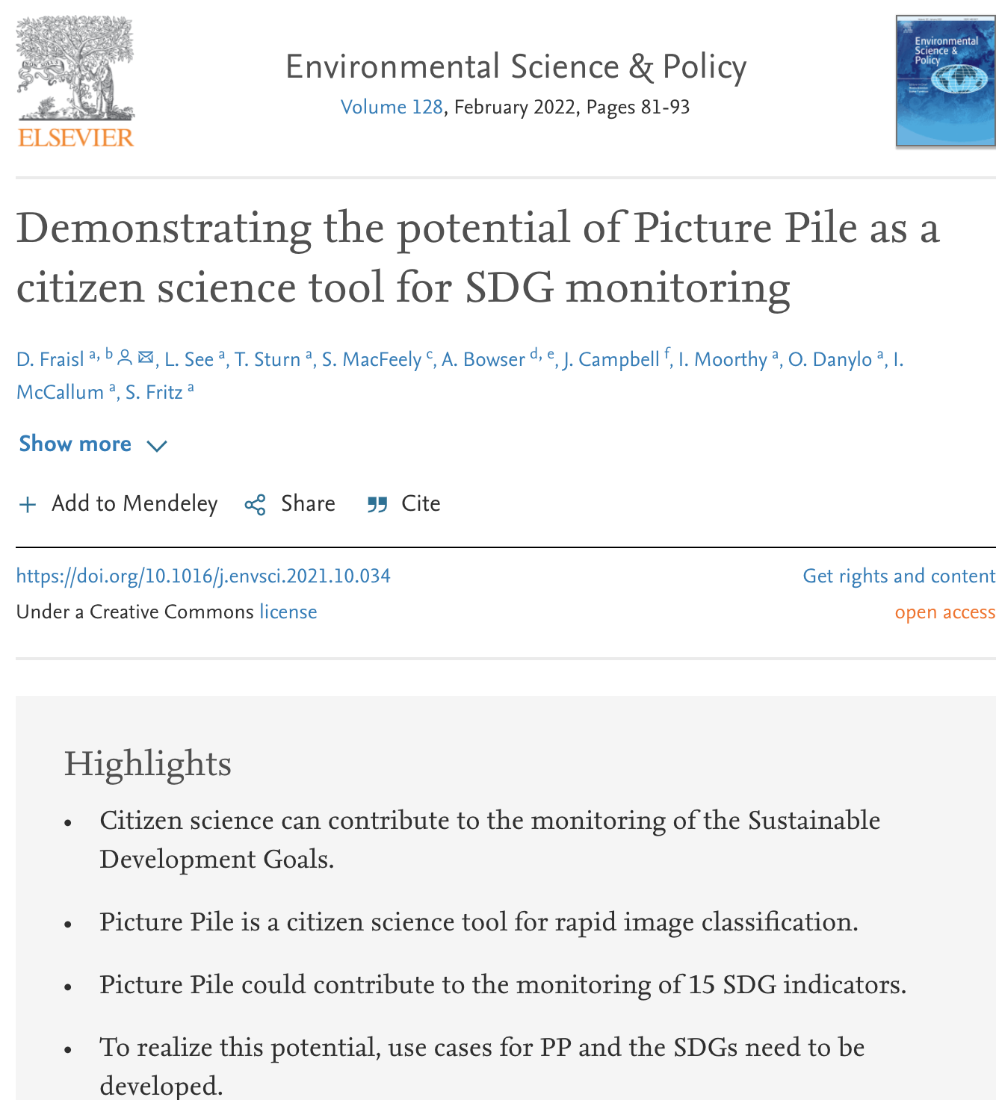
Recent Publications

Slide 36

Group Work

Slide 37
Task
Identify 3-5 challenges for the official uptake of citizen science data for SDG monitoring or monitoring of other international development frameworks or official monitoring in general?
Choose a presenter and report back on your challenges (max 2 min)

Slide 38
Guiding Questions
Do you have a citizen science project that you think the data can be useful for official monitoring purposes?
Have you had any experience on working with government authorities or others to understand the possibility of having your data to be used for official monitoring purposes?
Based on this experience, what challenges have you faced or identified for the official uptake of citizen science data?
If you haven’t had this experience, what in your opinion the challenges are for the official uptake of citizen science data?

Slide 39

Reporting back from the group discussions

Slide 40
Discussion with the speakers on how to overcome the challenges related to the official uptake of citizen science data?

Slide 41
Q&A

Slide 42
How can you get involved?
Weobserve SDGs and Citizen Science Community of Practice: https://www.weobserve.eu/weobserve-cop4-sdgs/
COST Action Proposal: Citizen Science in support of the UN SDGs
UN World Data Forum – Submit a session

Slide 43
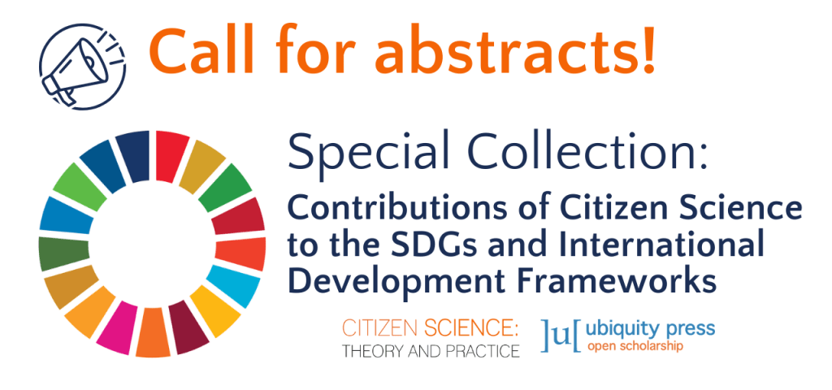
Citizen Science: Theory and Practice - Special Collection: "Contributions of Citizen Science to the SDGs and International Development Frameworks”
DEADLINE FOR ABSTRACT SUBMISSION: 30 APRIL
Send your abstract to Dilek Fraisl: fraisl@iiasa.ac.at
Editorial Team: Dilek Fraisl, Linda See, Jillian Campbell, Herizo T. Andrianandrasana and Finn Danielsen
MORE INFO: https://citizenscience.org/2022/03/17/special-collection-sdgs-and-international-development-frameworks/#deadlines

Slide 44
Thank you!
Dilek Fraisl, Steve MacFeely, Maciej Truszczynski
Dilek Fraisl, PhD
Research Scholar
International Institute for Applied Systems Analysis (IIASA)
Email: fraisl@iiasa.ac.at
Twitter: @dilekfraisl1
Web: www.iiasa.ac.at

