Slide 1
SDGs, Data Issues, Citizen Science
Dilek Fraisl, PhD
Novel Data Ecosystems for Sustainability Research (NODES)
International Institute for Applied Systems Analysis (IIASA)
Email: fraisl@iiasa.ac.at
Twitter: @dilekfraisl1
Web: www.iiasa.ac.at
www.geo-wiki.org

Slide 2
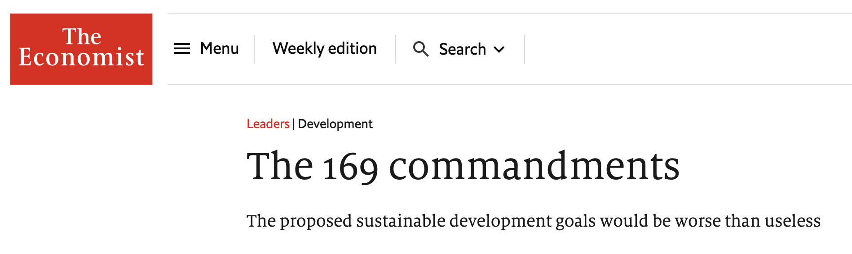

Critisism
169 priorities, in practice, no priorities at all
Fragmentation of effort and resources
Measuring, validating and communicating 232 indicators difficult and expensive
Response
Democratic process
More targets may mean more funding
It has flaws and it could have been better, some targets are not achievable, but ...

Slide 3

The SDGs mark the first time in human history that the nations of the world agreed on a comprehensive vision, supported by concrete goals and targets, for the future we want, for “sustainable development”…

Slide 4

Unclear definitions and inconsistent use of terminology
  Sustainable
  Basic services
  new technologies
Decoding
the SDGs
Data issues related to traditional sources of data:
  high costs,
  infrequent data collection cycles,
  lack of spatial variations across a country,
  openness,
  accuracy, etc.

Slide 5
The SDG Report 2021, UNSD.
58% of the environmental SDG indicators lack data.

Slide 6
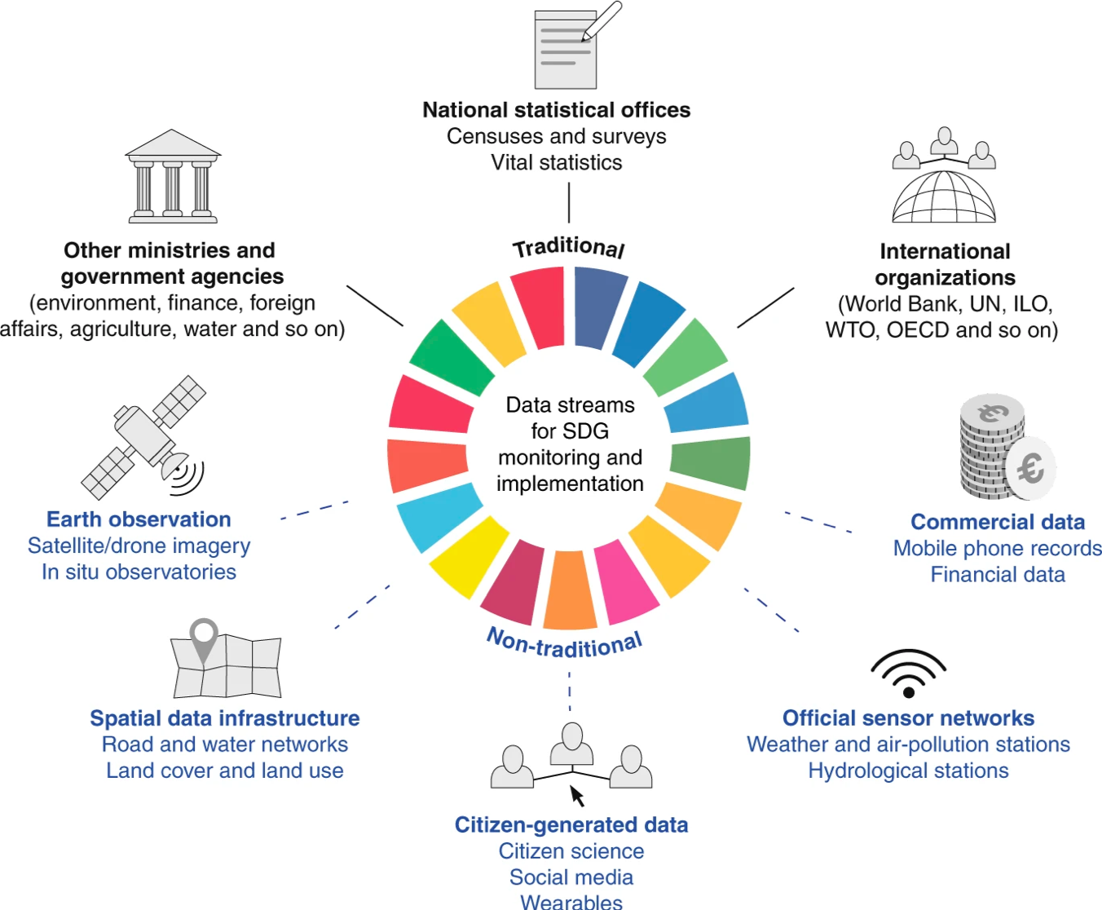
Traditional and non-traditional data sources for SDG monitoring
Fritz et al, Nature Sustainability, 2019

Slide 7
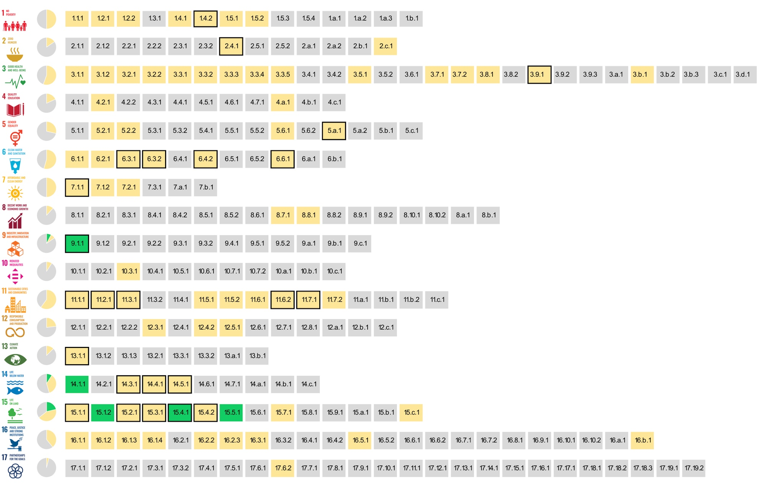
The SDG indicators where citizen science projects are ‘already contributing’, ‘could contribute’ or where there is ‘no alignment'
Fraisl, D., Campbell, J., See, L. et al. Mapping citizen science contributions to the UN sustainable development goals. Sustain Sci 15, 1735–1751 (2020). https://doi.org/10.1007/s11625-020-00833-7

Slide 8







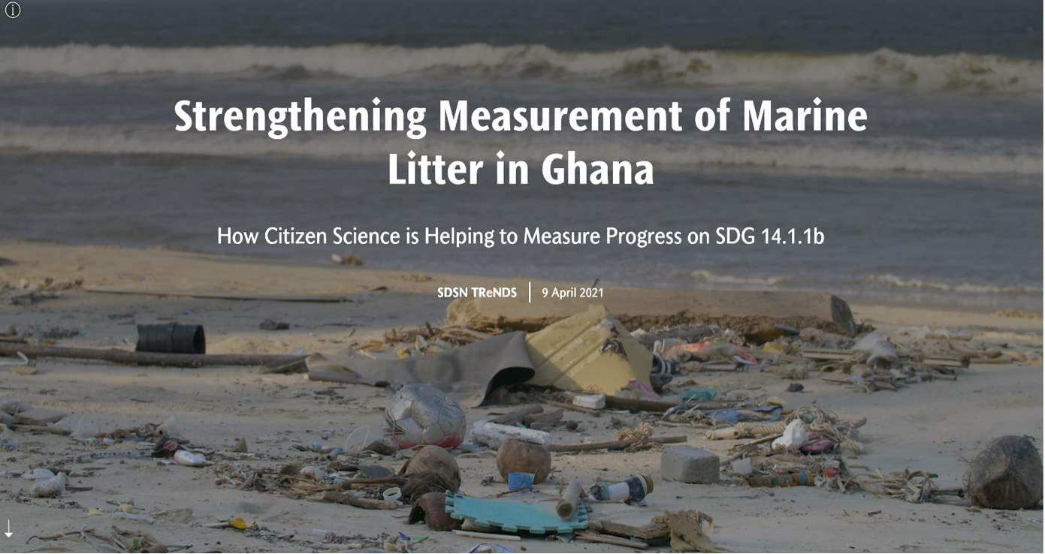
Citizen Science for the SDGs StoryMap: https://dataforchange.net/strengthening-measurement-of-marine-litter-in-Ghana

Slide 9
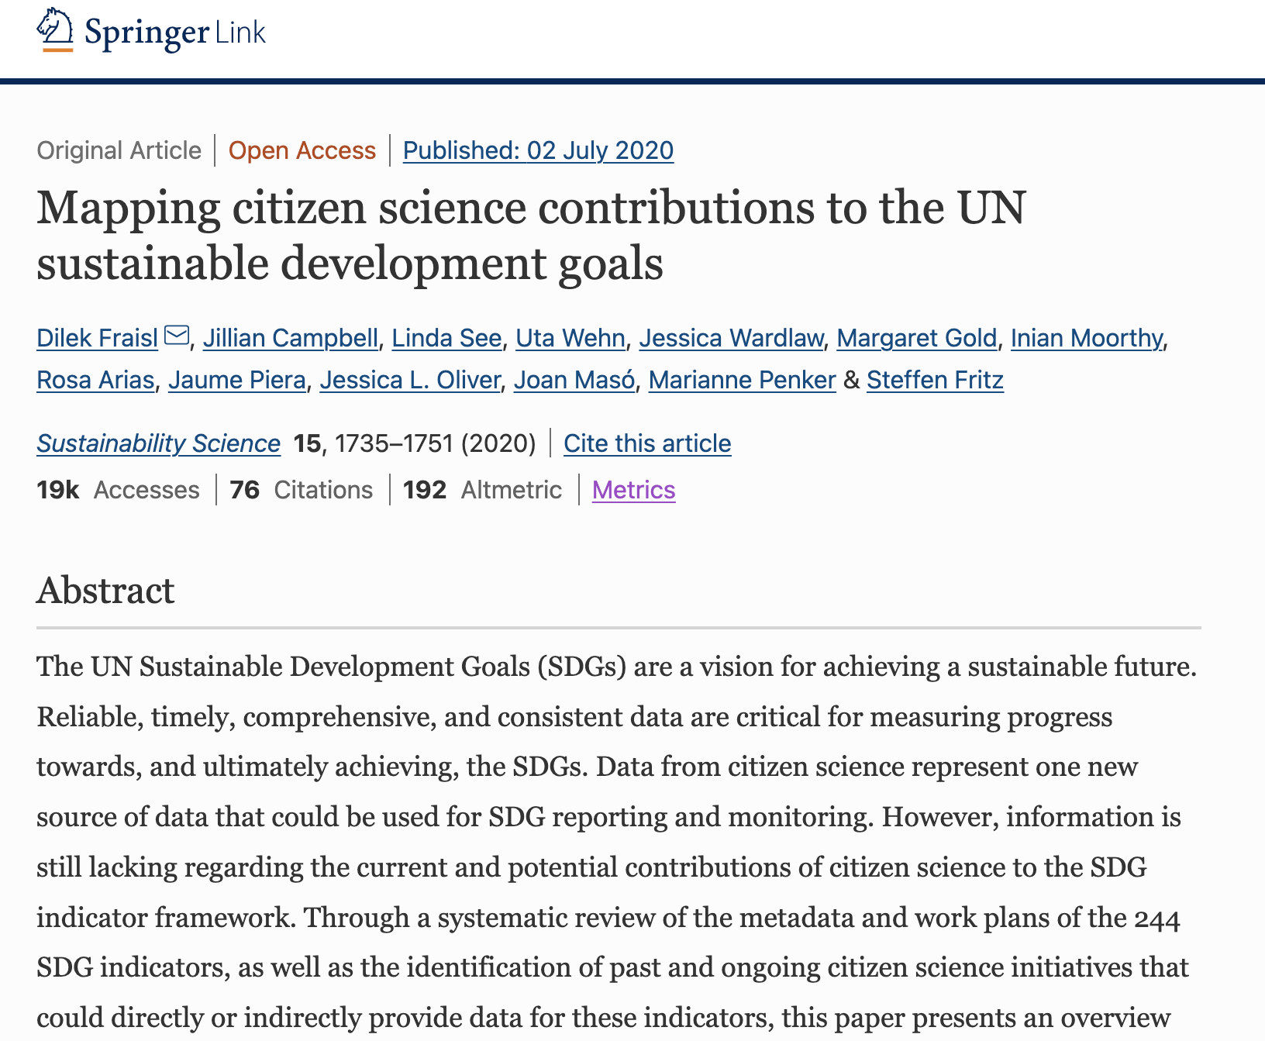
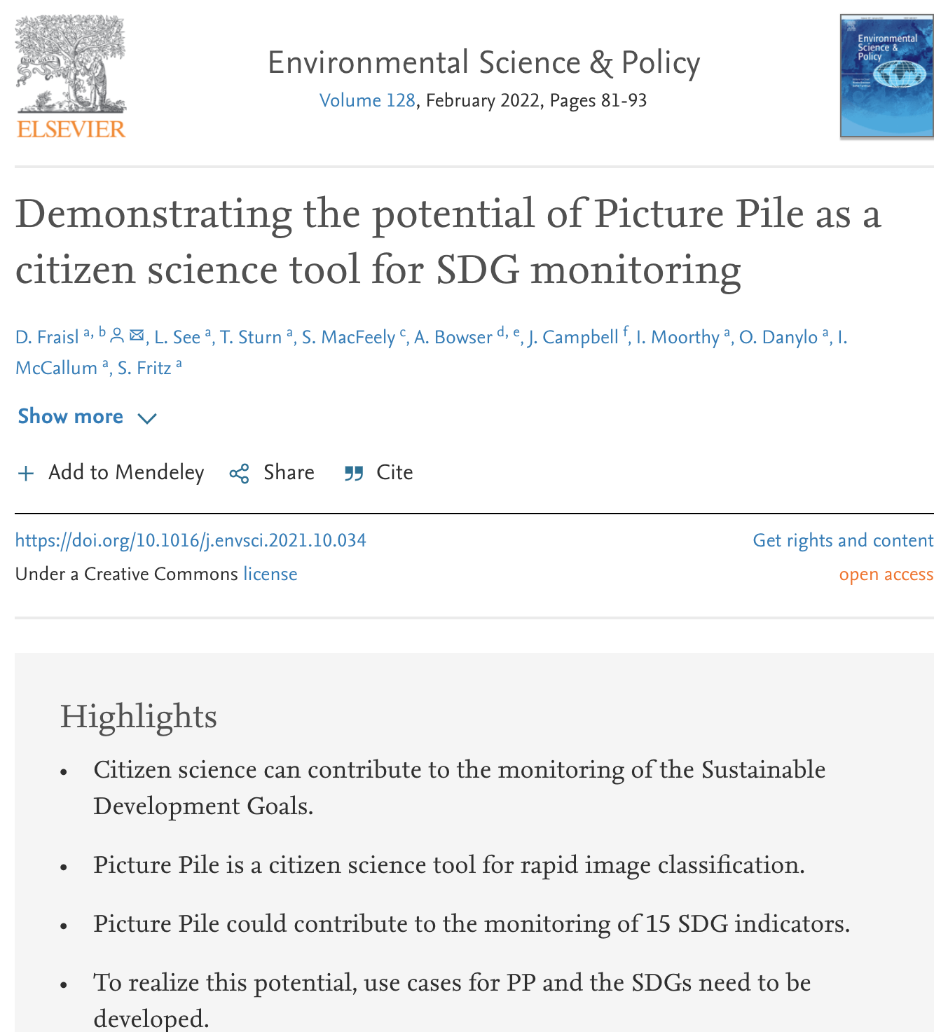
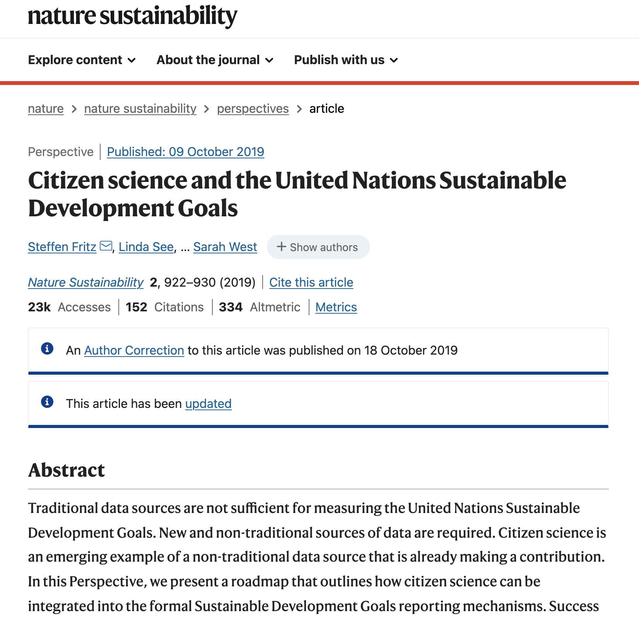
Recent Publications

Slide 10
Thank you!
Dilek Fraisl, PhD
International Institute for Applied Systems Analysis (IIASA)
on behalf of the WeObserve SDGs CoP
Email: fraisl@iiasa.ac.at
Twitter: @dilekfraisl1
Web: www.iiasa.ac.at
www.geo-wiki.org

