Slide 1

Citizen Science and the UN Sustainable Development Goals (SDGs)
Dr Dilek Fraisl
Research Scholar
International Institute for Applied Systems Analysis (IIASA)
fraisl@iiasa.ac.at
Twitter: dilekfraisl1
www.iiasa.ac.at

Slide 2
Session: Citizen Science and the UN Sustainable Development Goals (SDGs)
Dr Linda See
Senior Research Scholar, International Institute for Applied Systems Analysis (IIASA) see@iiasa.ac.at
Dr Elena Proden
Senior Specialist, UN Institute for Training and Research (UNITAR) Elena.PRODEN@unitar.org
Ms Sarah Omache
Statistician, Kenya National Bureau of Statistics (KNBS) somache@knbs.or.ke
Ms Liliana Suchodolska
Policy Analyst, Partnership in Statistics for Development in the 21st Century, Liliana.SUCHODOLSKA@oecd.org
Ms Karen Bett
Policy Manager, Global Partnership for Sustainable Development Data (GPSDD) kbett@data4sdgs.org

Slide 4
The SDG Report 2021, UN DESA.
Data are available for only 33% of the 104 gender-related SDG indicators in OECD countries (OECD, 2020)
58% of the environmental SDG indicators lack data (UN Environment, 2019).

Slide 5
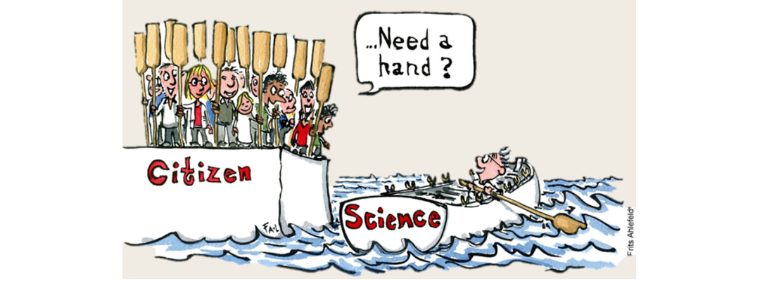
Danish Citizen Science Network Website, 2021

Slide 6

Citizen Science
Examples include sharing biodiversity related observations, measuring water or air quality, reporting on safety or violence, identifying slums and poverty, etc.
From hypothesis driven research led by scientists and volunteers contribute data, to initiatives volunteers and scientists identify the research question together and work together in many aspects of research.

Slide 7
Session Objectives
Demonstrating the value of citizen science/citizen-generated data (CGD) for the SDGs
Discussing the opportunities and challenges of using citizen science/CGD for official statistics and how to overcome these challenges
Providing examples of how citizen science data are used by National Statistical Offices (NSOs) and UN agencies for SDG monitoring and informing policies
Discussing what’s next for citizen science in the context of the SDG agenda
Providing recommenations of how to leverage the use of citizen science/CGD for SDG monitoring, implementation and addressing sustainable development

Slide 8
Citizen Science and the SDGs: Examples, Opportunities and Challenges
Linda See
Novel Data Ecosystems for Sustainability (NoDES) Research Group
Advancing Systems Analysis (ASA) Program
SRI 2022

Slide 9
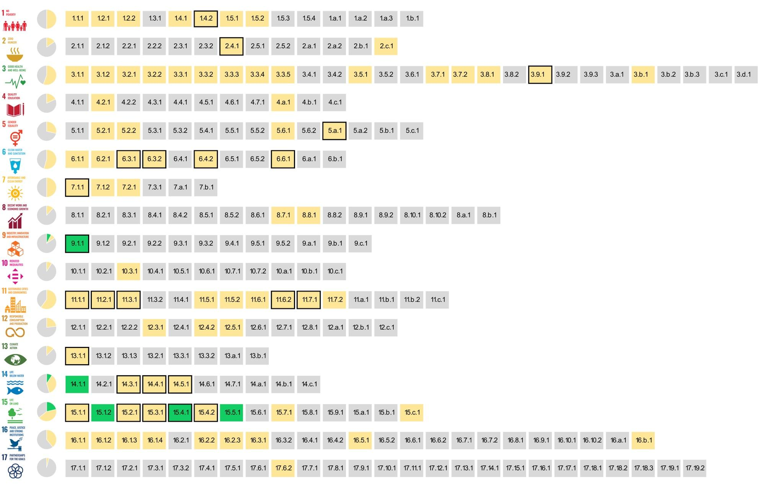
Systematic Review of Citizen Science and SDG Indicators
Green = where citizen science is already contributing
Yellow = where citizen science has the potential to contribute
Black boxes indicate both citizen science and EO can contribute together
Citizen science already contributing to 5 indicators with the potential to contribute to 76 more
Potential in both environmental and social indicators
Source: Fraisl et al. (2020) https://link.springer.com/article/10.1007/s11625-020-00833-7

Slide 10
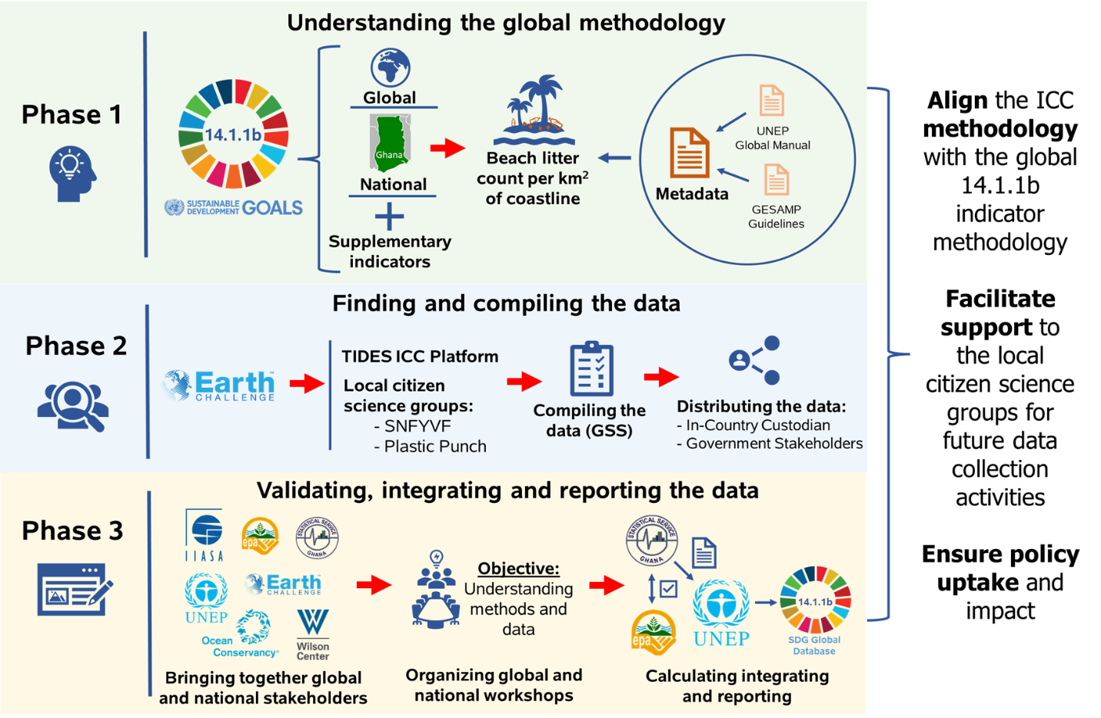
Reporting on Indicator 14.1.1b with Citizen Science
Citizen science data (monitoring beach litter) have been integrated into the official SDG monitoring and reporting mechanisms of Ghana = first country to do so
Legal framework was in place
Inputs to Ghana’s Ocean Plan and other relevant policies
Bridging local data collection efforts with global monitoring processes by leveraging the SDG framework

Slide 11
Also of Relevance for Social Indicators
SDG 3 (Health and Wellbeing) and SDG6 (Clean Water and Sanitation) were identified in the systematic review as having a high potential to benefit from citizen science
Undertook a review of health-related indicators (SDGs and WHO’s Triple Billion Targets)
Found that citizen science can contribute to at least 42 indicators (out of 58 health-related ones): 9 in a direct way and the rest in a supplementary way
Ongoing project looking into citizen science for indicator 16.6.2 (UNDPOGC):
  Satisfaction with healthcare, education and government services
  Access, affordability, quality of facilities, equal treatment for everyone, overall satisfaction
  Courtesy and treatment (healthcare), effective delivery (education), timeliness (government services)
  Talking to NSOs, designing a citizen science strategy, identifying challenges

Slide 12


Citizen Science for SDG Monitoring
Opportunities
More frequent data collection
Higher spatial resolution/remote places
Filling gaps in cases where no data exist
Local knowledge/thematic richness
Raising awareness of global and local issues related to sustainable development
Transformative behaviors
Challenges
Data quality and trust in the data
Alignment with official protocols and data requirements, and legal environment
Representativeness of the data/other biases
Digital divide
Inclusivity
Engagement (recruitment, sustained participation, aligning motivations with purpose)
Images: flaticon.com

Slide 13
Thank you for your time
Any questions?
Linda See
NoDES Research Group, ASA Program
see@iiasa.ac.at

Slide 14






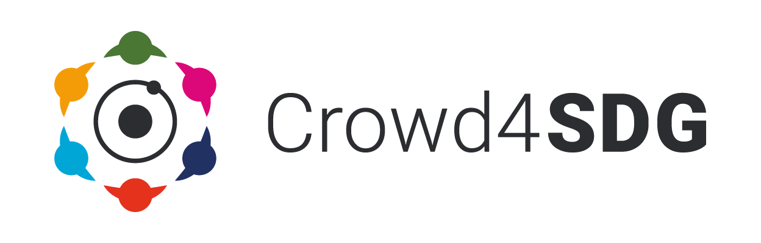






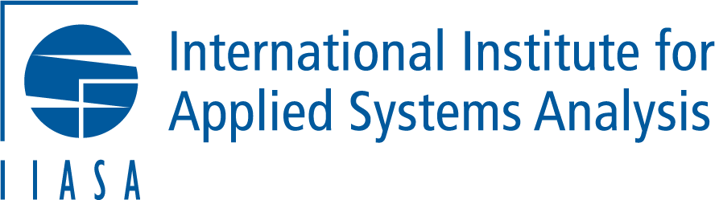

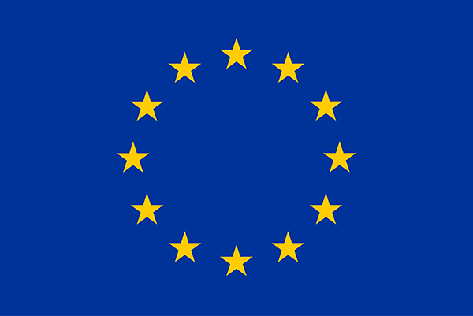
2022 Policy Brief “Citizen science data to track SDG progress: Low-hanging fruit for Governments and NSOs”
Elena Proden, Senior Specialist, UNITAR
SRI2022 session: Citizen Science and the UN SDGs
20 June 2022
This project has received funding from the European Union’s Horizon 2020 research and innovation programme under grant agreement No 872944

Slide 15
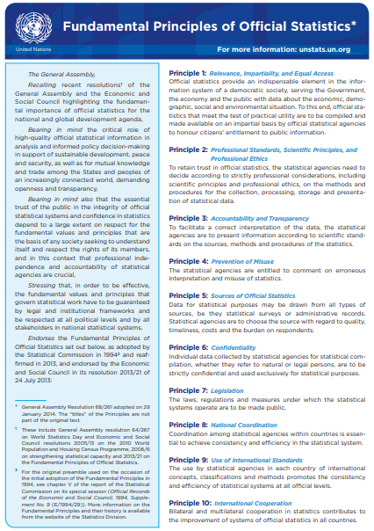
Official statistics
OFFICIAL STATISTICS
Official statistics produced by NSO and NSS in compliance with UN FPOS describes the economic, demographic, social and environmental phenomena meeting diverse user requirements. Can be produced using primary data sources (census, surveys) and secondary data sources (admin. data, new data sources).
CITIZEN SCIENCE DATA
Data produced -by citizens who voluntarily contribute their time, knowledge, skills and/or their data to help produce evidence, strengthen accountability or develop locally-rooted solutions.

Slide 16
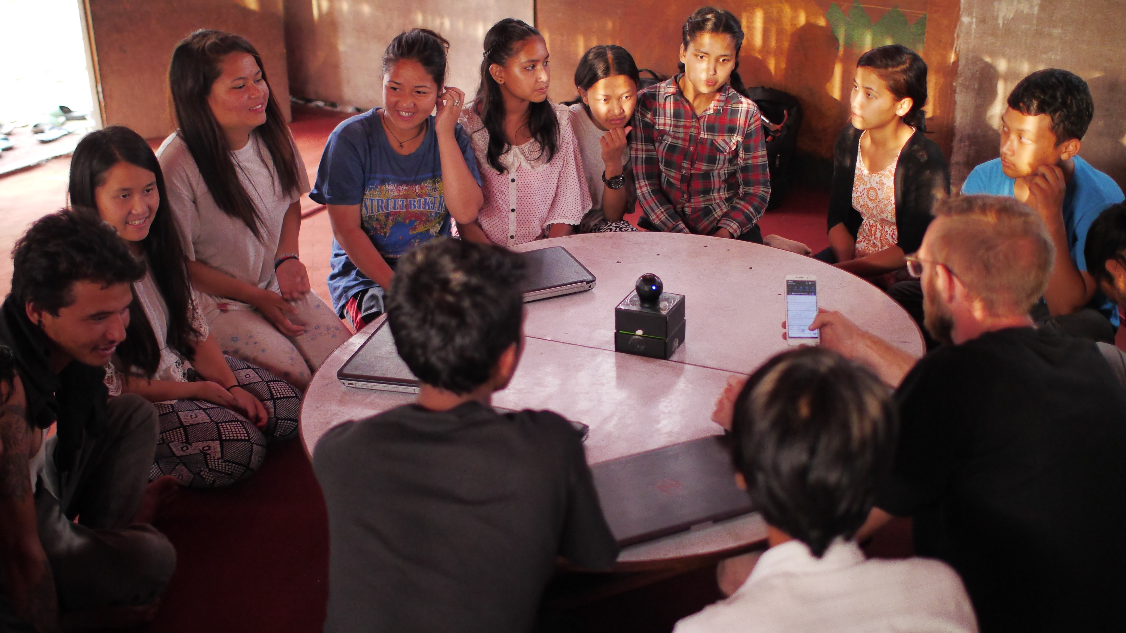

Citizen science data – Examples
Citizens can
Help define locally relevant indicators
Collect data
Analyze or classify data
Share their personal data (ie. health and lifestyle)
Donate their devices’ computer power for modelling and simulations
In other ways

Slide 17
Quality Assurance Framework for data processed by non-official data producers
Example of a scoring matrix
CRITERIA | Score | Notes | CRITERIA | Score | Notes
Accessibility | 1 |  | Coherence, Comparability and Integrability | 1
Timeliness, Frequency and Sustainability | 1 |  | Documented data collection/production/ dissemination process | 2
Accuracy and Reliability | 2 |  | Impartiality | 2
Coverage | 1 |  | Confidentiality/Privacy | 2
Relevance | 1 |  | Self-Identification | na
Metadata | 2 |  | TOTAL | 1.5
0 – zero compliance, 1 – partially compliant, 2 – fully compliant (based by UK ONS’s approach with additional criteria)

Slide 18
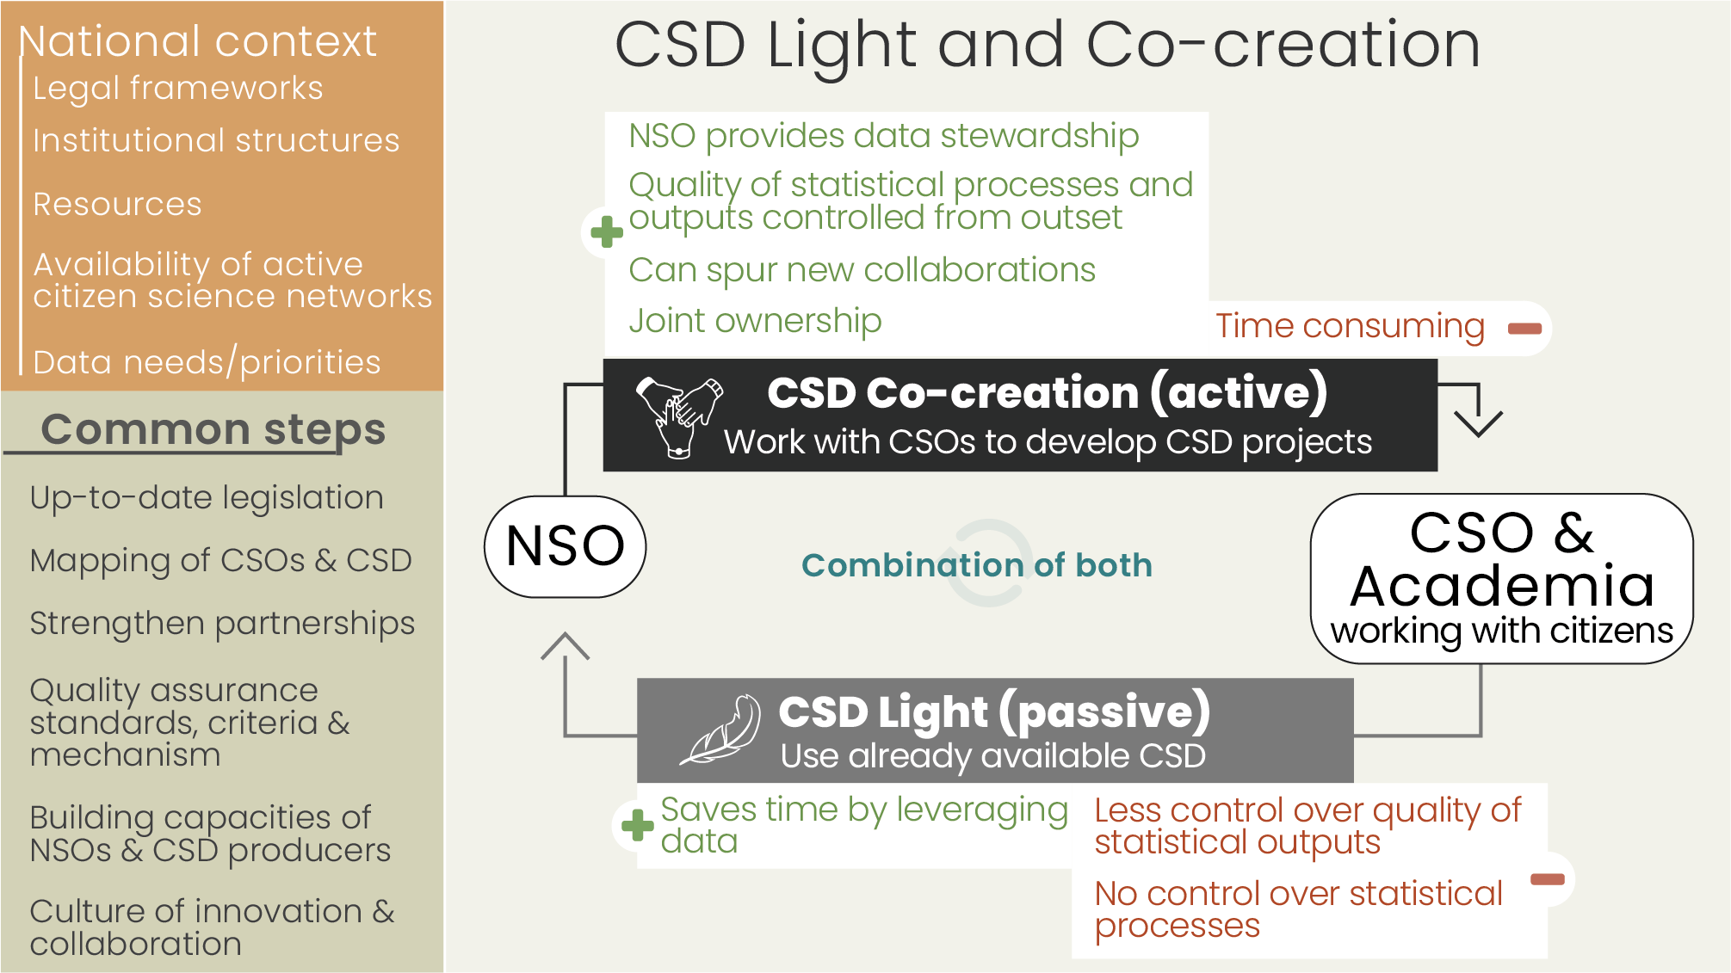

Slide 19



elena.proden@unitar.org
www.crowd4sdg.eu

Slide 20
The National Statistics Office Experience
(Harnessing Citizen Generated Data for Official Reporting)
Presented By: Sarah Omache

Slide 21
Why Does the NSO need Citizen Generated Data?
Data gaps in official statistics
Data to compliment official statistics
Data to assist in data collection
Data for reporting on SDGs Indicators

Slide 22
Collaborations around CGD
Preparation of guidelines for CGD
Reaching out to producers of CGD (CSOs) and umbrella bodies
Creating awareness and training
Identification of Data gaps
Mapping of Producers of CGD
Meetings, workshops, Forums
Collaborations in development of guidelines, criteria for validating CGD and data collection
Data literacy

Slide 23
Focus Areas in CGD in Kenya
The gaps in data for reporting on SDGs
Inventory of Producers of CGD and available datasets
Gender sensitive CGD
Sectors reaching out to CSOs such as Culture and the county Governments

Slide 24
The Quality Criteria for Validating CGD in Kenya
Was launched with KeSQAF and inaugurated in June 2022
Developed by KNBS, Producers of CGD, partners and other stakeholders
Will be used to validate gender sensitive CGD
Forms part of the Kenya Statistical Quality Assurance Framework
It is based on the quality dimensions
Gaps will be identified, relevant CGD identified and then subjected to the criteria

Slide 25
Asante!

Slide 26
Citizen-generated data
– how can governments and civil society monitor SDGs together
PARIS21 approach
Liliana Suchodolska, PARIS21/OECD June 2022

Slide 27
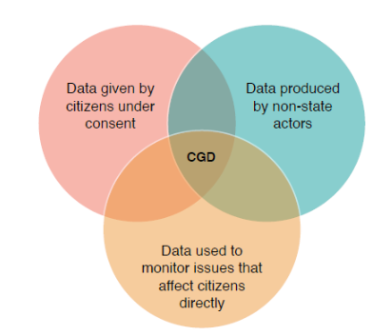
What is citizen-generated data?
Source: PARIS21, Reusing Citizen-Generated Data for Official Reporting (2021)
Notes:
Persisting data gaps in SDGs
Insufficient data disaggregation
“Grey zones” in official reporting: gender, human-rights, climate change, migration
Opportunity to improve dialogue with non-state actors and co-create public value with citizens

Slide 28
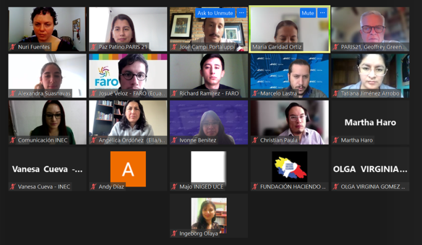
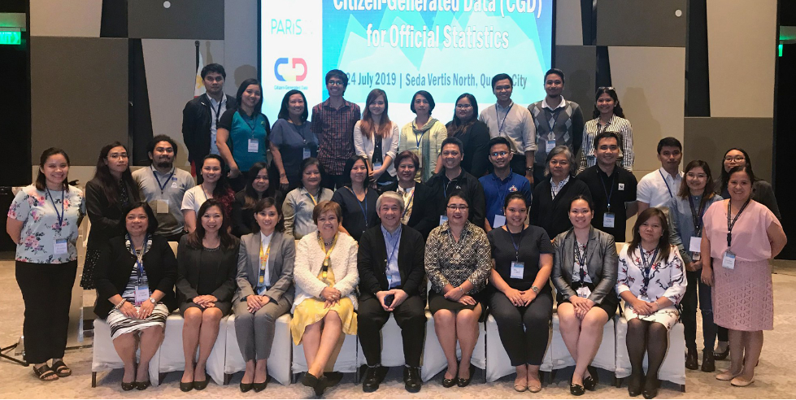
PARIS21 support to national statistical offices
Philippines
Ecuador
Embedding CGD-criteria in existing quality assurance
Opportunity: 36 Tier I, 24 Tier II and 21 Tier III indicators can be filled in
Grupo Faro (umbrella CSO) to coordinate participating CSOs
Opportunity: INEC can capacitate CSOs to improve their data practices
Source: PARIS21
Source: PARIS21

Slide 29


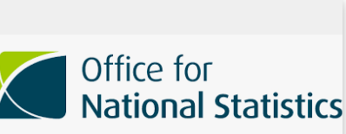

CGD use in other countries
Data from NGOs (Pharos and Rutgers) on genital mutilation and on sexual and reproductive health to measure progress on SDG 5 and 16 in its second SDG report 2018
Data from NGO (Transparency International) on corruption to measure progress on SDG 16 in its Sustainable Development Indicator Report 2018
SDG Indicator 12.3.1 – Food waste per capita from WRAP charity
Data from CSO (MYSU) on sexual and reproductive health to report on SDG 3 in its Voluntary National Review 2017

Slide 30
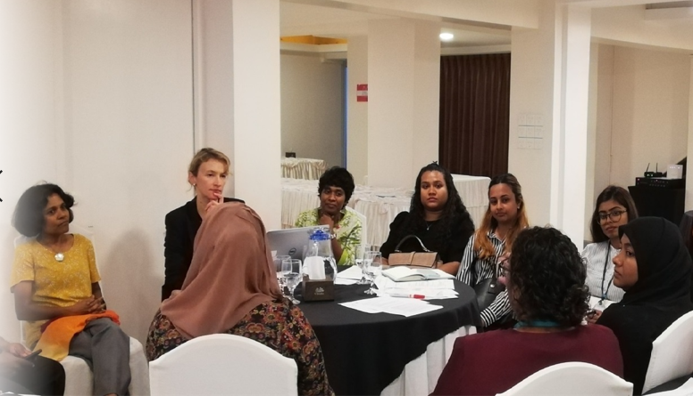
Challenges
Source: PARIS21

Slide 31
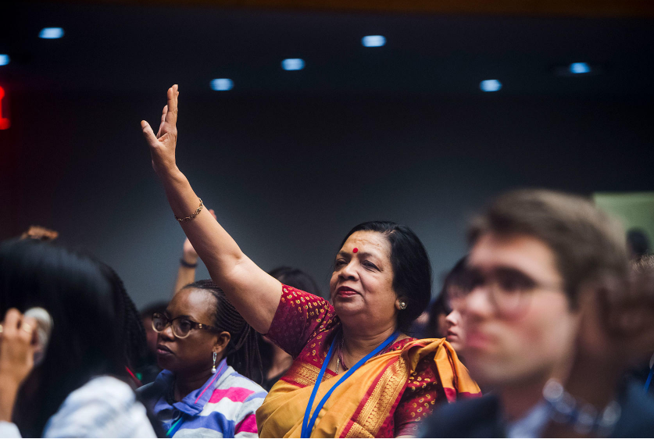
Opportunies
Source: usip.org

Slide 32
Thank you
www.paris21.org
liliana.suchodolska@OECD.org

Slide 33

Citizen-Generated Data: Evolution and looking forward
Karen Bett, GPSDD
PHOTO CAPTION + CREDIT

Slide 34
The greatest insight was the power of people’s knowledge that we take for granted.
- Government representative

Slide 35
2015
2016
2017
2017
2018
2019
2020
2022
In-country work to further promote CGD/ Citizen Science e.g Ghana, Philippines
Conversations taken to global platforms e.g. WDF, HLPF
In-country work and cross-country learning promoted.
Strong emphasis on CGD for gender
CGD positioned as a data source for measuring and monitoring the SDGs
Countries start piloting CGD e.g. Tanzania, LATAM through Civicus
CGD task team hosted by GPSDD
Citizen Science Global Partnership established
CGD conversations make it to the UN Stats Commission side events
Convergence of multiple actors to champion CGD. (Collaborative model)

Slide 36
What next for CGD?
Positioning CGD at the Global level
Showcasing what has worked, for others to learn
Positioning NSOs as the stewards of CGD (especially if it is needed for SDG reporting)
Promoting the use of Citizen data

Slide 37
Storytelling is something that’s impactful, it makes people change behaviors. Numbers alone are not relatable.
- Gilbert Nakweya, Journalist

Slide 38
kbett@data4sdgs.org
sharon@africasvoices.org

Slide 39

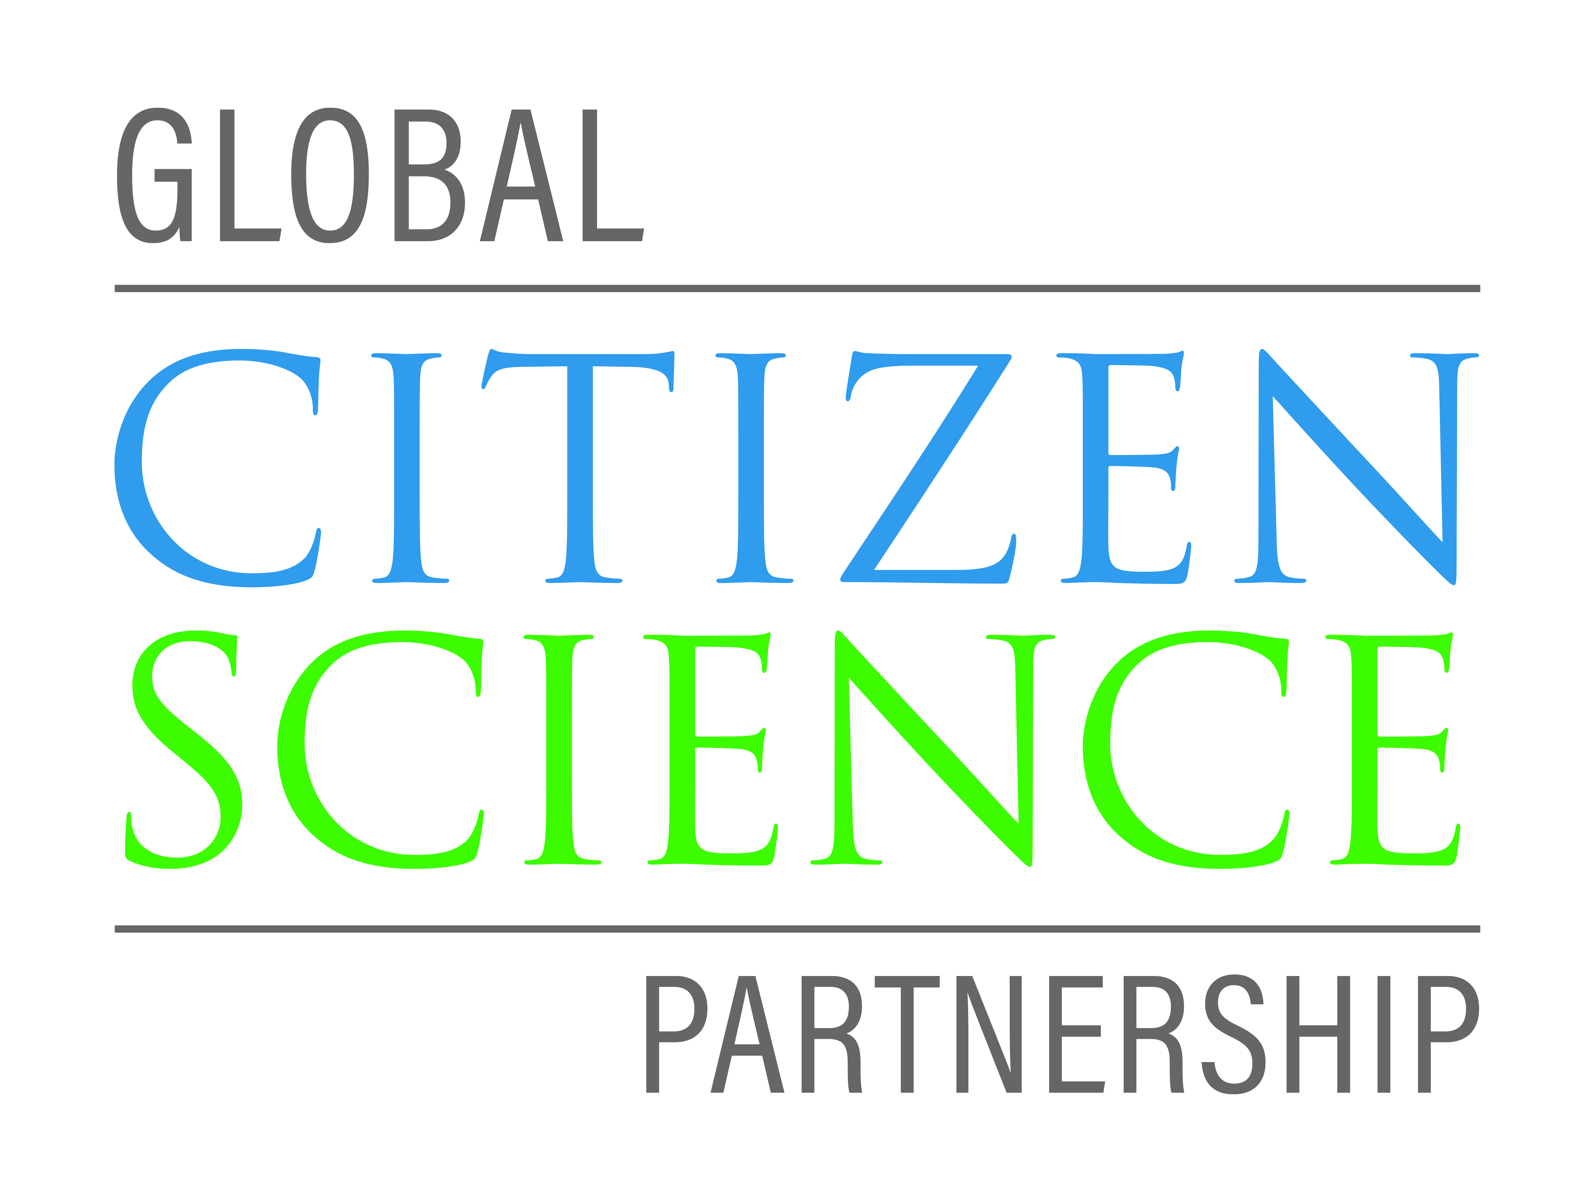


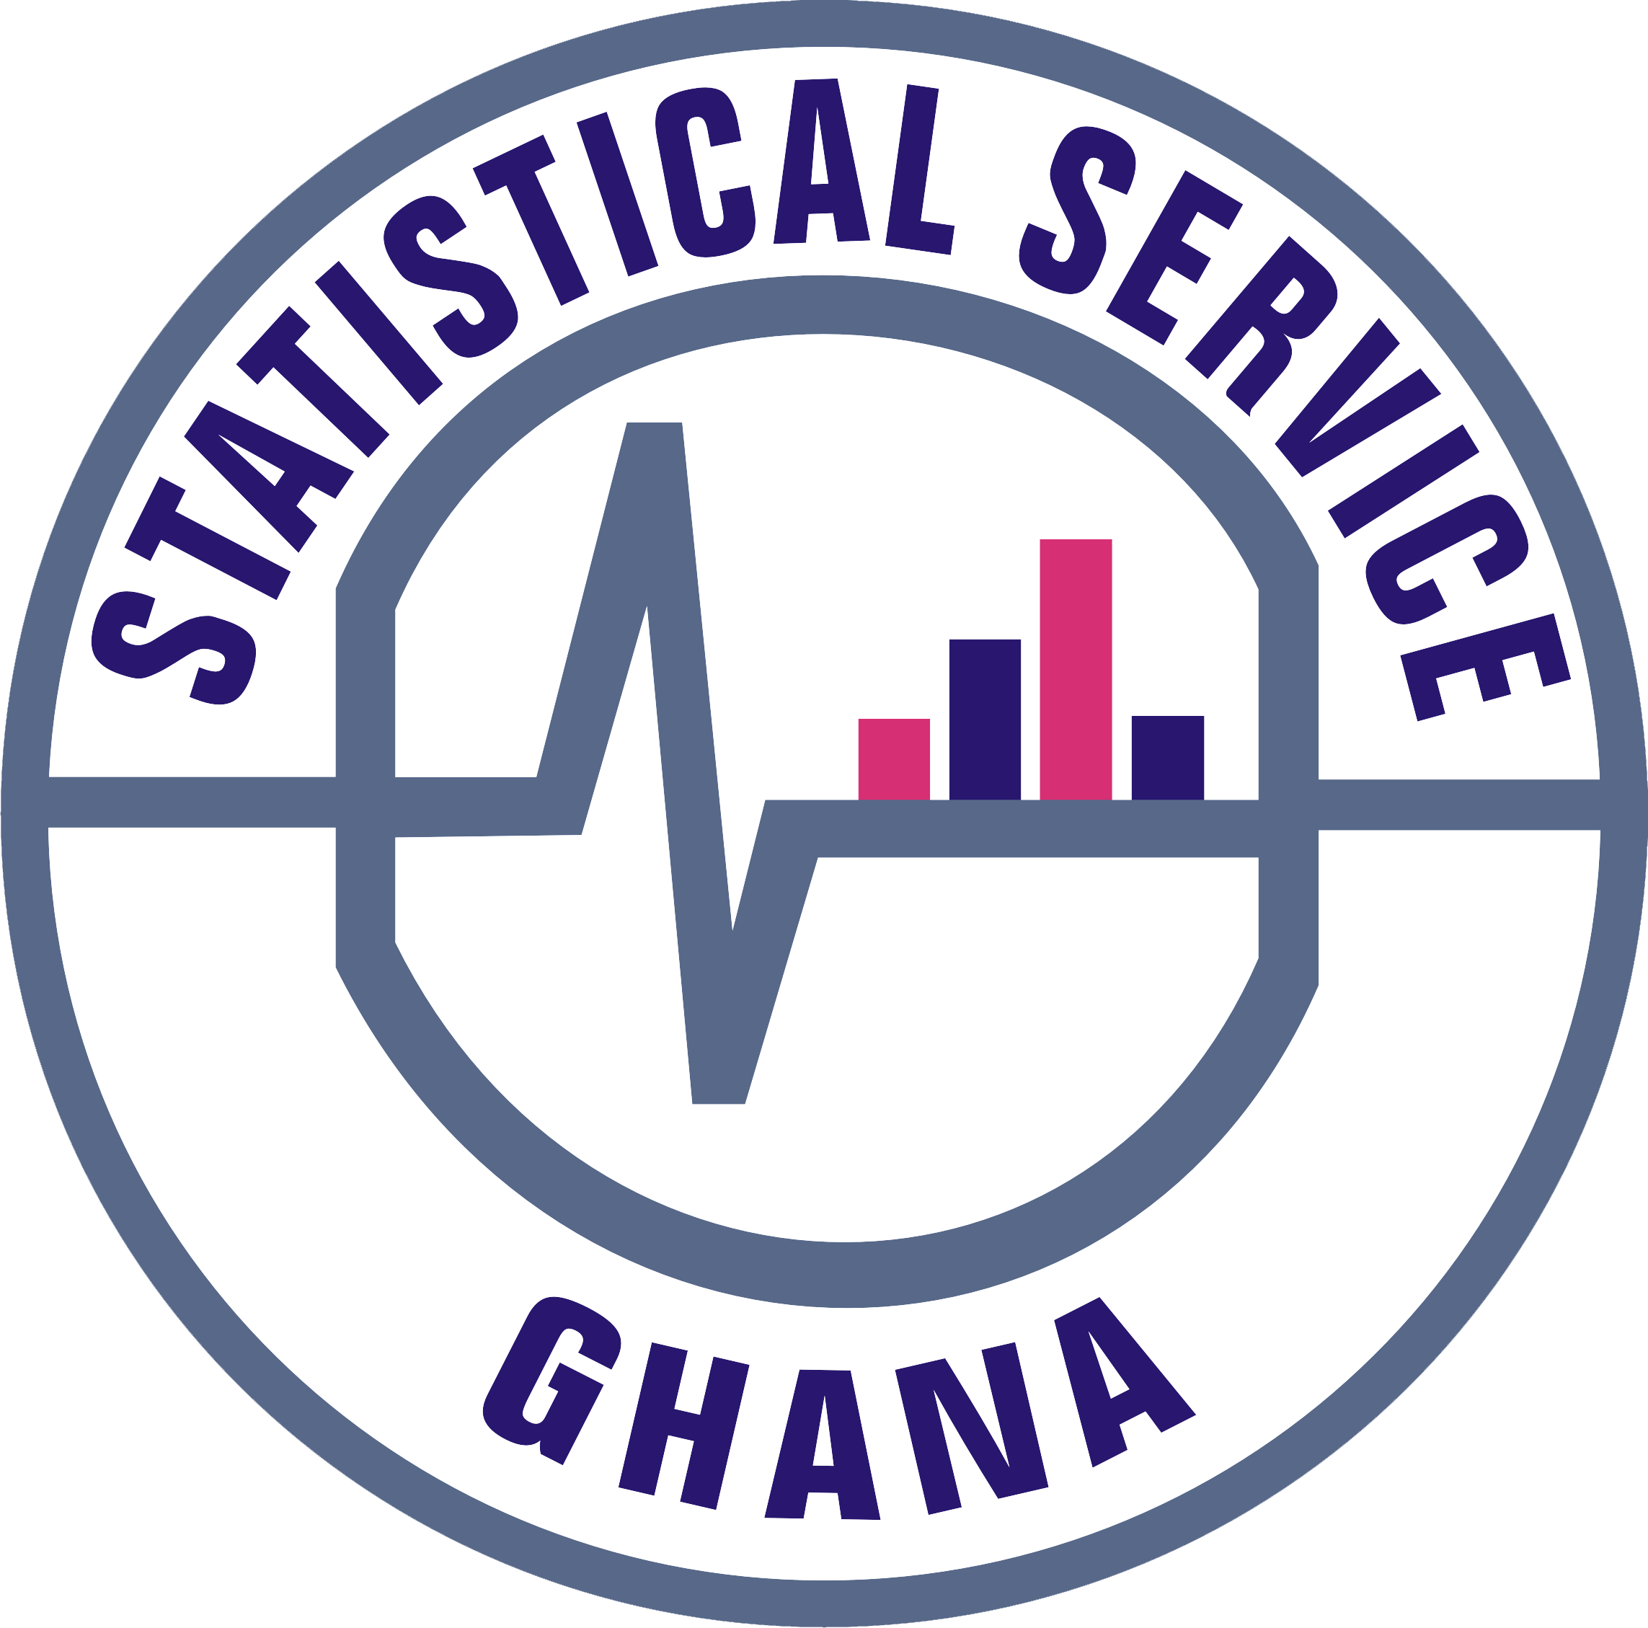

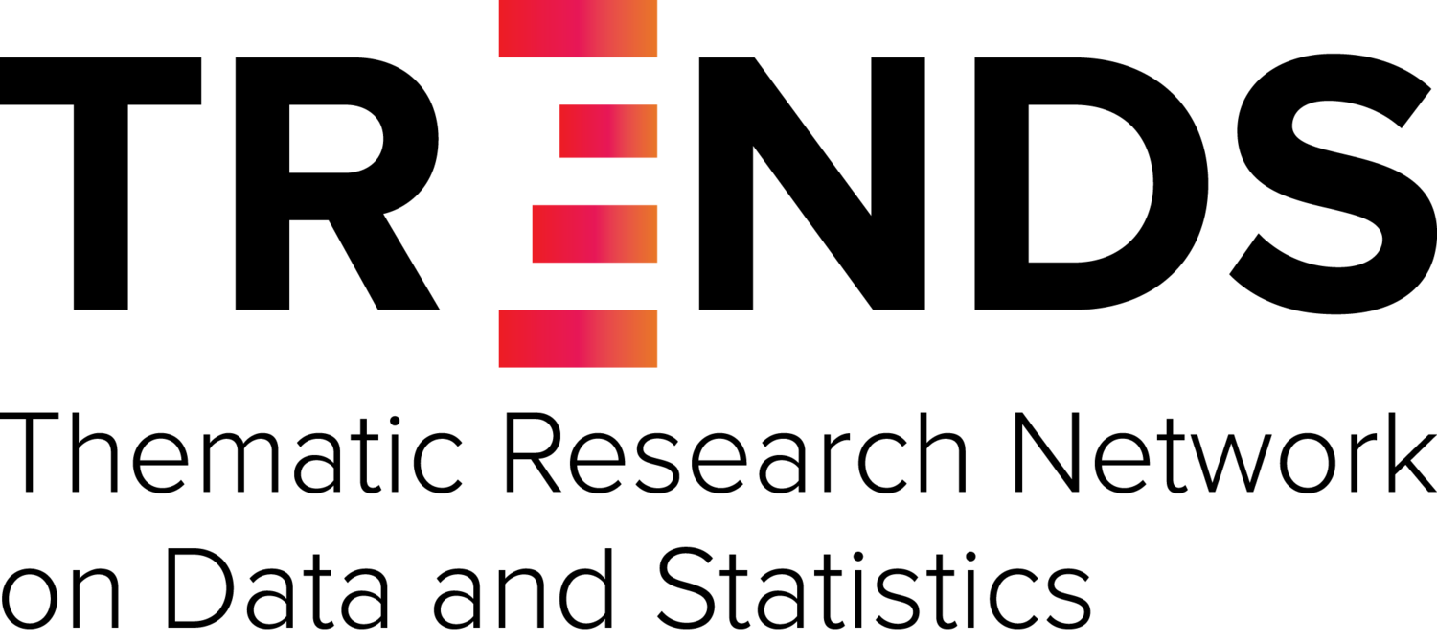
THANK YOU
Session TA2.12: Integrating Citizen Science into the Official SDG Monitoring Mechanisms and Introducing the Global Citizen Science Partnership (GCSP)

