Slide 1
How can we build trust in citizen science data to inform policy decisions and action?
Dilek Fraisl, Gerid Hager
Email: fraisl@iiasa.ac.at
Twitter: @dilekfraisl1
Web: www.iiasa.ac.at
www.geo-wiki.org
Email: hager@iiasa.ac.at
Web: www.iiasa.ac.at
www.geo-wiki.org

Slide 2
Agenda
Intro to the session
Multiple dimensions of trust in citizen science data – Gerid Hager, Research Scholar, IIASA
Citizen science data in support of policy decisions and action – Dilek Fraisl, Research Scholar, IIASA
Partner's Experiences
Group work/discussion
Closing of the session

Slide 3
Introduction to the session
Notes:
people move to different sides of the rooms to indicate answers and ask one or two people max their experiences based on the question/answer?

Slide 4
Who is or has been involved in a citizen science project that you think the data would be helpful for SDG monitoring, for official monitoring or for policy-making in general?
Notes:
Ask those who are/have been involved to stand up!
Then ask one or two participant in what context they have been involved (short answer)..

Slide 5
Who is or was involved in a citizen science project that have achieved tangible policy impact and/or recognition?
Notes:
Ask those who are/have been involved to go to one side of the room for 'achieved tangible policy impact', to the middle of the room for 'could do better', to the other side for 'no policy impact')
Then ask one or two participants what kind of policy impact they have achieved (short answer)..

Slide 6
What level of policymakers or government agencies have you been collaborating with or involved in discussions with?
Notes:
Ask people to move to four different locations for local; national; regional (e.g., the EU), and global (e.g., the UN).
Ask one or two participants to clarify…

Slide 7
Have you experienced any trust issue between these policymakers and citizen science researchers or practitioners?
Notes:
Ask participants to move to the different sides of the room for the great, moderate or no issue.

Slide 8
Session Objectives
Provide examples of how citizen science data have informed policies and action in the field of planetary health
Discuss the challenges of building trusted partnerships around citizen science data involving global policy actors, government bodies, citizen science researchers and practitioners, citizen scientists, and other stakeholders
Provide concrete recommendations on how to overcome these challenges
Main outcome:
An increased understanding of the necessary ingredients for building successful citizen science data partnerships that can feed into official monitoring processes to inform policies and invoke action

Slide 9
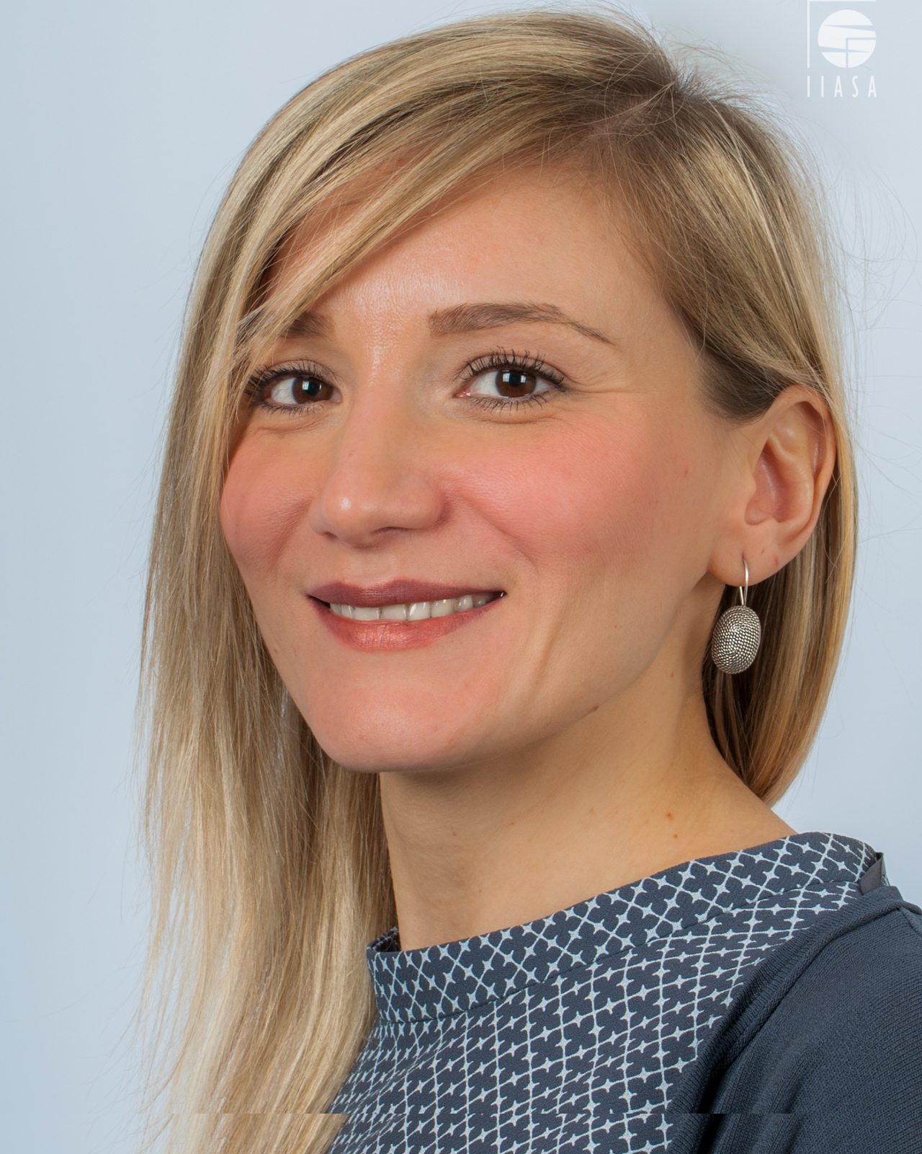
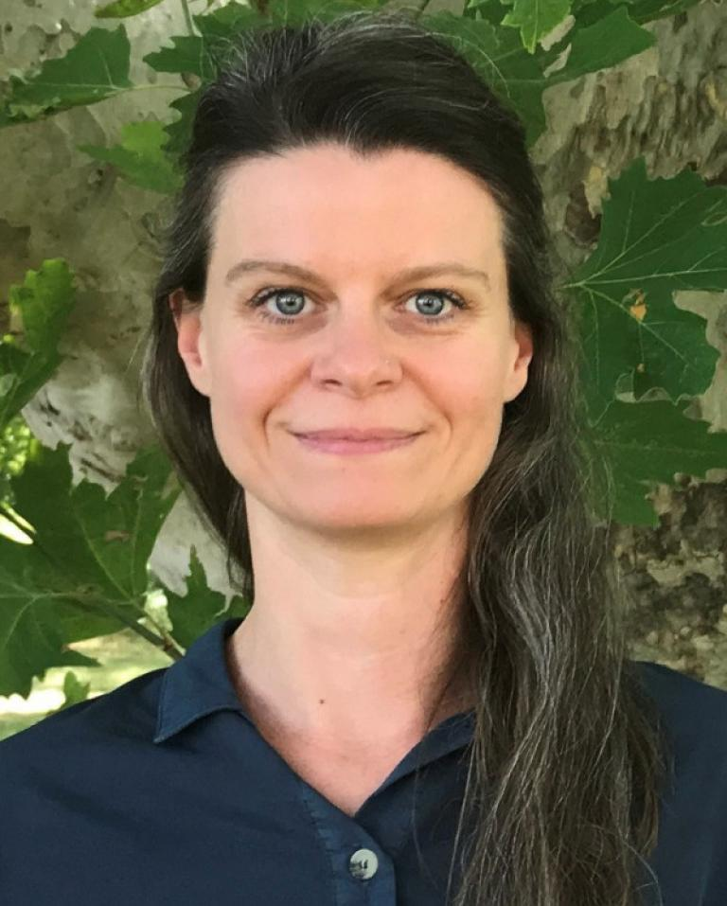
Dr. Dilek Fraisl
Research Scholar, IIASA
Gerid Hager
Research Scholar, IIASA

Slide 10
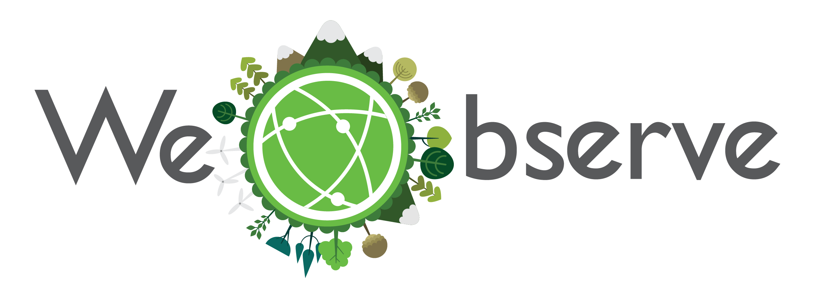
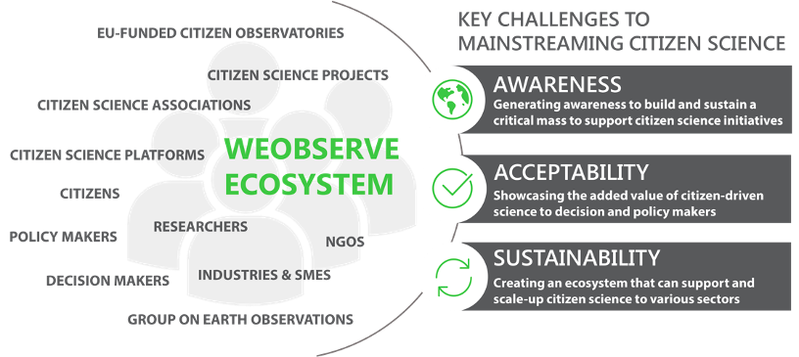
Multiple dimensions of trust in citizen science data
H2020 CSA, 2017-2021

Slide 11
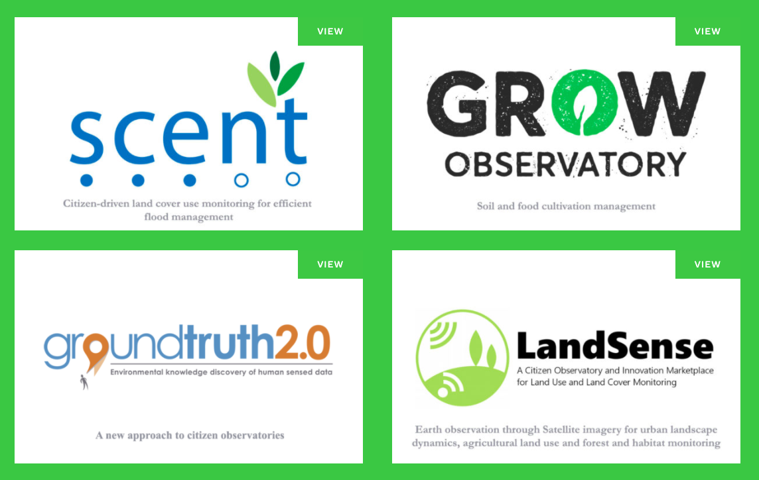
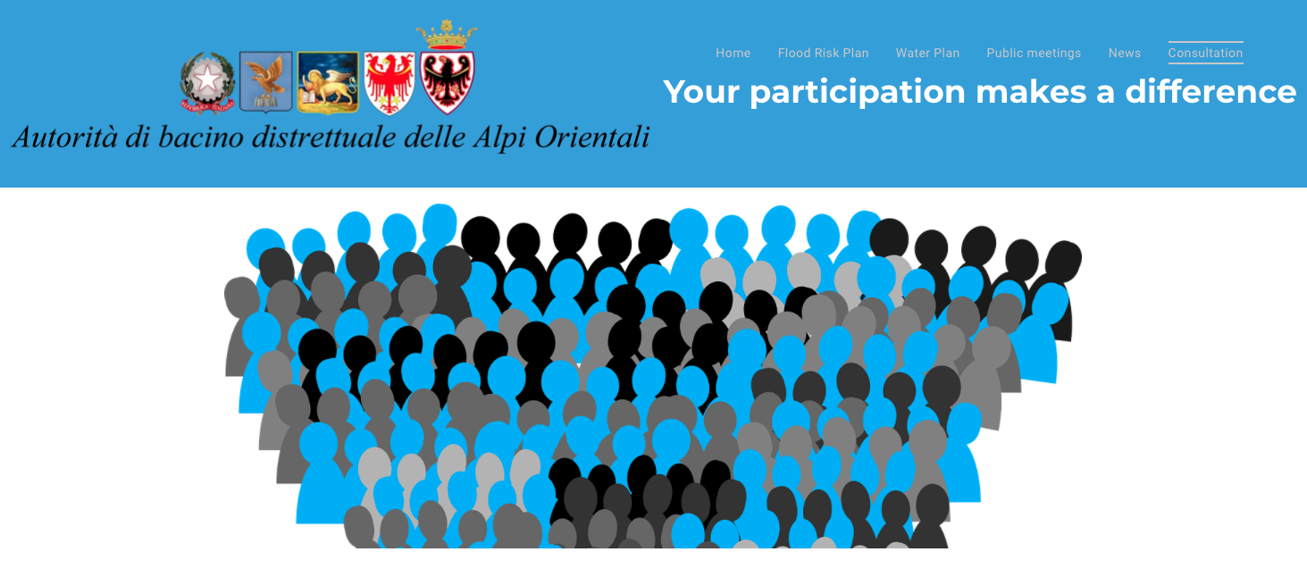
WeObserve “sister” Citizen Observatory projects
Citizen Observatory for flood risk management in the Brenta-Bacchiglione river basin in Italy
Alto Adriatico Water Authority
FP7 - WeSensIt
Horizon 2020

Slide 13
Multiple dimensions of trust in citizen science and citizen science data
Often focus on data quality and acceptability of the data only
Often focus on scientists/researchers and policy makers as addressants of trust question (i.e., can they trust citizen science data?)
Question of trust is multidimensional and multidirectional

Slide 14
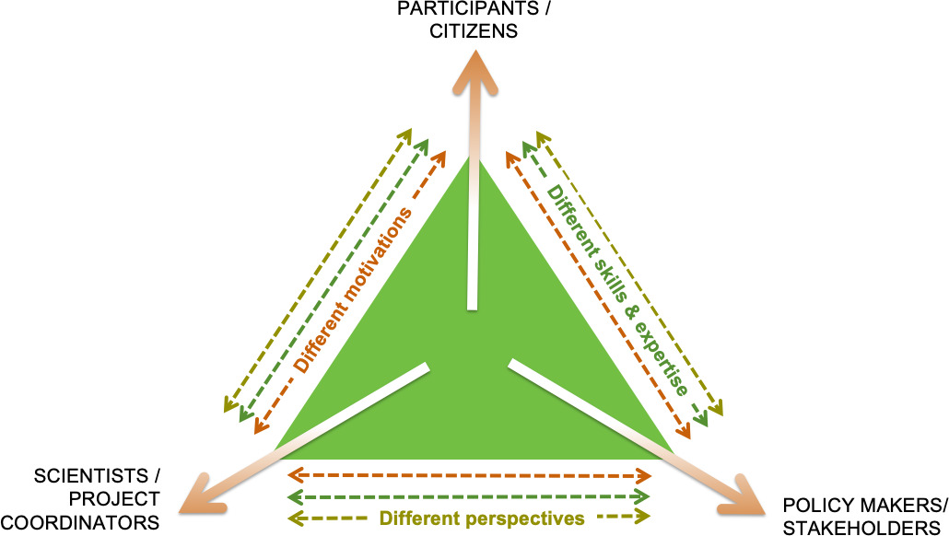
Multiple dimensions of trust in citizen science and citizen science data
Looking beyond acceptability of data itself
Consider theme of ”trust” and acceptability in context of different mindsets and perspectives, possible underlying tensions between the needs and motivations of the various involved actors and parties.

Slide 15
Multiple dimensions of trust in citizen science and citizen science data
Acceptability issues can arise around, e.g.,
Ownership of the data
Ability of citizen science to bring about the desired changes or impact without compromising the ethos of the initiatives
Process related aspects and narratives
Need to address
Privacy and security issues regarding personal, or personally identifiable data (e.g., location data)
Importance of tracing citizen-based contributions such that correct credit can be given
Fear that the data might be ‘sold’ to commercial interests. Transparent data management measures and procedures, and open communication must be established up front.

Slide 16
Multiple dimensions of trust in citizen science and citizen science data
Acceptability issues can arise around, e.g.,
Ownership of the data
Ability of citizen science to bring about the desired changes or impact without compromising the ethos of the initiatives
Process related aspects and narratives
Need to address
Privacy and security issues regarding personal, or personally identifiable data (e.g., location data)
Importance of tracing citizen-based contributions such that correct credit can be given
Fear that the data might be ‘sold’ to commercial interests. Transparent data management measures and procedures, and open communication must be established up front.
Failing to address the challenges can sufficiently affect the trustworthiness of an entire project

Slide 17
Triangle of Trust
Addressing the triangle of trust:
Impact potential of citizen science and citizen science data is increased significantly
Hager, G. et al. (2021). ‘Onto new horizons: insights from theWeObserve project to strengthen the awareness, acceptability an sustainability of Citizen Observatories in Europe’. JCOM 20 (06), A01. https://doi.org/10.22323/2.20060201

Slide 19
Citizen science in support of policy decisions and action
Dr. Dilek Fraisl
Email: fraisl@iiasa.ac.at
Twitter: @dilekfraisl1
Web: www.iiasa.ac.at
www.geo-wiki.org

Slide 20
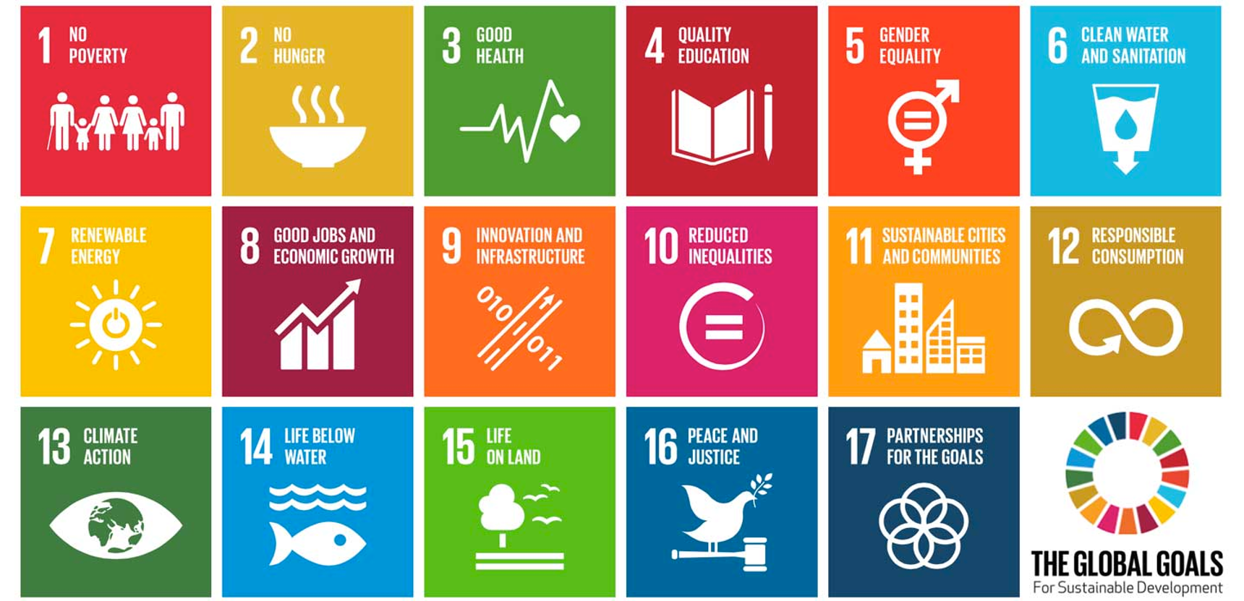
Notes:
SDGs are a call to action to address

Slide 21
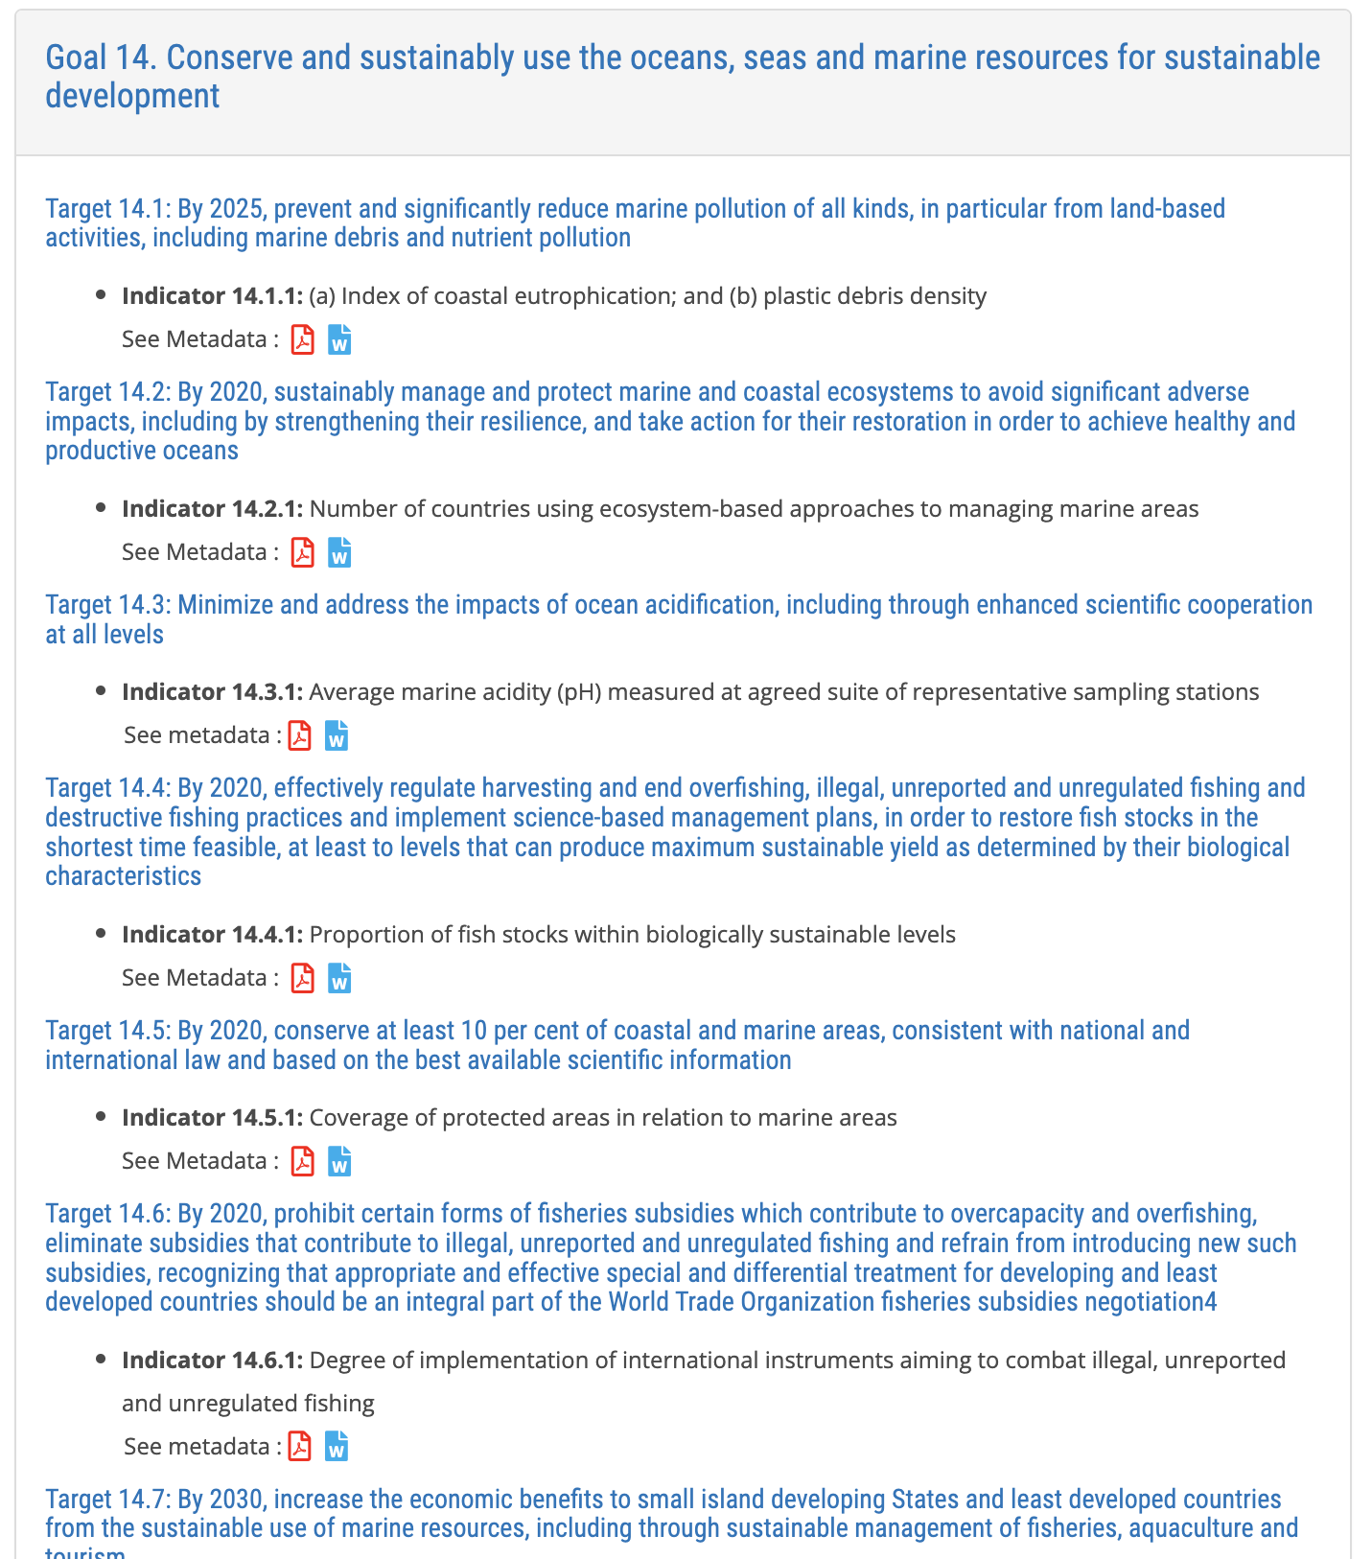
Notes:
to achieve the SDGs, we need timely, reliable and comprehensive data

Slide 22
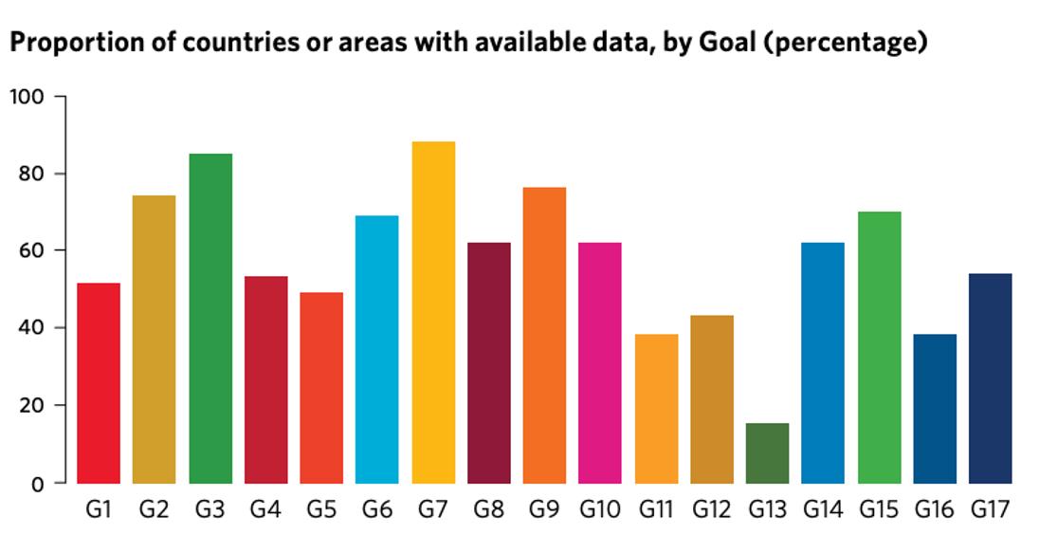

Slide 23
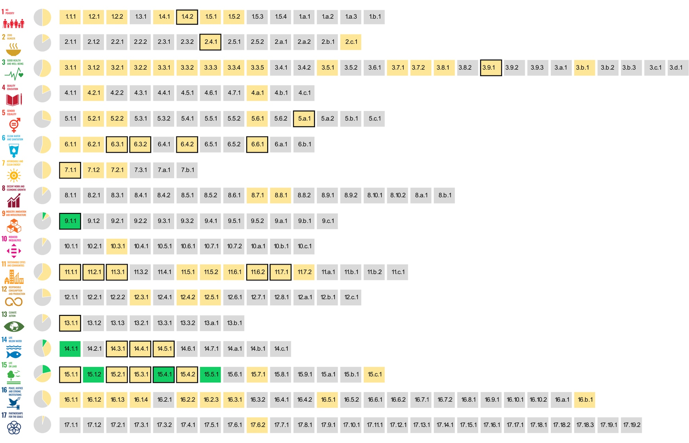
The SDG indicators where citizen science projects are ‘already contributing’, ‘could contribute’ or where there is ‘no alignment'
Fraisl, D., Campbell, J., See, L. et al. Mapping citizen science contributions to the UN sustainable development goals. Sustain Sci 15, 1735–1751 (2020). https://doi.org/10.1007/s11625-020-00833-7

Slide 24
The greatest contribution of citizen science data to SDG monitoring would be in:
Notes:
Link to planetary health

Slide 25
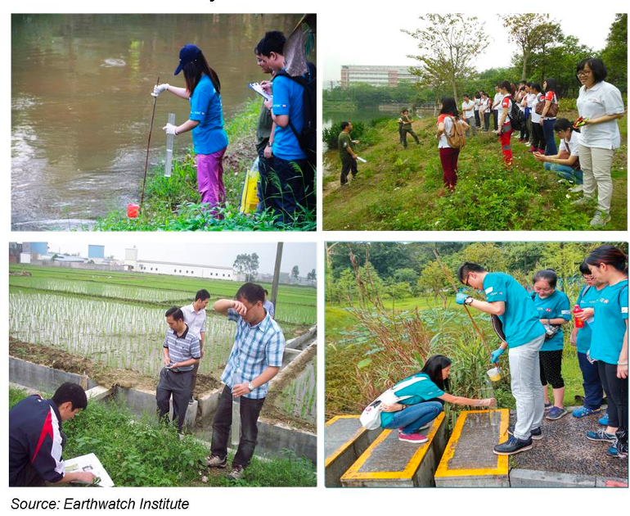
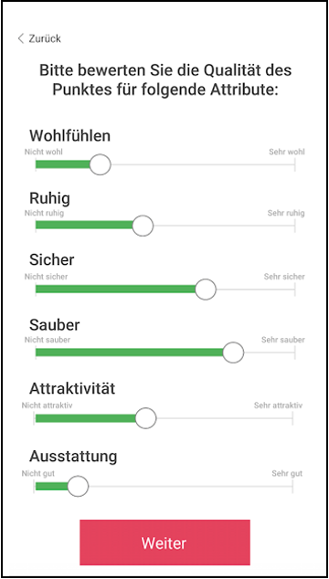
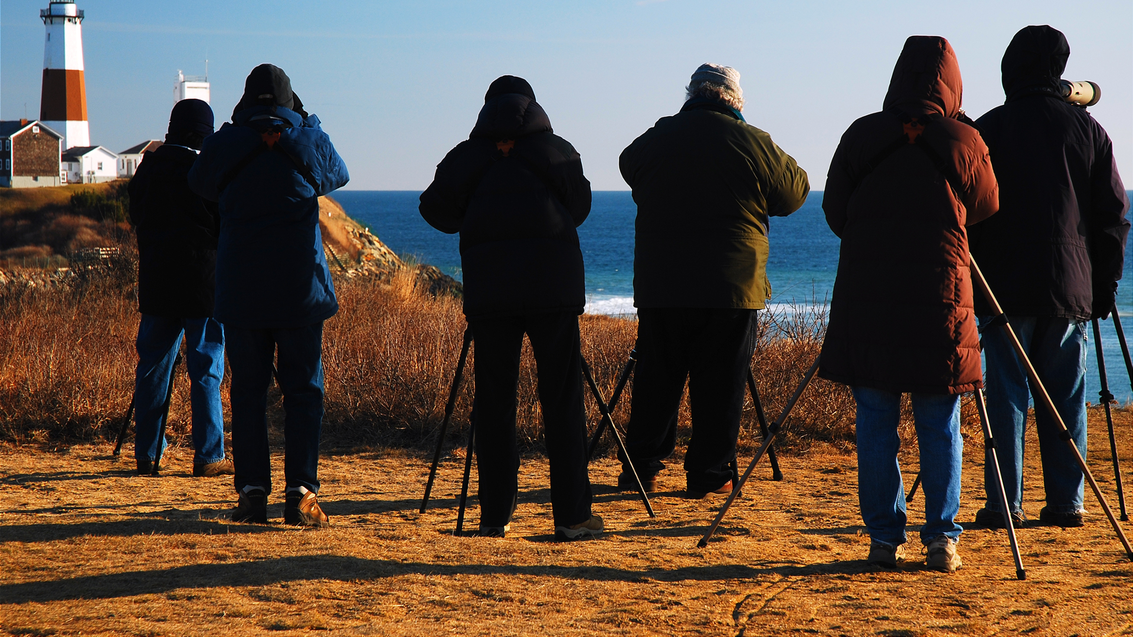
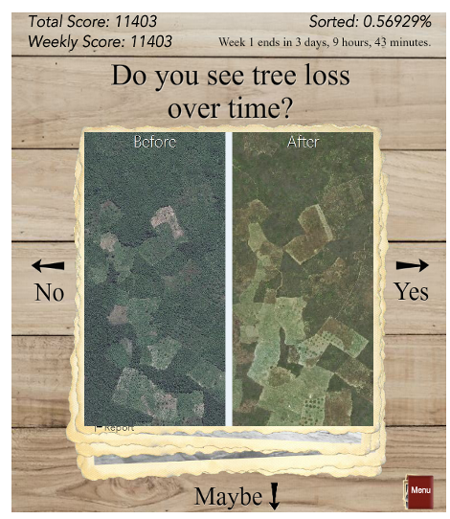
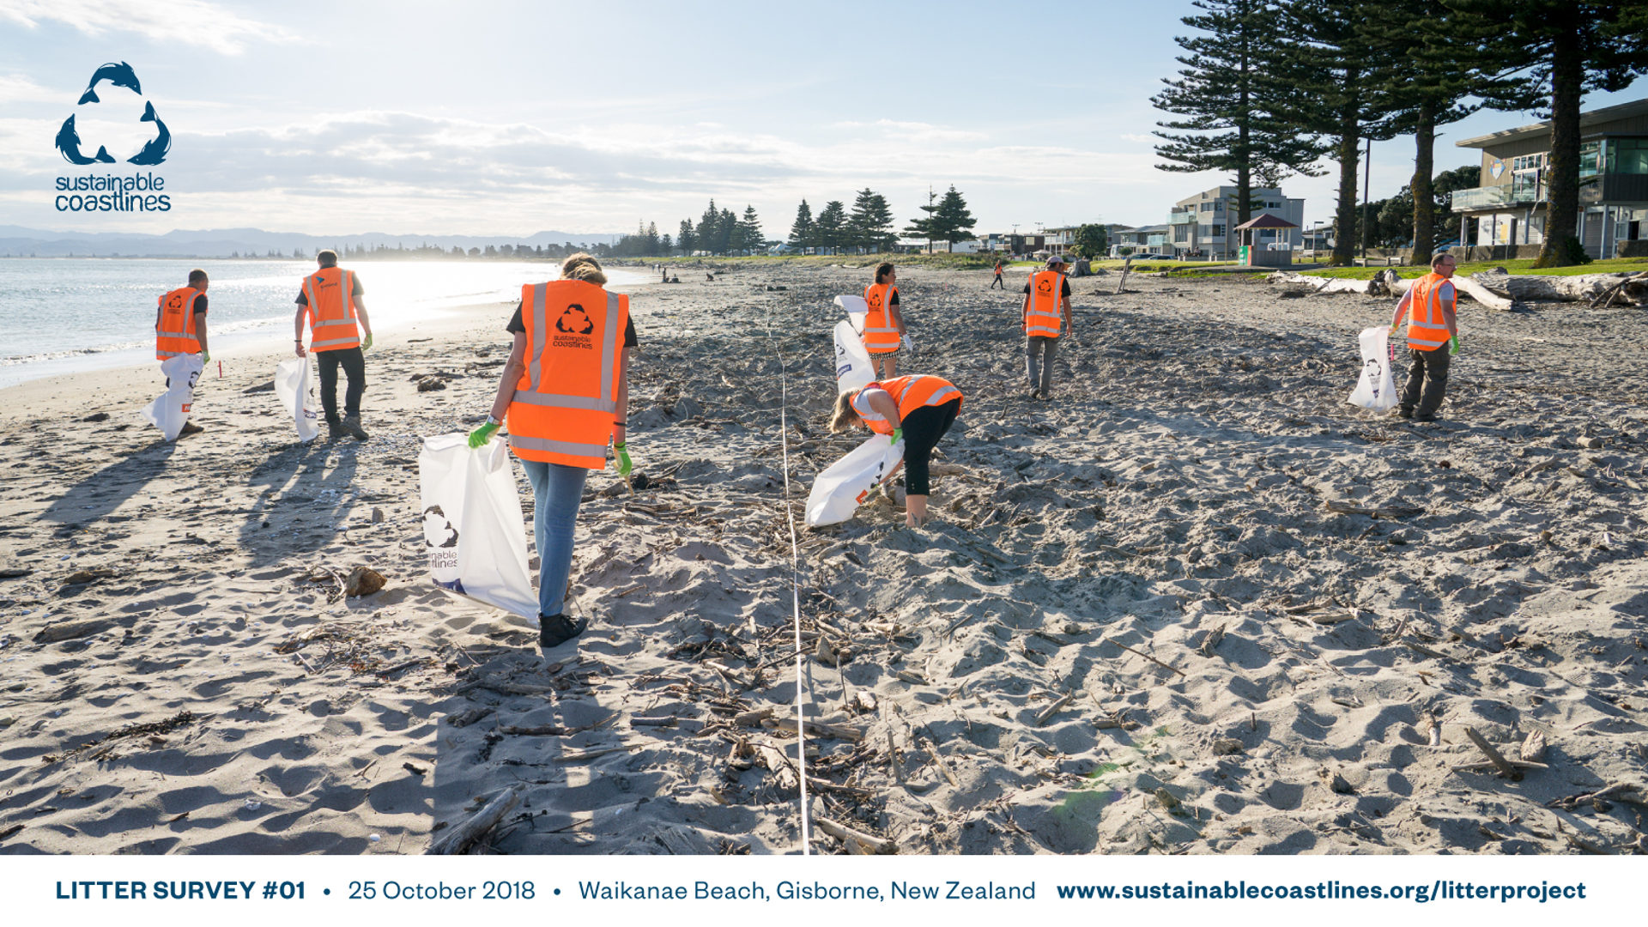
Examples

Slide 26
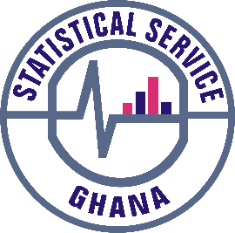
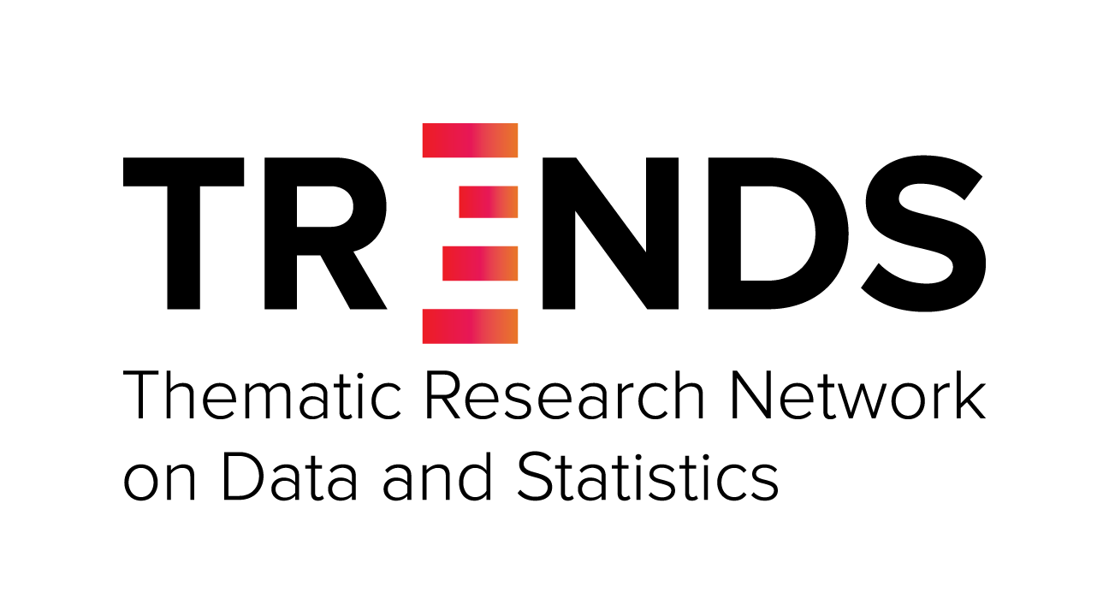
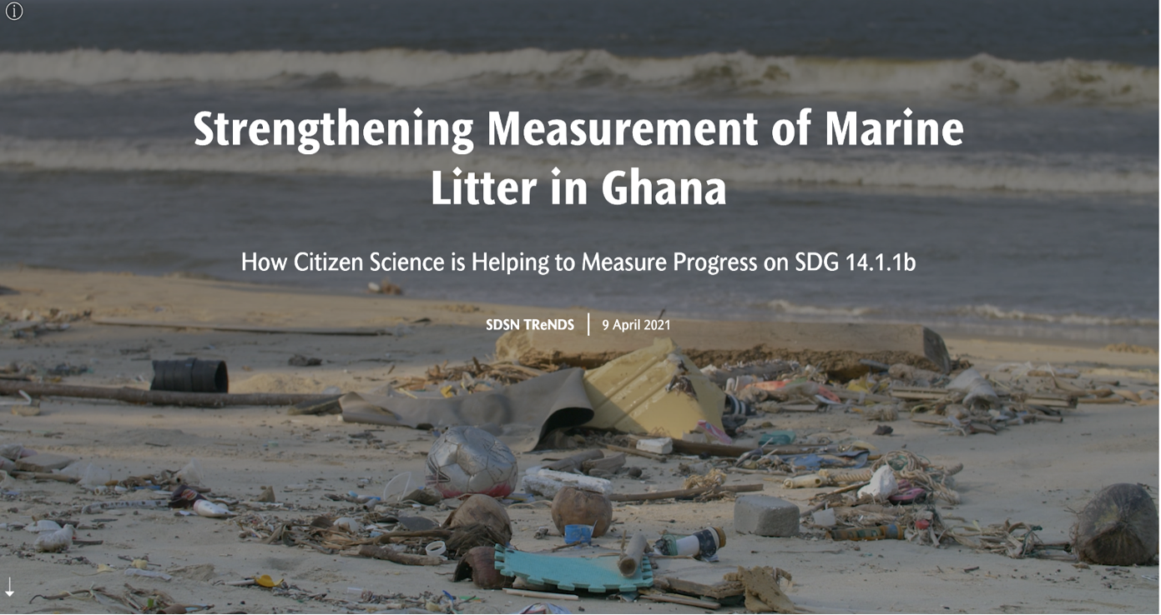
Citizen Science for the SDGs StoryMap: https://dataforchange.net/strengthening-measurement-of-marine-litter-in-Ghana

Slide 27
Citizen Science Data…
…for monitoring beach litter have been integrated into the official SDG monitoring and reporting mechanisms of Ghana in a sustainable way, which makes Ghana the first country to report on SDG indicator 14.1.1b and first country to use citizen science data for that purpose.
…will serve as inputs to Ghana’s Integrated Coastal and Marine Policy, currently under development, as well as other relevant policies to address the marine litter problem.
…has helped to bridge local data collection efforts with global monitoring processes by leveraging the SDG framework.

Slide 28
Lessons
Rather than the time- and resource-intensive process of designing a project from scratch, using off-the-shelf solutions requires fewer resources to implement and enabled the reuse of data.
By tapping into Smart Nature Freaks Youth Volunteers and Plastic Punch, who are already established and sustainable networks, data could be efficiently collected as a by-product of existing activities.
Importance of creating time and spaces for the government, international organisation and CSOs to meet, in order to build trust, common goals and ownership over the result.

Slide 29
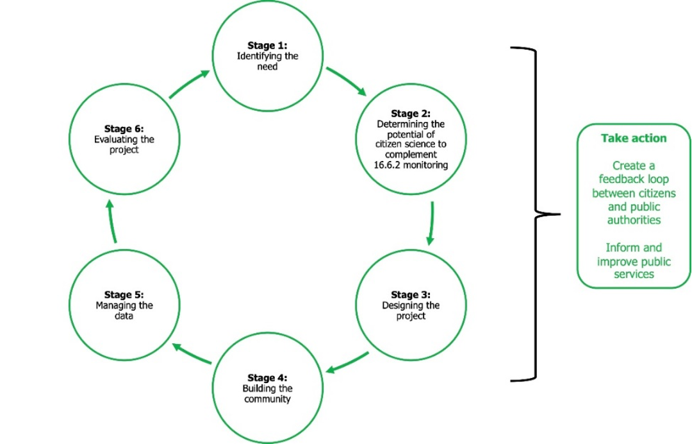
A STRATEGY FOR A CITIZEN SCIENCE APPROACH IN MEASURING SDG INDICATOR 16.6.2
PROPORTION OF POPULATION SATISFIED WITH THEIR LAST EXPERIENCE OF PUBLIC SERVICES
Fraisl, D., Hager, G., Bedessem, B. et al. Citizen science in environmental and ecological sciences. Nat Rev Methods Primers 2, 64 (2022). https://doi.org/10.1038/s43586-022-00144-4

Slide 30
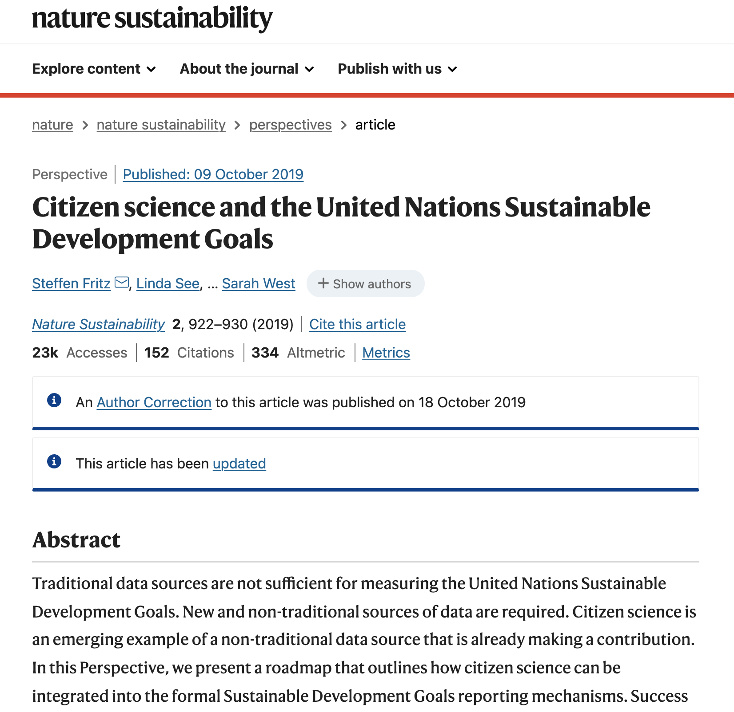
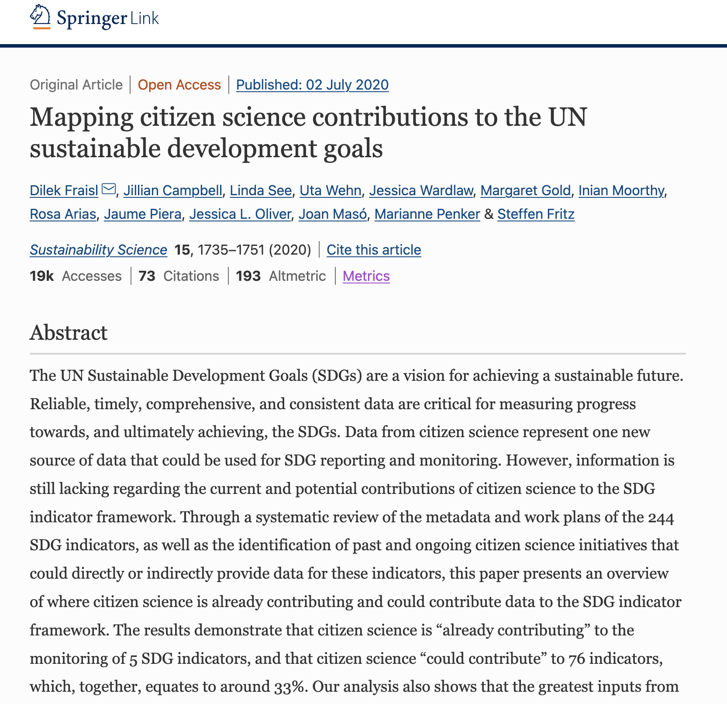
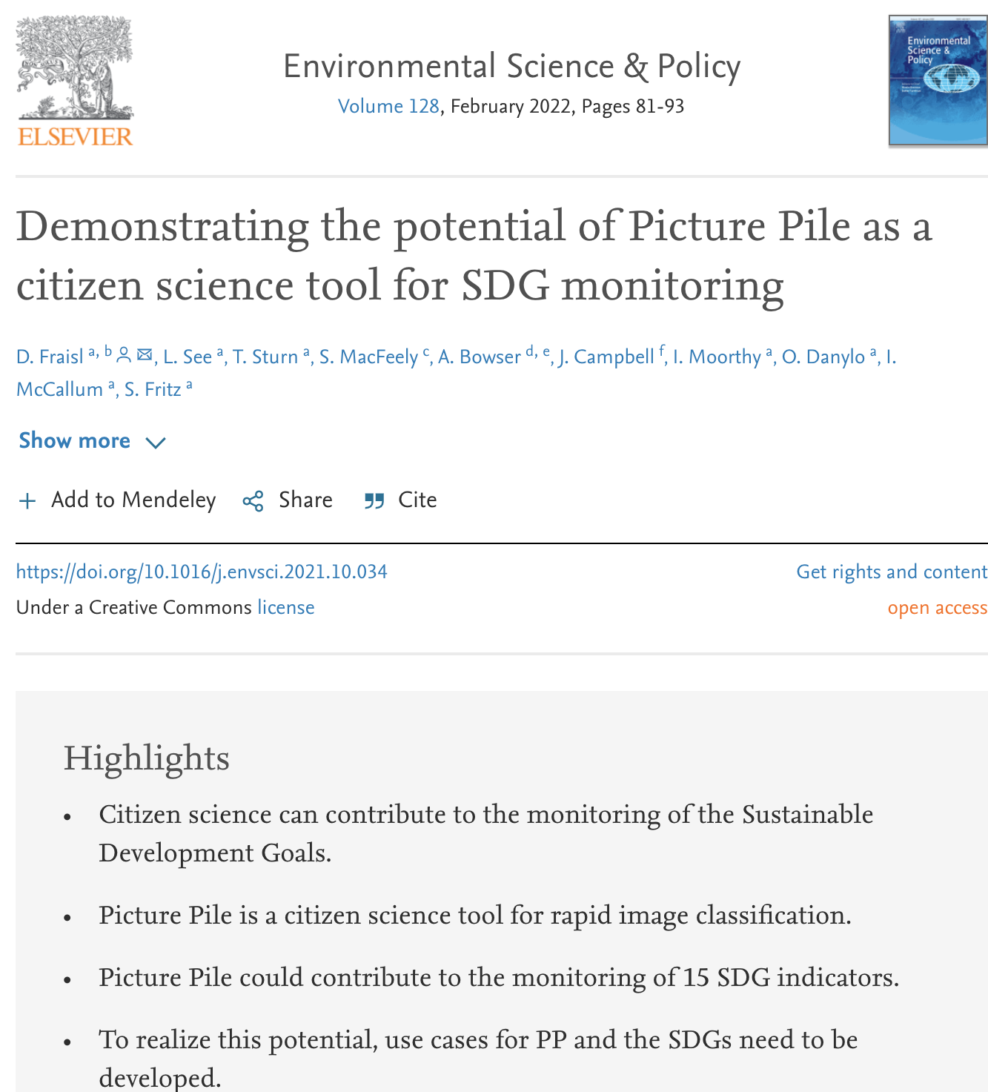

Slide 32
Citizen Science for the SDGs
Partner Views
Jillian Campbell, Head of Monitoring, Reporting and Evaluation, United Nations Environment Program Convention on Biological Diversity (UNEP CBD)
Omar Seidu, Head of Demographic Statitscs and SDG Coordinator, Ghana Statistical Service (GSS)
Steve MacFeely, Director of Data and Analytics, World Health Organization (WHO)
Anne Bowser, Director of Innovation, Wilson Center
ONE OCEAN, NO NATURE, NO FUTURE, Tyler Kobla, Smart Nature Freaks Youth Volunteers Foundation (SNFYVF)

Slide 33
Notes:
If any comments/questions, let’s discuss during the discussion part!

Slide 34
Group Work
3 groups/10 min discussion

Slide 35
Task
Think about your experiences and talks/discussions today
Identify 3-5 challenges for building trust in citizen science data to inform policy decisions and invoke action
Choose a presenter and report back on your challenges (max 2 min)

Slide 36
Guiding Questions
Going back to the exercise at the start of the session:
Have you been involved in a citizen science project that you think the data can be useful for official monitoring and policy purposes?
Have you had any experience in working with government authorities or others to understand the possibility of having your data to be used for official monitoring purposes?
Based on this experience, what challenges have you faced or identified for building trust in citizen science data and among partners?

Slide 37
Reporting back from the group discussions

Slide 38
Discussion
Recommendations on how to overcome the identified challenges??

Slide 39
Thank you!
Dilek Fraisl, Gerid Hager
Dilek Fraisl
Research Scholar International Institute for Applied Systems Analysis (IIASA)
Email: fraisl@iiasa.ac.at
Twitter: @dilekfraisl1
Web: www.iiasa.ac.at
Gerid Hager
Research Scholar International Institute for Applied Systems Analysis (IIASA)
Email: hager@iiasa.ac.at
Web: www.iiasa.ac.at

